Slide 1
Network Administration Practice
pschiu

Slide 2
Syllabus
Website:
e3.nctu.edu.tw
Instructor:
吳育松
易志偉
Time:
Thu. IJK (PM 6:30 ~ 9:20)
Place:
EC115
English Slides and Exams, Chinese Lecture (TAs can support)
TAs:
Email
ta@nasa.cs.nctu.edu.tw
IRC channel
#nctuNASA on freenode
Facebook
https://www.facebook.com/groups/NCTUCSNASA/

Slide 3
Syllabus – Course Textbook and Reference
Textbook
UNIX and Linux System Administration Handbook, 4th ed.
Slides
Reference book
FreeBSD handbook
TCP/IP Illustrated Volume 1
Postfix
DNS and BIND
SNMP, SNMPv2, SNMPv3 and RMON 1, 2

Slide 4
Syllabus – Course Overview
Main topics
DNS -- BIND (Berkeley Internet Name Domain)
DNSSEC
Web
Apache
Nginx
PHP

Slide 5
Syllabus – Course Overview
Main topics
Mail System -- Postfix
SPF (Sender Policy Framework)
DKIM (DomainKeys Identified Mail)
DMARC (Domain Message Authentication Reporting & Conformance)
Network Management
SNMP (Simple Network Management Protocol)
Networking
Routing (Global Internet Routes & DDoS mitigation)
Network Environment
NAT, DHCP, Firewall, …

Slide 6
Syllabus – Adjunct Lecturer Overview
Nagios
Ansible
Containe
Quagga (Quagga Routing Suite)
Service Infrastructure
Lecturer
Edge Core - Phil Huang
NCHC - Chunhung Huang

Slide 7
Syllabus – Prerequisite
Background Knowledges
It is better to have taken
“System Administration Practice” (計算機系統管理實務)
“Introduction to Networking” (計算機網路概論)
At least
Experience of using Unix-like environment

Slide 8
Syllabus – Prerequisite
Environment
Server
One dedicated PC
Virtual Machine
CSCC
VPS
Linode (recommended)
DigitalOcean (second choice)
Operation System
With Unix-like OS installed (e.g. FreeBSD, Linux, Sun OS, …etc.)
FreeBSD is recommended for the reason: TA supports.
Network
Public IP (No NCTU Dormitory IP for Some Reasons)
Domain Name

Slide 9
Attitude
Attend every class
Do every exercise
As early as possible
On your own
Read book and practice at least 6 hours every week
Use unix-like environment
Recommend: more than 1.5 hours/day averagely.
Collect information on the internet
The newer, the better.

Slide 10
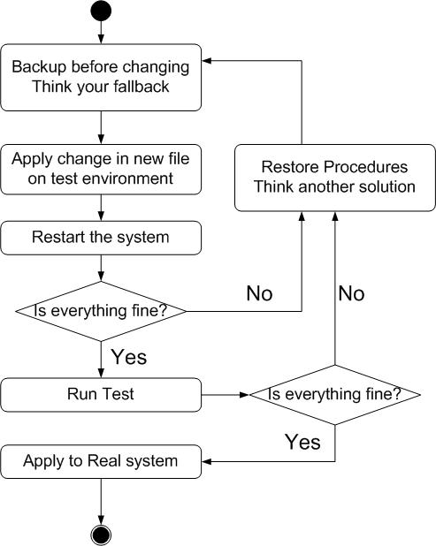
When You Perform Any Changes…
Flow of Change

Slide 11
Mission Goal
Web Server Check
ssllabs.com - A+
DNS Server
http://dnsviz.net – all dnssec chain
Email Server
https://mxtoolbox.com/SuperTool.aspx

Slide 12
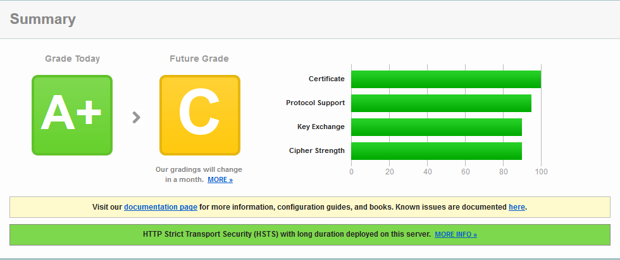
Web Server Goal
No more unnecessary information leak
SSL Certificate
Notes:
https://www.ssllabs.com/ssltest/analyze.html?d=jal.tw

Slide 13
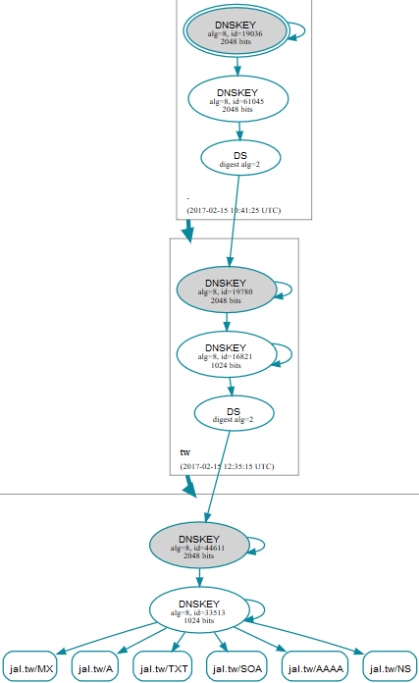
DNS Server Goal
DNSSEC Chain
Notes:
https://www.ssllabs.com/ssltest/analyze.html?d=jal.tw

Slide 14
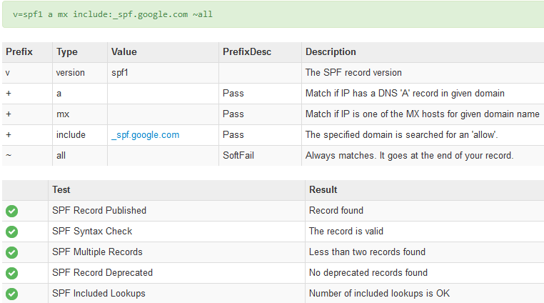
Email Server Goal - SPF

Slide 15
Email Server Goal - DMARC

Slide 16
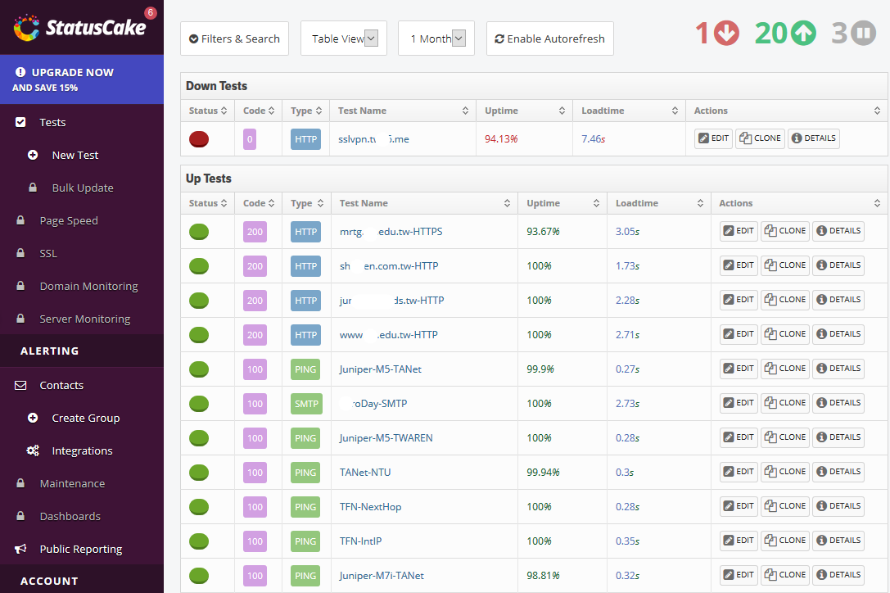
This Semester
Availability !
Keep Server Always Up.
We Will Monitor Your Service
Based Security !
Notes:
CTF 守城遊戲

Slide 17
Syllabus – Grade Policy
Mid
10 ~ 15 %
Final
10 ~ 15 %
Exercise
60 ~ 70 %
No Delay Work
10 Exercises
Your Server Availability
10 ~ 15 %

Slide 18
SA-NA Junction
FreeBSD
10.3-RELEASE
http://ftp.freebsd.org/pub/FreeBSD/releases/ISO-IMAGES/10.3/

Slide 19
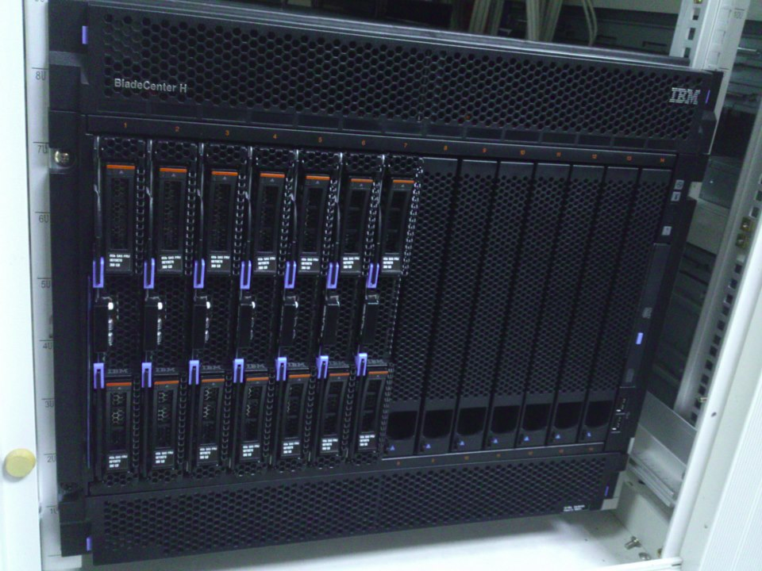
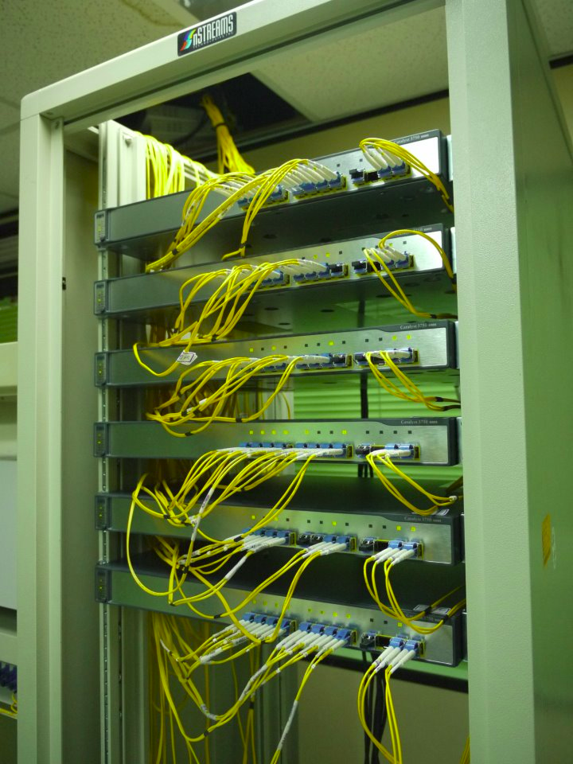
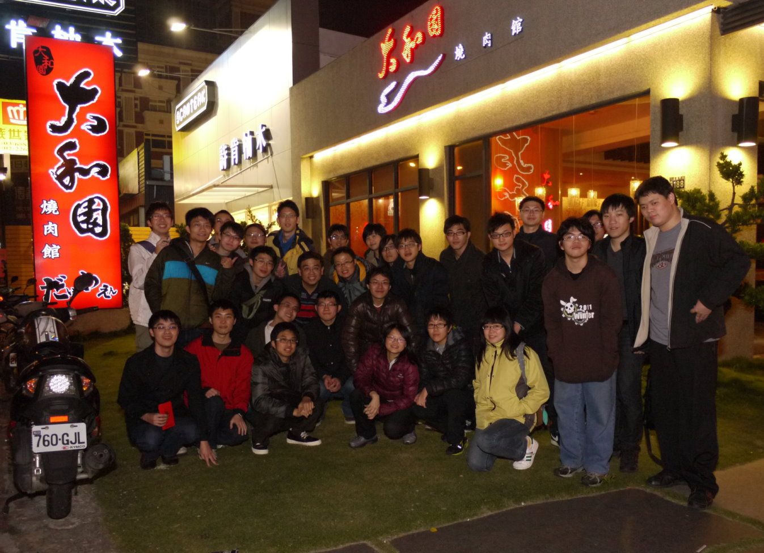
We Want You!

