Slide 1
Domain
pschiu

Slide 2
Your Own Domain
Already have a domain name
You can take a break, I’ll call you later.
You don’t have any domain name
Get once.
We offer 1 year free domain name. *.idv.tw
Registry Page:
https://rs.twnic.net.tw/cgi-bin/FunHeart2016/pages/student-login.cgi

Slide 3
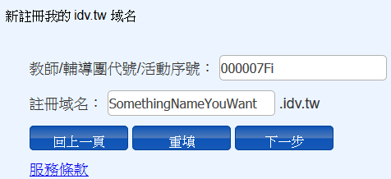

Slide 4
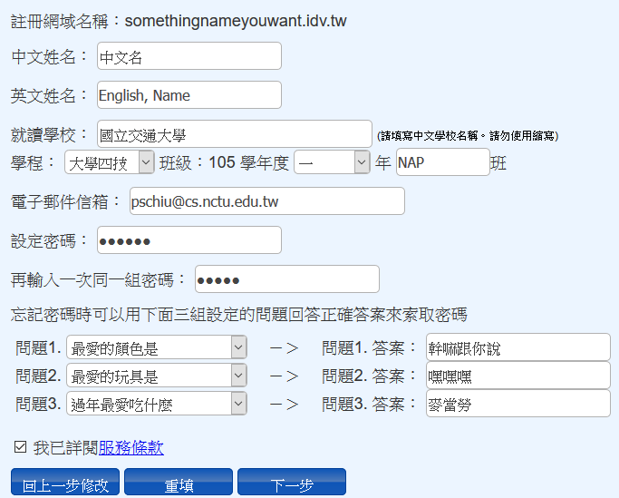

Slide 5
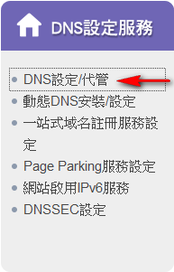
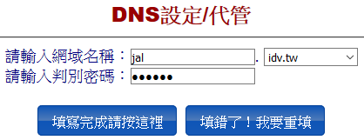
網域管理介面 https://rs.twnic.net.tw

Slide 7
怎麼設定？
下一堂課告訴你

