Slide 1
Server
pschiu

Slide 2
Your Own Server
One dedicated PC
Hardware
Virtual Machine
CSCC
VPS - Virtual Private Server
Linode
DigitalOcean

Slide 3
Dedicated PC / Server
Desktop PC
CPU: PentiumIII 500 Mhz
RAM: 384MB
HDD: 20G
Server
CPU: Pentium III Xeon 700 MHz
RAM: 2G
HDD: SCSI 36G
Foreign Garbage
Taobao

Slide 4
Virtual Machine
CSCC VMware

Slide 5
CSCC VM
Application Form
https://goo.gl/forms/ByB0uF2g3UdPc73v1
Virtual Hardware
CPU: Single Core
RAM: 1G
HDD: 20G
Network
Working progress

Slide 6
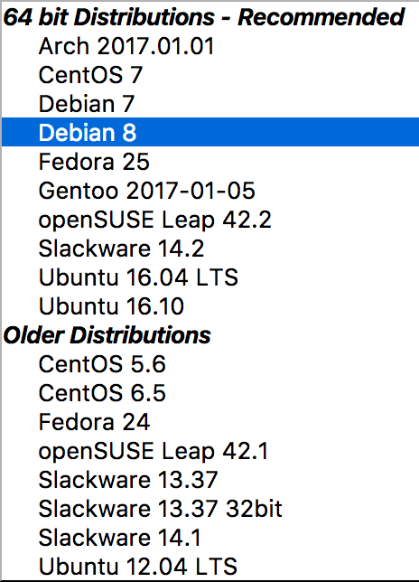
VPS - Virtual Private Server Linode
Fee: USD 10 / month
Network
Data Transfer: 2T / month
Location: Tokyo2, Singapore, USA
Hardware
CPU: E5-2697 v4 @ 2.30GHz * 1 Core
RAM: 2G
HDD: SSD 25G
OS
FreeBSD
goo.gl/T0RJeM
Linux

Slide 7
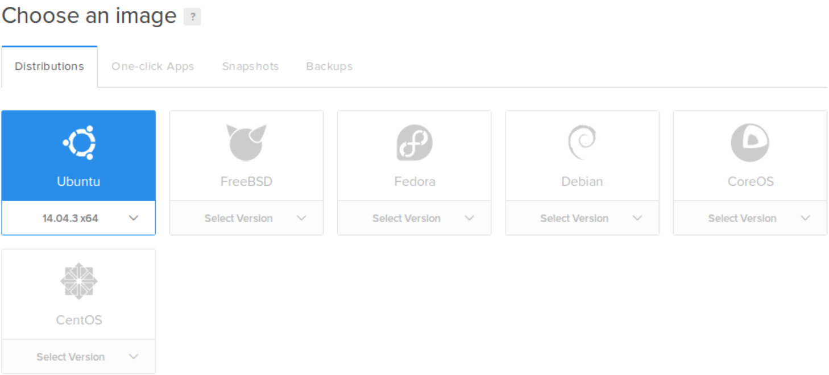
VPS - Virtual Private Server DigitalOcean
Fee: USD 5 / month
Network
Data Transfer: 1T / month
Location: Singapore
Hardware
CPU: 1 Core
RAM: 512M
HDD: SSD 20G
OS
FreeBSD
Linux

