Slide 1
Domain Name System

Slide 2
History of DNS
Before DNS
ARPAnet
HOSTS.txt contains all the hosts’ information
Maintained by SRI’s Network Information Center
In SRI-NIC host
Problems: Not scalable!
Traffic and Load
Name Collision
Consistency
Domain Name System
Administration decentralization
1984
Paul Mockapetris (University of Southern California)
RFC 882, 883, 973 → 1034, 1035
1034: Concepts and facilities
Updated by: 4033, 4034, 4035, 4343
1035: Implementation and Specification
Updated by: 3658, 4033, 4034, 4035, 4343, 6604
RFC Sourcebook:
http://www.networksorcery.com/enp/default.htm
Notes:
ARPA - Advanced Research Projects Agency Network
SRI - Stanford Research Institute In Menlo Park, California

Slide 3
DNS Introduction – DNS Specification
Make domain name system as
Distributed database
Each site maintains segment of DB
Each site open self information via network
Client-Server architecture
Name servers provide information (Name Server)
Clients make queries to server (Resolver)
Tree architecture
Each subtree ➔ “domain”
Domain can be divided in to “subdomain”

Slide 4
DNS Introduction – Domain and Subdomain
DNS Namespace
A tree of domains
Domain and subdomain
Each domain has a “domain name” to identify its position in database
EX: nctu.edu.tw
EX: cs.nctu.edu.tw
domain
subdomain

Slide 5
DNS Introduction – Delegation
Administration delegation
Each domain can delegate responsibility to subdomain
Notes:
ICANN - Internet Corporation for Assigned Names and Numbers
NSI - Network Solutions, Incorporated.
https://archive.icann.org/en/nsi/
https://en.wikipedia.org/wiki/Network_Solutions

Slide 6
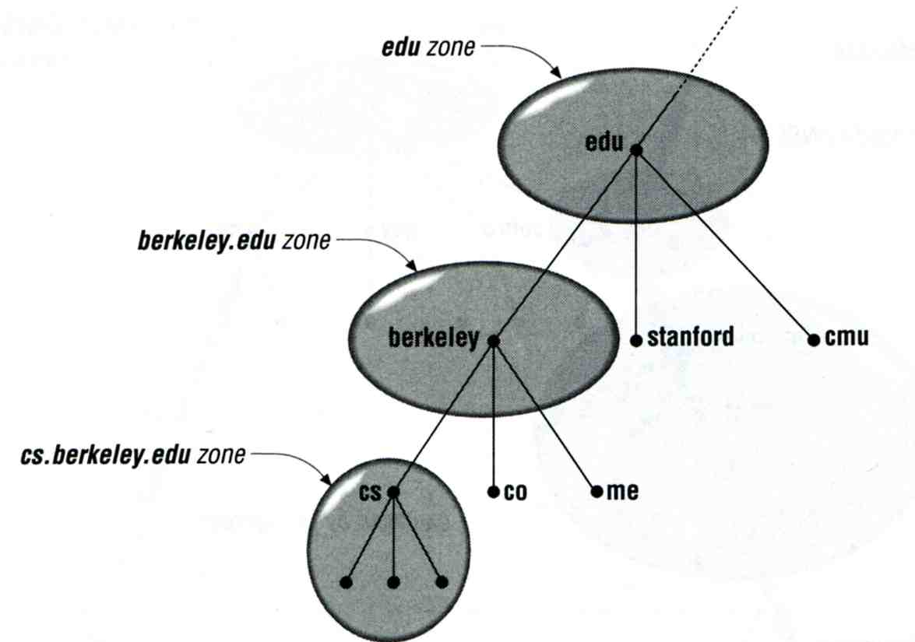
DNS Introduction – Administrated Zone
Zone
Autonomously administered piece of namespace
Once the subdomain becomes a zone, it is independent to it’s parent

Slide 7
DNS Introduction – Implementation of DNS
JEEVES
Written by Paul Mockapetris for “TOPS-20” OS of DEC
BIND
Berkeley Internet Name Domain
Written by Kevin Dunlap for 4.3 BSD UNIX OS

Slide 8
The DNS Namespace (1)
A inverted tree (Rooted tree)
Root with label “.”
Domain level
Top-level or First level
Child of the root
Second-level
Child of a First-level domain
Domain name limitation
63-characters in each component and
Up to 255-characters in a complete name
Notes:
.edu education Educause (via Verisign)

Slide 9
The DNS Namespace (2)
infrastructure top-level domain (ARPA)
generic top-level domains (gTLD)
restricted generic top-level domains (grTLD)
sponsored top-level domains (sTLD)
country-code top-level domains (ccTLD)
internationalized country code top-level domains (IDN ccTLD)
ccTLDs in non-Latin character sets (e.g., Arabic, Cyrillic, Hebrew, or Chinese)
test top-level domains (tTLD)
Geographic top-level domains
Notes:
https://en.wikipedia.org/wiki/Top-level_domain
https://en.wikipedia.org/wiki/List_of_Internet_top-level_domains

Slide 10
The DNS Namespace (3)
gTLDs
generic Top-Level Domains, including:
com: commercial organization, such as ibm.com
edu: educational organization, such as purdue.edu
gov: government organization, such as nasa.gov
mil: military organization, such as navy.mil
net: network infrastructure providing organization, such as hinet.net, twnic.net
org: noncommercial organization, such as x11.org
int: International organization, such as nato.int
ICANN – Internet Corporation for Assigned Names and Numbers
http://www.icann.org/
Notes:
https://zh.wikipedia.org/wiki/通用頂級域
https://en.wikipedia.org/wiki/Generic_top-level_domain

Slide 11
The DNS Namespace (4)
New gTLDs launched in year 2000:
aero: for air-transport industry
biz: for business
coop: for cooperatives
info: for all uses
museum: for museum
name: for individuals
pro: for professionals
Notes:
https://en.wikipedia.org/wiki/Top-level_domain

Slide 12
The DNS Namespace (5)
sponsored top-level domains (sTLD)
.aero SITA
.asia DotAsia Organisation
.cat Fundació puntCat
.coop DotCooperation LLC
.int IANA
.jobs Society for Human Resource Management
.mobi dotMobi
.museum Museum Domain Management Association
.post Universal Postal Union
.tel Telnic Ltd.
.travel Tralliance Corporation
.xxx ICM Registry
Notes:
https://en.wikipedia.org/wiki/List_of_Internet_top-level_domains

Slide 13
The DNS Namespace (6)
Other than US, ccTLD
country code TLD (ISO 3166)
Taiwan → tw
Japan → jp
Follow or not follow US-like scheme
US-like scheme example
edu.tw, com.tw, gov.tw
Other scheme
co.jp, ac.jp

Slide 14
The DNS Namespace (6)
https://en.wikipedia.org/wiki/List_of_Internet_top-level_domains
https://en.wikipedia.org/wiki/Top-level_domain
https://en.wikipedia.org/wiki/Generic_top-level_domain

Slide 15
The DNS Namespace (7)
Zone
Autonomously administered piece of namespace
Two kinds of zone files
Forward Zone files
Hostname-to-Address mapping
Ex:
bsd1 IN A 140.113.235.131
Reverse Zone files
Address-to-Hostname mapping
Ex:
131.235.113.140 IN PTR bsd1.cs.nctu.edu.tw.
1.235.113.140.in-addr.arpa.

Slide 16
BIND
BIND
the Berkeley Internet Name Domain system
Main versions
BIND4
Announced in 1980s
Based on RFC 1034, 1035
BIND8
Released in 1997
Improvements including:
efficiency, robustness and security
BIND9
Released in 2000
Enhancements including:
multiprocessor support, DNSSEC, IPv6 support, etc
BIND10
The next generation of BIND
Modularity, Customizability, Clusterization, Integration with customer workflow, Resilience, Runtime control
https://www.isc.org/bind10/project
Notes:
delphij: hmm...
bind 4 was a disaster
bind 8 lived too long
bind 9 is a rewrite
what about bind 10 XD

Slide 17
BIND – components
Three major components
named
Daemon that answers the DNS query
Library routines
Routines that used to resolve host by contacting the servers of DNS distributed database
Ex: res_query, res_search, …etc.
Command-line interfaces to DNS
Ex: nslookup, dig, hosts

Slide 18
BIND – named (1)
Categories of name servers
Based on a name server’s source of data
Authoritative: official representative of a zone
Master: get zone data from disk
Slave: copy zone data from master
Nonauthoritative: answer a query from cache
caching: cashes data from previous queries
Based on the type of data saved
Stub: a slave that copy only name server data (no host data)
Based on the type of answers handed out
Recursive: do query for you until it return an answer or error
Nonrecursive: refer you to the authoritative server
Based on the query path
Forwarder: performs queries on behalf of many clients with large cache

Slide 19
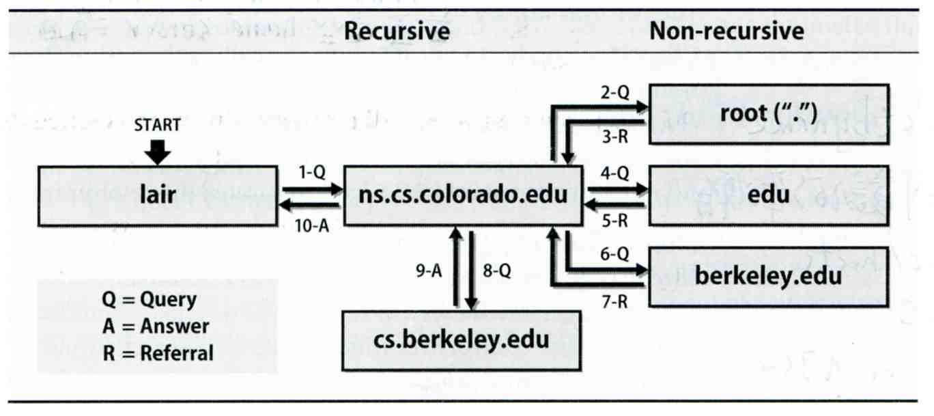
BIND – named (2)
Recursive query process
Ex: query lair.cs.colorado.edu → vangogh.cs.berkeley.edu,
name server “ns.cs.colorado.edu” has no cache data

Slide 20
BIND – named (3)
Nonrecursive referral
Hierarchical and longest known domain referral with cache data of other zone’s name servers’ addresses
Ex:
Query lair.cs.colorado.edu from a nonrecursive server
Whether cache has
Name servers of cs.colorado.edu, colorado.edu, edu, root
The resolver libraries do not understand referrals mostly. They expect the local name server to be recursive

Slide 21
BIND – named (4)
Caching
Positive cache
Negative cache
No host or domain matches the name queried
The type of data requested does not exist for this host
The server to ask is not responding
The server is unreachable of network problem
negative cache
60% DNS queries are failed
To reduce the load of root servers, the authoritative negative answers must be cached

Slide 22
BIND – named (5)
Root name servers
List in named.root file of BIND (/usr/local/etc/namedb/named.root)
Get root.slave from F.ROOT-SERVERS.NET.
. 3600000 NS A.ROOT-SERVERS.NET.
A.ROOT-SERVERS.NET. 3600000 A 198.41.0.4
A.ROOT-SERVERS.NET. 3600000 AAAA 2001:503:BA3E::2:30
. 3600000 NS B.ROOT-SERVERS.NET.
B.ROOT-SERVERS.NET. 3600000 A 192.228.79.201
. 3600000 NS C.ROOT-SERVERS.NET.
C.ROOT-SERVERS.NET. 3600000 A 192.33.4.12
. 3600000 NS D.ROOT-SERVERS.NET.
D.ROOT-SERVERS.NET. 3600000 A 128.8.10.90
. 3600000 NS E.ROOT-SERVERS.NET.
E.ROOT-SERVERS.NET. 3600000 A 192.203.230.10
. 3600000 NS F.ROOT-SERVERS.NET.
F.ROOT-SERVERS.NET. 3600000 A 192.5.5.241
F.ROOT-SERVERS.NET. 3600000 AAAA 2001:500:2f::f
. 3600000 NS G.ROOT-SERVERS.NET.
G.ROOT-SERVERS.NET. 3600000 A 192.112.36.4
. 3600000 NS H.ROOT-SERVERS.NET.
H.ROOT-SERVERS.NET. 3600000 A 128.63.2.53
H.ROOT-SERVERS.NET. 3600000 AAAA 2001:500:1::803f:235
. 3600000 NS I.ROOT-SERVERS.NET.
I.ROOT-SERVERS.NET. 3600000 A 192.36.148.17
. 3600000 NS J.ROOT-SERVERS.NET.
J.ROOT-SERVERS.NET. 3600000 A 192.58.128.30
J.ROOT-SERVERS.NET. 3600000 AAAA 2001:503:C27::2:30
. 3600000 NS K.ROOT-SERVERS.NET.
K.ROOT-SERVERS.NET. 3600000 A 193.0.14.129
K.ROOT-SERVERS.NET. 3600000 AAAA 2001:7fd::1
. 3600000 NS L.ROOT-SERVERS.NET.
L.ROOT-SERVERS.NET. 3600000 A 199.7.83.42
. 3600000 NS M.ROOT-SERVERS.NET.
M.ROOT-SERVERS.NET. 3600000 A 202.12.27.33
M.ROOT-SERVERS.NET. 3600000 AAAA 2001:dc3::35
A.ROOT-SERVERS.NET.
198.41.0.4
2001:503:ba3e::2:30
B.ROOT-SERVERS.NET.
192.228.79.201
2001:500:84::b
C.ROOT-SERVERS.NET.
192.33.4.12
2001:500:2::c
D.ROOT-SERVERS.NET.
199.7.91.13
2001:500:2d::d
E.ROOT-SERVERS.NET.
192.203.230.10
F.ROOT-SERVERS.NET.
192.5.5.241
2001:500:2f::f
G.ROOT-SERVERS.NET.
192.112.36.4
H.ROOT-SERVERS.NET.
198.97.190.53
2001:500:1::53
I.ROOT-SERVERS.NET.
192.36.148.17
2001:7fe::53
J.ROOT-SERVERS.NET.
192.58.128.30
2001:503:c27::2:30
K.ROOT-SERVERS.NET.
193.0.14.129
2001:7fd::1
L.ROOT-SERVERS.NET.
199.7.83.42
2001:500:9f::42
M.ROOT-SERVERS.NET.
202.12.27.33
2001:dc3::35

Slide 23
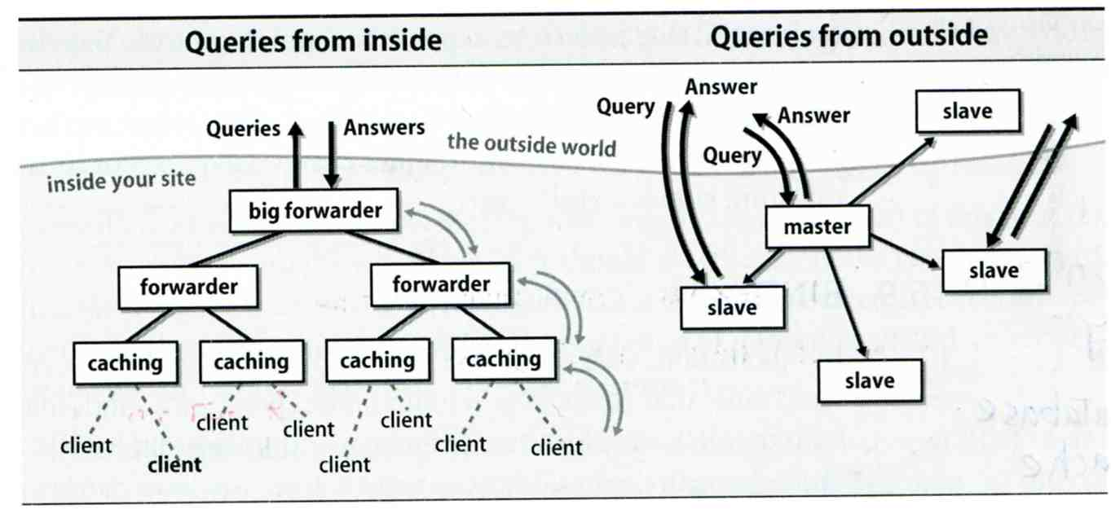
BIND – named (6)
How to arrange your DNS servers?
Ex:

Slide 24
The DNS Database
A set of text files such that
Maintained and stored on the domain’s master name server
Two types of entries
Resource Records (RR)
Used to store the information of
The real part of DNS database
Parser commands
Used to modify or manage other RR data
http://en.wikipedia.org/wiki/List_of_DNS_record_types

Slide 25
The DNS Database – Parser Commands
Commands must start in first column and be on a line by themselves
$ORIGIN domain-name
Used to append to un-fully-qualified name
$INCLUDE file-name
Separate logical pieces of a zone file
Keep cryptographic keys with restricted permissions
$TTL default-ttl
Default value for time-to-live filed of records
$GENERATE start-stop/[step] lhs type rhs
Used to generate a series of similar records
Can be used in only CNAME, PTR, NS record types

Slide 26
The DNS Database – Resource Record (1)
Basic format
[name] [ttl] [class] type data
name: the entity that the RR describes
ttl: time in second of this RR’s validity in cache
class: network type
IN for Internet
CH for ChaosNet
HS for Hesiod
Special characters
; (comment)
@ (The current domain name)
() (allow data to spam lines
* (wild card character, name filed only)

Slide 27
The DNS Database – Resource Record (2)
Type of resource record discussed later
Zone records: identify domains and name servers
SOA
NS
Basic records: map names to addresses and route mail
A
PTR
MX
Optional records: extra information to host or domain
CNAME
TXT
LOC
SRV

Slide 28
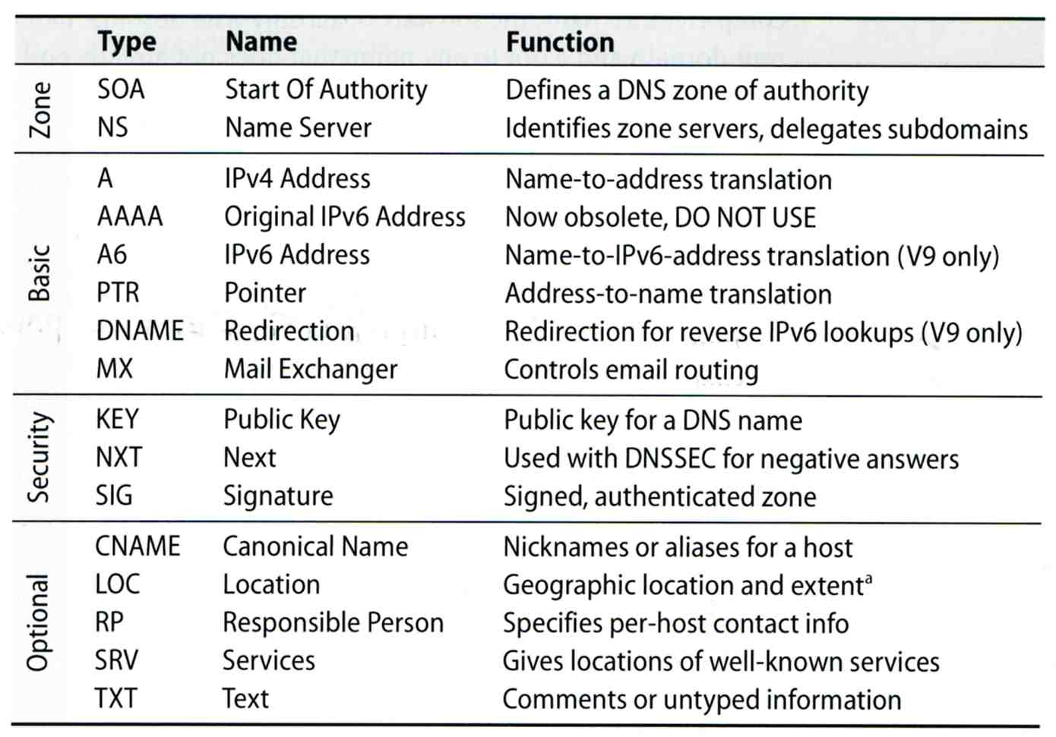
The DNS Database – Resource Record (3)

Slide 29
The DNS Database – Resource Record (4)
SOA: Start Of Authority
Defines a DNS zone of authority, each zone has exactly one SOA record.
Specify the name of the zone, the technical contact and various timeout information
Format:
[zone] IN SOA [server-name] [administrator’s mail] ( serial, refresh, retry, expire, ttl )
Ex:
; means comments
@ means current domain name
( ) allow data to span lines
* Wild card character
$TTL 3600;
$ORIGIN cs.nctu.edu.tw.
@ IN SOA csns.cs.nctu.edu.tw. root.cs.nctu.edu.tw. (
2009051102 ; serial number
1D ; refresh time for slave server
30M ; retry
1W ; expire
2H ) ; minimum

Slide 30
The DNS Database – Resource Record (5)
NS: Name Server
Identify the authoritative server for a zone
Usually follow the SOA record
Every authoritative name servers should be listed both in current domain and parent domain zone files
Delegation purpose
Ex: cs.nctu.edu.tw and nctu.edu.tw
$TTL 3600;
$ORIGIN cs.nctu.edu.tw.
@ IN SOA csns.cs.nctu.edu.tw. root.cs.nctu.edu.tw. (
2009051102 ; serial number
1D ; refresh time for slave server
30M ; retry
1W ; expire
2H ) ; minimum
IN NS dns.cs.nctu.edu.tw.
IN NS dns2.cs.nctu.edu.tw.

Slide 31
The DNS Database – Resource Record (6)
A record: Address
Provide mapping from hostname to IP address
Ex:
$ORIGIN cs.nctu.edu.tw.
@ IN NS dns.cs.nctu.edu.tw.
IN NS dns2.cs.nctu.edu.tw.
dns IN A 140.113.235.107
dns2 IN A 140.113.235.103
www IN A 140.113.235.111

Slide 32
The DNS Database – Resource Record (7)
PTR: Pointer
Perform the reverse mapping from IP address to hostname
Special top-level domain: in-addr.arpa
Used to create a naming tree from IP address to hostnames
$TTL 259200;
$ORIGIN 235.113.140.in-addr.arpa.
@ IN SOA cs.nctu.edu.tw. root.cs.nctu.edu.tw. (
2009050801 ; serial
1D ; refresh time for secondary server
30M ; retry
1W ; expire
2H) ; minimum
IN NS dns.cs.nctu.edu.tw.
IN NS dns2.cs.nctu.edu.tw.
$ORIGIN in-addr.arpa.
103.235.113.140 IN PTR csmailgate.cs.nctu.edu.tw.
107.235.113.140 IN PTR csns.cs.nctu.edu.tw.

Slide 33
The DNS Database – Resource Record (8)
MX: Mail exchanger
Direct mail to a mail hub rather than the recipient’s own workstation
Ex:
$TTL 3600;
$ORIGIN cs.nctu.edu.tw.
@ IN SOA csns.cs.nctu.edu.tw. root.cs.nctu.edu.tw. (
2009051102 ; serial number
1D ; refresh time for slave server
30M ; retry
1W ; expire
2H ) ; minimum
IN NS dns.cs.nctu.edu.tw.
IN NS dns2.cs.nctu.edu.tw.
7200 IN MX 5 csmx1.cs.nctu.edu.tw.
7200 IN MX 5 csmx2.cs.nctu.edu.tw.
60 IN MX 10 csmx3.cs.nctu.edu.tw.
csmx1 IN A 140.113.235.104
csmx2 IN A 140.113.235.105
csmx3 IN A 140.113.235.119

Slide 34
The DNS Database – Resource Record (9)
CNAME: Canonical name
Add additional names to a host
CNAME record can nest eight deep in BIND
Ex:
www IN A 140.113.209.63
IN A 140.113.209.77
penghu-club IN CNAME www
King IN CNAME www
R21601 IN A 140.113.214.31
superman IN CNAME r21601

Slide 35
The DNS Database – Resource Record (10)
TXT: Text
Add arbitrary text to a host’s DNS records
$TTL 3600;
$ORIGIN cs.nctu.edu.tw.
@ IN SOA csns.cs.nctu.edu.tw. root.cs.nctu.edu.tw. (
2009051102 ; serial number
1D ; refresh time for slave server
30M ; retry
1W ; expire
2H ) ; minimum
IN NS dns.cs.nctu.edu.tw.
IN NS dns2.cs.nctu.edu.tw.
IN TXT “Department of Computer Science”

Slide 36
The DNS Database – Resource Record (11)
LOC: Location
Describe the geographic location and physical size of a DNS object
Format:
name [ttl] IN LOC latitude longitude [altitude [size [hp [vp]]]]
latitude 緯度
longitude 經度
altitude 海拔
size: diameter of the bounding sphere
hp: horizontal precision
vp: vertical precision
caida.org. IN LOC 32 53 01 N 117 14 25 W 107m 30m 18m 15m

Slide 37
The DNS Database – Resource Record (12)
SRV: Service
Specify the location of services within a domain
Format:
_service._proto.name [ttl] IN SRV pri weight port target
Ex:
; don’t allow finger
_finger._tcp SRV 0 0 79 .
; 1/4 of the connections to old, 3/4 to the new
_ssh._tcp SRV 0 1 22 old.cs.colorado.edu.
_ssh._tcp SRV 0 3 22 new.cs.colorado.edu.
; www server
_http._tcp SRV 0 0 80 www.cs.colorado.edu.
SRV 10 0 8000 new.cs.colorado.edu.
; block all other services
*._tcp SRV 0 0 0 .
*._udp SRV 0 0 0 .

Slide 38
[pschiu@bsd4 ~]$dig SRV _http._tcp.update.freebsd.org
; <<>> DiG 9.11.0-P3 <<>> SRV _http._tcp.update.freebsd.org
;; global options: +cmd
;; Got answer:
;; ->>HEADER<<- opcode: QUERY, status: NOERROR, id: 2612
;; flags: qr rd ra ad; QUERY: 1, ANSWER: 4, AUTHORITY: 3, ADDITIONAL: 0
;; OPT PSEUDOSECTION:
; EDNS: version: 0, flags: do; udp: 4096
;; QUESTION SECTION:
;_http._tcp.update.freebsd.org. IN SRV
;; ANSWER SECTION:
_http._tcp.update.freebsd.org. 2953 IN SRV 1 50 80 update5.freebsd.org.
_http._tcp.update.freebsd.org. 2953 IN SRV 1 5 80 update3.freebsd.org.
_http._tcp.update.freebsd.org. 2953 IN SRV 1 35 80 update4.freebsd.org.
_http._tcp.update.freebsd.org. 2953 IN SRV 1 40 80 update6.freebsd.org.
;; AUTHORITY SECTION:
freebsd.org. 2155 IN NS ns3.isc-sns.info.
freebsd.org. 2155 IN NS ns2.isc-sns.com.
freebsd.org. 2155 IN NS ns1.isc-sns.net.
;; Query time: 0 msec
;; SERVER: 140.113.235.1#53(140.113.235.1)
;; WHEN: WHEN: Thu Feb 23 00:33:14 CST 2017
;; MSG SIZE rcvd: 1542

Slide 39
The DNS Database – Resource Record (13)
Glue record – Link between zones
Parent zone needs to contain the NS records for each delegated zone
Ex: In zone files of nctu, it might contain:
Lame delegation
DNS subdomain administration has delegate to you and you never use the domain or parent domain’s glue record is not updated
cs IN NS dns.cs.nctu.edu.tw.
IN NS dns2.cs.nctu.edu.tw.
IN NS dns3.cs.nctu.edu.tw.
dns.cs IN A 140.113.235.1
dns2.cs IN A 140.113.235.107
dns3.cs IN A 125.227.8.127
ee IN NS ns.ee.nctu.edu.tw.
IN NS dns.ee.nctu.edu.tw.
IN NS reds.ee.nctu.edu.tw.
IN NS InterNetNS2.nctu.edu.tw.
ns.ee IN A 140.113.212.150
dns.ee IN A 140.113.11.4
reds.ee IN A 140.113.202.1
InterNetNS2 IN A 140.113.250.133

Slide 40
BIND Configuration

Slide 41
named in FreeBSD
startup
Edit /etc/rc.conf
named_enable=“YES”
Manual utility command
% rndc {stop | reload | flush …}
In old version of BIND, use ndc command
Configuration files
/etc/namedb/named.conf (Configuration file)
/etc/namedb/named.root (DNS root server cache hint file)
Zone data files
See your BIND version
% dig @127.0.0.1 version.bind txt chaos
version.bind. 0 CH TXT "9.3.3"
Notes:
knight:~ -lwhsu- dig @140.113.17.209 version.bind txt chaos
;; ANSWER SECTION:
version.bind. 0 CH TXT "There is no version."
knight:~ -lwhsu- dig @140.113.1.1 version.bind txt chaos
;; ANSWER SECTION:
version.bind. 0 CH TXT "9.3.5-P2"

Slide 42
BIND Configuration – named.conf (1)
/etc/namedb/named.conf
Roles of this name server
Master, slave, or stub
Global options
Zone specific options
named.conf is composed of following statements:
include, options, server, key, acl, zone, view, controls, logging, trusted-keys

Slide 43
BIND Configuration – named.conf (2)
Address Match List
A generalization of an IP address that can include:
An IP address
Ex. 140.113.17.1
An IP network with CIDR netmask
Ex. 140.113/16
Ex. 140.113.0.0/16
The ! character to do negate
The name of a previously defined ACL
A cryptographic authentication key
First match
Example:
{ !1.2.3.4; 1.2.3/24; };
{ 168.95/16; 140.113.209/24; 140.113.235/24; 127.0.0.1; };
{ 2001:288:4001::/48; };

Slide 44
BIND Configuration – named.conf include
The "include" statement
Used to separate large configuration file
Another usage is used to separate cryptographic keys into a restricted permission file
Ex:
include "/etc/namedb/rndc.key";
-rw-r--r-- 1 root wheel 28980 Feb 18 22:40 named.conf
-rw-r----- 1 root bind 141 Jan 6 2016 rndc.key
If the path is relative
Relative to the directory option
Ex: chroot
Notes:
舊投影片寫錯
-rw-r----- 1 bind wheel 92 Aug 15 2005 rndc.key

Slide 45
BIND Configuration – named.conf acl
The "acl" statement
Define a class of access control
Define before they are used
Syntax
acl acl_name {
address_match_list;
};
Predefined acl classes
any, localnets, localhost, none
Example
acl CSnets {
140.113.235/24; 140.113.17/24; 140.113.209/24;
};
acl NCTUnets {
140.113/16; 140.126.237/24; 2001:288:4001::/48;
};
allow-transfer {localhost; CSnets; NCTUnets};

Slide 46
BIND Configuration – named.conf key
The "key" statement
Define a encryption key used for authentication with a particular server
Syntax
key "key-id" {
algorithm string;
secret "string";
}
Example:
key "serv1-serv2" {
algorithm hmac-md5;
secret "ibkAlUA0XXAXDxWRTGeY+d4CGbOgOIr7n63eizJFHQo=";
}
This key is used to
Sign DNS request before sending to target
Validate DNS response after receiving from target

Slide 47
BIND Configuration – named.conf option (1)
The “option” statement
Specify global options
Some options may be overridden later for specific zone or server
Syntax:
options {
option;
option;
}
There are about 50 options in BIND9
version “There is no version.”; [real version num]
directory “/etc/namedb/db”;
Base directory for relative path and path to put zone data files
version.bind. 0 CH TXT "9.8.1-P1"
version.bind. 0 CH TXT "9.10.4-P2"
version.bind. 0 CH TXT "There is no version."
version.bind. 0 CH TXT "JAL-DNS-Ver-1.8"

Slide 48
BIND Configuration – named.conf option (2)
notify yes | no [yes]
Whether notify slave sever when relative zone data is changed
also-notify 140.113.235.101; [empty]
Also notify this non-NS server
recursion yes | no [yes]
Recursive name server
allow-recursion {address_match_list }; [all]
Finer granularity recursion setting
check-names {master|slave|response action};
check hostname syntax validity
Letter, number and dash only
64 characters for each component, and 256 totally
Action:
ignore: do no checking
warn: log bad names but continue
fail: log bad names and reject
default action
master fail
slave warn
response ignore

Slide 49
BIND Configuration – named.conf option (3)
listen-on port ip_port address_match_list; [53, all]
NIC and ports that named listens for query
Ex: listen-on port 5353 { 192.168.1/24; };
query-source address ip_addr port ip_port; [random]
NIC and port to send DNS query
forwarders { in_addr; … }; [empty]
Often used in cache name server
Forward DNS query if there is no answer in cache
forward only | first; [first]
If forwarder does not response, queries for forward only server will fail
allow-query address_match_list; [all]
Specify who can send DNS query to you
allow-transfer address_match_list; [all]
Specify who can request zone transfer to you
blackhole address_match_list; [empty]
Reject queries and would never ask them for answers

Slide 50
BIND Configuration – named.conf option (4)
transfer-format one-answer | many-answers; [many-answers]
Ways to transfer data records from master to slave
How many data records in single packet
transfers-in num; [10]
transfers-out num; [10]
Limit of the number of inbound and outbound zone transfers concurrently
transfers-per-ns num; [2]
Limit of the inbound zone transfers concurrently from the same remote server
transfer-source IP-address;
IP of NIC used for inbound transfers

Slide 51
BIND Configuration – named.conf server
The "server" statement
Tell named about the characteristics of its remote peers
Syntax
server ip_addr {
bogus no | yes;
provide-ixfr yes | no; (for master)
request-ixfr yes | no; (for slave)
transfers num;
transfer-format many-answers | one-answer;
keys { key-id; key-id};
};
ixfr
Incremental zone transfer
transfers
Limit of number of concurrent inbound zone transfers from that server
Server-specific transfers-in
keys
Any request sent to the remote server is signed with this key

Slide 52
BIND Configuration – named.conf zone (1)
The "zone" statement
Heart of the named.conf that tells named about the zones that it is authoritative
zone statement format varies depending on roles of named
Master or slave
Basically
Syntax:
zone "domain_name" {
type master | slave | stub;
file "path";
masters { ip_addr; ip_addr; };
allow-query { address_match_list; }; [all]
allow-transfer { address_match_list; }; [all]
allow-update { address_match_list; }; [empty]
};

Slide 53
BIND Configuration – named.conf zone (2)
Master server zone configuration
Slave server zone configuration
zone "cs.nctu.edu.tw" IN {
type master;
file "named.hosts";
allow-query { any; };
allow-transfer { localhost; CS-DNS-Servers; };
allow-update { none; };
};
zone "cs.nctu.edu.tw" IN {
type slave;
file "cs.hosts";
masters { 140.113.235.107; };
allow-query { any; };
allow-transfer { localhost; CS-DNS-Servers; };
};

Slide 54
BIND Configuration – named.conf zone (3)
Forward zone and reverse zone
zone "cs.nctu.edu.tw" IN {
type master;
file "named.hosts";
allow-query { any; };
allow-transfer { localhost; CS-DNS-Servers; };
allow-update { none; };
};
zone "235.113.140.in-addr.arpa" IN {
type master;
file "named.235.rev";
allow-query { any; };
allow-transfer { localhost; CS-DNS-Servers; };
allow-update { none; };
};

Slide 55
BIND Configuration – named.conf zone (4)
Example
In named.hosts, there are plenty of A or CNAME records
In named.235.rev, there are plenty of PTR records
$ORIGIN cs.nctu.edu.tw.
…
bsd1 IN A 140.113.235.131
csbsd1 IN CNAME bsd1
bsd2 IN A 140.113.235.132
bsd3 IN A 140.113.235.133
bsd4 IN A 140.113.235.134
bsd5 IN A 140.113.235.135
…
$ORIGIN 235.113.140.in-addr.arpa.
…
131 IN PTR bsd1.cs.nctu.edu.tw.
132 IN PTR bsd2.cs.nctu.edu.tw.
133 IN PTR bsd3.cs.nctu.edu.tw.
134 IN PTR bsd4.cs.nctu.edu.tw.
135 IN PTR bsd5.cs.nctu.edu.tw.
…

Slide 56
BIND Configuration – named.conf zone (5)
Setting up root hint
A cache of where are the DNS root servers
Setting up forwarding zone
Forward DNS query to specific name server, bypassing the standard query path
zone "." IN {
type hint;
file "named.root";
};
zone "nctu.edu.tw" IN {
type forward;
forward first;
forwarders { 140.113.250.135; 140.113.1.1; };
};
zone "113.140.in-addr.arpa" IN {
type forward;
forward first;
forwarders { 140.113.250.135; 140.113.1.1; };
};

Slide 57
BIND Configuration – named.conf view (1)
The "view" statement
Create a different view of DNS naming hierarchy for internal machines
Restrict the external view to few well-known servers
Supply additional records to internal users
Also called "split DNS"
In-order processing
Put the most restrictive view first
All-or-nothing
All zone statements in your named.conf file must appear in the content of view

Slide 58
BIND Configuration – named.conf view (2)
Syntax
view view-name {
match_clients {address_match_list};
view_options;
zone_statement;
};
Example
view "internal" {
match-clients { our_nets; };
recursion yes;
zone "cs.nctu.edu.tw" {
type master;
file "named-internal-cs";
};
};
view "external" {
match-clients { any; };
recursion no;
zone "cs.nctu.edu.tw" {
type master;
file "named-external-cs";
};
};

Slide 59
BIND Configuration – named.conf controls
The "controls" statement
Specify how the named server listens for control message
Syntax
controls {
inet ip_addr allow {address_match_list} keys {key-id;};
};
Example:
include "/etc/named/rndc.key";
controls {
inet 127.0.0.1 allow { 127.0.0.1; } keys { rndc_key; };
}
key "rndc_key" {
algorithm hmac-md5;
secret "GKnELuie/G99NpOC2/AXwA==";
};
SYNOPSIS
rndc [-c config-file] [-k key-file] [-s server] [-p port] [-V]
[-y key_id] {command}

Slide 60
Updating zone files
Master
Edit zone files
Serial number
Forward and reverse zone files for single IP
Do “rndc reload”
“notify” is on, slave will be notify about the change
“notify” is off, refresh timeout, or do “rndc reload” in slave
Zone transfer
DNS zone data synchronization between master and slave servers
AXFR (all zone data are transferred at once, before BIND8.2)
IXFR (incremental updates zone transfer)
TCP port 53

Slide 61
Non-byte boundary (1)
In normal reverse configuration:
named.conf will define a zone statement for each reverse subnet zone and
Your reverse db will contains lots of PTR records
Example:
zone "1.168.192.in-addr.arpa." {
type master;
file "named.rev.1";
allow-query {any;};
allow-update {none;};
allow-transfer {localhost;};
};
$TTL 3600
$ORIGIN 1.168.192.in-addr.arpa.
@ IN SOA lwhsu.csie.net lwhsu.lwhsu.csie.net. (
2007050401 ; Serial
3600 ; Refresh
900 ; Retry
7D ; Expire
2H ) ; Minimum
IN NS ns.lwhsu.csie.net.
254 IN PTR ns.lwhsu.csie.net.
1 IN PTR www.lwhsu.csie.net.
2 IN PTR ftp.lwhsu.csie.net.
…

Slide 62
看到這

Slide 63
Non-byte boundary (2)
What if you want to delegate 192.168.2.0 to another sub-domain
Parent
Remove forward db about 192.168.2.0/24 network
Ex:
pc1.lwhsu.csie.net. IN A 192.168.2.35
pc2.lwhsu.csie.net. IN A 192.168.2.222
…
Remove reverse db about 2.168.192.in-addr.arpa
Ex:
35.2.168.192.in-addr.arpa. IN PTR pc1.lwhsu.csie.net.
222.2.168.192.in-addr.arpa. IN PTR pc2.lwhsu.csie.net.
…
Add glue records about the name servers of sub-domain
Ex: in zone db of “lwhsu.csie.net”
sub1 IN NS ns.sub1.lwhsu.csie.net.
ns.sub1 IN A 192.168.2.1
Ex: in zone db of “168.192.in-addr.arpa.”
2 IN NS ns.sub1.lwhsu.csie.net.
ns.sub1 IN A 192.168.2.1

Slide 64
Non-byte boundary (3)
What if you want to delegate 192.168.3.0 to four sub-domains (a /26 network)
192.168.3.0 ~ 192.168.3.63
ns.sub1.lwhsu.csie.net.
192.168.3.64 ~ 192.168.3.127
ns.sub2.lwhsu.csie.net.
192.168.3.128 ~ 192.168.3.191
ns.sub3.lwhsu.csie.net.
192.168.3.192 ~ 192.168.3.255
ns.sub4.lwhsu.csie.net.
It is easy for forward setting
In zone db of lwhsu.csie.net
sub1 IN NS ns.sub1.lwhsu.csie.net.
ns.sub1 IN A 1921.68.3.1
sub2 IN NS ns.sub2.lwhsu.csie.net.
ns.sub2 IN A 192.168.3.65
…

Slide 65
Non-byte boundary (4)
Non-byte boundary reverse setting
Method1
$GENERATE 0-63 $.3.168.192.in-addr.arpa. IN NS ns.sub1.lwhsu.csie.net.
$GENERATE 64-127 $.3.168.192.in-addr.arpa. IN NS ns.sub2.lwhsu.csie.net.
$GENERATE 128-191 $.3.168.192.in-addr.arpa. IN NS ns.sub3.lwhsu.csie.net.
$GENERATE 192-255 $.3.168.192.in-addr.arpa. IN NS ns.sub4.lwhsu.csie.net.
And
zone “1.3.168.192.in-addr.arpa.” {
type master;
file “named.rev.192.168.3.1”;
};
; named.rev.192.168.3.1
@ IN SOA sub1.lwhsu.csie.net. root.sub1.lwhsu.csie.net. (1;3h;1h;1w;1h)
IN NS ns.sub1.lwhsu.csie.net.

Slide 66
Non-byte boundary (5)
Method2
$ORIGIN 3.168.192.in-addr.arpa.
$GENERATE 1-63 $ IN CNAME $.0-63.3.168.192.in-addr.arpa.
0-63.3.168.192.in-addr.arpa. IN NS ns.sub1.lwhsu.csie.net.
$GENERATE 65-127 $ IN CNAME $.64-127.3.168.192.in-addr.arpa.
64-127.3.168.192.in-addr.arpa. IN NS ns.sub2.lwhsu.csie.net.
$GENERATE 129-191 $ IN CNAME $.128-191.3.168.192.in-addr.arpa.
128-191.3.168.192.in-addr.arpa. IN NS ns.sub3.lwhsu.csie.net.
$GENERATE 193-255 $ IN CNAME $.192-255.3.168.192.in-addr.arpa.
192-255.3.168.192.in-addr.arpa. IN NS ns.sub4.lwhsu.csie.net.
zone “0-63.3.168.192.in-addr.arpa.” {
type master;
file “named.rev.192.168.3.0-63”;
};
; named.rev.192.168.3.0-63
@ IN SOA sub1.lwhsu.csie.net. root.sub1.lwhsu.csie.net. (1;3h;1h;1w;1h)
IN NS ns.sub1.lwhsu.csie.net.
1 IN PTR www.sub1.lwhsu.csie.net.
IN PTR abc.sub1.lwhsu.csie.net.
…

Slide 67
BIND Security

Slide 68
Security – named.conf security configuration
Security configuration
Feature | Config. Statement | comment
allow-query | options, zone | Who can query
allow-transfer | options, zone | Who can request zone transfer
allow-update | zone | Who can make dynamic updates
blackhole | options | Which server to completely ignore
bogus | server | Which servers should never be queried

Slide 69
Security – With TSIG (1)
TSIG (Transaction SIGnature)
Developed by IETF (RFC2845)
Symmetric encryption scheme to sign and validate DNS requests and responses between servers
Algorithm in BIND9
HMAC-MD5, HMAC-SHA1, HMAC-SHA224, HMAC-SHA256, HMAC-SHA384, HMAC-SHA512
Usage
Prepare the shared key with dnssec-keygen
Edit “key” statement
Edit “server” statement to use that key
Edit “zone” statement to use that key with:
allow-query
allow-transfer
allow-update

Slide 70
Security – With TSIG (2)
TSIG example (dns1 with dns2)
% dnssec-keygen –a HMAC-MD5 –b 128 –n HOST cs
Edit /etc/named/dns1-dns2.key
Edit both named.conf of dns1 and dns2
Suppose dns1 = 140.113.235.107 dns2 = 140.113.235.103
% dnssec-keygen -a HMAC-MD5 -b 128 -n HOST cs
Kcs.+157+35993
% cat Kcs.+157+35993.key
cs. IN KEY 512 3 157 oQRab/QqXHVhkyXi9uu8hg==
% cat Kcs.+157+35993.private
Private-key-format: v1.2
Algorithm: 157 (HMAC_MD5)
Key: oQRab/QqXHVhkyXi9uu8hg==
key dns1-dns2 {
algorithm hmac-md5;
secret “oQRab/QqXHVhkyXi9uu8hg==”
};
include “dns1-dns2.key”
server 140.113.235.103 {
keys {dns1-dns2;};
};
include “dns1-dns2.key”
server 140.113.235.107 {
keys {dns1-dns2;};
};

Slide 71
BIND Debugging and Logging

Slide 72
Logging (1)
Terms
Channel
A place where messages can go
Ex: syslog, file or /dev/null
Category
A class of messages that named can generate
Ex: answering queries or dynamic updates
Module
The name of the source module that generates the message
Facility
syslog facility name
Severity
Priority in syslog
Logging configuration
Define what are the channels
Specify where each message category should go
When a message is generated
It is assigned a “category”, a “module”, a “severity”
It is distributed to all channels associated with its category

Slide 73
Logging (2)
The “logging” statement
Either “file” or “syslog” in channel sub-statement
size:
ex: 2048, 100k, 20m, 15g, unlimited, default
facility:
ex: local0 ~ local7
severity:
critical, error, warning, notice, info, debug, dynamic
logging {
channel_def;
channel_def;
…
category category_name {
channel_name;
channel_name;
…
};
};
channel channel_name {
file path [versions num|unlimited] [size siznum];
syslog facility;
severity severity;
print-category yes|no;
print-severity yes|no;
print-time yes|no;
};

Slide 74
Logging (3)
Predefined channels
Available categories
default_syslog | Sends severity info and higher to syslog with facility daemon
default_debug | Logs to file “named.run”, severity set to dynamic
default_stderr | Sends messages to stderr or named, severity info
null | Discards all messages
default | Categories with no explicit channel assignment
general | Unclassified messages
config | Configuration file parsing and processing
queries/client | A short log message for every query the server receives
dnssec | DNSSEC messages
update | Messages about dynamic updates
xfer-in/xfer-out | zone transfers that the server is receiving/sending
db/database | Messages about database operations
notify | Messages about the “zone changed” notification protocol
security | Approved/unapproved requests
resolver | Recursive lookups for clients

Slide 75
Logging (4)
Example of logging statement
logging {
channel security-log {
file "/var/named/security.log" versions 5 size 10m;
severity info;
print-severity yes;
print-time yes;
};
channel query-log {
file "/var/named/query.log" versions 20 size 50m;
severity info;
print-severity yes;
print-time yes;
};
category default { default_syslog; default_debug; };
category general { default_syslog; };
category security { security-log; };
category client { query-log; };
category queries { query-log; };
category dnssec { security-log; };
};

Slide 76
Debug
Named debug level
From 0 (debugging off) ~ 11 (most verbose output)
% named -d2 (start named at level 2)
% rndc trace (increase debugging level by 1)
% rndc trace 3 (change debugging level to 3)
% rndc notrace (turn off debugging)
Debug with “logging” statement
Define a channel that include a severity with “debug” keyword
Ex: severity debug 3
All debugging messages up to level 3 will be sent to that particular channel

Slide 77
Tools

Slide 78
Tools – nslookup
Interactive and Non-interactive
Non-Interactive
% nslookup cs.nctu.edu.tw.
% nslookup –type=mx cs.nctu.edu.tw.
% nslookup –type=ns cs.nctu.edu.tw. 140.113.1.1
Interactive
% nslookup
> set all
> set type=any
> set server host
> set lserver host
> set debug
> set d2
csduty:~ -lwhsu- nslookup
> set all
Default server: 140.113.235.107
Address: 140.113.235.107#53
Default server: 140.113.235.103
Address: 140.113.235.103#53
Default server: 140.113.1.1
Address: 140.113.1.1#53
Set options:
novc nodebug nod2
search recurse
timeout = 0 retry = 3 port = 53
querytype = A class = IN
srchlist = cs.nctu.edu.tw/csie.nctu.edu.tw
>

Slide 79
Tools – dig
Usage
% dig cs.nctu.edu.tw
% dig cs.nctu.edu.tw mx
% dig @ns.nctu.edu.tw cs.nctu.edu.tw mx
% dig -x 140.113.209.3
Reverse query
Find out the root servers
% dig @a.root-servers.net . ns

Slide 80
Tools – host
host command
% host cs.nctu.edu.tw.
% host –t mx cs.nctu.edu.tw.
% host 140.113.1.1
% host –v 140.113.1.1

Slide 81
Miscellaneous

Slide 82
SSHFP record
RFC4255
ssh_config
VerifyHostKeyDNS ask
dns/sshfp
knight:~ -lwhsu- dig anoncvs.tw.freebsd.org sshfp
;; ANSWER SECTION:
anoncvs.tw.freebsd.org. 259200 IN CNAME freebsd.cs.nctu.edu.tw.
freebsd.cs.nctu.edu.tw. 3600 IN SSHFP 2 1 2723C6CF4EF655A6A5BE86CC9E039F1762450FE9
knight:~ -lwhsu- cvs -d anoncvs@anoncvs.tw.freebsd.org:/home/ncvs co ports
The authenticity of host 'anoncvs.tw.freebsd.org (140.113.17.209)' can't be established.
DSA key fingerprint is e8:3b:29:7b:ca:9f:ac:e9:45:cb:c8:17:ae:9b:eb:55.
Matching host key fingerprint found in DNS.
Are you sure you want to continue connecting (yes/no)?

Slide 83
DNS Accept filters
accf_dns(9)
buffer incoming DNS requests until the whole first request is present
options INET
options ACCEPT_FILTER_DNS
kldload accf_dns
Currently only on 8-CURRENT

Slide 84
Other references & tools
Administrator's Reference Manual
https://www.isc.org/software/bind/documentation
FAQ
https://www.isc.org/faq/bind
DNS for Rocket Scientists
http://www.zytrax.com/books/dns/
Swiss army knife internet tool
http://www.robtex.com/
DNS Network Tools
http://dnsstuff.com/

