Slide 1
Web

Slide 2
Outline
Web hosting
Basics
Client-Server architecture
HTTP protocol
Static vs. dynamic pages
Virtual hosts
Proxy
Forward proxy
Reverse proxy
squid

Slide 3
Web Hosting – Basics (1)
Three major techniques in WWW (World Wide Web) System
HTML
HTTP
URL
HTML (1) – HyperText Markup Language
Providing a means to describe the structure of text-based information in a document.
The original HTML is created by Tim Berners-Lee.
Published in 1993 by the IETF as a formal "application" of SGML (with an SGML Document Type Definition defining the grammar).
The HTML specifications have been maintained by the World Wide Web Consortium (W3C).
http://www.w3.org/

Slide 4
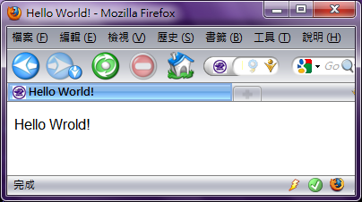
Web Hosting – Basics (2)
HTML (2)
Mark-up the text and define presentation effect by HTML Tags.
<!DOCTYPE HTML PUBLIC "-//W3C//DTD HTML 4.01//EN">
<html>
<head>
<title>Hello World!</title>
</head>
<body>
<p>Hello Wrold!</p>
</body>
</html>

Slide 5
Web Hosting – Basics (3)
HTTP – Hyper-Text Transfer Protocol
A TCP-based protocol
Communication method between client and server. All browsers and web servers have to follow this standard.
Originally designed to transmit HTML pages.
Now it is used to format, transmit, and link documents of variety media types
Text, picture, sound, animation, video, …
HTTPS – secured version.

Slide 6
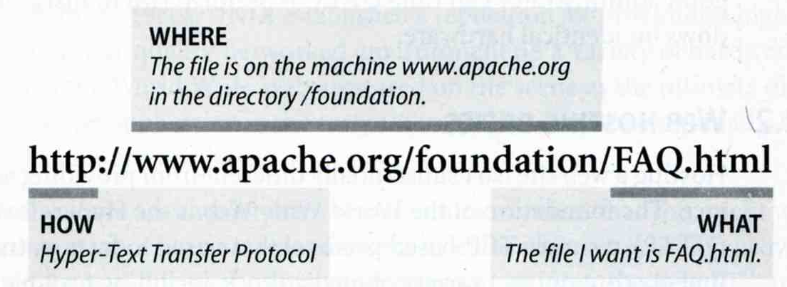
Web Hosting – Basics (4)
URL – Uniform Resource Locator
Describe how to access an object shared on the Internet (RFC 1738)
Format
Protocol :// [ [ username [ :password ] @ ] hostname [ :port ] ] [ /directory ] [ /filename ]
ex:
http://www.cs.nctu.edu.tw/
ftp://ftp.cs.nctu.edu.tw/
ftp://ca.nctu.edu.tw/
telnet://ptt.cc/

Slide 7
Web Hosting – Basics (5)
URL Protocols
Proto | What it does | Example
http | Accesses a remote file via HTTP | http://www.cs.nctu.edu.tw
https | Accesses a remote file via HTTP/SSL | https://www.cs.nctu.edu.tw
ftp | Accesses a remote file via FTP | ftp://ftp.cs.nctu.edu.tw/
file | Access a local file | file:///home/lwhsu/.tcshrc
mailto | Sends mail | mailto:liuyh@cs.nctu.edu.tw
news | Accesses Usenet newsgroups | news:tw.bbs.comp.386bsd

Slide 8
Web Hosting – Client-Server Architecture (1)
Client-server architecture
Web Server: Answer HTTP request
Web Client: Request certain page using URL
1. Send the request to server which URL point to
3. Respond the HTML resource pointed by URL
Client
Browser
Web Server
2. HTTP Request
4. HTTP Response
5. Show the data which HTML resource describes.

Slide 9
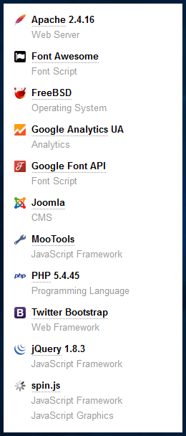
Web Hosting – Client-Server Architecture (2)
Using “telnet” to retrieve data from web server
[pschiu@bsd4 ~]$ telnet www.cs.nctu.edu.tw 80
Trying 140.113.235.47...
Connected to www.cs.nctu.edu.tw.
Escape character is '^]'.
GET /~liuyh/sa.html HTTP/1.0
HTTP/1.1 200 OK
Server: nginx/0.7.62
Date: Sat, 12 Dec 2009 02:14:45 GMT
Content-Type: text/html
Connection: close
Last-Modified: Sat, 12 Dec 2009 02:14:09 GMT
Accept-Ranges: bytes
Content-Length: 201
Vary: Accept-Encoding
<!DOCTYPE HTML PUBLIC "-//W3C//DTD HTML 4.01//EN">
<html>
<head>
<title>Hello World!</title>
</head>
<body>
<p>Hello Wrold!</p>
</body>
</html>

Slide 10
Web Hosting – The HTTP Protocol (1)
HTTP: Hypertext Transfer Protocol
RFCs: (HTTP 1.1)
http://www.faqs.org/rfcs/rfc2068.html
http://www.faqs.org/rfcs/rfc2616.html (Updated Version)
Useful Reference: http://jmarshall.com/easy/http/
A network protocol used to deliver virtually all files and other data on the World Wide Web.
HTML files, image files, query results, or anything else.
Client-Server Architecture
A browser is an HTTP client because it sends requests to an HTTP server (Web server), which then sends responses back to the client.

Slide 11
Web Hosting – The HTTP Protocol (2)
Clients:
※ Send Requests to Servers
Action “path or URL” Protocal
Actions: GET, POST, HEAD
Ex. GET /index.php HTTP/1.1
Headers
Header_Name: value
Ex.
Host: www.cs.nctu.edu.tw
(blank line)
Data …
Servers:
※ Respond to the clinets
Status:
200: OK
403: Forbidden
404: Not Found
426: Upgrade Required
…
Ex. HTTP/1.1 200 OK
Headers
Same as clients
Ex.
Content-Type: text/html
(blank line)
Data…

Slide 12
Web Hosting – The HTTP Protocol (3)
liuyh@bsd5 ~/public_html $ telnet www.cs.nctu.edu.tw 80
Trying 140.113.235.47...
Connected to www.cs.nctu.edu.tw.
Escape character is '^]'.
GET /~liuyh/sa.html HTTP/1.0
HTTP/1.1 200 OK
Server: nginx/0.7.62
Date: Sat, 12 Dec 2009 02:14:45 GMT
Content-Type: text/html
Connection: close
Last-Modified: Sat, 12 Dec 2009 02:14:09 GMT
Accept-Ranges: bytes
Content-Length: 201
Vary: Accept-Encoding
<!DOCTYPE HTML PUBLIC "-//W3C//DTD HTML 4.01//EN">
<html>
<head>
<title>Hello World!</title>
</head>
<body>
<p>Hello Wrold!</p>
</body>
</html>
action
Headers
status
Headers
Data

Slide 13
Web Hosting – The HTTP Protocol (4)
Get vs. Post (client side)
Get:
Parameters in URL
GET /get.php?a=1&b=3 HTTP/1.1
No data content
Corresponding in HTML files
Link URL: http://nasa.cs.nctu.edu.tw/get.php?a=1&b=3
Using Form:
<form method=“GET” action=“get.php”> … </form>
Post:
Parameters in Data Content
POST /post.php HTTP/1.1
Corresponding in HTML files
Using Form:
<form method=“POST” action=“post.php”> … </form>
Read it: https://www.w3schools.com/tags/ref_httpmethods.asp

Slide 14
Web Hosting – The HTTP Protocol (5)
Get vs. Post Security Issue
Get:
GET requests can be cached
GET requests remain in the browser history
GET requests can be bookmarked
GET requests should never be used when dealing with sensitive data
GET requests have length restrictions
GET requests should be used only to retrieve data
Post:
POST requests are never cached
POST requests do not remain in the browser history
POST requests cannot be bookmarked
POST requests have no restrictions on data length
Read it: https://www.w3schools.com/tags/ref_httpmethods.asp

Slide 15
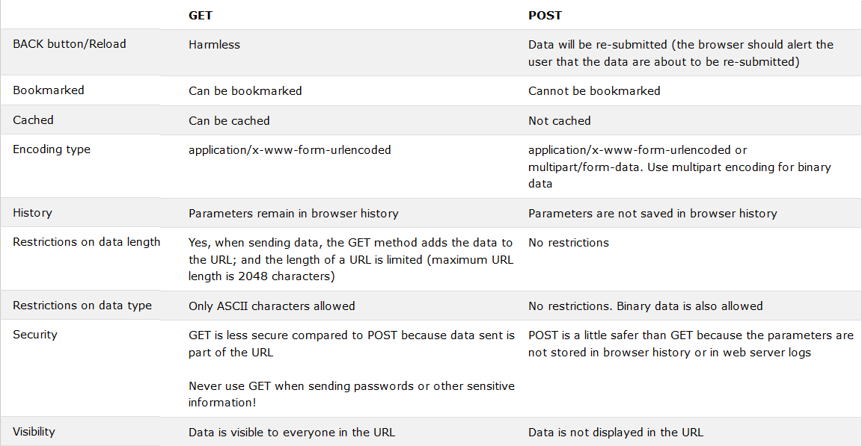
Web Hosting – The HTTP Protocol (6)
Read it: https://www.w3schools.com/tags/ref_httpmethods.asp

Slide 16
Web Hosting – The HTTP Protocol (7)
HTTP Headers:
What HTTP Headers can do?
[Ref] http://www.cs.tut.fi/~jkorpela/http.html
Content information (type, date, size, encoding, …)
Cache control
Authentication
URL Redirection
Transmitting cookies
Knowing where client come from
Knowing what software client use
…
Web Developer Tool

Slide 17
Web Hosting – Static vs. Dynamic Pages (1)
Static vs. Dynamic Pages
Technologies of Dynamic Web Pages
Client Script Language
JavaScript, Jscript, VBScript
Client Interactive Technology
Java Applet, Flash, XMLHTTP,AJAX
Server Side
CGI
Languages: Perl, ASP, ASP.NET, JSP, PHP, C/C++, …etc.
Static vs. Dynamic

Slide 18
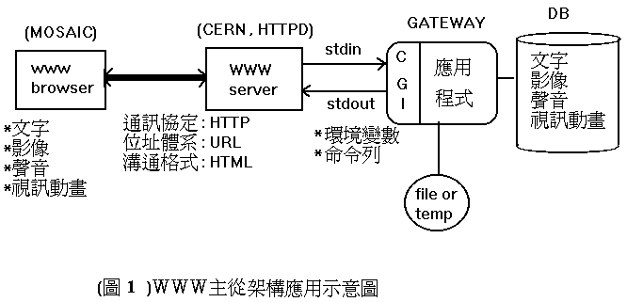
Web Hosting – Static vs. Dynamic Pages (2)
CGI (Common Gateway Interface)
A specification that allows an HTTP server to exchange information with other programs

Slide 19
Web Hosting – Virtual Hosting (1)
Providing services for more than one domain-name (or IP) in one web server.
IP-Based Virtual Hosting vs. Name-Based Virtual Hosting
IP-Base – Several IPs (or ports)
Name-Base – Singe IP, several hostnames
Example (Apache configuration)
<VirtualHost *:80>
ServerName nabsd.cs.nctu.edu.tw
DocumentRoot "/www/path/a"
</VirtualHost>
<VirtualHost *:80>
ServerName sabsd.cs.nctu.edu.tw
DocumentRoot "/www/path/b"
</VirtualHost>
<VirtualHost 140.113.17.215:80>
ServerName sabsd.cs.nctu.edu.tw
DocumentRoot /www/sabsd
</VirtualHost>
<VirtualHost 140.113.17.221:80>
ServerName tphp.cs.nctu.edu.tw
DocumentRoot /www/tphp
</VirtualHost>

Slide 20
Web Hosting – Virtual Hosting (2)
Q: How Name-Based Virtual Hosting works?
A: It takes use of HTTP Headers.
$ telnet www.cs.nctu.edu.tw 80
Trying 140.113.235.47...
Connected to www.cs.nctu.edu.tw.
Escape character is '^]'.
GET / HTTP/1.0
Host: www.cs.nctu.edu.tw
HTTP/1.1 301 Moved Permanently
Server: nginx/0.7.62
Date: Sat, 12 Dec 2009 02:50:22 GMT
Content-Type: text/html
Connection: close
Cache-Control: no-cache, must-revalidate
Location: cht/announcements/index.php
Vary: Accept-Encoding
Connection closed by foreign host.
$ telnet www.cs.nctu.edu.tw 80
Trying 140.113.235.47...
Connected to www.cs.nctu.edu.tw.
Escape character is '^]'.
GET / HTTP/1.0
Host: www.ccs.nctu.edu.tw
HTTP/1.1 200 OK
Server: nginx/0.7.62
Date: Sat, 12 Dec 2009 02:51:43 GMT
Content-Type: text/html
Connection: close
Vary: Accept-Encoding
<!DOCTYPE html PUBLIC "-//W3C//DTD HTML 4.01//EN" "http://www.w3.org/TR/html4/strict.dtd">
<html lang="zh-Hant">
<head>
<meta http-equiv="content-type" content="text/html; charset=utf-8">
<title>國立交通大學資訊學院</title>
...

Slide 21
Proxy
Proxy
A proxy server is a server which services the requests of its clients by:
Making requests to other servers
Caching some results for further same requests
Goals:
Performance
Stability
Central Control
…etc.
Roles:
Forward Proxy
Reverse Proxy
Targets
Web pages/FTP files
TCP/IP Connections
…etc.
Proxy Server
Request
Request
client
Reply
Reply
Original
Server
Request
Reply (using cached result)
client

Slide 22
Proxy – The Forward Proxy
Forward Proxy
Proxy the outgoing requests, for the reason of
Bandwidth saving
Performance
Central control
Some institution may forced MITM (Man in the Middle) to check encrypt transfer
When objects requested are
In cache, return the cached objects
Otherwise, proxy server requests object from origin server, then cache it and return to client
Proxy Server
Request
Request
client
Reply
Reply
Original
Server
Request
Reply (using cached result)
client

Slide 23
Proxy – The Reverse Proxy
Reverse Proxy
Proxy the incoming requests, for the reason of
Reducing Server Load (by caching)
Load Balance
Fault Tolerant
Reverse proxy acts as the original server, accept incoming requests, reply corresponding result. SEAMLESS for clients!
Reverse
Proxy Server
Request
Internet
Reply
client
Server1
Request
Reply
client
Server1

Slide 24
Proxy – The Reverse Proxy - Cont.
Modem Hardware Server Load Balance
Application layer load balancing (L7)
Application layer service health check
Global server load balancing
SSL off load
Data acceleration
Cache
Compression (gzip)
Programmable server load balancing
F5 iRule
A10 aFlex

Slide 25
Proxy – SQUID
A web proxy server & cache daemon.
Supports HTTP, FTP
Limited support for TLS, SSL, Gopher, HTTPS
Port install: /usr/ports/www/squid{,30,31}
Startup:
/etc/rc.conf
squid_enable="YES"
/usr/local/etc/rc.d/squid start
Configuration Sample/Documents:
/usr/local/etc/squid/squid.conf.default

Slide 26
Proxy – SQUID Configuration (1)
Listen Port
Service Port
http_port 3128
Neighbored Communication
icp_port 3130
Logs
access_log
access_log /var/log/squid/access.log squid
cache_log
cache_log /var/log/squid/cache.log
cache_store_log
cache_store_log /var/log/squid/store.log

Slide 27
Proxy – SQUID Configuration (2)
Access Control
acl – define an access control list
Format: acl acl-name acl-type data
acl all src 0.0.0.0/0.0.0.0
acl NCTU srcdomain .nctu.edu.tw
acl YAHOO dstdomain .yahoo.com
acl allowhost src “/usr/local/etc/squid.squid.allow”
http_access – define the control rule
Format: http_access allow|deny acl-name
http_access allow NCTU
http_access allow allowhost
http_access deny all

Slide 28
Proxy – SQUID Configuration (3)
Proxy Relationship
Protocol: ICP (Internet Cache Protocol) RFC 2186 2187, using UDP
Related Configuration
cache_peer hostname type http_port icp_port [options]
cache_peer_domain cache-host domain [domain …]
cache_peer_access cache-host allow|deny acl-name

Slide 29
Proxy – SQUID Configuration (4)
Cache Control
cache_mem 512 MB
cache_dir ufs /usr/local/squid/cache 100 16 256
cache_swap_low 93
cache_swap_high 98
maximum_object_size 4096 KB
maximum_object_size_in_memory 8 KB
forwarded_for off
via off

Slide 30
Proxy – SQUID Configuration (5)
Sample: Proxy Configuration
http_port 3128
icp_port 3130
cache_mem 32 MB
cache_dir ufs /usr/local/squid/cache 100 16 256
access_log /var/log/squid/access.log squid
cache_log /var/log/squid/cache.log
cache_store_log /var/log/squid/store.log
pid_filename /usr/local/squid/logs/squid.pid
visible_hostname nabsd.cs.nctu.edu.tw
acl allowhosts src "/usr/local/etc/squid/squid.allow“
http_access allow allowhosts
http_access deny all

Slide 31
Proxy – SQUID Configuration (6)
Sample: Reverse Proxy Configuration
http_port 80 vhost
icp_port 3130
cache_mem 32 MB
cache_dir ufs /usr/local/squid/cache 100 16 256
access_log /var/log/squid/access.log squid
cache_log /var/log/squid/cache.log
cache_store_log /var/log/squid/store.log
pid_filename /usr/local/squid/logs/squid.pid
visible_hostname nabsd.cs.nctu.edu.tw
url_rewrite_program /usr/local/squid/bin/redirect.sh
acl cswww dstdomain csws1 csws2
http_access allow all cswww
always_direct allow cswww

Slide 32
Proxy – SQUID Configuration (7)
% cat /usr/local/squid/bin/redirect.sh
#!/bin/sh
while read line
do
TIME=`date "+%S"`
SERV=`expr $TIME % 2 + 1`
echo $line | sed -e \ "s/^http:\/\/www\.cs\.nctu\.edu\.tw\//http:\/\/csws$SERV\.cs\.nctu\.edu\.tw\//"
done

