Slide 1
Homework 4

Slide 2
Homework 4
Secure your web server
No Apache version
No email showing when error occurred
40x, 50x
No PHP version

Slide 3
Homework 4 - DNS
web2.nasa IN A <Your Server IP>
slave.nasa IN A <Your Slave IP 1>
slave.nasa IN A <Your Slave IP 2>
slave.nasa IN A <Your Slave IP 3>
Remind
Don’t change any setting about homework 1
NAP2016-WEB1.nasa
NAP2016-DNS1.nasa
NAP2016-DNS2.nasa

Slide 4
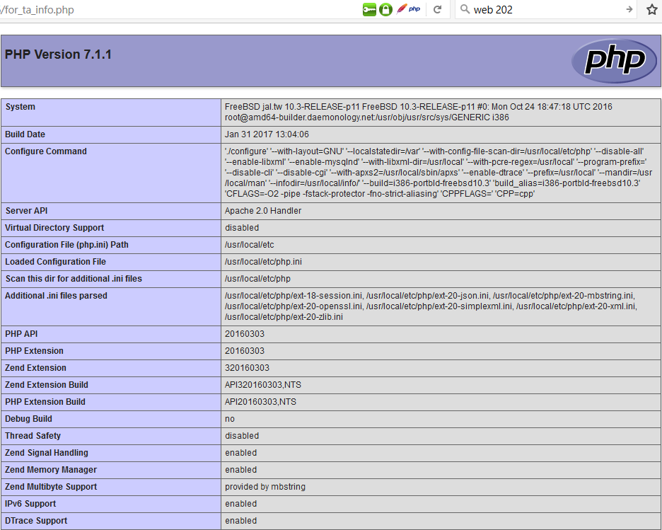
Homework 4 - Web
http://Web2.nasa.name.idv.tw/for_ta_info.php
Print out phpinfo();

Slide 5
Show client ip
http://Web2.nasa.name.idv.tw/myip.php
No additional info and content only showing ip
Careful about X-Forwarded-For Confusion
Considering below blog, and decide which variable is correct.
http://devco.re/blog/2014/06/19/client-ip-detection/
Ex: http://web2.nasa.nasa.idv.tw/myip.php
Detect script will using X-Forwarded-For to confused you.

Slide 6
Site Protect
http://<Your Server IP>/
http://Web2.nasa.name.idv.tw/
Must be a empty page
Content-Length must be 0
Ex: http://web2.nasa.nasa.idv.tw
Ex: http://140.131.188.41

