Slide 1
FAMP
FreeBSD/Apache/MySQL/PHP

Slide 2
Outline
Introduction
Apache
MySQL
PHP
Installation and Administration
MySQL
Apache
PHP
Appendix
phpMyAdmin
lighttpd
FastCGI

Slide 3
OpenSource Web Server
Lighttpd
Apache
Nginx

Slide 4
Lighttpd
Low resource (cpu & memory) usage
Supported
FastCGI, CGI, Auth, Compress, URL Rewrite, Alias, chroot, vhost
https://www.lighttpd.net/

Slide 5
Apache
Apache Software Foundation: https://www.apache.org/
Apache HTTP Server Project: https://httpd.apache.org/
Web httpd server that
HTTP/1.1
Modular design
Can be customized by writing modules using Apache module API
Freely available cross many platforms
Two main parts
Core: implement basic functions and provide the interface for Apache modules
Modules: extend or override the funcation of Core
Example: Access control, logging, CGI, proxy, cache control, PHP…

Slide 6
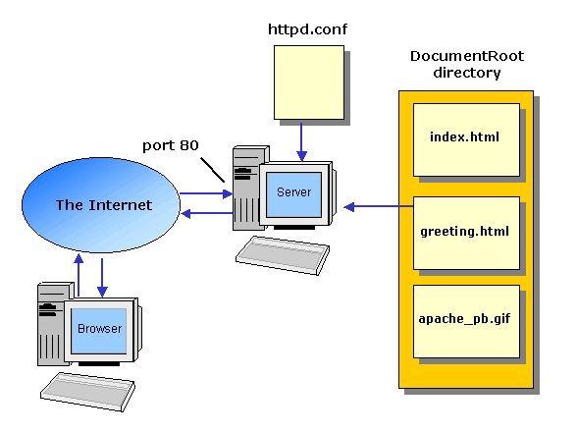
How Apache Works – request and response

Slide 7
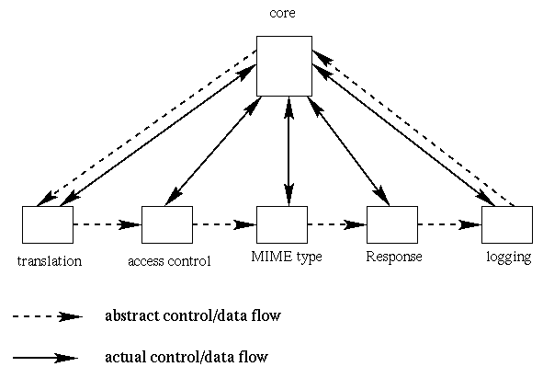
How Apache Works – Each request-response
Apache breaks client request into several steps which are implemented as modules

Slide 8
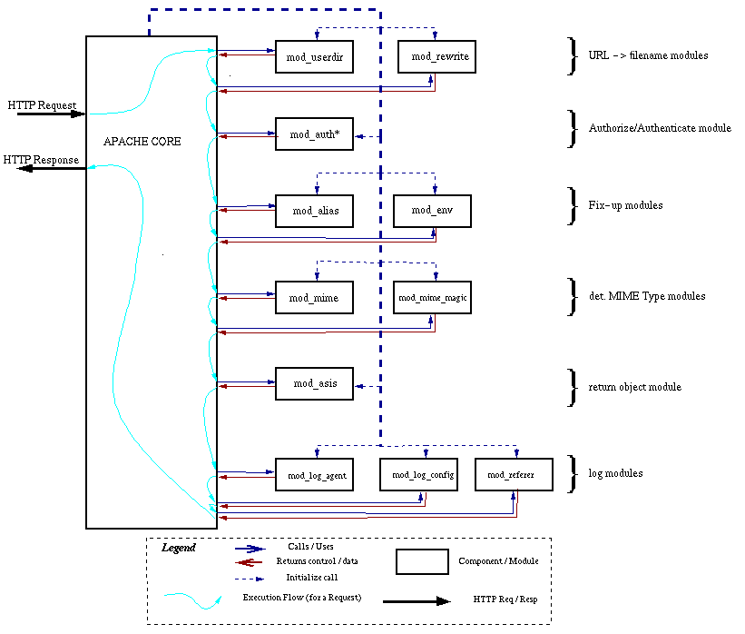
A p a c h e D e t a i l

Slide 9
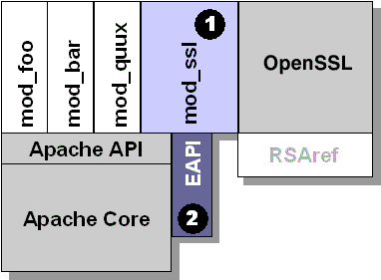
Apache with mod_ssl

Slide 10
Nginx – the High-Performance Web Server and Reverse Proxy
From Russia
HTTP/2 Supported
Ability to handle 10,000 simultaneous connections with a low memory footprint

Slide 11
The Nginx Process Model
https://www.nginx.com/blog/inside-nginx-how-we-designed-for-performance-scale/
Notes:
https://www.nginx.com/blog/inside-nginx-how-we-designed-for-performance-scale/

Slide 12
Inside the Nginx Worker Process
https://www.nginx.com/blog/inside-nginx-how-we-designed-for-performance-scale/

Slide 13
How Nginx Works
https://www.nginx.com/blog/inside-nginx-how-we-designed-for-performance-scale/

Slide 15
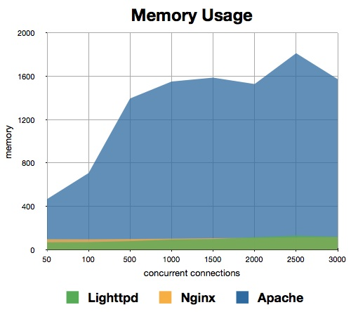
Performance Comparison
Memory usage
https://help.dreamhost.com/hc/en-us/articles/215945987-Web-server-performance-comparison

Slide 16
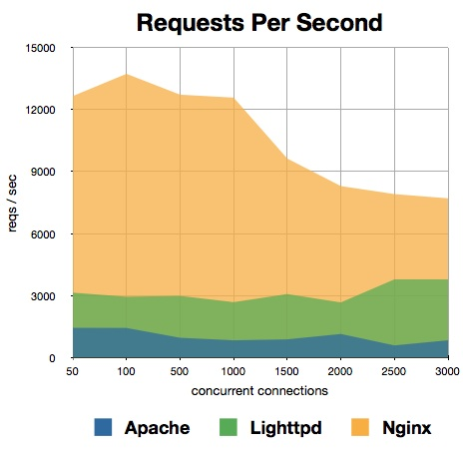
Performance Comparison
Requests per second
https://help.dreamhost.com/hc/en-us/articles/215945987-Web-server-performance-comparison

Slide 17
Some of benchmark
Throughput
Layer 4 Throughput
Layer 7 Throughput
Concurrent Sessions
Connections per second(CPS)
Layer 4 CPS
SSL CPS
SSL key 1024/2048/4096
Layer 7 CPS (1 HTTP/con)
Requests per second (RPS)
Layer 4 HTTP RPS
Layer 7 HTTP RPS

Slide 18
Others Web Server
IBM WebSphere Application Server (WAS)
SAP EAServer (Sybase)
Microsoft IIS
Oracle WebLogic
Google Servers
Tomcat
Node.js
IdeaWebServer
Tengine
Cowboy
LiteSpeed

Slide 19
Usage share of web servers
https://news.netcraft.com/archives/category/web-server-survey/

Slide 20
MySQL (1)
SQL (Structured Query Language)
The most popular computer language used to create, modify, retrieve and manipulate data from relational database management systems.
Introduction to SQL: http://www.1keydata.com/tw/sql/sql.html
In Chinese.
A multithreaded, multi-user, SQL Database Management System.
Owned and sponsored by a Swedish company MySQL AB, acquired by Sun Microsystems 2008.
Acquired by Oracle Corporation 2009.
Before acquire Monty Widenius fork GPL-only to MariaDB
Official Site: https://www.mysql.com
Documentation: https://dev.mysql.com/doc

Slide 21
MySQL (2)
Features:
Writing in C/C++, tested by many compilers, portable to many platforms.
AIX, FreeBSD, HP-UX, Linux, Mac OS, Solaris, Windows, …etc.
Providing APIs for C/C++, Java, Perl, PHP, Python, Ruby, Tcl, …etc.
Multi-threaded kernel, supporting systems with multiple CPUs.
Optimized algorithm for SQL Query.
Multi-Language (coding) Supports.
Lots of connecting method: TCP/IP, ODBC, JDBC, Unix domain socket.
Free Software (GNU General Public License version 2)
Popular for web applications

Slide 22
PHP
PHP: Hypertext Preprocessor
A widely-used Open Source general-purpose scripting language.
Originally designed to create dynamic web pages, PHP's principal focus is server-side scripting.
PHP scripts can be embedded into HTML.
The LAMP architecture has become popular in the Web industry as a way of deploying inexpensive, reliable, scalable, secure web applications.
Official Site: https://secure.php.net/

Slide 23
Installation and Administration
MySQL
Apache
PHP
phpMyAdmin

Slide 24
Installing MySQL / MariaDB(1)
Steps (on FreeBSD)
#pkg install mysql55-server
#pkg install mysql56-server
#pkg install mysql57-server
#pkg install mariadb100-server
#pkg install mariadb101-server
#pkg install mariadb55-server
Client
mariadb100-client
mariadb101-client
mysql55-client
mysql56-client
#yum install mariadb
#apt-get install mariadb

Slide 25
Installing MySQL (2)
After install
#mysql_secure_installation

Slide 26
mysql_secure_installation
NOTE: RUNNING ALL PARTS OF THIS SCRIPT IS RECOMMENDED FOR ALL MySQL
SERVERS IN PRODUCTION USE! PLEASE READ EACH STEP CAREFULLY!
In order to log into MySQL to secure it, we'll need the current
password for the root user. If you've just installed MySQL, and
you haven't set the root password yet, the password will be blank,
so you should just press enter here.
Enter current password for root (enter for none):
OK, successfully used password, moving on...
Setting the root password ensures that nobody can log into the MySQL
root user without the proper authorisation.
Set root password? [Y/n] y
New password: **************
Re-enter new password: **************
Password updated successfully!
Reloading privilege tables..
... Success!

Slide 27
mysql_secure_installation
By default, a MySQL installation has an anonymous user, allowing anyone
to log into MySQL without having to have a user account created for
them. This is intended only for testing, and to make the installation
go a bit smoother. You should remove them before moving into a
production environment.
# 移除 anonymous 使用者
Remove anonymous users? [Y/n] y
... Success!
Normally, root should only be allowed to connect from 'localhost'. This
ensures that someone cannot guess at the root password from the network.
# 取消 root 遠端登入
Disallow root login remotely? [Y/n] y
... Success!

Slide 28
mysql_secure_installation
By default, MySQL comes with a database named 'test' that anyone can
access. This is also intended only for testing, and should be removed
before moving into a production environment.
# 移除 test 資料表
Remove test database and access to it? [Y/n] y
- Dropping test database...
... Success!
- Removing privileges on test database...
... Success!
Reloading the privilege tables will ensure that all changes made so far
will take effect immediately.
# 重新載入資料表權限
Reload privilege tables now? [Y/n] y
... Success!
Cleaning up...

Slide 29
mysql_secure_installation
All done! If you've completed all of the above steps, your MySQL
installation should now be secure.
Thanks for using MySQL!

Slide 30
Installing MySQL (3)
Startup script…
#
# Add the following line to /etc/rc.conf to enable mysql:
# mysql_enable (bool): Set to "NO" by default.
# Set it to "YES" to enable MySQL.
# mysql_limits (bool): Set to "NO" by default.
# Set it to yes to run `limits -e -U mysql`
# just before mysql starts.
# mysql_dbdir (str): Default to "/var/db/mysql"
# Base database directory.
# mysql_args (str): Custom additional arguments to be passed
# to mysqld_safe (default empty).
#

Slide 31
Administrating MySQL (1)
Configuration file
Edit /usr/local/etc/my.cnf
Start mysql daemon
Using startup script
# /usr/local/etc/rc.d/mysql-server start

Slide 32
Administrating MySQL (2)
Test
% mysql –u root –p
The initial password for root is empty
nasa [/usr/local/etc] -randy- mysql -u root -p
Enter password:
Welcome to the MySQL monitor. Commands end with ; or \g.
Your MySQL connection id is 1
Server version: 5.1.41-log FreeBSD port: mysql-server-5.1.41
Type 'help;' or '\h' for help. Type '\c' to clear the current input statement.
mysql> show databases;
+-------------------------+
| Database |
+-------------------------+
| information_schema |
| mysql |
| test |
+-------------------------+
3 rows in set (0.06 sec)

Slide 33
Administrating MySQL (3)
Securing initial accounts
Two initial accounts
root
anonymous
mysql> SELECT Host, User From mysql.user;
+-----------------------------+------+
| Host | User |
+-----------------------------+------+
| 127.0.0.1 | root |
| nasa.cs.nctu.edu.tw | |
| nasa.cs.nctu.edu.tw | root |
| localhost | |
| localhost | root |
+-----------------------------+------+
mysql> UPDATE mysql.user SET Password = PASSWORD('test123') WHERE User = 'root';
Query OK, 3 rows affected (0.08 sec)
Rows matched: 3 Changed: 3 Warnings: 0
mysql> FLUSH PRIVILEGES; # Reload the grant tables
Query OK, 0 rows affected (0.00 sec)
mysql> SET PASSWORD FOR 'root'@'localhost' = PASSWORD('ttt123');
Query OK, 0 rows affected (0.02 sec)

Slide 34
Installing Apache (1)
Steps
# pkg install apache24
# make install clean
Options
A lot of options for modules
WITH_SSL (default)
WITH_MPM=worker
WITH_THREADS=yes
WITH_SUEXEC=yes

Slide 35
Installing Apache (2)
Installed…
Startup script
/usr/local/etc/rc.d/apache24
apache24_http_accept_enable
accf_http
/boot/loader.conf
accf_http_load="YES“
#kldload accf_http (Prevent Slowloris attack)
https://en.wikipedia.org/wiki/Slowloris_(computer_security)
To run apache www server from startup, add apache24_enable="YES"
in your /etc/rc.conf. Extra options can be found in startup script.
Your hostname must be resolvable using at least 1 mechanism in
/etc/nsswitch typically DNS or /etc/hosts or apache might
have issues starting depending on the modules you are using.
Notes:
accf_http - buffer incoming connections until a certain complete HTTP requests arrive

Slide 36
Apache configuration – Configuration files
Location
The default location of apache (in ports) is /usr/local/etc/apache24
Major configuration file: httpd.conf
Other configuration files could be included. (setting in httpd.conf)
extra/httpd-*.conf, Includes/*.conf
Two types
Global settings
Server configurations
Options of modules
Directory Configuration
Local setting for certain directory

Slide 37
Apache configuration – Global Settings (httpd.conf)
Server configuration
Listen 80
ServerAdmin liuyh@cs.nctu.edu.tw
ServerName nasa.cs.nctu.edu.tw
DocumentRoot "/home/wwwadm/data“
Remember create DocumentRoot directory if you modify it
Options of modules
Include supplemental configuration files
Include etc/apache24/extra/httpd-*.conf
Include etc/apache24/Includes/*.conf

Slide 38
Apache configuration – Directory Configuration (1)
Configuration parameters
Options
All
ExecCGI
FollowSymLinks
Indexs
MultiViews
SymLinksIfOwnerMatch
https://httpd.apache.org/docs/2.4/mod/core.html#options
<Directory "/home/hosts/ftp">
Options Indexes FollowSymlinks
AllowOverride None
<IfModule !mod_authz_core.c>
Order allow,deny
Allow from all
</IfModule>
<IfModule mod_authz_core.c>
Require all granted
Require method GET POST HEAD
</IfModule>
</Directory>

Slide 39
Apache configuration – Directory Configuration for 1.3 (2)
Configuration parameters
AllowOverride
All (Read .htaccess)
None (ignoring .htaccess)
Order
Solve collision of deny and allow rules
Deny/Allow
IP/DN (control access to this directory)
<Directory "/home/hosts/ftp">
Options Indexes FollowSymlinks
AllowOverride None
<IfModule !mod_authz_core.c>
Order allow, deny
Allow from all
</IfModule>
<IfModule mod_authz_core.c>
Require all granted
Require method GET POST HEAD
</IfModule>
</Directory>
<Directory "/home/hosts/ftp/none_pub">
Options -Indexes -FollowSymlinks
AllowOverride None
<IfModule !mod_authz_core.c>
Order allow,deny
Allow from all
</IfModule>
<IfModule mod_authz_core.c>
Require all granted
Require method GET POST HEAD
</IfModule>
</Directory>

Slide 40
Apache configuration – Directory Configuration for 2.x (3)
Configuration parameters
AllowOverride
All (Read .htaccess)
None (ignoring .htaccess)
Order
Solve collision of deny and allow rules
Deny/Allow
IP/DN (control access to this directory)
<Directory "/home/hosts/ftp">
Options Indexes FollowSymlinks
AllowOverride None
<IfModule !mod_authz_core.c>
Order allow, deny
Allow from all
</IfModule>
<IfModule mod_authz_core.c>
Require all granted
Require method GET HEAD
</IfModule>
</Directory>
<Directory "/home/hosts/ftp/none_pub">
Options -Indexes -FollowSymlinks
AllowOverride None
<IfModule !mod_authz_core.c>
Order allow,deny
Allow from all
</IfModule>
<IfModule mod_authz_core.c>
Require all granted
Require method GET HEAD
</IfModule>
</Directory>

Slide 41
Apache configuration – Directory Configuration for 2.x (3)
Comparison
Deny All
2.2 configuration:
Order deny,allow
Deny from all
2.4 configuration:
Require all denied
Allow All
2.2 configuration:
Order allow,deny
Allow from all
2.4 configuration:
Require all granted
Allow Host
2.2 configuration:
Order Deny,Allow
Deny from all
Allow from example.org
2.4 configuration:
Require host example.org

Slide 42
Apache configuration – Options of Modules
dir_module
alias_module (http://httpd.apache.org/docs/2.4/mod/mod_alias.html)
mime_module
<IfModule dir_module>
DirectoryIndex index.html
</IfModule>
<IfModule alias_module>
Redirect /foo http://www.example.com/bar
Alias /webpath /full/filesystem/path
ScriptAlias /cgi-bin/ "/usr/local/www/apache24/cgi-bin/"
</IfModule>
DefaultType text/plain
<IfModule mime_module>
TypesConfig etc/apache24/mime.types
AddType application/x-compress .Z
AddHandler cgi-script .cgi
</IfModule>

Slide 43
Supplemental configuration – httpd-mpm.conf (Multi-Processing Module)
Server-pool management (MPM specific)
Include etc/apache24/extra/httpd-mpm.conf
WITH_MPM
prefork: non-threaded, pre-forking
worker: hybrid multi-process multi-threaded
<IfModule mpm_worker_module>
StartServers 3
MinSpareThreads 75
MaxSpareThreads 250
ThreadsPerChild 25
MaxRequestWorkers 400
MaxConnectionsPerChild 0
</IfModule>

Slide 44
Supplemental configuration – httpd-userdir.conf
User home directories
Include etc/apache24/extra/httpd-userdir.conf
Methods: http://www.w3.org/Protocols/rfc2616/rfc2616-sec9.html
UserDir public_html
UserDir disabled root toor daemon operator bin tty kmem games news man sshd bind proxy _pflogd _dhcp uucp pop www nobody mailnull smmsp
<Directory "/home/*/public_html">
AllowOverride FileInfo AuthConfig Limit Indexes
Options MultiViews Indexes SymLinksIfOwnerMatch IncludesNoExec
<Limit GET POST OPTIONS>
Order allow,deny
Allow from all
</Limit>
<LimitExcept GET POST OPTIONS>
Order deny,allow
Deny from all
</LimitExcept>
</Directory>

Slide 45
Supplemental configuration – httpd-vhosts.conf
Listen 80 Listen 8080 NameVirtualHost 172.20.30.40:80 NameVirtualHost 172.20.30.40:8080 <VirtualHost 172.20.30.40:80> ServerName www.example.com DocumentRoot /www/domain-80 </VirtualHost> <VirtualHost 172.20.30.40:8080> ServerName www.example.com DocumentRoot /www/domain-8080 </VirtualHost> <VirtualHost 172.20.30.40:80> ServerName www.example.org DocumentRoot /www/otherdomain-80 </VirtualHost> <VirtualHost 172.20.30.40:8080> ServerName www.example.org DocumentRoot /www/otherdomain-8080 </VirtualHost>
Virtual hosts
Include etc/apache24/extra/
httpd-vhosts.conf
Name-based
NameVirtualHost
<VirtualHost>
IP-based
<VirtualHost>
ServerName
DocumentRoot
Ref: http://httpd.apache.org/docs/2.4/vhosts/

Slide 46
Supplemental configuration – More…
Multi-language error messages
httpd-multilang-errordoc.conf
Fancy directory listings
httpd-autoindex.conf
Language settings
httpd-languages.conf
Real-time info on requests and configuration
httpd-info.conf
Local access to the Apache HTTP Server Manual
httpd-manual.conf
Various default settings
httpd-default.conf

Slide 47
Other configuration for Apache – log
Rotate your log using newsyslog
In httpd config
ErrorLog "/var/log/httpd-error.log“
TransferLog "/var/log/httpd-access.log“
In startup script
_pidprefix="/var/run/httpd"
pidfile="${_pidprefix}.pid"
/var/log/httpd-access.log 640 5 * @T00 Z /var/run/httpd.pid
/var/log/httpd-error.log 640 5 * @T00 Z /var/run/httpd.pid
/www/jal.tw/logs/access.log 644 5 10240 * JC /var/run/httpd.pid
/www/jal.tw/logs/ssl-access.log 644 5 10240 * JC /var/run/httpd.pid
/www/jal.tw/logs/error.log 644 5 10240 * JC /var/run/httpd.pid
/www/140.131.150.111/logs/access.log 644 5 10240 * JC /var/run/httpd.pid
/www/140.131.150.111/logs/error.log 644 5 10240 * JC /var/run/httpd.pid

Slide 48
Other configuration for Apache – Secure your Server
Prevents git file leak
# jal.20150317: protect git file
<Directorymatch "^/.*/\.git+/">
Require all denied
</Directorymatch>
<Files ~ "^\.git">
Require all denied
</Files>

Slide 49
.htaccess (1)
.htaccess
Allow admin or users to control access to certain directory
Usage
Modify httpd.conf
Create .htaccess file
Generate password database
Test

Slide 50
.htaccess (2)
<Directory "/home/wwwadm/data/test1">
Options None
AllowOverride All
Order allow,deny
Allow from all
</Directory>
Example
Modify httpd.conf
Create .htaccess file
Generate password file
liuyh@nasa /home/wwwadm/data/test1> cat .htaccess
AuthName "SA-test1"
AuthType "Basic"
AuthUserFile "/home/wwwadm/data/test1/.htpasswd"
Require valid-user
Options Indexes
liuyh@nasa /home/wwwadm/data/test1> htpasswd -c ./.htpasswd SA-user1
New password:
Re-type new password:
Adding password for user SA-user1

Slide 51
.htaccess (3)

Slide 52
Installing PHP (1)
Steps
#pkg install php70
#pkg install mod_php70

Slide 53
Installing PHP (2)
Installed…
For use of Apache, you should restart apache to load php7_module
php.conf
Make sure index.php is part of your DirectoryIndex.
You should add the following to your Apache configuration file:
AddType application/x-httpd-php .php
AddType application/x-httpd-php-source .phps
LoadModule php7_module libexec/apache24/libphp7.so
<IfModule dir_module>
DirectoryIndex index.php index.html
</IfModule>

Slide 54
Test PHP in apache (1)
Edit httpd.conf
% mkdir –p /home/wwwadm/data
% cd /usr/local/etc/apache24/
Edit httpd.conf
<IfModule mime_module>
…
AddType application/x-httpd-php .php .phtml .php5
AddType application/x-httpd-php-source .phps
…
</IfModule>
<IfModule dir_module>
DirectoryIndex index.php index.html
</IfModule>

Slide 55
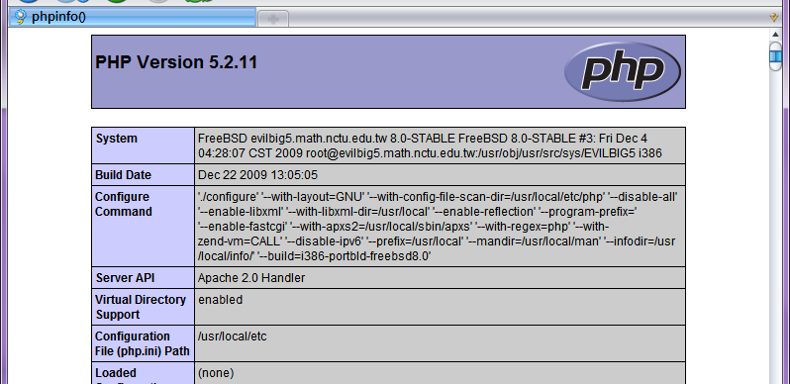
Test PHP in apache (2)
Start apache
/usr/local/etc/rc.d/apache24 start
Test PHP
% Edit /home/wwwadm/data/index.php
<?php
phpinfo();
?>

Slide 56
Appendix
phpMyAdmin
lighttpd
FastCGI

Slide 57
phpMyAdmin
phpMyAdmin can manage a whole MySQL server as well as a single database over the World Wide Web.
Official Site: http://www.phpmyadmin.net/
Documentation: http://www.phpmyadmin.net/documentation/
Features
Browser-based, Supporting PHP5.3+, MySQL 5.0+, Open Source
There are four authentication modes offered:
http
cookie
signon
config(the less secure one, not recommanded).

Slide 58
Installing phpMyAdmin (1)
databases/phpmyadmin
# make install clean
Installed…
phpMyAdmin-3.2.4 has been installed into:
/usr/local/www/phpMyAdmin
Please edit config.inc.php to suit your needs.
To make phpMyAdmin available through your web site, I suggest
that you add something like the following to httpd.conf:
Alias /phpmyadmin/ "/usr/local/www/phpMyAdmin/"
<Directory "/usr/local/www/phpMyAdmin/">
Options none
AllowOverride Limit
Order Deny,Allow
Deny from all
Allow from 127.0.0.1 .example.com
</Directory>

Slide 59
Installing phpMyAdmin (2)
config.inc.php
Override libraries/config.default.php
config.sample.inc.php
$cfg['blowfish_secret']

Slide 60
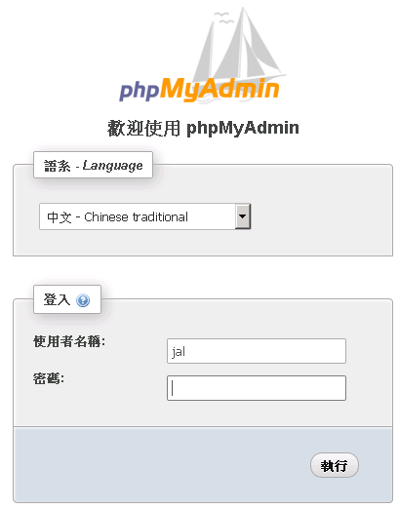
Administrating MySQL – Using phpMyAdmin (2)

Slide 61
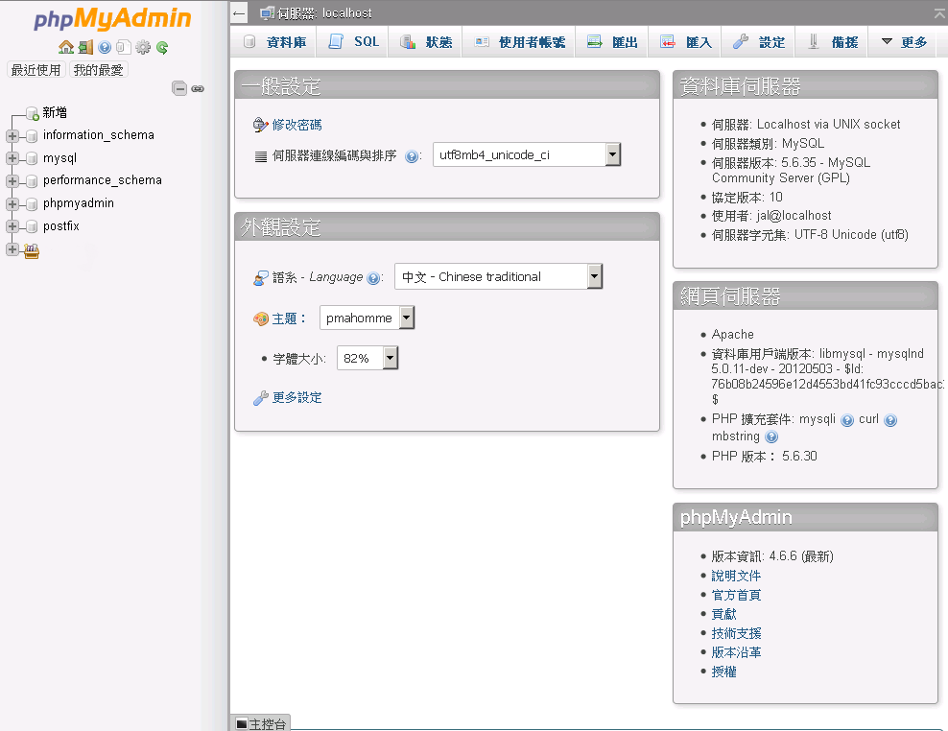
Administrating MySQL – Using phpMyAdmin (3)

Slide 62
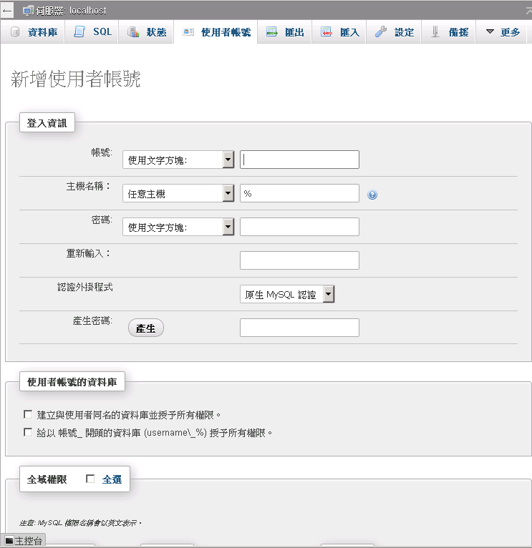
Administrating MySQL – Using phpMyAdmin (4)
Create another user with limited privilege

Slide 63
Installing lighttpd
www/lighttpd
Official: http://www.lighttpd.net/
Configuration files
/usr/local/etc/lighttpd/{lighttpd,modules}.conf
/usr/local/etc/lighttpd/{vhosts,conf}.d/
Startup script
/usr/local/etc/rc.d/lighttpd
Documentation:
https://redmine.lighttpd.net/projects/1/wiki/Docs
alias, cgi, dirlisting, fastcgi, ssl, userdir
Virtual hosts: evhost, mysqlvhost, simple-vhost

Slide 64
FastCGI
FastCGI is actually CGI with only a few extensions.
FastCGI is language-independent.
FastCGI run applications in processes isolated from the core Web server, which provides greater security than APIs.
FastCGI developers are committed to propagating FastCGI as an open standard. (C/C++, Java, Perl, Tcl)
FastCGI is not tied to the internal architecture of any Web server and is therefore stable even when server technology changes.
Benefits:
Distributed computing
Multiple and extensible roles

