Slide 1
Mail System
chenshh

Slide 2
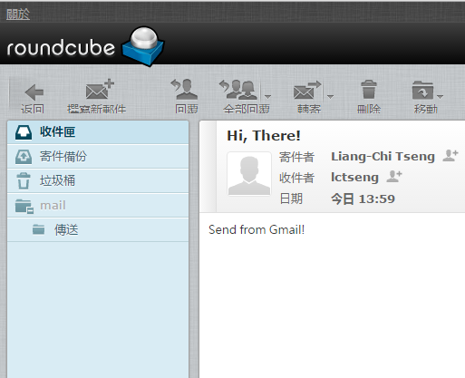
Mail System
What behinds the scene when you send an email?
Gmail
NCTU-CS Mailbox

Slide 3
Mail System
What behinds the scene when you send an email?
Gmail Servers
CS Mail Servers
Internet
Web Mail: Gmail
Web Mail: CS Mail

Slide 4
Mail System
More detailed view (outgoing, for illustration only)
Mail Submission Agent (MSA)
Mail Transport Agent (MTA)
Internet
SMTP
Lots of MTAs
Inside Gmail Domain
Mail User Agent (MUA)

Slide 5
Mail System
More detailed view (outgoing, for illustration only)
Mail User Agent (MUA)
Help user read and compose mails
Mail Submission Agent (MSA)
Route mails to local MTA
Mail Transport Agent (MTA)
Route mails among machines, using SMTP protocol
MSA
MTA
Internet
MUA

Slide 6
Mail System
More detailed view (incoming, for illustration only)
MTA
Mail Delivery Agent (MDA)
Internet
Message Store (NFS, RAID)
SMTP
Mail Access Agent (MAA)
IMAP/POP3
MUA
Inside CS Mail Domain

Slide 7
Mail System
More detailed view (incoming, for illustration only)
Mail Delivery Agent (MDA)
Place mails in users’ mail boxes
Mail Access Agent (MAA)
Connects the user agent to the mail box using POP or IMAP protocols
MTA
MDA
Storage
Internet
SMTP
MAA
IMAP/POP3
MUA

Slide 8
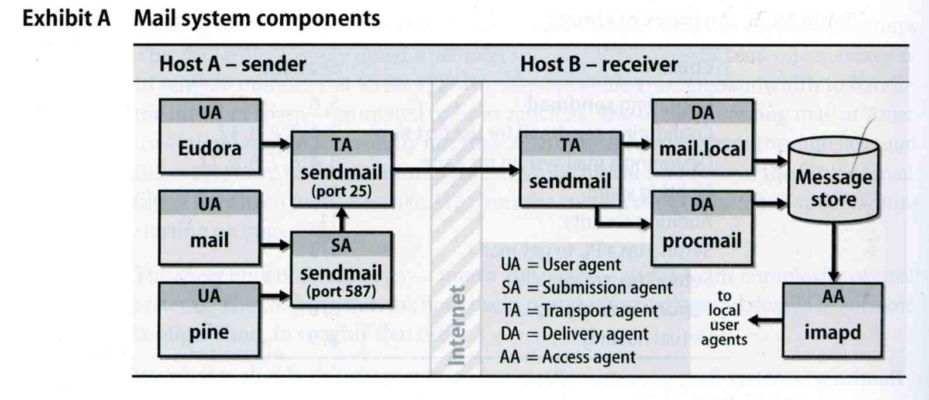
Mail System
Major components
Mail User Agent (MUA)
Help user read and compose mails
Outlook, web mail, Eudora…
Mail Transport Agent (MTA)
Route mails among machines
Mail Delivery Agent (MDA)
Place mails in users’ mail boxes
Filter spam, virus…
Mail Access Agent (MAA)
Connects the user agent to the mail box using POP or IMAP protocols
Mail Submission Agent (MSA)
Route mails to local MTA
Filter spam or virus before MUA sends mails to MTA

Slide 9
Mail System – The Message Stores
The place on the local machine where email is stored
Usually the directory: /var/mail or /var/spool/mail
Users’ mails are stored in files named with each user’s login name
Such as /var/mail/lctseng
Permission “775” and root:mail as the owner and group owner
drwxrwxr-x 2 root mail 512 Dec 16 15:51 mail/
For special mail programs
Using database
When the organization is large or for ISP with millions of customers
Better performance

Slide 10
Mail System – The User Agent (UA) (1)
Help user read and compose mails
UA must know mail format
Originally: Text only
Now: MIME (for multi-media)
※ MIME (Multipurpose Internet Mail Extensions)
Include several types of content that can be encoded in the mail, such as image, video, …

Slide 11
Mail System – The User Agent (UA) (2)
Popular Mail User Agents
User Agent | System Config. | User Config. | MIME | POP | IMAP | SMTP
bin/mail | mail.rc | .mailrc
pine | pine.conf | .pinerc
elm | lib/elm.rc | .elm/elmrc
mutt | /etc/Muttrc | .muttrc
Netscape | - | -
Eudora | - | -
Outlook Ep. | - | -

Slide 12
Mail System – The Transport Agent (TA) (1)
Route mails among machines
Accept mail from UA, examine the recipients’ addresses, and delivery the mail to the correct host
Protocols
SMTP (Simple Mail Transport Protocol)
RFC 821
Easy to be broke
ESMTP (Extended SMTP)
RFC 1869, 1870, 1891, 1985
Popular transport agents
sendmail
http://www.sendmail.org/
Postfix
http://www.postfix.org/

Slide 13
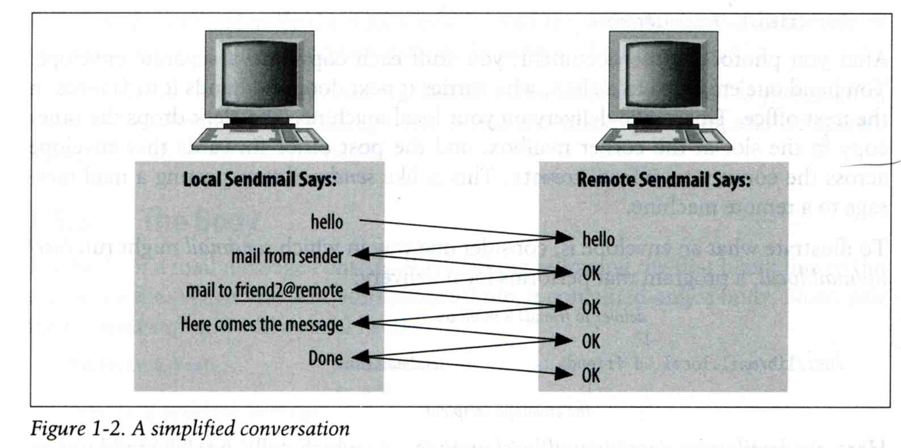
Mail System – The Transport Agent (TA) (2)
Conversation between TAs

Slide 14
Mail System – The Transport Agent (TA) (3)
Protocol: SMTP
chbsd [/home/chwong] -chwong- telnet chbsd.cs.nctu.edu.tw 25
Trying 140.113.17.212...
Connected to chbsd.cs.nctu.edu.tw.
Escape character is '^]'.
220 chbsd.cs.nctu.edu.tw ESMTP Sendmail 8.13.8/8.13.8; Sun, 15 Apr 2007 13:50:16 +0800 (CST)
HELP
214-2.0.0 This is sendmail version 8.13.8
214-2.0.0 Topics:
214-2.0.0 HELO EHLO MAIL RCPT DATA
214-2.0.0 RSET NOOP QUIT HELP VRFY
214-2.0.0 EXPN VERB ETRN DSN AUTH
214-2.0.0 STARTTLS
214-2.0.0 For more info use "HELP <topic>".
214-2.0.0 To report bugs in the implementation see
214-2.0.0 http://www.sendmail.org/email-addresses.html
214-2.0.0 For local information send email to Postmaster at your site.
214 2.0.0 End of HELP info
HELO chbsd
250 chbsd.cs.nctu.edu.tw Hello chbsd.csie.nctu.edu.tw [140.113.17.212], pleased to meet you
QUIT
221 2.0.0 chbsd.cs.nctu.edu.tw closing connection
Connection closed by foreign host.

Slide 15
Mail System – The Transport Agent (TA) (4)
Example of sending an email via telnet
220 nasa.cs.nctu.edu.tw ESMTP Postfix
EHLO somehost.my.domain
250-nasa.cs.nctu.edu.tw
250-PIPELINING
250-SIZE 10240000
250-VRFY
250-ETRN
250-STARTTLS
…
MAIl FROM: someone@nctucs.tw
250 2.1.0 Ok
RCPT TO: lctseng@cs.nctu.edu.tw
250 2.1.5 Ok
DATA
354 End data with <CR><LF>.<CR><LF>
Subject: Hi, there!
From: yourfriend@google.com
To: you@your.home
Hi! This is a test mail
.
250 2.0.0 Ok: queued as 76818366B292
Some lines omitted
Mail header
Must have empty line after header

Slide 16
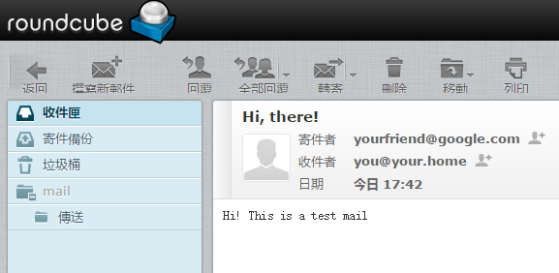
Mail System – The Transport Agent (TA) (5)
Obviously, we send a fake mail in the last page
With fake sender and receiver
Just like spam mails!

Slide 17
Mail System – The Delivery Agent (DA)
Place mails in users’ mail boxes
Accept mail from MTA and deliver the mail to the local recipients
Type of recipients
User
Program, such as
mail.local
procmail
mail.local
Read the stdin up to an EOF and appends it to each user’s mail file
procmail
Do something between mail coming in and stored in mail box
Spam filter
CS: http://www.cs.nctu.edu.tw/help/procmail.htm

Slide 18
Mail System – The Access Agent (AA)
Help user download mail from server
Protocols
IMAP (Internet Message Access Protocol)
Support both “online” and “offline” mode
Synchronize with server
POP (Post Office Protocol)
Download mails from server

Slide 19
Mail System – The Submission Agent (SA)
Route mails to local MTA
Typical works that a MTA must do:
Ensuring that all hostname are fully qualified
Modifying headers
E.g. remove the hostname (bsd5.cs.nctu.edu.tw → cs.nctu.edu.tw)
Logging errors
Filter spam and virus
…
RFC2476 introduces the idea of splitting MTA
Let SA to share the load
Avoid abuse on MTA

Slide 20
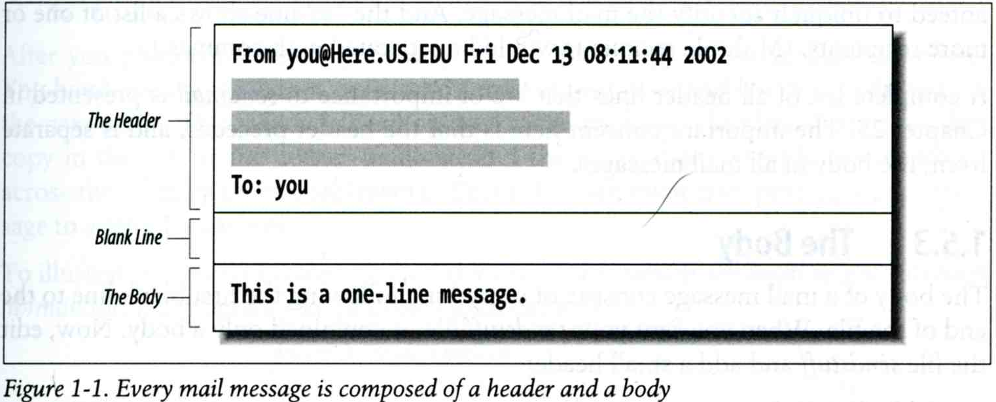
Components of a Mail (1)

Slide 21
Components of a Mail (2)
Three major components
The envelope
Invisible to users
Determine where the message should be delivered, or to whom it should be returned
The headers
Information about the messages, defined in RFC822
From, To, Date, Time, MTA, …
The message body
Plain text only
Various MIME contents are encoded as printable characters using radix-64 algorithm
The letter
MUA usually shows information of letter, not envelope

Slide 22
Mail Addressing (1)
Two kinds of email addresses:
Route based address
Message will travel through several intermediate hosts to the destination
Format: host!path!user
Ex: castle!sun!sierra!hplabs!ucbvax!winsor
This mail is sent from “castle” host to the user “winsor” at “ucbvax” host
Location independent address
Simply identify the final destination
Format: user@host.domain
Ex: lctseng@nabsd.cs.nctu.edu.tw
Alias
Map a username to something else, such as
To a group of users (easy to management)
Ex: ta → lctseng, yench, chchang2222, …
To the same user at different machine
Ex: lctseng@nasa.cs.nctu.edu.tw → lctseng@cs.nctu.edu.tw
To another user (or another domain)
Ex: admin@some.domain → lctseng@cs.nctu.edu.tw

Slide 23
Mail Addressing (2) -- (Mail eXchanger, mx)
Where to send the mail?
When you want to send the mail to lctseng@cs.nctu.edu.tw, the MTA will:
First, lookup up the mail exchanger (DNS Record) of “cs.nctu.edu.tw”
% dig mx cs.nctu.edu.tw
If there is any servers, choose the higher preference one (lower value)
If this preferred one can not be connected, choose another
If all the mx servers can not be connected (or not available), mail it directly to the host
nasa [/home/lctseng] -lctseng- dig mx cs.nctu.edu.tw
;; ANSWER SECTON:
cs.nctu.edu.tw. 7200 IN MX 5 csmx2.cs.nctu.edu.tw.
cs.nctu.edu.tw. 7200 IN MX 10 csmx3.cs.nctu.edu.tw.
cs.nctu.edu.tw. 7200 IN MX 5 csmx1.cs.nctu.edu.tw.

Slide 24
Mail Addressing (3) -- (Mail eXchanger, mx) (2)
Why using “Mail eXchanger”?
We can centralize all the mail tasks to group of servers
Multiple mail exchangers make it more robust

Slide 25
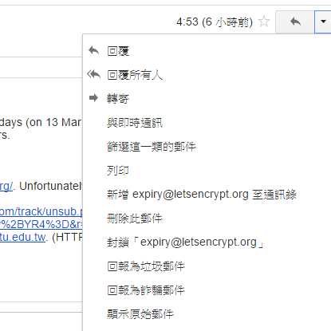
Mail Headers (1)
Defined by RFC822 which is obsoleted by RFC2822
Mail reader will hide some uninteresting header information
Date: Wed, 18 Apr 2007 14:05:04 +0800
From: 大小姐 <lkkg-girl@mail.richhome.net>
Subject: 笑狗好可怕
To: Liang-Chi Tseng <lctseng@nabsd.cs.nctu.edu.tw>
User-Agent: Mutt/1.5.15 (2007-04-06)
你趕快把牠趕跑好不好？

Slide 26
Mail Headers (2)
From lctseng@chbsd.cs.nctu.edu.tw Wed Apr 18 14:07:21 2007
Return-Path: <lctseng@chbsd.cs.nctu.edu.tw>
X-Original-To: lctseng@nabsd.cs.nctu.edu.tw
Delivered-To: lctseng@nabsd.cs.nctu.edu.tw
Received: from chbsd.cs.nctu.edu.tw (chbsd.csie.nctu.edu.tw [140.113.17.212])
by nabsd.cs.nctu.edu.tw (Postfix) with ESMTP id 22EC73B4D51
for <lctseng@nabsd.cs.nctu.edu.tw>; Wed, 18 Apr 2007 14:07:21 +0800 (CST)
Received: from chbsd.cs.nctu.edu.tw (localhost [127.0.0.1])
by chbsd.cs.nctu.edu.tw (8.13.8/8.13.8) with ESMTP id l3I654P3060925
for <lctseng@nabsd.cs.nctu.edu.tw>; Wed, 18 Apr 2007 14:05:04 +0800 (CST)
(envelope-from lctseng@chbsd.cs.nctu.edu.tw)
Received: (from lctseng@localhost)
by chbsd.cs.nctu.edu.tw (8.13.8/8.13.8/Submit) id l3I654AY060924
for lctseng@nabsd.cs.nctu.edu.tw; Wed, 18 Apr 2007 14:05:04 +0800 (CST)
(envelope-from lctseng)
Date: Wed, 18 Apr 2007 14:05:04 +0800
From: =?utf-8?B?5aSn5bCP5aeQ?= <lkkg-girl@mail.richhome.net>
To: Liang-Chi Tseng <lctseng@nabsd.cs.nctu.edu.tw>
Subject: =?utf-8?B?56yR54uX5aW95Y+v5oCV?=
Message-ID: <20070418060503.GA60903@chbsd.csie.nctu.edu.tw>
MIME-Version: 1.0
Content-Type: text/plain; charset=utf-8
Content-Disposition: inline
Content-Transfer-Encoding: 8bit
User-Agent: Mutt/1.5.15 (2007-04-06)
Status: RO
Content-Length: 23
Lines: 1
你趕快把牠趕跑好不好？
Newer
Older
Encoding is important!

Slide 27
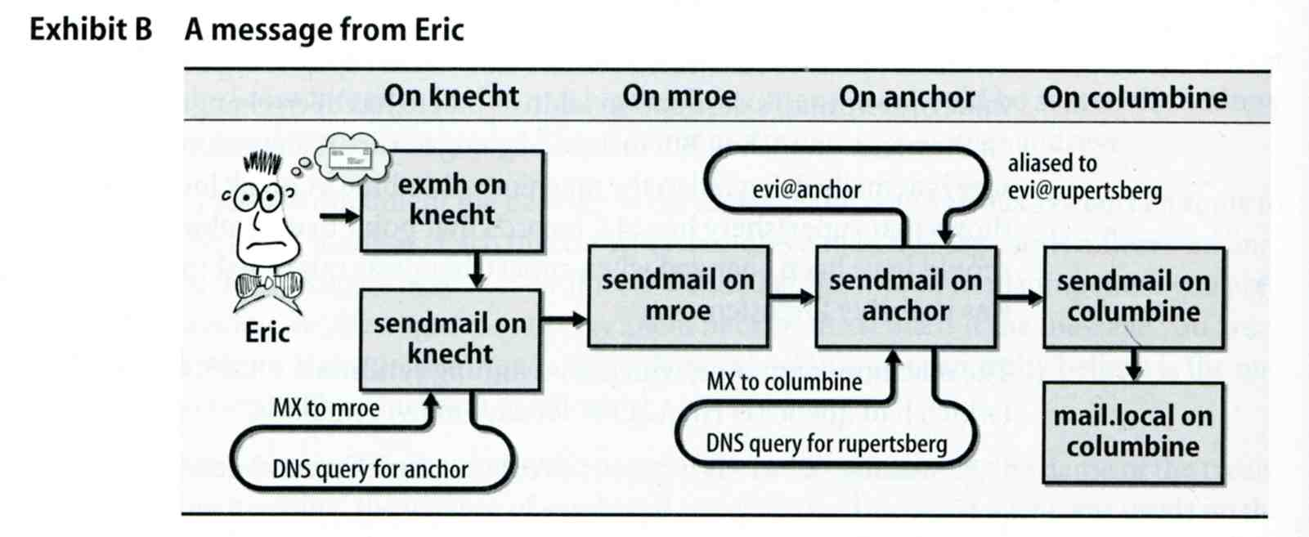
Mail Headers (3)
Example
User “eric” on “knecht.sendmail.org” sends a email to user “evi” on “anchor.cs.colorado.edu”
% dig mx anchor.cs.colorado.edu
mroe.cs.colorado.edu

Slide 28
Mail Headers (4)
Headers in this example
From eric@knecht.sendmail.org
Added by mail.local when the mail is put in user’s mailbox
Used to separate message boundary
Return-Path: eric@knecht.sendmail.org
Used to send the error message to this address
May be different to the “From” address
Received: from knecht.sendmail.org (localhost [127.0.0.1]) by knecht.sendmail.org (8.9.3/8.9.2) with ESMTP id GAA18984; Fri 1 Oct 1999 06:04:02 -800 (PST)
Every machine that is ever processed this mail will add a “Received” record in top of headers
Sending machine
Receiving machine
Version of sendmail in receiving machine
Message unique identifier in receiving machine
Date and time

Slide 29
Mail Headers (5)
Received: from anchor.cs.Colorado.EDU (root@anchor.cs.colorado.edu [128.138.242.1]) by columbine.cs.colorado.edu (8.9.3/8.9.2) with ESMTP id HAA21741 for <evi@rupertsberg.cs.colorado.edu>; Fri, 1 Oct 1999 07:04:25 -0700 (MST)
Received: from mroe.cs.colorado.edu (more.cs.colorado.edu [128.138.243.1]) by anchor.cs.colorado.edu (8.9.3/8.9.2) with ESMTP id HAA26176 for <evi@anchor.cs.colorado.edu>; Fri, 1 Oct 1999 07:04:24 -0700 (MST)
Received: from knecht.sendmail.org (knecht.sendmail.org [209.31.233.160]) by mroe.cs.colorado.edu (8.9.3/8.9.2) with ESMTP id HAA09899 fro <evi@anchor.cs.colorado.edu>; Fri, 1 Oct 1999 07:04:23 -700 (MST)
Received: from knecht.sendmail.org (localhost [127.0.0.1]) by knecht.sendmail.org (8.9.3/8.9.2) with ESMTP id GAA18984; Fri 1 Oct 1999 06:04:02 -800 (PST)

Slide 30
Mail Headers (6)
Message-Id: <199910011404.GAA18984@knecht.sendmail.org)
Add by sender’s MTA
X-Mailer: exmh version 2.0.2 2/24/98
MUA
Non-standard header information
To: Evi Nemeth <evi@anchor.cs.colorado.edu>
Subject: Re: hi
Date: Fri, 1 Oct 1999 06:04:02 -800

Slide 31
Mail System Architecture
Components in a mail system architecture
Mail servers for incoming and outgoing mails
Mail home
IMAP or POP to integrate PC and remote clients
Simplest architecture
Only one machine
This machine has sendmail to let you send and receive mail
This machine is also the mailbox home
This machine also provides IMAP or POP to let you download mail from PC

Slide 32
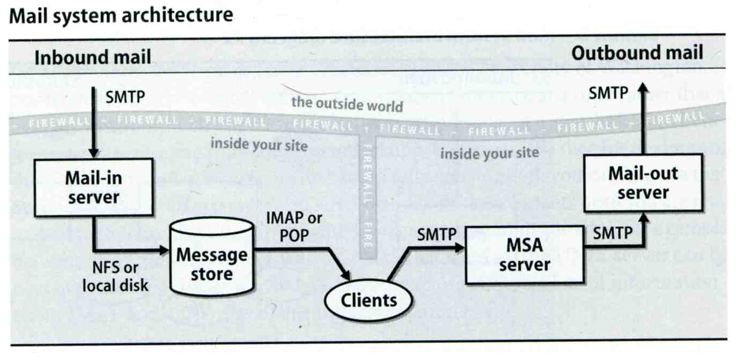
Mail System Architecture – Scalable architecture for medium sites
Centralize
At least one machine for incoming message and
Mail home can be the same host or another one
At least one machine for outgoing message
Each host run MSA and forward mail to the same mail-out server or send the mail directly

Slide 33
Mail Alias
Several mechanisms to define aliases:
Traditional method: in files
Traditional method with NIS
LDAP (Light-weight Directory Access Protocol)
When the sendmail wants to resolve name
File-based method
sendmail looks up files to resolve it by itself
LDAP-based method
sendmail call LDAP server to resolve the name and return the results

Slide 34
Mail Alias – Traditional aliasing mechanism (1)
Aliases can be defined in three places
In MUA’s configuraiton file
Read by MUA and expand the alias before injecting the message into the mail system
In the system-wide /etc/mail/aliases file
Read by MTA
The path to the system-wide alias file can be specified in sendmail’s configuration file
In user’s forwarding file, ~/.forward
Read by MTA after system-wide alias file
forward(5)

Slide 35
Mail Alias – Traditional aliasing mechanism (2)
The format of an entry in aliases file
Local-name: recipient1,recipient2,…
Ex:
admin: lctseng,yench
lctseng: lctseng@nasa.cs.nctu.edu.tw
Local-name: :include:another-file
Ex:
bsdTA: :include:/usr/local/mail/bsdTA
Contents of bsdTA
lctseng
yench
chchang2222
hmwang

Slide 36
Mail Alias – Traditional aliasing mechanism (3)
Local-name: absolute-path-file
Mails will be appended to this file
Ex:
complaints: /dev/null
troubles: trouble_admin,trouble_log
trouble_admin: :include:/usr/local/mail/troadm
trouble_log: /usr/local/mail/logs/troublemail
Local-name: "|program-path"
Route mail to stdin of program
Ex:
autoftp: “|/usr/local/bin/ftpserver”

Slide 37
Mail Alias – Traditional aliasing mechanism (4)
The hashed aliases DB
/etc/mail/aliases is the plaintext aliases information
/etc/mail/aliases.db is the hashed version for efficiency
Use “newaliases” command to rebuild the hashed version when you change the aliases file

Slide 38
Mail Alias – Traditional aliasing mechanism (5)
User maintainable forwarding file
In ~/.forward
Format: newline-separated
Ex:
"|/usr/local/bin/procmail"
lctseng@gmail.com
~/mail_log, lctseng@gmail.com, lctseng@other.domain
Must be owned by user and writable only to user
The path to .forward file should be writable only to user

Slide 39
Mail Alias – Traditional aliasing mechanism (6)
Alias must
postmaster and MAILER-DAEMON
Mail system maintainer
bin, sys, daemon, nobody, …
System accounts (root)
root
forward root mail to the administrator (.forward)
MAILER-DAEMON: postmaster
postmaster: root
bin: root
bind: root
daemon: root
games: root
kmem: root
mailnull: postmaster
nobody: root
operator: root
…

Slide 40
vacation(1)
E-mail auto-responder
returns a message, ~/.vacation.msg by default
~/.vacation.db
default database file for db(3)
~/.vacation.{dir,pag}
default database file for dbm(3)
~/.vacation.msg
default message to send
Use with forward(5)
|/usr/bin/vacation <login name>
"|/usr/bin/vacation lctseng"
‹#›

