Slide 1
Postfix
chenshh

Slide 2
Outline
A very long topic
Step-by-step examples after brief introduction
Outline
Brief introduction to Postfix
Step by step examples
Build a basic MTA that can send mails to other domain
Clients from localhost only
Add authentication to MTA so that other host can send with your host
Add encryption
Basic MTA/MDA/MAA that you can receive mails from other domain
Detailed Postfix configuration

Slide 3
Postfix
Free and open source mail transfer agent (MTA)
For the routing and delivery of email
Intended as a fast, easy-to-administer, and secure alternative to the widely-used Sendmail
Formerly VMailer / IBM Secure Mailer
By Wietse Venema at the IBM Thomas J. Watson Research Center
IBM Public License
First released in mid-1999
http://www.postfix.org
http://www.postfix.org/documentation.html
‹#›

Slide 4
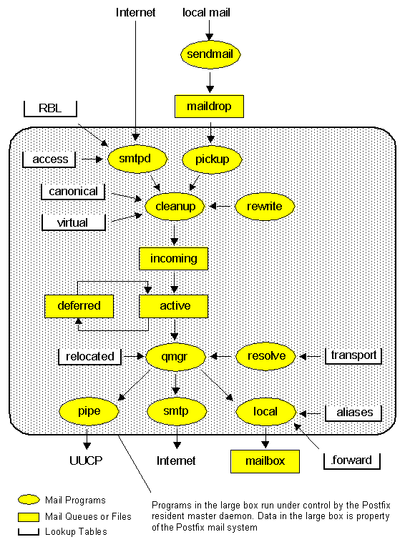
http://www.postfix.org/OVERVIEW.html

Slide 5
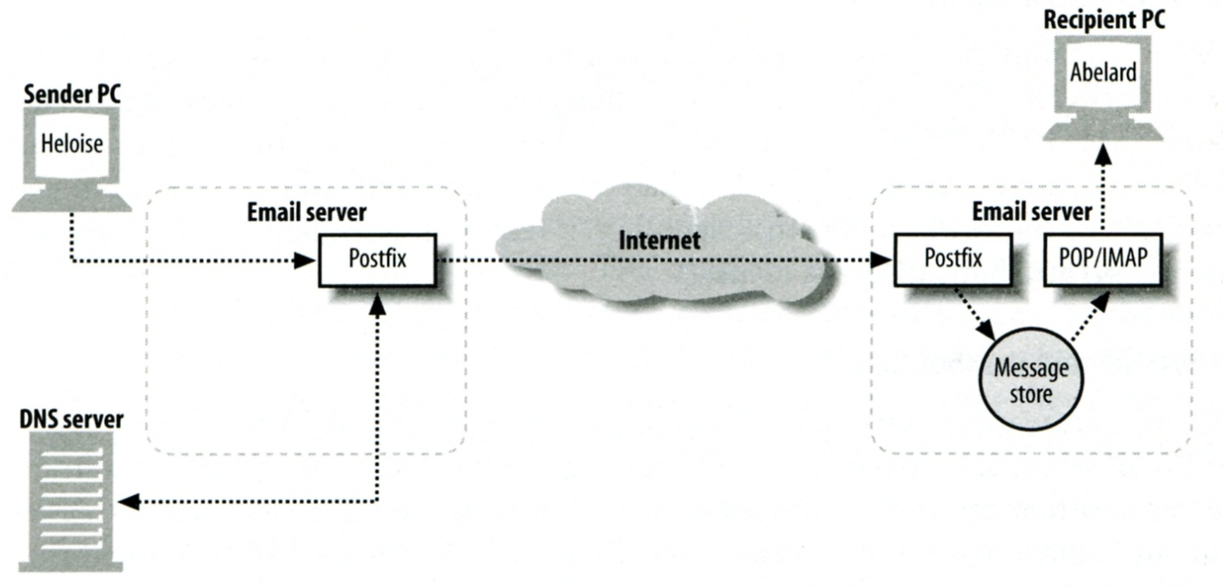
Role of Postfix
MTA that
Receive and deliver email over the network via SMTP
Local delivery directly or use other mail delivery agent

Slide 6
Postfix Architecture
Modular-design MTA
Not like sendmail of monolithic system
Decompose into several individual program that each one handle specific task
The most important daemon: master daemon
Reside in memory
Get configuration information from master.cf and main.cf
Invoke other process to do jobs
Major tasks
Receive mail and put in queue
Queue management
Delivery mail from queue

Slide 7
Postfix Architecture – Message IN
Four ways
Local submission
postdrop command
maildrop directory
pickup daemon
cleanup daemon
Header validation
address translation
incoming directory
Network submission
smtpd daemon
Local forwarding
Resubmit for such as .forward
Notification
defer daemon
bounce daemon
Local submission
Network submission

Slide 8
Postfix Architecture – Queue
Five different queues
incoming
The first queue that every incoming email will stay
active
Queue manager will move message into active queue whenever there is enough system resources
Queue manager then invokes suitable DA to delivery it
deferred
Messages that cannot be delivered are moved here
These messages are sent back either with bounce or defer daemons
corrupt
Used to store damaged or unreadable message
hold Used to hold message and wait admin to manually process
http://www.postfix.org/QSHAPE_README.html#queues

Slide 9
Postfix Architecture – Message OUT (1)
Address classes
Used to determine which destinations to accept for delivery
How the delivery take place
Main address classes
Local delivery
Domain names in “mydestination” is local delivered
Ex:
mydestination = nabsd.cs.nctu.edu.tw localhost
It will check alias and .forward file to do further delivery
Virtual alias
Ex:
virtual-alias.domain
user1@virtual-alias.domain address1
Virtual mailbox
Each recipient address can have its own mailbox
Ex:
virtual_mailbox_base = /var/vmail
/var/mail/vmail/CSIE, /var/mail/vmail/CS
Relay
Transfer mail for others to not yours domain
It is common for centralize mail architecture to relay trusted domain
Deliver mail to other domain for authorized user
The queue manager will invoke the smtp DA to deliver this mail

Slide 10
Postfix Architecture – Message OUT (2)
Other delivery agent (MDA)
Specify in /usr/local/etc/postfix/master.cf
How a client program connects to a service and what daemon program runs when a service is requested
lmtp
Local Mail Transfer Protocol (Replaced by ESMTP)
Used for deliveries between mail systems on the same network even the same host
Such as postfix → POP/IMAP to store message in store with POP/IMAP proprietary format
pipe
Used to deliver message to external program
pickup fifo n - n 60 1 pickup
cleanup unix n - n - 0 cleanup
bounce unix - - n

Slide 11
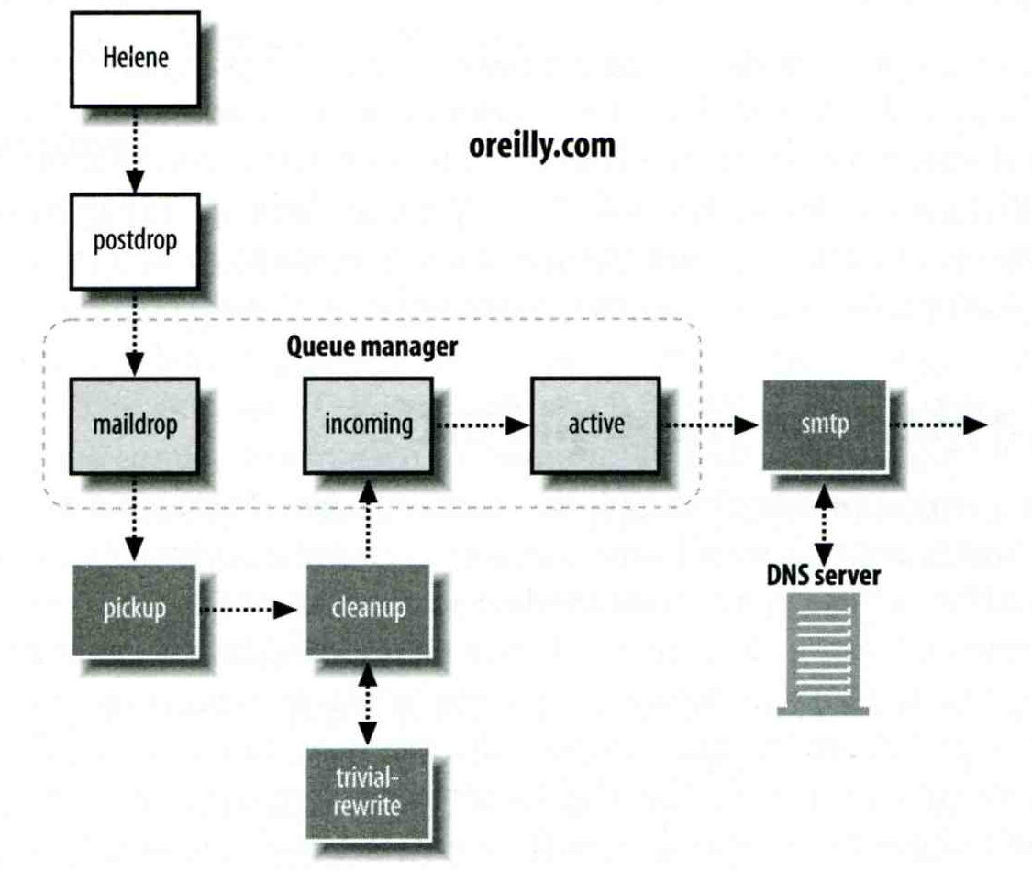
Message Flow in Postfix (1)
Example
helene@oreilly.com → frank@postfix.org (doel@onlamp.com)
Phase1:
Helene compose mail using her MUA, and then call postfix’s sendmail command to send it

Slide 12
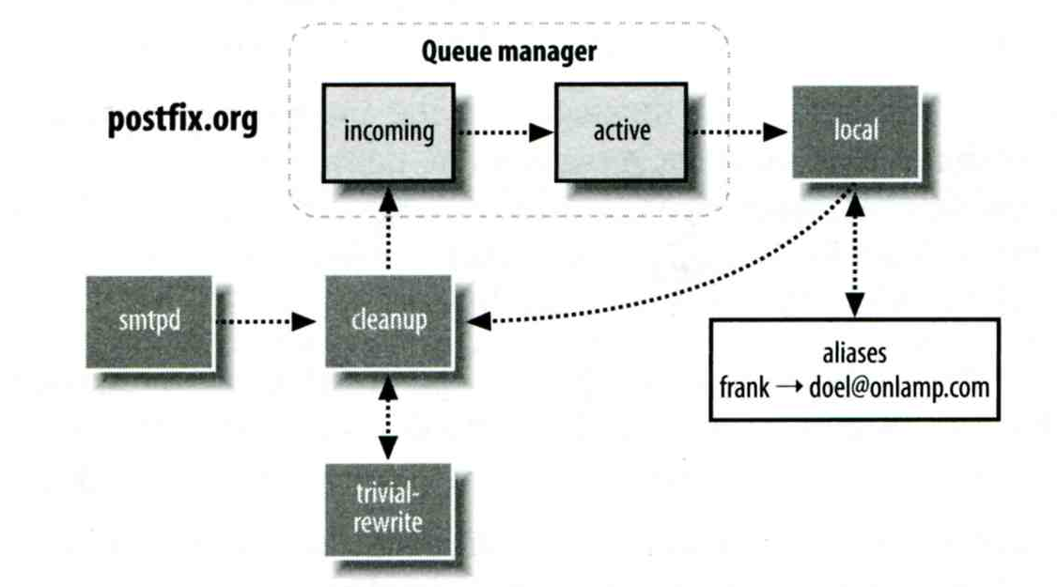
Message Flow in Postfix (2)
Phase2:
The smtpd on postfix.org takes this message and invoke cleanup then put in incoming queue
The local DA find that frank is an alias, so it resubmits it through cleanup daemon for further delivery

Slide 13
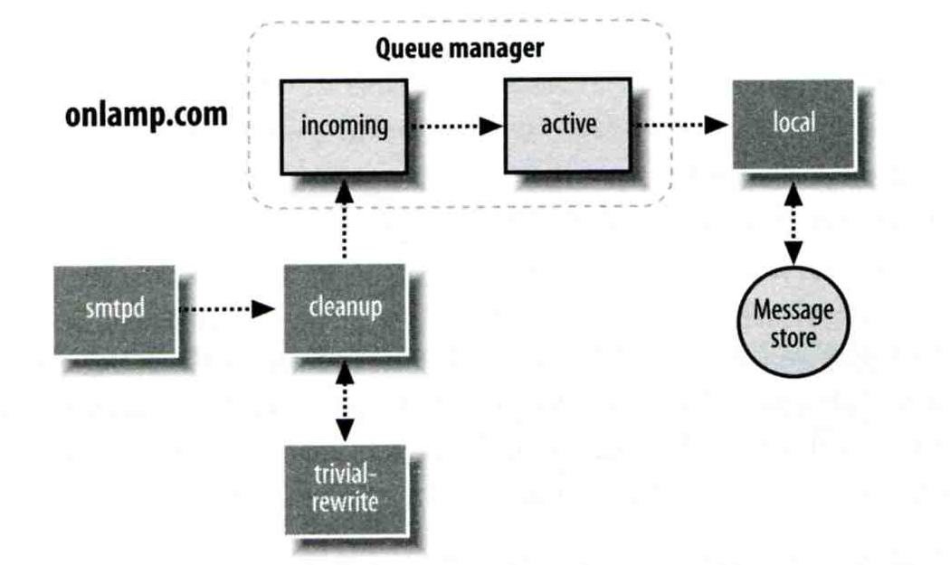
Message Flow in Postfix (3)
Phase3
The smtpd on onlamp.com takes this message and invoke cleanup then put in incoming queue
Local delivery to message store

Slide 14
Message Store Format
The Mbox format
Store messages in single file for each user
Each message start with “From ” line and continued with message headers and body
Mbox format has file-locking problem
The Maildir format
Use structure of directories to store email messages
Each message is in its owned file
Three subdirectories
cur, new and tmp
Quick in locating and deleting
Related parameters (in main.cf)
mail_spool_directory = /var/spool/mail (Mbox)
mail_spool_directory = /var/spool/mail/ (Maildir)

Slide 15
Postfix and POP/IMAP
POP vs. IMAP
Both are used to retrieve mail from server for remote clients
POP has to download entire message, while IMAP can download headers only
POP can download only single mailbox, while IMAP can let you maintain multiple mailboxes and folders on server
Cooperation between Postfix and POP/IMAP
Postfix and POP/IMAP must agree on the type of mailbox format and style of locking
Standard message store
Unstandard message store (using LMTP)
Such as Cyrus IMAP or Dovecot

Slide 16
Postfix Configuration
Two most important configuration files
/usr/local/etc/postfix/main.cf
Core configuration
/usr/local/etc/postfix/master.cf
Which postfix service should invoke which program
Edit configuration file
Using text editor
postconf
% postconf –e myhostname=nabsd.cs.nctu.edu.tw
% postconf –d myhostname (print default setting)
% postconf myhostname (print current setting)
Reload postfix whenever there is a change
# postfix reload
# /usr/local/etc/rc.d/postfix reload

Slide 17
Step by Step Examples
Let’s learn from examples

Slide 18
Step by Step Examples
Build a Basic MTA
Send test mails to verify your MTA
Check whether your mail is sent or not
MTA Authentication
MTA Encryption
MAA for POP3 and IMAP

Slide 19
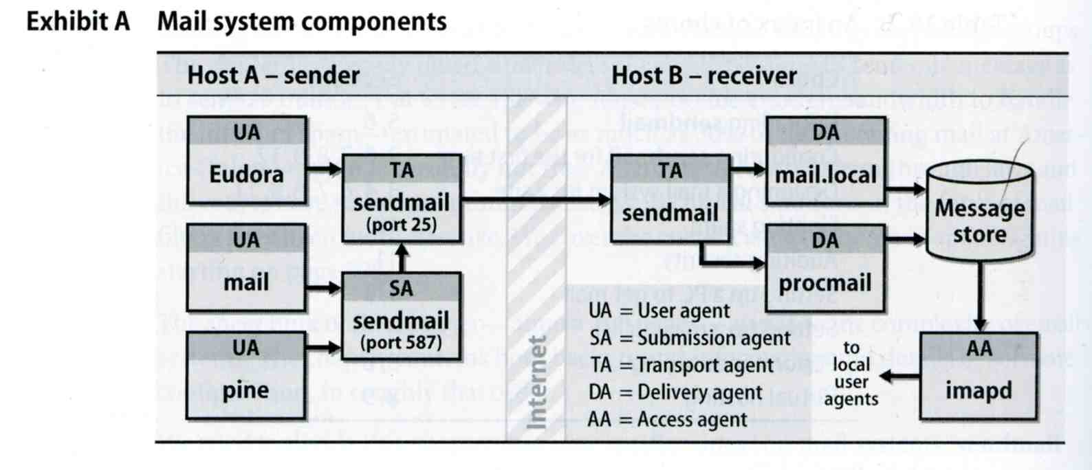
Build a Basic MTA
Can send mails to other domain

Slide 20
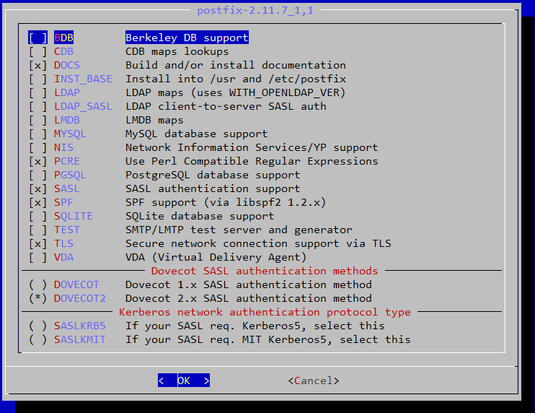
Build a basic MTA(1)
Can send mails to other domain
Install Postfix from port (need customization) (version 2.11)
mail/postfix
mail/postfix211
SASL
DOVECOT2

Slide 21
Build a basic MTA(2)
The default version of Postfix is changed to 3.1
You can install them from package
There may be some compatibility issue
All configuration in this slide is based on Postfix 2.11
Postfix can run in backwards-compatible mode
Reference: http://www.postfix.org/COMPATIBILITY_README.html

Slide 22
Build a basic MTA(3)
During installation
Would you like to activate Postfix in /etc/mail/mailer.conf [n]?
Answer “y” here
After installation
Disable “sendmail” program
service sendmail stop
In /etc/rc.conf
In /etc/periodic.conf (create if not exists)
sendmail_enable="NONE"
daily_clean_hoststat_enable="NO"
daily_status_mail_rejects_enable="NO"
daily_status_include_submit_mailq="NO"
daily_submit_queuerun="NO"

Slide 23
Build a basic MTA(4)
After installation
Enable postfix
Edit /etc/rc.conf
service postfix start
Set up DNS records
Some domains will reject mails from hosts without DNS record
Suppose the hostname is “demo1.nasa.lctseng.nctucs.net”
Set up these records
(A record) demo1.nasa.lctseng.nctucs.net
(A record) nasa.lctseng.nctucs.net
(MX record) nasa.lctseng.nctucs.net
Points to “demo1.nasa.lctseng.nctucs.net”
postfix_enable="YES"

Slide 24
Build a basic MTA(5)
Set up MTA identity
See Postfix Configuration: MTA identity
In main.cf
Reload or restart postfix to apply changes
postfix reload
myhostname = demo1.nasa.lctseng.nctucs.net
mydomain = nasa.lctseng.nctucs.net
myorigin = $myhostname
mydestination = $myhostname, localhost.$mydomain,
localhost, $mydomain

Slide 25
Send test mails to verify your MTA(1)
“telnet” or “mail” command
> telnet localhost 25
Trying 127.0.0.1...
Connected to localhost.
Escape character is '^]'.
220 demo1.nasa.lctseng.nctucs.net ESMTP Postfix
EHLO localhost
250-demo1.nasa.lctseng.nctucs.net
250-PIPELINING
250-SIZE 10240000
250-VRFY
250-ETRN
250-ENHANCEDSTATUSCODES
250-8BITMIME
250 DSN
MAIL FROM: lctseng@nasa.lctseng.nctucs.net
250 2.1.0 Ok
RCPT TO: lctseng@cs.nctu.edu.tw
250 2.1.5 Ok
DATA
354 End data with <CR><LF>.<CR><LF>
Subject: This is test mail
DATA
.
250 2.0.0 Ok: queued as 3C868150
telnet

Slide 26
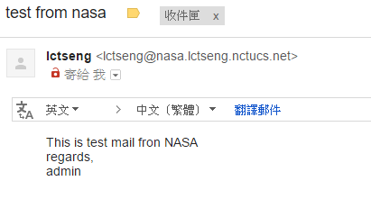
Send test mails to verify your MTA(2)
The “mail” command
See man page for more details
Result (gmail)
> mail -s "test from nasa" lctseng@gmail.com
This is test mail from NASA
regards,
admin
(Press Ctrl+D)
mail

Slide 27
Send test mails to verify your MTA(3)
Mail source text of last example
Delivered-To: lctseng@gmail.com
Received: by 10.129.125.135 with SMTP id y129csp874822ywc;
Sun, 6 Mar 2016 02:39:22 -0800 (PST)
X-Received: by 10.98.87.90 with SMTP id l87mr25639644pfb.70.1457260762400;
Sun, 06 Mar 2016 02:39:22 -0800 (PST)
Return-Path: <lctseng@nasa.lctseng.nctucs.net>
Received: from demo1.nasa.lctseng.nctucs.net …(omitted)
by mx.google.com with ESMTP id bz6si20406744pad.30.2016.03.06.02.39.21
for <lctseng@gmail.com>;
Sun, 06 Mar 2016 02:39:21 -0800 (PST)
Received-SPF: neutral (google.com: 140.113.168.238 is neither permitted …(omitted)
Authentication-Results: mx.google.com;
spf=neutral (google.com: 140.113.168.238 is neither permitted …(omitted)
Received: by demo1.nasa.lctseng.nctucs.net (Postfix, from userid 1001)
id 6D916162; Sun, 6 Mar 2016 18:38:04 +0800 (CST)
To: lctseng@gmail.com
Subject: test from nasa
Message-Id: <20160306103804.6D916162@demo1.nasa.lctseng.nctucs.net>
Date: Sun, 6 Mar 2016 18:38:04 +0800 (CST)
From: lctseng@nasa.lctseng.nctucs.net (lctseng)
This is test mail from NASA
regards,
admin

Slide 28
Check whether your mail is sent or not (1)
Sometimes, we do not receive mails immediately
There may be some errors when your MTA sending mails to other domain
Mails will stay in queues
Contain information about each mail
Tools to management mail queues
See Postfix Configuration: Queue Management - Queue Tools

Slide 29
Check whether your mail is sent or not (2)
Example for rejected mails
Problem
The destination MX cannot verify the domain of sender host
Reason
You may forget to set up correct DNS record
This mail will NOT be delivered until you set up your DNS record
-Queue ID- --Size-- ----Arrival Time---- -Sender/Recipient-------
3C868150 377 Sun Mar 6 18:23:11 lctseng@nasa.lctseng.nctucs.net
(host csmx3.cs.nctu.edu.tw[140.113.235.119] said: 450 4.1.8
<lctseng@nasa.lctseng.nctucs.net>: Sender address rejected: Domain not found
(in reply to RCPT TO command)) lctseng@cs.nctu.edu.tw
-- 0 Kbytes in 1 Request.

Slide 30
Check whether your mail is sent or not (3)
Example for deferred mails
Problem
The mail is deferred for a short time
Reason
Destination host wants to examine our server is a spamming host or not
The mail will be delivered after a short time
Generally within 30 minutes
-Queue ID- --Size-- ----Arrival Time---- -Sender/Recipient-------
3C868150 377 Sun Mar 6 18:23:11 lctseng@nasa.lctseng.nctucs.net
(host csmx1.cs.nctu.edu.tw[140.113.235.104] said: 450 4.2.0
<lctseng@cs.nctu.edu.tw>: Recipient address rejected: Greylisted,
see http://postgrey.schweikert.ch/help/cs.nctu.edu.tw.html
(in reply to RCPT TO command)) lctseng@cs.nctu.edu.tw
-- 0 Kbytes in 1 Request.

Slide 31
MTA Authentication
We don’t want unauthorized user to access our MTA

Slide 32
MTA authentication(1)
In previous example, only localhost can send mail to other domain
If you try telnet on other host, when you try to send mails to other domain, you will get:
That is because you have following lines in main.cf
So Postfix only trust clients from localhost
See Postfix Configuration: Relay Control
> telnet demo1.nasa.lctseng.nctucs.net 25
Trying 140.113.168.238...
Connected to demo1.nasa.lctseng.nctucs.net.
Escape character is '^]'.
220 demo1.nasa.lctseng.nctucs.net ESMTP Postfix
MAIL FROM: lctseng@demo1.nasa.lctseng.nctucs.net
250 2.1.0 Ok
RCPT TO: lctseng@gmail.com
454 4.7.1 <lctseng@gmail.com>: Relay access denied
mynetworks_style = host

Slide 33
MTA authentication(2)
How to let SMTP clients outside from trust networks get the same privileges as trusted hosts?
Can send mails to other domain, not only $mydestination
We need authentication (account and password)
SASL Authentication
Simple Authentication and Security Layer
RFC 2554, RFC 4954
To configure SASL for Postfix, we need another daemon
Dovecot SASL (we use it in our example)
Cyrus SASL
References
http://wiki2.dovecot.org/
http://www.postfix.org/SASL_README.html

Slide 34
MTA authentication(3) - Dovecot SASL
Installation
mail/dovecot2
Should be installed when you install Postfix (dependency)
Note: dovecot still have version 1.x, but it is obsolete
Enable Dovecot SASL daemon
In /etc/rc.conf
Copy configuration files
Create SSL keys for Dovecot (self-signed or use Let’s Encrypt)
Change path for SSL files in /usr/local/etc/dovecot/conf.d/10-ssl.conf
In fact, these are mainly for POP3s and IMAPs, not SASL in Postfix
service dovecot start
dovecot_enable="YES"
cp -R /usr/local/etc/dovecot/example-config/* \
/usr/local/etc/dovecot

Slide 35
MTA authentication(4) - Postfix with Dovecot SASL
Set up Dovecot SASL authenticate (using system account)
In /usr/local/etc/dovecot/conf.d/10-master.conf:
In /usr/local/etc/dovecot/conf.d/10-auth.conf
service auth {
...
unix_listener /var/spool/postfix/private/auth {
mode = 0660
user = postfix
group = postfix
}
...
}
auth_mechanisms = plain login

Slide 36
MTA authentication(5) - Postfix with Dovecot SASL
Set up Dovecot SASL in Postfix
In main.cf
Restart/Reload Dovecot and Postfix
# Set SASL to Dovecot
smtpd_sasl_type = dovecot
# Specify the UNIX socket path
smtpd_sasl_path = private/auth
# Enable SASL
smtpd_sasl_auth_enable = yes
# For client capability
broken_sasl_auth_clients = yes
# Allow SASL authenticated clients
smtpd_recipient_restrictions = permit_mynetworks,
permit_sasl_authenticated,
reject_unauth_destination

Slide 37
MTA authentication(6)
Now you can authenticate your identity in SMTP
> telnet demo1.nasa.lctseng.nctucs.net 25
Trying 140.113.168.238...
Connected to demo1.nasa.lctseng.nctucs.net.
Escape character is '^]'.
220 demo1.nasa.lctseng.nctucs.net ESMTP Postfix
EHLO linuxhome.cs.nctu.edu.tw
250-demo1.nasa.lctseng.nctucs.net
250-PIPELINING
250-SIZE 10240000
250-VRFY
250-ETRN
250-AUTH PLAIN LOGIN
250-AUTH=PLAIN LOGIN
250-ENHANCEDSTATUSCODES
250-8BITMIME
250 DSN

Slide 38
MTA authentication(7)
The account and password are encoded in Base64
If you have perl installed, suggest your account is test and password is testpassword
It will generate encoded account and password
For example: AHRlc3QAdGVzdHBhc3N3b3Jk
perl -MMIME::Base64 -e 'print encode_base64("\000test\000testpassword");'

Slide 39
MTA authentication(8)
Use the encoded account and password to authenticate it
> telnet demo1.nasa.lctseng.nctucs.net 25
Trying 140.113.168.238...
Connected to demo1.nasa.lctseng.nctucs.net.
Escape character is '^]'.
220 demo1.nasa.lctseng.nctucs.net ESMTP Postfix
AUTH PLAIN AHRlc3QAdGVzdHBhc3N3b3Jk
235 2.7.0 Authentication successful
MAIL FROM: lctseng@nasa.lctseng.nctucs.net
250 2.1.0 Ok
RCPT TO: lctseng@gmail.com
250 2.1.5 Ok
DATA
354 End data with <CR><LF>.<CR><LF>
To: lctseng@gmail.com
Subject: This is authenticated client
Message-Id: <20160307120109.861A9154@demo1.nasa.lctseng.nctucs.net>
Date: Mon, 7 Mar 2016 15:01:09 +0800 (CST)
From: lctseng@demo1.nasa.lctseng.nctucs.net (lctseng)
Test Mail
.
250 2.0.0 Ok: queued as F3D59171

Slide 40
MTA Encryption
The Internet is dangerous. We need to protect ourselves from sniffing.

Slide 41
MTA encryption(1)
In previous example, all SMTP sessions are in plain text
Your encoded authentication information is in danger!
We need encryption over SSL/TLS
Like HTTP can be enhanced to HTTPs
Postfix supports two kinds of encryption
SMTP over TLS
SMTPs
Before we enable SMTP over TLS (or SMTPs), you need SSL keys and certificates
Again, just like HTTPs
Self-signed or use Let’s Encrypt
You can use the same certificates/keys as Dovecot’s
In main.cf
smtpd_tls_cert_file = /path/to/cert.pem
smtpd_tls_key_file = /path/to/key.pem

Slide 42
MTA encryption(2-1) - Set up SMTP over TLS
Recommended for SMTP encryption
Use the same port as SMTP (port 25)
No force encryption
Client can choose whether to encrypt mails or not
But server can configured to force encryption
In main.cf
No force encryption
Force encryption
Reload Postfix
smtpd_tls_security_level = may
smtpd_tls_security_level = encrypt

Slide 43
MTA encryption(2-2) - Set up SMTP over TLS
Now your server supports SMTP over TLS
If you use force encryption, you must STARTTLS before sending mails
> telnet demo1.nasa.lctseng.nctucs.net 25
Trying 140.113.168.238...
Connected to demo1.nasa.lctseng.nctucs.net.
Escape character is '^]'.
220 demo1.nasa.lctseng.nctucs.net ESMTP Postfix
EHLO linuxhome.cs.nctu.edu.tw
250-demo1.nasa.lctseng.nctucs.net
250-PIPELINING
250-SIZE 10240000
250-VRFY
250-ETRN
250-STARTTLS
250-ENHANCEDSTATUSCODES
250-8BITMIME
250 DSN
MAIL FROM: lctseng@nasa.lctseng.nctucs.net
530 5.7.0 Must issue a STARTTLS command first

Slide 44
MTA encryption(3-1) - Set up SMTPs
Alternative way to encrypt SMTP sessions
Use different port: 465(deprecated,but still using) , 587
Force encryption
Can coexist with SMTP over TLS
In master.cf
Uncomment these lines
This will open port 465 for SMTPs and use “smtps” as syslog name
Reload Postfix
smtps inet n - n - - smtpd
-o syslog_name=postfix/smtps
-o smtpd_tls_wrappermode=yes

Slide 45
MTA encryption(3-2) - Set up SMTPs
Now you can use SSL clients to use SMTPs
telnet may not work in encrypted sessions
SSL client:
Important note
In openssl s_client, DO NOT use capital character “R”
“R” is a special command in openssl s_client (for renegotiating)
So use “rcpt to” instead of “RCPT TO”
For SMTP, they are all the same
If you use “R”, you will see following output (NOT a part of SMTP)
openssl s_client –connect host:port
RENEGOTIATING
depth=2 O = Digital Signature Trust Co., CN = DST Root CA X3
verify return:1
depth=1 C = US, O = Let's Encrypt, CN = Let's Encrypt Authority X1
verify return:1
depth=0 CN = nasa.lctseng.nctucs.net
verify return:1

Slide 46
MAA for POP3 and IMAP
Read mails from remote host

Slide 47
MAA for POP3 and IMAP (1) - Read mails from terminal
In fact, you mail server can receive mails now
But all messages are store in local disk
To read mails, you must login via ssh
Built-in command to read mail: “mail”
Friendly command-line MUA: “mutt”
Packages:
zh-mutt (Chinese version)
mutt (English version)
Ports:
chinese/mutt
mail/mutt
How to read mails from remote host?
MUA like Outlook, Thunderbird, or even Gmail
We need MAA

Slide 48
MAA for POP3 and IMAP (2)
Fortunately, the Dovecot already provides POP3 and IMAP services
Include SSL versions: POP3s, IMAPs
That why we need SSL certificates and keys for Dovecot
When you activate Dovecot service, these MAA services are also brought up.
But you cannot access mail directly, you need some configuration
Configuration files are in : /usr/local/etc/dovecot/
There are many files included by dovecot.conf
In conf.d directory
Splitting configuration files is easier to management
Reference: http://wiki2.dovecot.org/QuickConfiguration

Slide 49
MAA for POP3 and IMAP (3) - Dovecot Configuration
Allow GID = 0 to access mail (optional)
By default, Dovecot do not allow users with GID = 0 to access mail. If your users are in wheel group, you need following settings
In dovecot.conf
Specify the mail location
In conf.d/10-mail.conf
Add authenticate configuration to use PAM module
Dovecot use system PAM module to authenticate
Allow system users to access mails
Create a new file: /etc/pam.d/dovecot
first_valid_gid = 0
mail_location = mbox:~/mail:INBOX=/var/mail/%u
auth required pam_unix.so
account required pam_unix.so

Slide 50
MAA for POP3 and IMAP (4)
After restart Dovecot, your MAA is ready
To check these services, you can use “telnet” or “openssl s_client”
POP3: 110
POP3s: 995
IMAP: 143
IMAPs: 993
Messages for these services when you connect to the server
POP3
IMAP
+OK Dovecot ready.
* OK [CAPABILITY IMAP4rev1 LITERAL+ SASL-IR LOGIN-REFERRALS ID ENABLE IDLE AUTH=PLAIN AUTH=LOGIN] Dovecot ready.

Slide 51
MAA for POP3 and IMAP (5)
Set up MUAs like Outlook or Thunderbird
You can see the tutorial in CS mail server, they should be similar to set up your server
Settings for Gmail is also available
https://mail.cs.nctu.edu.tw/

Slide 52
Postfix Configuration
Reference: http://www.postfix.org/postconf.5.html

Slide 53
Postfix Configuration – Lookup tables (1)
Parameters that use external files to store values
Such as mydestination, mynetwork, relay_domains
Text-based table is ok, but time-consuming when table is large
Lookup tables syntax
Key values
postmap command
% postmap /etc/access (generate database)
% postmap –q 140.113.235.150 /etc/access (query)
140.113.235.150 REJECT
140.113.235 OK
> postmap -q 140.113.235.150 /etc/access
REJECT
> postmap -q 140.113.235 /etc/access
OK
/etc/access

Slide 54
Postfix Configuration – Lookup tables (2)
% postconf -m
btree
cidr
environ
hash
pcre
proxy
regexp
static
unix
% postconf default_database_type
default_database_type = hash
Database format
% postconf –m
List all available database format
% postconf default_database_type
Use databased-lookup table in main.cf
syntax
Parameter = type:name
or
Parameter = option type:name

Slide 55
Postfix Configuration – Lookup tables (3)
Example: Reject SMTP clients
In main.cf
Try SMTP clients from rejected host
smtpd_client_restrictions =
check_client_access hash:/etc/access
rcpt to: lctseng@nasa.lctseng.nctucs.net
554 5.7.1 <linuxhome.cs.nctu.edu.tw[140.113.235.150]>: Client host rejected: Access denied

Slide 56
Postfix Configuration – Lookup tables (4)
Regular expression tables
More flexible for matching keys in lookup tables
Two regular expression libraries used in Postfix
POSIX extended regular expression (regexp, default)
Perl-Compatible regular expression (PCRE)
Usage
/pattern/ value
It is useful to use regular expression tables to do checks, such as
header_checks parameters
body_checks parameters

Slide 57
Postfix Configuration – system-wide aliases files
Using aliases in Postfix
alias_maps = hash:/etc/aliases
alias_maps = hash:/etc/aliases, nis:mail.aliases
alias_database = hash:/etc/aliases
Tell newaliases command which aliases file to build
alias_maps: may not control by Postfix (may be NIS)
alias_database: under control by Postfix
To Build alias database file
% postalias /etc/aliases
Alias file format (same as sendmail)
RHS can be
Email address, filename, |command, :include:
Alias restriction
allow_mail_to_commands = alias, forward
allow_mail_to_files = alias, forward

Slide 58
Postfix Configuration – MTA Identity
Four related parameters
myhostname
myhostname = nabsd.cs.nctu.edu.tw
If un-specified, postfix will use ‘hostname’ command
mydomain
mydomain = cs.nctu.edu.tw
If un-specified, postfix use myhostname minus the first component
myorigin
myorigin = $mydomain (default is myhostname)
Used to append unqualified address
mydestination
List all the domains that postfix should accept for local delivery
mydestination = $myhostname, localhost.$mydomain $mydomain
This is the CS situation that mx will route mail to mailgate
mydestination = $myhostname, localhost.$mydomain

Slide 59
Postfix Configuration – Relay Control (1)
Open relay
A mail server that permit anyone to relay mails
Often abused by spammer
Denied by other domains due to blacklist mechanism
By default, postfix is not an open relay
A mail server should
Relay mail for trusted user
Such as smtp.cs.nctu.edu.tw trust all authenticated users
Relay mail for trusted domain
Such as smtp.csie.nctu.edu.tw trust nctu.edu.tw

Slide 60
Postfix Configuration – Relay Control (2)
Restricting relay access by mynetworks_style
mynetworks_style = subnet
Allow relaying from other hosts in the same subnet
mynetworks_style = host
Allow relaying for only local machine
mynetworks_style = class
Any host in the same class A, B or C
Restricting relay access by mynetworks
List individual IP or subnets in network/netmask notation
Ex: in /usr/local/etc/postfix/mynetworks
127.0.0.0/8
140.113.0.0/16
10.113.0.0/16
Relay depends on what kind of your mail server is
smtp.cs.nctu.edu.tw will be different from csmx1.cs.nctu.edu.tw

Slide 61
Postfix Configuration – master.cf (1)
/usr/local/etc/postfix/master.cf
Define what services the master daemon can invoke
Each row defines a service and
Each column contains a specific configuration option
# ==========================================================================
# service type private unpriv chroot wakeup maxproc command + args
# (yes) (yes) (yes) (never) (100)
# ==========================================================================
smtp inet n - n - - smtpd
pickup fifo n - n 60 1 pickup
cleanup unix n - n - 0 cleanup
qmgr fifo n - n 300 1 qmgr
tlsmgr unix - - n 1000? 1 tlsmgr
rewrite unix - - n - - trivial-rewrite
bounce unix - - n - 0 bounce
flush unix n - n 1000? 0 flush
127.0.0.1:10025 inet n - n - - smtpd

Slide 62
Postfix Configuration – master.cf (2)
Configuration options
Service name and transport type
inet
Network socket
In this type, name can be combination of IP:Port
unix and fifo
Unix domain socket and named pipe respectively
Inter-process communication through file
private
Access to this component is restricted to the Postfix system
unpriv
Run with the least amount of privilege required
y will run with the account defined in “mail_owner”
n will run with root privilege

Slide 63
Postfix Configuration – master.cf (3)
chroot
chroot location is defined in “queue_directory”
wakeup
Periodic wake up to do jobs, such as pickup daemon
maxproc
Number of processes that can be invoked simultaneously
Default count is defined in “default_process_limit”
0: no limitation
command + args
Default path is defined in “daemon_directory”
/usr/libexec/postfix

Slide 64
Postfix Configuration – Receiving limits
Enforce limits on incoming mail
The number of recipients for single delivery
smtpd_recipient_limit = 1000
Message size
message_size_limit = 10240000
The number of errors before breaking off communication
Postfix keep a counter of errors for each client and increase delay time once there is error
E.g. No such user
smtpd_error_sleep_time = 1s
Delay all responses if there are too many errors
Between soft and hard limit
smtpd_soft_error_limit = 10
smtpd_hard_error_limit = 20
Force disconnect if exceeds

Slide 65
Postfix Configuration – Rewriting address (1)
For unqualified address
To append “myorigin” to local name.
append_at_myorigin = yes
To append “mydomain” to address that contain only host.
append_dot_mydomain = yes
Masquerading hostname
Hide the names of internal hosts to make all addresses appear as if they come from the mail gateway
It is often used in out-going mail gateway
masquerade_domains = cs.nctu.edu.tw
masquerade_domains = !chairman.cs.nctu.edu.tw cs.nctu.edu.tw
masquerade_exceptions = admin, root
Rewrite to all envelope and header address excepts envelope recipient address
masquerade_class = envelope_sender, header_sender, header_recipient

Slide 66
Postfix Configuration – Rewriting address (2)
Canonical address
Rewrite both header and envelope recursively invoked by cleanup daemon
Configuration
canonical_maps = hash:/usr/local/etc/postfix/canonical
canonical_classes = envelope_sender, envelope_recipient, header_sender, header_recipient
/usr/local/etc/postfix/canonical
lctseng@cs.nctu.edu.tw lctseng.NETADM@cs.nctu.edu.tw
Simlar maps
sender_canonical_maps
recipient_canonical_maps

Slide 67
Postfix Configuration – Rewriting address (3)
Relocated users
Used to inform sender that the recipient is moved
relocated_maps = hash:/usr/local/etc/postfix/relocated
Ex:
@nabsd.cs.nctu.edu.tw nasa.cs.nctu.edu.tw
alice@nasa.cs.nctu.edu.tw bob@abc.com
Unknown users
Not local user and not found in maps
Default action: reject
rcpt to: alice@nasa.lctseng.nctucs.net
550 5.1.6 <alice@nasa.lctseng.nctucs.net>: Recipient address rejected: User has moved to bob@abc.com

Slide 68
Queue Management
The queue manage daemon
qmgr daemon
Queue directories (under /var/spool/postfix)
active, bounce, corrupt, deferred, hold
Message movement between queues
Temporary problem → deferred queue
qmgr takes messages alternatively between incoming and deferred queue to active queue

Slide 69
Queue Management – Queue Scheduling
Double delay in deferred messages
Between
minimal_backoff_time = 1000s
maximal_backoff_time = 4000s
qmgr daemon periodically scan deferred queue for reborn messages
queue_run_delay = 1000s
Deferred → bounce
maximal_queue_lifetime = 5d
Exceeds → this messages is undeliverable
Set to 0: mail delivery should be tried only once

Slide 70
Queue Management – Message Delivery
Controlling outgoing messages
When there are lots of messages in queue for the same destination, it should be careful not to overwhelm it
If concurrent delivery is success, postfix can increase concurrency between:
initial_destination_concurrency = 5
default_destination_concurrency_limit = 20
Under control by
maxproc in /usr/local/etc/postfix/master.cf
default_process_limit
You can override the default_destination_concurrency_limit for any transport mailer:
smtp_destination_concurrency_limit = 25
local_destination_concurrency_limit = 10
Control how many recipients for a single outgoing message
default_destination_recipient_limit = 50
You can override it for any transport mailer in the same idea:
smtp_destination_recipient_limit = 100

Slide 71
Queue Management – Error Notification
Sending error messages to administrator
Set notify_classes parameter to list error classes that should be generated and sent to administrator
Ex: notify_classes = resource, software
Error classes
Error Class | Description | Noticed Recipient (all default to postmaster)
bounce | Send headers of bounced mails | bounce_notice_recipient
2bounce | Send undeliverable bounced mails | 2boucne_notice_recipient
delay | Send headers of delayed mails | delay_notice_recipient
policy | Send transcript when mail is reject due to anti-spam restrictions | error_notice_recipient
protocol | Send transcript that has SMTP error | error_notice_recipient
resource | Send notice because of resource pro. | error_notice_recipient
software | Send notice because of software pro. | error_notice_recipient

Slide 72
Queue Management – Queue Tools (1)
postqueue command
postqueue –p
Generate sendmail mailq output
postqueue –f
Attempt to deliver all queued mail
postqueue –s cs.nctu.edu.tw
Schedule immediate delivery of all mail queued for site
postsuper command
postsuper –d DBA3F1A9 (from incoming, active, deferred, hold)
postsuper –d ALL
Delete queued messages
postsuper –h DBA3F1A9 (from incoming, active, deferred)
postsuper –h ALL
Put messages “on hold” so that no attempt is made to deliver it
postsuper –H DBA3F1A9
postsuper –H ALL
Release messages in hold queue
postsuper –r DBA3F1A9
postsuper –r ALL
Requeue messages into maildrop queue

Slide 73
Queue Management – Queue Tools (2)
postcat
Display the contents of a queue file
nabsd [/home/lctseng] -lctseng- sudo postqueue -p
-Queue ID- --Size-- ----Arrival Time---- -Sender/Recipient-------
DEC003B50E2 344 Tue May 8 19:58:37 lctseng@nabsd.cs.nctu.edu.tw
(connect to chbsd.cs.nctu.edu.tw[140.113.17.212]: Connection refused)
lctseng@chbsd.cs.nctu.edu.tw
-- 0 Kbytes in 1 Request.
nabsd [/home/lctseng] -lctseng- sudo postcat -q DEC003B50E2
*** ENVELOPE RECORDS deferred/D/DEC003B50E2 ***
message_size: 344 252 1 0 344
message_arrival_time: Tue May 8 19:58:37 2007
create_time: Tue May 8 19:58:37 2007
named_attribute: rewrite_context=local
sender_fullname: Tsung-Hsi Weng
sender: lctseng@nabsd.cs.nctu.edu.tw
original_recipient: lctseng@chbsd.cs.nctu.edu.tw
recipient: lctseng@chbsd.cs.nctu.edu.tw
*** MESSAGE CONTENTS deferred/D/DEC003B50E2 ***
Received: by nabsd.cs.nctu.edu.tw (Postfix, from userid 1001)
id DEC003B50E2; Tue, 8 May 2007 19:58:37 +0800 (CST)
To: lctseng@chbsd.cs.nctu.edu.tw
Subject: Testing Mail
Message-Id: <20070508115837.DEC003B50E2@nabsd.cs.nctu.edu.tw>
Date: Tue, 8 May 2007 19:58:37 +0800 (CST)
From: lctseng@nabsd.cs.nctu.edu.tw (Liang-Chi Tseng)
hello
*** HEADER EXTRACTED deferred/D/DEC003B50E2 ***
*** MESSAGE FILE END deferred/D/DEC003B50E2 ***

Slide 74
Mail Relaying – Transport Maps (1)
Transport maps
It override default transport types for delivery of messages
transport_maps = hash:/usr/local/etc/postfix/transport
Ex:
domain_or_address transport:nexthop
csie.nctu.edu.tw smtp:[mailgate.csie.nctu.edu.tw]
cs.nctu.edu.tw smtp:[csmailgate.cs.nctu.edu.tw]
cis.nctu.edu.tw smtp:[mail.cis.nctu.edu.tw]
example.com smtp:[192.168.23.56]:20025
orillynet.com smtp
ora.com maildrop
kdent@ora.com error:no mail accepted for kdent

Slide 75
Mail Relaying – Transport Maps (2)
One usage in transport map
Postponing mail relay
Such as ISP has to postpone until customer network is online
Ex:
I am an ISP, and I has a mail server that is MX for abc.com
In /usr/local/etc/postfix/transport
abc.com ondemand
In /usr/local/etc/postfix/master.cf
ondemand unix - - n - - smtp
In /usr/local/etc/postfix/main.cf
defer_transports = ondemand
transport_maps = hash:/usr/local/etc/postfix/transport
Whenever the customer network is online, do
$ postqueue –f abc.com
No auto deliver for this transport name

Slide 76
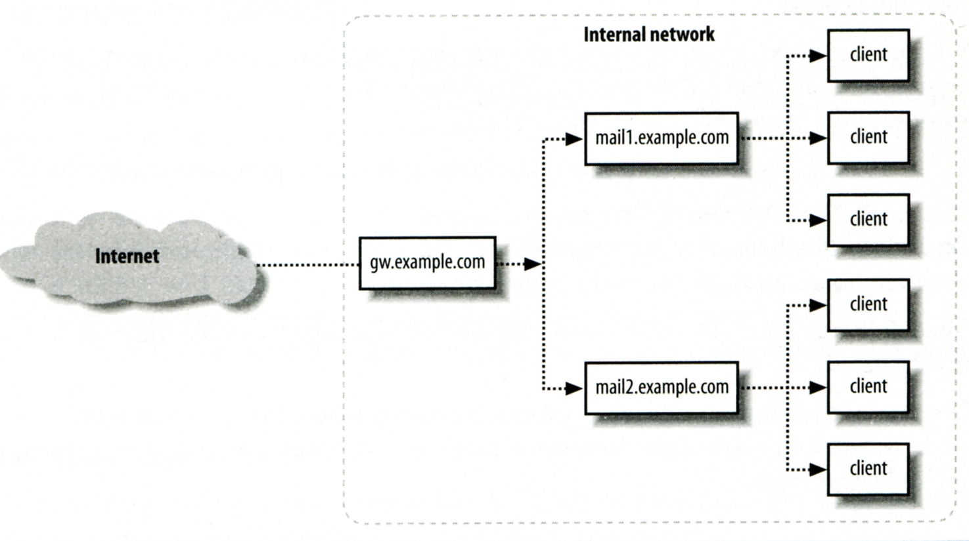
Mail Relaying – Inbound Mail Gateway (1)
Inbound Mail Gateway
Accept all mail for a network from the Internet and relays it to internal mail systems
Ex:
csmx1.cs.nctu.edu.tw is a IMG
csmailgate.cs.nctu.edu.tw is internal mail system

Slide 77
Mail Relaying – Inbound Mail Gateway (2)
To be IMG, suppose
You are administrator for cs.nctu.edu.tw
You have to be the IMG for secureLab.cs.nctu.edu.tw and javaLab.cs.nctu.edu.tw
The MX record for secureLab.cs.nctu.edu.tw and javaLab.cs.nctu.edu.tw should point to csmx1.cs.nctu.edu.tw
In csmx1.cs.nctu.edu.tw,
relay_domains = secureLab.cs.nctu.edu.tw javaLab.cs.nctu.edu.tw
transport_maps = hash:/usr/local/etc/postfix/transport
secureLab.cs.nctu.edu.tw relay:[secureLab.cs.nctu.edu.tw]
javaLab.cs.nctu.edu.tw relay:[javaLab.cs.nctu.edu.tw]
In secureLab.cs.nctu.edu.tw ( and so do javaLab.cs.nctu.edu.tw)
mydestination = secureLab.cs.nctu.edu.tw
Notes:
1

Slide 78
Mail Relaying – Outbound Mail Gateway
Outbound Mail Gateway
Accept mails from inside network and relay them to Internet hosts on behalf of internal mail servers
To be OMG, suppose
You are administrator for cs.nctu.edu.tw
You have to be the OMG for secureLab.cs.nctu.edu.tw and javaLab.cs.nctu.edu.tw
In csmailer.cs.nctu.edu.tw
mynetworks = hash:/usr/local/etc/postfix/mynetworks
secureLab.cs.nctu.edu.tw
javaLab.cs.nctu.edu.tw
All students in secureLab/javaLab will configure there MUA (ex. outlook) to use secureLab/javaLab.cs.nctu.edu.tw to be the SMTP server
In secureLab/javaLab.cs.nctu.edu.tw,
relayhost = [csmailer.cs.nctu.edu.tw]

Slide 79
Advanced Aliasing – Virtual Alias Maps
Virtual Alias Map
It rewrites recipient addresses for all local, all virtual, and all remote mail destinations.
Route virtual email addresses to real users on the system
virtual_alias_maps = hash:/usr/local/etc/postfix/virtual
Ex:
src-address dst-address
lctseng@csie.nctu.edu.tw @chbsd.cs.nctu.edu.tw
@csie.nctu.edu.tw @cs.nctu.edu.tw
lctseng lctseng@gmai1.com
Applying regular expression
virtual_alias_maps = pcre:/usr/local/etc/postfix/virtual
/lctseng@csie\.nctu\.edu\.tw/ @chbsd.cs.nctu.edu.tw
/@csie\.nctu\.edu\.tw/ @cs.nctu.edu.tw
/(\S+)\.(\S+)@cs\.nctu\.edu\.tw/ $1@cs.nctu.edu.tw

Slide 80
Multiple Domains
Use single system to host many domains
Ex:
We use csmailgate.cs.nctu.edu.tw to host both
cs.nctu.edu.tw
csie.nctu.edu.tw
Purpose
Can be used for final delivery on the machine or
Can be used for forwarding to destination elsewhere
Important considerations
Does the same user id with different domain should go to the same mailbox or different mailbox ?
YES (shared domain)
NO (Separate domain)
Does every user require a system account in /etc/passwd ?
YES (system account)
NO (virtual account)

Slide 81
Multiple Domains – Shared Domain with System Account
Situation
The mail system should accept mails for both canonical and virtual domains and
The same mailbox for the same user id
Procedure
Modify “mydomain” to canonical domain
Modify “mydestination” parameter to let mails to virtual domain can be local delivered
Ex:
mydomain = cs.nctu.edu.tw
mydestination = $myhostname, $mydomain, csie.nctu.edu.tw
※ In this way, mail to both lctseng@cs.nctu.edu.tw and lctseng@csie.nctu.edu.tw will go to csmailgate:/var/mail/lctseng
Limitation
Can not separate lctseng@cs.nctu.edu.tw from lctseng@csie.nctu.edu.tw

Slide 82
Multiple Domains – Separate Domains with System Accounts
Situation
The mail system should accept mails for both canonical and virtual domains and
Mailboxes are not necessarily the same for the same user id
Procedure
Modify “mydomain” to canonical domain
Modify “virtual_alias_domains” to accept mails to virtual domains
Create “virtual_alias_maps” map
Ex:
mydomain = cs.nctu.edu.tw
virtual_alias_domains = abc.com.tw, xyz.com.tw
virtual_alias_maps = hash:/usr/local/etc/postfix/virtual
In /usr/local/etc/postfix/virtual
CEO@abc.com.tw andy
@xyz.com.tw jack
Limitation
Need to maintain UNIX account for virtual domain user

Slide 83
Multiple Domains – Separate Domains with Virtual Accounts (1)
Useful when users in virtual domains:
Do not need to login to system
Only need to retrieve mail through POP/IMAP server
Procedure
Modify “virtual_mailbox_domains” to let postfix know what mails it should accepts
Or simply included in “virtual_mailbox_maps” map
Modify “virtual_mailbox_base” and create related directory to put mails
Create “virtual_mailbox_maps” map
Ex:
Create /var/vmail/abc-domain and /var/vmail/xyz-domain
In /usr/local/etc/postfix/vmailbox
virtual_mailbox_base = /var/vmail
virtual_mailbox_maps = hash:/usr/local/etc/postfix/vmailbox
abc.com.tw this-text-is-ignore
xyz.com.tw this-text-is-ignore
CEO@abc.com.tw abc-domain/CEO
CEO@xyz.com.tw xyz-domain/CEO/
MailBox format
MailDir format

Slide 84
Multiple Domains – Separate Domains with Virtual Accounts (2)
Ownerships of virtual mailboxes
Simplest way:
The same owner of POP/IMAP Servers
Flexibility in postfix
virtual_uid_maps and virtual_gid_maps
Ex:
virtual_uid_maps = static:143
virtual_gid_maps = static:6
virtual_uid_maps = hash:/usr/local/etc/postfix/virtual_uids
virtual_uid_maps = hash:/usr/local/etc/postfix/virtual_uids static:143
In /usr/local/etc/postfix/virtual_uids
CEO@abc.com.tw 1004
CEO@xyz.com.tw 1008
How to let virtual users authenticate and retrieve their mails?
You need other mechanism or modules (out of scope now)

Slide 85
Handling Spam in Postfix

Slide 86
Nature of Spam
Spam – Simultaneously Posted Advertising Message
UBE – Unsolicited Bulk Email
UCE – Unsolicited Commercial Email
Spam
There is no relationship between receiver and
Sender
Message content
Opt out instruction
Conceal trail
False return address
Forged header information
Use misconfigured mail system to be an accomplice
Circumvent spam filters either encode message or insert random letters

Slide 87
Problems of Spam
Cost
Waste bandwidth and disk space
DoS like side-effect
Waste time and false deletion
Bounce messages of nonexistent users
Nonexistent return address
Forged victim return address
Detection
Aggressive spam policy may cause high false positive

Slide 88
Anti-Spam – Client-Based Detection (1)
Client-blocking
Use IP address, hostnames or email address supplied by clients when they connect to send a message
Compared with Spammer list
Problems
IP address, hostname, email address are forged
Innocent victim open relay host
DNSBL (DNS-based Blacklist)
Maintain large database of systems that are known to be open relays or that have been used for spam
Grey Listing
SPF – Sender Policy Framework
…

Slide 89
Anti-Spam – Client-Based Detection (2)
What DNSBL maintainers do
Suppose csie has a Blacklist DNS database
Suppose DNSBL Domain “dnsbl.cs.nctu.edu.tw”
If 140.112.23.118 is detected as open relay
There will be a new entry in cs’s blacklist DB
118.23.112.140.dnsbl.cs.nctu.edu.tw
When we receive a connection from 140.112.23.118
Compose 118.23.112.140.dnsbl.cs.nctu.edu.tw
DNS query for this hostname
Successful means this IP address is suspicious
Failed means ok
Using DNSBL
Review their service options and policies carefully

Slide 90
Anti-Spam – Content-Based Detection
Spam patterns in message body
Detection difficulties
Embed HTML codes within words of their message to break up phrases
Randomly inserted words
Content-based detection is slower

Slide 91
Anti-Spam – Action
When you detect a spam, you can:
Reject immediately during the SMTP conversation
Save spam into a suspected spam repository
Label spam and deliver it with some kind of spam tag
Ex:
X-Spam-Status: Yes, hits=18.694 tagged_above=3 required=6.3
X-Spam-Level: ******************
X-Spam-Flag: YES

Slide 92
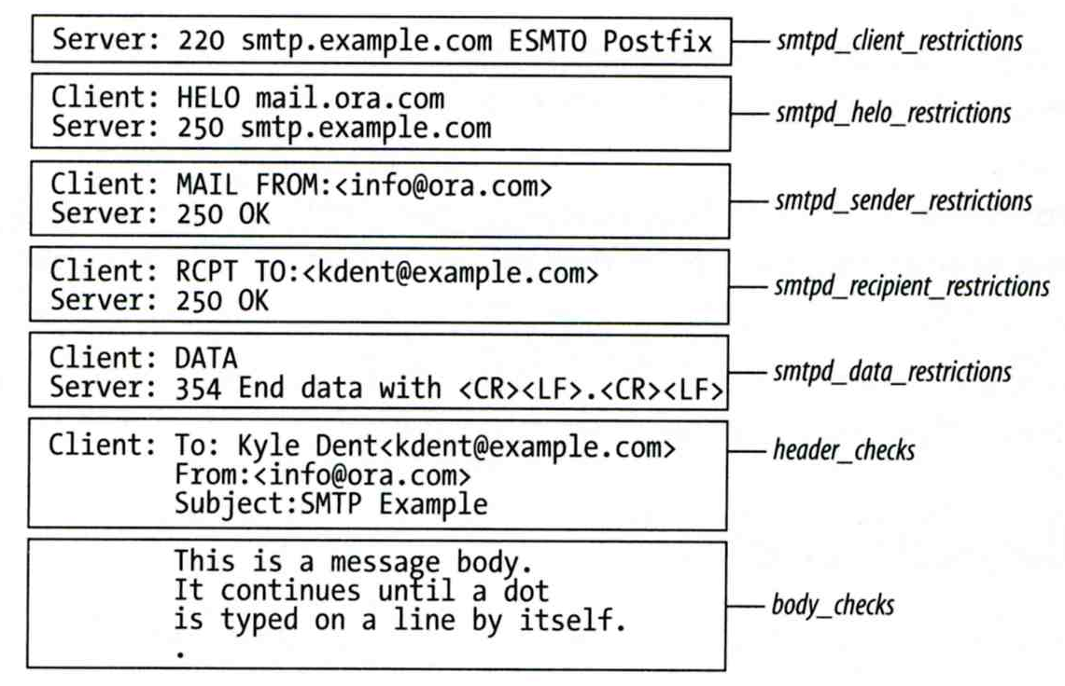
Postfix Anti-Spam configuration
The SMTP Conversation
info@ora.com → smtp.example.com → kdent@example.com

Slide 93
Postfix Anti-Spam configuration – Client Detection Rules (1)
Four rules in relative detection position
Rules and their default values
smtpd_client_restrictions =
smtpd_helo_restrictions =
smtpd_sender_restrictions =
smtpd_recipient_restrictions =
permit_mynetworks, reject_unauth_destination
Each restriction check result can be:
OK (Accept in this restriction)
REJECT (Reject immediately without further check)
DUNNO (do next check)
There are 5 types of restrictions

Slide 94
Postfix Anti-Spam configuration – Client Detection Rules (2)
Access maps
List of IP addresses, hostnames, email addresses
Can be used in:
smtpd_client_restrictions = check_client_access hash:/etc/access
smtpd_helo_restrictions = check_helo access hash:/usr/local/etc/postfix/helohost
smtpd_sender_restrictions = check_sender_access hash:/usr/local/etc/postfix/sender_access
smtpd_recipient_restrictions = check_recipient_access hash:/usr/local/etc/postfix/recipient_access
Actions
OK, REJECT, DUNNO
FILTER (redirect to content filter)
HOLD (put in hold queue)
DISCARD (report success to client but drop)
4xx message or 5xx message

Slide 95
Postfix Anti-Spam configuration – Client Detection Rules (3)
Example of access maps
check_client_access hash:/etc/access
nctu.edu.tw OK
127.0.0.1 OK
61.30.6.207 REJECT
check_helo access hash:/postfix/helohost
greatdeals.example.com REJECT
oreillynet.com OK
check_sender_access hash:/usr/local/etc/postfix/sender_access
viagra.com 553 Please contact +886-3-5712121-54707.
aaa@ 553 Invalid MAIL FROM
sales@ 553 Invalid MAIL FROM
hchen@ 553 Invalid MAIL FROM
check_recipient_access hash:/usr/local/etc/postfix/recipient_access
bin@cs.nctu.edu.tw 553 Invalid RCPT TO command
ftp@cs.nctu.edu.tw 553 Invalid RCPT TO command
man@cs.nctu.edu.tw 553 Invalid RCPT TO command

Slide 96
Postfix Anti-Spam configuration – Client Detection Rules (4)
Special client-checking restrictions
permit_auth_destination
Mostly used in “smtpd_recipient_restrictions”
Permit request if destination address matches:
The postfix system’s final destination setting
mydestination, inet_interfaces, vitual_alias_maps, virtual_mailbox_maps
The postfix system’s relay domain
relay_domains
Found ➔ OK, UnFound ➔ DUNNO
reject_unauth_destination
Opposite to permit_auth_destination
Found ➔ REJECT, UnFound ➔ DUNNO
permit_mynetworks
Allow a request if interest IP match any address in “mynetworks”
Used in smtpd_recipient_restrictions
Used in smtpd_client_restrictions

Slide 97
Postfix Anti-Spam configuration – Client Detection Rules (5)
Strict syntax restrictions
Restrictions that does not conform to RFC
reject_invalid_hostname
Reject hostname with bad syntax
reject_non_fqdn_hostname
Reject hostname not in FQDN format (HELO or EHLO)
reject_non_fqdn_sender
reject_non_fqdn_recipient
For “MAIL FROM” and “RCPT TO” command respectively

Slide 98
Postfix Anti-Spam configuration – Client Detection Rules (6)
DNS restrictions
Make sure that clients and email envelope addresses have valid DNS information
reject_unknown_client
Reject if the client IP has no DNS PTR record
215.17.113.140 IN PTR nabsd.cs.nctu.edu.tw.
False detection: many normal MTAs have A records only
reject_unknown_hostname
Reject if EHLO hostname has no DNS MX or A record
reject_unknown_sender_domain
Reject if MAIL FROM domain name has no DNS MX or A record
Spammers don’t want to receive return mails
reject_unknown_recipient_domain
Reject if RCPT TO domain name has no DNS MX or A record

Slide 99
Postfix Anti-Spam configuration – Client Detection Rules (7)
Real-time blacklists
Check with DNSBL services
reject_rbl_client domain.tld
Reject if client IP is detect in DNSBL
reject_rhsbl_client domain.tld
Reject if client hostname has an A record under specified domain
reject_rhsbl_sender domain.tld
Reject if MAIL FROM domain in address has an A record under specified domain
smtpd_client_restrictions =
hash:/etc/access, reject_rbl_client relays.ordb.org
smtpd_sender_restrictions =
hash:/usr/local/etc/postfix/sender_access, reject_rhsbl_sender dns.rfc-ignorant.org

Slide 100
Postfix Anti-Spam configuration – Client Detection Rules (8)
Policy Service
Postfix SMTP server sends in a delegated SMTPD access policy request to one special service (policy serivce).
Policy service replies actions allowed in Postfix SMTPD access table.
Usage:
check_policy_service servicename
Example: Grey Listing (Using Postgrey)
Postgrey daemon runs on port:10023
Don’t need to specify it in master.cf
In main.cf:
smtpd_recipient_restrictions = check_policy_service inet:127.0.0.1:10023

Slide 101
Postfix Anti-Spam configuration – Client Detection Rules (8)
smtpd_client_restrictions
check_client_access
reject_unknown_client
permit_mynetworks
reject_rbl_client
reject_rhsbl_client
smtpd_helo_restrictions
check_helo_access
reject_invalid_hostname
reject_unknown_hostname
reject_non_fqdn_hostname
smtpd_sender_restrictions
check_sender_access
reject_unknown_sender_domain
reject_rhsbl_sender
smtpd_recipient_restrictions
check_recipient_access
permit_auth_destination
reject_unauth_destination
reject_unknown_recipient_domain
reject_non_fqdn_recipient
check_policy_service

Slide 102
Postfix Anti-Spam configuration
The SMTP Conversation
info@ora.com → smtp.example.com → kdent@example.com

Slide 103
Postfix Anti-Spam configuration – Content-Checking rules (1)
4 rules
header_checks
Check for message headers
mime_header_checks
Check for MIME headers
nested_header_checks
Check for attached message headers
body_check
Check for message body
All rules use lookup tables
Ex:
header_checks = regexp:/usr/local/etc/postfix/header_checks
body_checks = pcre:/usr/local/etc/postfix/body_checks

Slide 104
Postfix Anti-Spam configuration – Content-Checking rules (2)
Content-checking lookup table
Regular_Expression Action
Actions
REJECT message
WARN message
Logs a rejection without actually rejecting
IGNORE
Delete matched line of headers or body
HOLD message
DISCARD message
Claim successful delivery but silently discard
FILTER message
Send message through a separate content filter (may be external program)

Slide 105
Postfix Anti-Spam configuration – Content-Checking rules (3)
Example of header check
header_checks = regexp:/usr/local/etc/postfix/header_checks
In /usr/local/etc/postfix/header_checks
/take advantage now/ REJECT
/repair your credit/ REJECT
Example of body check
body_checks = regexp:/usr/local/etc/postfix/body_checks
In /usr/local/etc/postfix/body_checks
/lowest rates.*\!/ REJECT
/[:alpha:]<!--.*-->[:alpha:]/ REJECT

Slide 106
External Filters
Filtering can be done on
MTA
MDA
MUA
※ Combination of MTA and MUA
Adding some extra headers or modifying subject in MTA, and filtering in MUA.
External filters for postfix
Command-based filtering
New process is started for every message
Accept message from STDIN
Daemon-based filtering
Stay resident
Accept message via SMTP or LMTP

Slide 107
MDA Filter: Procmail (1)
Install procmail (port or package)
Enable Procmail in Postfix
In main.cf
Create configuration file
Create /usr/local/etc/procmailrc
Create log files
touch /var/log/procmail.log
Create directories (optional)
mkdir -p /tmp/trash
mailbox_command = /usr/local/bin/procmail
VERBOSE=off
LOGFILE=/var/log/procmail.log
:0b
* ^Subject:.*GGWP.*
/dev/null
:0b
* ^Subject:.*LOL.*
/tmp/trash
procmailrc

Slide 108
MDA Filter: Procmail (2-1) - Filter Chinese Text
Encoding problem
We need to set two types of encoded Chinese text
Base64 and Quote-Printable
Tool: mmencode (port or package)
Generate encoded text
Filter “減肥”
Generate Base64 code
Generate QP code
> echo -n "減肥" | mmencode
5rib6IKl
> echo -n "減肥" | mmencode -q
=E6=B8=9B=E8=82=A5=

Slide 109
MDA Filter: Procmail (2-2) - Filter Chinese Text
Write two rules to filter Chinese text
Log file
# Base64
:0b
* ^Subject:.*5rib6IKl.*
/dev/null
# Quote-Printable
:0b
* ^Subject:.*=E6=B8=9B=E8=82=A5=.*
/dev/null
From lctseng@nasa.lctseng.nctucs.net Wed Mar 9 12:14:46 2016
Subject: =?UTF-8?B?5rib6IKl?=
Folder: /dev/null 1

Slide 110
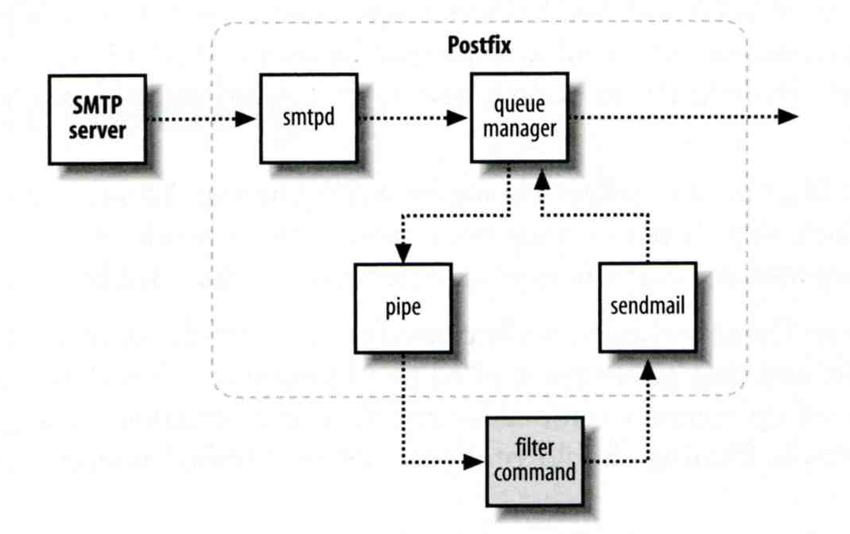
Command-Based Filtering (1)
Usage
Postfix delivers message to this filter via “pipe” mailer
Program that accepts content on its STDIN
Program gives the filtered message back to Postfix using the “sendmail” command (with same queue ID)

Slide 111
Command-Based Filtering (2)
Configuration
Prepare your filter program (/usr/local/bin/simple_filt)
Modify master.cf
#==========================================================================
# service type private unpriv chroot wakeup maxproc command + args
#==========================================================================
filter unix - n n - - pipe
flags=Rq user=filter argv=/usr/local/bin/simple_filt -f ${sender} - -${recipient}
smtpd inet n - n - - smtpd
-o content_filter=filter:

Slide 112
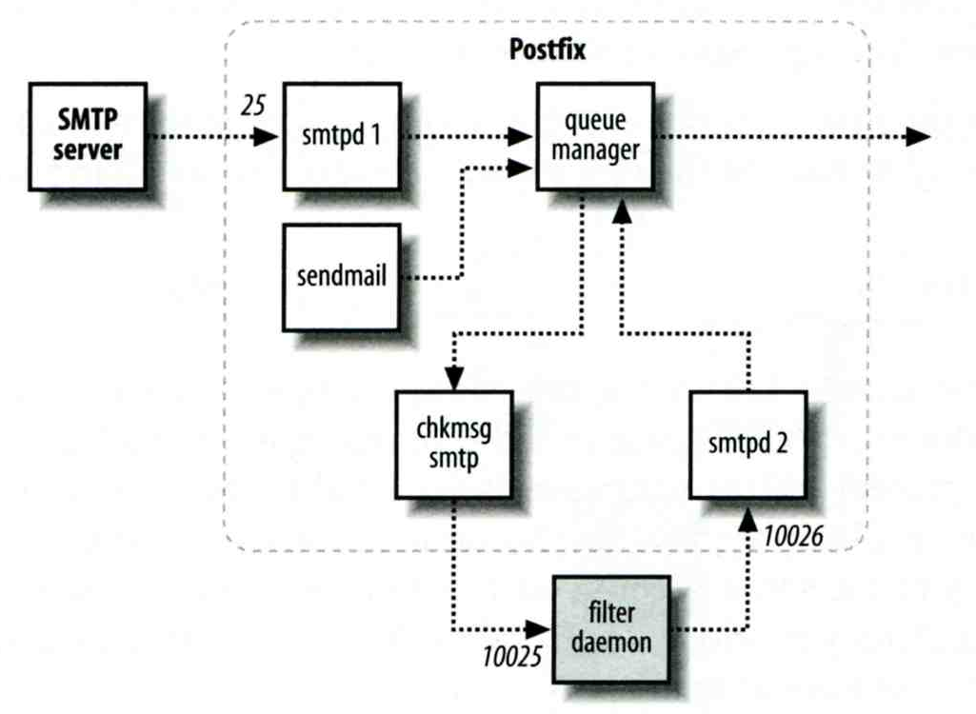
Daemon-Based Filtering (1)
Usage
Message is passed back and forth between Postfix and filtering daemon via SMTP or LMTP
10025
10024

Slide 113
Daemon-Based Filtering (2) - amavisd-new
Primary daemon: amavisd-new
Cooperate with other programs
Clamav (anti-virus), SpamAssassin (anti-spam)
Configuration for amavisd
Install and configure your content filter
security/amavisd-new (port or package)
Modify amavisd.conf to send message back
Edit /etc/rc.conf
Edit main.cf to let postfix use filtering daemon
$forward_method = 'smtp:127.0.0.1:10025';
amavisd_enable="YES"
content_filter = smtp-amavis:[127.0.0.1]:10024

Slide 114
Daemon-Based Filtering (3) - amavisd-new
Configuration
Edit master.cf to add two additional services
smtp-amavis unix - - n - 10 smtp
-o smtp_data_done_timeout=1200s
-o smtp_never_send_ehlo=yes
-o notify_classes=protocol,resource,software
127.0.0.1:10025 inet n - n - - smtpd
-o content_filter=
-o mynetworks=127.0.0.0/8
-o local_recipient_maps=
-o notify_classes=protocol,resource,software
-o myhostname=localhost
-o smtpd_client_restrictions=
-o smtpd_sender_restrictions=
-o smtpd_recipient_restrictions=permit_mynetworks,reject
-o smtpd_tls_security_level=

Slide 115
Daemon-Based Filtering (4) - amavisd-new
Now, your amavisd-new is ready
With SpamAssassin installed
Run “sa-update” to update the SpamAssassin rules
Edit SpamAssassin configuration in amavisd.conf
E.g. Change spam detect level
$sa_tag2_level_deflt = 3.0;

Slide 116
Daemon-Based Filtering (5) - amavisd-new
The mail source in SPAM-detected mail
Received: from demo1.nasa.lctseng.nctucs.net (localhost [127.0.0.1])
by localhost (Postfix) with ESMTP id 1A945274
for <lctseng@nasa.lctseng.nctucs.net>; Wed, 9 Mar 2016 14:14:39 +0800 (CST)
X-Virus-Scanned: amavisd-new at nasa.lctseng.ncatucs.net
X-Spam-Flag: YES
X-Spam-Score: 4.85
X-Spam-Level: ****
X-Spam-Status: Yes, score=4.85 tagged_above=2 required=3
tests=[FREEMAIL_ENVFROM_END_DIGIT=0.25, FREEMAIL_FROM=0.001,
HTML_FONT_LOW_CONTRAST=0.001, HTML_MESSAGE=0.001,
RCVD_IN_DNSWL_LOW=-0.7, RCVD_IN_MSPIKE_H3=-0.01,
RCVD_IN_MSPIKE_WL=-0.01, T_REMOTE_IMAGE=0.01, URIBL_ABUSE_SURBL=1.948,
URIBL_BLACK=1.7, URIBL_WS_SURBL=1.659] autolearn=no autolearn_force=no
Authentication-Results: demo1.nasa.lctseng.nctucs.net (amavisd-new);
dkim=pass (2048-bit key) header.d=gmail.com
Received: from demo1.nasa.lctseng.nctucs.net ([127.0.0.1])
by demo1.nasa.lctseng.nctucs.net (demo1.nasa.lctseng.nctucs.net [127.0.0.1]) (amavisd-new, port 10024)
with SMTP id CjRyliYl5l6x for <lctseng@nasa.lctseng.nctucs.net>;
Wed, 9 Mar 2016 14:14:38 +0800 (CST)

Slide 117
Daemon-Based Filtering (6) - amavisd-new + ClamAV
amavisd-new supports lots of anti-virus scanner
Anti-virus with ClamAV
Install security/clamav (port or package)
Edit /etc/rc.conf
Update virus database
Run “freshclam”
Specify to use clamav in amavisd.conf
clamav_clamd_enable="YES"
@av_scanners = (
['ClamAV-clamd',
\&ask_daemon, ["CONTSCAN {}\n", "/var/run/clamav/clamd.sock"],
qr/\bOK$/m, qr/\bFOUND$/m,
qr/^.*?: (?!Infected Archive)(.*) FOUND$/m ],
);

Slide 118
Daemon-Based Filtering (7) - amavisd-new + ClamAV
Set alias for “virusalert” user
When there is an infected mail, it will send a notification to this user
Alias to “root” or “postmaster”
Start ClamAV and restart amavisd-new
service clamav-clamd start
service amavisd restart
Send a test virus by EICAR organization
Plain text
Reference: https://en.wikipedia.org/wiki/EICAR_test_file

Slide 119
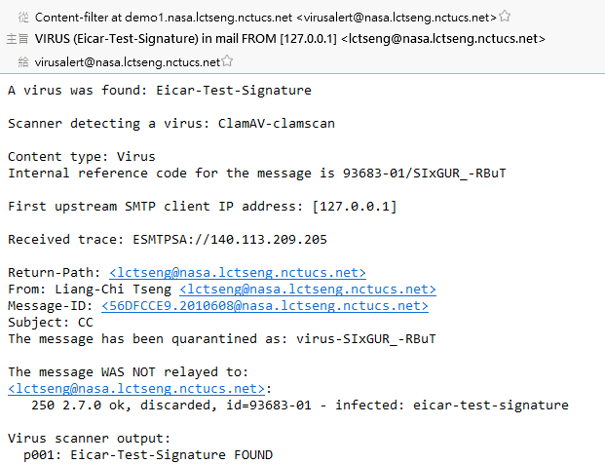
Daemon-Based Filtering (8) - amavisd-new + ClamAV
Result of sending EICAR test mail

