Slide 1
BIND Part 2
pschiu

Slide 2
BIND Configuration – named.conf view (1)
The "view" statement
Create a different view of DNS naming hierarchy for internal machines
Restrict the external view to few well-known servers
Supply additional records to internal users
Also called "split DNS"
In-order processing
Put the most restrictive view first
All-or-nothing
All zone statements in your named.conf file must appear in the content of view

Slide 3
BIND Configuration – named.conf view (2)
Syntax
view view-name {
match_clients {address_match_list};
view_options;
zone_statement;
};
Example
view "internal" {
match-clients { our_nets; };
recursion yes;
zone "cs.nctu.edu.tw" {
type master;
file "named-internal-cs";
};
};
view "external" {
match-clients { any; };
recursion no;
zone "cs.nctu.edu.tw" {
type master;
file "named-external-cs";
};
};

Slide 4
BIND Configuration – named.conf controls
The "controls" statement
Specify how the named server listens for control message
Syntax
controls {
inet ip_addr allow {address_match_list} keys {key-id;};
};
Example:
include "/etc/named/rndc.key";
controls {
inet 127.0.0.1 allow { 127.0.0.1; } keys { rndc_key; };
}
key "rndc_key" {
algorithm hmac-md5;
secret "GKnELuie/G99NpOC2/AXwA==";
};
SYNOPSIS
rndc [-c config-file] [-k key-file] [-s server] [-p port] [-V]
[-y key_id] {command}

Slide 5
Updating zone files
Master
Edit zone files
Serial number
Forward and reverse zone files for single IP
Do “rndc reload”
“notify” is on, slave will be notify about the change
“notify” is off, refresh timeout, or do “rndc reload” in slave
Zone transfer
DNS zone data synchronization between master and slave servers
AXFR (all zone data are transferred at once, before BIND8.2)
IXFR (incremental updates zone transfer)
TCP port 53

Slide 6
Non-byte boundary (1)
In normal reverse configuration:
named.conf will define a zone statement for each reverse subnet zone and
Your reverse db will contains lots of PTR records
Example:
zone "1.168.192.in-addr.arpa." {
type master;
file "named.rev.1";
allow-query {any;};
allow-update {none;};
allow-transfer {localhost;};
};
$TTL 3600
$ORIGIN 1.168.192.in-addr.arpa.
@ IN SOA lwhsu.csie.net lwhsu.lwhsu.csie.net. (
2007050401 ; Serial
3600 ; Refresh
900 ; Retry
7D ; Expire
2H ) ; Minimum
IN NS ns.lwhsu.csie.net.
254 IN PTR ns.lwhsu.csie.net.
1 IN PTR www.lwhsu.csie.net.
2 IN PTR ftp.lwhsu.csie.net.
…

Slide 7
Non-byte boundary (2)
What if you want to delegate 192.168.2.0 to another sub-domain
Parent
Remove forward db about 192.168.2.0/24 network
Ex:
pc1.lwhsu.csie.net. IN A 192.168.2.35
pc2.lwhsu.csie.net. IN A 192.168.2.222
…
Remove reverse db about 2.168.192.in-addr.arpa
Ex:
35.2.168.192.in-addr.arpa. IN PTR pc1.lwhsu.csie.net.
222.2.168.192.in-addr.arpa. IN PTR pc2.lwhsu.csie.net.
…
Add glue records about the name servers of sub-domain
Ex: in zone db of “lwhsu.csie.net”
sub1 IN NS ns.sub1.lwhsu.csie.net.
ns.sub1 IN A 192.168.2.1
Ex: in zone db of “168.192.in-addr.arpa.”
2 IN NS ns.sub1.lwhsu.csie.net.
ns.sub1 IN A 192.168.2.1

Slide 8
Non-byte boundary (3)
What if you want to delegate 192.168.3.0 to four sub-domains (a /26 network)
192.168.3.0 ~ 192.168.3.63
ns.sub1.lwhsu.csie.net.
192.168.3.64 ~ 192.168.3.127
ns.sub2.lwhsu.csie.net.
192.168.3.128 ~ 192.168.3.191
ns.sub3.lwhsu.csie.net.
192.168.3.192 ~ 192.168.3.255
ns.sub4.lwhsu.csie.net.
It is easy for forward setting
In zone db of lwhsu.csie.net
sub1 IN NS ns.sub1.lwhsu.csie.net.
ns.sub1 IN A 1921.68.3.1
sub2 IN NS ns.sub2.lwhsu.csie.net.
ns.sub2 IN A 192.168.3.65
…

Slide 9
Non-byte boundary (4)
Non-byte boundary reverse setting
Method1
$GENERATE 0-63 $.3.168.192.in-addr.arpa. IN NS ns.sub1.lwhsu.csie.net.
$GENERATE 64-127 $.3.168.192.in-addr.arpa. IN NS ns.sub2.lwhsu.csie.net.
$GENERATE 128-191 $.3.168.192.in-addr.arpa. IN NS ns.sub3.lwhsu.csie.net.
$GENERATE 192-255 $.3.168.192.in-addr.arpa. IN NS ns.sub4.lwhsu.csie.net.
And
zone “1.3.168.192.in-addr.arpa.” {
type master;
file “named.rev.192.168.3.1”;
};
; named.rev.192.168.3.1
@ IN SOA sub1.lwhsu.csie.net. root.sub1.lwhsu.csie.net. (1;3h;1h;1w;1h)
IN NS ns.sub1.lwhsu.csie.net.

Slide 10
Non-byte boundary (5)
Method2
$ORIGIN 3.168.192.in-addr.arpa.
$GENERATE 1-63 $ IN CNAME $.0-63.3.168.192.in-addr.arpa.
0-63.3.168.192.in-addr.arpa. IN NS ns.sub1.lwhsu.csie.net.
$GENERATE 65-127 $ IN CNAME $.64-127.3.168.192.in-addr.arpa.
64-127.3.168.192.in-addr.arpa. IN NS ns.sub2.lwhsu.csie.net.
$GENERATE 129-191 $ IN CNAME $.128-191.3.168.192.in-addr.arpa.
128-191.3.168.192.in-addr.arpa. IN NS ns.sub3.lwhsu.csie.net.
$GENERATE 193-255 $ IN CNAME $.192-255.3.168.192.in-addr.arpa.
192-255.3.168.192.in-addr.arpa. IN NS ns.sub4.lwhsu.csie.net.
zone “0-63.3.168.192.in-addr.arpa.” {
type master;
file “named.rev.192.168.3.0-63”;
};
; named.rev.192.168.3.0-63
@ IN SOA sub1.lwhsu.csie.net. root.sub1.lwhsu.csie.net. (1;3h;1h;1w;1h)
IN NS ns.sub1.lwhsu.csie.net.
1 IN PTR www.sub1.lwhsu.csie.net.
IN PTR abc.sub1.lwhsu.csie.net.
…

Slide 11
BIND Security

Slide 12
Security – named.conf security configuration
Security configuration
Feature | Config. Statement | comment
allow-query | options, zone | Who can query
allow-transfer | options, zone | Who can request zone transfer
allow-update | zone | Who can make dynamic updates
blackhole | options | Which server to completely ignore
bogus | server | Which servers should never be queried

Slide 13
Security – With TSIG (1)
TSIG (Transaction SIGnature)
Developed by IETF (RFC2845)
Symmetric encryption scheme to sign and validate DNS requests and responses between servers
Algorithm in BIND9
HMAC-MD5, HMAC-SHA1, HMAC-SHA224, HMAC-SHA256, HMAC-SHA384, HMAC-SHA512
Usage
Prepare the shared key with dnssec-keygen
Edit “key” statement
Edit “server” statement to use that key
Edit “zone” statement to use that key with:
allow-query
allow-transfer
allow-update

Slide 14
Security – With TSIG (2)
TSIG example (dns1 with dns2)
% dnssec-keygen –a HMAC-MD5 –b 128 –n HOST cs
Edit /etc/named/dns1-dns2.key
Edit both named.conf of dns1 and dns2
Suppose dns1 = 140.113.235.107 dns2 = 140.113.235.103
% dnssec-keygen -a HMAC-MD5 -b 128 -n HOST cs
Kcs.+157+35993
% cat Kcs.+157+35993.key
cs. IN KEY 512 3 157 oQRab/QqXHVhkyXi9uu8hg==
% cat Kcs.+157+35993.private
Private-key-format: v1.2
Algorithm: 157 (HMAC_MD5)
Key: oQRab/QqXHVhkyXi9uu8hg==
key dns1-dns2 {
algorithm hmac-md5;
secret “oQRab/QqXHVhkyXi9uu8hg==”
};
include “dns1-dns2.key”
server 140.113.235.103 {
keys {dns1-dns2;};
};
include “dns1-dns2.key”
server 140.113.235.107 {
keys {dns1-dns2;};
};

Slide 15
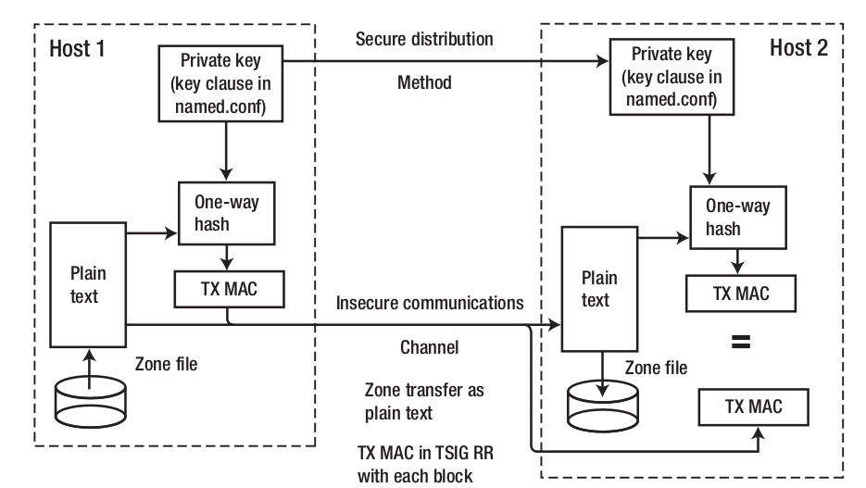
Security – With TSIG (3)

Slide 16
Security – Securing zone transfer
Securing zone transfer with ACL
zone “example.com” in {
type master;
file “host”;
allow-transfer { trusted; 192.168.10.2; };
};

Slide 17
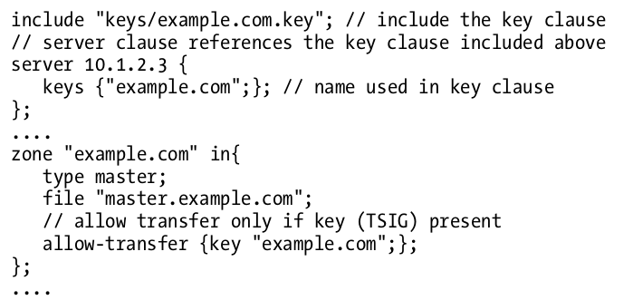
Security – Securing zone transfer
Securing zone transfer with Key (Master)

Slide 18
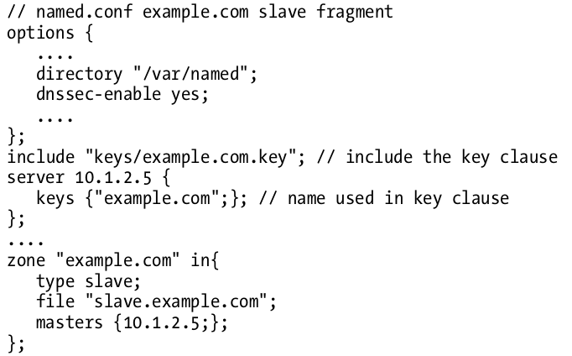
Security – Securing zone transfer
Securing zone transfer with TSIG (Slave)

Slide 19
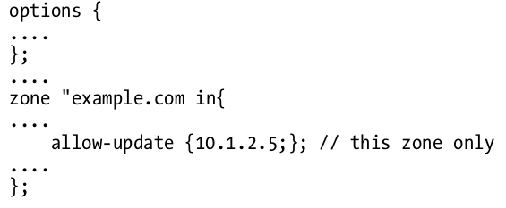
Security – Securing dynamic update
Securing dynamic update with ACL

Slide 20
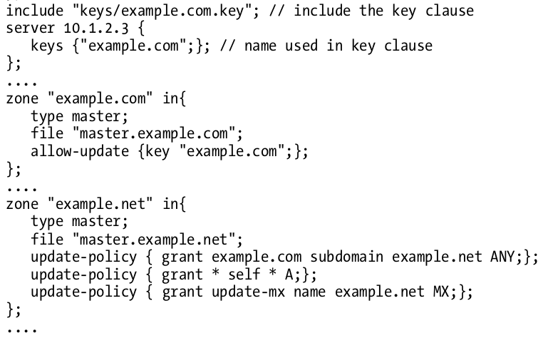
Security – Securing dynamic update
Securing dynamic update with TSIG

Slide 21
Security - Attck
Cache poisoning
Recursion Denied of Service Attacks
Reflection/Amplification Attacks
Zone Transfer Attacks
Buffer Overflow Attacks
Notes:
http://www.lijyyh.com/2012/07/dns-dns-server-security-management.html

Slide 22
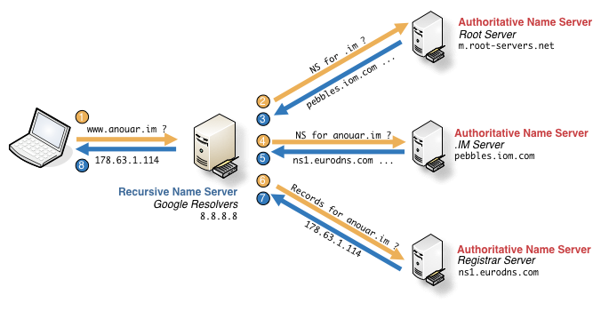
Security – Cache poisoning
A Normal Resolving Process

Slide 23
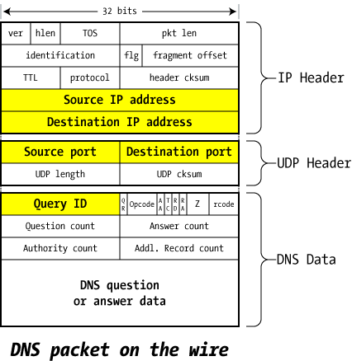
Security – Cache poisoning
DNS packet on the wire

Slide 24
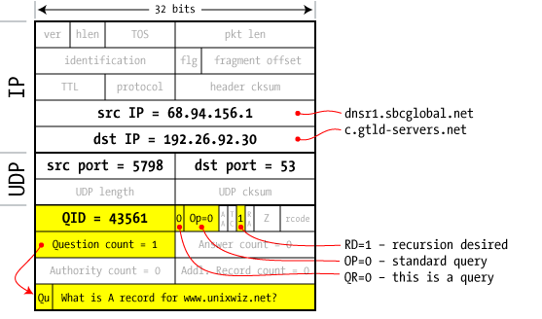
Security – Cache poisoning
Query from resolver to NS

Slide 25
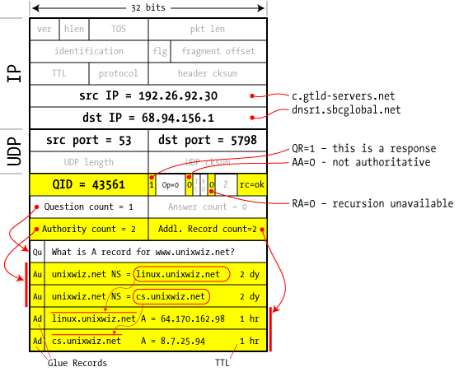
Security – Cache poisoning

Slide 26
Security – Cache poisoning

Slide 27
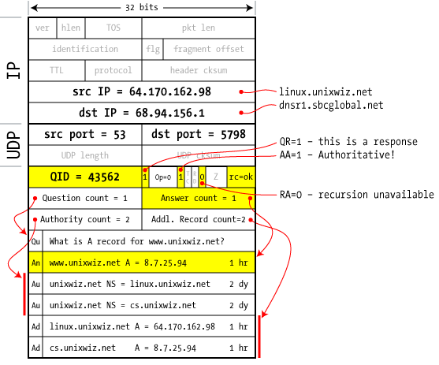
Security – Cache poisoning
Bailiwick checking:
response is cached if it is
within the same domain
of query
(a.com cannot set NS for b.com)

Slide 28
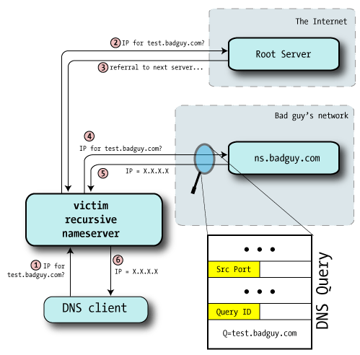
Security – Cache poisoning
Guessing Query ID

Slide 29
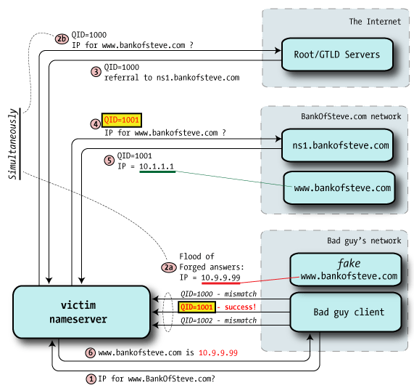
Security – Cache poisoning
Flooding

Slide 30
Security – Cache poisoning
Easier to understand
https://www.checkpoint.com/defense/advisories/public/dnsvideo/

Slide 31
Security – Cache poisoning
Kaminsky Attack
Poison cache for NS record instead
Take over all of second level domain

Slide 32
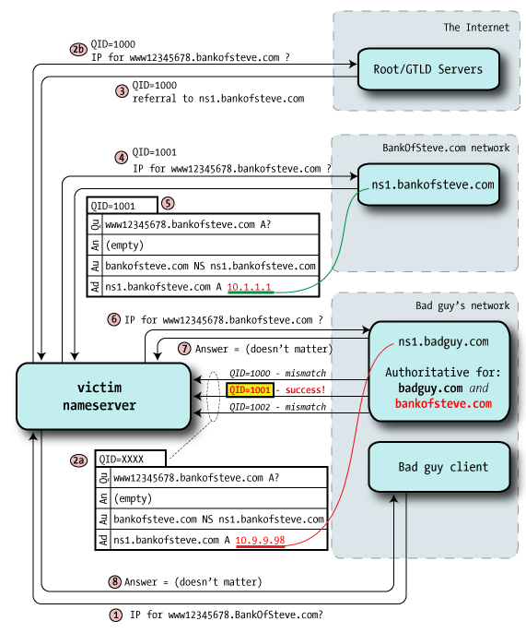

Slide 33
Security – Cache poisoning
Defense
Randomized query ID
Randomized UDP port
DNSSEC
Cryptographically sign DNS responses

Slide 34
Security - Recursion Denied of Service Attacks
Problem
DDoS of DNS service.
Defense
Restrict recursion source

Slide 35
Security - Reflection/Amplification Attacks
Defense
Query rate-limiting
options { directory "/usr/local/etc/named/working"; ... rate-limit { responses-per-second 10; log-only yes; }; };

Slide 36
Security - Zone Transfer
Problem
Information leak
Defense
Restrict allow-transfer

Slide 37
Security - Buffer Overflow Attacks
Problem
Any possible.
Defense
Always update to date your software

Slide 38
Security – DNSSEC
What is DNSSEC?
Using Public-key crypto (asymmetric)
Follow the delegation of authority model
Data authenticity and integrity
Signing the RRSets with private key
Public DNSKEYs are published, used to verify RRSIGs
Children sign their zones with private key
The private key is authenticated by parent’s signing hash(DS) of the child zone’s key

Slide 39
Security – DNSSEC
Resource Records
RRSIG
Crypto signatures for A, AAAA, NS, etc.
Tracks the type and number at each node.
NSEC/NSEC3
Confirms the NXDOMAIN response.
DNSKEY
Public keys for the entire zone.
Private side is used generate RRSIGs
DS Record
Handed up to parent zone to authenticate the NS record

Slide 40
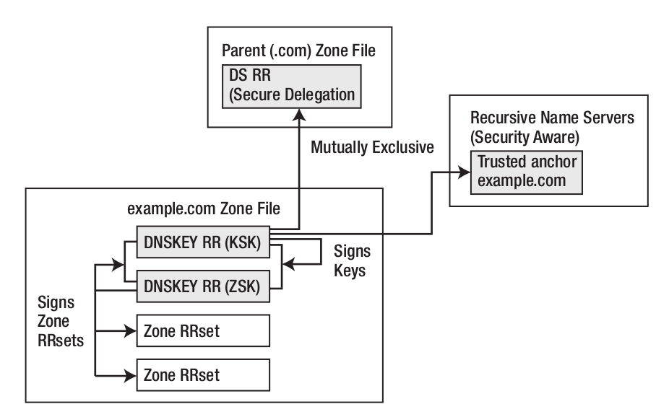
Security – DNSSEC
ZSK and KSK

Slide 41
Security – DNSSEC Implementation
Generate ZSK (Zone signing key)
$dnssec-keygen -a rsasha256 -b 2048 -n zone \
example.com
Kexample.com.+008+27228
Generate KSK (Key signing key)
$dnssec-keygen -a rsasha256 -b 2048 -f KSK -n zone \
example.com
Kexample.com.+008+34957

Slide 42
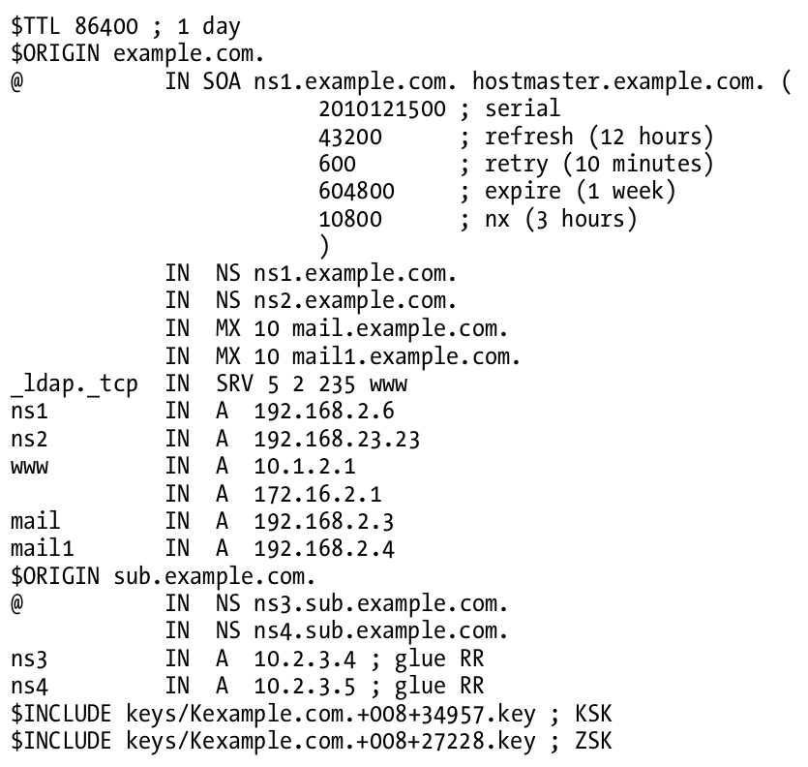
Security – DNSSEC Implementation
In zone file

Slide 43
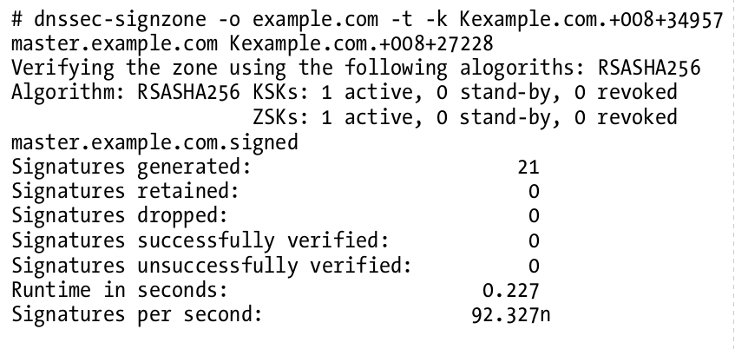
Security – DNSSEC Implementation
Signing the zone
When signing the zone with only ZSK, just omit the -k parameter

Slide 44
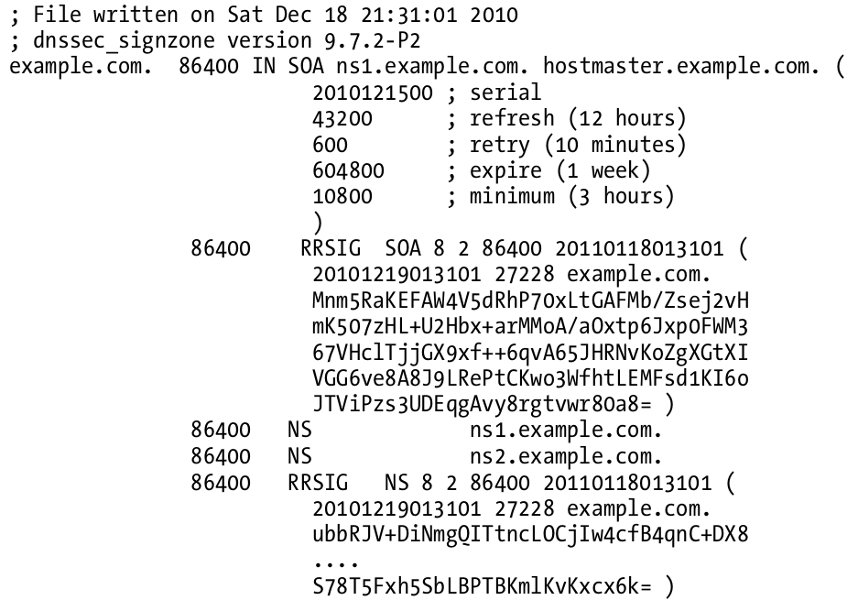
Security – DNSSEC Implementation
Signing the zone (example.com.signed)

Slide 45
Security – DNSSEC Implementation
Update the Zone clause to use the signed zone
zone "example.com" {
type master;
file "example.com.signed”;
masters {ip_addr; ip_addr;};
allow-query {address_match_list};
allow-transfer { address_match_list};
allow-update {address_match_list};
};

Slide 46
Security – DNSSEC Implementation
Create Trust Anchor

Slide 47
Security – DNSSEC Implementation
Create Chain of Trust
Extract DNSKEY RR and use dnssec-dsfromkey
Add -g parameter when signing zone using dnssec-signzone
dnssec-signzone -g ….
ds-set.example.com
contains DS record that you should hand to parent

Slide 48
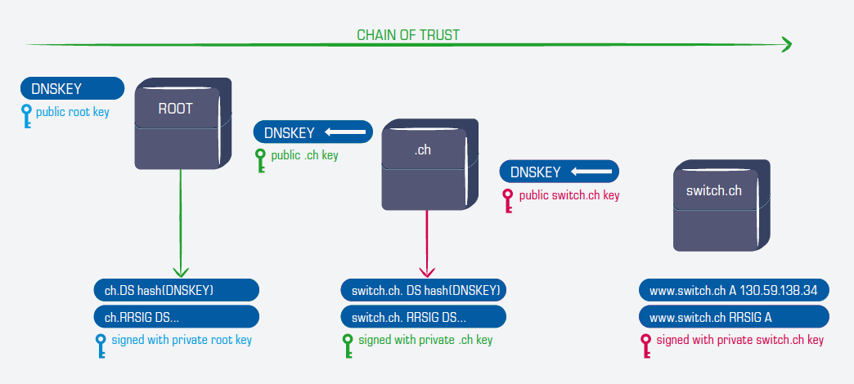
Security – DNSSEC Implementation
Create Chain of Trust
Extract DNSKEY RR and use dnssec-dsfromkey
Add -g parameter when signing zone using dnssec-signzone
dnssec-signzone -g ….
ds-set.example.com
contains DS record that you should hand to parent

Slide 49
BIND Debugging and Logging

Slide 50
Logging (1)
Terms
Channel
A place where messages can go
Ex: syslog, file or /dev/null
Category
A class of messages that named can generate
Ex: answering queries or dynamic updates
Module
The name of the source module that generates the message
Facility
syslog facility name
Severity
Priority in syslog
Logging configuration
Define what are the channels
Specify where each message category should go
When a message is generated
It is assigned a “category”, a “module”, a “severity”
It is distributed to all channels associated with its category

Slide 51
Logging (2)
The “logging” statement
Either “file” or “syslog” in channel sub-statement
size:
ex: 2048, 100k, 20m, 15g, unlimited, default
facility:
ex: local0 ~ local7
severity:
critical, error, warning, notice, info, debug, dynamic
logging {
channel_def;
channel_def;
…
category category_name {
channel_name;
channel_name;
…
};
};
channel channel_name {
file path [versions num|unlimited] [size siznum];
syslog facility;
severity severity;
print-category yes|no;
print-severity yes|no;
print-time yes|no;
};

Slide 52
Logging (3)
Predefined channels
Available categories
default_syslog | Sends severity info and higher to syslog with facility daemon
default_debug | Logs to file “named.run”, severity set to dynamic
default_stderr | Sends messages to stderr or named, severity info
null | Discards all messages
default | Categories with no explicit channel assignment
general | Unclassified messages
config | Configuration file parsing and processing
queries/client | A short log message for every query the server receives
dnssec | DNSSEC messages
update | Messages about dynamic updates
xfer-in/xfer-out | zone transfers that the server is receiving/sending
db/database | Messages about database operations
notify | Messages about the “zone changed” notification protocol
security | Approved/unapproved requests
resolver | Recursive lookups for clients

Slide 53
Logging (4)
Example of logging statement
logging {
channel security-log {
file "/var/named/security.log" versions 5 size 10m;
severity info;
print-severity yes;
print-time yes;
};
channel query-log {
file "/var/named/query.log" versions 20 size 50m;
severity info;
print-severity yes;
print-time yes;
};
category default { default_syslog; default_debug; };
category general { default_syslog; };
category security { security-log; };
category client { query-log; };
category queries { query-log; };
category dnssec { security-log; };
};

Slide 54
Debug
Named debug level
From 0 (debugging off) ~ 11 (most verbose output)
% named -d2 (start named at level 2)
% rndc trace (increase debugging level by 1)
% rndc trace 3 (change debugging level to 3)
% rndc notrace (turn off debugging)
Debug with “logging” statement
Define a channel that include a severity with “debug” keyword
Ex: severity debug 3
All debugging messages up to level 3 will be sent to that particular channel

Slide 55
Tools

Slide 56
Tools – nslookup
Interactive and Non-interactive
Non-Interactive
% nslookup cs.nctu.edu.tw.
% nslookup –type=mx cs.nctu.edu.tw.
% nslookup –type=ns cs.nctu.edu.tw. 140.113.1.1
Interactive
% nslookup
> set all
> set type=any
> set server host
> set lserver host
> set debug
> set d2
csduty:~ -lwhsu- nslookup
> set all
Default server: 140.113.235.107
Address: 140.113.235.107#53
Default server: 140.113.235.103
Address: 140.113.235.103#53
Default server: 140.113.1.1
Address: 140.113.1.1#53
Set options:
novc nodebug nod2
search recurse
timeout = 0 retry = 3 port = 53
querytype = A class = IN
srchlist = cs.nctu.edu.tw/csie.nctu.edu.tw
>

Slide 57
Tools – dig
Usage
% dig cs.nctu.edu.tw
% dig cs.nctu.edu.tw mx
% dig @ns.nctu.edu.tw cs.nctu.edu.tw mx
% dig -x 140.113.209.3
Reverse query
% dig +dnssec jal.tw
Find out the root servers
% dig @a.root-servers.net . ns

Slide 58
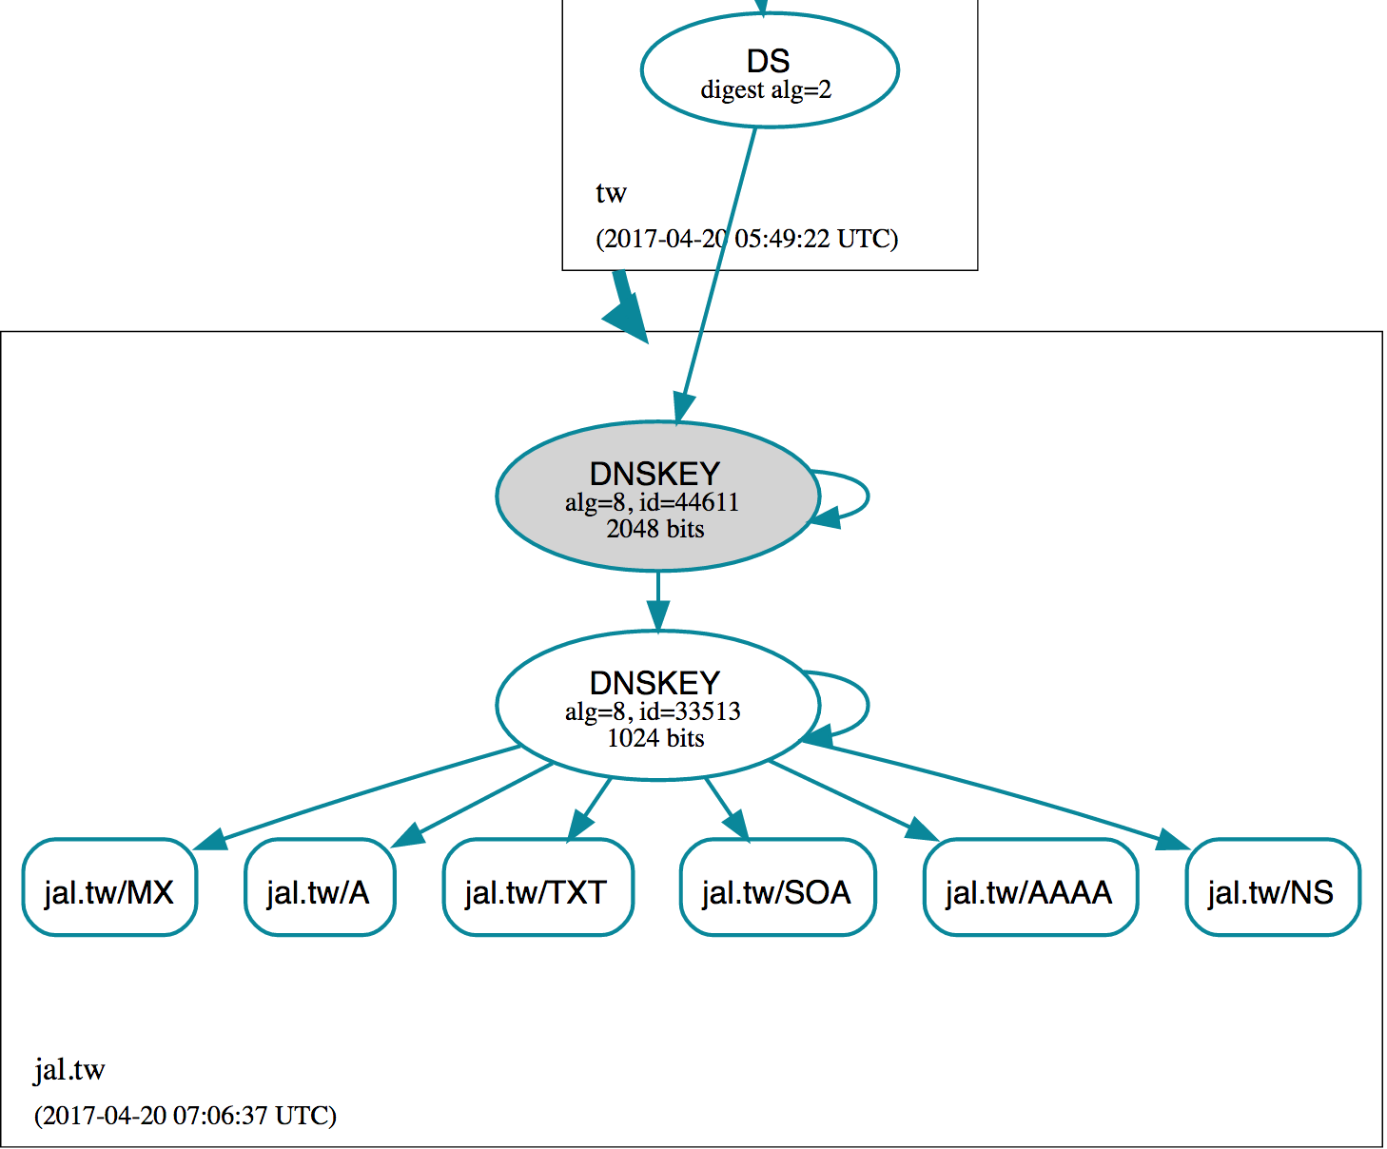
Online Check Tools – http://dnsviz.net

Slide 59
Miscellaneous

Slide 60
SSHFP record
RFC4255
ssh_config
VerifyHostKeyDNS ask
dns/sshfp
knight:~ -lwhsu- dig anoncvs.tw.freebsd.org sshfp
;; ANSWER SECTION:
anoncvs.tw.freebsd.org. 259200 IN CNAME freebsd.cs.nctu.edu.tw.
freebsd.cs.nctu.edu.tw. 3600 IN SSHFP 2 1 2723C6CF4EF655A6A5BE86CC9E039F1762450FE9
knight:~ -lwhsu- cvs -d anoncvs@anoncvs.tw.freebsd.org:/home/ncvs co ports
The authenticity of host 'anoncvs.tw.freebsd.org (140.113.17.209)' can't be established.
DSA key fingerprint is e8:3b:29:7b:ca:9f:ac:e9:45:cb:c8:17:ae:9b:eb:55.
Matching host key fingerprint found in DNS.
Are you sure you want to continue connecting (yes/no)?

Slide 61
DNS Accept filters
accf_dns(9)
buffer incoming DNS requests until the whole first request is present
options INET
options ACCEPT_FILTER_DNS
kldload accf_dns
Currently only on 8-CURRENT
/boot/loader.conf
accf_dns_load="YES"

Slide 62
Other references & tools
Administrator's Reference Manual
https://www.isc.org/software/bind/documentation
FAQ
https://www.isc.org/faq/bind
DNS for Rocket Scientists
http://www.zytrax.com/books/dns/
Swiss army knife internet tool
http://www.robtex.com/
DNS Network Tools
http://dnsstuff.com/

