Slide 1
TCP/IP Protocols

Slide 2
TCP/IP and the Internet
In 1969
ARPA funded and created the “ARPAnet” network
美國高級研究計劃署（Advanced Research Project Agency）
NCP - network control protocol
Two disadvantages
In 1973
How to connect ARPAnet with SAT Net and ALOHAnet
TCP/IP begun to be developed
In 1983
TCP/IP protocols replaced NCP as the ARPANET’s principal protocol
ARPnet → MILNET + ARPnet = Internet
In 1985
The NSF created the NSFnet to connect to Internet
In 1990
ARPA passed out of existence, and in 1995, the NSFnet became the primary Internet backbone network
ARPA = Advanced Research Project Agency
NSF = National Science Foundation
Notes:
1983 年時, ARPnet 分成 MILNET 以及較小的 ARPnet
大約從那時候起, 有了 Internet 這個名詞
自從 1985 年, NSFnet 串上 Internet 後, 開始一連串的蓬勃發展
NSFnet 的目的就是希望能夠將網路帶給美國每一位 scientist, engineer

Slide 3
Introduction - Why TCP/IP ?
The gap between applications and Network
Network
802.3 Ethernet
802.4 Token bus
802.5 Token Ring
802.11 Wireless
Application
Reliable
Performance
We need something to do the translating work!
TCP/IP it is!!

Slide 4
Introduction - Layers of TCP/IP (1)
TCP/IP is a suite of networking protocols
4 layers Layering architecture
Link layer (data-link layer)
Include device drivers to handle hardware details
Network layer (IP)
Handle the movement of packets around the network
Transport layer (Port)
Handle flow of data between hosts
Application

Slide 5
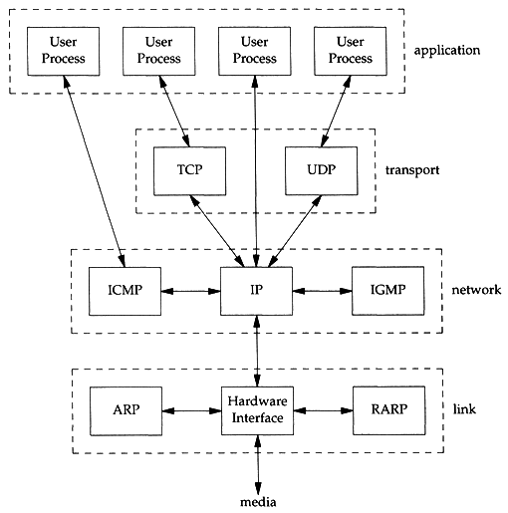
Introduction - Layers of TCP/IP (2)
Each layer has several protocols
A layer define a data communication function that may be performed by certain protocols
A protocol provides a service suitable to the function of that layer

Slide 6
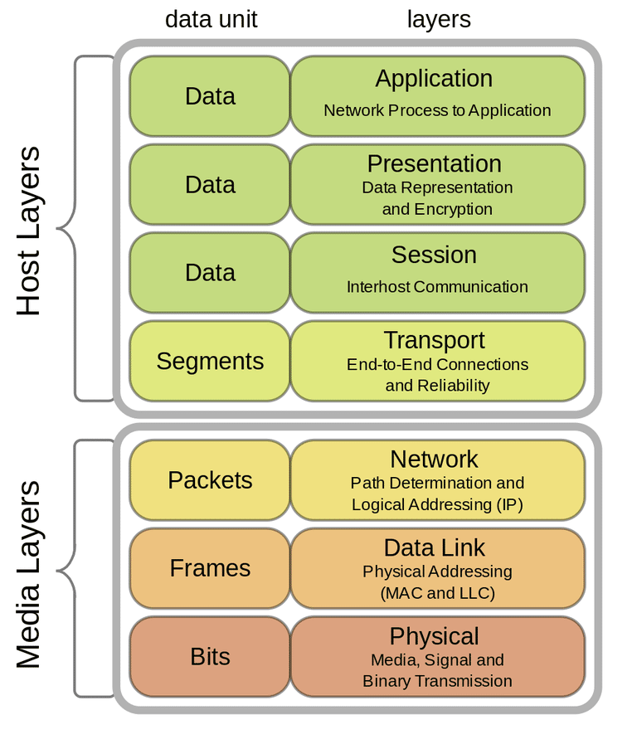
Introduction - Layers of TCP/IP (3)
ISO/OSI Model and TCP/IP Model
Offnfopt / Wikimedia Commons / CC0 1.0
Notes:
https://www.lifewire.com/open-systems-interconnection-model-816290

Slide 7
http://www.escotal.com/osilayer.html

Slide 8
https://vwannabe.com/2013/07/29/objective-1-01-explain-compare-and-contrast-the-osi-layers/
Notes:
https://vwannabe.com/2013/07/29/objective-1-01-explain-compare-and-contrast-the-osi-layers/

Slide 9
Introduction
TCP/IP
Used to provide data communication between hosts
How to delivery data reliably
How to address remote host on the network
How to handle different type of hardware device

Slide 10
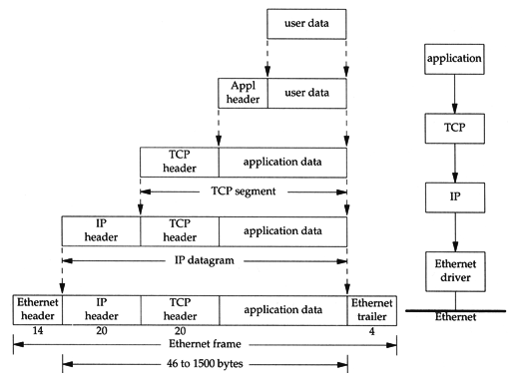
Introduction - Encapsulation
Send data
encapsulation

Slide 11
https://www.dreamstime.com/stock-images-osi-network-model-image28867034

Slide 12
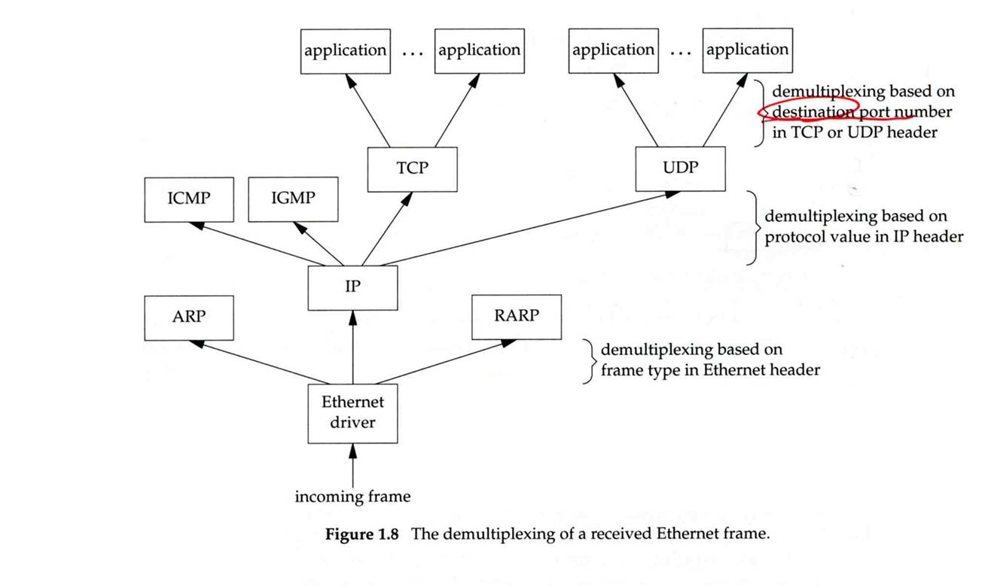
Introduction - Demultiplex
Demultiplexing

Slide 13
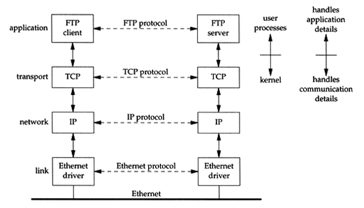
Introduction - Addressing
Addressing
Nearby (same network)

Slide 14
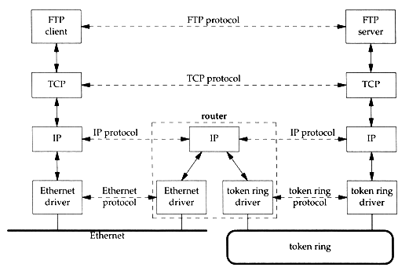
Introduction - Addressing
Addressing
Faraway (across network)

Slide 15
Introduction - Addressing
Addressing
MAC Address
Media Access Control Address
48-bit Network Interface Card Hardware Address
24bit manufacture ID
24bit serial number
Ex:
00:07:e9:10:e6:6b (Intel Corporation also reported as Trendnet)
00:1e:0b:65:ca:07 (Hewlett Packard)
http://www.coffer.com/mac_find/
IP Address
32-bit Internet Address (IPv4)
Ex:
140.113.209.64
http://bgp.he.net/
Port
16-bit uniquely identify application (1 ~ 65536)
Ex:
FTP port 21, ssh port 22, telnet port 23, HTTP port 80, HTTPS port 443
/etc/services

Slide 16
https://www.slideshare.net/00priya33/osi-model-25757020

Slide 17
Link Layer

Slide 18
Link Layer - Introduction of Link Layer
Purpose of the link layer
Send and receive IP datagram for IP module
ARP request and reply
RARP request and reply
TCP/IP support various link layers, depending on the type of hardware used:
Ethernet
Teach in this class
Token Ring
FDDI (Fiber Distributed Data Interface)
ISDN
Serial Line
T1 (1.544Mbps), E1 (2.048Mbps), T2, T3
OC1, OC3, OC12, ATM
STM1, STM4
Notes:
T1 = 1.544 Mbps
E1 = 2.048 Mbps
T2 = 6.17 Mbps
T3 = 45 Mbps
OC1 = 51.84 Mbps
OC3 = 155.5 Mbps
OC12 = 622 Mbps
ATM = 155 Mbps
STM1 = 155.5 Mbps
STM4 = 622 Mbps

Slide 19
Link Layer - Ethernet
Features
Predominant form of local LAN technology used today
Use CSMA/CD
Carrier Sense, Multiple Access with Collision Detection
Use 48bit MAC address
Operate at 10 Mbps
Fast Ethernet at 100 Mbps
Gigabit Ethernet at 1000Mbps
Ethernet frame format is defined in RFC894
This is the actually used format in reality

Slide 20
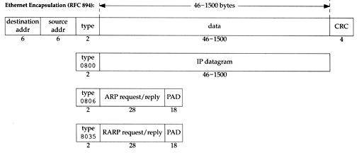
Link Layer - Ethernet Frame Format
48bit hardware address
For both destination and source address
16bit type is used to specify the type of following data
0800 → IP datagram
0806 → ARP, 8035 → RARP

Slide 21
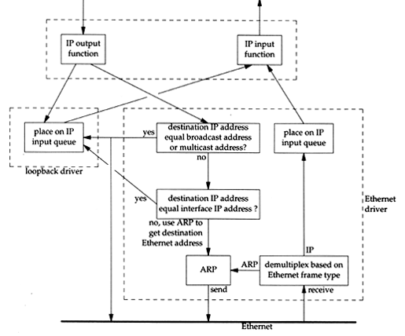
Link Layer - Loopback Interface
Pseudo NIC
Allow client and server on the same host to communicate with each other using TCP/IP
IP
127.0.0.1
Hostname
localhost

Slide 22
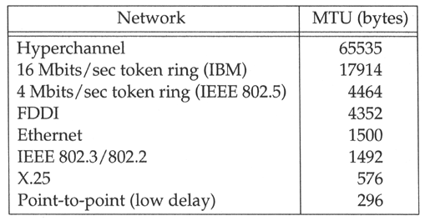
Link Layer - MTU
Maximum Transmission Unit
Limit size of payload part of Ethernet frame
1500 bytes
If the IP datagram is larger than MTU,
IP performs “fragmentation”
MTU of various physical device
Path MTU
Smallest MTU of any data link MTU between the two hosts
Depend on route
Notes:
Path MTU 並不一定要 constant , 得要看當時的 route 來決定

Slide 23
https://cciethebeginning.wordpress.com/tag/eompls/

Slide 24
Link Layer - MTU
To get MTU info
% ifconfig
em0: flags=8843<UP,BROADCAST,RUNNING,SIMPLEX,MULTICAST> mtu 9000
options=b<RXCSUM,TXCSUM,VLAN_MTU>
inet 192.168.7.1 netmask 0xffffff00 broadcast 192.168.7.255
ether 00:0e:0c:01:d7:c8
media: Ethernet autoselect (1000baseTX <full-duplex>)
status: active
fxp0: flags=8843<UP,BROADCAST,RUNNING,SIMPLEX,MULTICAST> mtu 1500
options=b<RXCSUM,TXCSUM,VLAN_MTU>
inet 140.113.17.24 netmask 0xffffff00 broadcast 140.113.17.255
ether 00:02:b3:99:3e:71
media: Ethernet autoselect (100baseTX <full-duplex>)
status: active

Slide 25
Industry term
L2 Switch
L2 Hub
Jumbo Frame
L2VPN

Slide 26
Network Layer

Slide 27
Network Layer - Introduction to Network Layer
Unreliable and connectionless datagram delivery service
IP Routing
IP provides best effort service (unreliable)
IP datagram can be delivered out of order (connectionless)
Protocols using IP
TCP, UDP, ICMP, IGMP

Slide 28
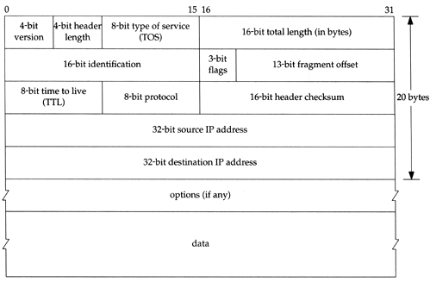
Network Layer - IP Header (1)
20 bytes in total length, excepts options

Slide 29
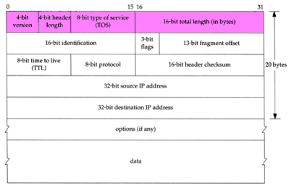
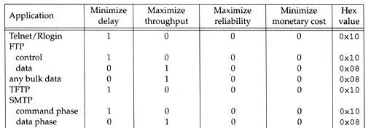
Network Layer - IP Header (2)
Version (4bit)
4 for IPv4 and 6 for IPv6
Header length (4bit)
The number of 32bit words in the header (15*4=60bytes)
Normally, the value is 5 (no option)
TOS-Type of Service (8bit)
3bit precedence + 4bit TOS + 1bit unused
Total length (16bit)
Total length of the IP datagram in bytes

Slide 30
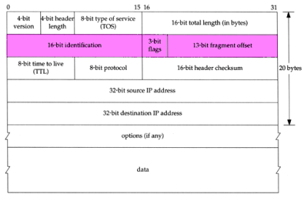
Network Layer - IP Header (3)
Identification (16bit)
Fragmentation offset (13bit)
Flags (3bit)
All these three fields are used for fragmentation

Slide 31
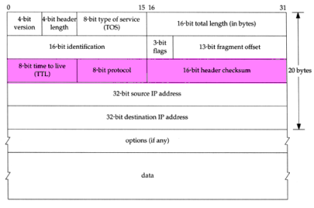
Network Layer - IP Header (4)
TTL (8bit)
Limit of next hop count of routers
Protocol (8bit)
Used to demultiplex to other protocols
TCP, UDP, ICMP, IGMP
Header checksum (16bit)
Calculated over the IP header only
If checksum error, IP discards the datagram and no error message is generated

Slide 32
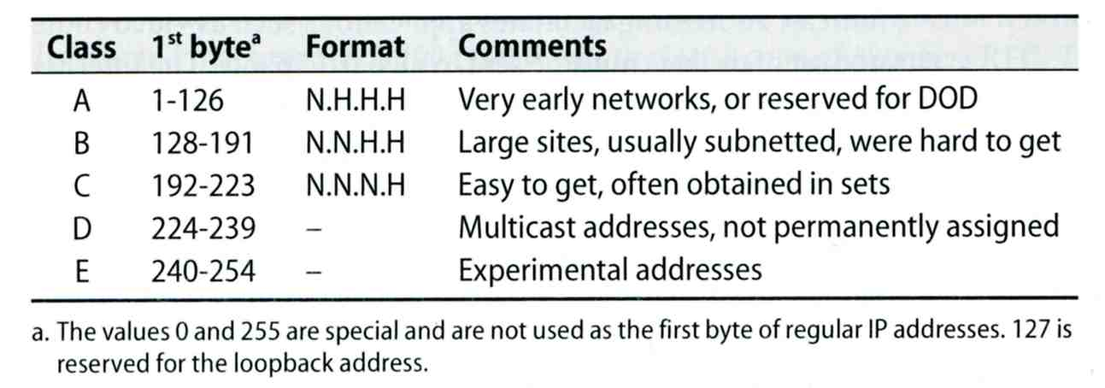
Network Layer - IP Address (1)
32-bit long
Network part
Identify a logical network
Host part
Identify a machine on certain network
IP address category
Ex:
NCTU
Class B address: 140.113.0.0
Network ID: 140.113
Number of hosts: 255*255 = 65535

Slide 33
Network Layer - Subnetting, CIDR, and Netmask (1)
Problems of Class A or B network
Number of hosts is enormous
Hard to maintain and management
Solution ➔ Subnetting
Problems of Class C network
255*255*255 number of Class C network make the size of Internet routes huge
Solution ➔ Classless Inter-Domain Routing

Slide 34
Network Layer - Subnetting, CIDR, and Netmask (2)
Subnetting
Borrow some bits from network ID to extends hosts ID
Ex:
ClassB address : 140.113.0.0
= 256 ClassC-like IP addresses
in N.N.N.H subnetting method
140.113.209.0 subnet
Benefits of subnetting
Reduce the routing table size of Internet’s routers
Ex:
All external routers have only one entry for 140.113 Class B network

Slide 35
Network Layer - Subnetting, CIDR, and Netmask (3)
Netmask
Specify how many bits of network-ID are used for network-ID
Continuous 1 bits form the network part
Ex:
255.255.255.0 in NCTU-CS example
256 hosts available
255.255.255.248 in ADSL example
Only 8 hosts available
Shorthand notation
Address/prefix-length
Ex: 140.113.209.8/24

Slide 36
Network Layer - Subnetting, CIDR, and Netmask (4)
How to determine your network ID?
Bitwise-AND IP and netmask
Ex:
140.113.214.37 & 255.255.255.0 ➔ 140.113.214.0
140.113.209.37 & 255.255.255.0 ➔ 140.113.209.0
140.113.214.37 & 255.255.0.0 ➔ 140.113.0.0
140.113.209.37 & 255.255.0.0 ➔ 140.113.0.0
211.23.188.78 & 255.255.255.248 ➔ 211.23.188.72
78 = 01001110
78 & 248= 01001110 & 11111000 =72

Slide 37
Network Layer - Subnetting, CIDR, and Netmask (5)
In a subnet, not all IP are available
The first one IP ➔ network ID
The last one IP ➔ broadcast address
Ex:
Netmask 255.255.255.0
140.113.209.32/24
140.113.209.0 ➔ network ID
140.113.209.255 ➔ broadcast address
1 ~ 254, total 254 IPs are usable
Netmask 255.255.255.252
211.23.188.78/29
211.23.188.72 ➔ network ID
211.23.188.79 ➔ broadcast address
73 ~ 78, total 6 IPs are usable

Slide 38
Network Layer - Subnetting, CIDR, and Netmask (6)
The smallest subnetting
Network portion : 30 bits
Host portion : 2 bits
➔ 4 hosts, but only 2 IPs are available
ipcalc
#pkg install ipcalc

Slide 39
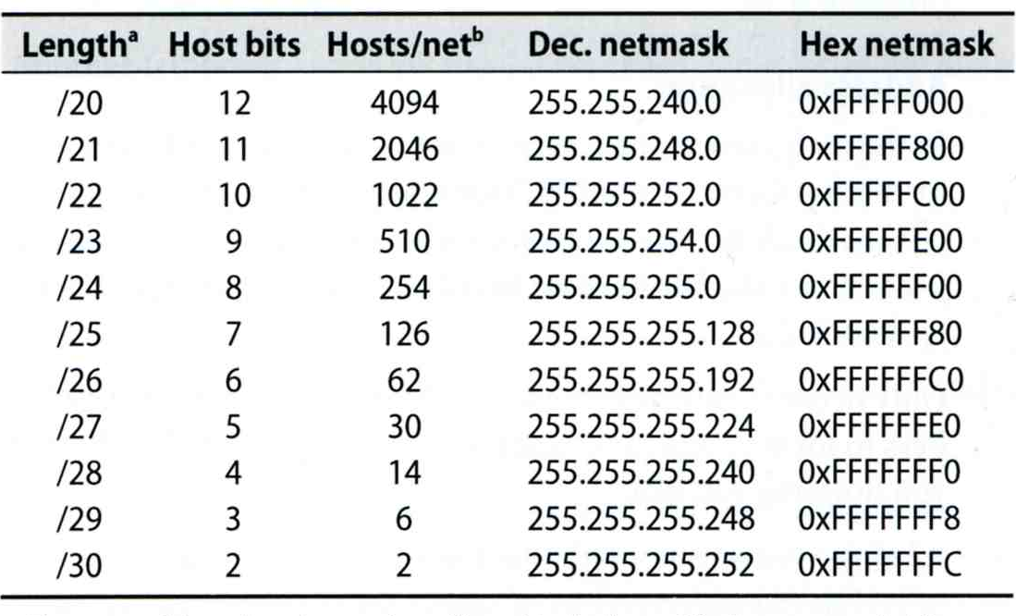
Network Layer - Subnetting, CIDR, and Netmask (7)
Network configuration for various lengths of netmask

Slide 40
Network Layer - Subnetting, CIDR, and Netmask (8)
CIDR (Classless Inter-Domain Routing)
Use address mask instead of old address classes to determine the destination network
CIDR requires modifications to routers and routing protocols
Need to transmit both destination address and mask
Ex:
We can merge two ClassC network:
203.19.68.0/24, 203.19.69.0/24 ➔ 203.19.68.0/23
Benefit of CIDR
We can allocate continuous ClassC network to organization
Reflect physical network topology
Reduce the size of routing table

Slide 41
Network Layer - IP Routing (1)
Difference between Host and Router
Router forwards datagram from one of its interface to another, while host does not
Almost every Unix system can be configured to act as a router or both
net.inet.ip.forwarding=1
Router
IP layer has a routing table, which is used to store the information for forwarding datagram
When router receiving a datagram
If Dst. IP = my IP, demultiplex to other protocol
Other, forward the IP based on routing table

Slide 42
Network Layer - IP Routing (2)
Routing table information
Destination IP
IP address of next-hop router or IP address of a directly connected network
Flags
Next interface
IP routing
Done on a hop-by-hop basis
It assumes that the next-hop router is closer to the destination
Steps:
Search routing table for complete matched IP address
Send to next-hop router or to the directly connected NIC
Search routing table for matched network ID
Send to next-hop router or to the directly connected NIC
Search routing table for default route
Send to this default next-hop router
host or network unreachable

Slide 43
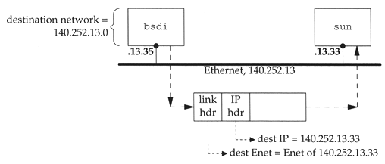
Network Layer - IP Routing (3)
Ex1: routing in the same network
bsdi: 140.252.13.35
sun: 140.252.13.33
Ex Routing table:
140.252.13.33 00:d0:59:83:d9:16 UHLW fxp1

Slide 44
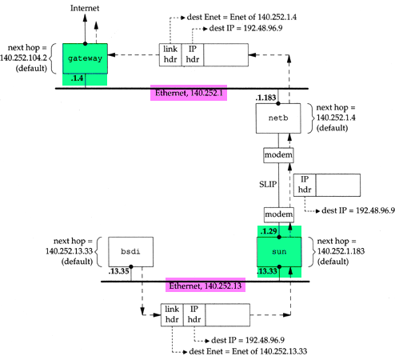
Network Layer - IP Routing (4)
Ex2:
routing across multi-network

Slide 45
Industry term
L3 Switch
Router
Default route
Default gateway
Static route
Dynamic route

Slide 46
ARP and RARP
Something between
MAC (link layer)
And
IP (network layer)

Slide 47
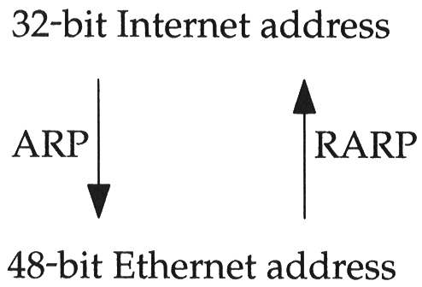
ARP and RARP
ARP - Address Resolution Protocol and RARP - Reverse ARP
Mapping between IP and Ethernet address
When an Ethernet frame is sent on LAN from one host to another,
It is the 48bit Ethernet address that determines for which interface the frame is destined

Slide 48
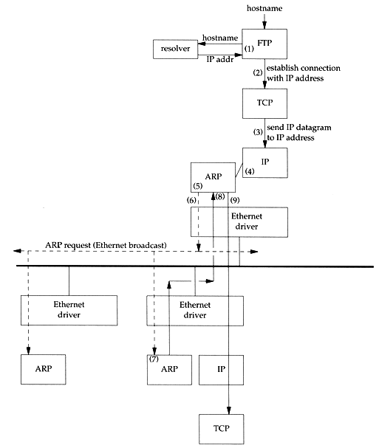
ARP and RARP - ARP Example
Example
% ftp bsd1
(4) next-hop or direct host
(5) Search ARP cache
(6) Broadcast ARP request
(7) bsd1 response ARP reply
(9) Send original IP datagram

Slide 49
ARP and RARP - ARP Cache
Maintain recent ARP results
come from both ARP request and reply
expiration time
Complete entry = 20 minutes
Incomplete entry = 3 minutes
Use arp command to see the cache
Ex:
% arp -a
% arp -a -n
% arp -da
% arp -S 140.113.235.132 00:0e:a6:94:24:6e

Slide 50
ARP and RARP - ARP/RARP Packet Format
Ethernet destination addr: all 1’s (broadcast)
Known value for IP <-> Ethernet
Frame type: 0x0806 for ARP, 0x8035 for RARP
Hardware type: type of hardware address (1 for Ethernet)
Protocol type: type of upper layer address (0x0800 for IP)
Hard size: size in bytes of hardware address (6 for Ethernet)
Protocol size: size in bytes of upper layer address (4 for IP)
Op: 1, 2, 3, 4 for ARP request, reply, RARP request, reply

Slide 51
https://www.slideshare.net/naveenarvinth/arp-36193303

Slide 52
ARP and RARP - Use tcpdump to see ARP
Host 140.113.17.212 → 140.113.17.215
Clear ARP cache of 140.113.17.212
% sudo arp -d 140.113.17.215
Run tcpdump on 140.113.17.215 (00:11:d8:06:1e:81)
% sudo tcpdump -i em0 -e arp
% sudo tcpdump -i em0 -n -e arp
% sudo tcpdump -i em0 -n -t -e arp
On 140.113.17.212, ssh to 140.113.17.215
15:18:54.899779 00:90:96:23:8f:7d > Broadcast, ethertype ARP (0x0806), length 60:
arp who-has nabsd tell chbsd.csie.nctu.edu.tw
15:18:54.899792 00:11:d8:06:1e:81 > 00:90:96:23:8f:7d, ethertype ARP (0x0806), length 42:
arp reply nabsd is-at 00:11:d8:06:1e:81
15:26:13.847417 00:90:96:23:8f:7d > ff:ff:ff:ff:ff:ff, ethertype ARP (0x0806), length 60:
arp who-has 140.113.17.215 tell 140.113.17.212
15:26:13.847434 00:11:d8:06:1e:81 > 00:90:96:23:8f:7d, ethertype ARP (0x0806), length 42:
arp reply 140.113.17.215 is-at 00:11:d8:06:1e:81
00:90:96:23:8f:7d > ff:ff:ff:ff:ff:ff, ethertype ARP (0x0806), length 60:
arp who-has 140.113.17.215 tell 140.113.17.212
00:11:d8:06:1e:81 > 00:90:96:23:8f:7d, ethertype ARP (0x0806), length 42:
arp reply 140.113.17.215 is-at 00:11:d8:06:1e:81

Slide 53
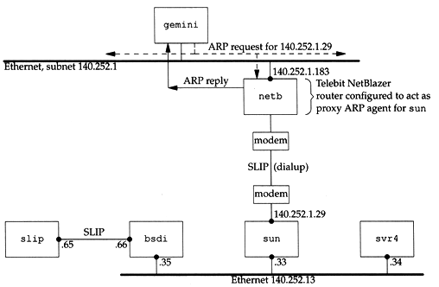
ARP and RARP - Proxy ARP
Let router answer ARP request on one of its networks for a host on another of its network

Slide 54
ARP and RARP - Gratuitous ARP
Gratuitous ARP
The host sends an ARP request looking for its own IP
Provide two features
Used to determine whether there is another host configured with the same IP
Used to cause any other host to update ARP cache when changing hardware address

Slide 55
ARP and RARP - RARP
Principle
Used for the diskless system to read its hardware address from the NIC and send an RARP request to gain its IP
RARP Server Design
RARP server must maintain the map from hardware address to an IP address for many host
Link-layer broadcast
This prevent most routers from forwarding an RARP request

Slide 56
In fact
RARP is an obsolete and useless protocol

Slide 57
ICMP - Internet Control Message Protocol

Slide 58
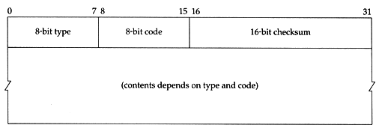
ICMP - Introduction
Part of the IP layer
ICMP messages are transmitted within IP datagram
ICMP communicates error messages and other conditions that require attention for other protocols
ICMP message format

Slide 59
ICMP - Message Type (1)

Slide 60
ICMP - Message Type (2)

Slide 61
ICMP - Query Message - Address Mask Request/Reply (1)
Address Mask Request and Reply
Used for diskless system to obtain its subnet mask
Identifier and sequence number
Can be set to anything for sender to match reply with request
The receiver will response an ICMP reply with the subnet mask of the receiving NIC

Slide 62
ICMP - Query Message - Address Mask Request/Reply (2)
Ex:
chbsd [/home/chwong] -chwong- ping -M m sun1.cs.nctu.edu.tw
ICMP_MASKREQ
PING sun1.cs.nctu.edu.tw (140.113.235.171): 56 data bytes
68 bytes from 140.113.235.171: icmp_seq=0 ttl=251 time=0.663 ms mask=255.255.255.0
68 bytes from 140.113.235.171: icmp_seq=1 ttl=251 time=1.018 ms mask=255.255.255.0
68 bytes from 140.113.235.171: icmp_seq=2 ttl=251 time=1.028 ms mask=255.255.255.0
68 bytes from 140.113.235.171: icmp_seq=3 ttl=251 time=1.026 ms mask=255.255.255.0
^C
--- sun1.cs.nctu.edu.tw ping statistics ---
4 packets transmitted, 4 packets received, 0% packet loss
round-trip min/avg/max/stddev = 0.663/0.934/1.028/0.156 ms
chbsd [/home/chwong] -chwong- icmpquery -m sun1
sun1 : 0xFFFFFF00
※ icmpquery can be found in /usr/ports/net-mgmt/icmpquery

Slide 63
ICMP - Query Message - Timestamp Request/Reply (1)
Timestamp request and reply
Allow a system to query another for the current time
Milliseconds resolution, since midnight UTC
Requestor
Fill in the originate timestamp and send
Reply system
Fill in the receive timestamp when it receives the request and the transmit time when it sends the reply

Slide 64
ICMP - Query Message - Timestamp Request/Reply (2)
chbsd [/home/chwong] -chwong- ping -M time nabsd
ICMP_TSTAMP
PING nabsd.cs.nctu.edu.tw (140.113.17.215): 56 data bytes
76 bytes from 140.113.17.215: icmp_seq=0 ttl=64 time=0.663 ms
tso=06:47:46 tsr=06:48:24 tst=06:48:24
76 bytes from 140.113.17.215: icmp_seq=1 ttl=64 time=1.016 ms
tso=06:47:47 tsr=06:48:25 tst=06:48:25
chbsd [/home/chwong] -chwong- icmpquery -t nabsd
nabsd : 14:54:47
Ex:
nabsd [/home/chwong] -chwong- sudo tcpdump -i sk0 -e icmp
tcpdump: verbose output suppressed, use -v or -vv for full protocol decode
listening on sk0, link-type EN10MB (Ethernet), capture size 96 bytes
14:48:24.999106 00:90:96:23:8f:7d > 00:11:d8:06:1e:81, ethertype IPv4 (0x0800), length 110:
chbsd.csie.nctu.edu.tw > nabsd: ICMP time stamp query id 18514 seq 0, length 76
14:48:24.999148 00:11:d8:06:1e:81 > 00:90:96:23:8f:7d, ethertype IPv4 (0x0800), length 110:
nabsd > chbsd.csie.nctu.edu.tw: ICMP time stamp reply id 18514 seq 0: org 06:47:46.326,
recv 06:48:24.998, xmit 06:48:24.998, length 76
14:48:26.000598 00:90:96:23:8f:7d > 00:11:d8:06:1e:81, ethertype IPv4 (0x0800), length 110:
chbsd.csie.nctu.edu.tw > nabsd: ICMP time stamp query id 18514 seq 1, length 76
14:48:26.000618 00:11:d8:06:1e:81 > 00:90:96:23:8f:7d, ethertype IPv4 (0x0800), length 110:
nabsd > chbsd.csie.nctu.edu.tw: ICMP time stamp reply id 18514 seq 1: org 06:47:47.327,
recv 06:48:25.999, xmit 06:48:25.999, length 76

Slide 65
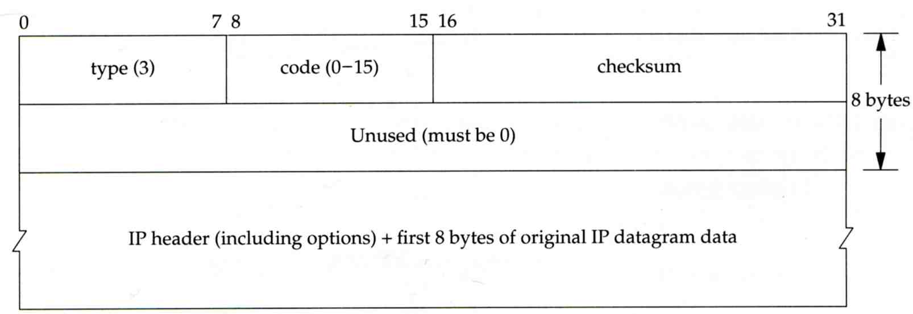
ICMP - Error Message - Unreachable Error Message
Format
8bytes ICMP Header
Application-depend data portion
IP header
Let ICMP know how to interpret the 8 bytes that follow
first 8bytes that followed this IP header
Information about who generates the error

Slide 66
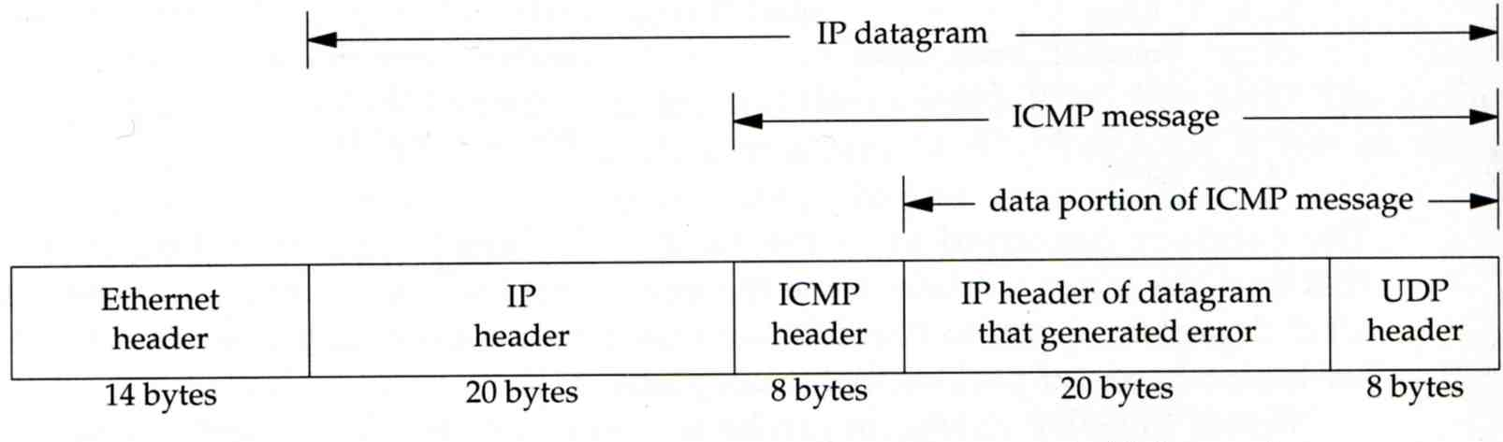
ICMP - Error Message - Port Unreachable (1)
ICMP port unreachable
Type = 3 , code = 3
Host receives a UDP datagram but the destination port does not correspond to a port that some process has in use

Slide 67
ICMP - Error Message - Port Unreachable (2)
Ex:
Using TFTP (Trivial File Transfer Protocol)
Original port: 69
chbsd [/home/chwong] -chwong- tftp
tftp> connect localhost 8888
tftp> get temp.foo
Transfer timed out.
tftp>
chbsd [/home/chwong] -chwong- sudo tcpdump -i lo0
tcpdump: verbose output suppressed, use -v or -vv for full protocol decode
listening on lo0, link-type NULL (BSD loopback), capture size 96 bytes
15:01:24.788511 IP localhost.62089 > localhost.8888: UDP, length 16
15:01:24.788554 IP localhost > localhost:
ICMP localhost udp port 8888 unreachable, length 36
15:01:29.788626 IP localhost.62089 > localhost.8888: UDP, length 16
15:01:29.788691 IP localhost > localhost:
ICMP localhost udp port 8888 unreachable, length 36

Slide 68
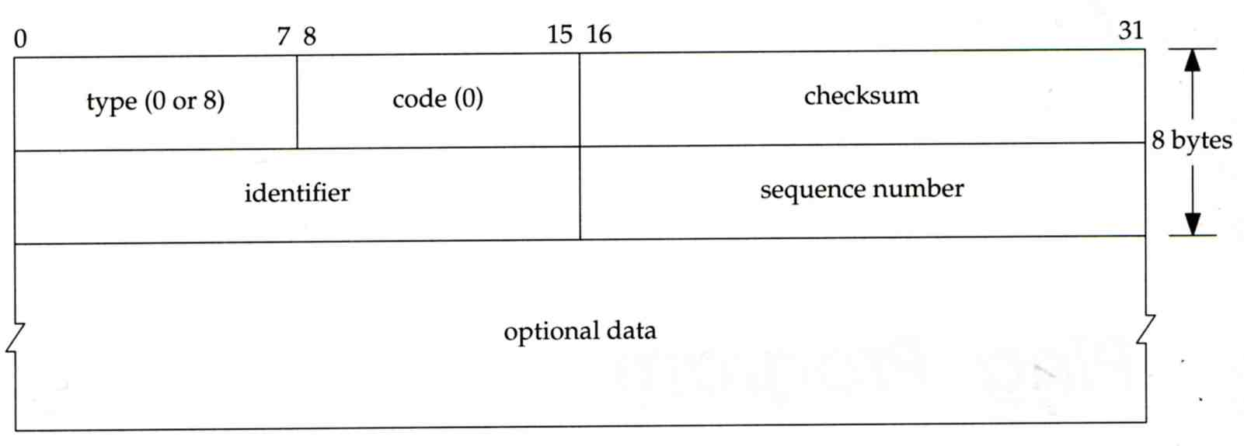
ICMP - Ping Program (1)
Use ICMP to test whether another host is reachable
Type 8, ICMP echo request
Type 0, ICMP echo reply
ICMP echo request/reply format
Identifier: process ID of the sending process
Sequence number: start with 0
Optional data: any optional data sent must be echoed

Slide 69
ICMP - Ping Program (2)
Ex:
chbsd ping nabsd
execute “tcpdump -i em0 -X -e icmp” on nabsd
chbsd [/home/chwong] -chwong- ping nabsd
PING nabsd.cs.nctu.edu.tw (140.113.17.215): 56 data bytes
64 bytes from 140.113.17.215: icmp_seq=0 ttl=64 time=0.520 ms
15:08:12.631925 00:90:96:23:8f:7d > 00:11:d8:06:1e:81, ethertype IPv4 (0x0800), length 98:
chbsd.csie.nctu.edu.tw > nabsd: ICMP echo request, id 56914, seq 0, length 64
0x0000: 4500 0054 f688 0000 4001 4793 8c71 11d4 E..T....@.G..q..
0x0010: 8c71 11d7 0800 a715 de52 0000 45f7 9f35 .q.......R..E..5
0x0020: 000d a25a 0809 0a0b 0c0d 0e0f 1011 1213 ...Z............
0x0030: 1415 1617 1819 1a1b 1c1d 1e1f 2021 2223 .............!"#
0x0040: 2425 2627 2829 2a2b 2c2d 2e2f 3031 3233 $%&'()*+,-./0123
0x0050: 3435 45
15:08:12.631968 00:11:d8:06:1e:81 > 00:90:96:23:8f:7d, ethertype IPv4 (0x0800), length 98:
nabsd > chbsd.csie.nctu.edu.tw: ICMP echo reply, id 56914, seq 0, length 64
0x0000: 4500 0054 d97d 0000 4001 649e 8c71 11d7 E..T.}..@.d..q..
0x0010: 8c71 11d4 0000 af15 de52 0000 45f7 9f35 .q.......R..E..5
0x0020: 000d a25a 0809 0a0b 0c0d 0e0f 1011 1213 ...Z............
0x0030: 1415 1617 1819 1a1b 1c1d 1e1f 2021 2223 .............!"#
0x0040: 2425 2627 2829 2a2b 2c2d 2e2f 3031 3233 $%&'()*+,-./0123
0x0050: 3435 45

Slide 70
ICMP - Ping Program (3)
To get the route that packets take to host
Taking use of “IP Record Route Option”
Command: ping -R
Cause every router that handles the datagram to add its (outgoing) IP address to a list in the options field.
Format of Option field for IP RR Option
code: type of IP Option (7 for RR)
len: total number of bytes of the RR option
ptr:4 ~ 40 used to point to the next IP address
Only 9 IP addresses can be stored
Limitation of IP header

Slide 71
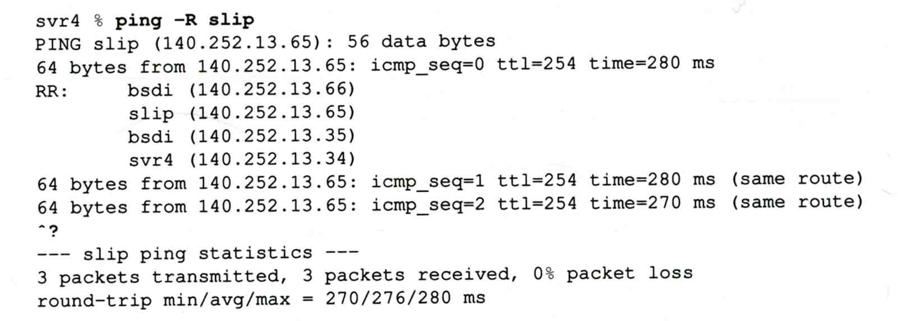
ICMP - Ping Program (4)
Example:

Slide 72
ICMP - Ping Program (5)
Example
chbsd [/home/chwong] -chwong- ping -R www.nctu.edu.tw
PING www.nctu.edu.tw (140.113.250.5): 56 data bytes
64 bytes from 140.113.250.5: icmp_seq=0 ttl=61 time=2.361 ms
RR: ProjE27-253.NCTU.edu.tw (140.113.27.253)
140.113.0.57
CC250-gw.NCTU.edu.tw (140.113.250.253)
www.NCTU.edu.tw (140.113.250.5)
www.NCTU.edu.tw (140.113.250.5)
140.113.0.58
ProjE27-254.NCTU.edu.tw (140.113.27.254)
e3rtn.csie.nctu.edu.tw (140.113.17.254)
chbsd.csie.nctu.edu.tw (140.113.17.212)
64 bytes from 140.113.250.5: icmp_seq=1 ttl=61 time=3.018 ms (same route)
chbsd [/home/chwong] -chwong- sudo tcpdump -v -n -i dc0 -e icmp
tcpdump: listening on dc0, link-type EN10MB (Ethernet), capture size 96 bytes
22:57:04.507271 00:90:96:23:8f:7d > 00:90:69:64:ec:00, ethertype IPv4 (0x0800), length 138: (tos 0x0, ttl 64, id 17878, offset 0, flags [none], proto: ICMP (1), length: 124,
options ( RR (7) len 390.0.0.00.0.0.00.0.0.00.0.0.00.0.0.00.0.0.00.0.0.00.0.0.00.0.0.0EOL
(0) len 1 )) 140.113.17.212 > 140.113.250.5: ICMP echo request, id 45561, seq 0, length 64
22:57:04.509521 00:90:69:64:ec:00 > 00:90:96:23:8f:7d, ethertype IPv4 (0x0800), length 138:
(tos 0x0, ttl 61, id 33700, offset 0, flags [none], proto: ICMP (1), length: 124,
options ( RR (7) len 39140.113.27.253, 140.113.0.57, 140.113.250.253, 140.113.250.5,
140.113.250.5, 140.113.0.58, 140.113.27.254, 140.113.17.254, 0.0.0.0EOL (0) len 1 ))
140.113.250.5 > 140.113.17.212: ICMP echo reply, id 45561, seq 0, length 64
※

Slide 73
Traceroute Program (1)
To print the route packets take to network host
Drawbacks of IP RR options (ping -R)
Not all routers have supported the IP RR option
Limitation of IP header length
Background knowledge of traceroute
When a router receive a datagram, , it will decrement the TTL by one
When a router receive a datagram with TTL = 0 or 1,
it will through away the datagram and
sends back a “Time exceeded” ICMP message
Unused UDP port will generate a “port unreachable” ICMP message

Slide 74
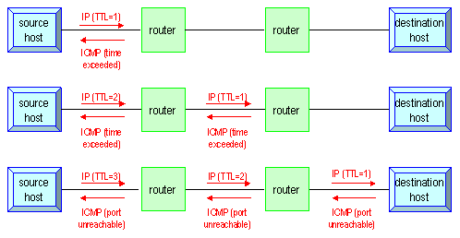
Traceroute Program (2)
Operation of traceroute
Send UDP with port > 30000, encapsulated with IP header with TTL = 1, 2, 3, … continuously
When router receives the datagram and TTL = 1, it returns a “Time exceed” ICMP message
When destination host receives the datagram and TTL = 1, it returns a “Port unreachable” ICMP message

Slide 75
Traceroute Program (3)
Time exceed ICMP message
Type = 11, code = 0 or 1
Code = 0 means TTL=0 during transit
Code = 1 means TTL=0 during reassembly
First 8 bytes of datagram
UDP header

Slide 76
Traceroute Program (4)
Ex:
nabsd [/home/chwong] -chwong- traceroute bsd1.cs.nctu.edu.tw
traceroute to bsd1.cs.nctu.edu.tw (140.113.235.131), 64 hops max, 40 byte packets
1 e3rtn.csie.nctu.edu.tw (140.113.17.254) 0.377 ms 0.365 ms 0.293 ms
2 ProjE27-254.NCTU.edu.tw (140.113.27.254) 0.390 ms 0.284 ms 0.391 ms
3 140.113.0.58 (140.113.0.58) 0.292 ms 0.282 ms 0.293 ms
4 140.113.0.165 (140.113.0.165) 0.492 ms 0.385 ms 0.294 ms
5 bsd1.cs.nctu.edu.tw (140.113.235.131) 0.393 ms 0.281 ms 0.393 ms
nabsd [/home/chwong] -chwong- sudo tcpdump -i em0 -t icmp
tcpdump: verbose output suppressed, use -v or -vv for full protocol decode
listening on sk0, link-type EN10MB (Ethernet), capture size 96 bytes
IP e3rtn.csie.nctu.edu.tw > nabsd: ICMP time exceeded in-transit, length 36
IP e3rtn.csie.nctu.edu.tw > nabsd: ICMP time exceeded in-transit, length 36
IP e3rtn.csie.nctu.edu.tw > nabsd: ICMP time exceeded in-transit, length 36
IP ProjE27-254.NCTU.edu.tw > nabsd: ICMP time exceeded in-transit, length 36
IP ProjE27-254.NCTU.edu.tw > nabsd: ICMP time exceeded in-transit, length 36
IP ProjE27-254.NCTU.edu.tw > nabsd: ICMP time exceeded in-transit, length 36
IP 140.113.0.58 > nabsd: ICMP time exceeded in-transit, length 36
IP 140.113.0.58 > nabsd: ICMP time exceeded in-transit, length 36
IP 140.113.0.58 > nabsd: ICMP time exceeded in-transit, length 36
IP 140.113.0.165 > nabsd: ICMP time exceeded in-transit, length 36
IP 140.113.0.165 > nabsd: ICMP time exceeded in-transit, length 36
IP 140.113.0.165 > nabsd: ICMP time exceeded in-transit, length 36
IP bsd1.cs.nctu.edu.tw > nabsd: ICMP bsd1.cs.nctu.edu.tw udp port 33447 unreachable, length 36
IP bsd1.cs.nctu.edu.tw > nabsd: ICMP bsd1.cs.nctu.edu.tw udp port 33448 unreachable, length 36
IP bsd1.cs.nctu.edu.tw > nabsd: ICMP bsd1.cs.nctu.edu.tw udp port 33449 unreachable, length 36

Slide 77
Traceroute Program (5)
The router IP in traceroute is the interface that receives the datagram. (incoming IP)
Traceroute from left host to right host
if1, if3
Traceroute from right host to left host
if4, if2

Slide 78
Traceroute Program - IP Source Routing Option (1)
Source Routing
Sender specifies the route
Two forms of source routing
Strict source routing
Sender specifies the exact path that the IP datagram must follow
Loose source routing
As strict source routing, but the datagram can pass through other routers between any two addresses in the list
Format of IP header option field
Code = 0x89 for strict and code = 0x83 for loose SR option

Slide 79
Traceroute Program - IP Source Routing Option (2)
Scenario of source routing
Sending host
Remove first entry and append destination address in the final entry of the list
Receiving router != destination
Loose source route, forward it as normal
Receiving router = destination
Next address in the list becomes the destination
Change source address
Increment the pointer

Slide 80
Traceroute Program - IP Source Routing Option (3)
Traceroute using IP loose SR option
Ex:
nabsd [/home/chwong] -chwong- traceroute u2.nctu.edu.tw
traceroute to u2.nctu.edu.tw (211.76.240.193), 64 hops max, 40 byte packets
1 e3rtn-235 (140.113.235.254) 0.549 ms 0.434 ms 0.337 ms
2 140.113.0.166 (140.113.0.166) 108.726 ms 4.469 ms 0.362 ms
3 v255-194.NTCU.net (211.76.255.194) 0.529 ms 3.446 ms 5.464 ms
4 v255-229.NTCU.net (211.76.255.229) 1.406 ms 2.017 ms 0.560 ms
5 h240-193.NTCU.net (211.76.240.193) 0.520 ms 0.456 ms 0.315 ms
nabsd [/home/chwong] -chwong- traceroute -g 140.113.0.149 u2.nctu.edu.tw
traceroute to u2.nctu.edu.tw (211.76.240.193), 64 hops max, 48 byte packets
1 e3rtn-235 (140.113.235.254) 0.543 ms 0.392 ms 0.365 ms
2 140.113.0.166 (140.113.0.166) 0.562 ms 9.506 ms 0.624 ms
3 140.113.0.149 (140.113.0.149) 7.002 ms 1.047 ms 1.107 ms
4 140.113.0.150 (140.113.0.150) 1.497 ms 6.653 ms 1.595 ms
5 v255-194.NTCU.net (211.76.255.194) 1.639 ms 7.214 ms 1.586 ms
6 v255-229.NTCU.net (211.76.255.229) 1.831 ms 9.244 ms 1.877 ms
7 h240-193.NTCU.net (211.76.240.193) 1.440 ms !S 2.249 ms !S 1.737 ms !S

Slide 81
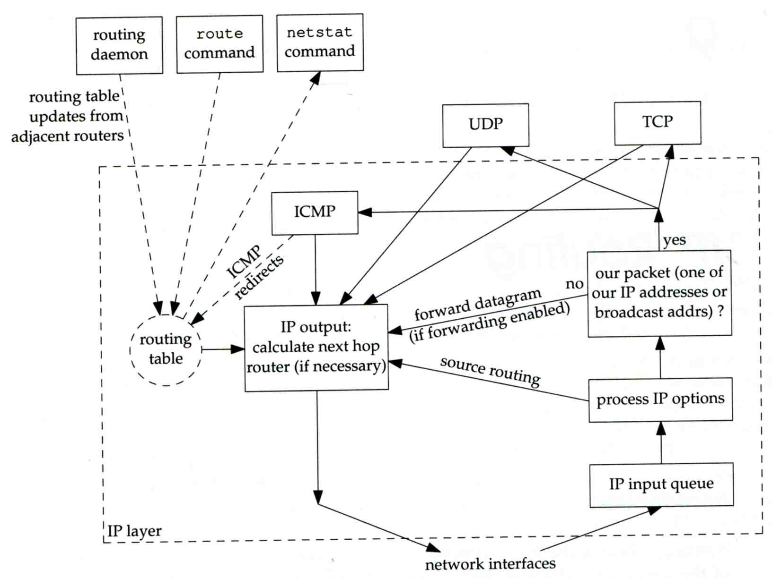
IP Routing - Processing in IP Layer

Slide 82
IP Routing - Routing Table (1)
Routing Table
Command to list: netstat -rn
Flag
U: the route is up
G: the route is to a router (indirect route)
Indirect route: IP is the dest. IP, MAC is the router’s MAC
H: the route is to a host (Not to a network)
The dest. filed is either an IP address or network address
Refs: number of active uses for each route
Use: number of packets sent through this route
nabsd [/home/chwong] -chwong- netstat -rn
Routing tables
Internet:
Destination Gateway Flags Refs Use Netif Expire
default 140.113.17.254 UGS 0 178607 sk0
127.0.0.1 127.0.0.1 UH 0 240 lo0
140.113.17/24 link#1 UC 0 0 sk0
140.113.17.5 00:02:b3:4d:44:c0 UHLW 1 12182 sk0 1058
140.113.17.212 00:90:96:23:8f:7d UHLW 1 14 sk0 1196
140.113.17.254 00:90:69:64:ec:00 UHLW 2 4 sk0 1200

Slide 83
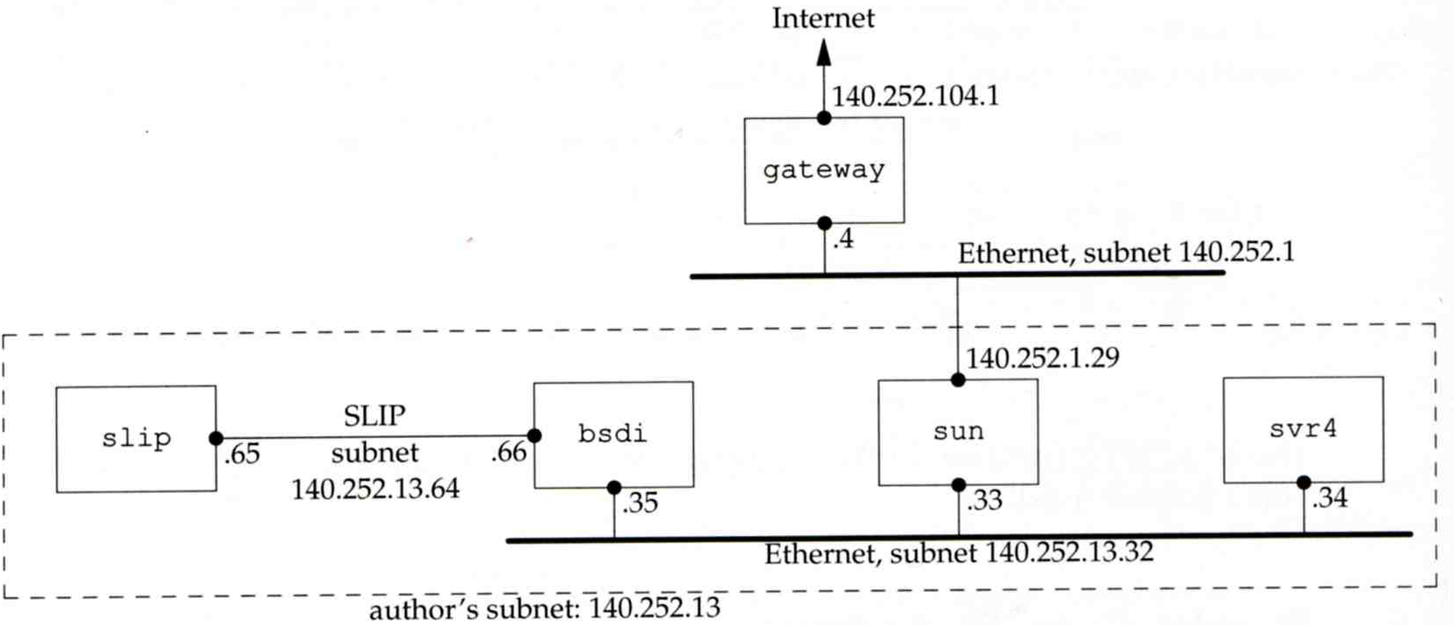
IP Routing - Routing Table (2)
dst. = sun
dst. = slip
dst. = 192.207.117.2
dst. = svr4 or 140.252.13.34
dst. = 127.0.0.1
Ex:
loopback

Slide 84
ICMP - No Route to Destination
If there is no match in routing table
If the IP datagram is generated on the host
“host unreachable” or “network unreachable”
If the IP datagram is being forwarded
ICMP “host unreachable” error message is generated and sends back to sending host
ICMP message
Type = 3, code = 0 for host unreachable
Type = 3, code = 1 for network unreachable

Slide 85
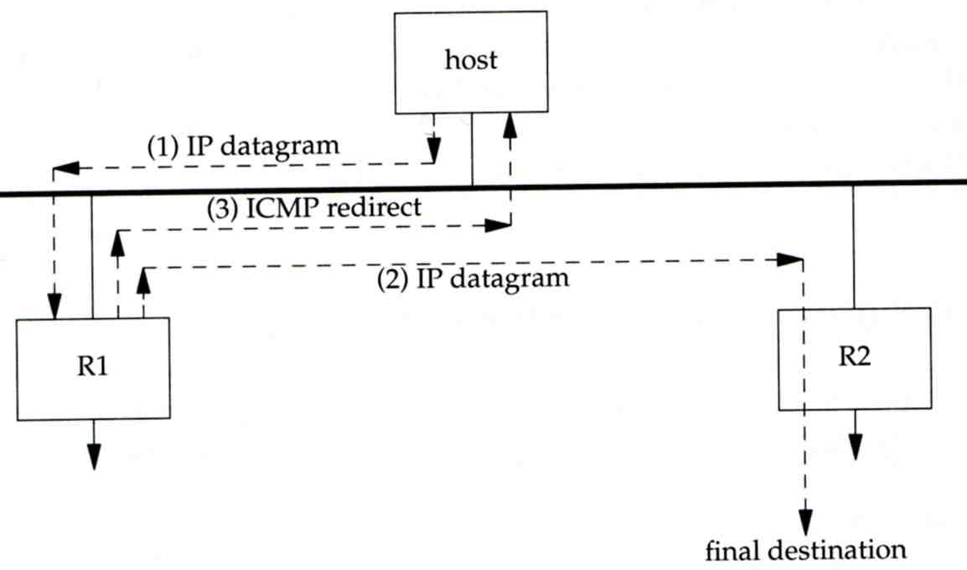
ICMP - Redirect Error Message (1)
Concept
Used by router to inform the sender that the datagram should be sent to a different router
This will happen if the host has a choice of routers to send the packet to
Ex:
R1 found sending and receiving interface are the same

Slide 86
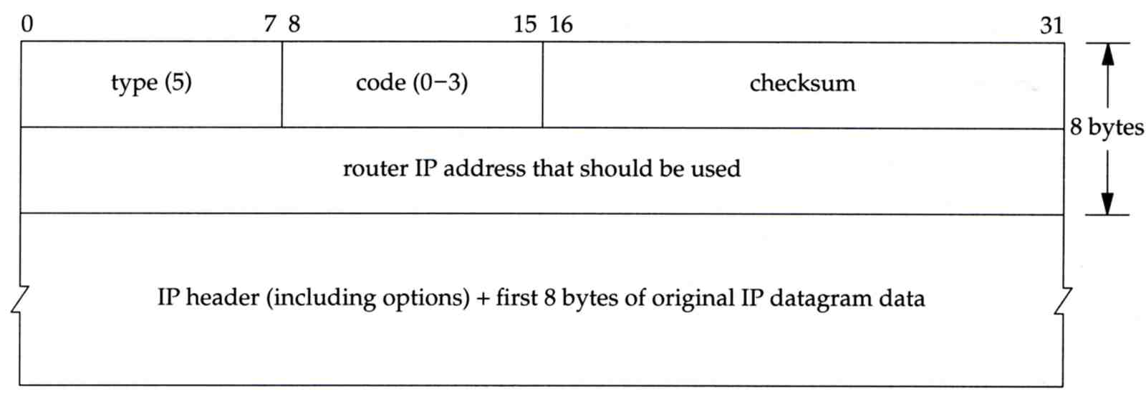
ICMP - Redirect Error Message (2)
ICMP redirect message format
Code 0: redirect for network
Code 1: redirect for host
Code 2: redirect for TOS and network (RFC 1349)
Code 3: redirect for TOS and hosts (RFC 1349)

Slide 87
ICMP - Router Discovery Messages (1)
Dynamic update host’s routing table
ICMP router solicitation message (懇求)
Host broadcast or multicast after bootstrapping
ICMP router advertisement message
Router response
Router periodically broadcast or multicast
Format of ICMP router solicitation message

Slide 88
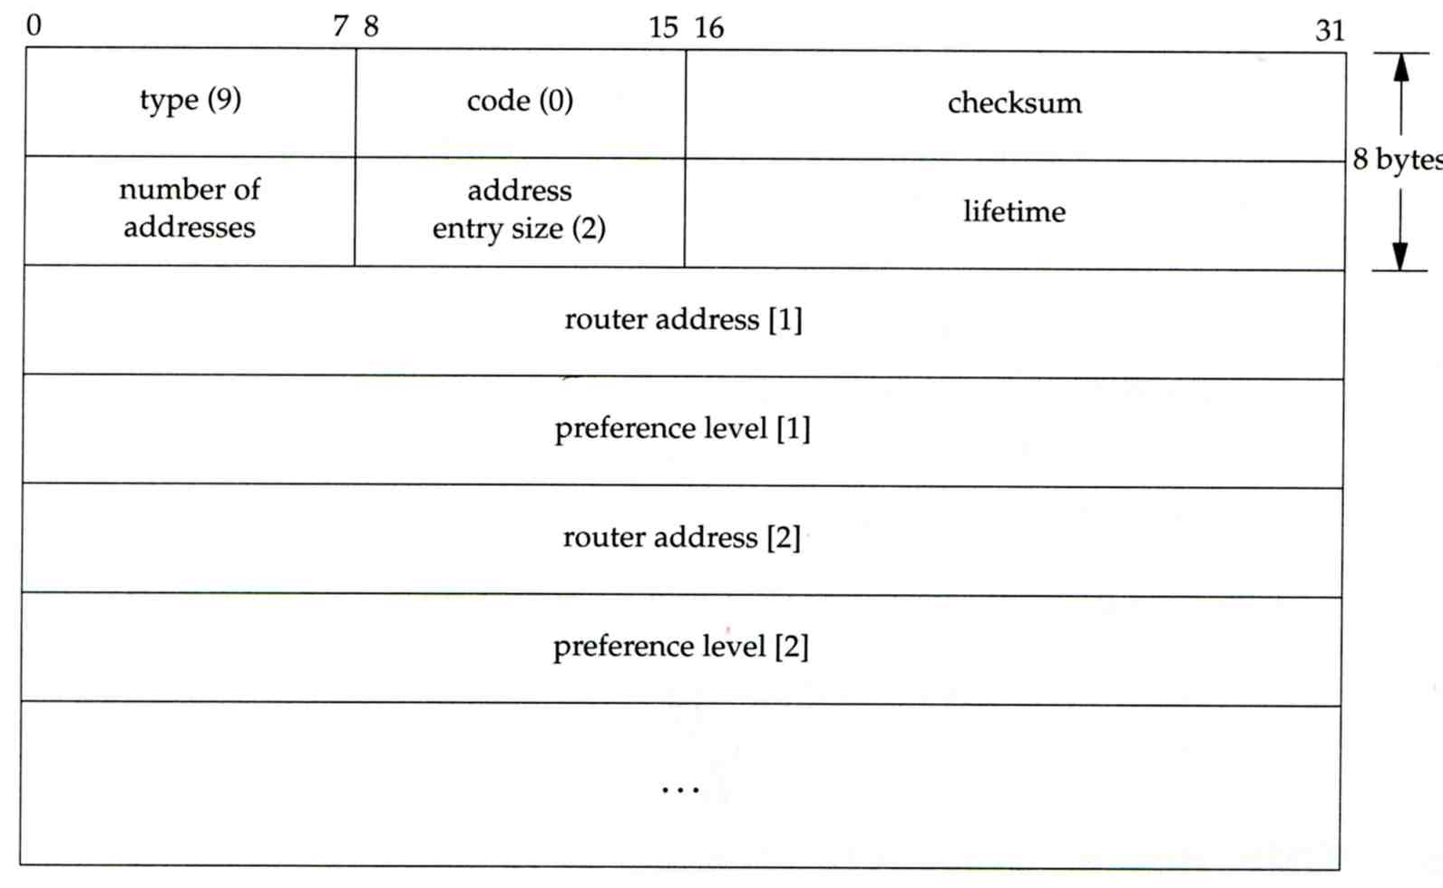
ICMP - Router Discovery Messages (2)
Format of ICMP router advertisement message
Router address
Must be one of the router’s IP address
Preference level
Preference as a default router address

Slide 89
UDP - User Datagram Protocol

Slide 90
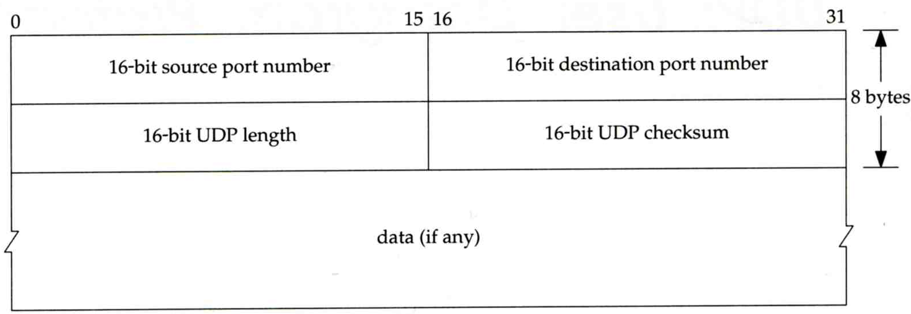
UDP
No reliability
Datagram-oriented, not stream-oriented protocol
UDP header
8 bytes
Source port and destination port
Identify sending and receiving process
UDP length: ≧ 8

Slide 91
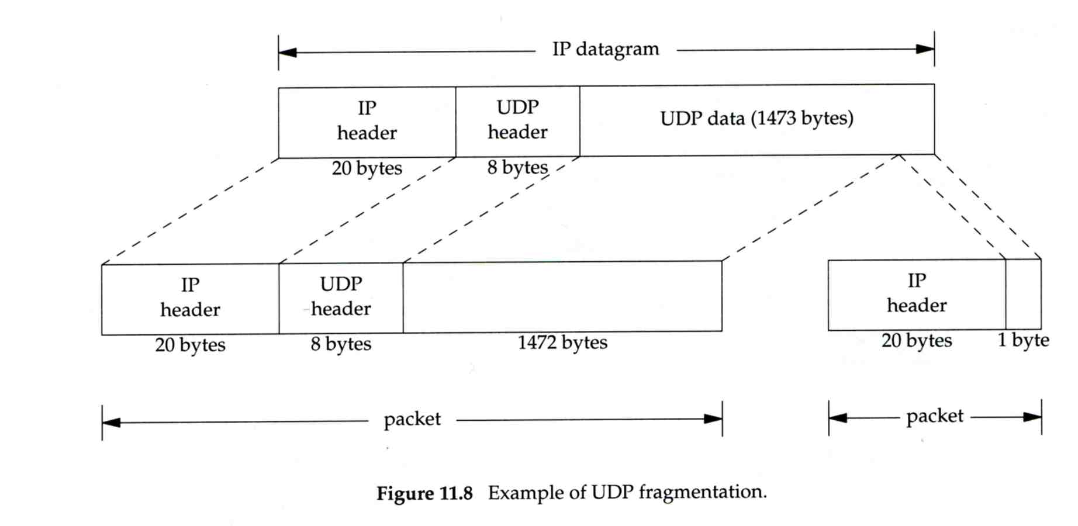
IP Fragmentation (1)
MTU limitation
Before network-layer to link-layer
IP will check the size and link-layer MTU
Do fragmentation if necessary
Fragmentation may be done at sending host or routers
Reassembly is done only in receiving host
1501 bytes
1500 bytes

Slide 92
IP Fragmentation (2)
identification: which unique IP datagram
flags: more fragments?
fragment offset offset of this datagram from the beginning of original datagram
identification: the same
flags: more fragments
fragment offset 0
identification: the same
flags: end of fragments
fragment offset 1480

Slide 93
IP Fragmentation (3)
Issues of fragmentation
One fragment lost, entire datagram must be retransmitted
If the fragmentation is performed by intermediate router, there is no way for sending host how fragmentation did
Fragmentation is often avoided
There is a “don’t fragment” bit in flags of IP header

Slide 94
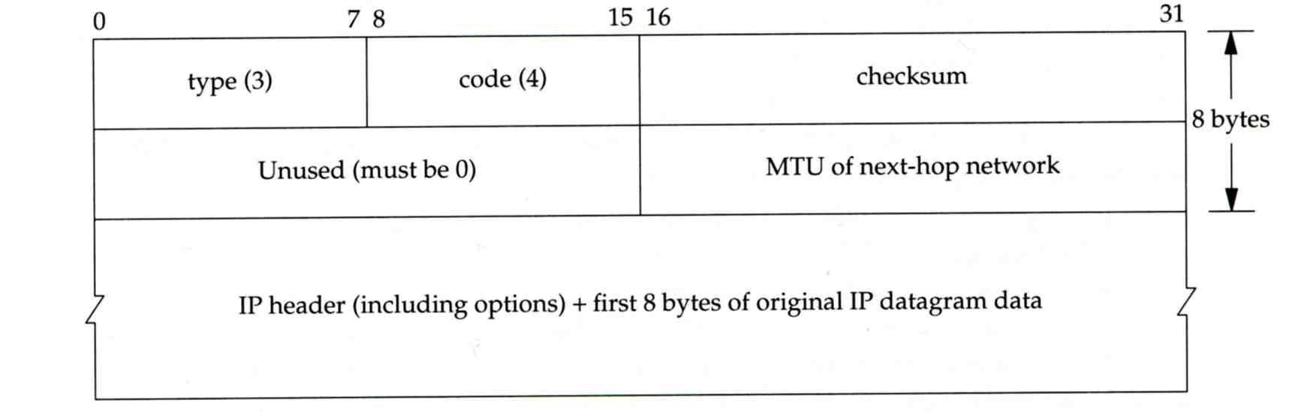
ICMP Unreachable Error - Fragmentation Required
Type=3, code=4
Router will generate this error message if the datagram needs to be fragmented, but the “don’t fragment” bit is turn on in IP header
Message format

Slide 95
ICMP - Source Quench Error
Type=4, code=0
May be generated by system when it receives datagram at a rate that is too fast to be processed
Host receiving more than it can handle datagram
Send ICMP source quench or
Throw it away
Host receiving UDP source quench message
Ignore it or
Notify application

Slide 96
TCP - Transmission Control Protocol

Slide 97
TCP
Services
Connection-oriented
Establish TCP connection before exchanging data
Reliability
Acknowledgement when receiving data
Retransmission when timeout
Ordering
Discard duplicated data
Flow control

Slide 98
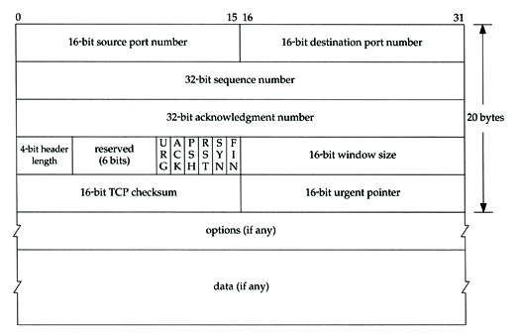
TCP - Header (1)

Slide 99
TCP - Header (2)
Flags
SYN
Establish new connection
ACK
Acknowledgement number is valid
Used to ack previous data that host has received
RST
Reset connection
FIN
The sender is finished sending data

Slide 100
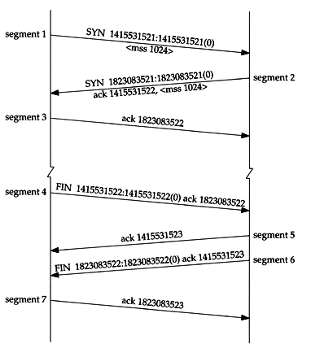
TCP connection establishment and termination
Three-way handshake
TCP’s half close

Slide 101
Appendix of IP Options: IP Timestamp Option
IP Timestamp Option
Similar to RR option
Record Timestamp in option filed
code, len, ptr are the same as IP RR option
OF
Overflow field
Router will increment OF if it can’t add a timestamp because of no room left
FL
Flags
0: only timestamp
1: both timestamp and IP address
3: the sender initiates the options with up to 4
pairs of IP address and timestamp
※

Slide 102
Physical
Layer 1

Slide 103
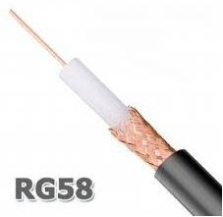
Medium Type
Electronics
Cable
RJ45
GJ-11, RG-58
Optical Fiber
Multi Mode
Single Mode
http://leeselectronic.com/tw/product/2290.html

Slide 104
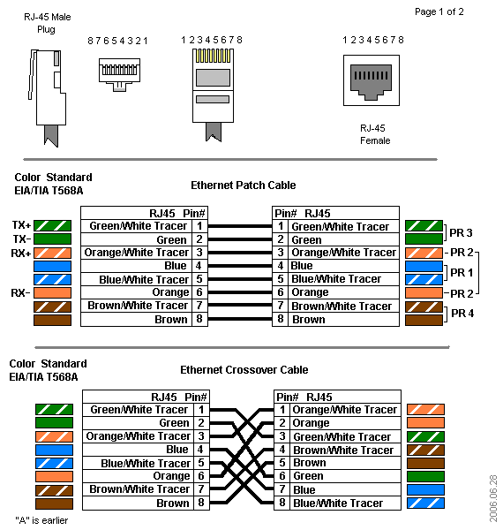
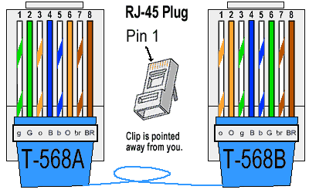
RJ-45 (1)
8P8C
8 position
8 contact
100 meter
http://www.bb-elec.com/Learning-Center/All-White-Papers/Ethernet/Ethernet-Cables-RJ45-Colors-Crossover.aspx

Slide 105
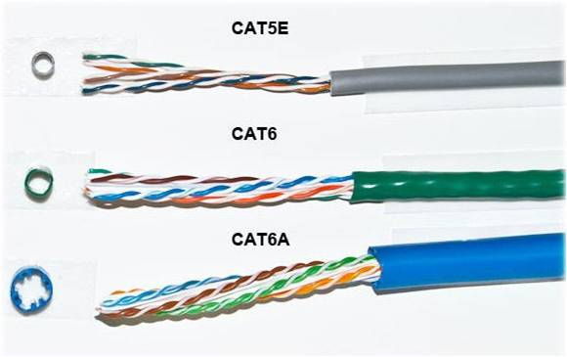
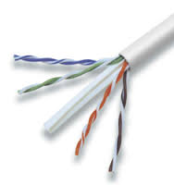
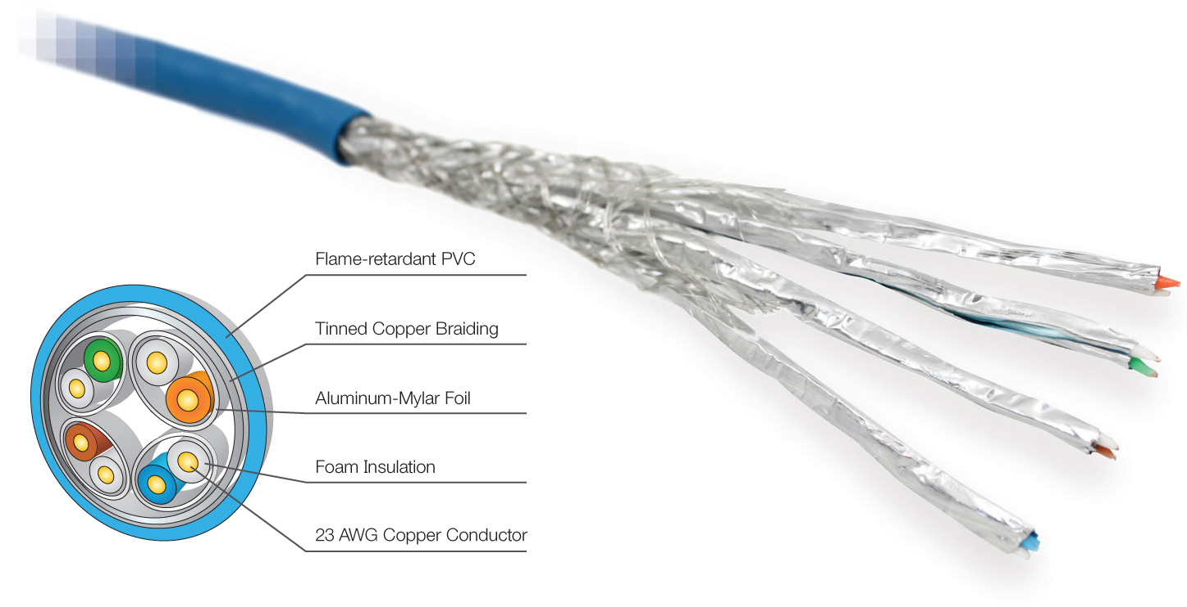
RJ-45 (2)
Category 5
Category 5e
Category 6
http://www.datacommun.com/interconnection/362.html
https://avprosupply.com/CAT5/Cables/
https://dir.indiamart.com/surat/cat-6-cable.html

Slide 106
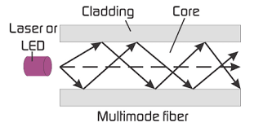
Optical Fiber - Multi Mode
core size
62.5/125 µm - 275 m
1G - 275m
10G - 33 m
50/125 µm - 550 m
1G - 550m
10G - 82 m
可見光

Slide 107
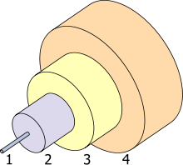
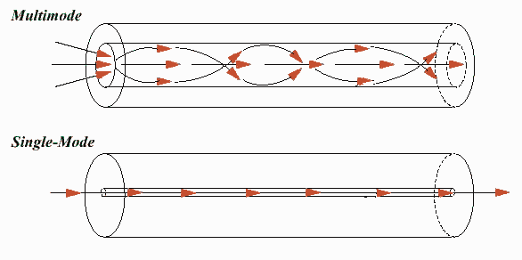
Optical Fiber - Single Mode
Core size
Between 8 and 10.5 µm
雷射光
Distance
10KM
40KM
70KM
The structure of a typical
single-mode fiber. 1. Core 8 µm diameter 2. Cladding 125 µm dia. 3. Buffer 250 µm dia. 4. Jacket 400 µm dia.

Slide 108
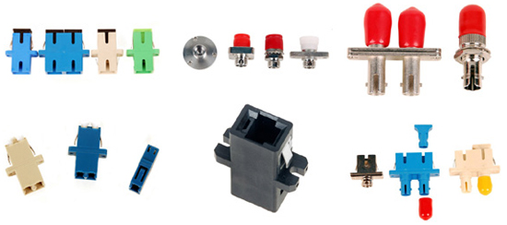
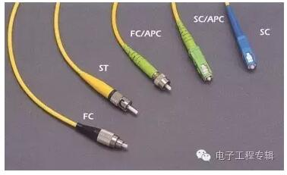
Optical Jack
LC
SC
ST
FC
SMT

Slide 109
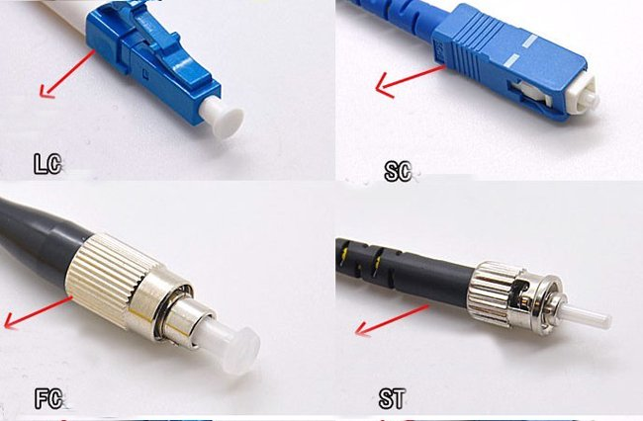

Slide 110
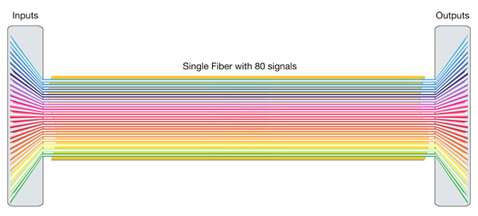
DWDM - Dense Wavelength Division Multiplexing

Slide 113
CWDM

