Slide 1
System Administration HW1-2 Build your FreeBSD Desktop
MarsW

Slide 2
Requirement
Basic system
Build a basic X Server and Window Manager and Wine
Software Rank B
Software Rank A
Software Rank S
Bonus

Slide 3
Basic system
Install the X Server and any of Window Managers.
xfce4*
kde4
gnome
Wine and PC Game
emulators/wine
Reference
http://zh.wikipedia.org/zh-tw/Wine
http://wiki.freebsd.org/Wine #amd64
Plants VS. Zombies
http://0rz.tw/53KfJ

Slide 4
Software Rank B
Termial
rxvt
xterm*
eterm
aterm
FTP client
filezilla*
Instant Messenger
pidgin*
Mail client
Thunder bird
Evolution*
PDF reader
Xpdf *
evince
Mupdf
Browser
Firefox
Opera
Chromium*

Slide 5
Software Rank A
Browser with flash supported
Firefox/Opera/Chromium*
Multimedia : Video, Audio
Xmms
Mplayer*
Bmpx
Beep-media-player
BBS client
pcmanx*
Pictures editor/viewer
Gimp*
gsnapshot

Slide 6
Software Rank S
Office
openoffice.org-
libreoffice*
Remote desktop
freeNX*
Tsclient
Rdesktop
Tightvnc
Virtual Machine
virtualbox-ose*
vmware-guestd
P2P software
Mldonkey
transmission*

Slide 7
Bonus
IDE Enviroment
Misc

Slide 8
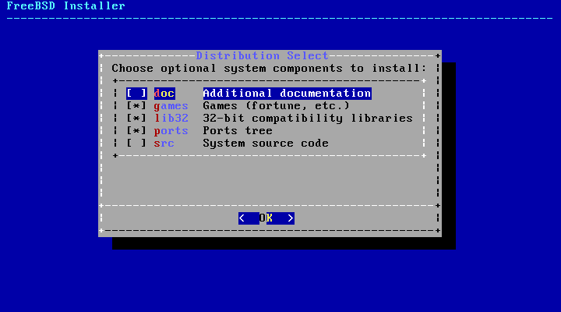
FAQ
Note
root
portmaster
FreeBSD ports tree updating
/etc/make.conf
portsnap fetch extract
portsnap update

Slide 9
Help!
BS2 board CS-SysAdmin
e3
CSCC
ta@nasa.cs.nctu.edu.tw
How To Ask Questions The Smart Way !!!

