Slide 1
X Window System
shunyi
2014/09/25

Slide 2
Outline
X Window System
Introduction
Architecture
X11 Implementation
The Window Manager
Steps of exercise
Install and Configuring X11
Install Window Manager
2

Slide 3
X Window System (1)
Introduction
X can be called "X"、"X11"、"X Window", using to provides a graphical user interface (GUI).
X was designed from the beginning to be network-centric, and adopts a "client-server" model.
History
1984: The X Window system was developed as part of Project Athena at MIT.
1987: X Version 11 is released. X is now controlled and maintained by the Open Group.
2005/12: X11R7.0
2009/10: X11R7.5
2010/11: X11R7.6
2012/6/6: X11R7.7
3

Slide 4
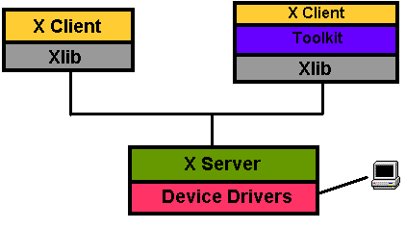
X Window System (2)
Architecture:
A client-server architecture
The X client request display service
The X server provide display service
Communicate with X Protocol
4

Slide 5
X Window System (3)
Client-Server Design
Client
An application written using X libraries (e.g. Xlib)
Request service (like create window)
Receive events from X server (like mouse input)
Server
Runs locally and accepts multiple X clients
Manage the keyboard, mouse and display device
Create, draw and destroy graphic objects on screen
5

Slide 6
X Window System (4)
X Protocol
The X Protocol is also divided into device dependent and device independent layers.
Advantages of X protocol
The X server is highly portable (various OS, Language)
The X Clients also have high portability
Local and network based computing look and feel the same
6

Slide 7
X11 Implementation
Open-source implementations of X Window System
XFree86 project
Since 1992, dormant in Dec, 2011
Latest Version: 4.8.0 Dec 15, 2008
Xorg foundation
Since 2004, forked from XFree86 4.4 RC2
X11 official flavor
Latest Version: 7.7 June 6, 2012
7

Slide 8
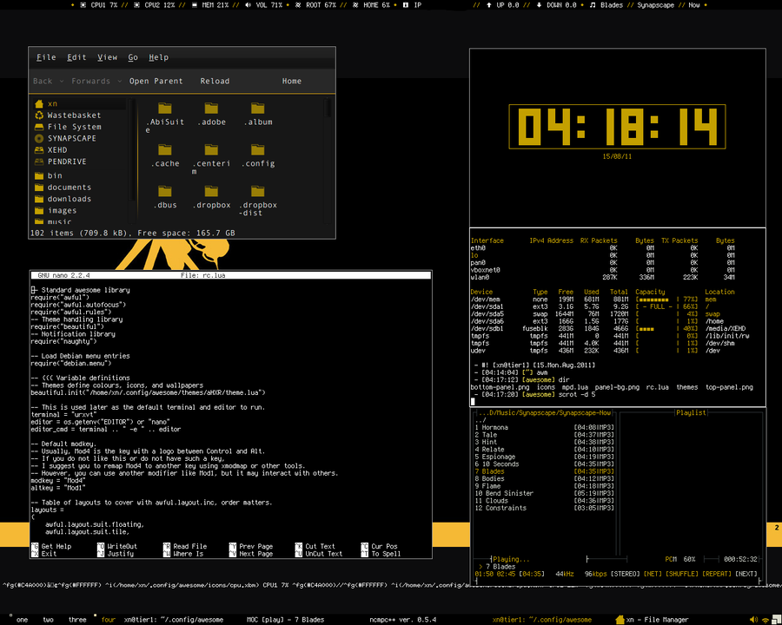
The Window Manager (1)
Window Manager
A special kind of "X Client" provides certain look-and-feel window in front of you.
Background, desktop, theme
Virtual desktop
Window attributes and operations size
resize, minimize, maximize
position: overlap, move
Interactions between X server and X client will be redirected to a window manager.
8

Slide 9
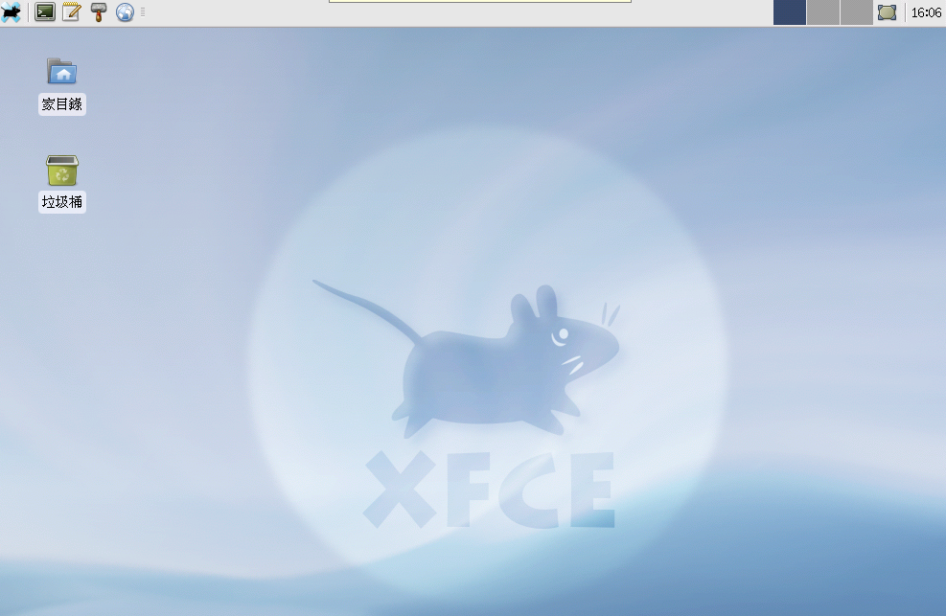
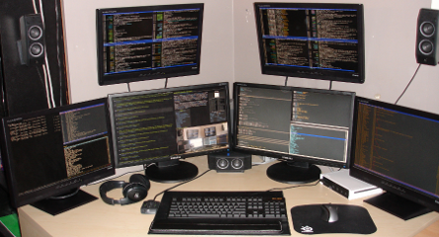
The Window Manager (2)
Some Popular Window Managers
Gnome
KDE
awesome
LXDE
LXQt
Xfce
Afterstep
etc..
9

Slide 10
Steps of exercise
Install X11
Configuring X11
Install Window Manager
Configuring Window Manager
10

Slide 11
Install X11
We use Xorg as our X Server
To build and install Xorg from the ports
Login as root
/usr/ports/x11/xorg
# portmaster x11/xorg (7.5.2) or # pkg install xorg
To build Xorg in its entirety, be sure to have at least 4 GB of free space available.
/usr/ports/*/*/work/*
/usr/local/*
11

Slide 12
Configuring X11 (1)
Pre-step – know your hardware
Monitor specifications
Horizon Synchronization frequency
Ex: 31 ~ 81 KHz
Vertical Synchronization frequency
Ex: 56 ~ 76 KHz
Video adaptor chipset
Ex: ATI Radeon 4670EAH
Ex: nVIDIA GeFource 9800GT
Ex: ATI Mobility RADEON 7500 (16M) (IBMT30)
Ex: vboxvideo
Video Adapter Memory
Ex:128MB
12

Slide 13
Configuring X11 (2)
Starting with version 7.4
Xorg can use HAL (Hardware Abstraction Layer) to autodetect keyboards and mice.
Install the following ports
sysutils/hal
devel/dbus
And adding the following lines into /etc/rc.conf
hald_enable="YES"
dbus_enable="YES"
13

Slide 14
Configuring X11 (3)
Steps of X11 configuration
As of version 7.3, Xorg often work without any configuration file.
# startx
X11 configuration
Generate an X11 configuration skeleton file
# Xorg -configure
The file will be put in /root/xorg.conf.new
Test the existing configuration
# Xorg -config /root/xorg.conf.new -retro
If a black and grey grid and an X mouse cursor appear, the configuration was successful
14

Slide 15
Configuring X11 (4)
Section "Screen"
Identifier "Screen0"
Device "Card0"
Monitor "Monitor0"
DefaultDepth 24
SubSection "Display"
Viewport 0 0
Depth 24
Modes "1280x1024" "1024x768"
EndSubSection
EndSection
Tune Configuration file
Edit /root/xorg.conf.new
Section Monitor
Section Screen
Section InputDevice
Section "InputDevice"
Identifier "Mouse0"
Driver "mouse"
Option "Protocol" "auto"
Option "Device" "/dev/sysmouse"
Option "ZAxisMapping" "4 5"
EndSection
Section "Monitor"
Identifier "Monitor0"
VendorName "Monitor Vendor"
ModelName "Monitor Model“
HorizSync 31.0 - 81.0
VertRefresh 56.0 - 76.0
EndSection
15

Slide 16
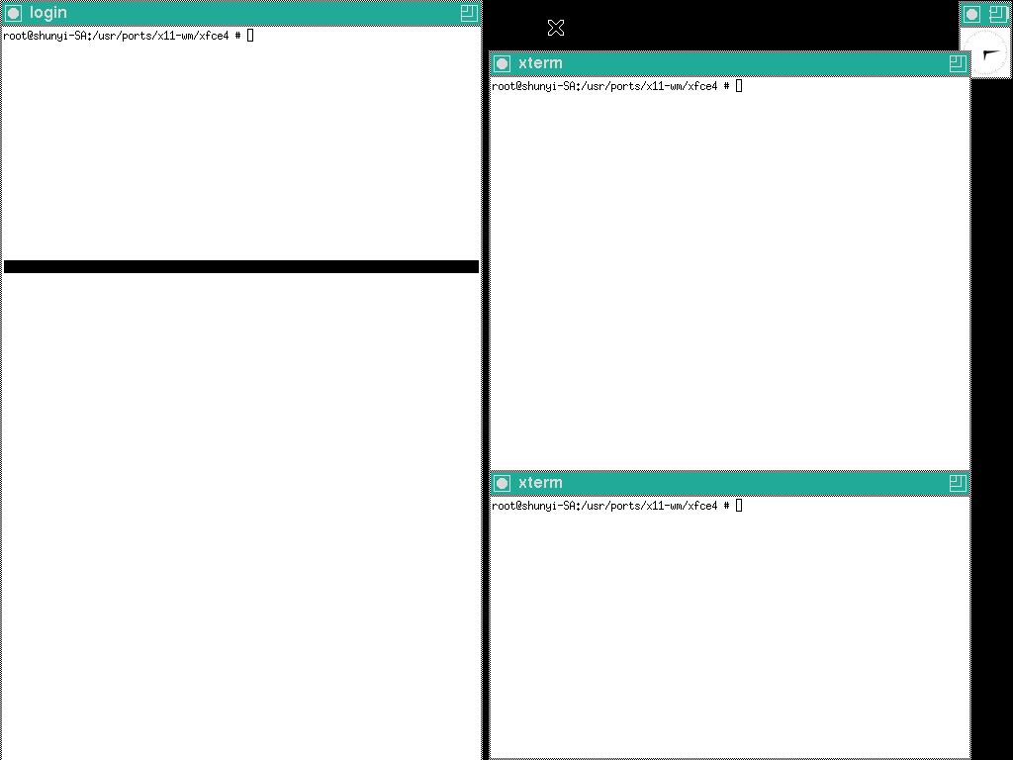
Configuring X11 (5)
Copy the configuration file to real place
% cp /root/xorg.conf.new /etc/X11/xorg.conf
Start X
% startx
16

Slide 17
Install Window Manager (1)
Here we use xfce4 as our WM
http://www.xfce.org
Installation
x11-wm/xfce4
# portmaster x11-wm/xfce4 or # pkg install xfce4
17

Slide 18
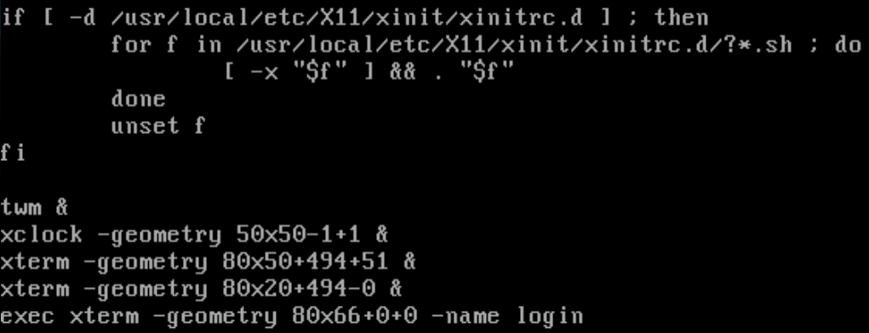
Install Window Manager (2)
Configuring X11 to use Xfce4
Edit "xinitrc"
File Location:
System Default: /usr/local/etc/X11/xinit/xinitrc
Personal: ~/.xinitrc
Format: just like a shell script!
exec /usr/local/bin/xfce4-session
echo "/usr/local/bin/startxfce4" > ~/.xinitrc
18

Slide 19
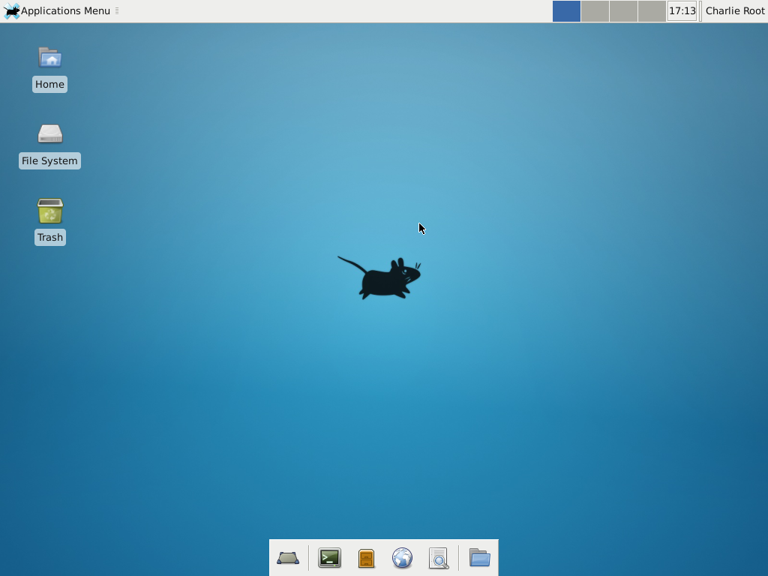
Install Window Manager (3)
Run your X Window
% startx
19

Slide 20
Appendix A: X Startup (1)
xinit - X Window System initializer
xinit [ [ client ] options ] [ -- [ server ] [ display ] options ]
Files
Default client script:
~/.xinitrc
/usr/local/etc/X11/xinit/xinitrc
(run xterm if .xinitrc does not exist)
Default server script:
~/ .xserverrc
/usr/local/etc/X11/xinit/xserverrc
(run X if .xserverrc does not exist)
startx:
script to initiate an X session
20

Slide 21
Appendix A: X Startup (2)
Xdm - X Display Manager
Xdm provides services similar to those provided by init, getty and login on character terminals
x11/xdm
Other display manager
gdm, kdm
Files:
/etc/ttys
Default script
~/.xsession
ttyv8 "/usr/local/bin/xdm -nodaemon" xterm on secure
21

Slide 22
Appendix B: Remote X client
To launch an X client from a remote host for display on the local X server, you need to do following steps:
Start X Server with tcp connection support
% X
Permit for the remote host to display X clients on the local machine.
% xhost [+]remotehost
Set DISPLAY for remote X clients
% setenv DISPLAY server:display
22

Slide 23
Appendix C: X11 forwarding
To forward X11 connection
Connection to X11 DISPLAY can be forward by ssh, any X11 programs started will go through the encrypted channel.
Server:
Enables X11 forwarding: ssh -X
Enables trusted X11 forwarding: ssh -Y (may be dangerous)
Client:
Execute any X clients you want
※Note:
X11 forwarding can represent a security hazard.
23

Slide 24
Appendix D: VNC
VNC (Virtual Network Computing)
a graphical desktop sharing system to remotely control another computer.
Use Remote Frame Buffer (RFB) protocol.
Start VNC Server (and input a connection password)
% vncserver
VNC startup script
~/.vnc/xstartup (just like ~/.xinitrc)
Than you can connect to vnc server by a vnc client
Common VNC Client
RealVNC https://www.realvnc.com/
UltrlVNC http://www.uvnc.com/
24

Slide 25
References
http://www.x.org/wiki/
http://en.wikipedia.org/wiki/X_Window_System
http://en.wikipedia.org/wiki/XFree86
http://en.wikipedia.org/wiki/X.Org_Server
http://en.wikipedia.org/wiki/X_display_manager_(program_type)
http://en.wikipedia.org/wiki/Virtual_Network_Computing
http://www.xfce.org
http://www.freebsd.org/doc/handbook/x11.html
http://www.freebsd.org/doc/zh_TW/books/handbook/x11.html
http://www.gilesorr.com/wm/table.html
25

