Slide 1
FTP
File Transfer Protocol
hlku

Slide 2
FTP
FTP
File Transfer Protocol
Used to transfer data from one computer to another over the internet.
Client-Server Architecture.
Separated control/data connections.
Modes:
Active Mode, Passive Mode
Request For Comments (RFCs):
RFC 959 – File Transfer Protocol
RFC 2228 – FTP Security Extensions
RFC 2428 – FTP Extensions for IPv6 and NATs
RFC 2640 – UTF-8 support for file name
RFC 2324 – Hyper Text Coffee Pot Control Protocol

Slide 3
FTP - Security
Security concern
As we seen, FTP connections (both command and data) are transmitted in clear text.
What if somebody sniffing the network?
We need encryption.
Solutions
FTP over TLS (FTPS、FTPES)
Only commands are encrypted while transmitting.
Better performance.
FTP over SSH
Tunneling a normal FTP session over an SSH connection.
SSH File Transfer Protocol (SFTP)
Both commands and data are encrypted while transmitting.
One connection, but poor performance.

Slide 4
Pure-FTPd - Intro (1)
Introduction
A small, easy to set up, fast and secure FTP server
Support chroot
Restrictions on clients, and system-wide.
Verbose logging with syslog
Anonymous FTP with more restrictions
Virtual Users, and Unix authentication
FXP (File eXchange Protocol)
FTP over TLS
UTF-8 support for filenames

Slide 5
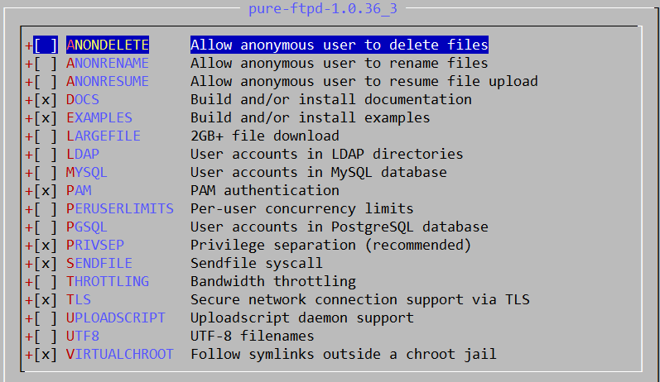
Pure-FTPd - Intro (2)
Installation
Ports: /usr/ports/ftp/pure-ftpd
Options

Slide 6
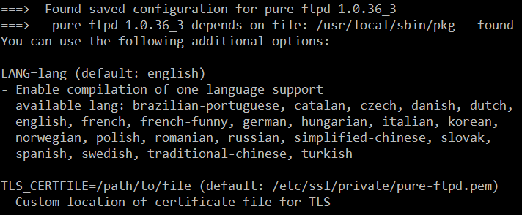
Pure-FTPd - Intro (3)
Other options
TLS_CERTFILE (Default: /etc/ssl/private/pure-ftpd.pem)
LANG (Change the language of output messages)
Startup:
Add pureftpd_enable=“YES” in /etc/rc.conf

Slide 7
Pure-FTPd - Configurations (1)
Configurations:
File: /usr/local/etc/pure-ftpd.conf
Documents
Configuration sample: /usr/local/etc/pure-ftpd.conf.sample
All options are explained clearly in this file.
Other documents
See /usr/local/share/doc/pure-ftpd/*

Slide 8
Pure-FTPd - Configurations(2)
ChrootEveryone yes
TrustedGID 0
AnonymousOnly no
NoAnonymous no
PureDB /usr/local/etc/pureftpd.pdb
UnixAuthentication yes
AntiWarez yes
Umask 133:022
TrustedIP 140.113.0.0
CreateHomeDir yes
TLS 2
FileSystemCharset UTF-8
ClientCharset UTF-8
...... etc.

Slide 9
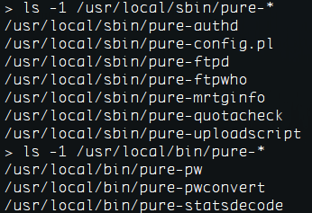
Pure-FTPd - Tools
pure-*
pure-ftpwho
List info of users who are currently connecting to the FTP server.
pure-pw
Manage Virtual Users in PureDB format
pure-pw(8)
See README.Virtual-Users

Slide 10
Pure-FTPd - Anonymous Users and Virtual Users
Anonymous Users
Virtual Users
FTP-only accounts without messing up your system accounts.
Store individual quotas, ratios, bandwidth.
Virtual users share the same system user.
They are chrooted and have their own home directory.

Slide 11
Pure-FTPd - Problem Shooting
Logs Location
In default, syslogd keeps ftp logs in /var/log/xferlog
Most frequent problems
pure-ftpd: (?@?) [ERROR] Unable to find the 'ftp' account
It’s ok, but you may need it for Anonymous FTP Account.
pure-ftpd: (?@?) [ERROR] Sorry, but that file doesn't exist: [/etc/ssl/private/pure-ftpd.pem]
If you set TLS = 2, then this file is needed.
How to generate a pure-ftpd.pem?
See README.TLS

Slide 12
FTP - More Tools
ftp/pureadmin
Management utility for the PureFTPd
ftp/lftp
Shell-like command line ftp client, support TLS
ftp/wget, ftp/curl
Retrieve files from the Net via HTTP(S) and FTP
ftp/mget
Multithreaded commandline web-download manager
FileZilla
A graphical cross-platform FTP client, support TLS
Pure-FTPd WebUI
PHP based web interface for ​Pure-FTPd

