Slide 1
ZFS
Zetabyte FileSystem
The Last Word In File Systems
hlku
Notes:
Zetabyte = 10^9 TB

Slide 2
Are you tired of…
Disk Partitioning (Slice, label….)
Physical volume limitation
Long FSCK time
Silent corruption on your disk
waiting when moving large files
…etc
Try ZFS!

Slide 3
Outline
Z File System Introduction
Using ZFS
zpool
Zfs
Reference
http://docs.oracle.com/cd/E19120-01/open.solaris/817-2271/index.html
http://docs.oracle.com/cd/E19963-01/pdf/821-1448.pdf
http://en.wikipedia.org/wiki/ZFS
https://www.freebsd.org/doc/handbook/zfs.html

Slide 4
ZFS Intro
Storage Pools
Constructed of files, partitions, or entire disks
Does for storage what VM did for memory
stripe, mirror(RAID1), raidz(RAID5), raidz2, raidz3
Hot spares
Capacity
128-bit file system
Max File Size
16 EB (1 EB = 10³ PB = 10⁶ TB)
Max Volume Size
16 EB

Slide 5
ZFS Intro (Cont.)
Variable block size
Data compression (CPU-bound vs. I/O-bound)
Adaptive endianness
Sparc(Big-endian) & others(Little-endian)
Break the limitation of traditional File System!

Slide 6
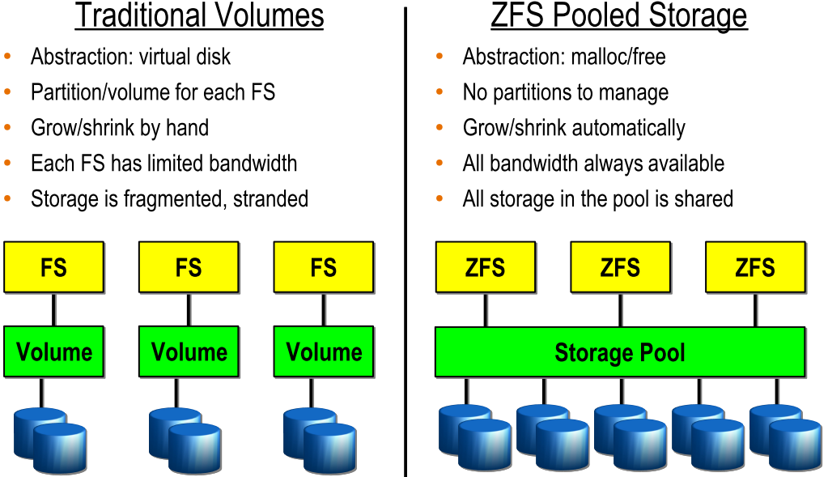
FS/Volume model vs. ZFS

Slide 7
ZFS Intro (Cont.)
Data Integrity
Checksums
Resilver
Online “scrub”
fsck is offline and only check metadata
scrub once per week for cheap disks or per month for enterprise disks
No FSCK and silent corruption!

Slide 8
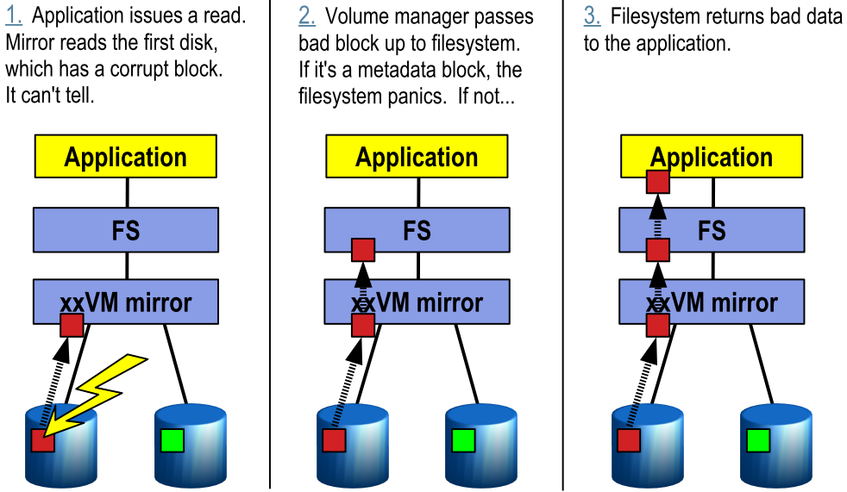
Traditional Mirroring

Slide 9
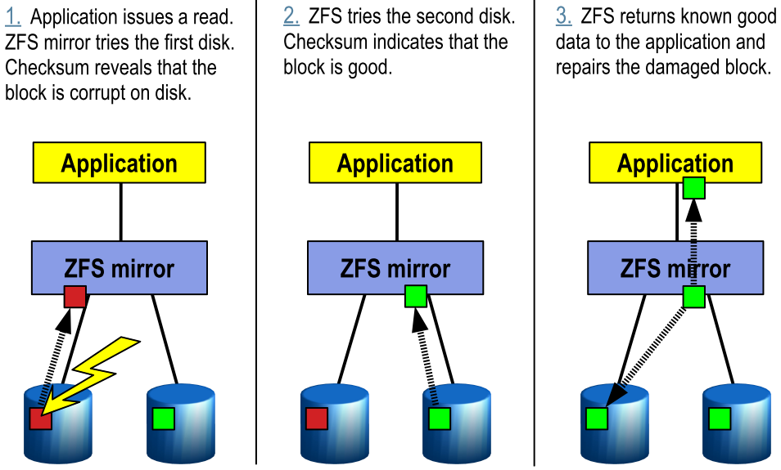
Self-Healing in ZFS

Slide 10
ZFS Intro (Cont.)
Dynamic striping
Across all devices to maximize throughput
What if I only have one disk….
Copy-on-write
Modified data is in a new block
Improve throughput and efficiency

Slide 11
ZFS Intro – Other Features
Snapshots & Clones & Rollbacks
Fast creation
Space efficiency
Clones are writeable snapshots
Compression
lzjb, gzip-*, lz4
Data deduplication
Cache management
ARC, L2ARC, ZIL
Encryption
ZFS Pool Version 30

Slide 12
ZFS – Platforms
Oracle Solaris 10 / 11
OpenSolaris / OpenIndiana
Nexenta
FreeBSD
8.4, 9.2, 10.0
FreeNAS
GNU/kFreeBSD
NetBSD
Mac X OS
Linux / Linux FUSE / Kernel Module

Slide 13
Using ZFS
zpool
Maintain relations between hard disk and ZFS pool
zfs
Manage ZFS and configuration setting
In /etc/rc.conf
zfs_enable="YES“
# /etc/rc.d/zfs start

Slide 14
zpool
zpool create tank
ad0 ad1
mirror ad0 ad1
raidz ad0 ad1 ad2
zpool destroy tank
zpool add/attach/detach/online/offline
zpool clear/replace
zpool list/status
zpool export/import
zpool upgrade -v/-a
zpool get/set …
get all

Slide 15
zfs – (1)
zfs create
tank/fs0
zfs destroy
tank/fs0
zfs snapshot
tank/fs0@today
tank/fs0/.zfs/snapshot/today/
zfs clone
zfs rollback
zfs list
zfs set

Slide 16
zfs – (2)
zfs mount/unmount
zfs upgrade -v/-a
zfs send/receive
zfs allow/unallow
zfs hold/holds/release
zfs diff
zfs jail/unjail

Slide 17
Under these attracting features
There must be a price…
ZFS can be a monster which eat up all your memory
So watch out your hardware limit
or it will CRASH!

Slide 18
Ten Ways To Improve ZFS Performance
1: Add Enough RAM
2: Add More RAM
3: Boost Deduplication Performance With Even More RAM
4: Use SSDs to Improve Read Performance
5: Use SSDs to Improve Write Performance
6: Use Mirroring
7: Add More Disks
8: Leave Enough Free Space
9: Hire An Expert
10: Be An Evil Tuner - But Know What You Do
http://constantin.glez.de/blog/2010/04/ten-ways-easily-improve-oracle-solaris-zfs-filesystem-performance

Slide 19
Tuning for production use
Users of the i386™ architecture
add in kernel configuration file, rebuild their kernel, and reboot
options KVA_PAGES=512
There is one example of ZFS running nicely on a laptop with 768 MB of physical RAM with the following settings in /boot/loader.conf:
vm.kmem_size="330M"
vm.kmem_size_max="330M"
vfs.zfs.arc_max="40M"
vfs.zfs.vdev.cache.size="5M“
http://wiki.freebsd.org/ZFSTuningGuide

Slide 20
Further Reading
https://www.freebsd.org/doc/handbook/zfs.html
zpool(1M)、zfs(1M)
https://wiki.freebsd.org/ZFS
Live demos!!!!
https://wiki.freebsd.org/ZFSQuickStartGuide
https://wiki.freebsd.org/RootOnZFS
ZFS-only FreeBSD

Slide 21
Appendix – Create zpool using files
Prepare BIG blank files
dd if=/dev/zero of=/zfs/device/disk1 bs=1m count=1024
…
Create zpool
zpool create filetank mirror /zfs/device/disk1 …

