Slide 1
System Administration HW1-1
shunyi
2014/09/18

Slide 2
Requirements
Basic
Install FreeBSD 9.2-RELEASE
i386
http://freebsd.cs.nctu.edu.tw/pub/FreeBSD/releases/i386/ISO-IMAGES/9.2/
amd64
http://freebsd.cs.nctu.edu.tw/pub/FreeBSD/releases/amd64/ISO-IMAGES/9.2/
Add a user and a group
Group name should be identical to your username
User should also be in the ‘wheel’ group
Set your machine to current time zone and adjust current time
Enable and run sshd
2

Slide 3
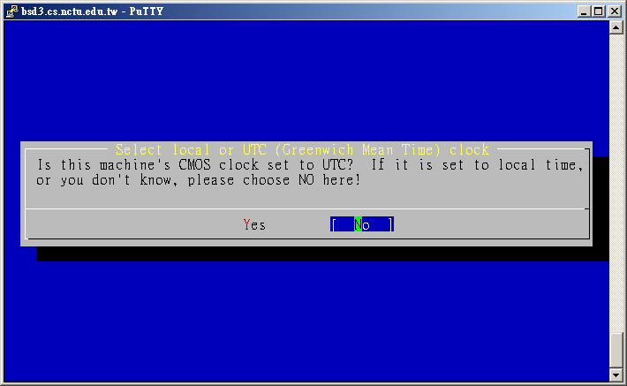
Timezone
bsdconfig
(sysinstall has been replaced by bsdinstall & bsdconfig)
tzsetup
Find right timezone file in /usr/share/zoneinfo and copy to /etc/localtime
3

Slide 4
Submission
$ : shell prompt
Login with the user you created
$ cd
$ fetch http://cs.nctu.edu.tw/~shunyi/sahw1-1.sh
$ sh ~/sahw1-1.sh
Key in your student ID while see
“Please input your student ID: ”
then press Enter
Check http://nasa.cs.nctu.edu.tw/sysadm/hw1-1 for your submission.
4

Slide 5
FAQ (1/3)
Adjust current time
ntpdate(8) //non-continuous
or
ntpd(8) //continuous
http://www.freebsd.org/doc/en/books/handbook/network-ntp.html
Server
time.stdtime.gov.tw
tick.stdtime.gov.tw
tock.stdtime.gov.tw
watch.stdtime.gov.tw
clock.stdtime.gov.tw
server 0.tw.pool.ntp.org
server 1.asia.pool.ntp.org
server 2.asia.pool.ntp.org
5

Slide 6
FAQ(2/3)
My network is not working
實體機
強烈建議使用測試平台，免認證
6

Slide 7
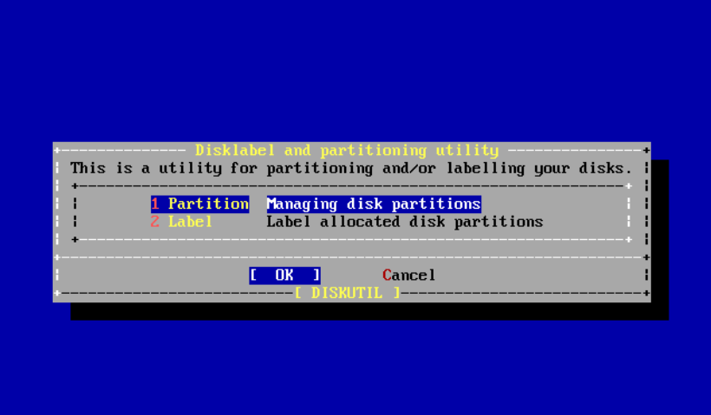
FAQ(3/3)
My WinXP / Win7 / Win8 is gone…
# sysctl kern.geom.debugflags=16
# sade => Partition
7

Slide 8
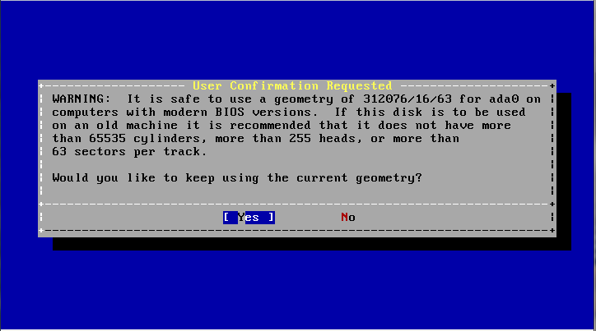
FAQ(3/3)
Yes
8

Slide 9
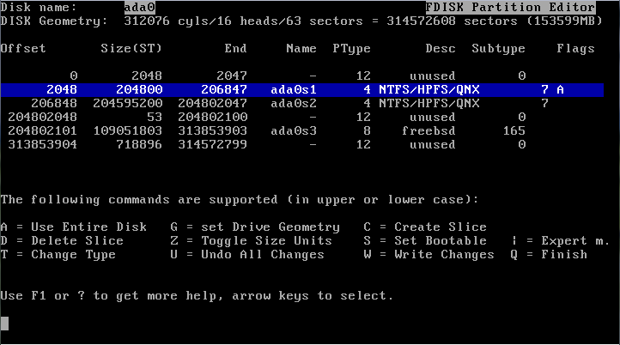
FAQ(3/3)
Select your XP / Win7 / Win8 partition and click S to set it bootable note: Win7's boot partition will be about 100MB And XP's will be the same size as C:
9

Slide 10
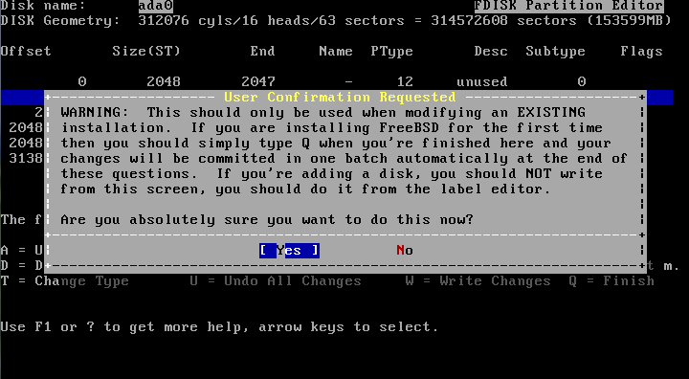
FAQ(3/3)
Press W to Write your ChangesQ to finish
10

Slide 11
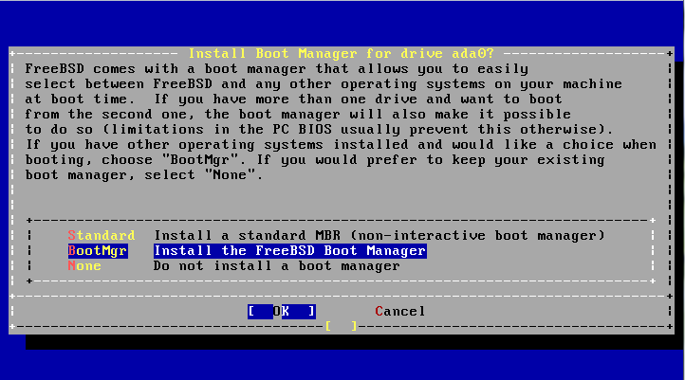
FAQ(3/3)
Install FreeBSD Boot Manager
11

Slide 12
Help!
Newsgroup cs.course.sysadm
BS2 board CS-SysAdmin
CSCC
ta@nasa.cs.nctu.edu.tw
12

