Slide 1
Port Forwarding
( VirtualBox / VMware Player )
shunyi
2014/09/18

Slide 2
Port Forwarding in VM brief intro
NAT Mode
With the NAT network type, your host operating system performs Network Address Translation.
The virtual machine (Guest OS) looks like sharing your Host computer’s IP address from the external network.
Guest OS won’t receive any incoming traffic unless you set port forwarding rules for it.
2

Slide 3
VirtualBox
Recommended
Have Free version for
Windows
GNU/Linux
FreeBSD
Mac
Simple Setting than VMware Player

Slide 4
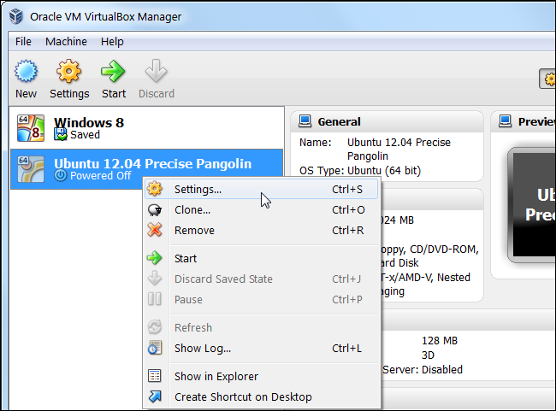
Port Forwarding (VirtualBox)
NAT Mode
Choose your VM => right click => Settings.
4

Slide 5
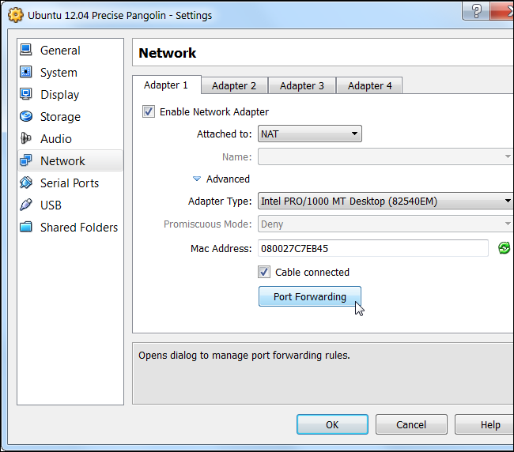
Port Forwarding (VirtualBox)
NAT Mode
Network => Check Network Adapter => NAT
Advanced => Check Cable Connected => Port Forwarding
5

Slide 6
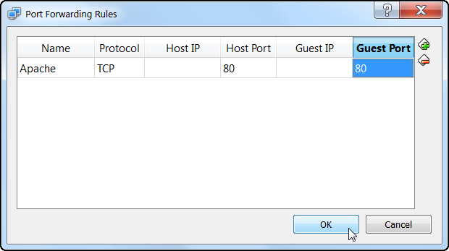
Port Forwarding (VirtualBox)
NAT Mode
Set forwarding port for your VM.
TCP 22 Port for SSH
`$ less /etc/services` for more TCP/UDP ports info
6

Slide 7
VMware Player
Have Free version for
Windows
GNU/Linux
VMware Fusion for Mac (need $$$)
No supported version for FreeBSD
Port Forwarding setting is a little complicated than

Slide 8
Port Forwarding (VMware Player)
NAT Mode
For Windows
VMware Player Networking Options
http://ideasboxs.wordpress.com/2014/01/07/vmware-player-networking-options/
For GNU/Linux
Find about “vmware-netcfg” command with your distro.
Port Forwarding on Arch Linux and VMPlayer with a NAT connection
http://dale.io/2013/02/26/port-forwarding-with-arch-and-vmplayer.html
8

Slide 9
Appendix
Network address translation - Wikipedia
http://en.wikipedia.org/wiki/Network_address_translation
VirtualBox Manual - Chapter 6. Virtual networking
http://www.virtualbox.org/manual/ch06.html
Bridged Mode
If you have another available public IP in the same subnet as your host OS.
List of TCP and UDP port numbers - Wikipedia
http://en.wikipedia.org/wiki/List_of_TCP_and_UDP_port_numbers
FreeBSD Handbook - Ch 22.2. FreeBSD as a Guest OS
https://www.freebsd.org/doc/handbook/virtualization-guest.html
9

Slide 10
References
VIRTUALBOX, NAT, AND PORT FORWARDING
http://maazanjum.com/2014/04/09/virtualbox-nat-and-port-forwarding/
How to Forward Ports to a Virtual Machine and Use It as a Server
http://www.howtogeek.com/122641/how-to-forward-ports-to-a-virtual-machine-and-use-it-as-a-server/
VirtualBox lab: Port Forwarding
https://nsrc.org/workshops/2014/sanog23-virtualization/raw-attachment/wiki/Agenda/ex-virtualbox-portforward-ssh.htm
VMware Player vs. VirtualBox: feature comparison
http://unix.stackexchange.com/questions/39075/vmware-player-on-linux-bridge-networking
10

