Slide 1
Computer System Administration
Computer Center, Department of Computer Science
(CSCC)
Lecturer: Liang-Chi Tseng (lctseng)

Slide 2
What System Administrator Should do? (1)
Ordinary list
Install new system, programs and OS updates
Monitoring system and trying to Tune performance
Adding and removing users
Adding and removing hardware
Backup and Restore
Configuration management (Ansible, Chef, Puppet, SaltStack, …)
Infrastructure management (Terraform, …)
Continuous Integration / Continuous Delivery (Git, Jenkins / Travis CI, …)
Log management (Fluentd, Papertrail, … )
Security
Virtualization (Docker, …)
…

Slide 3
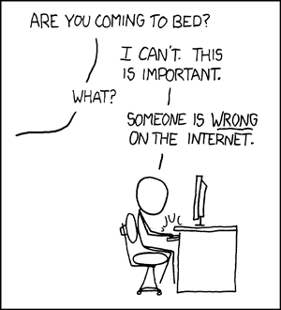
What System Administrator Should do? (2)
Non-technique list
Helping users
Maintaining documentation
Moving furniture
Burning your liver
Good communication and memorization

Slide 4
What System Administrator Should do? (3)
The best words to describe the job
Thankless job.
http://www.sysadminday.com/
System administration is like keeping the trains on time; no one notices except when they’re late.
氣象局：「我們對的時候，沒人記得；我們錯的時候，沒人忘記。」
Philosophy of system administration
Know how things really work.
Plan it before you do it.
Make it reversible.
Make changes incrementally.
Test before you unleash it.

Slide 5
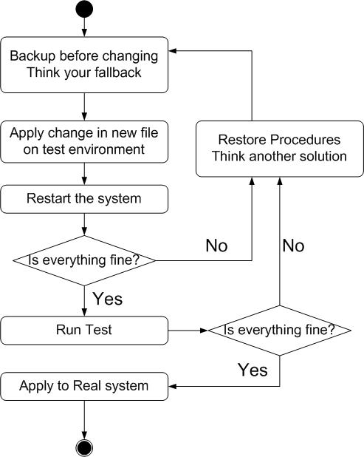
What System Administrator Should do? (4)
Flow of Change

Slide 6
What you can learn in this course?
The skill to be a candidate of system administrator
We are not going to teach you cool & new things
But the how to master these skills
Read official docs, not just copy & paste from stackoverflow
Information about CS computer center
What FreeBSD can do.
System Admin / Network Admin ?
SA: manage one computer
NA: manage a network consist of multiple computers
Notes:
新瓶裝舊酒(docker)，先懂基本系統再去碰docker這類技術。課程不是告訴大家很新很酷的東西，而是教大家如何掌握這些東西。
如果你能夠自己去摸懂docker了，那你大概也不用修這堂課了

Slide 7
Why FreeBSD
Our goal is to learn "How it works"
FreeBSD is simple and easy to learn
Linux?
Lots of distributions
Ubuntu, Mint, Debian, Red Hat, Arch, Kali, Fedora, CentOS, …
BSD is still popular in some ways
Apple MacOS, iOS are based on BSD
https://en.wikipedia.org/wiki/Darwin_(operating_system)

Slide 8
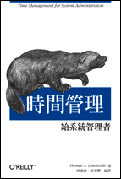
Attitude
Attend every class
Do every exercise
As early as possible
On your own
Read book and practice at least 6 hours every week
Use unix-like environment
Recommend: more than 1.5 hours/day averagely.
Collect information on the internet
The newer, the better.

Slide 9
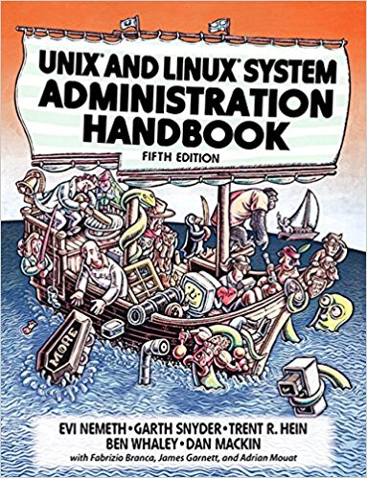
Syllabus
Website:
https://nasa.cs.nctu.edu.tw/sa/2019/
Instructors:
曾亮齊 lctseng@cs.nctu.edu.tw
王則涵 wangth@cs.nctu.edu.tw
林瑞男 jnlin@cs.nctu.edu.tw
許立文 lwhsu@cs.nctu.edu.tw
Time:
Thu. IJK (PM 6:30 ~ 9:20)
Place:
EC122
TAs:
We might get about 6 TAs.
Email to TAs: ta@nasa.cs.nctu.edu.tw
3GH every week
Textbook:
Unix and Linux System Administration Handbook (5th Edition)

Slide 10
Syllabus – Content
We will cover the following chapters in this semester (SysAdm):
Chapter 1 ~ 14
Chapter 16, 19, 20
Chapter 27, 31
The following chapters is covered in the next semester (NetAdm):
Chapter 15 ~ 18, 21, 23 ~ 25, 30 ~ 32
NAT, DHCP, VPN, Proxy, …
Python Programming for system administration

Slide 11
Syllabus – Text book outline
Part I. Basic Administration
Chap 1 – Where to start.
Chap 2 – Booting and Shutting Down
Chap 3 – The Filesystem
Chap 4 – Access control and rootly powers
Chap 5 – Controlling processes
Chap 6 – User Management
Chap 7 – Storage
Chap 8 – Periodic processes
Chap 9 – Backups
Chap 10 – Syslog and log files
Chap 11 – Software installation and management
Chap 12 – The Kernel
Chap 13 – Scripting and the Shell
Chap 14 – Configuration Management
Part II. Networking
Chap 15 – Physical Networking
Chap 16 – TCP/IP
Chap 17 – Routing
Chap 18 – DNS: Domain Name System
Chap 19 – NFS: Network File System
Chap 20 – HTTP: Hypertext Transfer Protocol
Chap 21 – SMTP: Simple Mail Transfer Protocol
Chap 22 – Directory Services
Chap 23 – Electronic Mail
Chap 24 – Web Applications
Chap 25 – Network Management and Debugging

Slide 12
Syllabus – Text book outline (Cont.)
Part III. Operations
Chap 26 – Continuous Integration and Delivery
Chap 27 – Security
Chap 28 – Cloud Computing
Chap 29 – Containers and Virtualization
Chap 30 – Monitoring
Chap 31 – Performance Analysis
Chap 32 – Policy and Politics

Slide 13
Syllabus – Grade Policy
Mid
15 ~ 20%
Final
15 ~ 20%
Exercise (Homeworks)
60 ~ 70%
No Delay Work
4 exercises
1 term project

Slide 14
What you should prepare?
Background knowledge
Basic knowledge of UNIX commands
Basic Programming skills
Basic of TCP/IP Networking
Environment
One dedicated PC
Dual OS in your PC
Virtual Machine (Virtualbox, VMWare)
Yourself
Your hard study

Slide 15
Finally, Am I OK to take this course?
Are you willing to devote yourself to exercise?
Yes! Please come
Are you newbie in this area?
Yes!? It’s ok, Please come
Do you take more than 3 major courses?
Yes!??? It is quite dangerous, but I can not stop you
Sometimes your may spend the whole weekend to just figure out what to do in the homework
Experience from past students: loading of this course equals to 2-3 major courses
You will learn a lot if you work hard

Slide 16
Basic knowledge in this course

Slide 17
Play with FreeBSD system
Our department has FreeBSD servers for all students
bsd{1,2,3,4}.cs.nctu.edu.tw
alumni.cs.nctu.edu.tw
About CS workstation
https://cscc.cs.nctu.edu.tw/workstation-guide
Login and play with it!
Get familiar with CLI (command line interface)
Without GUI (graphics user interface)
Don't be afraid ☺

Slide 18
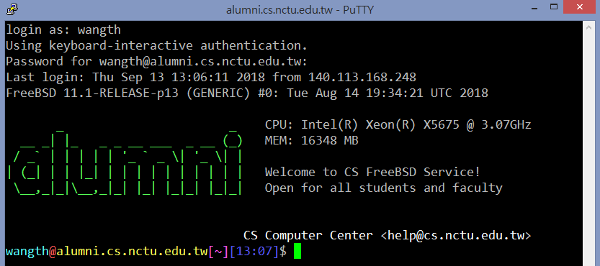
Login
SSH (Secure Shell)
PuTTY: (for Windows) https://www.chiark.greenend.org.uk/~sgtatham/putty/latest.html

Slide 19
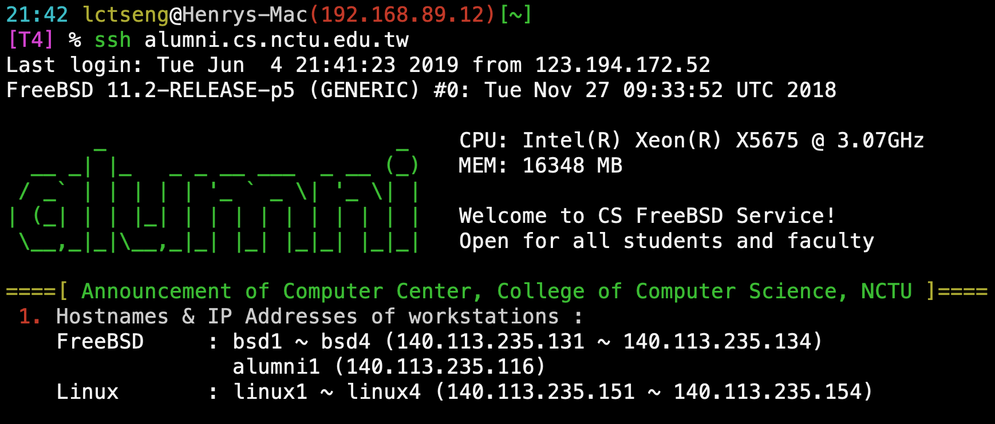
Login
SSH (Secure Shell)
Terminal (for MacOS)

Slide 20
Commands
Useful commands
passwd, chsh, chfn, chpass
ls
ps, top
mkdir/rmdir
cp/mv/rm
write
Email reader: mutt, …etc.
News reader: tin
Connecting: ssh/telnet
Manual: man, info, …etc.
Editor: vim, joe, ee, …etc.
File Transmission: ftp, ncftp, lftp, scp, wget, curl, …etc.
Compilers: gcc, g++, javac, …etc.
Scripting: perl, php, ruby, python …etc.
login/exit/logout/screen/tmux
Basic command tutorials
https://cscc.cs.nctu.edu.tw/unix-basic-commands

Slide 21
Conventions
Syntax of commands:
Anything between “[” and “]” – is optional.
Anything followed by “…” – can be repeated.
{a | b} – you should choose one of them.
Example:
bork [-x] { on | off } filename …
bork on /etc/hosts ○
bork -x off /etc/hosts /etc/passwd ○
bork -x /etc/hosts Ｘ
bork -h /etc/hosts Ｘ
Globing characters
“*” matches zero or more characters.
“?” match one character.
“~” (twiddle) means home directory
“~user” means home directory of user

Slide 22
man pages (manual)
man pages (manual)
Contain descriptions of
Individual command.
% man cp
File format.
% man rc.local
Library routines.
% man strcpy

Slide 23
man command
Command
% man [section] title (BSD)
% man printf (printf command)
% man 3 printf (C Standard printf func.)
% man -k exit (keyword search)
Man pages organization
%man man
AT&T | BSD | Contents
1 | 1 | User-Level commands and applications
2 | 2 | System calls and kernel error code
3 | 3 | Library calls
4 | 5 | Standard file format
5 | 7 | Miscellaneous files and documents
6 | 6 | Games and demonstrations
7 | 4 | Device Drivers and network protocols
1m | 8 | System administration commands
9 | 9 | Obscure kernel specs and interfaces

Slide 24
HOWTO - Shutdown
FreeBSD Shutdown
shutdown -p now
Or "poweroff"
shutdown -r now
Or "reboot"
Everyone can shutdown!?
No, only authorized users (root)
Of course, you have no permission to shutdown our workstations ☺

Slide 25
Q&A
Break time.

