Slide 1
Shells
lctseng

Slide 2
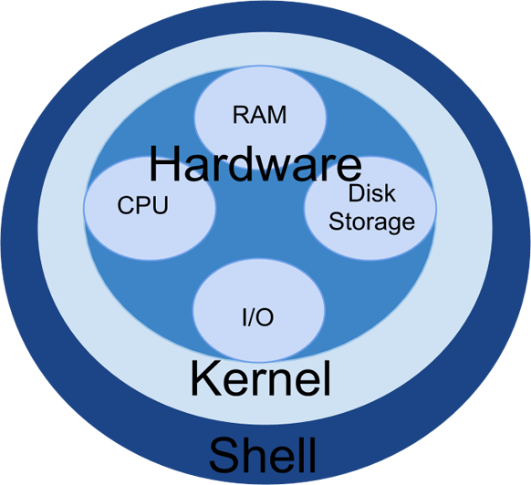
Introduction – UNIX Kernel and Shell
Interface to communicate with kernel
Where you type commands
Commands…
Picture from bashcodes.com

Slide 3
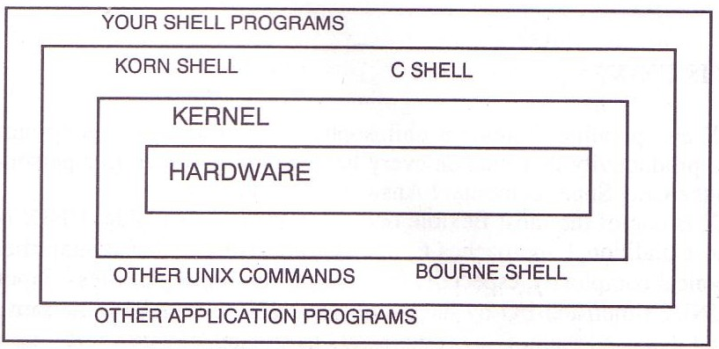
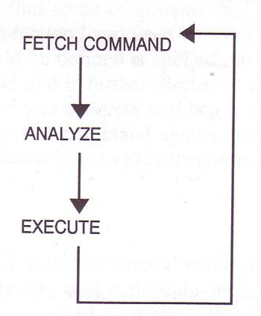
Introduction – UNIX Kernel and Shell
interpret

Slide 4
The UNIX Shells
How shell works
Fetch command → Analyze → Execute
Unix shells
Shell | Originator | System Name | Prompt
Bourne Shell | S. R. Bourne | /bin/sh | $
Csh | Bill Joy | /bin/csh | %
Tcsh | Ken Greer | /bin/tcsh | >
Korn Shell | David Korn | (shells/ksh93) | $
Z Shell | Paul Falstad | (shells/zsh) | %

Slide 5
Shell Startup Files
sh
/etc/profile login shell, system wide
~/.profile login shell
ENV
csh
/etc/csh.cshrc always, system wide
/etc/csh.login login shell, system wide
~/.cshrc always
~/.login login shell
~/.logout logout shell
/etc/csh.logout logout shell, system wide
tcsh
~/.tcshrc login shell
bash
/etc/profile → ~/.bash_profile or ~/.bash_login or ~/.profile
~/.bashrc
BASH_ENV

Slide 6
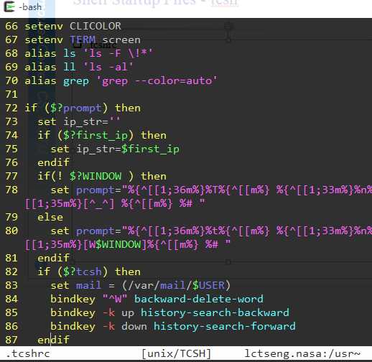
Shell Startup Files - tcsh
.tcshrc
https://github.com/lctseng/Unix-User-Config/blob/master/.tcshrc

Slide 7
Shell Startup Files - tcsh
A sample tcshrc for you to change your prompt
http://bit.ly/2kmT3gD
How to use
Copy the content as your .tcshrc
Simplest install steps
$ cd ~
$ fetch http://bit.ly/2kmT3gD -o .tcshrc

Slide 8
Shell Environment Variables
Controlling shell behaviors
There are many environment variables that control the shell behavior
To dump them: env command
To get value: $variable_name or ${variable_name}
echo "$PATH"
Useful Environment Variables
sh | csh | description
HOME |  | User’s home directory
MAIL |  | User’s mailbox
PATH |  | Search path
PS1 | prompt | Primary prompt string (waiting for input commands)
PS2 | prompt2 | Secondary prompt string (after lines end with \)
 | prompt3 | Third prompt string (automatic spelling correction)
 | history | Number of history commands

Slide 9
Variables and Strings Quotes
Char. | Purpose
var=value set var=value | Assign value to variable
$var ${var} | Get shell variable
`cmd` | Substitution stdout
'string' | Quote character without substitution
"string" | Quote character with substitution
% varname=`/bin/date`
% echo $varname
% echo 'Now is $varname'
% echo "Now is $varname"
% set varname2=`/bin/date`
% echo $varname2
% echo 'Now is $varname2'
% echo "Now is $varname2"
Sun Jun 9 06:22:19 CST 2019
Now is $varname
Now is Sun Jun 9 06:22:19 CST 2019

Slide 10
Global Variables
Assignment
Example:
$ export EDITOR=/usr/bin/ee
% setenv EDITOR /usr/bin/ee
$ current_month=`date +%m`
% set current_month=`date +%m`
Use “env” command to display global variables
 | Bourne Shell | C Shell
Local variable | my=test | set my=test
Global variable | export my=test | setenv my test

Slide 11
Shell Special Characters (1)
Reduce typing as much as possible
Characters | Description
* | Match any string of characters
? | Match any single alphanumeric character
[…] | Match any single character within []
[!...] | Match any single character not in []
~ | Home directory
Example
If following files:
test1 test2 test3 test4
test-5 testmess
are in current directory.
Command | Result
% ls test* | test1 test2 test3 test4 test-5 testmess
% ls test? | test1 test2 test3 test4
% ls test[123] | test1 test2 test3
% ls test[!345]* | test1 test2 test-5 testmess
% ls ~ | List files under your home

Slide 12
Shell Special Characters (2)
Char. | Purpose | Example
# | Start a shell comment | # this is a comment
; | Command separator | % ls test*; ls test?
&& | executes the first command, and then executes the second if first command success (exit code=0) | % cd foo/bar && make install
|| | executes the first command, and then executes the second if first command fail (exit code≠0) | % cp x y || touch y
\ | Escape character Command continuation indicator | % touch test\*; ls test\* % ls \ > test*
& | Background execution | % make buildworld & % sleep 5 &

Slide 13
Built-in Shell Commands (1)
sh | csh | description
set/unset | set/unset | Set/Unset shell’s parameters
 | set/unset | Set/Unset a local variable
export | setenv/unsetenv | Set/Unset a global variable
set | @, set | Display or set shell variables
 | login, logout | Logout
exit | exit | exit shell
cd | cd | change directory
 | dirs | print directory stack
 | popd, pushd | Pop/push directory stack
echo | echo | write arguments on stdout
alias/unalias | alias/unalias | command aliases
fg, bg | fg, bg | Bring a process to foreground/background (e.g. sleep 5 &)
Notes:
Dirs/ popd/ pushd：類似於windows的上一頁/下一頁

Slide 14
Built-in Shell Commands (2)
sh | csh | description
jobs | jobs | List active jobs (with job numbers)
%[job no.] | %[job no.] | Bring a process to foreground
 | kill | Send a signal to a job (kill %job or kill pid)
 | stop | Suspend a background process(%job | pid)
exec | exec | execute arguments
 | nice | Change nice value
 | nohup | Ignore hangups
 | notify | Notify user when jobs status changes
 | history | Display history list
 | rehash | Evaluate the internal hash table of the contents of directories
. | source | Read and execute a file

Slide 15
Built-in Shell Commands (3)
References:
https://cscc.cs.nctu.edu.tw/unix-basic-commands (Chinese)
http://www.unix.org.ua/orelly/unix/unixnut/ch04_06.htm
http://publib.boulder.ibm.com/infocenter/pseries/index.jsp?topic=/com.ibm.aix.doc/aixuser/usrosdev/list_c_builtin_cmds.htm
sh(1)
tcsh(1)

Slide 16
Input/Output Redirection
3 default file descriptors
0(stdin)、1(stdout)、2(stderr)
“Redirection” in sh(1), or “Input/Output” in tcsh(1)
Method | Description
cmd < file | Open the file as stdin of cmd
cmd > file | Write stdout of cmd in the following file (noclobber) (tcsh: set noclobber)
cmd >> file | Append stdout of cmd to the following file
2>&1 | Merge stdout with stderr
cmd1 | cmd2 | Pipe stdout of cmd1 into stdin of cmd2
Notes:
Noclobber：設置後會使得檔案存在實無法複寫

Slide 17
File and Directory Related Commands
Command | Purpose
ls | List a directory’s content
pwd | Print working directory
mkdir | Make(create) a new directory
rmdir | Remove existing empty directory
cat | Concatenate file
cp | Copy file
ln | Link files
mv | Move file
rm | Remove file
split | Split a file into n line chunks
stat | Display file status

Slide 18
Select and File Processing Related Commands (1)
Command | Purpose
head | Display first lines of a file
tail | Select trailing lines
grep | Select lines
diff | Compare and select difference in two files
wc | Count characters, words or lines of a file
uniq | Select uniq lines
cut | Select columns
tr | Transform character
sort | Sort and merge multiple files together
join | Join two files, matching row by row
sed | Edit streams of data
awk | Pattern scanning and processing language

Slide 19
Select and File Processing Related Commands (2)
Example usage:
Look first few lines or last few lines
% head /var/log/message
-n : specific how many lines
% tail /var/log/message
Find the occurrence of certain pattern in file
% grep -l lctseng *
Print the filename that has “lctseng” as content
Print the line number when using grep
% grep -n lctseng /etc/passwd
Ignore case-sensitive
% grep -i lctseng /etc/passwd
List any line contains any combination of “lctseng”
% ps auxww | grep ^lctseng | wc -l
Count number of processes owned by lctseng

Slide 20
Select and File Processing Related Commands (3)
Example usage:
List lctseng’s id, uid, home, shell in /etc/passwd
% grep lctseng /etc/passwd | cut -f1,3,6,7 -d:
-f1,3,6,7 : fetch 1st ,3rd ,6th ,7th column
-d : separation symbol
Cut out file permission and file name from ls output
% ls -l | grep -v ^total | cut -c1-11 -c47-
-c1-12：1st~12th characters (start from 1, instead of 0)
-c45-：characters after 47th character (include 47th )
lctseng:*:1001:20:Liang-Chi Tseng:/home/lctseng:/bin/tcsh
lctseng:1001:/home/lctseng:/bin/tcsh
total 12
drwxr-xr-x 4 lctseng staff 512 9 20 16:21 Unix-User-Config/
-rw-r--r-- 1 lctseng staff 274 9 19 16:09 sa.tmp
-rw-r--r-- 1 lctseng staff 0 9 19 16:38 yankring_history_v2.txt
drwxr-xr-x Unix-User-Config/
-rw-r--r-- sa.tmp
-rw-r--r-- yankring_history_v2.txt

Slide 21
Select and File Processing Related Commands (4)
Example usage:
Use awk to generate the same behavior of cut
% awk -F: '{print $1 " " $6}' /etc/passwd
-F ：separation symbol
% ls -l | grep -v ^total | awk '{print $1 " " $9}‘
Result same as “ls -l | grep -v ^total | cut -c1-11 -c47-”
lctseng:*:1001:20:Liang-Chi Tseng:/home/lctseng:/bin/tcsh
lctseng /home/lctseng

Slide 22
Select and File Processing Related Commands (5)
Example usage:
Sort
-r : reverse
-u : unique keys
-n : numeric keys sorting
Default: string sorting, 14 > 123
-k : specific columns to sort with

Slide 23
Select and File Processing Related Commands (6)
Example usage:
Sort
% ls -al | sort -k 5,5 -r
List directory contents and sort by file size decreasingly
% sort -t: -k 1,1 /etc/passwd | grep -v ^#
List records in /etc/passwd increasingly by id
-rw------- 1 lctseng staff 3954 9 20 18:39 .viminfo
-rw-r--r-- 1 lctseng staff 1066 9 20 00:05 .cshrc
-rw-r--r-- 1 lctseng staff 978 9 20 00:05 .shrc
-rw-r--r-- 1 lctseng staff 817 9 20 00:05 .profile
games:*:7:13:Games pseudo-user:/usr/games:/usr/sbin/nologin
git_daemon:*:964:964:git daemon:/nonexistent:/usr/sbin/nologin
hast:*:845:845:HAST unprivileged user:/var/empty:/usr/sbin/nologin
kmem:*:5:65533:KMem Sandbox:/:/usr/sbin/nologin
lctseng:*:1001:20:Liang-Chi Tseng:/home/lctseng:/bin/tcsh

Slide 24
Select and File Processing Related Commands (7)
Example usage:
Sort
% sort -t. -n -k 1,1 -k 2,2 -k 3,3 -k 4,4 '/etc/hosts' | grep -v ^#
List records in /etc/hosts sorted by IPv4 address
# In the presence of the domain name service or NIS, this file may
# not be consulted at all; see /etc/nsswitch.conf for the
# resolution order.
#
#
::1 localhost localhost.my.domain
127.0.0.1 localhost localhost.my.domain
140.113.17.26 nctucs.tw
64.233.187.95 www.googleapis.com googleapis.l.google.com
::1 localhost localhost.my.domain
64.233.187.95 www.googleapis.com googleapis.l.google.com
127.0.0.1 localhost localhost.my.domain
140.113.17.26 nctucs.tw

Slide 25
Select and File Processing Related Commands (8)
tr – Translate characters
% tr "A-Z" "a-z" < file1 > file2
Change all alphabet to uppercase
% grep lctseng /etc/passwd | tr ":" "\n“
% tr -d "\t" < file1
Delete tab in file1
% tr -s " " " " < file1
Delete multiple space in file1
lctseng
*
1001
20
Liang-Chi Tseng
/home/lctseng
/bin/tcsh

Slide 26
xargs Command (1)
xargs – construct argument list(s) and execute utility
-n number
-I replstr (every)
-J replstr (first )
-s size
…
% ls
2.sh 3.csh 4.csh 4.sh bsd1.ping testin
% ls | xargs echo
2.sh 3.csh 4.csh 4.sh bsd1.ping testin
% ls | xargs -n1 echo
2.sh
3.csh
4.csh
4.sh
bsd1.ping
testin
% ls | xargs -I % -n1 echo % here %
2.sh here 2.sh
3.csh here 3.csh
4.csh here 4.csh
4.sh here 4.sh
bsd1.ping here bsd1.ping
testin here testin
% ls | xargs -J % -n1 echo % here %
2.sh here %
3.csh here %
4.csh here %
4.sh here %
bsd1.ping here %
testin here %
Notes:
-n1：拆出一個單元作為args

Slide 27
xargs Command (2)
Example : ping all hosts in file
File “host”
$ cat host | xargs -n1 ping -c 1 | grep "bytes from"
www.google.com
bsd5.cs.nctu.edu.tw
linux3.cs.nctu.edu.tw
cs.nctu.edu.tw
64 bytes from 64.233.188.103: icmp_seq=0 ttl=47 time=6.944 ms
64 bytes from 140.113.235.135: icmp_seq=0 ttl=57 time=1.451 ms
64 bytes from 140.113.235.153: icmp_seq=0 ttl=57 time=1.612 ms
64 bytes from 140.113.235.47: icmp_seq=0 ttl=57 time=1.856 ms
Notes:
xargs：
-n1：指定判斷出多少個文字單元後切割並執行(1：一個單元)

Slide 28
The Unix Way
Lots of little tools, each good at one thing
Use them together to achieve your goal
Try other shells (install from package/ports)
zsh
Oh-my-zsh: https://github.com/robbyrussell/oh-my-zsh
fish

Slide 29
Appendix
Command History in (t)csh

Slide 30
Command History in (t)csh
!n - exec previous command line n
!-n - exec current command line minus n
!! - exec last command (the same as !-1)
!str - exec previous command line beginning with str
!?str? - exec previous command line containing str
% history
9 8:30 nroff –man ypwhich.1
10 8:31 cp ypwhich.1 ypwhich.1.old
11 8:31 vi ypwhich.1
12 8:32 diff ypwhich.1.old ypwhich.1
13 8:32 history
% !?old?

Slide 31
Command History in (t)csh
!!:n - use the nth word of previous command
!!:m-n - select words m ~ n of previous command
!!:* - use all arguments of previous command
!!:s/str1/str2/ - substitute str1 with str2 in previous command
“History Substitution” in tcsh(1)
% history
15 8:35 cd /etc
16 8:35 ls HOSTS FSTAB
17 8:35 history
% cat !-2:*:s/HOSTS/hosts/:s/FSTAB/fstab

