Slide 1
tmux
lctseng

Slide 2
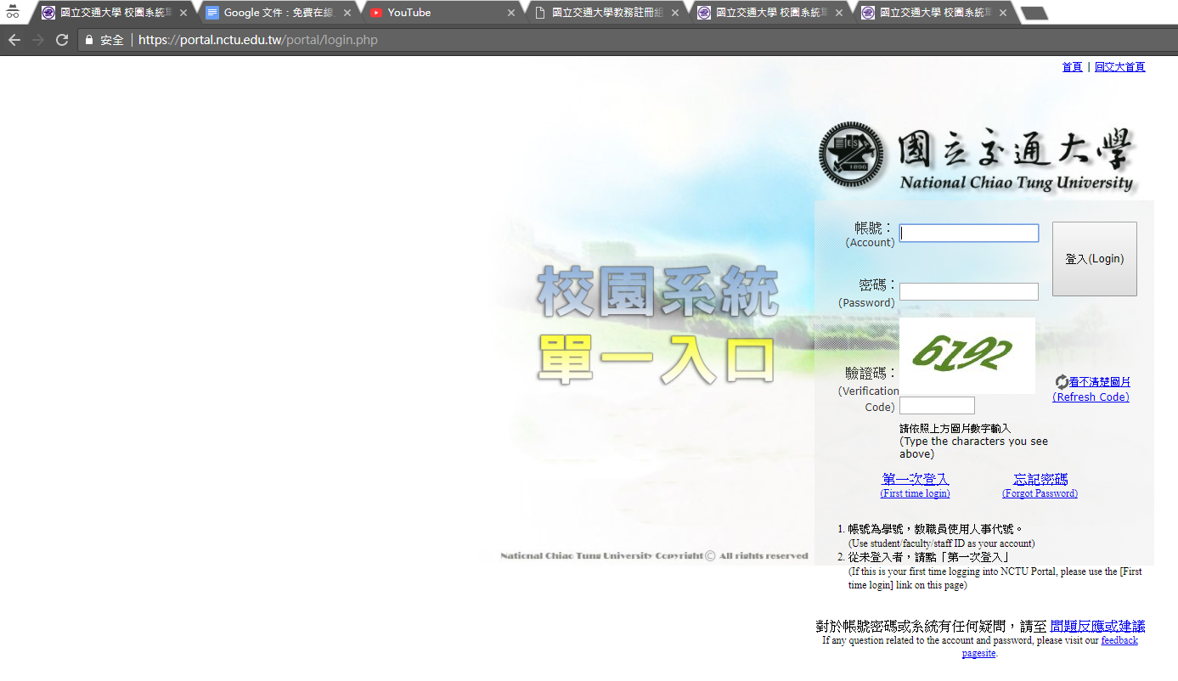
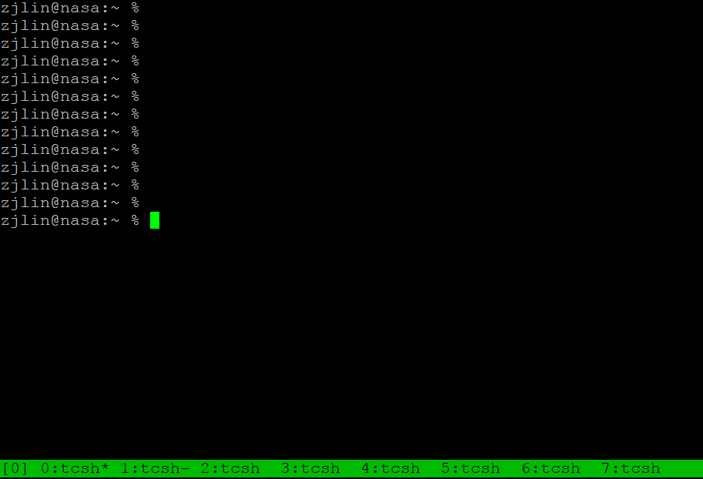
What is tmux?
terminal multiplexer
Allow open multiple tabs (multiple terminals)

Slide 3
What is tmux?

Slide 4
What is tmux?

Slide 5
What is tmux?

Slide 6
Why should I use tmux?

Slide 7
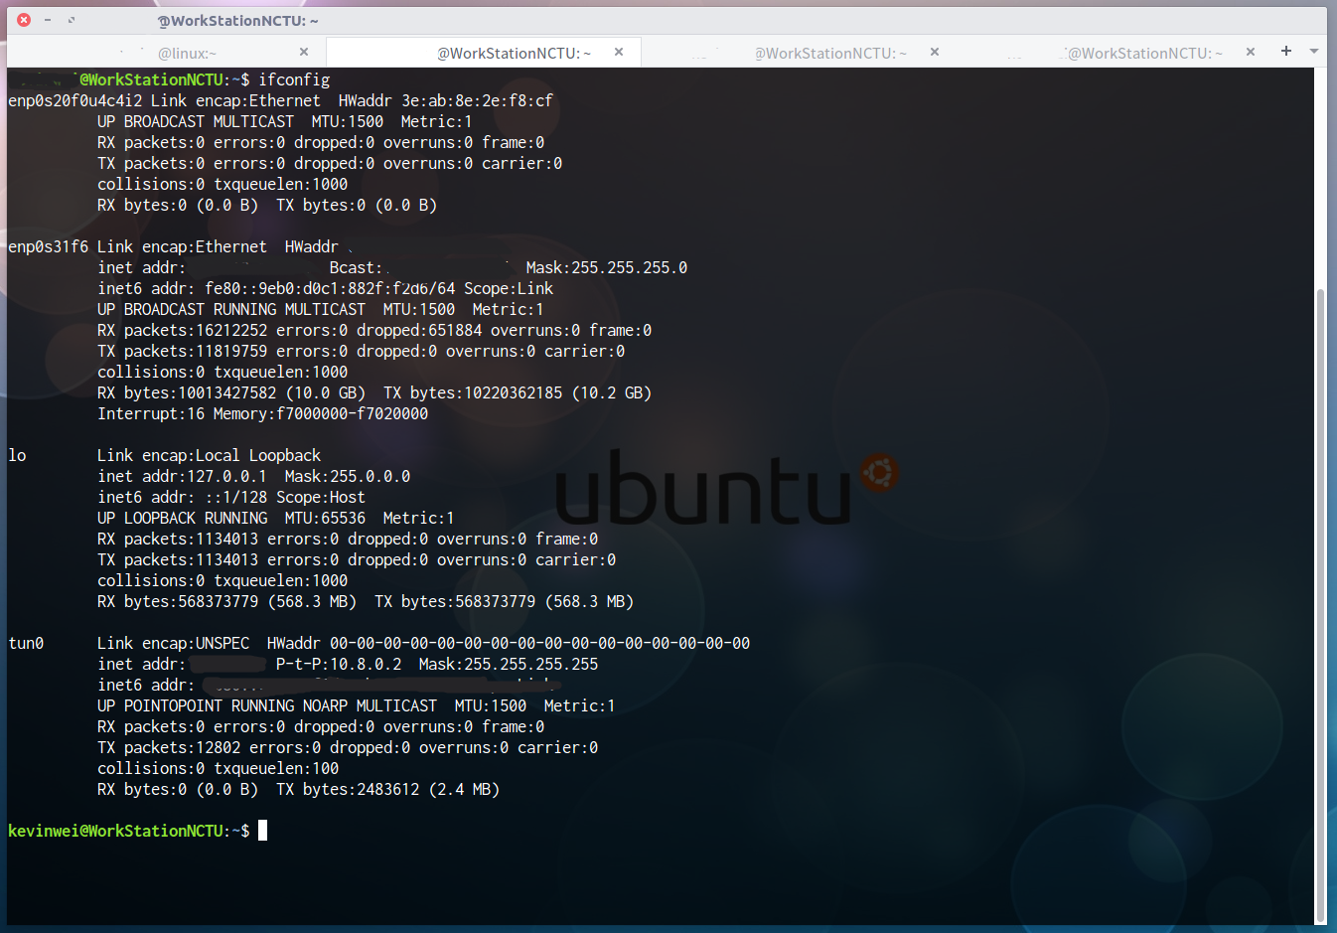
Why should I use tmux?

Slide 8
Why should I use tmux?
Keep your working session alive
By default, shell is terminated when connection is lost
Including any programs/editors opened
Any unsaved changes are discarded without warning
tmux will not be terminated when connection is lost
Attach to previous sessions!

Slide 9
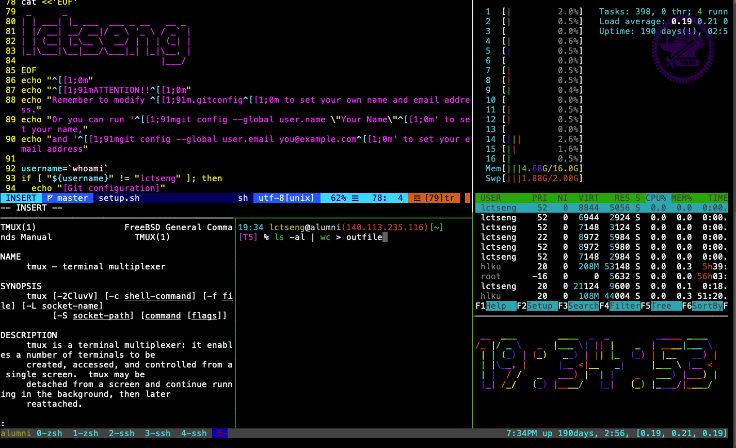
Example screenshot of tmux
https://github.com/lctseng/Unix-User-Config/blob/master/.tmux.conf

Slide 10
Advantages of tmux
Multiple sessions, windows, panes
Keep the sessions, attach/detach anytime
Powerful window division (panes)
Share screen by attaching to the same session

Slide 11
Start tmux
tmux
tmux attach [ -t <number> ]
tmux detach
tmux ls
tmux kill-session [ <number> ]

Slide 12
tmux - session, window, pane
session – browser
You can open multiple sessions by opening lots of terminals
window – tab
One session can have multiple windows
pane - split window
A window can be split into multiple panes

Slide 13
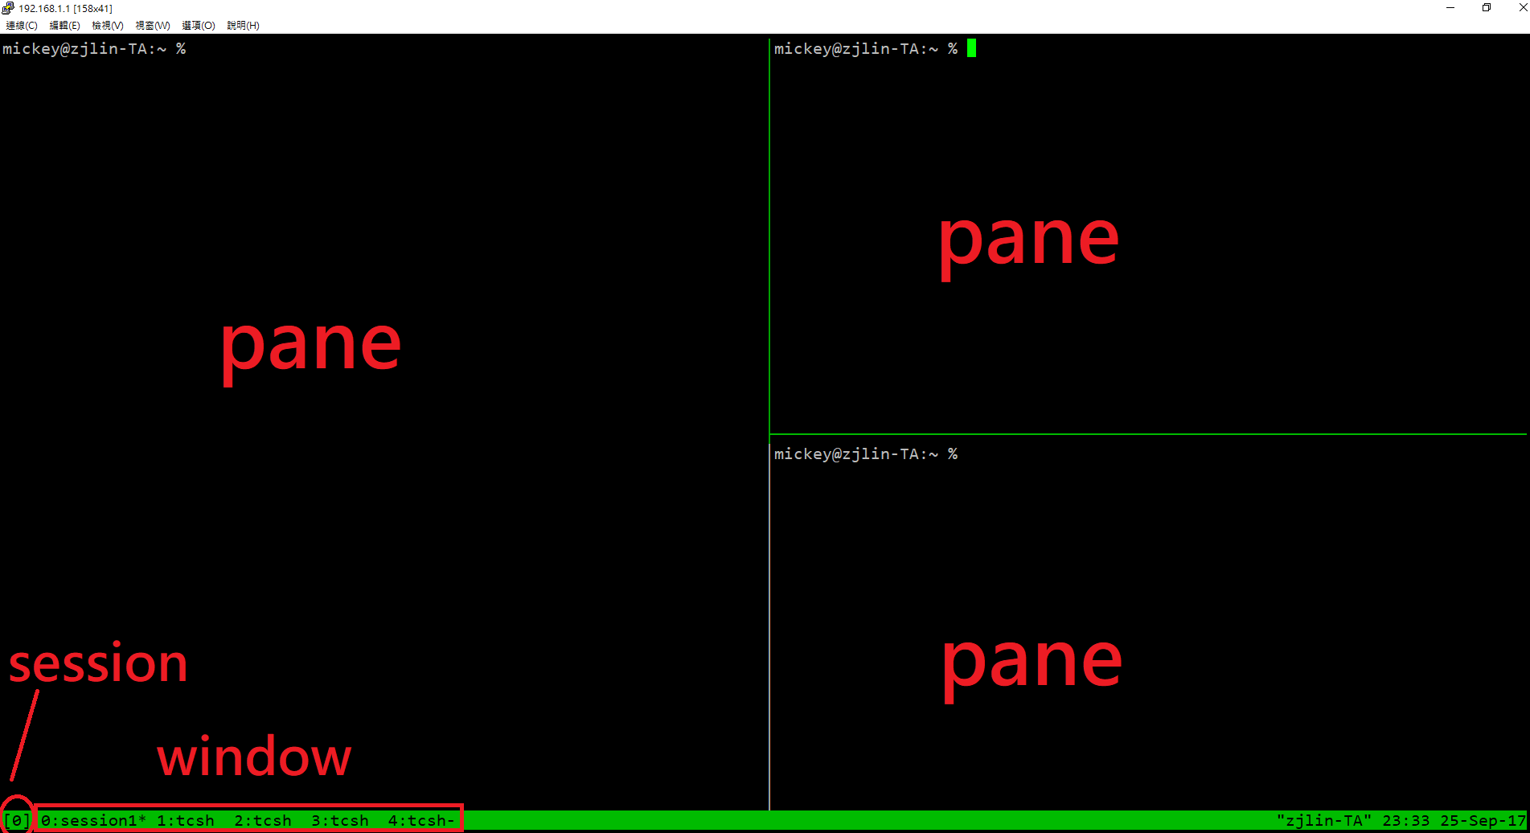
tmux - session, window, pane

Slide 14
tmux 101
Basic operations and configurations

Slide 15
Session
Create new session (open a new browser)
Execute outside of any tmux sessions
$ tmux
Detach current session
When attached in a session
$ tmux detach
Or close the terminal directly
Attach to previous session
$ tmux attach
Attach only if previous sessions exist

Slide 16
Multiple sessions (1)
Open multiple browsers

Slide 17
Multiple sessions (2)
Open multiple browsers
List opened sessions
$ tmux list-sessions
Attach to previous session by id
$ tmux attach -t session-id
0: 1 windows (created Sun Jun 16 18:49:57 2019) [128x38]
1: 3 windows (created Sun Jun 16 18:50:03 2019) [128x38]

Slide 18
tmux - bindkey
Operations start with a special key combination
Default is C-b
Where C is Ctrl (control)

Slide 19
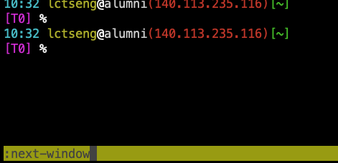
tmux - command
Bindkey + :
Open command prompt and execute tmux commands

Slide 20
Bindkey - window
bindkey (default is C-b) //C == control | c | new-window
 | n | next-window
 | p | previous-window
 | l | last-window
 | <num> | select-window -t := <num>
 | & | confirm-before -p "kill-window #W? (y/n)" kill-window
 | , | command-prompt -I "#W" "rename-window '%%'"
 | . | command-prompt "move-window -t '%%'"

Slide 21
Bindkey - pane
bindkey (default is C-b) //C == control | % | split-window -h
 | “ | split-window
 | arrow-key | select-pane
 | alt+arrow-key | resize-pane
 | x | confirm-before -p "kill-pane #P? (y/n)" kill-pane
 | { | swap-pane -U
 | } | swap-pane -D

Slide 22
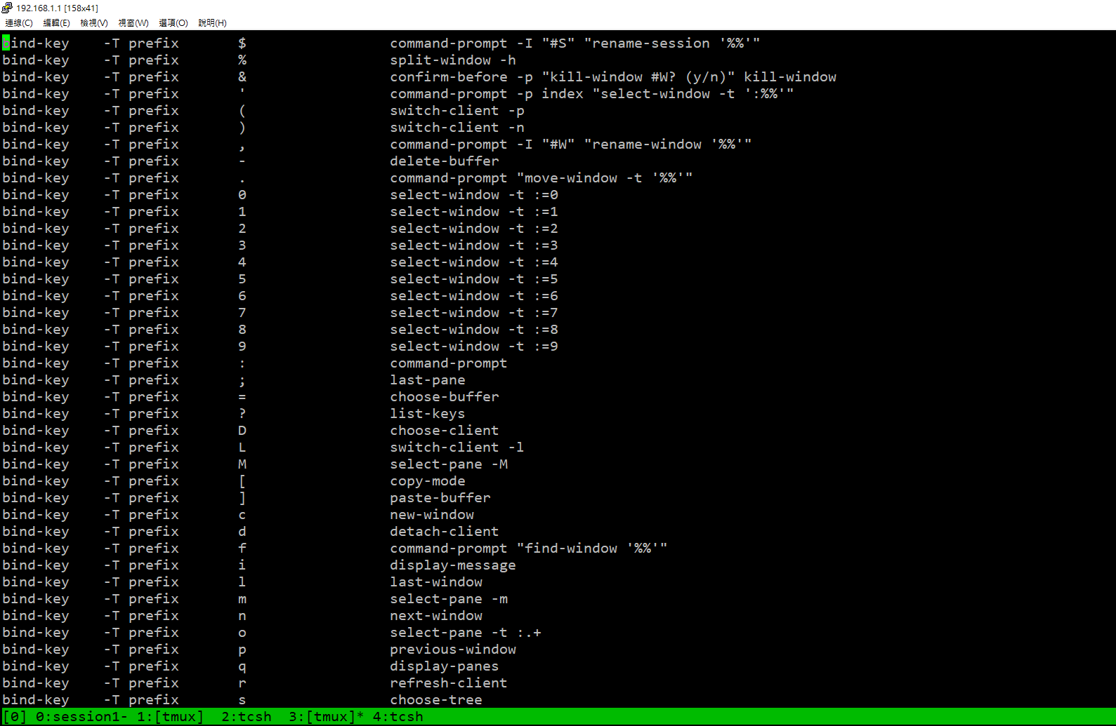
tmux - bindkey
bindkey + ?

Slide 23
Configuration - tmux.conf
~/.tmux.conf
design yourself style
colorful

Slide 24
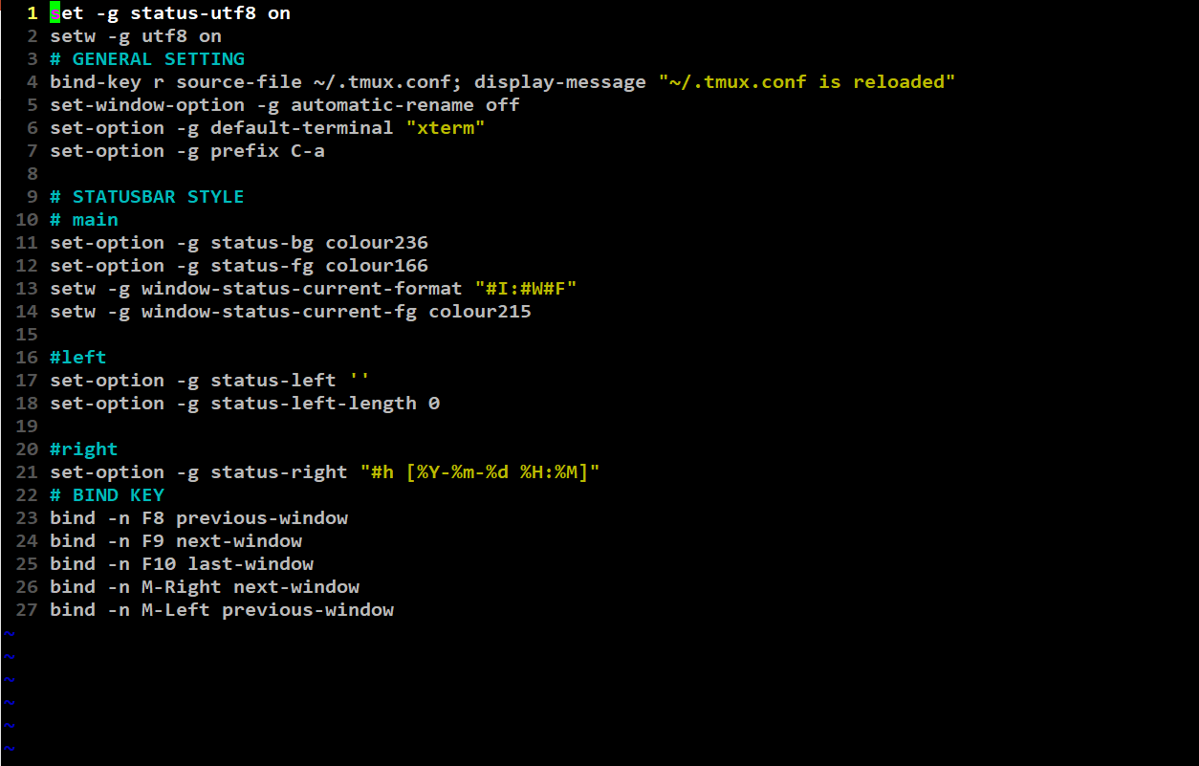
Configuration - tmux.conf
~/.tmux.conf

Slide 25
Configuration - bindkey
~/.tmux.conf
bind-key ( alias: bind )
C ( alias: <Ctrl> )
M ( alias: <Alt> )
bind-key <key> <command>
-T key-table ( default table is prefix )
-n : alias for -T root ➔ don’t need to press C-b first
-r : repeat

Slide 26
Configuration - set
~/.tmux.conf
set-window-option ( alias: setw )

Slide 27
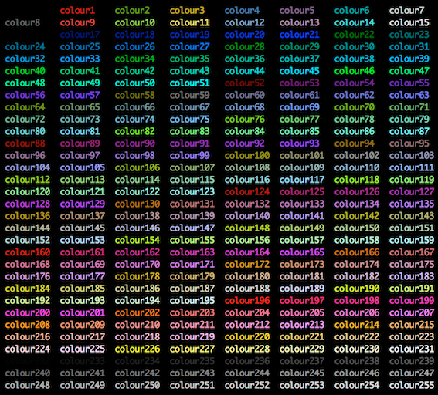
Configuration - set

Slide 28
tmux - share session
Both side can edit and execute commands

Slide 29
Reference
tmux (1)
tmux shortcuts & cheatsheet
https://gist.github.com/MohamedAlaa/2961058
tmux brief introduction (chinese)
https://5xruby.tw/posts/tmux/

Slide 30
Appendix: tmux v.s. screen
 | tmux | screen
window split | top-down & left-right | top-down only (default)
 | different sessions can have different schemes | scheme must shared by all sessions
session | switch between sessions without detach | detach first then re-attach another session
 | multiple clients can attach to same session | one session for one client only (force detach)
profile | .tmux.conf | .screenrc
 | highly customizable | less than tmux

