Slide 1
Booting Up and Shutting Down
lctseng

Slide 2
Booting Up
Starting up a computer
Load kernel into memory and execute it.
BIOS load and run the MBR (Master Boot Record)
MBR searches for the bootable slice (partition) on the disk and then run the code on the slice to load OS.
kernel is loaded into memory, and then probing, initialization, init process.
MBR
http://en.wikipedia.org/wiki/Master_boot_record
FreeBSD Handbook
http://www.freebsd.org/doc/en/books/handbook/boot.html

Slide 3
MBR – Master Boot Record
First 512 bytes of disk, outside the FreeBSD area, last 2 Bytes are 0x55AA
Corresponding copy in FreeBSD is /boot/boot0 or /boot/mbr
nctucs [~] -lctseng- ls -l /boot/boot0
-r--r--r-- 1 root Wheel 512 Nov 12 2014 /boot/boot0
nctucs [~] -lctseng- ls -l /boot/mbr
-r--r--r-- 1 root Wheel 512 Nov 12 2014 /boot/mbr
nctucs [~] -lctseng- xxd /boot/mbr
00000000: fc31 c08e c08e d88e d0bc 007c be1a 7cbf .1.........|..|.
00000010: 1a06 b9e6 01f3 a4e9 008a 31f6 bbbe 07b1 ..........1.....
…
…
…
000001d0: 0000 0000 0000 0000 0000 0000 0000 0000 ................
000001e0: 0000 0000 0000 0000 0000 0000 0000 0000 ................
000001f0: 0000 0000 0000 0000 0000 0000 0000 55aa ..............U.

Slide 4
MBR – Master Boot Record
Responsible to find the boot code on the boot sector of bootable slice.
Fig. boot0 Screenshot
MBR
Slice 1 (/dev/ad0s1)
Slice 2 (/dev/ad0s2)
Slice 3 (/dev/ad0s3)
Slice 4 (/dev/ad0s4)
F1 Win
F2 FreeBSD
Default: F2
Slice 5 /dev/ad0s5 | Slice 6 /dev/ad0s6

Slide 5
Boot Stage One and Stage Two
boot1 and boot2 (/boot/boot1 + /boot/boot2 = /boot/boot)
Members of booting chain
Used to run the loader.
As MBR, boot1 and boot2 are outside the FreeBSD, and the copy of these two are
/boot/boot1
/boot/boot2
MBR(512 bytes)
Slice 1 (/dev/ad0s1)
Slice 2 (/dev/ad0s2)
Slice 3 (/dev/ad0s3)
/boot/boot2
/boot/loader
Fig. boot2 Screenshot
>> FreeBSD/i386 BOOT
Default: 0:ad(0,a)/boot/loader
boot:

Slide 6
Boot Stage Three
Boot Stage Three: The loader
Provide a user-friendly interface to configure booting choice.
/boot/loader
/boot/loader.rc use processing commands in /boot/loader.4th to manipulate loader.conf
Wait for 10 seconds then autoboot
/boot/default/loader.conf
Default loader behavior
/boot/loader.conf
autoboot_delay="10"
password="ooxx"
User-defined loader behavior

Slide 7
Files in /boot/
/boot/mbr (Standard)
Simplified version of boot0, blindly boot the partition marked active
/boot/boot0 (BootMgr)
bootmanager
/boot/boot{1,2}
boot1 is very simple, since it can only be 512 bytes in size, and knows just enough about the FreeBSD bsdlabel, which stores information about the slice, to find and execute boot2.
boot2 is slightly more sophisticated, and understands the FreeBSD file system enough to find files on it, and can provide a simple interface to choose the kernel or loader to run /boot/loader
/boot/loader
load the kernel from disk
/boot/kernel/kernel

Slide 8
MBR recover
If MBR is overwritten by MS (or others), and you want to replace it with FreeBSD MBR:
Boot with CD or Floppy
% fdisk -B -b /boot/boot0 ad0
or
% boot0cfg -B /dev/ad0
If you want to replace it with MS MBR
Boot with DOS floppy
C:\fdisk /mbr
-B means reinitialize the boot code contained
in sector 0 of the disk
-b is used to specify the boot code

Slide 9
Boot in single user mode
OS | command
FreeBSD | Interrupt the boot loader and type “boot -s” Or type “2” in the menu
Linux | LILO: linux single
Solaris | Press “STOP” and “a” to enter the boot PROM and Press “boot -s”

Slide 10
Insecure single user mode
Single user mode requires no password by default
When the physical security to the console is considerable,
Set console to be insecure in /etc/ttys
# name getty type status comments
#
# If console is marked "insecure", then init will ask for the root password
# when going to single-user mode.
# console none unknown off secure
console none unknown off insecure

Slide 11
Multibooting (1)
FreeBSD
FreeBSD’s boot loader will try to detect bootable partitions
You can also declare the bootable partitions explicitly with boot0cfg
% boot0cfg -B -m 0x7 ad0
-m means mask
Specify slices to be enabled/disabled,
ex. 0x7 means 0111,boot menu will detect slice1~3 to show the options

Slide 12
Multibooting (2)
default 0
timeout 30
fallback 1
# For booting GNU/Linux
title GNU/Linux
kernel (hd1,0)/vmlinuz root=/dev/hdb1
# For booting FreeBSD
title FreeBSD
root (hd0,2,a)
kernel /boot/loader
# For booting Windows NT or Windows95
title Windows NT / Windows 95 boot menu
root (hd0,0)
makeactive
chainloader +1
Linux
Using lilo or GRUB

Slide 13
Steps in the boot process
Loading and initialization of the kernel
Device detection and configuration
Creation of spontaneous system processes
Operator intervention
Execution of system startup scripts
Multiuser operation

Slide 14
Steps in the boot process – Kernel initialization
Get kernel image into memory to be executed
Perform memory test
Allocate kernel’s internal data structures
OS | Kernel image path
FreeBSD | /boot/kernel/kernel
Linux | /boot/vmlinuz
Solaris | /kernel/genunix
SunOS | /vmunix

Slide 15
Steps in the boot process – Hardware configuration
Devices specified in kernel configuration file
Kernel will try to locate and initialize it
Devices not specified in kernel configuration file
Kernel tries to determine the other information by probing the bus
If the driver is missing or not responsible to the probe, device is disabled
We can load kernel module to support this device.
kldload, kldstat, kldunload
/boot/kernel/*.ko
/boot/loader.conf
if_em_load="YES"
vboxdrv_load="YES"
vboxnet_enable="YES"

Slide 16
Steps in the boot process – System Processes
Spontaneous process
Not created by the normal UNIX fork mechanism
OS | Pid 0 | Pid 1 | Pid 2 and more
FreeBSD | kernel | init | g_event
Linux | - | init | kthreadd, kflushed,kupdate Kpiod,kswapd
SunOS | sched | init | pageout

Slide 17
Steps in the boot process – Operator intervention
Manual boot only (boot into single)
Only the root partition is mounted and mounted as read only
mount -u /
Indicates that the status of an already mounted file system should be changed
mount -a -t ufs (or other external types)
Mount all file systems with specific type
swapon -a
Enable all swap

Slide 18
Steps in the boot process – Execution of startup scripts
The startup scripts are selected and run by init
Typical works are:
Setting the name of the computer
Setting the time zone
Checking the disk with fsck
Mounting the system’s disks
Removing files from /tmp directory
Configuring network interface
Starting up daemons and network services

Slide 19
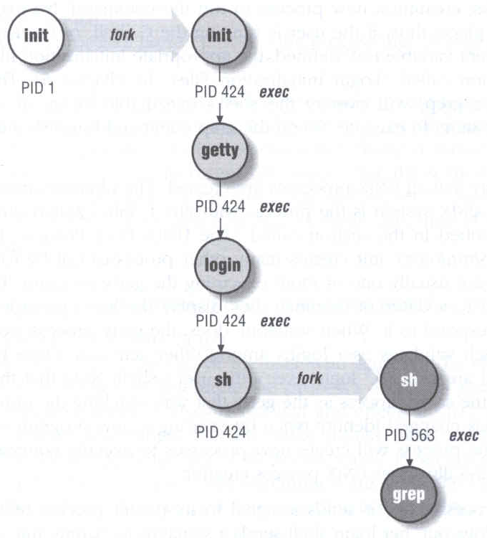
Steps in the boot process – multiuser operator
From now on, the system is fully operational, but no one can login
init will spawn getty processes to listen for login

Slide 20
FreeBSD startup scripts
The BSD-style booting
init will run /etc/rc
/etc/rc will reads the following configuration
/etc/defaults/rc.conf
/etc/rc.conf
/etc/rc.d
Manual: rc(8)

Slide 21
Ways to shut down or reboot
Turning off the power ⬅ Please Don’t！
Using the shutdown command
Using the halt and reboot command
halt = shutdown -h
reboot = shutdown -r

Slide 22
Ways to shut down or reboot – shutdown command
OS | Pathname | Time | R | H | S | F
FreeBSD | /sbin/shutdown | time | -r | -h
Linux | /sbin/shutdown | time | -r | -h
Solaris | /usr/sbin/shutdown | -gsecs | -i6 | -i0 | -is
SunOS | /usr/sbin/shutdown | +mins | -r | -h |  | -f
R=Reboot, H=Halt, S=Enter Single user mode, F=Skip fsck
time format can be
+m
hh:mm ➔linux
yymmddhhmm ➔ FreeBSD

Slide 23
Halt ? Poweroff ?
Halt
Terminate all processes, write data back to disks
When everything is ready, tell user to turn off the power
Or reboot by press any key
In older systems, you need to manually do so

Slide 24
Poweroff
Halt + Turn off the power
ACPI / APM
Advanced Configuration and Power Management
Advanced Power Management
In FreeBSD,
(1) Try “shutdown -p now”
(2) Compile this into kernel
device apm0 at nexus?flag 0x20
(3) Rebuild the kernel
(4) Edit /etc/rc.conf
apm_enable="YES"
apmd_enable="YES"
(5) Reboot
(6) Try “shtudown -p now” (or poweroff)
In case it does not work…

Slide 25
Other Booting Manager
Besides BSD-style booting, another line is System-V
Used by many Linux distributions
Solaris, Debian

Slide 26
System-V Startup Scripts
Run-level
/etc/inittab
init follow the inittab from level 0 to level k
Example: inittab in sun1
Run Level | Startup scripts | Meaning
0 | /etc/rc.d/rc0.d/ | Halt
1 | /etc/rc.d/rc1.d/ | Single user mode
2 | /etc/rc.d/rc2.d/ | Multiuser without NFS
3 | /etc/rc.d/rc3.d/ | Full multiuser mode
4 | /etc/rc.d/rc4.d/ | User defined
5 | /etc/rc.d/rc5.d/ | Multiuser with graphical interface
6 | /etc/rc.d/rc6.d/ | Reboot

Slide 27
Ways to shut down or reboot – telinit
Only for SystemV systems (and Systemd)
telinit: change run-level
Halt/poweroff
% telinit 0
Reboot
% telinit 6
Single user mode
% telinit 1

Slide 28
Systemd
Modern system/service manager for many Linux distributions
Ubuntu, Debian, …
Evolved from System-V
Another booting manager beside BSD
Used by older versions of Linux distributions
Debian < 8.0 : System-V
Debian >= 8.0 : Systemd
Similar to System-V, but faster and easier to use

Slide 29
Systemd
Use ‘targets’ to replace run-levels
SysV Run Level | Systemd targets | Meaning
0 | runlevel0.target, poweroff.target | Poweroff
1 | runlevel1.target, rescue.target | Single user mode
2 | runlevel2.target, multi-user.target | User defined. Default: same as level 3
3 | runlevel3.target, multi-user.target | Multiuser mode
4 | runlevel4.target, multi-user.target | User defined. Default: same as level 3
5 | runlevel5.target, graphical.target | Multiuser with graphical interface
6 | runlevel6.target, reboot.target | Reboot

