Slide 1
Services & Settings
lctseng

Slide 2
Basic Knowledge about Services
For FreeBSD

Slide 3
Common Flow of Running a Service
Installation
Through ports, packages, or source tarballs
pkg install kde4
Configuration
Service specific configuration file(s)
Update /etc/rc.conf
kdm4_enable="YES”
service kdm4 enable
Start
rc.d/*
/usr/local/etc/rc.d/kdm4 start
service kdm4 start
Maintenance
Updating、Restarting

Slide 4
Configuration Files (1/3)
Local installed programs’ configuration files are located under /usr/local/etc
Daemon → program-name.conf
pure-ftpd.conf
user-program → program-namerc
vimrc
screenrc
Default config file usually installed with .sample or .default suffix
pure-ftpd.conf.sample
or different suffix for different purpose
php.ini-dist
php.ini-recommended
copy and rename before use it

Slide 5
Configuration Files (2/3)
A program with multiple config files are usually located in /usr/local/etc/program-name/
apache*
postfix
Most configuration files have clear comment at the beginning or before each description
Most popular styles
key <space>value
key = value
Read documents to know each option’s meaning
# pure-ftpd.conf
# IP address/port to listen to (default=all IP and port 21)
Bind 127.0.0.1,21
# Fork in background
Daemonize yes
Notes:
5

Slide 6
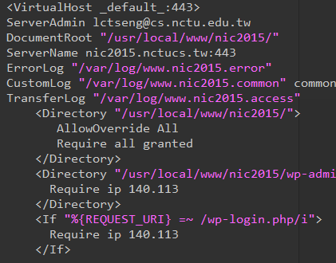
Configuration Files (3/3)
Some with local effectiveness (e.g. http server)
Markup language-like
<directory /path> setting-for-this-path… </directory>
Samba、rsync、devfs…
[xxxx]
settings…
[yyyy]
settings….

Slide 7
RC Script
Scripts for starting / stopping a service

Slide 8
What does RC means?
Run Commands (RunCom)
Command scripts for auto-reboot and daemon startup
rc(8)
https://www.freebsd.org/doc/handbook/configtuning-rcd.html

Slide 9
Why do we need RC Script?
Start services on system startup
Starting and Stopping services in a standard way
Without rc
/usr/local/sbin/pure-ftpd -g /var/run/pure-ftpd.pid -A -c50 -B -C8 -D -fftp -H -I15 -lpam -lunix -L10000:8 -m4 -s -U133:022 -u100 -k99 -Z
v.s.
With rc
service pure-ftpd start
Write configuration in the rc script for easy launch

Slide 10
RC Script
Dependency between each service is described in header of the script
rcorder is used to find out dependency ordering of each script
Each rc script defines what to do when start / stop …
/etc/rc.subr defines what to do & check before / after start stop ….
rc.subr(8)

Slide 11
Components to launch daemon processes
To launch a daemon process in background, we need:
Launch command
Path to the executable binary/script
/usr/sbin/inetd
Path to configuration file
Program-specified configuration (ports to use, files to read/write, … )
/etc/inetd.conf
Pidfile
Records (master) process id of the service
Other process (like “service” tool) can know what PID to show/kill
/var/run/inetd.pid

Slide 12
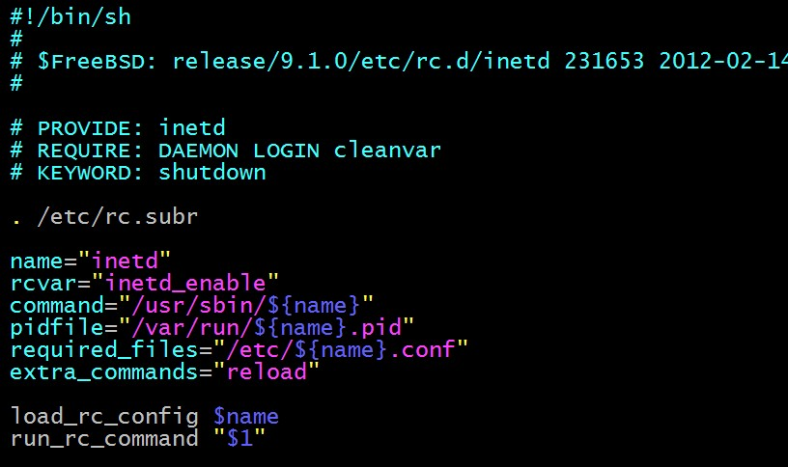
Inside the RC Script
Example: /etc/rc.d/inetd
for rcorder(8) to sort.
need to be included
by every RC script.
what to do with
start/stop/....

Slide 13
How to use rc script (1)
Example: ntpd
After booting… (rc.conf)
An easy way to access: “service”
$ service ntpd start/stop/restart/reload/…
Search /etc/rc.d and /usr/local/etc/rc.d
nctucs [~] -lctseng- /etc/rc.d/ntpd
Usage: /etc/rc.d/ntpd [fast|force|one|quiet](start|stop|restart|rcvar|enable|disable|delete|enab
led|describe|extracommands|fetch|needfetch|status|poll
nctucs [~] -lctseng- cat /var/db/ntp/ntpd.pid
4239
nctucs [~] -lctseng- ps aux | grep ntp
ntpd 4239 0.0 0.8 16488 16580 - Ss 08:45 0:00.02 /usr/sbin/ntpd -p /var/db/ntp/ntpd.pid -c /etc/ntp.conf -f /var/db/

Slide 14
How to use rc script (2)
Start
Start the service and write PID files now
Stop
Terminates the service by killing the process with PID recorded in pidfile
Restart
Restart the service (or just start a new one if not running)
Some services implement ’restart’ by ‘stop + start’
Enable/Disable
Edit /etc/rc.conf with XXX_enable=“YES” or “NO”
Will automatically launch when booting

Slide 15
How to use rc script (3)
Status
Check the service is running or not
Reload
Reload configuration file if the service support
Rcvar
Show the variables used in rc.conf
nctucs [~] -lctseng- service pure-ftpd rcvar
# pureftpd
#
pureftpd_enable="no"
# (default: "")

Slide 16
How to use rc script (4)
[one | fast | force]
One
Skip the check of rcvar="YES"
Start the service even if XXXX_enable="NO"
Force
Force start the service
Ignore any error it encountered (no prerequisite test)
ignore rcvar="YES" and set rc_force="YES"
Fast
Skip the check for an existing running process (pid check)
Set rc_fast="YES"

Slide 17
Local installed service
More about how to use rc.conf for an installed service, read comments from that script
/usr/local/etc/rc.d/pure-ftpd
# Add the following lines to /etc/rc.conf to enable pure-ftpd:
#
# pureftpd_enable="yes"
# pureftpd_flags="<set as needed>"
#
# Add the following lines to /etc/rc.conf to enable pure-authd daemon:
#
# pureftpd_authd_enable="yes"
# pureftpd_authdscript="/full/path/to/auth_script"
# pureftpd_authsocket="/var/run/ftpd.sock"
#
# Add the following lines to /etc/rc.conf to enable uploadscript daemon:
#
# pureftpd_upload_enable="yes"
# pureftpd_uploadscript="/full/path/to/upload_script"

Slide 18
System-V

Slide 19
Startup Scripts
SystemV-style startup scripts
Sun
/etc/init.d/
/etc/rc.d/rcn.d/
Each script is responsible for one
daemon or one aspect of system.
Example: sshd in SunOS
Symbolic link
case "$1" in
'start')
if [ -x /usr/local/sbin/sshd ]; then
echo "Starting the secure shell daemon"
/usr/local/sbin/sshd &
fi
;;
'stop')
echo "Stopping the secure shell daemon "
pkill -TERM sshd
;;
*)
echo "Usage: /etc/init.d/sshd { start | stop }"
;;
esac
exit 0

Slide 20
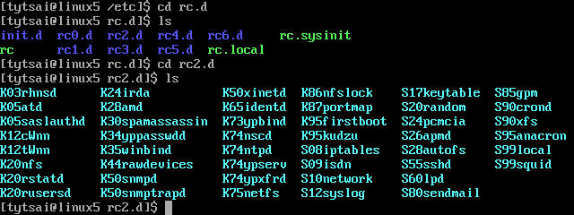
Startup Scripts – SystemV-style startup scripts (1)
/etc/rc.d/rcn.d/
When init transitions from lower run level to higher one,
it runs all the scripts that start with “S” in ascending order with “start” argument
When init transitions from high run level to lower one,
it runs all the scripts that start with “K” in descending order with “stop” argument

Slide 21
Startup Scripts – SystemV-style startup scripts (2)
If you write a daemon and want init to start/stop it,
write a script and put in /etc/init.d
make suitable symbolic link in rcn.d
ln -s /etc/init.d/initiald /etc/rc2.d/S61initiald
ln -s /etc/init.d/initiald /etc/rc0.d/K33initiald

Slide 22
Systemd
Service management for modern Linux distributions

Slide 23
Systemd
Evolved from System-V
Backward compability
Goal: provide a faster booting process
Less processes
Parallel launching
Use ‘targets’ replace run-levels
Easier to use
Tool
systemctl (1)
Similar to ‘service’ tool in FreeBSD

Slide 24
Flow of Running a Service with Systemd
Example with Ubuntu 18.04
Installation
Through packages, or source tarballs
apt install apache2
Configuration
Service specific configuration file(s)
/etc/apache2/*
systemctl enable apache2
Start
systemctl start apache2
Maintenance
Updating、Restarting

Slide 25
How to use systemctl
Usage
systemctl [OPTIONS…] {COMMAND} …
Common commands
enable / disable
Enable/disable launch when booting
start / stop / reload / restart / status
condrestart
Restart only if service is running

Slide 26
Unit files
Define services
/lib/systemd/system/*
Similar to /etc/rc.d/* in FreeBSD
systemd.service (5)
Example 1: (simple service)
Type
Simple: main process keeps running
Forking: main process forks and exits
ExecStart
Command to launch the service
WantedBy
Run this service at which target
[Unit]
Description=Some simple daemon
[Service]
Type=forking
ExecStart=/usr/sbin/my-simple-daemon -d
PIDFile=/var/run/my-daemon.pid
[Install]
WantedBy=multi-user.target

Slide 27
Unit files
Example 2: (apache2.service)
After
Dependency. Start service after dependency is fulfilled
ExecStop / ExecReload
Custom command to stop / reload the service
[Unit]
Description=The Apache HTTP Server
After=network.target remote-fs.target nss-lookup.target
[Service]
Type=forking
Environment=APACHE_STARTED_BY_SYSTEMD=true
ExecStart=/usr/sbin/apachectl start
ExecStop=/usr/sbin/apachectl stop
ExecReload=/usr/sbin/apachectl graceful
PrivateTmp=true
Restart=on-abort
[Install]
WantedBy=multi-user.target

Slide 28
Unit files
When enable a service, it will create links from “/lib/systemd/system/*.service” to “/etc/systemd/system/XXX.target.wants/*”
/etc/systemd/system/multi-user.target.wants/apache2.service -> /lib/systemd/system/apache2.service

