Slide 1
ZFS -
The Last Word in Filesystem
lwhsu (2019, CC-BY)
tzute (2018)
? (?-2018)
Philip Paeps <Philip@FreeBSD.org> (CC-BY)
Benedict Reuschling <bcr@FreeBSD.org> (CC-BY)

Slide 2
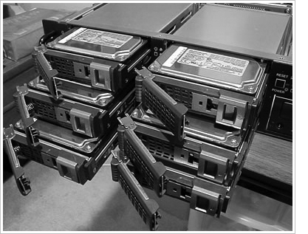
RAID
Redundant Array of Independent Disks
A group of drives glue into one

Slide 3
Common RAID types
JBOD
RAID 0
RAID 1
RAID 5
RAID 6
RAID 10
RAID 50
RAID 60

Slide 4
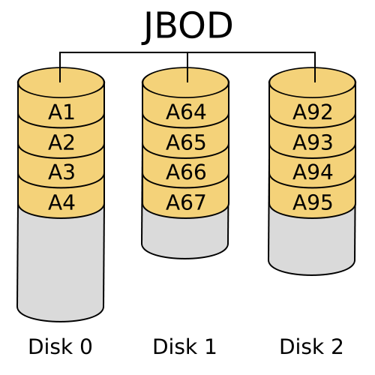
JBOD (Just a Bunch Of Disks)
https://zh.wikipedia.org/zh-tw/RAID
Notes:
循序使用硬碟
空間：N
速度：1 / 1
容錯：0

Slide 5
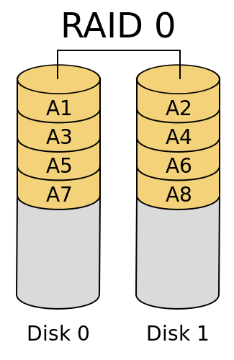
RAID 0 (Stripe)
https://zh.wikipedia.org/zh-tw/RAID
Notes:
分散資料至不同硬碟
空間：N
速度：N / N
容錯：0

Slide 6
RAID 0 (Stripe)
Striping data onto multiple devices
Increase write/read speed
Data corrupt if ANY of the device fails
Notes:
分散資料至不同硬碟
空間：N
速度：N / N
容錯：0

Slide 7
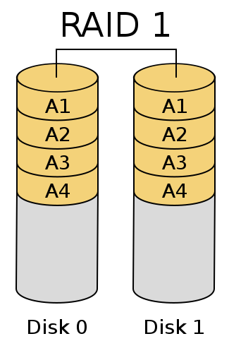
RAID 1 (Mirror)
https://zh.wikipedia.org/zh-tw/RAID
Notes:
完全拷貝資料至所有硬碟
空間：1
速度：N / 1
容錯：N - 1

Slide 8
RAID 1 (Mirror)
Devices contain identical data
100% redundancy
Faster read (but might be slower write)
Notes:
完全拷貝資料至所有硬碟
空間：1
速度：N / 1
容錯：N - 1

Slide 9
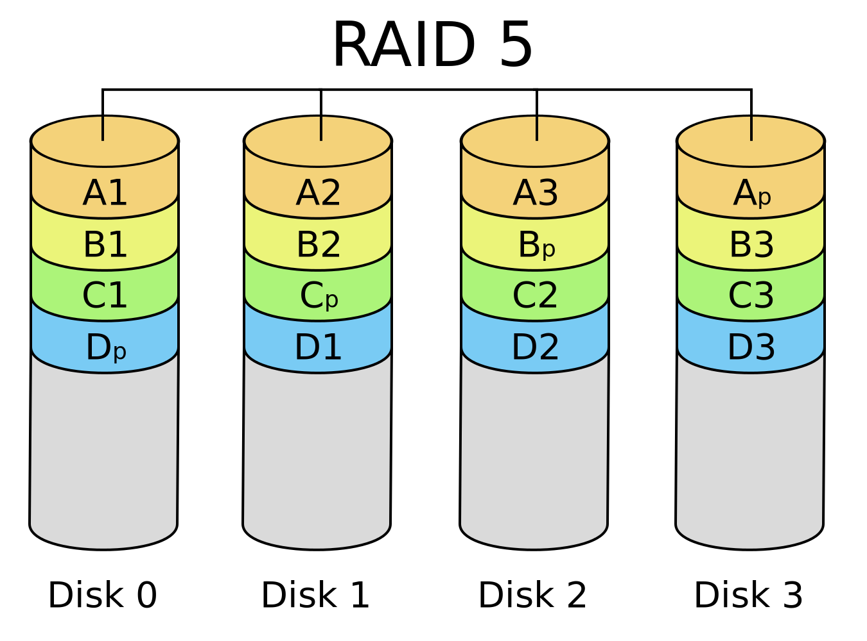
RAID 5
https://zh.wikipedia.org/zh-tw/RAID
Notes:
分散資料及校驗碼至所有硬碟
空間：N - 1
速度：N - 1 / N - 1
容錯：1

Slide 10
RAID 5
Slower than RAID 0 / RAID 1
Higher CPU usage
Notes:
分散資料及校驗碼至所有硬碟
空間：N - 1
速度：N - 1 / N - 1
容錯：1

Slide 11
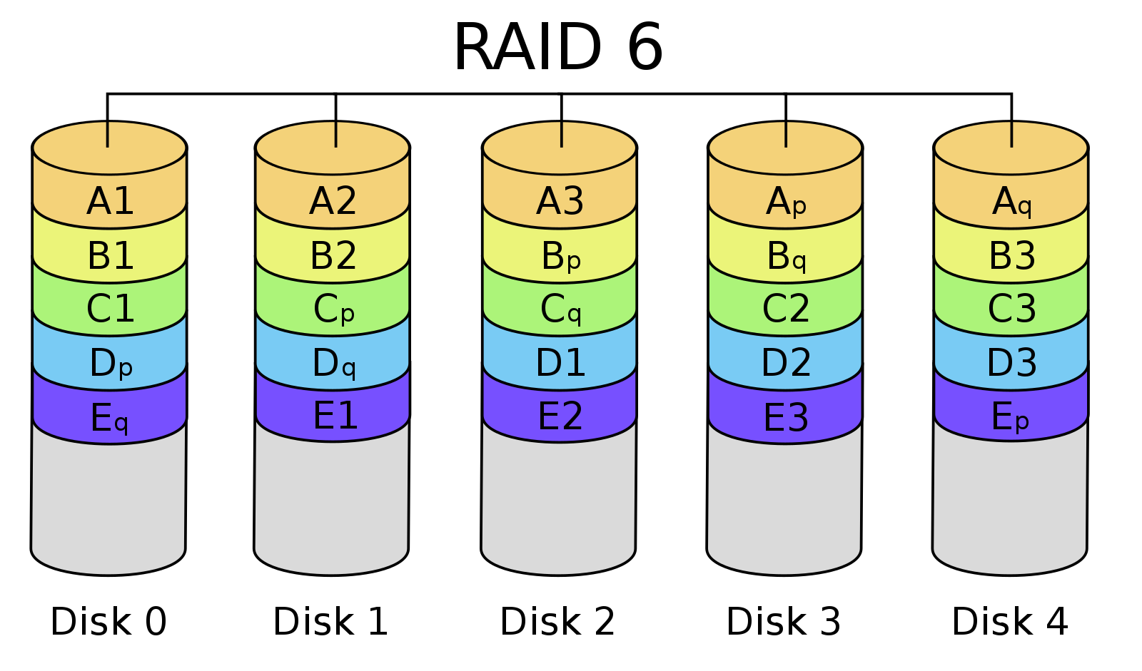
RAID 6
https://zh.wikipedia.org/zh-tw/RAID
Notes:
分散資料及兩種校驗碼至所有硬碟
空間：N - 2
速度：N - 2 / N - 2
容錯：2

Slide 12
RAID 6
Slower than RAID 5
Use two different correcting algorithms
Usually implemented via hardware
Notes:
分散資料及兩種校驗碼至所有硬碟
空間：N - 2
速度：N - 2 / N - 2
容錯：2

Slide 13
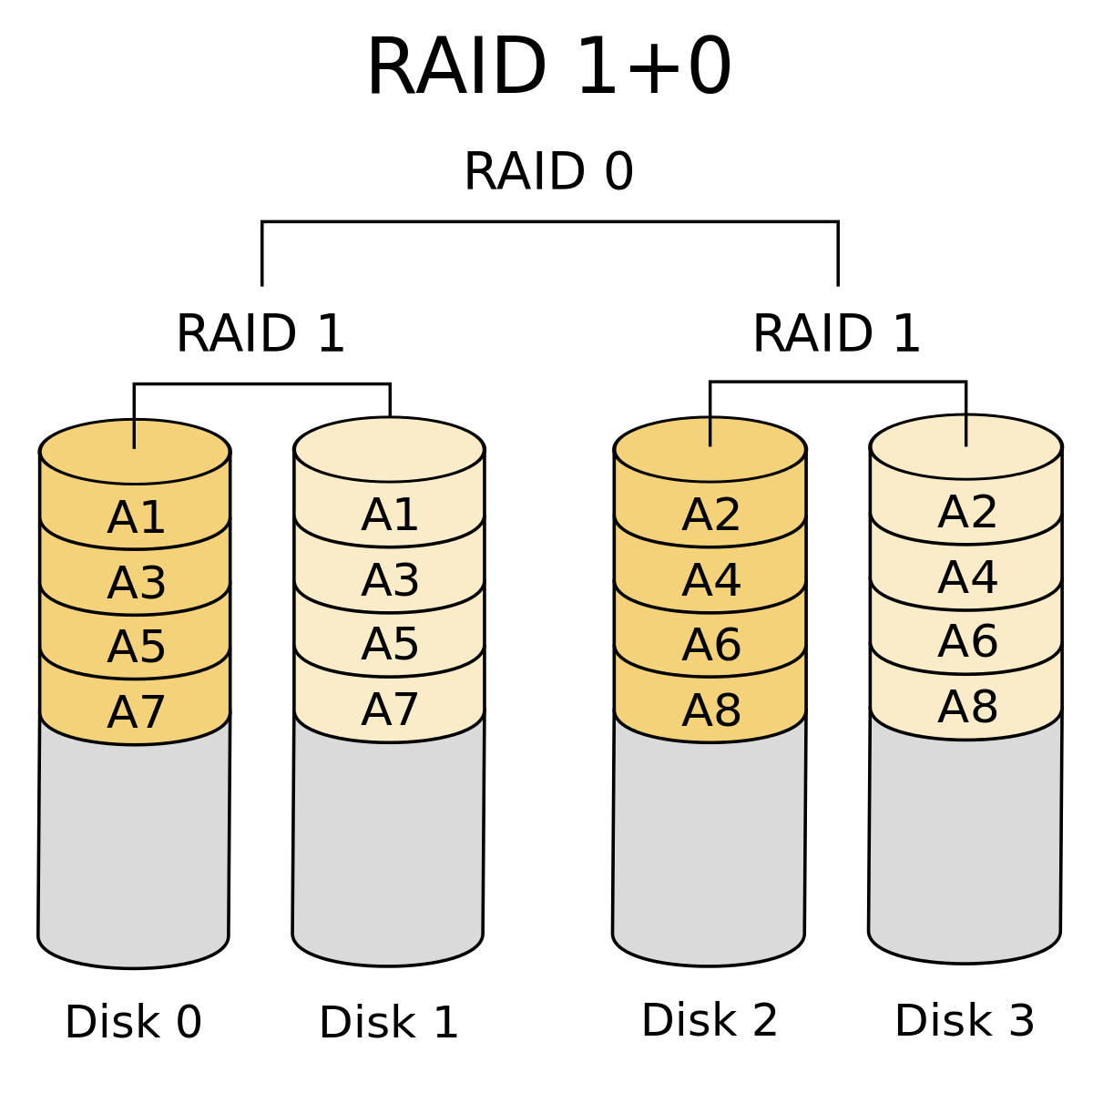
RAID 10
RAID 1+0
https://zh.wikipedia.org/zh-tw/RAID
Notes:
在 RAID 1 的基礎上建立 RAID 0
空間：N / 2
速度：(N / 2) / (N / 2)
容錯：N – 1 / per RAID 1

Slide 14
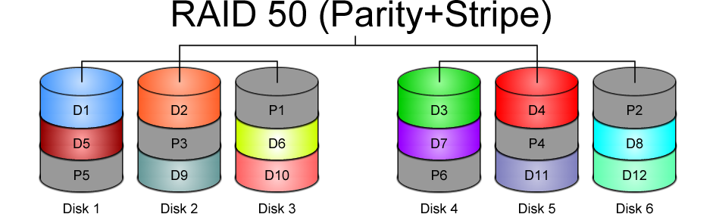
RAID 50?
https://www.icc-usa.com/wp-content/themes/icc_solutions/images/raid-calculator/raid-50.png

Slide 15
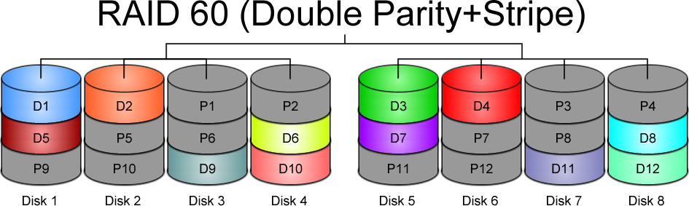
RAID 60?
https://www.icc-usa.com/wp-content/themes/icc_solutions/images/raid-calculator/raid-60.png

Slide 16
Issues of RAID
https://en.wikipedia.org/wiki/RAID#Weaknesses
  Correlated failures
    Use different batches of drivers!
  Unrecoverable read errors during rebuild
  Increasing rebuild time and failure probability
  Atomicity: including parity inconsistency due to system crashes
  Write-cache reliability
Know the limitations and make decision for your scenario

Slide 17
Software Implementations
Linux – mdadm
FreeBSD – GEOM classes

Slide 18
Here comes ZFS

Slide 19
Why ZFS?
Filesystem is always consistent
  Never overwrite an existing block (transactional Copy-on-Write)
  State atomically advance at checkpoints
  Metadata redundancy and data checksums
Snapshots (ro) and clones (rw) are cheap and plentiful
Flexible configuration
  Stripe, mirror, single/double/triple parity RAIDZ
Fast remote replication and backups
Scalable (the first 128 bit filesystem)
SSD and memory friendly
Easy administration (2 commands: zpool & zfs)
https://www.bsdcan.org/2015/schedule/events/525.en.html

Slide 20

End-to-end data integrity
Disks
Controllers
Cables
Firmware
Device drivers
Non-ECC memory

Slide 21
Disk block checksums
Checksums are stored with the data blocks
Any self-consistent block will have a correct checksum
Can’t even detect stray writes
Inherently limited to single filesystems or volumes
Bit rot
Phantom writes
Misdirected reads and writes
DMA parity errors
Driver bugs
Accidental overwrite
Disk block checksums only validate media

Slide 22
ZFS data authentication
Checksums are stored in parent block pointers
Fault isolation between data and checksum
Entire storage pool is a self-validating Merkle tree
Bit rot
Phantom writes
Misdirected reads and writes
DMA parity errors
Driver bugs
Accidental overwrite
ZFS data authentication validates entire I/O path

Slide 23
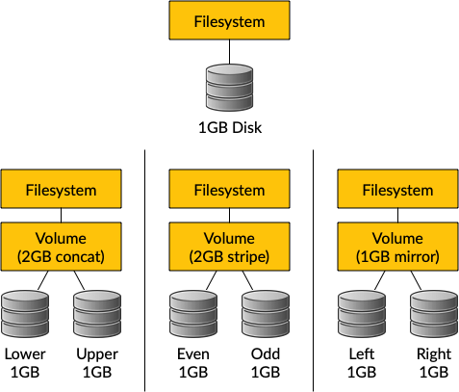
Traditional storage architecture
Single partition or volume per filesystem
Each filesystem has limited I/O bandwidth
Filesystems must be manually resized
Storage is fragmented

Slide 24
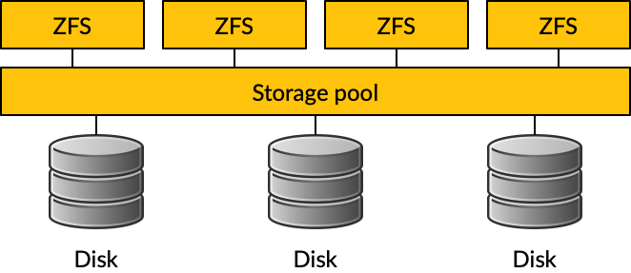
ZFS pooled storage
No partitions required
Storage pool grows automatically
All I/O bandwidth is always available
All storage in the pool is shared

Slide 25
Copy-on-write transactions

Slide 26
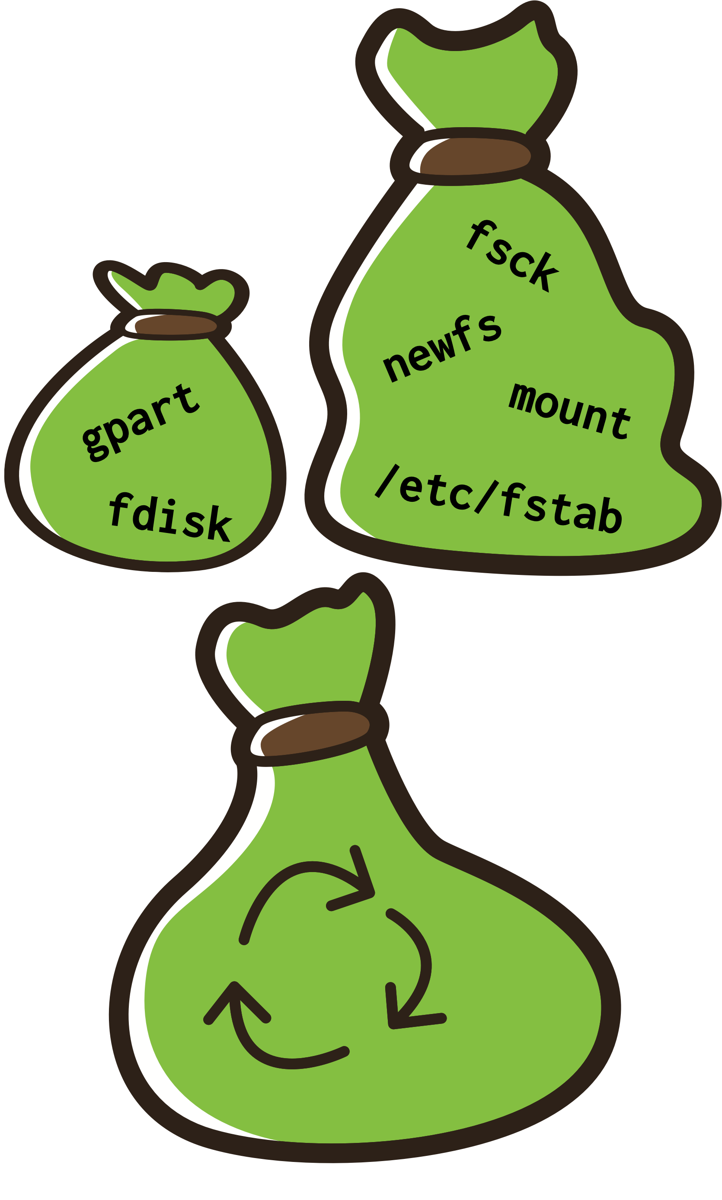
Simple administration
Only two commands:
Storage pools: zpool
  Add and replace disks
  Resize pools
Filesystems: zfs
  Quotas, reservations, etc.
  Compression and deduplication
  Snapshots and clones
  atime, readonly, etc.

Slide 27
Storage Pools

Slide 28
ZFS Pools
ZFS is not just a filesystem
ZFS = filesystem + volume manager
Works out of the box
“Z”uper “z”imple to create
Controlled with single command
  zpool

Slide 29
ZFS Pools Components
Pool is create from “Virtual Devices” (vdevs)
disk: A real disk (typically under /dev)
file: A file
mirror: Two or more disks mirrored together
raidz1/2/3: Three or more disks in RAID5/6*
spare: A spare drive
log: A write log device (ZIL SLOG; typically SSD)
cache: A read cache device (L2ARC; typically SSD)

Slide 30
RAID in ZFS
Dynamic Stripe: Intelligent RAID 0
  zfs copies=1 | 2 | 3
Mirror: RAID 1
Raidz1: Improved from RAID5 (parity)
Raidz2: Improved from RAID6 (double parity)
Raidz3: triple parity

Slide 31
Storage pools
Creating storage pools (1/2)
After creating a storage pool, ZFS will automatically:
Create a filesystem with the same name (e.g. tank)
Mount the filesystem under that name (e.g. /tank)
The storage is immediately available
To create a storage pool named “tank” from a single disk:
# zpool create tank /dev/md0
ZFS can use disks directly. There is no need to create partitions or volumes.

Slide 32
Storage pools
Creating storage pools (2/2)
All configuration is stored with the storage pool and persists across reboots.
No need to edit /etc/fstab.
# mount | grep tank
# ls -al /tank
ls: /tank: No such file or directory
# zpool create tank /dev/md0
# mount | grep tank
tank on /tank (zfs, local, nfsv4acls)
# ls -al /tank
total 9
drwxr-xr-x 2 root wheel 2 Oct 12 12:17 .
drwxr-xr-x 23 root wheel 28 Oct 12 12:17 ..
# reboot
[...]
# mount | grep tank
tank on /tank (zfs, local, nfsv4acls)

Slide 33
Storage pools
Displaying pool status
# zpool list
NAME SIZE ALLOC FREE CKPOINT EXPANDSZ FRAG CAP DEDUP HEALTH ALTROOT
tank 1016G 83K 1016G - - 0% 0% 1.00x ONLINE -
# zpool status
pool: tank
state: ONLINE
scan: none requested
config:
NAME STATE READ WRITE CKSUM
tank ONLINE 0 0 0
md0 ONLINE 0 0 0
errors: No known data errors

Slide 34
Storage pools
Displaying I/O statistics
ZFS contains a built-in tool to display I/O statistics.
Given an interval in seconds, statistics will be displayed continuously until the user interrupts with Ctrl+C.
Use -v (verbose) to display more detailed statistics.
# zpool iostat 5
capacity operations bandwidth
pool alloc free read write read write
---------- ----- ----- ----- ----- ----- -----
tank 83K 1016G 0 0 234 841
tank 83K 1016G 0 0 0 0
# zpool iostat -v
capacity operations bandwidth
pool alloc free read write read write
---------- ----- ----- ----- ----- ----- -----
tank 83K 1016G 0 0 206 739
md0 83K 1016G 0 0 206 739
---------- ----- ----- ----- ----- ----- -----

Slide 35
Storage pools
Destroying storage pools
Destroying storage pools is a constant time operation. If you want to get rid of your data, ZFS will help you do it very quickly!
All data on a destroyed pool will be irretrievably lost.
# time zpool create tank /dev/md0
0.06 real 0.00 user 0.02 sys
# time zpool destroy tank
0.09 real 0.00 user 0.00 sys

Slide 36
Storage pools
Creating stripes
A pool with just one disk does not provide any redundancy, capacity or even adequate performance.
Stripes offer higher capacity and better performance (reading will be parallelised) but they provide no redundancy.
# zpool create tank /dev/md0 /dev/md1
# zpool status
pool: tank
state: ONLINE
scan: none requested
config:
NAME STATE READ WRITE CKSUM
tank ONLINE 0 0 0
md0 ONLINE 0 0 0
md1 ONLINE 0 0 0
errors: No known data errors
# zpool list
NAME SIZE ALLOC FREE CAP DEDUP HEALTH
tank 1.98T 86K 1.98T 0% 1.00x ONLINE

Slide 37
Storage pools
Creating mirrors (RAID-1)
Mirrored storage pools provide redundancy against disk failures and better read performance than single-disk pools.
However, mirrors only have 50% of the capacity of the underlying disks.
# zpool create tank mirror /dev/md0 /dev/md1
# zpool status
pool: tank
state: ONLINE
scan: none requested
config:
NAME STATE READ WRITE CKSUM
tank ONLINE 0 0 0
mirror-0 ONLINE 0 0 0
md0 ONLINE 0 0 0
md1 ONLINE 0 0 0
errors: No known data errors
# zpool list
NAME SIZE ALLOC FREE CAP DEDUP HEALTH
tank 1016G 93K 1016G 0% 1.00x ONLINE

Slide 38
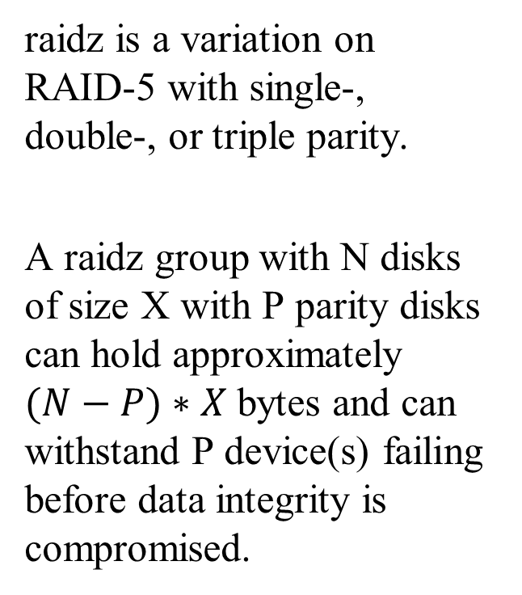
Storage pools
Creating raidz groups
raidz is a variation on RAID-5 with single-, double-, or triple parity.
A raidz group with N disks of size X with P parity disks can hold approximately $(N−P)∗X$ bytes and can withstand P device(s) failing before data integrity is compromised.
# zpool create tank \
> raidz1 /dev/md0 /dev/md1 /dev/md2 /dev/md3
# zpool status
pool: tank
state: ONLINE
scan: none requested
config:
NAME STATE READ WRITE CKSUM
tank ONLINE 0 0 0
raidz1-0 ONLINE 0 0 0
md0 ONLINE 0 0 0
md1 ONLINE 0 0 0
md2 ONLINE 0 0 0
md3 ONLINE 0 0 0
errors: No known data errors

Slide 39
Storage pools
Combining vdev types
Single disks, stripes, mirrors and raidz groups can be combined in a single storage pool
ZFS will complain when adding devices would make the pool less redundant
` zpool add log/cache/spare`
# zpool create tank mirror /dev/md0 /dev/md1
# zpool add tank /dev/md2
invalid vdev specification
use '-f' to override the following errors:
mismatched replication level:
pool uses mirror and new vdev is disk
# zpool create tank \
> raidz2 /dev/md0 /dev/md1 /dev/md2 /dev/md3
# zpool add tank \
> raidz /dev/md4 /dev/md5 /dev/md6
invalid vdev specification
use '-f' to override the following errors:
mismatched replication level:
pool uses 2 device parity and new vdev uses 1

Slide 40
Storage pools
Increasing storage pool capacity
More devices can be added to a storage pool to increase capacity without downtime.
Data will be striped across the disks, increasing performance, but there will be no redundancy.
If any disk fails, all data is lost!
# zpool create tank /dev/md0
# zpool add tank /dev/md1
# zpool list
NAME SIZE ALLOC FREE CAP DEDUP HEALTH
tank 1.98T 233K 1.98T 0% 1.00x ONLINE
# zpool status
pool: tank
state: ONLINE
scan: none requested
config:
NAME STATE READ WRITE CKSUM
tank ONLINE 0 0 0
md0 ONLINE 0 0 0
md1 ONLINE 0 0 0
errors: No known data errors

Slide 41
Storage pools
Creating a mirror from a single-disk pool (1/4)
A storage pool consisting of only one device can be converted to a mirror.
In order for the new device to mirror the data of the already existing device, the pool needs to be “resilvered”.
This means that the pool synchronises both devices to contain the same data at the end of the resilver operation.
During resilvering, access to the pool will be slower, but there will be no downtime.

Slide 42
Storage pools
Creating a mirror from a single-disk pool (2/4)
# zpool create tank /dev/md0
# zpool status
pool: tank
state: ONLINE
scan: none requested
config:
NAME STATE READ WRITE CKSUM
tank ONLINE 0 0 0
md0 ONLINE 0 0 0
errors: No known data errors
# zpool list
NAME SIZE ALLOC FREE CKPOINT EXPANDSZ FRAG CAP DEDUP HEALTH ALTROOT
tank 1016G 93K 1016G - - 0% 0% 1.00x ONLINE -

Slide 43
Storage pools
Creating a mirror from a single-disk pool (3/4)
`zpool attach`
# zpool attach tank /dev/md0 /dev/md1
# zpool status tank
pool: tank
state: ONLINE
status: One or more devices is currently being resilvered. The pool
will continue to function, possibly in a degraded state.
action: Wait for the resilver to complete.
scan: resilver in progress since Fri Oct 12 13:55:56 2018
5.03M scanned out of 44.1M at 396K/s, 0h1m to go
5.03M resilvered, 11.39% done
config:
NAME STATE READ WRITE CKSUM
tank ONLINE 0 0 0
mirror-0 ONLINE 0 0 0
md0 ONLINE 0 0 0
md1 ONLINE 0 0 0 (resilvering)
errors: No known data errors

Slide 44
Storage pools
Creating a mirror from a single-disk pool (4/4)
# zpool status
pool: tank
state: ONLINE
scan: resilvered 44.2M in 0h1m with 0 errors on Fri Oct 12 13:56:29 2018
config:
NAME STATE READ WRITE CKSUM
tank ONLINE 0 0 0
mirror-0 ONLINE 0 0 0
md0 ONLINE 0 0 0
md1 ONLINE 0 0 0
errors: No known data errors
# zpool list
NAME SIZE ALLOC FREE CKPOINT EXPANDSZ FRAG CAP DEDUP HEALTH ALTROOT
tank 1016G 99.5K 1016G - - 0% 0% 1.00x ONLINE -

Slide 45
Zpool command
zpool(8)
zpool list
list all the zpool
zpool status [pool name]
show status of zpool
zpool export/import [pool name]
export or import given pool
zpool set/get <properties/all>
set or show zpool properties
zpool online/offline <pool name> <vdev>
set an device in zpool to online/offline state
zpool attach/detach <pool name> <device> <new device>
attach a new device to an zpool/detach a device from zpool
zpool replace <pool name> <old device> <new device>
replace old device with new device
zpool scrub
try to discover silent error or hardware failure
zpool history [pool name]
show all the history of zpool
zpool add <pool name> <vdev>
add additional capacity into pool
zpool create/destroy
create/destory zpool

Slide 46
Zpool properties
`zpool get all zroot`
NAME PROPERTY VALUE SOURCE
zroot size 460G -
zroot capacity 4% -
zroot altroot - default
zroot health ONLINE -
zroot guid 13063928643765267585 default
zroot version - default
zroot bootfs zroot/ROOT/default local
zroot delegation on default
zroot autoreplace off default
zroot cachefile - default
zroot failmode wait default
zroot listsnapshots off default
zroot feature@async_destroy enabled local
zroot feature@device_removal enabled local
Notes:
大小
使用率
掛載點 root
狀態
default bootable dataset
Auto `replace`

Slide 47
Zpool Sizing
ZFS reserve 1/64 of pool capacity for safe-guard to protect CoW
RAIDZ1 Space = Total Drive Capacity -1 Drive
RAIDZ2 Space = Total Drive Capacity -2 Drives
RAIDZ3 Space = Total Drive Capacity -3 Drives
Dynamic Stripe of 4* 100GB= 400 / 1.016= ~390GB
RAIDZ1 of 4* 100GB = 300GB - 1/64th= ~295GB
RAIDZ2 of 4* 100GB = 200GB - 1/64th= ~195GB
RAIDZ2 of 10* 100GB = 800GB - 1/64th= ~780GB
http://cuddletech.com/blog/pivot/entry.php?id=1013

Slide 48
ZFS Dataset

Slide 49
ZFS Datasets
Three forms:
  filesystem: just like traditional filesystem
  volume: block device
  snapshot: read-only version of a file system or volume at a given point of time.
Nested
Each dataset has associated properties that can be inherited by sub-filesystems
Controlled with single command:
  zfs(8)

Slide 50
Filesystem Datasets
Create new dataset with
  zfs create <pool name>/<dataset name>(/<dataset name>/…)
New dataset inherits properties of parent dataset

Slide 51
Volumn Datasets (ZVols)
Block storage
Located at /dev/zvol/<pool name>/<dataset>
Useful for
  iSCSI
  Other non-zfs local filesystem
  Virtual Machine image
Support “thin provisioning” (“sparse volume”)

Slide 52
Dataset properties
$ zfs get all zroot
NAME PROPERTY VALUE SOURCE
zroot type filesystem -
zroot creation Mon Jul 21 23:13 2014 -
zroot used 22.6G -
zroot available 423G -
zroot referenced 144K -
zroot compressratio 1.07x -
zroot mounted no -
zroot quota none default
zroot reservation none default
zroot recordsize 128K default
zroot mountpoint none local
zroot sharenfs off default
Notes:
filesystem, volume, or snapshot

Slide 53
zfs command
zfs(8)
zfs set/get <prop. / all> <dataset>
set properties of datasets
zfs create <dataset>
create new dataset
zfs destroy
destroy datasets/snapshots/clones..
zfs snapshot
create snapshots
zfs rollback
rollback to given snapshot
zfs promote
promote clone to the orgin of the filesystem
zfs send/receive
send/receive data stream of the snapshot

Slide 54
Snapshots

Slide 55
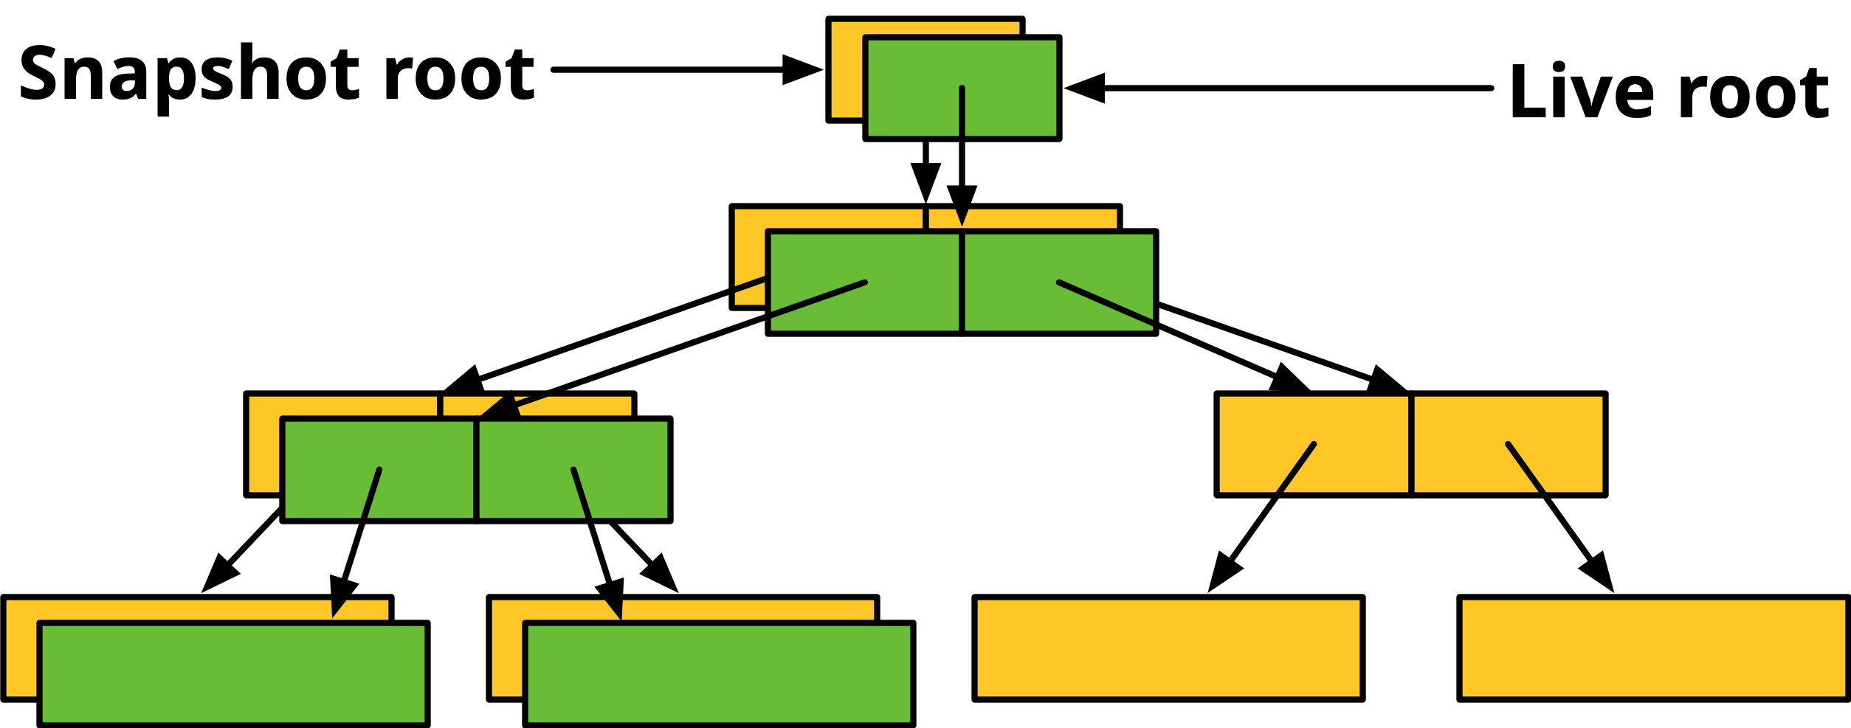
Snapshot
Read-only copy of a dataset or volume
Useful for file recovery or full dataset rollback
Denoted by @ symbol
Snapshots are extremely fast (-er than deleting data!)
Snapshots occupy (almost) no space until the original data start to diverge
How ZFS snapshots really work (Matt Ahrens)
  https://www.bsdcan.org/2019/schedule/events/1073.en.html

Slide 56
Snapshots
Creating and listing snapshots (1/2)
A snapshot only needs an identifier
  Can be anything you like!
  A timestamp is traditional
  But you can use more memorable identifiers too…
# zfs snapshot tank/users/alice@myfirstbackup
# zfs list -t snapshot
NAME USED AVAIL REFER MOUNTPOINT
tank/users/alice@myfirstbackup 0 - 23K -
# zfs list -rt all tank/users/alice
NAME USED AVAIL REFER MOUNTPOINT
tank/users/alice 23K 984G 23K /tank/users/alice
tank/users/alice@myfirstbackup 0 - 23K -

Slide 57
Snapshots
Creating and listing snapshots (2/2)
Snapshots save only the changes between the time they were created and the previous (if any) snapshot
If data doesn’t change, snapshots occupy zero space
# echo hello world > /tank/users/alice/important_data.txt
# zfs snapshot tank/users/alice@mysecondbackup
# zfs list -rt all tank/users/alice
NAME USED AVAIL REFER MOUNTPOINT
tank/users/alice 36.5K 984G 23.5K /tank/users/alice
tank/users/alice@myfirstbackup 13K - 23K -
tank/users/alice@mysecondbackup 0 - 23.5K -

Slide 58
Snapshots
Differences between snapshots
ZFS can display the differences between snapshots
# touch /tank/users/alice/empty
# rm /tank/users/alice/important_data.txt
# zfs diff tank/users/alice@mysecondbackup
M /tank/users/alice/
- /tank/users/alice/important_data.txt
+ /tank/users/alice/empty
Character | Type of change
+ | File was added
- | File was deleted
M | File was modified
R | File was renamed

Slide 59
Snapshots
Rolling back snapshots (1/2)
Snapshots can be rolled back to undo changes
All files changed since the snapshot was created will be discarded
# echo hello_world > important_file.txt
# echo goodbye_cruel_world > also_important.txt
# zfs snapshot tank/users/alice@myfirstbackup
# rm *
# ls
# zfs rollback tank/users/alice@myfirstbackup
# ls
also_important.txt important_file.txt

Slide 60
Snapshots
Rolling back snapshots (2/2)
By default, the latest snapshot is rolled back. To roll back an older snapshot, use -r
Note that intermediate snapshots will be destroyed
ZFS will warn about this
# touch not_very_important.txt
# touch also_not_important.txt
# ls
also_important.txt important_file.txt
also_not_important.txt not_very_important.txt
# zfs snapshot tank/users/alice@mysecondbackup
# zfs diff tank/users/alice@myfirstbackup \
> tank/users/alice@mysecondbackup
M /tank/users/alice/
+ /tank/users/alice/not_very_important.txt
+ /tank/users/alice/also_not_important.txt
# zfs rollback tank/users/alice@myfirstbackup
# zfs rollback -r tank/users/alice@myfirstbackup
# ls
also_important.txt important_file.txt

Slide 61
Snapshots
Restoring individual files
Sometimes, we only want to restore a single file, rather than rolling back an entire snapshot
ZFS keeps snapshots in a very hidden .zfs/snapshots directory
  It’s like magic :-)
  Set snapdir=visible to unhide it
Remember: snaphots are read-only. Copying data to the magic directory won’t work!
# ls
also_important.txt important_file.txt
# rm *
# ls
# ls .zfs/snapshot/myfirstbackup
also_important.txt important_file.txt
# cp .zfs/snapshot/myfirstbackup/* .
# ls
also_important.txt important_file.txt

Slide 62
Snapshots
Cloning snapshots
Clones represent a writeable copy of a read-only snapshot
Like snapshots, they occupy no space until they start to diverge
# zfs list -rt all tank/users/alice
NAME USED AVAIL REFER MOUNTPOINT
tank/users/alice 189M 984G 105M /tank/users/alice
tank/users/alice@mysecondbackup 0 - 105M -
# zfs clone tank/users/alice@mysecondbackup tank/users/eve
# zfs list tank/users/eve
NAME USED AVAIL REFER MOUNTPOINT
tank/users/eve 0 984G 105M /tank/users/eve

Slide 63
Snapshots
Promoting clones
Snapshots cannot be deleted while clones exist
To remove this dependency, clones can be promoted to ”ordinary” datasets
Note that by promoting the clone, it immediately starts occupying space
# zfs destroy tank/users/alice@mysecondbackup
cannot destroy 'tank/users/alice@mysecondbackup’:
snapshot has dependent clones
use '-R' to destroy the following datasets:
tank/users/eve
# zfs list tank/users/eve
NAME USED AVAIL REFER MOUNTPOINT
tank/users/eve 0 984G 105M /tank/users/eve
# zfs promote tank/users/eve
# zfs list tank/users/eve
NAME USED AVAIL REFER MOUNTPOINT
tank/users/eve 189M 984G 105M /tank/users/eve

Slide 64
Self-healing data

Slide 65
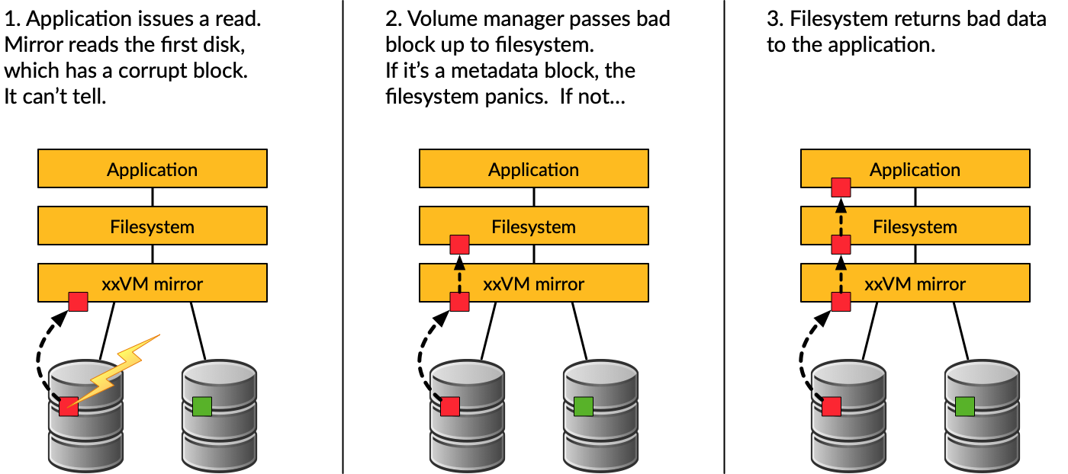
Traditional mirroring

Slide 66
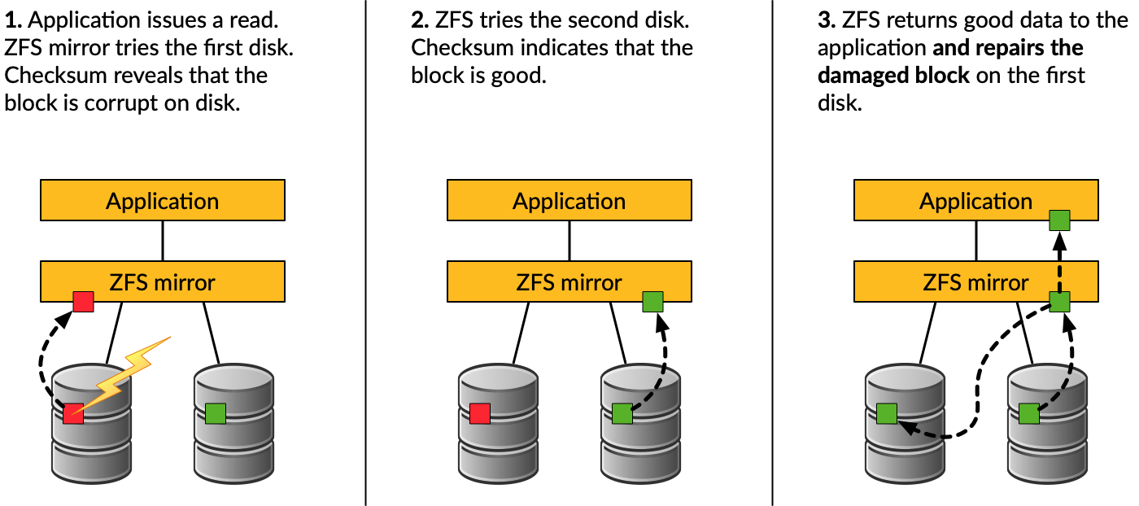
Self-healing data in ZFS

Slide 67
Self-healing data demo
Store some important data (1/2)
We have created a redundant pool with two mirrored disks and stored some important data on it
We will be very sad if the data gets lost! :-(
# zfs list tank
NAME USED AVAIL REFER MOUNTPOINT
tank 74K 984G 23K /tank
# cp -a /some/important/data/ /tank/
# zfs list tank
NAME USED AVAIL REFER MOUNTPOINT
tank 3.23G 981G 3.23G /tank

Slide 68
Self-healing data demo
Store some important data (2/2)
# zpool status tank
pool: tank
state: ONLINE
scan: none requested
config:
NAME STATE READ WRITE CKSUM
tank ONLINE 0 0 0
mirror-0 ONLINE 0 0 0
md0 ONLINE 0 0 0
md1 ONLINE 0 0 0
errors: No known data errors
# zpool list tank
NAME SIZE ALLOC FREE CKPOINT EXPANDSZ FRAG CAP DEDUP HEALTH ALTROOT
tank 1016G 3.51G 1012G - - 0% 0% 1.00x ONLINE -

Slide 69
Self-healing data demo
Destroy one of the disks (1/2)
Caution!
This example can destroy data when used on the wrong device or a non-ZFS filesystem!
Always check your backups!
# zpool export tank
# dd if=/dev/random of=/dev/md1 bs=1m count=200
# zpool import tank

Slide 70
Self-healing data demo
Destroy one of the disks (2/2)
# zpool status tank
pool: tank
state: ONLINE
status: One or more devices has experienced an unrecoverable error. An
attempt was made to correct the error. Applications are unaffected.
action: Determine if the device needs to be replaced, and clear the errors
using 'zpool clear' or replace the device with 'zpool replace'.
see: http://illumos.org/msg/ZFS-8000-9P
scan: none requested
config:
NAME STATE READ WRITE CKSUM
tank ONLINE 0 0 0
mirror-0 ONLINE 0 0 0
md0 ONLINE 0 0 5
md1 ONLINE 0 0 0
errors: No known data errors

Slide 71
Self-healing data demo
Make sure everything is okay (1/3)
# zpool scrub tank
# zpool status tank
pool: tank
state: ONLINE
status: One or more devices has experienced an unrecoverable error. An
attempt was made to correct the error. Applications are unaffected.
action: Determine if the device needs to be replaced, and clear the errors
using 'zpool clear' or replace the device with 'zpool replace'.
see: http://illumos.org/msg/ZFS-8000-9P
scan: scrub in progress since Fri Oct 12 22:57:36 2018
191M scanned out of 3.51G at 23.9M/s, 0h2m to go
186M repaired, 5.32% done
config:
NAME STATE READ WRITE CKSUM
tank ONLINE 0 0 0
mirror-0 ONLINE 0 0 0
md0 ONLINE 0 0 1.49K (repairing)
md1 ONLINE 0 0 0
errors: No known data errors

Slide 72
Self-healing data demo
Make sure everything is okay (2/3)
# zpool status tank
pool: tank
state: ONLINE
status: One or more devices has experienced an unrecoverable error. An
attempt was made to correct the error. Applications are unaffected.
action: Determine if the device needs to be replaced, and clear the errors
using 'zpool clear' or replace the device with 'zpool replace'.
see: http://illumos.org/msg/ZFS-8000-9P
scan: scrub repaired 196M in 0h0m with 0 errors on Fri Oct 12 22:58:14 2018
config:
NAME STATE READ WRITE CKSUM
tank ONLINE 0 0 0
mirror-0 ONLINE 0 0 0
md0 ONLINE 0 0 1.54K
md1 ONLINE 0 0 0
errors: No known data errors

Slide 73
Self-healing data demo
Make sure everything is okay (3/3)
# zpool clear tank
# zpool status tank
pool: tank
state: ONLINE
scan: scrub repaired 196M in 0h0m with 0 errors on Fri Oct 12 22:58:14 2018
config:
NAME STATE READ WRITE CKSUM
tank ONLINE 0 0 0
mirror-0 ONLINE 0 0 0
md0 ONLINE 0 0 0
md1 ONLINE 0 0 0
errors: No known data errors

Slide 74
Self-healing data demo
But what if it goes very wrong? (1/2)
# zpool status
pool: tank
state: ONLINE
status: One or more devices has experienced an error resulting in data
corruption. Applications may be affected.
action: Restore the file in question if possible. Otherwise restore the
entire pool from backup.
see: http://illumos.org/msg/ZFS-8000-8A
scan: scrub in progress since Fri Oct 12 22:46:01 2018
498M scanned out of 3.51G at 99.6M/s, 0h0m to go
19K repaired, 13.87% done
config:
NAME STATE READ WRITE CKSUM
tank ONLINE 0 0 1.48K
mirror-0 ONLINE 0 0 2.97K
md0 ONLINE 0 0 2.97K
md1 ONLINE 0 0 2.97K
errors: 1515 data errors, use '-v' for a list

Slide 75
Self-healing data demo
But what if it goes very wrong? (2/2)
# zpool status –v
pool: tank
state: ONLINE
status: One or more devices has experienced an error resulting in data
corruption. Applications may be affected.
action: Restore the file in question if possible. Otherwise restore the
entire pool from backup.
see: http://illumos.org/msg/ZFS-8000-8A
scan: scrub repaired 19K in 0h0m with 1568 errors on Fri Oct 12 22:46:25 2018
config:
NAME STATE READ WRITE CKSUM
tank ONLINE 0 0 1.53K
mirror-0 ONLINE 0 0 3.07K
md0 ONLINE 0 0 3.07K
md1 ONLINE 0 0 3.07K
errors: Permanent errors have been detected in the following files:
/tank/FreeBSD-11.2-RELEASE-amd64.vhd.xz
/tank/base-amd64.txz
/tank/FreeBSD-11.2-RELEASE-amd64-disc1.iso.xz
/tank/intro_slides.pdf

Slide 76
Deduplication

Slide 77

Duplication
Intentional duplication
Backups, redundancy
Unintentional duplication
Application caches
Temporary files
Node.js (Grrr!)

Slide 78
Deduplication
Implemented at the block layer
ZFS detects when it needs to store an exact copy of a block
Only a reference is written rather than the entire block
Can save a lot of disk space

Slide 79
Deduplication
Memory cost
ZFS must keep a table of the checksums of every block it stores
Depending on the blocksize, this table can grow very quickly
Deduplication table must be fast to access or writes slow down
Ideally, the deduplication table should fit in RAM
Keeping a L2ARC on fast SSDs can reduce the cost somewhat
Rule of thumb:
5GB of RAM for each TB of data stored

Slide 80
Deduplication
Is it worth it? (1/2)
The ZFS debugger (zdb) can be used to evaluate if turning on deduplication will save space in a pool
In most workloads, compression will provide much more significant savings than deduplication
Consider whether the cost of RAM is worth it
Also keep in mind that it is a lot easier and cheaper to add disks to a system than it is to add memory

Slide 81
Deduplication demo
Is it worth it? (2/2)
# zdb -S tank
Simulated DDT histogram:
bucket allocated referenced
______ ______________________________ ______________________________
refcnt blocks LSIZE PSIZE DSIZE blocks LSIZE PSIZE DSIZE
------ ------ ----- ----- ----- ------ ----- ----- -----
1 25.1K 3.13G 3.13G 3.13G 25.1K 3.13G 3.13G 3.13G
2 1.48K 189M 189M 189M 2.96K 378M 378M 378M
Total 26.5K 3.32G 3.32G 3.32G 28.0K 3.50G 3.50G 3.50G
dedup = 1.06, compress = 1.00, copies = 1.00, dedup * compress / copies = 1.06

Slide 82
Deduplication demo
Control experiment (1/2)
# zpool list tank
NAME SIZE ALLOC FREE CKPOINT EXPANDSZ FRAG CAP DEDUP HEALTH ALTROOT
tank 7.50G 79.5K 7.50G - - 0% 0% 1.00x ONLINE -
# zfs get compression,dedup tank
NAME PROPERTY VALUE SOURCE
tank compression off default
tank dedup off default
# for p in `seq 0 4`; do
> zfs create tank/ports/$p
> portsnap -d /tmp/portsnap -p /tank/ports/$p extract &
> done
# zpool list tank
NAME SIZE ALLOC FREE CKPOINT EXPANDSZ FRAG CAP DEDUP HEALTH ALTROOT
tank 7.50G 2.14G 5.36G - - 3% 28% 1.00x ONLINE -

Slide 83
Deduplication demo
Control experiment (2/2)
# zdb -S tank
Simulated DDT histogram:
bucket allocated referenced
______ ______________________________ ______________________________
refcnt blocks LSIZE PSIZE DSIZE blocks LSIZE PSIZE DSIZE
------ ------ ----- ----- ----- ------ ----- ----- -----
4 131K 374M 374M 374M 656K 1.82G 1.82G 1.82G
8 2.28K 4.60M 4.60M 4.60M 23.9K 48.0M 48.0M 48.0M
16 144 526K 526K 526K 3.12K 10.5M 10.5M 10.5M
32 22 23.5K 23.5K 23.5K 920 978K 978K 978K
64 2 1.50K 1.50K 1.50K 135 100K 100K 100K
256 1 512 512 512 265 132K 132K 132K
Total 134K 379M 379M 379M 685K 1.88G 1.88G 1.88G
dedup = 5.09, compress = 1.00, copies = 1.00, dedup * compress / copies = 5.09

Slide 84
Deduplication demo
Enabling deduplication
# zpool list tank
NAME SIZE ALLOC FREE CKPOINT EXPANDSZ FRAG CAP DEDUP HEALTH ALTROOT
tank 7.50G 79.5K 7.50G - - 0% 0% 1.00x ONLINE -
# zfs get compression,dedup tank
NAME PROPERTY VALUE SOURCE
tank compression off default
tank dedup on default
# for p in `seq 0 4`; do
> zfs create tank/ports/$p
> portsnap -d /tmp/portsnap -p /tank/ports/$p extract &
> done
# zpool list tank
NAME SIZE ALLOC FREE CKPOINT EXPANDSZ FRAG CAP DEDUP HEALTH ALTROOT
tank 7.50G 670M 6.85G - - 6% 8% 5.08x ONLINE -

Slide 85
Deduplication demo
Compare with compression
# zpool list tank
NAME SIZE ALLOC FREE CKPOINT EXPANDSZ FRAG CAP DEDUP HEALTH ALTROOT
tank 7.50G 79.5K 7.50G - - 0% 0% 1.00x ONLINE -
# zfs get compression,dedup tank
NAME PROPERTY VALUE SOURCE
tank compression gzip-9 local
tank dedup off default
# for p in `seq 0 4`; do
> zfs create tank/ports/$p
> portsnap -d /tmp/portsnap -p /tank/ports/$p extract &
> done
# zpool list tank
NAME SIZE ALLOC FREE CKPOINT EXPANDSZ FRAG CAP DEDUP HEALTH ALTROOT
tank 7.50G 752M 6.77G - - 3% 9% 1.00x ONLINE -

Slide 86
Deduplication
Summary
ZFS deduplication can save a lot of space under some workloads but at the expense of a lot of memory
Often, compression will give similar or better results
Always check with zdb -S whether deduplication would be worth it
Control experiment | 2.14G
Deduplication | 670M
Compression | 752M

Slide 87
Performance Tuning

Slide 88
General tuning tips
System memory
Access time
Dataset compression
Deduplication
ZFS send and receive

Slide 89
Random Access Memory
ZFS performance depends on the amount of system
  recommended minimum: 1GB
  4GB is ok
  8GB and more is good

Slide 90
Dataset compression
Save space
Increase CPU usage
Increase data throughput

Slide 91
Deduplication
requires even more memory
increases CPU usage

Slide 92
ZFS send/recv
using buffer for large streams
  misc/buffer
  misc/mbuffer (network capable)

Slide 93
Database tuning
For PostgreSQL and MySQL users recommend using a different recordsize than default 128k.
PostgreSQL: 8k
MySQL MyISAM storage: 8k
MySQL InnoDB storage: 16k

Slide 94
File Servers
Disable access time
keep number of snapshots low
dedup only if you have lots of RAM
for heavy write workloads move ZIL to separate SSD drives
optionally disable ZIL for datasets (beware consequences)

Slide 95
Webservers
Disable redundant data caching
  Apache
    EnableMMAP Off
    EnableSendfile Off
  Nginx
    Sendfile off
  Lighttpd
    server.network-backend="writev"

Slide 96
Cache and Prefetch

Slide 97
ARC
Adaptive Replacement Cache
Resides in system RAM
major speedup to ZFS
the size is auto-tuned
Default:
arc max: memory size - 1GB
metadata limit: ¼ of arc_max
arc min: ½ of arc_meta_limit (but at least 16MB)

Slide 98
Tuning ARC
Disable ARC on per-dataset level
maximum can be limited
increasing arc_meta_limit may help if working with many files
# sysctl kstat.zfs.misc.arcstats.size
# sysctl vfs.zfs.arc_meta_used
# sysctl vfs.zfs.arc_meta_limit
http://www.krausam.de/?p=70

Slide 99
L2ARC
L2 Adaptive Replacement Cache
  is designed to run on fast block devices (SSD)
  helps primarily read-intensive workloads
  each device can be attached to only one ZFS pool
# zpool add <pool name> cache <vdevs>
# zpool add remove <pool name> <vdevs>

Slide 100
Tuning L2ARC
enable prefetch for streaming or serving of large files
configurable on per-dataset basis
turbo warmup phase may require tuning (e.g. set to 16MB)
vfs.zfs.l2arc_noprefetch
vfs.zfs.l2arc_write_max
vfs.zfs.l2arc_write_boost

Slide 101
ZIL
ZFS Intent Log
  guarantees data consistency on fsync() calls
  replays transaction in case of a panic or power failure
  use small storage space on each pool by default
To speed up writes, deploy zil on a separate log device(SSD)
Per-dataset synchonocity behavior can be configured
  # zfs set sync=[standard|always|disabled] dataset

Slide 102
File-level Prefetch (zfetch)
Analyses read patterns of files
Tries to predict next reads
Loader tunable to enable/disable zfetch: vfs.zfs.prefetch_disable

Slide 103
Device-level Prefetch (vdev prefetch)
reads data after small reads from pool devices
useful for drives with higher latency
consumes constant RAM per vdev
is disabled by default
Loader tunable to enable/disable vdev prefetch: vfs.zfs.vdev.cache.size=[bytes]

Slide 104
ZFS Statistics Tools
# sysctl vfs.zfs
# sysctl kstat.zfs
using tools:
zfs-stats: analyzes settings and counters since boot
zfsf-mon: real-time statistics with averages
Both tools are available in ports under sysutils/zfs-stats

Slide 105
References
ZFS: The last word in filesystems (Jeff Bonwick & Bill Moore)
ZFS tuning in FreeBSD (Martin Matuˇska):
  Slide
    http://blog.vx.sk/uploads/conferences/EuroBSDcon2012/zfs-tuning-handout.pdf
  Video
    https://www.youtube.com/watch?v=PIpI7Ub6yjo
Becoming a ZFS Ninja (Ben Rockwood):
  http://www.cuddletech.com/blog/pivot/entry.php?id=1075
ZFS Administration:
  https://pthree.org/2012/12/14/zfs-administration-part-ix-copy-on-write

Slide 106
References (c.)
https://www.freebsd.org/doc/zh_TW/books/handbook/zfs-zfs.html
“ZFS Mastery” books (Michael W. Lucas & Allan Jude)
  FreeBSD Mastery: ZFS
  FreeBSD Mastery: Advanced ZFS
ZFS for Newbies (Dan Langille)
  https://www.youtube.com/watch?v=3oG-1U5AI9A&list=PLskKNopggjc6NssLc8GEGSiFYJLYdlTQx&index=20
The future of OpenZFS and FreeBSD (Allan Jude)
  https://www.youtube.com/watch?v=gmaHZBwDKho&list=PLskKNopggjc6NssLc8GEGSiFYJLYdlTQx&index=23
How ZFS snapshots really work (Matt Ahrens)
  https://www.bsdcan.org/2019/schedule/events/1073.en.html
An Introduction to the Implementation of ZFS (Kirk McKusick)
  https://www.bsdcan.org/2015/schedule/events/525.en.html
https://open-zfs.org
Boot environments: bectl(8)

