Slide 1
Version Control System - Git
lwhsu (2019, CC-BY)
zswu (2018)

Slide 2
Outline
Why VCS ?
Why Git ?
Using Git Personally
Using Git with Others
Etiquette Rules of Using Git
Tools & Services
Tips

Slide 3
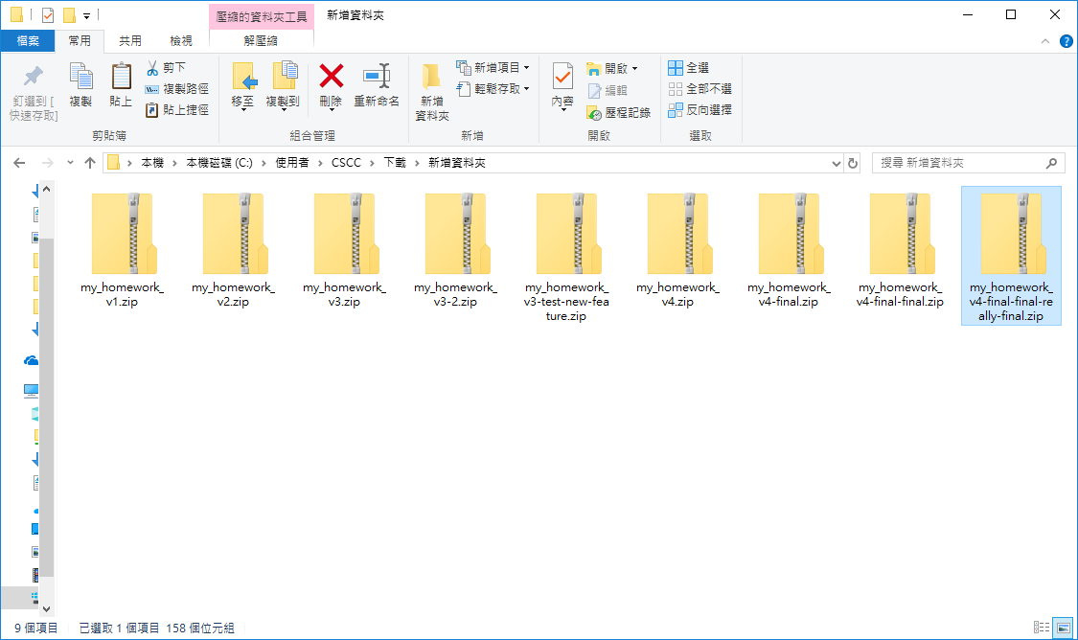
Why VCS (1/3)
How do you manage your homework ?

Slide 4
Why VCS (2/3)
How did people do version control ?
Share files or archivers through CD, USB or Network
Patch
What’s wrong with this?
Hard to maintain & debug
Hard for integrity checking
Hard for collaboration
Bad thing always happens

Slide 5
Why VCS (3/3)
Version Control System
A tool helps you keep tracking your project history
A tool helps you collaboration with others
Common VCS
RCS/CVS
Subversion (SVN)
Mercurial (hg)
Fossil
Bazaar (bzr)
Git
… https://en.wikipedia.org/wiki/Comparison_of_version-control_software

Slide 6
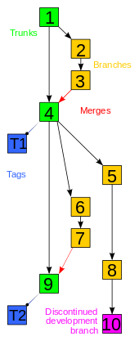
Version Control System
Common Concepts
Repository
Working Copy (or directory/tree)
Common Operations
Check in
Check out
Update
Merging / Resolving conflict
Locking
Labeling
https://zh.wikipedia.org/wiki/File:Revision_controlled_project_visualization-2010-24-02.svg

Slide 7
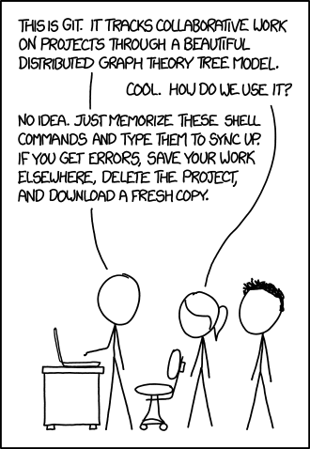
Git
NOT a software only for you to download codes from Github
Distributed version control system (DVCS)
P2P instead of Client-Server
Fast & convenient
Everything is at local and most of the operations don’t need to connect to the remote server
https://xkcd.com/1597/
https://explainxkcd.com/wiki/index.php/1597:_Git

Slide 8
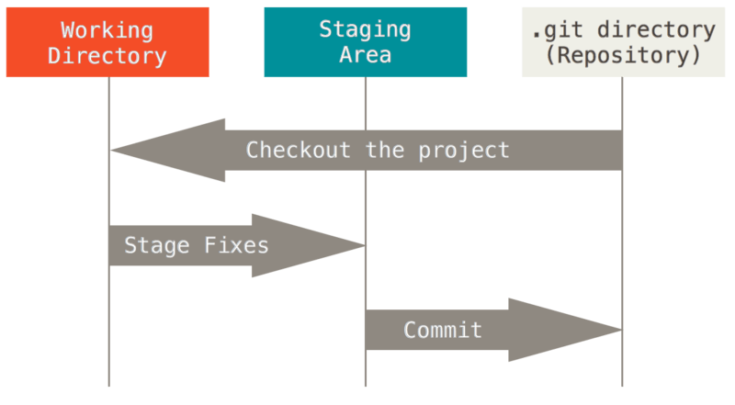
Git: the three sections & states
Modified, Staged, Committed
https://git-scm.com/book/en/v2/Getting-Started-What-is-Git%3F

Slide 9
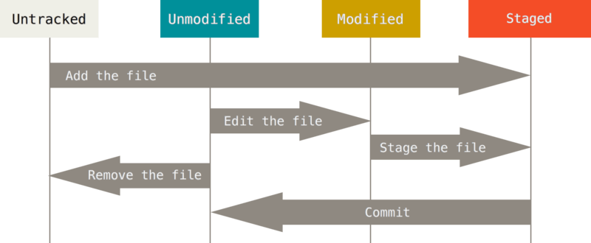
Lifecycle of the status of the files
https://git-scm.com/book/en/v2/Git-Basics-Recording-Changes-to-the-Repository

Slide 10
Using Git Personally
Help
`git help`
Base version control
init
status
add, commit
reset
View history
log
blame
Develop different feature
branch, tag, checkout
rebase, merge

Slide 11
Config
Set basic config before using git
Position
System (/etc/gitconfig or /usr/local/etc/gitconfig)
Personal (~/.gitconfig or ~/.config/git/config)
Repository (project-root/.git/config)
Try: `truss git 2>&1 | grep config`
Basic config
$ git config --global user.name "zswu"
$ git config --global user.email zswu@cs.nctu.edu.tw
Other useful config options
core.editor vim
merge.tool vimdiff
user.signkey

Slide 12
Init
Initialize an empty repository (or reinitialize)
Create a .git directory to store metadata

Slide 13
Status
Show the working tree status
Untracked files
Modified files
Deleted files
See “Short Format” section of `git help status`

Slide 14
Operations
https://zh.wikipedia.org/wiki/Git#/media/File:Git_operations.svg

Slide 15
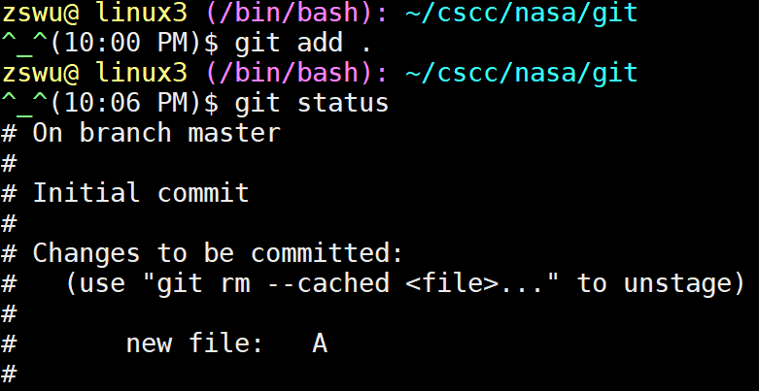
Add
Add files to the staging area (to be committed)
You don’t need to commit all the thing at the same time
Use a .gitignore file to prevent some files to be added

Slide 16
Commit
Save your current state
Has a hash ID
Parent hash ID
What you modified
Write some log message to help people know what and why have you done

Slide 17
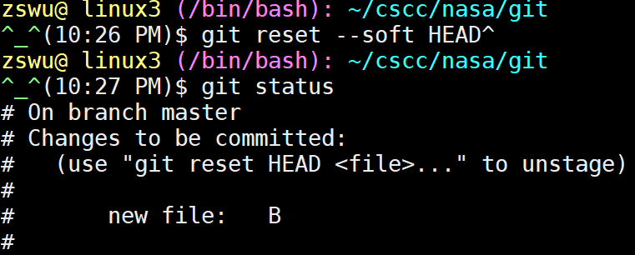
Reset
Reset a commit or reset temporary area
If you regret, you can remove all the changes from temporary area, or remove a commit
HEAD^ / HEAD~1, the previous commit of HEAD
https://gitbook.tw/chapters/using-git/reset-commit.html

Slide 18
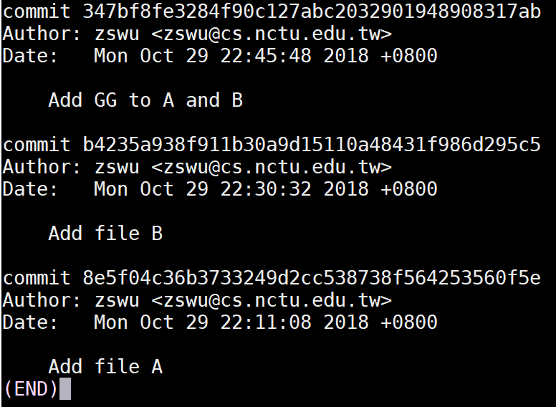
Log
List history of the repository
Commit message
Commit hash ID
Commit author

Slide 19
Blame
Detailed history of a file
To show the latest commit of each line
To find the last one edited this line

Slide 20
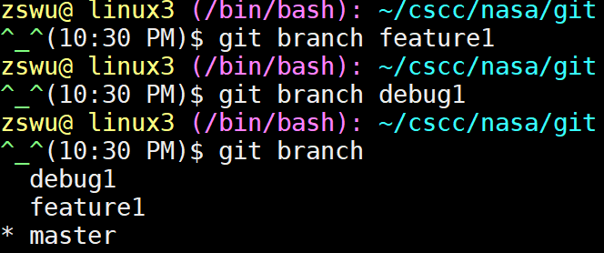
Branch
Work on multiple thing at the same time
Add feature or debug individually
Keep master branch stable

Slide 21
Tag
Tag specific commit
Release commit, e.g., v1.0.1, v1.2.3rc, v2.5b3
Tag point to only one commit
Ref: Semantic Versioning
https://semver.org/lang/zh-TW/

Slide 22
Checkout
Checkout something
Branch, Tag
Commit (by Hash ID)
A file / directory (to revert the local modification)

Slide 23
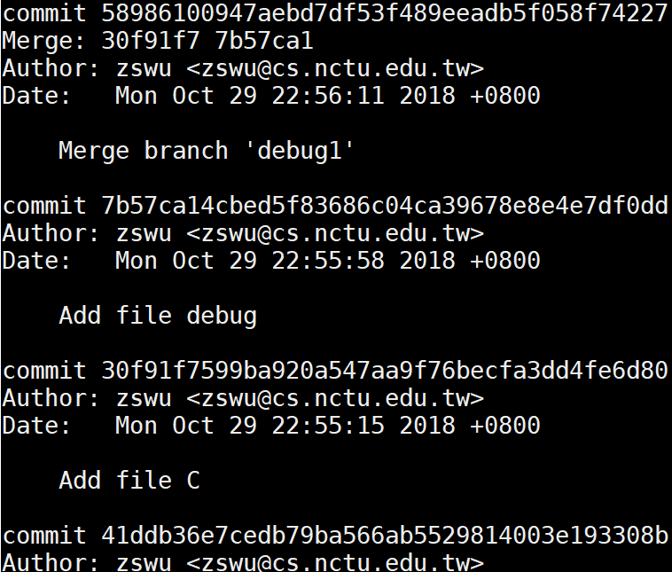
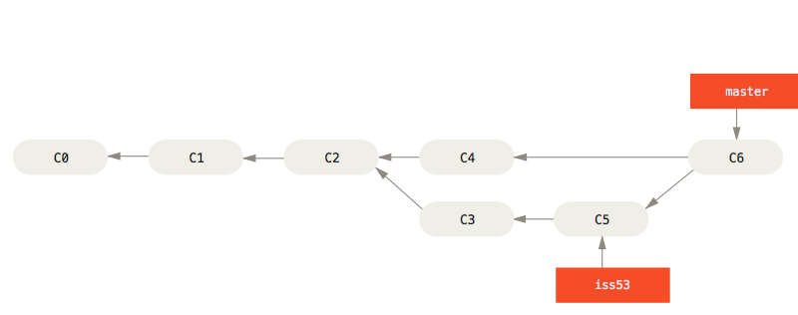
Merge
Merge branch B to branch A
If B is based on A, Fast-forward is applied
by default or can be turned off by --no-ff
If both A and B are changed, a merge commit is created
If auto merge failed, you need to resolve the conflict by yourself

Slide 24
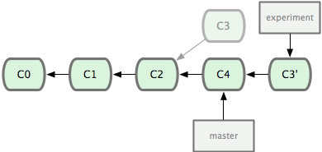
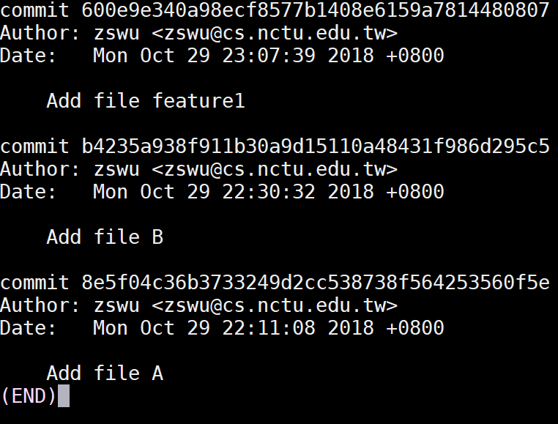
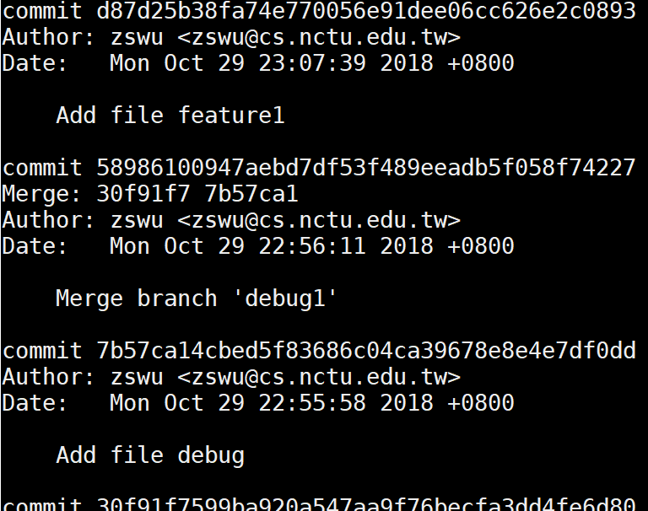
Rebase
Rebase branch B onto branch A
Apply each commit (diff) of branch B onto branch A
No merge commit (because it is not merge!)
If your branch B is forked from branch A, you can use rebase to apply the latest branch A commits
History is modified!

Slide 25
Using Git with Others
Remote repository
Clone
Remote
Fetch
Push
Pull => Fetch + Merge 、Fetch + Rebase
Conflict
Rebase/Merge --about/--skip/--continue
Stash / Stash pop
Revert

Slide 26
Clone
Clone a git repository
Copy all things including history, branches, tags

Slide 27
Remote
Manage remote (tracked) repositories
You can add many remote repositories
Usually, origin is your default remote repository

Slide 28
Fetch
Fetch new commits from remote
Remote branch will be placed at remote-name/branch-name
origin/master
origin/debug1
Usually, we will do this after fetch
$ git rebase origin/master

Slide 29
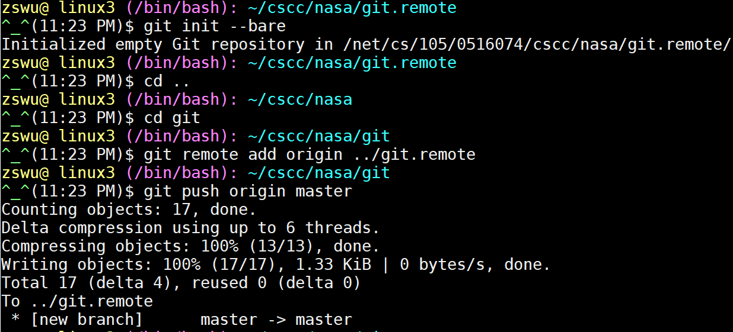
Push
Push things to remote branch
You must have write permission on the remote server
Push a branch to remote repository
If exists, update it
Can also be used to delete a remote repository (push an empty branch)

Slide 30
Pull
Pull is equal to fetch + merge, or fetch + rebase
Defaults to fetch + merge
Pull something adds a lots of merge message into your project
Use fetch + rebase instead
Still depends on your (team’s) workflow

Slide 31
Conflict
Why
Modify the same file
Auto merge failed
Squash commits
Squash will change commits history
$ git push -f
Try to not do this (to master branch)

Slide 32
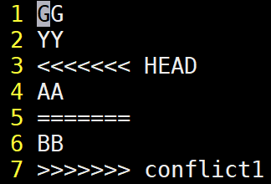
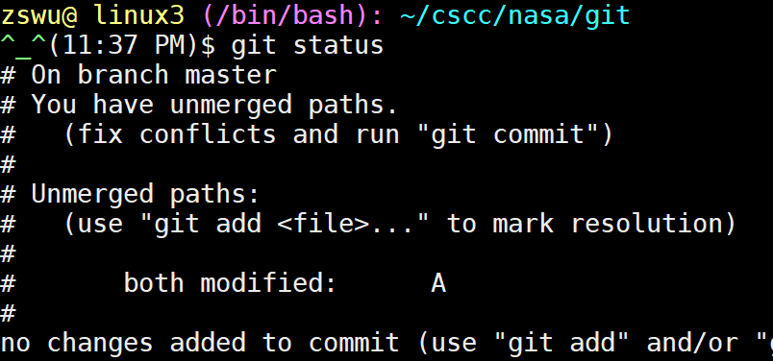
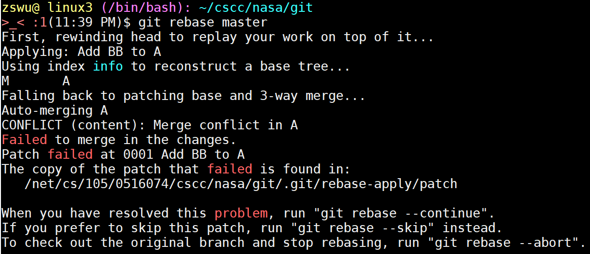
Merge/Rebase Conflict
Continue
After you fixed the conflict, continue the action (Merge/Rebase)
Skip
Skip this commit, it won’t be merge into target branch
Abort
Abort, nothing will change ☺

Slide 33
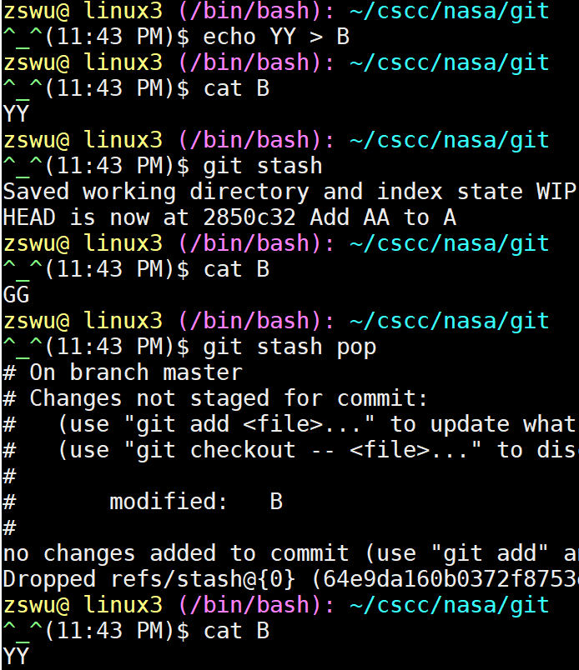
Stash / Stash Pop
Stash things not yet commit
Like a stack, first in last out
Convenient when rebasing/merging

Slide 34
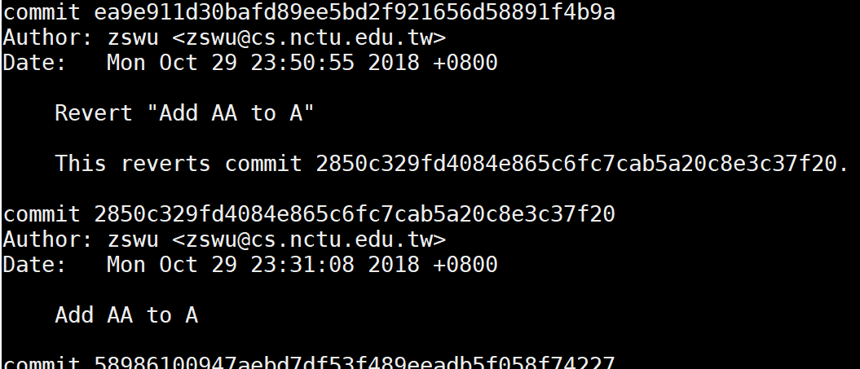
Revert
Revert a commit
Revert a commit by adding a new commit
Won’t break the history
The new commit is applying the negative version of the old commit

Slide 35
Etiquette Rules of Using Git (1/5)
Commit Message
What you done
Why
How
Format is important
`git --amend` / `git rebase -i HEAD~x`
Don’t modify master directly (after pushing)
Master branch may become unstable
Others need to solve the conflict that cause by your temporary code
To keep the history untouched

Slide 36
Etiquette Rules of Using Git (2/5)
Keep history clean
Don’t change the history if you share the branch with others
Unnecessary conflicts
Try not to use `git push -f`
Unnecessary conflicts
Try not to use merge except you are on the master branch
Use `rebase` instead
Branch may become incapable when being merged
unnecessary merge commit(s)
Try not to do `git pull` (fetch + merge)
Might add an unnecessary merge commit
Use `rebase -i`
Shape your commits

Slide 37
Etiquette Rules of Using Git (3/5)
Good commit message
Help others (including future you!)
Again, “what and why”
Ref:
https://chris.beams.io/posts/git-commit/
https://blog.louie.lu/2017/03/21/如何寫一個-git-commit-message/
http://blog.fourdesire.com/2018/07/03/撰寫有效的-git-commit-message

Slide 38
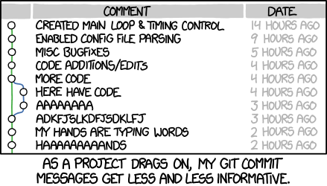
Etiquette Rules of Using Git (4/5)
Bad commit message
Ref:
http://www.commitlogsfromlastnight.com/
http://whatthecommit.com/
https://xkcd.com/1296/

Slide 39
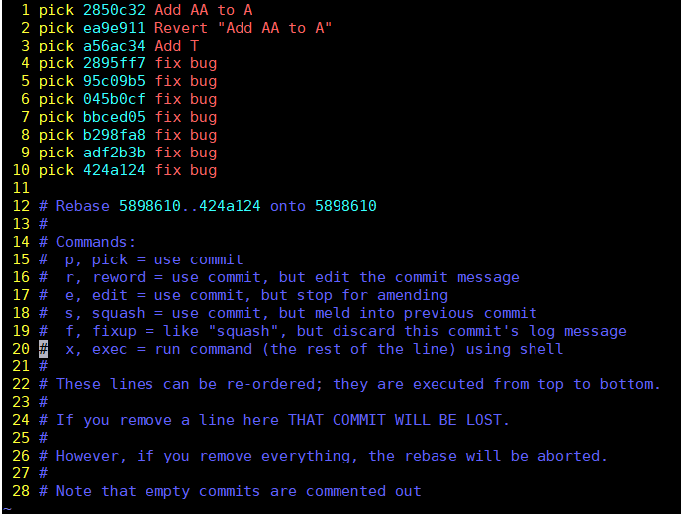
Etiquette Rules of Using Git (5/5)
Use rebase -i to create clean history
$ git rebase -i HEAD~10

Slide 40
Tools & Services (1/2)
Online Git Service
Web interface
Remote repository
Issue, Pull Requests (or Merge Requests… etc.)
Code Review
Community
CI/CD
Example
GitHub
GitLab
Bitbucket

Slide 41
Tools & Services (2/2)
Tools
Gerrit
Web-based code review tool
Tig
ncurses-based text-mode interface for Git
https://www.jianshu.com/p/e4ca3030a9d5
Git GUI
GUI-based interface for Git
KDiff3 / vimdiff / meld
Help users to solve conflict
etc.

Slide 42
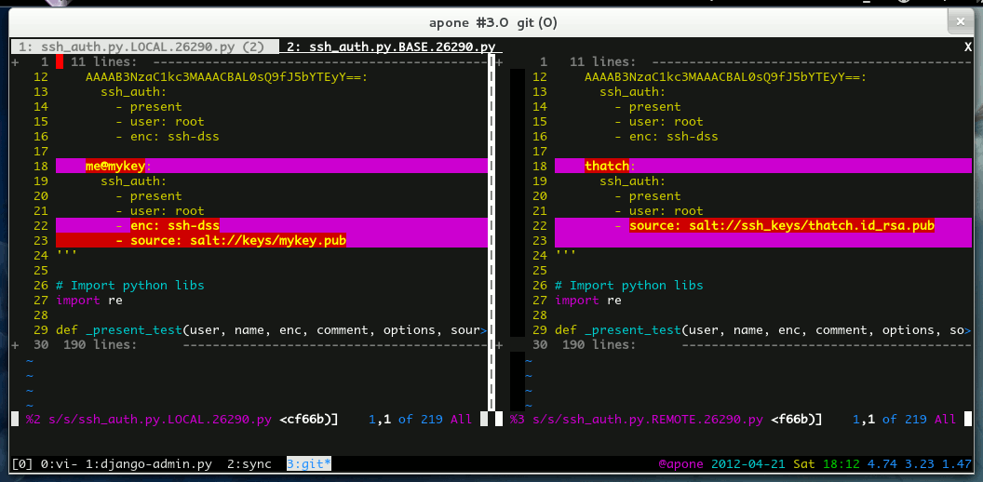
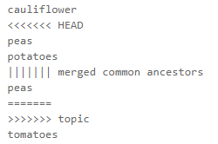
Tips (1/3)
Conflict Solving
Use merge tools
$ git config --global merge.tool kdiff3
Show common ancestor
$ git config --global merge.conflictstyle diff3
Change merge algorithm
$ git merge --strategy-option=patience
More...
https://developer.atlassian.com/blog/2015/12/tips-tools-to-solve-git-conflicts/

Slide 43
Tips (2/3)
History visualize
Use git log
$ git log --decorate --graph [--oneline]
$ git log --graph --abbrev-commit --decorate --format=format:'%C(bold blue)%h%C(reset) - %C(bold green)(%ar)%C(reset) %C(white)%s%C(reset) %C(dim white)- %an%C(reset)%C(bold yellow)%d%C(reset)' --all
$ man git-log
~/.gitconfig: [alias] gl = log --graph --pretty=oneline --

Slide 44
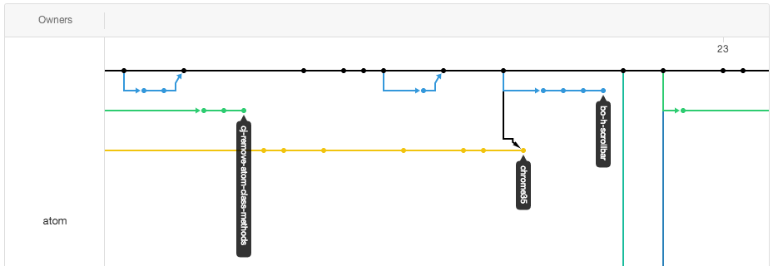
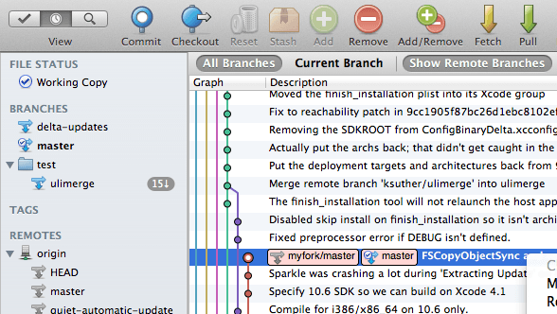
Tips (3/3)
History visualize (cont.)
GitHub / Online tools
Git GUI

Slide 45
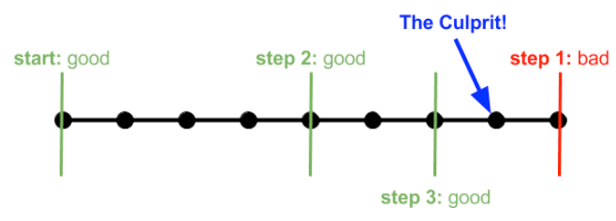
bisect
Use binary search to find the commit that introduced a bug
git bisect start
git bisect good/bad
Ref:
https://git-scm.com/book/en/v2/Git-Tools-Debugging-with-Git
https://www.sumologic.com/blog/who-broke-my-test-a-git-bisect-tutorial/

Slide 46
Useful links
Reference
為你自己學 Git
https://gitbook.tw
Pro Git
https://git-scm.com/book/en/v2
A Visual Git Reference
https://marklodato.github.io/visual-git-guide/index-en.html
Utilities
.gitignore generator
https://www.gitignore.io

Slide 47
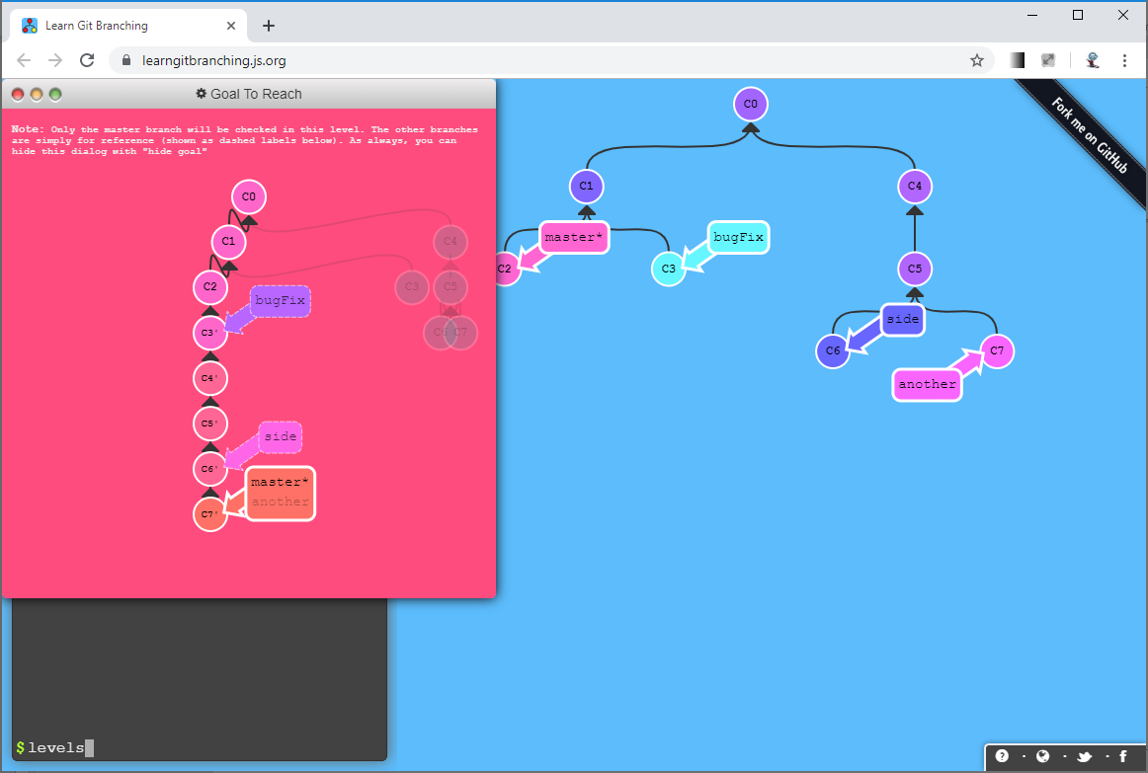
Learn Git Branching
https://learngitbranching.js.org/

Slide 48
Git Workflow(s)
GitHub flow
https://guides.github.com/introduction/flow/
Git workflow
https://nvie.com/posts/a-successful-git-branching-model/
https://gitbook.tw/chapters/gitflow/why-need-git-flow.html
Which one?
https://blog.wu-boy.com/2017/12/github-flow-vs-git-flow/

