Slide 1
The Network File System
lwhsu (2019, CC-BY)
? (?-2018)

Slide 2
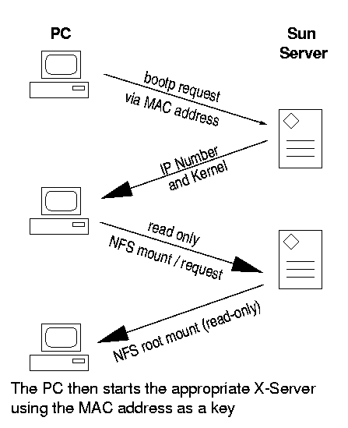
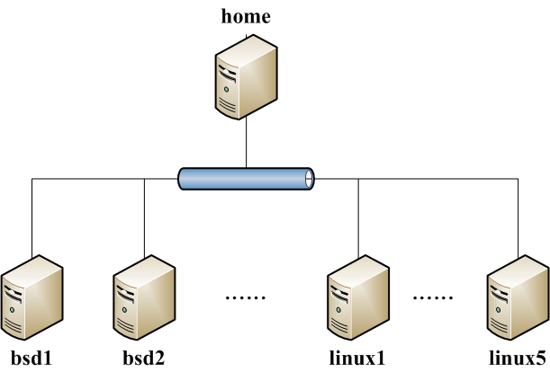
NFS
Share filesystem(s) to other hosts via network
NFS History
Introduced by Sun Microsystems in 1985
Originally designed for diskless client-server architecture

Slide 3
Components of NFS – mounting protocol (1)
NFSv1
In-house experiments in Sun
NFSv2
Synchronous write
V2 NFS server must commit each modified block to disk before replying to NFS client
Cause long delay when there is a NFS write operation
UDP
NFSv3 in 1990s
Asynchronous write
Provide increase performance and better support for large files
TCP support

Slide 4
Components of NFS – mounting protocol (2)
NFSv4 in 2003s
Influenced by AFS and SMB/CIFS
NFSv4 ACL
Stateful protocol
Unicode support
Only port 2049 is used
NFSv4.1 in 2010
pNFS, parallel access, distributed servers
Multipathing
NFSv4.2 in 2016
Minor revision to NFSv4.1, adds some optional features
lseek(SEEK_DATA/SEEK_HOLE)
posix_fallocate()
posix_fadvise(POSIX_FADV_WILLNEED/POSIX_FADV_DONTNEED)
Server side copy of byte ranges between two files on the same NFS mount point when the copy_file_range(2) syscall is used.
Extended attribute support as specified by RFC-8276.

Slide 5
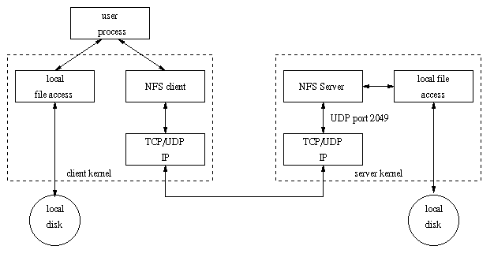
Components of NFS – mounting protocol (3)
Sun’s Open Network Computing (ONC) Remote Procedure Call (RPC) distributed computing standards
NFS client → RPC → Transport Layer → …
Transport Layer
UDP: Lack congestion control
TCP: become more suitable

Slide 6
Components of NFS
Including
Mounting Protocol
Mount Server
Daemons that coordinate basic file service
Diagnostic utilities

Slide 7
Components of NFS – Server-side NFS (1)
NFS Server
Export sharing filesystem
System dependent
Waiting for “mount request”
mountd (rpc.mountd) daemon
Waiting for “file access request”
nfsd (rpc.nfsd) daemon
Lock the files being accessed (optional)
lockd (rpc.lockd) daemon
Check the correctness of the files (optional)
statd (rpc.statd) daemon

Slide 8
Components of NFS – Server-side NFS (2)
Exporting filesystem
Edit export configuration file
Each line is “what to export and how”
Reload related daemons
System | Exports info file | How to reload
FreeBSD | /etc/exports | /etc/rc.d/mountd reload
Linux | /etc/exports | /usr/sbin/exportfs -a
Solaris | /etc/dfs/dfstab | /usr/sbin/shareall
SunOS | /etc/exports | /usr/sbin/exportfs -a

Slide 9
Components of NFS – Server-side NFS (FreeBSD.1)
Exporting filesystem
/etc/exports
White-space separated
Format: directory-list options-list client-list
Option | Description
-ro | Exports read-only, default is (read-write)
-alldirs | Allow any subdirectory to be mounted
-maproot=user | Maps root to the specified user.
-mapall=user | Maps all UIDs to the specified user.
Client | Description
hostname | Host name (ex: mailgate ccserv)
netgroup | NIS netgroups
-network -mask | -network 140.113.235.0 -mask 255.255.255.0

Slide 10
Components of NFS – Server-side NFS (FreeBSD.2)
Example of /etc/exports
Network and mask cannot appear on the same line with hosts and netgroups
Reload daemons
% kill -1 `cat /var/run/mountd.pid`
/etc/rc.d/mountd restart
/usr/sbin/service mountd restart
/raid -alldirs -maproot=root mailgate ccserv backup
/raid -alldirs -maproot=65534 -network 140.113.209 -mask 255.255.255.0
/home -ro -mapall=nobody -network 140.113.235.0 -mask 255.255.255.0
/usr/src /usr/obj -maproot=0 bsd_cc_csie

Slide 11
Components of NFS – Server-side NFS (Linux.1)
Exporting filesystem
/etc/exports
Format: directory client-list-with-option
Ex: /home1 ccbsd5(ro)
Client | Description
hostname | Host name (ex: mailgate ccserv)
@netgroup | NIS netgroups
ipaddr/mask | CIDR-style specification (ex: 140.113.235.2/24)
Wild cards * ? | FQND with wild cards (ex: ccbsd*.csie.nctu.edu.tw)

Slide 12
Components of NFS – Server-side NFS (Linux.2)
Option | Description
ro,rw | Read-only, Read-write (default)
rw=list | Hosts in the list can do rw, others ro only
root_squash | Maps UID 0 and GID 0 to the value of anonuid and anongid (default)
no_root_squash | Allow root access
all_squash | Maps all UID and GID to anonymous one
subtree_check | Check that the accessed file is in the appropriate filesystem and in the exported tree.
no_subtree_check | Disables subtree checking
anonuid=xxx | Related to root_squash
anongid=xxx | Related to root_squash
secure | Require remote access from privileged port
insecure | Allow remote access from any port
noaccess | Prevent access to this dir and it’s subdir

Slide 13
Components of NFS – Server-side NFS (Linux.3)
Example of /etc/exports
Run /usr/sbin/exportfs
% /usr/sbin/exportfs -a
Maintain /var/lib/nfs/xtab table which is read by mountd
/home1 ccsun*.csie.nctu.eud.tw(rw)
/home2 @sun_cc_csie(ro) dragon(rw,no_root_squash)
/home ccpc1(rw,all_squash,anonuid=150,anongid=100)
/ftp/pub (ro,insecure,all_squash)
/users *.xor.com(rw)
/users/evi (noaccess)

Slide 14
Components of NFS – Server-side NFS (Solaris.1)
Exporting filesystem
/etc/dfs/dfstab
Each line will execute “share” command to export one NFS
[format] share –F nfs -o option-list directory
Ex: share -F nfs -o rw=ccbsd5.csie.nctu.edu.tw /home2
Run shareall command
% /usr/sbin/shareall
Client | Description
hostname | Host name (ex: mailgate ccserv)
netgroup | NIS netgroups
IP networks | @CIDR-style specification (ex: @140.113.235.2/24)
DNS domains | .xxx.yyy any host within the domain (ex: .nctu.edu.tw)

Slide 15
Components of NFS – Server-side NFS (Solaris.2)
Option | Description
ro,rw | Read-only to all, Read-write to all
ro=list, rw=list | Hosts in the list can do ro/rw
root=list | Lists hosts permitted to access this filesystem as root. Otherwise, root access from a client is equivalent to by “nobody”
anon=xxx | Specify the UID to which root is remapped. Default is “nobody”
anongid=xxx | Related to root_squash
nosub | Forbids clients to mount subdirectories
nosuid | Prevents setuid and setgid from being created

Slide 16
Components of NFS – Server-side NFS (3)
nfsd daemon
Handle NFS file access request from NFS clients
Number of nfsd’s thread is important
Too small, some NFS requests’ response will be delayed
Too large, load will be high
nfsd(8)
-n thread
--maxthreads --minthreads
In FreeBSD
Specify nfsd options in /etc/rc.conf
nfs_server_enable="YES"
nfs_server_flags="-u –t –n 4"

Slide 17
Components of NFS – Client-side NFS (1)
NFS Client
Mount NFS filesystem first
Access file under NFS filesystem
mount command
[format]
mount [-o options] host:directory mount-point
Ex:
% mount –t nfs ccbsd4:/home/www /home/nfs/www
/etc/fstab (/etc/vfstab in Solaris)
% mount -a -t nfs (FreeBSD, Linux)
% mount -a -F nfs (Solaris)
mount_nfs(8)
# Device Mountpoint Fstype Options Dump Pass#
dragon:/usr/man /usr/man nfs ro,bg,soft 0 0
ccserv:/spool/mail /var/mail nfs rw,bg,intr 0 0

Slide 18
Components of NFS – Client-side NFS (2)
NFS mount flags
Flag | Systems | Description
ro or rw | S,L,F | Mount the NFS as ro or rw
bg | S,L,F | If failed, keep trying in background
hard | S,L | If server down, access will keep trying until server comes back
soft | S,L,F | If server down, let access fail and return error
intr, nointr | S,L,F | Allow/Disallow user to interrupt blocked access
retrans=n | S,L,F | # of times to repeat a request before error return
timeo=n | S,L,F | Timeout period of requests (tens of seconds)
rsize=n | S,L,F | Set read buffer size to n bytes
wsize=n | S,L,F | Set write buffer size to n bytes
vers=n | S | Selects NFS v2 or v3
nfsv3,nfsv2 | F | Selects NFS v2 or v3
proto=prot | S | tcp or udp
tcp | L,F | Select TCP. UDP is default

Slide 19
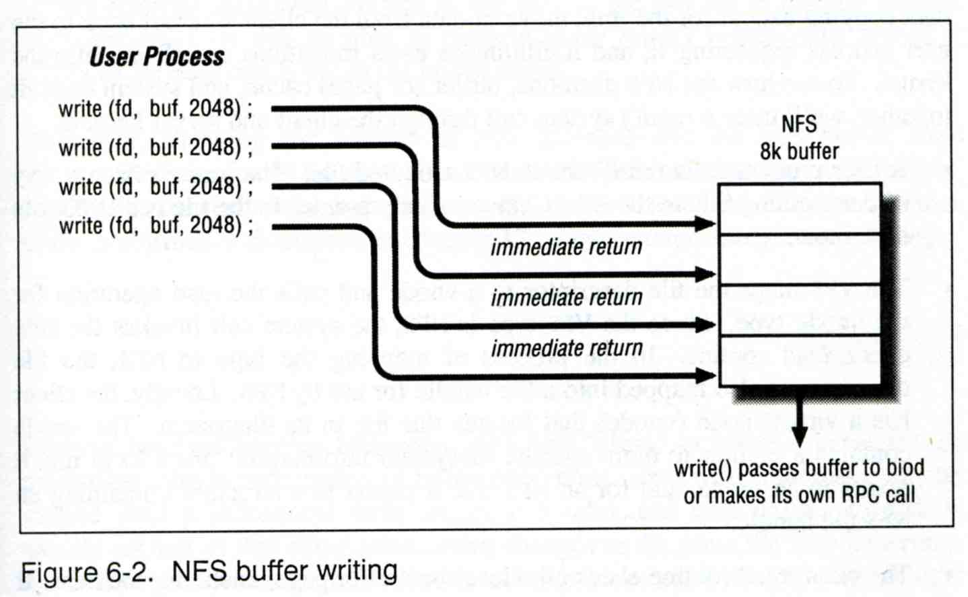
Components of NFS – Client-side NFS (3)
Client side daemons that enhance performance
biod (block I/O daemon, or called nfsiod)
Perform read-ahead and write-behind caching
A sysctl wrapper now (vfs.nfs.iodmin & vfs.nfs.iodmax)

Slide 20
Components of NFS – NFS Utilities (1)
nfsstat
Display NFS statistics
% nfsstat -s (display statistics of NFS server)
% nfsstat -c (display statistics of NFS client)
csduty [/u/dcs/94/9455832] -chwong- sudo nfsstat -c
Client Info:
Rpc Counts:
Getattr Setattr Lookup Readlink Read Write Create Remove
1065253 34196 379742 5187 111699 182603 18049 29803
Rename Link Symlink Mkdir Rmdir Readdir RdirPlus Access
20838 4746 1 10 1003 4705 0 316560
Mknod Fsstat Fsinfo PathConf Commit
0 13742 3889 0 75747
Rpc Info:
TimedOut Invalid X Replies Retries Requests
0 0 69 3994 2267773
Cache Info:
Attr Hits Misses Lkup Hits Misses BioR Hits Misses BioW Hits Misses
1920497 1259363 1256973 379714 352854 102015 521158 182603
BioRLHits Misses BioD Hits Misses DirE Hits Misses
347749 5187 14996 4685 6137 0

Slide 21
Components of NFS – NFS Utilities (2)
showmount
% showmount -e [host]
show the hosts’ export list (localhost if not specified)
% showmount -a
List all mount points
magpie [/u/dcs/94/9455832] -chwong- showmount -e magpie
Exports list on magpie:
/home ccduty mailgate 140.113.209.0
/drongo operator ccduty mailgate 140.113.209.0
cshome [/u/dcs/94/9455832] -chwong- showmount -a
All mount points on localhost:
bsd1:/home2
bsd1:/raid/home
csduty:/home2
csduty:/raid/home
linux1:/raid/home
linux2:/raid/home
nat235.dynamic:/raid/home
sun1:/raid/home

Slide 22
NFS in FreeBSD
NFS server
/etc/rc.conf
NFS client
/etc/rc.conf
…
nfs_server_enable="YES"
nfs_server_flags="-u -t -n 4"
rpcbind_enable="YES“
mount_enable="YES"
…
…
nfs_client_enable="YES"
…

Slide 23
NFS and ZFS
No need to edit /etc/exports
zfs sharenfs=
/etc/rc.d/mountd: if checkyesno zfs_enable; then
rc_flags="${rc_flags} /etc/exports /etc/zfs/exports"
fi
zfs(8)
sharenfs=on | off | opts
Controls whether the file system is shared via NFS, and what options
are used. A file system with a sharenfs property of off is managed
the traditional way via exports(5). Otherwise, the file system is
automatically shared and unshared with the "zfs share" and "zfs
unshare" commands. If the property is set to on no NFS export options
are used. Otherwise, NFS export options are equivalent to the
contents of this property. The export options may be comma-separated.
See exports(5) for a list of valid options.
When the sharenfs property is changed for a dataset, the mountd(8)
daemon is reloaded.

Slide 24
NFSv4
Server
/etc/rc.conf
nfsv4_server_enable="YES"
/etc/exports
V4: / …
Specify the NFSv4 tree root.
Still need to specify files systems in other lines, as in v2 or v3
Client
/etc/rc.conf
nfscbd_enable="YES"
Client side callback daemon
nfsv4(4), pnfs(4)

