Slide 1
Container
jnlin

Slide 2
Outline
Virtualization: machine level
Virtualization: OS level
FreeBSD jail
Docker

Slide 3
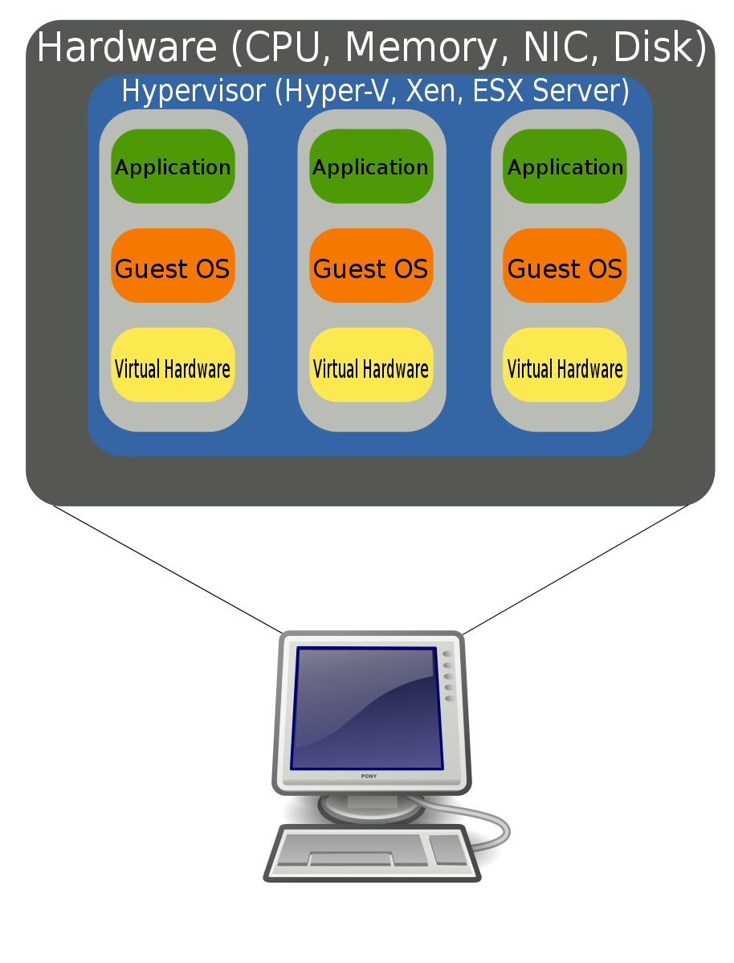
Virtualization – machine level (1)
Hardware virtualization
Emulate CPU, RAM, HDD, Network Interface …
Host OS and Guest OS
Isolated between each guest OS
Hypervisor
QEMU, VirtualBox, VMWare…
EC2, GCE (Google Computed Engine)

Slide 4
Virtualization – machine level (2)
Intel VT-x and AMD-V
An extension of CPU instructions to improve performance of virtualization
Include CPU and I/O virtualization
Pros
Better use of IT resources
Elasticity
Cons
Performance

Slide 5
Virtualization – OS level (1)
Multiple isolated user space instances
Share the same kernel
Must use the same operating system as the host one
Like chroot but more powerful
Containers can be live migrated (without restart service)
Container 1
Container 2
Container 3
App
App
App
OS Kernel

Slide 6
Virtualization – OS level (2)
Technologies
Docker – works on Windows, Mac OS X, and Linux as host OS
Jails – works on FreeBSD
LXC, OpenVZ
Pros
Better performance
Better security
Use the same environment in development and production
Cons
Complex to understand (by software developers, if they did not take the SysAdm course ;-)

Slide 7
FreeBSD jail (1)
jail(8)
Preparation (from base image)
% mkdir -p /home/jails/firstjail
% export DESTDIR=/home/jails/firstjail
% export DESTRELEASE=12.0-RELEASE
% export DESTARCH=`uname -m`
% export SOURCEURL=http://ftp.freebsd.org/pub/FreeBSD/releases/$DESTARCH/$DESTRELEASE/
% fetch $SOURCEURL/$base.txz
% tar -xf base.txz -C $DESTDIR

Slide 8
FreeBSD jail (2)
Start jail while booting
/etc/jail.conf
www {
host.hostname = www.example.org; # Hostname
ip4.addr = 192.168.0.10; # IP address of the jail
path ="/usr/jail/www"; # Path to the jail
devfs_ruleset = "www_ruleset"; # devfs ruleset
mount.devfs; # Mount devfs inside the jail
exec.start = "/bin/sh /etc/rc"; # Start command
exec.stop = "/bin/sh /etc/rc.shutdown"; # Stop command
}
jail_enable=“YES” (in /etc/rc.conf)

Slide 9
FreeBSD jail (3)
jls – list all jails
JID IP Address Hostname Path
3 192.168.0.10 www /usr/jail/www
jexec – execute commands in a jail
jexec 3 ps -auxww

Slide 10
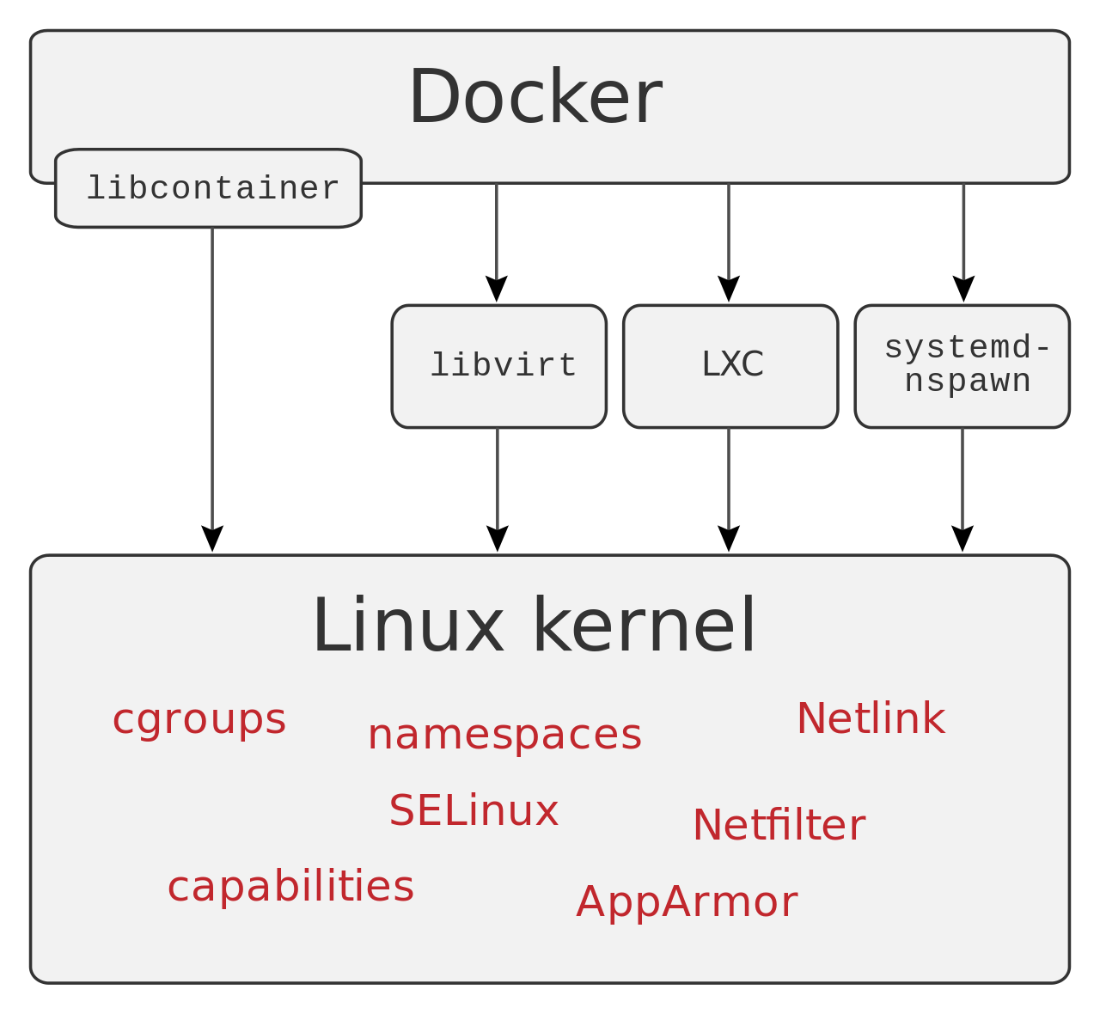
Docker
Most popular OS level virtualization technology in the 2010s
Open sourced (Apache License 2.0), Developed by Docker Inc.
Use different interfaces to access virtualization features of Linux kernel
Infrastructure as Code

Slide 11
Docker - Dockerfile (1)
Reuse pre-built images
Automate the process of building environment
Example
FROM alpine
RUN apk update && apk install curl
COPY myapp /app/myapp
CMD /app/myapp

Slide 12
Docker - Image Layer (1)
A writeable layer on top of a bunch of read-only layers
Each RUN has its own commit
FROM alpine
RUN apk add curl
RUN https://xxx.yyy.zzz/data.tgz
RUN rm data.tgz
% docker history <image>
Keep image as small as possible

Slide 13
Docker - Image Layer (2)
overlayfs
combining numerous directories into one directory that looks like it contains the content from all the them.
You also can use ZFS to implement the same feature

Slide 14
Docker - Docker (Command Line)
docker pull
Pull an image from public or private repository
docker build
Build image from Dockerfile
docker run
Start a docker instance
docker kill
Stop a docker instance
docker rm
Remove resource used by a docker instance
docker ps
Show all docker instances (running or stopped)
docker push
Push the image to docker repository

Slide 15
Docker
Pros
IaC simplify the operating effort
Works on my computer server
Cons
Security
Scalability

