Slide 1
Samba
jnlin

Slide 2
Network-based File Sharing
FTP (File Transfer Protocol)
NFS (UNIX-based)
mountd is responsible for mount request
nfsd and nfsiod
Based on RPC
CIFS (Microsoft)
Common Internet File System
網路芳鄰
SMB (Server Message Block)
Share access to files, printers, …
Based on NetBIOS
Applikation
SMB
NetBIOS
NetBEUI | TCP/IP | IPX/SPX
NDIS (2,3,3.1,4,5)-Interface
Karten-Treiber (MAC)
Netzwerk-Karte

Slide 3
Service of SMB and NetBIOS
NetBIOS (Network Basic Input/Output System)
API related to the session layer allowing applications to communicate over a local area network
Name Service for name registration and resolution
Session service for connection-oriented communication
Datagram distribution service for connectionless communication
SMB
File and printer sharing service
Authentication

Slide 4
NetBIOS – Network Basic Input/Output System
NetBIOS (API)
1983 – developed as an API for software communication over IBM’s PC-Network LAN
NetBIOS relied on proprietary Sytek networking protocols
In 1985, IBM went forward with the token ring network scheme
NetBEUI – NetBIOS Extended User Interface
using the NetBIOS Frames (NBF) routing protocol
1985 – Microsoft created a NetBIOS implementation for its MS-Net network topology
By NBF protocol
Difference between local filesystem and network filesystem when accessing
Used to share or access network-based filesystem just as BIOS does in local filesystem
NetBIOS over TCP/IP
In 1987
NBT

Slide 5
NetBIOS Naming Service
Peer to peer (Workgroup model)

Slide 6
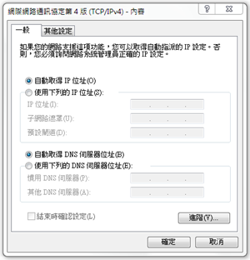
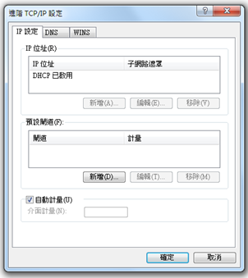
NetBIOS Naming Service
WINS

Slide 7
SMB – Server Message Block
SMB
Original designed by IBM with the aim of turning DOS interrupt local file access into a network filesystem
Run on top of netbios
Microsoft has made considerable modifications to the most common used version
1990 – Microsoft merged the SMB protocol with LAN Manager
1992 – Microsoft merged and add features to SMB protocol in Windows for Workgroup
1996 – Microsoft renames SMB as CIFS
Support for symbolic link, hard link, larger file sizes, …
Initial attempt at supporting direct connections over TCP port 445
2006 – Microsoft introduced SMB2 with Windows vista
Windows 7 – SMB 2.1
Performance enhancement with a new opportunistic locking
Windows 8/Windows Server 2012 – SMB 3.0 (Previously named SMB 2.2)
Enables the use of multiple physical network interfaces

Slide 8
UNIX-Windows communication
SAMBA
1991 – Andrew Tridgwell developed the first version of Samba
Using a packet sniffer on DEC Pathworks server software
A UNIX application that speak SMB protocol
Can not use the Original Name: Server Message Block (SMB)
Samba
grep -i '^s.*m.*b' /usr/share/dict/words
Napster, Simba
Why samba ?
Applikation
SMB
NetBIOS
NetBEUI | TCP/IP | IPX/SPX
NDIS (2,3,3.1,4,5)-Interface
Karten-Treiber (MAC)
Netzwerk-Karte

Slide 9
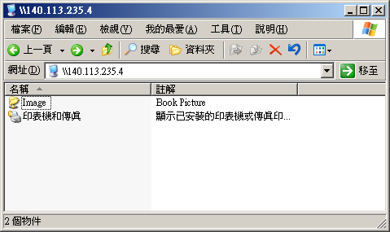
What SAMBA can do?
Sharing
Sharing files or printers just like Microsoft does
Authenticate user identity just like Microsoft does
Resolve NetBIOS name just like Microsoft does

Slide 10
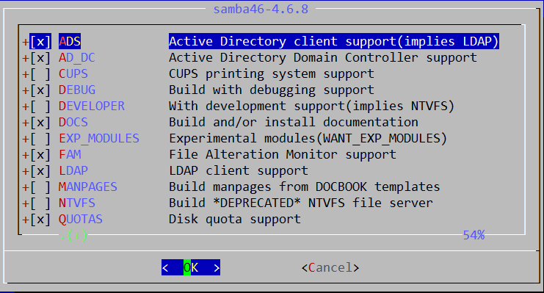
Install SAMBA
Using ports
% cd /usr/ports/net/samba46
Samba 4.6.8
% portmaster -BD net/samba46
Using package
% pkg install samba46

Slide 11
SAMBA components
Configuration files
/usr/local/etc/smb.conf.sample → /usr/local/etc/smb.conf
chmod 644 smb.conf
/usr/local/etc/lmhosts
Major execution files
smbd (/usr/local/sbin/smbd)
Management of sharing directories, files and printers
nmbd (/usr/local/sbin/nmbd)
Resolve NetBIOS name and manage workgroup
winbindd (/usr/local/sbin/winbindd)
WINS services
pdbedit (/usr/local/bin/pdbedit)
Manage the Samba user database
smbpasswd (/usr/local/bin/smbpasswd)

Slide 12
SAMBA password
samba4 password file
Now samba stores accounts and passwords in tdb
Default database path: /var/db/samba4
tdb v.s. smbpasswd
derek[~] -chiahung- sudo pdbedit -L -v
---------------
Unix username: chiahung
NT username:
Account Flags: [U ]
User SID: S-1-5-21-3763889141-129722405-4261865294-1000
Primary Group SID: S-1-5-21-3763889141-129722405-4261865294-513
Full Name: Chia-Hung Tsai
Home Directory: \\derek\chiahung
HomeDir Drive:
Logon Script:
Profile Path: \\derek\chiahung\profile
Domain: DEREK
Account desc:
Workstations:
Munged dial:
Logon time: 0
Logoff time: never
Kickoff time: never
Password last set: Mon, 12 Jul 2010 00:03:29 CST
Password can change: Mon, 12 Jul 2010 00:03:29 CST
Password must change: never
Last bad password : 0
Bad password count : 0
Logon hours : FFFFFFFFFFFFFFFFFFFFFFFFFFFFFFFFFFFFFFFFFF
---------------
derek[/var/db] -chiahung- sudo pdbedit -w -u chiahung
chiahung:1000:
XXXXXXXXXXXXXXXXXXXXXXXXXXXXXXXX:
3CDEC7966A2F9837F9F628DC13CC02AE:
[U ]:
LCT-4C39EB51:
https://www.samba.org/samba/docs/man/manpages/smbpasswd.5.html

Slide 13
SAMBA password
smbpasswd command
-a
Add new user
-d
Let some account in smbpasswd file can not login (to disable)
-e
Let some disable account resume (to enable)
pdbedit command
pdbedit -a username
Add new user
pdbedit -x username
delete user
pdbedit -L -v
List user
pdbedit -r -c username
pdbedit -r -c “[DX]” test

Slide 14
SAMBA configuration file
smb.conf
Sections
Each section in the smb.conf file represents either a share or a meta-service
Global section is special
Global setting
Meta-service
Printer Sharing Setting
Home Sharing Setting
# comments
[global]
para1 = value1
…
[printers]
para2 = value2
…
[homes]
para3 = value3
…
[share-dir]
para4 = value4
…

Slide 15
SAMBA configuration file – Global Setting (1)
Global Configuration
workgroup
Group name to join
Ex: workgroup = chwong
server string
Description of this host
Ex: server string = Samba Server of SA Course
netbios name
NetBIOS name of this host
Ex: netbios name = sabsd
Charset Settings
“display charset”, “unix charset”, “dos charset”
Ex:
unix charset = CP850
dos charset = CP850
hosts allow
Apply to all services, regardless or individual service setting;
Ex: hosts allow = 140.113.235. 140.113.

Slide 16
SAMBA configuration file – Global Setting (2)
guest ok (or public = yes)
If this is yes, no password is required
Ex: guest ok = no
guest account
If guest can use this samba service, any guest request will map to this guest account
Ex: guest account = ftp
Add this account into your /etc/passwd
Otherwise, the user nobody is used
log file
Full path of log file
Ex: log file = /var/log/samba/log.%m
max log size (KB)
Ex: max log size = 500

Slide 17
SAMBA configuration file – Global Setting (3)
security = [share/user/server/domain]
share: no need of id and password to login
user: default option, login with id and password
domain: check id and password by domain controller
ads: check id and password by AD server
server: check id and password by another server
It is highly recommended not to use this feature
Ex:
security = user
passdb backend = tdbsam

Slide 18
SAMBA configuration file – Global Setting (4)
Example of global setting
[global] server string = Samba Server Version %v
unix charset = CP850
workgroup = MYGROUP
log file = /var/log/samba/log.%m
max log size = 50
usershare allow guests = Yes
guest account = pcguest
security = USER
idmap config * : backend = tdb
cups options = raw

Slide 19
Samba parameters
Default parameters in samba
%m
Client NetBIOS name
%M
Client Hostname
%I
Client IP
%L
Samba server NetBIOS name
%h
Samba server Hostname
%H
User home directory
%U
Login name
%T
Current Date time

Slide 20
SAMBA configuration file – Home Sharing Setting (1)
Home sharing setting
comment
Description of this directory
path
Sharing directory path
browseable
Display sharing name or not
read only , writeable
admin users = $username
valid users = %S (write list)
Only users on this can write content if read only
create mode / create mask
Default permission when file is created
directory mode / directory mask
Default permission when directory is created
guest ok (or public = yes)

Slide 21
SAMBA configuration file – Sharing Setting (2)
Example of image sharing
[Image]
comment = Book Picture
path = /home/image
read only = no
public = yes
writable = yes
create mode = 0664
directory mode = 0775

Slide 22
SAMBA configuration file Additional tuning
Disable printer
load printers = no
printing = bsd
printcap name = /dev/null
disable spoolss = yes
Performance tuning
max protocol = SMB2
socket options = TCP_NODELAY
socket options = TCP_NODELAY SO_RCVBUF=8192 SO_SNDBUF=8192
read size
read prediction
…

Slide 23
Starting SAMBA
Script
/usr/local/etc/rc.d/samba {start|stop}
/etc/rc.conf
samba_enable="YES"
smbd_enable="YES"
nmbd_enable="YES"
winbindd_enable="YES"

Slide 24
smbstatus
Report on current Samba connections
hscc[~] -chiahung- smbstatus
Samba version 3.0.37
PID Username Group Machine
-------------------------------------------------------------------
47945 hscc hscc hscc-d30aedc531 (140.113.240.124)
48533 Pegasus hscc simba-pc (140.113.240.135)
47944 zn hscc bdeca39d90d4 (140.113.240.133)
Service pid machine Connected at
-------------------------------------------------------
zn 47944 bdeca39d90d4 Mon Oct 18 17:12:02 2010
hscc 47945 hscc-d30aedc531 Mon Oct 18 17:12:02 2010
Pegasus 48533 simba-pc Mon Oct 18 17:58:46 2010
Locked files:
Pid Uid DenyMode Access R/W Oplock SharePath Name Time
--------------------------------------------------------------------------------------------------
47947 509 DENY_NONE 0x100001 RDONLY NONE /home/hscc UG/Films/[USA
47946 509 DENY_NONE 0x100001 RDONLY NONE /home/hscc UG/Animation

Slide 25
Tool: smbclient (1)
A client program that can talk to an SMB server
Usage:
-L [hostname]
List sharable resource
-U [username]
Login with username
smbclient -L host_IP -U user_ID

Slide 26
Tool: smbclient (2)
hsccws5[~] -chiahung- smbclient -L hscc -U chiahung
Enter chiahung's password:
Domain=[HSCCLAB] OS=[Unix] Server=[Samba 3.0.37]
Sharename Type Comment
--------- ---- -------
IPC$ IPC IPC Service (HSCC SAMBA)
chiahung Disk Home Directories
Domain=[HSCCLAB] OS=[Unix] Server=[Samba 3.0.37]
Server Comment
--------- -------
HSCC HSCC SAMBA
Workgroup Master
--------- -------
EC219 EC219
HSCCLAB HSCC
LAB635 JJSU-LABPC
LAB636 2AMW1GP6PMLTL77

Slide 27
Tool: smbtree
A smb browser program in text mode
Usage:
-b Query network nodes by sending requests as broadcasts instead of querying the local master browser.
-D Only print a list of all the domains known on broadcast or by the master browser
-S Only print a list of all the domains and servers responding on broadcast or known by the master browser.
smbtree -b
mango@mango:~ $ smbtree
WORKGORUP
\\MANGOCOLD
SANA
\\SATA sata server
\\SATA\IPC$ IPC Service (sata server)
\\SATA\Video ftp directory
\\SATA\Image test directory

Slide 28
Tool: mount_smbfs
Mount a shared resource from an SMB file server
Usage:
-I
Do not use NetBIOS name resolver and connect directly to host, which can be either a valid DNS name or an IP address.
-N
Do not ask for a password.
Mount_smbfs (-I IP or host name) -N ‘//NetBIOS name/dir’ mount_point

Slide 29
Tool: testparm
check an smb.conf configuration file for internal correctness
Usage
testparm /usr/local/etc/smb4.conf
Load smb config files from /usr/local/etc/smb4.conf Processing section "[homes]” Processing section "[printers]” Processing section "[public]” Loaded services file OK. Server role: ROLE_STANDALONE Press enter to see a dump of your service definitions

Slide 30
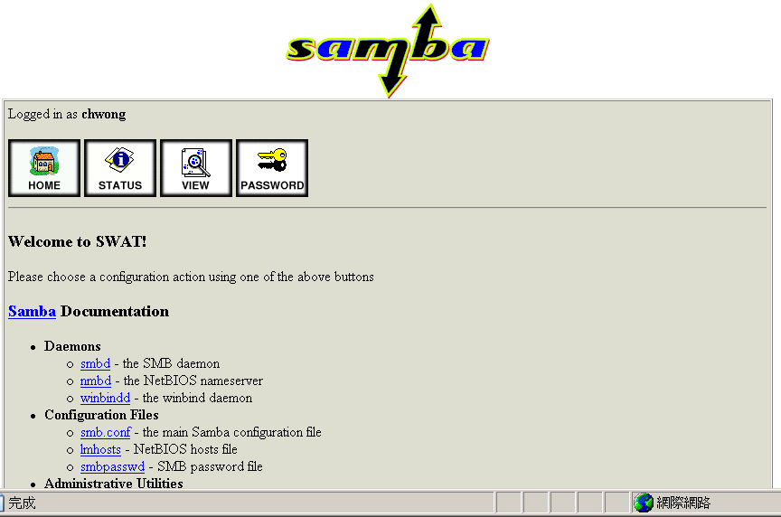
SWAT (1)
Edit /etc/inetd.conf
Unmark
Restart inetd
Browse http://sabsd.cs.nctu.edu.tw:901/
swat stream tcp nowait/400 root /usr/local/sbin/swat swat

Slide 31
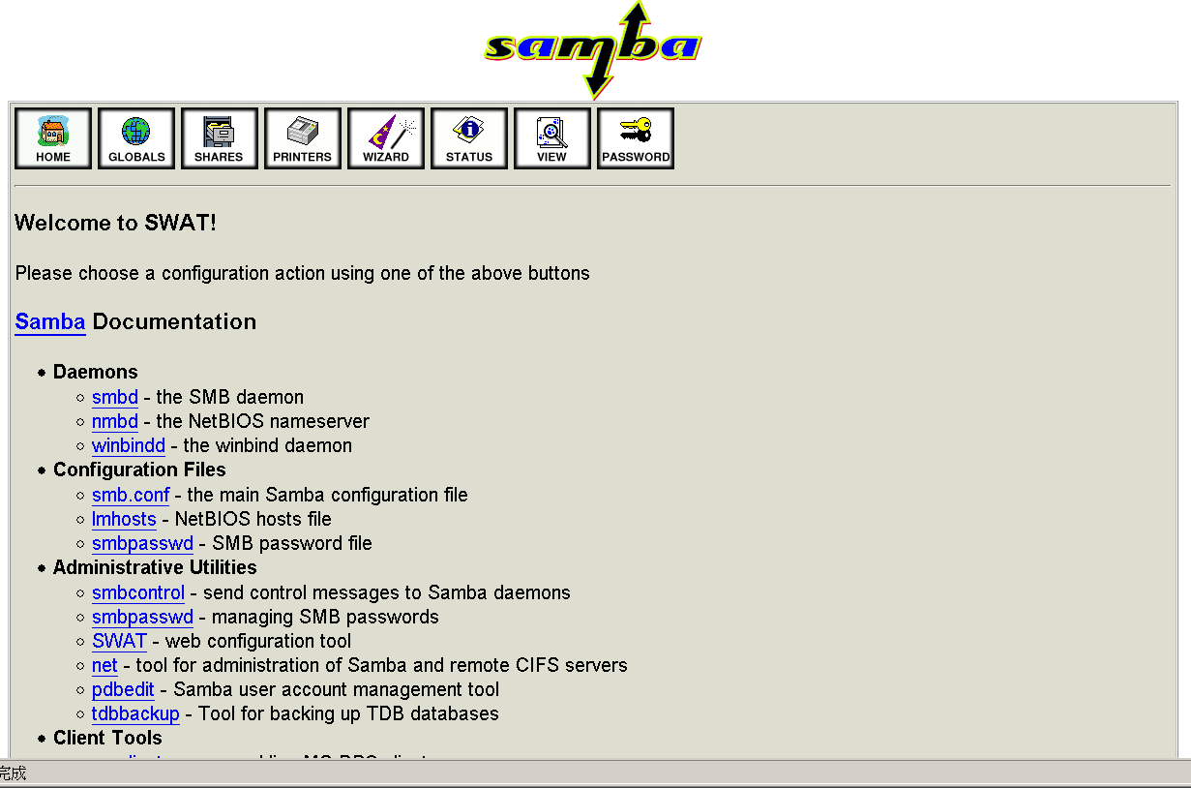
SWAT (2)
Root access

