Slide 1
Compute System Administration Homework 2: Shell Script
zswu

Slide 2
Requirements
2-1: File System Statistics (10%)
2-2: System Info Monitor (60%)
Demo (May include code modifications)(30%)
2-1 10%
2-2 20%

Slide 3
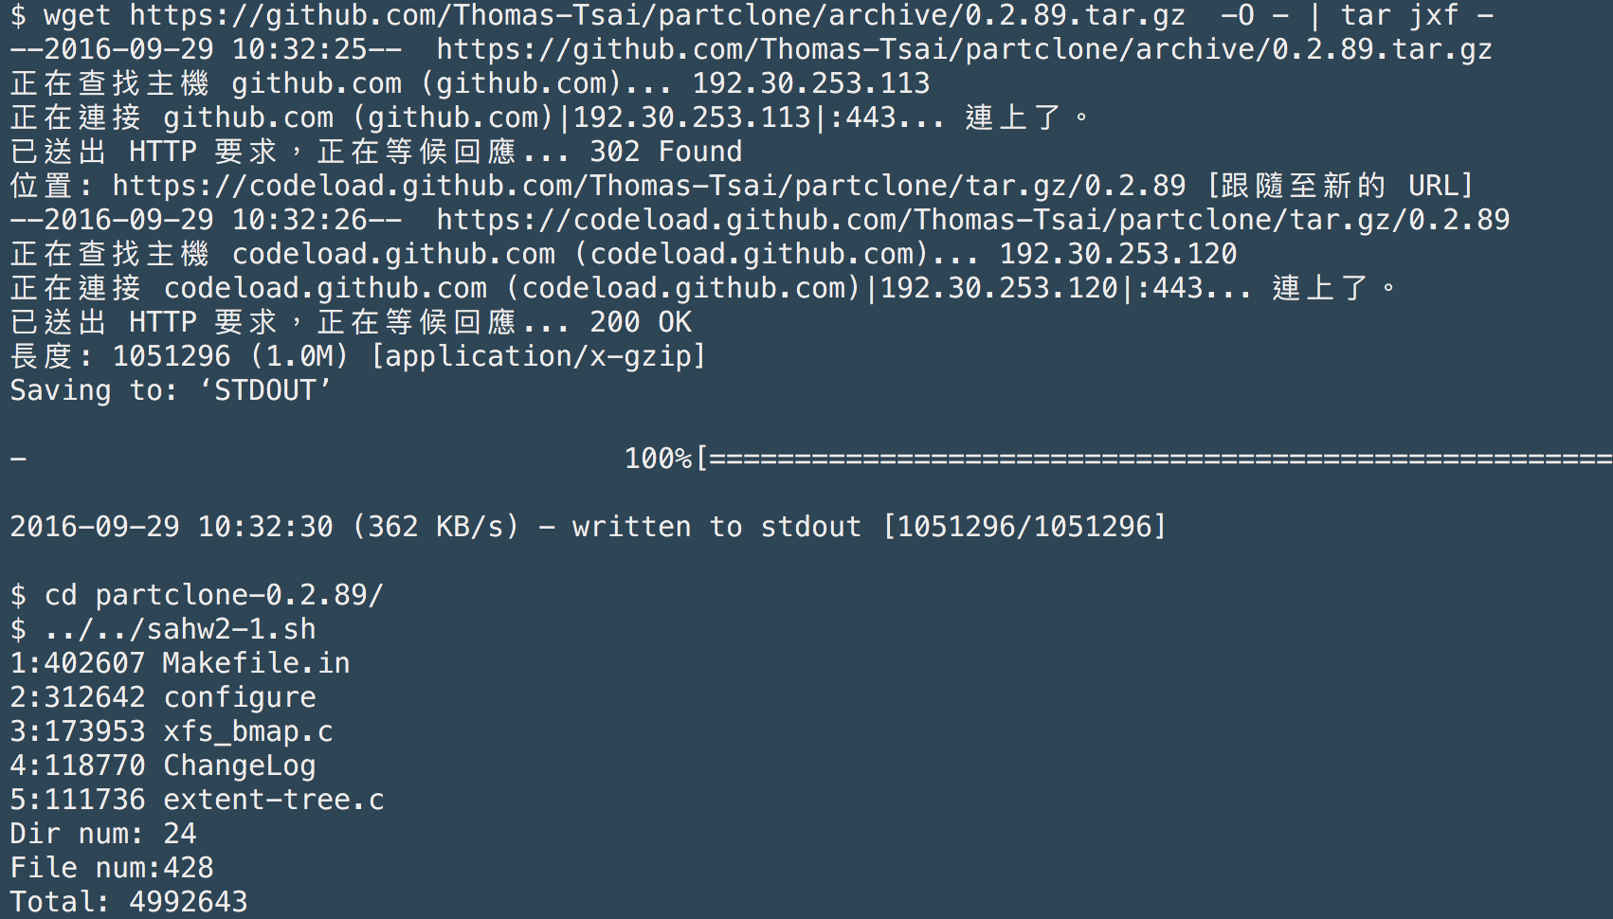
2-1: Filesystem Statistics

Slide 4
2-1: Filesystem Statistics – Requirement (1/3)
Inspect the current directory(“.”) and all sub-directories.
Calculate the number of directories.
Do not include ‘.’ and ‘..’
Calculate the number of files.
Calculate the sum of size of all files.
List the top 5 biggest files.
Only consider the regular files. Do not include links, FIFO, block devices... etc.

Slide 5
2-1: Filesystem Statistics – Requirement (2/3)
Use only Bourne Shell (/bin/sh).
No bash, csh, Python, Ruby…
/bin/sh in Linux is bash not Bourne Shell. Remember to test your code in a FreeBSD machine.
In ONLY ONE LINE. That is, use PIPE to calculate the results.
E.g. “ls | magic1 | magic2 | magic3” => results
No temporary files or shell variables.
Only PIPE is allowed.
Hint: ls(1) with -A and -R

Slide 6
2-1: Filesystem Statistics – Requirement (3/3)
Grade
File is executable. (4%)
You must know how to run your script with the following command
$ ./YOUR_SCRIPT_FILENAME
List the size and the name of the biggest 5 files. (4%)
Number of directories is correct. (4%)
Number of files is correct. (4%)
Total size is correct. (4%)

Slide 7
2-2: System Info Monitor (SIM)
Control Flow (10%)
CPU INFO (10%)
MEMORY INFO (10%)
NET INFO (10%)
FILE BROWSER (20%)
Please write the scripts in these shell languages.
sh, csh, tcsh, bash, ksh, zsh
No other languages. (e.g. Python, Ruby)
You can call “awk” in your script. (But you CANNOT call other languages like Python, Ruby… in your script)

Slide 8
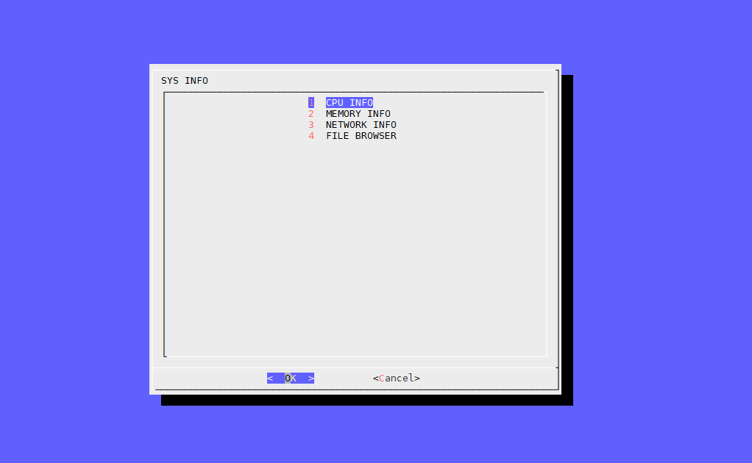
2-2: SIM – Control Flow (1/2)

Slide 9
2-2: SIM – Control Flow (2/2)
First menu shows four sub menus.
User can enter each of these sub menus by choosing each option.
User will return to the first menu after sub menu exit.
Program exit with return code 0 when user press “Cancel” button. If program exit by other ways (e.g. Ctrl + C), return code should be non-zero.

Slide 10
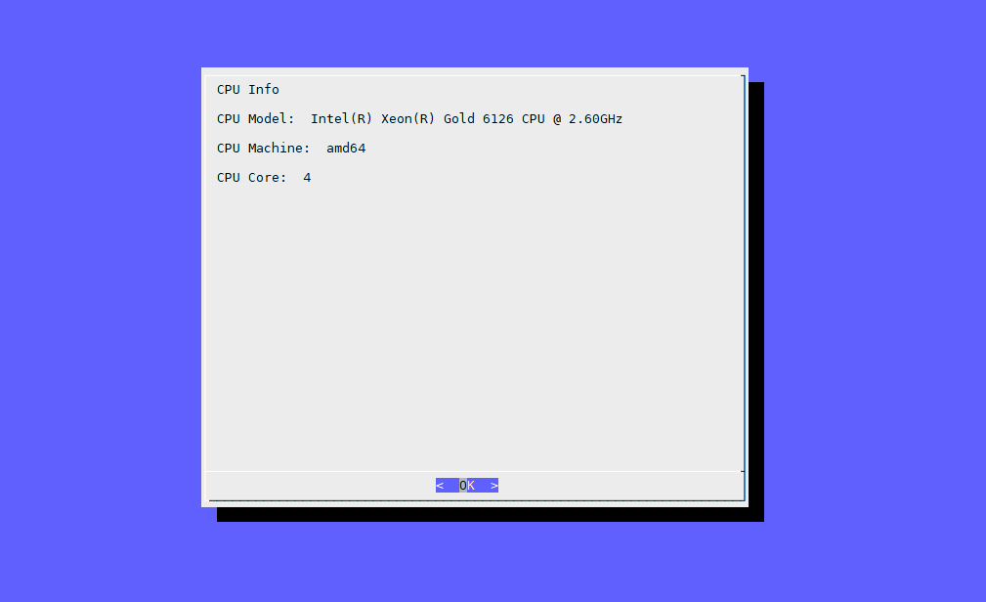
2-2: SIM – CPU INFO (1/2)

Slide 11
2-2: SIM – CPU INFO (2/2)
Show CPU Info
CPU Name
CPU Architecture (e.g. i386, amd64)
Number of CPU Cores
Hint: sysctl(8)

Slide 12
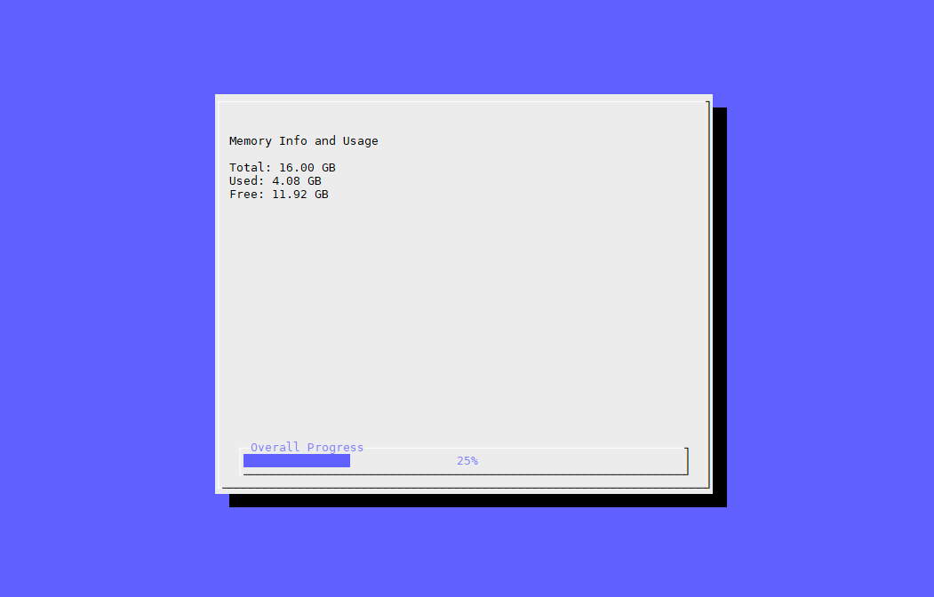
2-2: SIM – MEMORY INFO (1/2)

Slide 13
2-2: SIM – MEMORY INFO (2/2)
Show Memory Info
Total Memory
Used Memory
Free Memory
Percentage of used / total memory (progress bar)
Keep showing until user pressing ENTER.
Show suitable units
Number of memory must in the range 1 ~ 1024
If number is too large, use a bigger unit.
B, KB, MB, GB, TB…
Hint: sysctl(8)

Slide 14
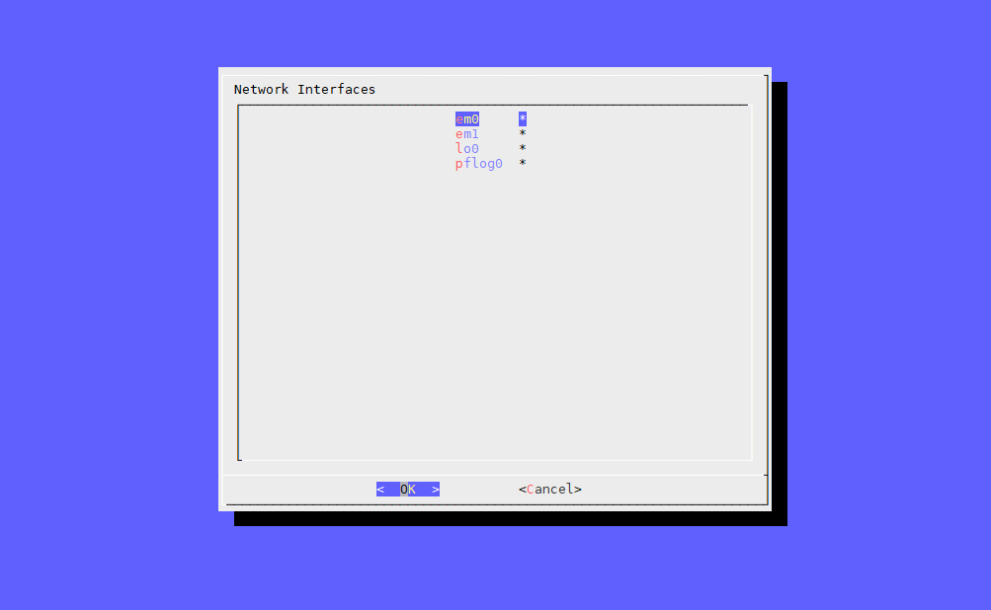
2-2: SIM – NET INFO (1/3)

Slide 15
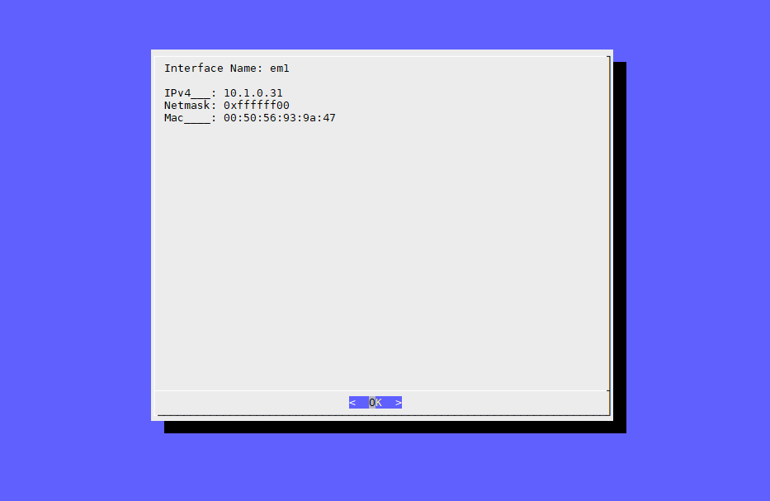
2-2: SIM – NET INFO (2/3)

Slide 16
2-2: SIM – NET INFO (3/3)
Show Net Info
Show all network devices in the sub menu.
For each devices show the following info
IPv4
Netmask
MAC
If the devices doesn’t have these info, keep that row blank.
After user press the OK button of the devices info panel, return to the Net Info sub menu.
Hint: ifconfig(8)

Slide 17
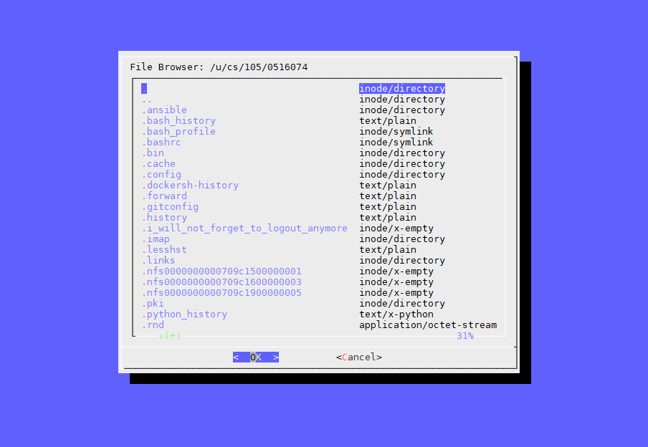
2-2: SIM – FILE BROWSER (1/4)

Slide 18
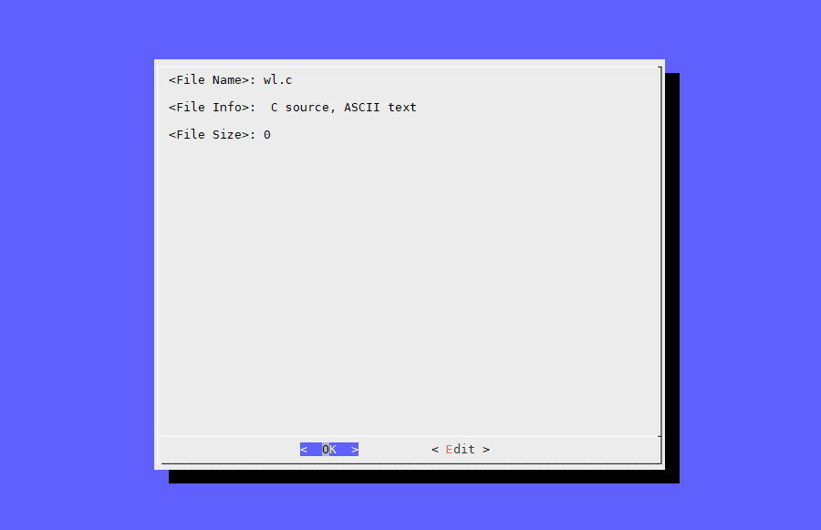
2-2: SIM – FILE BROWSER (2/4)

Slide 19
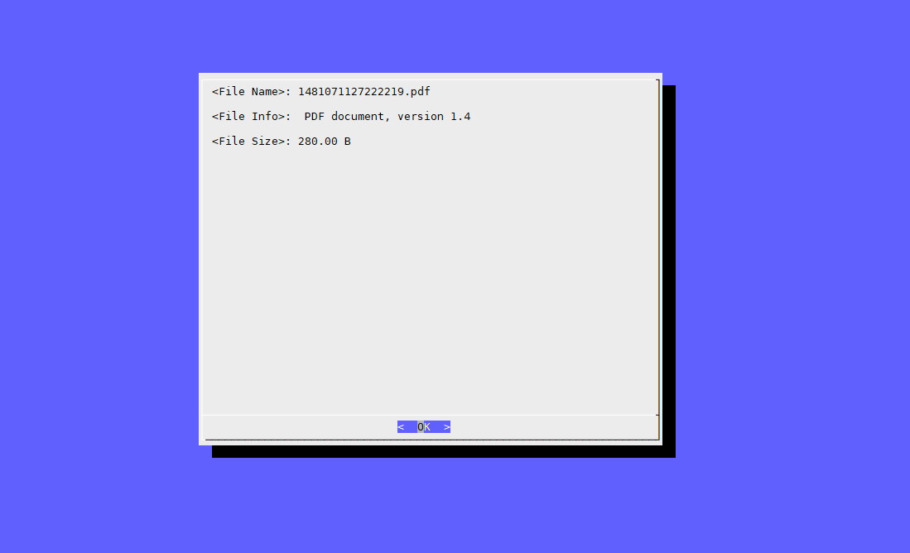
2-2: SIM – FILE BROWSER (3/4)

Slide 20
2-2: SIM – FILE BROWSER (4/4)
Show the current directory at the title.
Show all the files and directories under the current directory.
Name and MIME type of each file.
When user choose a directory, enter that directory and show the menu again.
When user choose a file, show a file panel with these info:
File name
File info (Hint: file(8))
File size (Suitable units, see MEMORY INFO)
If the file is a text file, show “edit” button.
When user press this button, open an editor to edit the file.
After the editor exit, return to the file panel.
Use “$EDITOR” environment variable to determine which editor to use.

Slide 21
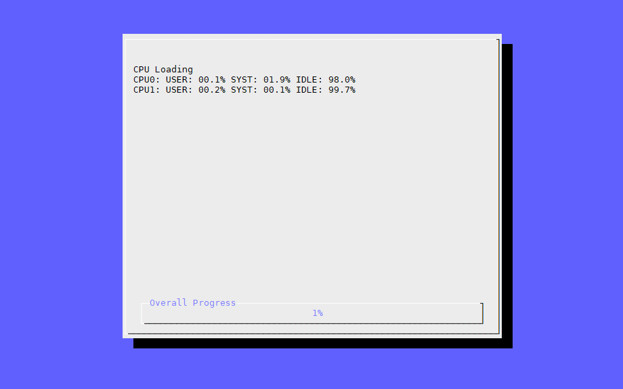
2-2: SIM – Bonus

Slide 22
2-2: SIM – Bonus
Show CPU Usage (+10%)
CPU usage is NOT average loading.
The style is similar to MEMORY INFO panel.
Show a progress bar of CPU loading.
Run until user pressing ENTER.
Show percentage of USER / SYS / IDLE CPU time for EACH CPU.
Hint
Try to understand what is user / sys / idle CPU time
top(8), htop(8), and others

Slide 23
Attention !
Don’t copy paste, or you will get 0 point.
If you use a shell or a language that is not allowed, you will get only 50% points in that part.
If you do not sure what can be use, ask TA first.
TA reserve the right of final explanations. Spec are subject to change without notice.
Due date: 2019/10/24 18:30
Upload ${student_ID}.tar which include all your scripts to New E3 (http://e3new.nctu.edu.tw)
Date of demo will be announced later.

Slide 24
Help!
Email to ta@nasa.cs.nctu.edu.tw
Don't email to TA directly. Use this mailing list.
Reply All !!!
New E3 https://e3new.nctu.edu.tw
Don’t ask question through E3.
Office hour: 3GH at EC318

