Slide 1
Computer System Administration Homework 3 – File Server
ychsiao

Slide 2
Overview (1/2)
Image that you are a TA of a course, the professor wants you to build a file server that students can submit their homework to
To prevent your colleagues from accidentally deleting files on the server, the snapshot and rollback features are needed

Slide 3
Overview (2/2)
File Server (100% + 15%)
FTP Server (50%)
ZFS on /home/ftp (25% + 10% Bonus)
Pure-ftpd uploadscript with rc (25%+5% Bonus)

Slide 4
FTP server

Slide 5
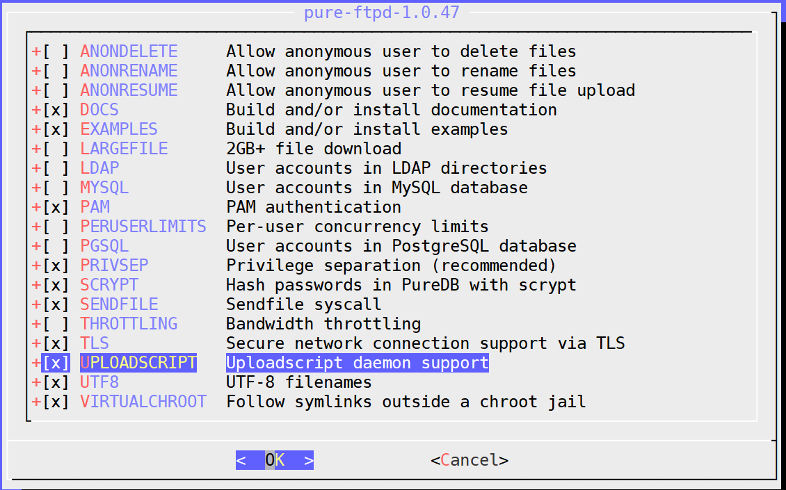
Installation
You can install pure-ftpd with pkg or port
If you install with port, remember to compile it with “upload script” support

Slide 6
Requirements (1/6) – Directories
Create three directories under /home/ftp
/home/ftp/public :
Everyone can download & upload file
Everyone can mkdir, rmdir, delete except anonymous.
/home/ftp/upload :
Everyone can upload & download
Everyone can mkdir except anonymous
Everyone can only delete & rmdir their own file or directory except anonymous and sysadm.
/home/ftp/hidden :
Create a directory called “treasure” inside hidden
Create a file called “secret” inside hidden/treasure
Anonymous can’t list /home/ftp/hidden but can enter hidden/treasure and show hidden/treasure/secret

Slide 7
Requirements (2/6)
Create four users
Create a system user “sysadm”
Can login by SSH
Password is your student ID
Full access to /home/ftp and subdirectories under “ftp”
Create two virtual users “ftp-vip1”, “ftp-vip2”
Password is your student ID
Can only delete files in /home/ftp/upload which are created by themselves.
Other permissions are same as sysadm.

Slide 8
Requirements (3/6)
Anonymous
Can’t create any directories
Can’t delete any files & directories
Can’t list /home/ftp/hidden but can enter hidden/treasure and show hidden/treasure/secret
Other requirements
Your ftp server should support Explicit FTP over TLS (FTPES)
All accounts are chrooted (/home/ftp is the root directory)

Slide 9
Requirements (4/6)
sysadm | public/ | upload/
upload | V | V
delete | V | V
mkdir | V | V
rmdir | V | V
download | V | V
V : full access △ : only the owner has permission
X : permission denied

Slide 10
Requirements (5/6)
ftp-vip | public/ | upload/
upload | V | V
delete | V | △
mkdir | V | V
rmdir | V | △
download | V | V
V : full access △ : only the owner has permission
X : permission denied

Slide 11
Requirements (6/6)
Anonymous | public/ | upload/
upload | V | V
delete | X | X
mkdir | X | X
rmdir | X | X
download | V | V
V : full access △ : only the owner has permission
X : permission denied

Slide 12
Grading (1/3)
FTP over TLS (5%)
sysadm (15%)
login from ssh (4%)
Full access to “public” (3%)
Full access to “upload” (4%)
Full access to “hidden” (4%)

Slide 13
Grading (2/3)
ftp-vip1, ftp-vip2 (15%)
Chrooted (/home/ftp) (4%)
Full access to “public” (3%)
Full access to “upload”, but can only delete their own files and directories. (4%)
Full access to “hidden” (4%)

Slide 14
Grading (3/3)
Anonymous login (15%)
chroot (/home/ftp) (4%)
Can only upload and download from “public” (3%)
Can only upload and download from “upload” (4%)
Hidden directory “/home/ftp/hidden” problem: can enter but can’t retrieve directory listing (4%)

Slide 15
Hint
README
/usr/local/share/doc/pure-ftpd/*
Accounts related
Virtual user
pure-pw(8)
pure-pwconvert(8)
README.Virtual-Users
If `pure-ftpd` is not working
Check your pure-ftpd.conf

Slide 16
ZFS on /home/ftp

Slide 17
Requirements (1/8)
Enable ZFS service
Reboot and everything is fine (ZFS still mount)
Add two new hard disks to create a mirror (RAID 1) storage called “mypool”
Use the added hard disk to create a mirror storage pool using the zpool command
Mount mypool on /home/ftp
Create ZFS datasets
Set lz4 compression, atime=off to all datasets
Create mypool/public, mypool/upload, mypool/hidden

Slide 18
Requirement (2/8): Zbackup
Automatic Snapshot Script
Usage:
Create: `zbackup DATASET [ROTATION_CNT]`
List: `zbackup -l|--list [DATASET|ID|DATASET ID]`
Delete: `zbackup -d|--delete [DATASET|ID|DATASET ID]`
Export: `zbackup -e|--export [DATASET|ID|DATASET ID]`
Import: `zbackup -i|--import FILENAME DATASET`

Slide 19
Requirement (3/8): Zbackup
Specification - Create (Default)
No more than rotation count snapshots per dataset
If rotation count has reached, delete the oldest one
If no rotation count specified, the default rotation shoud be 20
While creating a new snapshot, print log message to stdout
You’re snapshot should include the dataset name and date
[ychsiao@tSA ~]$ zbackup -l
ID DATASET TIME
[ychsiao@tSA ~]$ sudo zbackup mypool/public
Snap mypool/public@2019-10-31-13:52:01
[ychsiao@tSA ~]$ sudo zbackup mypool/public
Snap mypool/public@2019-10-31-13:52:20
[ychsiao@tSA ~]$ sudo zbackup mypool/public 1
Snap mypool/public@2019-10-31-13:52:47
Destroy mypool/public@2019-10-31-13:52:01
Destroy mypool/public@2019-10-31-13:52:20
[ychsiao@tSA ~]$

Slide 20
Requirement (4/8): Zbackup
Specification - List
The list should include id, dataset and time. Sorted by time.
If the variable is DATASET, list the snapshot of that dataset
If the variable is ID, list only the snapshot with that id
Otherwise, list all of the snapshot
[ychsiao]@[tSA][~]$ zbackup -l
ID DATASET TIME
1 mypool/public 2019-10-26-18:27:39
2 mypool/public 2019-10-26-18:27:41
3 mypool 2019-10-26-18:30:59
[ychsiao]@[tSA][~]$ zbackup -l 3
ID DATASET TIME
3 mypool 2019-10-26-18:30:59
[ychsiao]@[tSA][~]$ zbackup -l mypool/public
ID DATASET TIME
1 mypool/public 2019-10-26-18:27:39
2 mypool/public 2019-10-26-18:27:41
[ychsiao]@[tSA][~]$ zbackup -l mypool/public 2
ID DATASET TIME
2 mypool/public 2019-10-26-18:27:41
[ychsiao]@[tSA][~]$

Slide 21
Requirement (5/8): Zbackup
Specification - Delete
Delete snapshots created by zfs
If DATASET is specified, delete the whole dataset
If ID is specified, delete the dataset with that id
Otherwise, delete all snapshot of the dataset
[ychsiao]@[tSA][~]$ zbackup -l
ID DATASET TIME
1 mypool/public 2019-10-26-18:27:39
2 mypool/public 2019-10-26-18:27:41
3 mypool 2019-10-26-18:50:30
4 mypool 2019-10-26-20:11:32
5 mypool 2019-10-26-20:11:34
[ychsiao]@[tSA][~]$ sudo zbackup -d 1
Destroy mypool/public@2019-10-26-18:27:39
[ychsiao]@[tSA][~]$ sudo zbackup -d mypool 2
Destroy mypool@2019-10-26-20:11:32
[ychsiao]@[tSA][~]$ sudo zbackup -d mypool/public
Destroy mypool/public@2019-10-26-18:27:41
[ychsiao]@[tSA][~]$ sudo zbackup -d
Destroy mypool@2019-10-26-18:50:30
Destroy mypool@2019-10-26-20:11:34

Slide 22
Requirement (6/8): Zbackup
Specification - Export
Must specify dataset
ID defaults to 1
Compress with gzip
Encrypt with aes256 (Hint: Use openssl; Ask user to input password)
The filename for example: `dataset@2019-10-26-16:20:48.gz.enc`
You can put your export file at anywhere, as long as you can find it
[ychsiao@tSA ~]$ sudo zbackup -e mypool/public 1
enter aes-256-cbc encryption password:
Verifying - enter aes-256-cbc encryption password:
Export mypool/public@2019-10-29-13:07:36 to
/tmp/mypool/public@2019-10-29-13:07:36.gz.enc

Slide 23
Requirement (7/8): Zbackup
Specification
Import
Must specify filename and dataset
filename is the file exported by zbackup
Ask user to input password
Load the snapshot to the dataset
[ychsiao@tSA ~]$ sudo zbackup -i \
/tmp/mypool/public\@2019-10-29-13\:07\:36.gz.enc\
mypool/public2
enter aes-256-cbc decryption password:
[ychsiao@tSA ~]$ zbackup -l
ID DATASET TIME
1 mypool/public 2019-10-29-13:07:36
2 mypool/public2 2019-10-29-17:43:55
[ychsiao@tSA ~]$ ls /home/ftp/
hidden public public2 upload

Slide 24
Requirement (8/8): Zbackup
Error detection
Snap dataset@create_time of the new snap, e.g.,
Snap mypool@2019-10-25-09:36:02
Destroy dataset@create_time of the deleted snap, e.g.,
Destroy mypool@2019-10-25-09:31:55
Export dataset@create_time to your storage directory, e.g.
Export mypool/public@2019-10-25-09:31:55 to /tmp/mypool/public@2019-10-25-09:31:55.gz.enc
Import dataset@create_time.gz.enc to a new dataset@create_time
Import /tmp/mypool/public@2019-10-25-09:31:55.gz.enc to mypool/public2
Log must contain the action (e.g. snap), time and dataset name, but the format has no requirement
For any non-define operation, just print an error message and exit

Slide 25
Grading
ZFS on /home/ftp (25% + 10% Bonus)
Create a mirror storage (2%)
Create all dataset and set up correctly (3%)
Zbackup (20%+10%)
Create (5%)
List, Delete (10%)
Export, Import (+10%)
Error detection (5%)

Slide 26
Hint
It will be much easier if you implement `Delete`, `Export`, `Import` with a well coding `List`
Check handbook first
https://www.freebsd.org/doc/en/books/handbook/zfs-zfs.html
https://www.freebsd.org/doc/en/books/handbook/zfs-term.html

Slide 27
Pure-ftpd uploadscript with RC

Slide 28
Requirements (1/5) : uploadscript
Create a uploadscript.sh for recording every uploading into /var/log/uploadscript.log
The log message should required upload time, upload user, upload file name, and file size
Create the service `ftp-watchd` which enable to run the command after a successful upload
Execute uploadscript.sh when a file is successfully uploaded to the FTP Server
Passing arguments described in rc.conf
Don’t hardcore the command, the command can be specified in rc.conf

Slide 29
Requirements (2/5) : uploadscript
Execute a command defined in rc.conf whenever a file is uploaded
For example, set the following command in rc.conf :
echo “HI” and write to a file /tmp/hi
After four successful uploads, the command should be invoked as expected :

Slide 30
Requirements (3/5) : RC script
You should write an rc script ftp-watchd as a daemon to start the pure-uploadscript program
pure-uploadscript should be run in the background when ftp-watchd is started
Your service must support these operation
$ service ftp-watchd start
$ service ftp-watchd stop
$ service ftp-watchd restart
$ service ftp-watchd status
$ service ftp-watchd poll
[ychsiao@tSA ~]$ service ftp-watchd status
ftp_watchd is running as pid 9021.
[ychsiao]@[tSA][~]$ ps aux | grep pure-uploadscript root 9021 0.0 0.2 15560 6656 - Is 01:16 0:00.00 /usr/local/sbin/pure-uploadscript

Slide 31
Requirements (4/5) : RC script
Requires a pid file to indicate which process to stop
You should display as following format while using each command
Service start
Service stop
[ychsiao]@[tSA][~]$ cat /var/run/pure-uploadscript.pid
8210
[ychsiao]@[tSA][~]$ sudo service ftp-watchd start
Starting ftp_watchd.
[ychsiao]@[tSA][~]$ sudo service ftp-watchd stop
Kill: 8210

Slide 32
Requirements (5/5) : RC script
Service restart
Service status
Server poll
[ychsiao]@[tSA][~]$ sudo service ftp-watchd restart
Kill: 8191
Starting ftp_watchd.
[ychsiao]@[tSA][~]$ sudo service ftp-watchd status
ftp_watchd is running as pid 8210.
[ychsiao]@[tSA][~]$ sudo service ftp-watchd poll
Waiting for PIDS: 8210

Slide 33
Hint
Enable upload script under pure-ftpd.conf
CallUploadScript yes
For pure-uploadscript, you can manually start the daemon by following command
pure-uploadscript(8)
pure-uploadscript -B -r /your/uploadscript/to/execute

Slide 34
Grading
pure-uploadscript (10%)
pure-uploadscript should be activated (5%)
Record should be written in log file after any successful upload (5%)
ftp-watchd (15%+5%)
rc.d (5%)
Auto start on boot
Service operation work correctly (10%+5%)
User can specify command in rc.conf (5%)
start/status/restart (5%)
stop/poll (+5%)

Slide 35
Reminder
Demo with root is not allowed
Please use sudo
File/directory permissions are important
Owner, group, other
Read, write, execute
Set UID, set GID, sticky bit
Our demo will run on our intranet server savpn.nctu.me. Make sure your connection is available to the server. You can test it by the link below:
http://savpn.nctu.me:8080/
If the connect is not successful, check for your wireguard settings

Slide 36
Deadline
You do not need to submit anything
Due(Demo): 2019/11/27 (三)

Slide 37
Help!
Email to ta@nasa.cs.nctu.edu.tw
Do not send mail to New E3 https://e3new.nctu.edu.tw/ !!!
Office hour: 3GH at EC318

