Slide 1
System Administration Homework 4 – Web Server
austin

Slide 2
Environments
HTTP Server
NGINX and Apache are both allowed
PHP-FPM and PHP are both allowed
The TA has only tested all specs on NGINX+PHP-FPM currently
The content of pages that should display messages should satisfy:
Can be distinguished by eyes
Contain your Student ID

Slide 3
Environments
Networks
Intranet: Only one host other than your machine can access, which can be one of:
A VM with a host-only adapter connecting to the same network of the original machine
The host OS connecting to the machine using host-only adapter
One machine that is connected to your own private network
140.113.235.0/24 (If you have a public IP)
Public: The addresses that can be accessed from either:
The whole world: An public IP
The Wireguard VPN (10.113.0.0/16)

Slide 4
Outline
HTTP Server
Virtual Host (5%)
Access Control (5%)
Hiding server information (5%)
HTTPS (20%)
PHP (5%)
MySQL
Preparation for Nextcloud (10%)
HTTP Application
Basic app router (10%)
WebSocket Handling (10%)
Nextcloud (10%)
Personal webpage (10%)
DEMO (10%)

Slide 5
HTTP Server

Slide 6
Virtual Host
Setup a name-based virtual host
Show different content when connecting using domain name/IP (5%)
You can get a domain name from:
https://www.nctu.me
https://www.noip.com

Slide 7
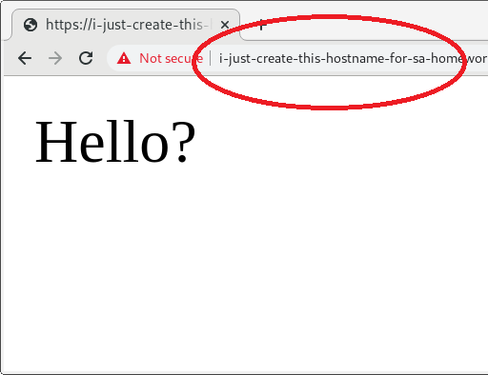
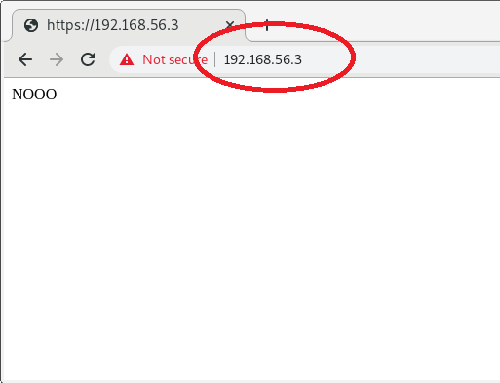
Virtual Host

Slide 8
Access Control
Place a webpage on https://{your-intranet-IP}/private
When accessing from intranet, it must show after passing Basic Auth authentication with username admin and password {your-student-ID}(3%)
Access from public network should be denied (return 403) (2%)

Slide 9
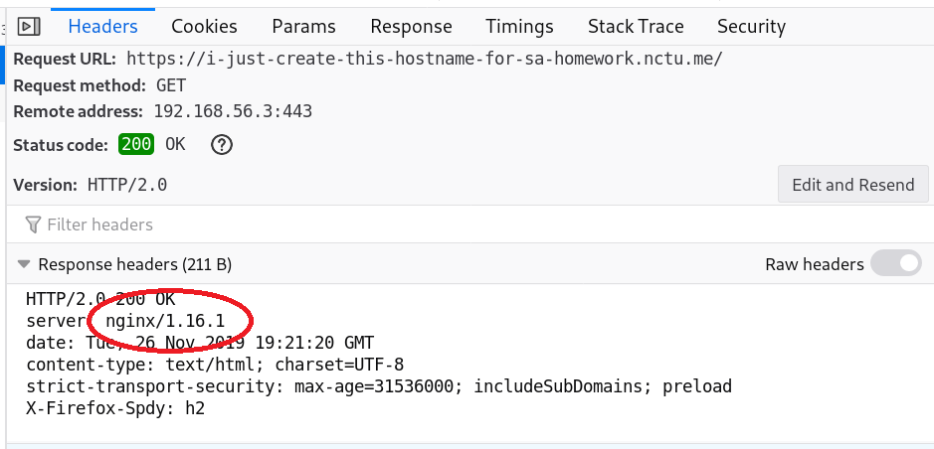
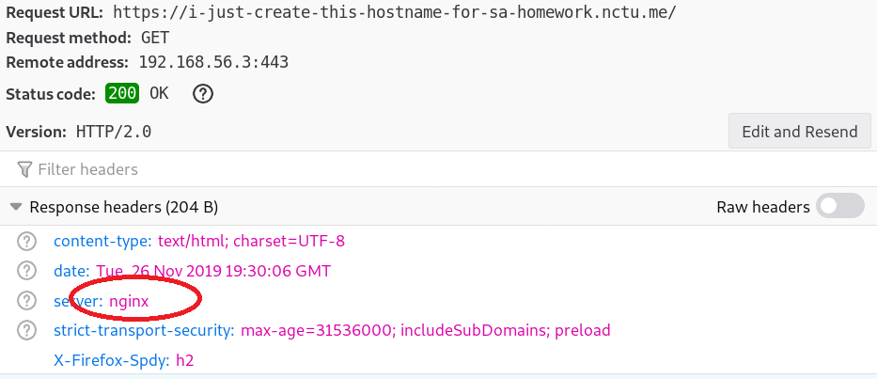
Hiding Server Information
Hide NGINX/Apache version in header (5%)

Slide 10
HTTPS
Enable HTTPS (5%)
Self-signed certificate is allowed
Supply –k option when testing with curl
Redirect to HTTPS automatically when attempting to connect to HTTP (5%)
Enable HSTS (5%)
Enable HTTP2 on pages connected with HTTPS (5%)
Can be tested with curl -–http2
Ensure that the server only provides ciphers not ‘blacklisted’ by http2

Slide 11
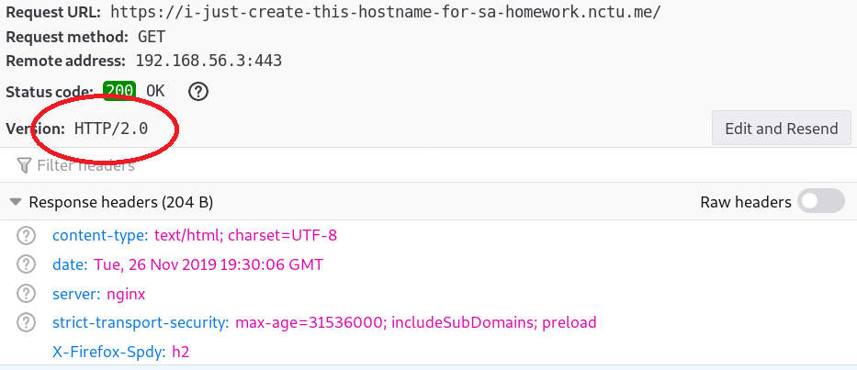
HTTPS

Slide 12
PHP/PHP-FPM
Set up PHP such that access to https://{your-domain}/info-{your-student-ID}.php gives response of phpinfo() (3%)
Hide PHP version information in header (2%)
Use PHP7 or higher, or you won’t get the points for this part

Slide 13
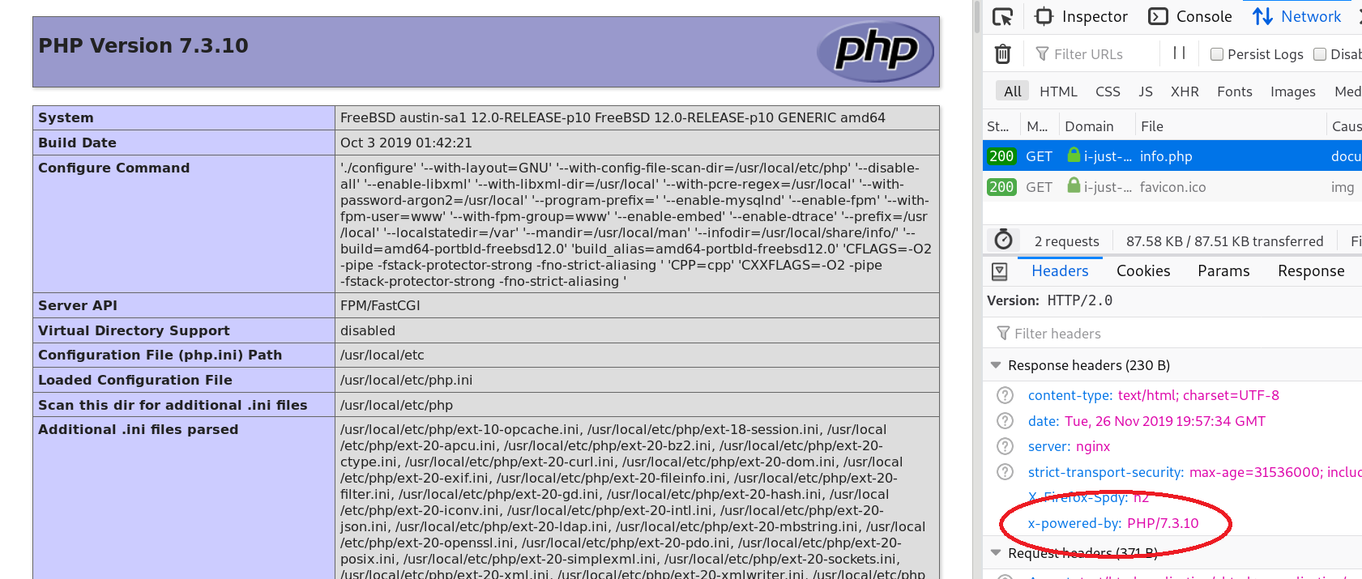

Slide 14
MySQL

Slide 15
MySQL: Prepare for Nextcloud
Set the transaction isolation levels to READ-COMMITED (3%)
Bonus: Explain what this and other isolation levels mean (+5%)
Create a MySQL user named ‘nc’ and a database named ‘nextcloud’, which satisfies:
The password of the user is your student ID (3%)
This user can only login from localhost (2%)
This user only have full privileges on database ‘nextcloud’ (2%)

Slide 16
HTTP Applications

Slide 17
Basic App Router
You can have only one file index.php in the root at the path https://{your-domain}/app , then rewrite all the request under this path to this file(You need to write php script)
There are three path displaying different contents:
https://{your-domain}/app
Display route: /
https://{your-domain}/app/{A}+{B} (A, B are integers)
Display result: {value of A+B}
https://{your-domain}/app?name={string}
Display Hello, {string}
(10%)

Slide 18
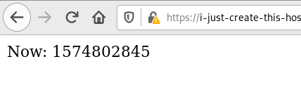
WebSocket
A sample program:
https://medium.com/@cn007b/super-simple-php-websocket-example-ea2cd5893575
This program crashes at client refresh, so just use it for test or demo
You can use other WebSocket program you want

Slide 19
WebSocket
You don’t need to support HTTP2 for WebSocket connection
You can use HTTP for this path if you cannot make it connected on port 443
Configure your HTTP server such the program run appropriately that when accessing http(s)://{your-domain}/wsdemo
Connect WebSocket on port other than 80, 443 (ws://) (3%)
Connect WebSocket on port 80 (ws://) (+3%)
Connect WebSocket on port 443 (wss://) (+4%)

Slide 20
Nextcloud
You can either install by pkg (v16) or download the latest version (v17)
Install on path https://{your-domain}/nextcloud
Use the database and user created in MySQL part
(10%)
Bonus: Fix all the warnings in Settings/Overview page (10%)

Slide 21
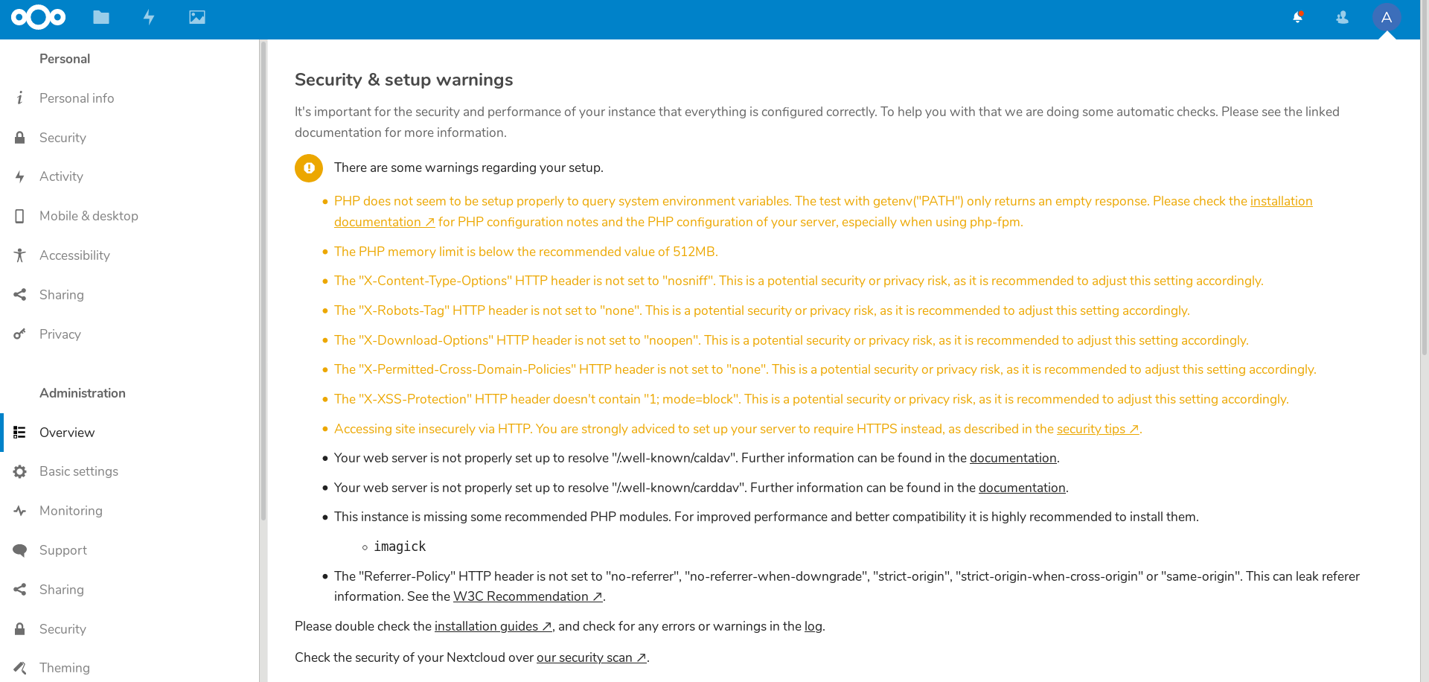

Slide 22
Personal Webpage
Each user in Nextcloud can put static(PHP is not needed) contents(img, html, css, js, etc.) in the public_html directory under their home
When accessing https://{your-domain}/sites/~{username}/ , it should show whatever {username} put in his public_html, with index index.html
(10%)

Slide 23
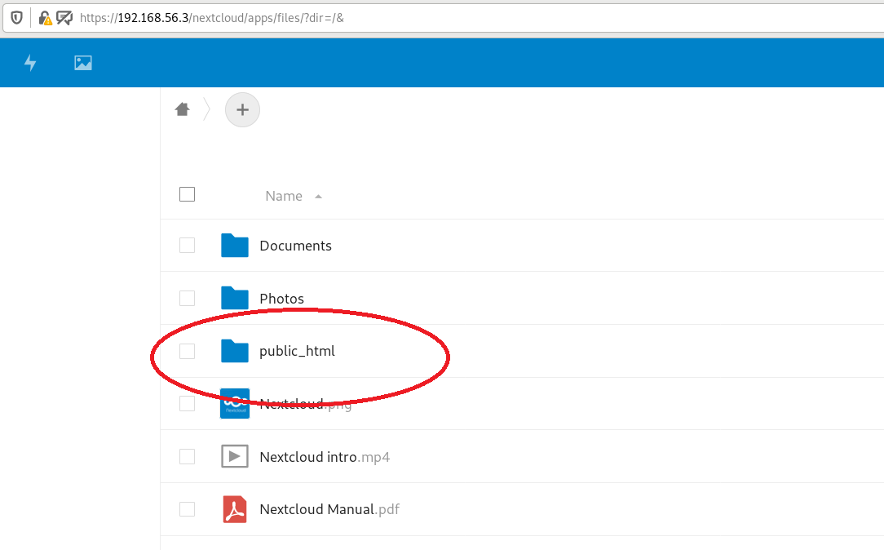

Slide 24
Deadline
2019/12/19
You do not need to submit anything

Slide 25
Help!
Email to ta@nasa.cs.nctu.edu.tw
New E3 https://e3new.nctu.edu.tw/
Office hour: 3GH at EC318

