Slide 1
Booting Up and Shutting Down
lctseng / Liang-Chi Tseng

Slide 2
Booting Up
Starting up a computer
Load kernel into memory and execute it.
BIOS load and run the MBR (Master Boot Record)
MBR searches for the bootable slice (partition) on the disk and then run the code on the slice to load OS.
kernel is loaded into memory, and then probing, initialization, init process.
MBR
http://en.wikipedia.org/wiki/Master_boot_record
FreeBSD Handbook
http://www.freebsd.org/doc/en/books/handbook/boot.html

Slide 3
MBR – Master Boot Record (1)
First 512 bytes of disk, outside the FreeBSD area, last 2 Bytes are 0x55AA
Corresponding copy in FreeBSD is /boot/boot0 or /boot/mbr

Slide 4
MBR – Master Boot Record (2)
Responsible to find the boot code on the boot sector of bootable slice.
MBR
Slice 1 (/dev/ad0s1)
Slice 2 (/dev/ad0s2)
Slice 3 (/dev/ad0s3)
Slice 4 (/dev/ad0s4)
F1 FreeBSD
Default: F1
Slice 5 /dev/ad0s5 | Slice 6 /dev/ad0s6

Slide 5
Boot Stage One and Stage Two
boot1 and boot2 (/boot/boot1 + /boot/boot2 = /boot/boot)
Members of booting chain
Used to run the loader.
As MBR, boot1 and boot2 are outside the FreeBSD, and the copy of these two are
/boot/boot1
/boot/boot2
MBR(512 bytes)
Slice 1 (/dev/ad0s1)
Slice 2 (/dev/ad0s2)
Slice 3 (/dev/ad0s3)
>>FreeBSD/i386 BOOT Default: 1:ad(1,a)/boot/loader
boot:
/boot/boot
/boot/loader

Slide 6
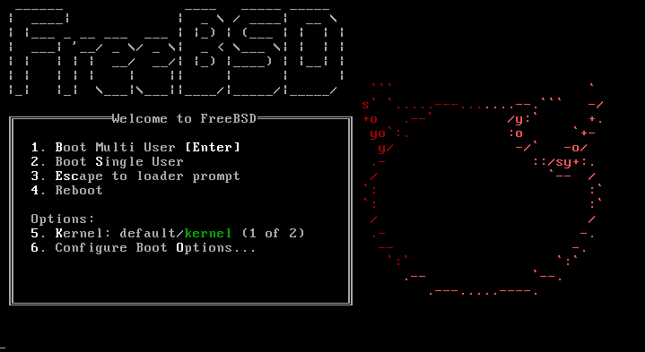
Boot Stage Two
boot2

Slide 7
Boot Stage Three
Boot Stage Three: The loader
Provide a user-friendly interface to configure booting choice.
/boot/loader
/boot/loader.rc use processing commands in /boot/loader.4th to manipulate loader.conf
Wait for 10 seconds then autoboot
/boot/default/loader.conf
Default loader behavior
/boot/loader.conf
autoboot_delay="10"
password="ooxx"
User-defined loader behavior

Slide 8
Boot Stage Three
loader

Slide 9
Files in /boot/
/boot/mbr (Standard)
Simplified version of boot0, blindly boot the partition marked active
/boot/boot0 (BootMgr)
bootmanager
/boot/boot{1,2}
boot1 is very simple, since it can only be 512 bytes in size, and knows just enough about the FreeBSD bsdlabel, which stores information about the slice, to find and execute boot2. /boot/boot2
boot2 is slightly more sophisticated, and understands the FreeBSD file system enough to find files on it, and can provide a simple interface to choose the kernel or loader to run /boot/loader
/boot/loader
load the kernel from disk
/boot/kernel/kernel

Slide 10
MBR recover
If MBR is overwritten by MS (or others), and you want to replace it with FreeBSD MBR:
Boot with CD or Floppy
% fdisk –B –b /boot/boot0 ad0
or
% boot0cfg –B /dev/ad0
If you want to replace it with MS MBR
Boot with DOS floppy
C:\fdisk /mbr
-B means reinitialize the boot code contained
in sector 0 of the disk
-b is used to specify the boot code

Slide 11
Boot in single user mode (1)
OS | command
FreeBSD | Enter OK mode and type “boot -s” Or type “2” in the menu
Linux | LILO: linux single
Solaris | Press “STOP” and “a” to enter the boot PROM and Press “boot –s”

Slide 12
Boot in single user mode (2)

Slide 13
Boot in single user mode (3)
The OK mode (loader prompt)
Type “boot -s” to enter single user mode

Slide 14
Insecure single user mode
Single user mode requires no password by default
When the physical security to the console is considerable,
Set console to be insecure in /etc/ttys
# name getty type status comments
#
# If console is marked "insecure", then init will ask for the root password
# when going to single-user mode.
# console none unknown off secure
console none unknown off insecure

Slide 15
Multibooting (1)
FreeBSD
FreeBSD’s boot loader will try to detect bootable partitions
You can also declare the bootable partitions explicitly with boot0cfg
% boot0cfg –B –m 0x7 ad0
-m means mask
Specify slices to be enabled/disabled,
ex. 0x7 means 0111,boot menu will detect slice1~3 to show the options

Slide 16
Multibooting (2)
default 0
timeout 30
fallback 1
# For booting GNU/Linux
title GNU/Linux
kernel (hd1,0)/vmlinuz root=/dev/hdb1
# For booting FreeBSD
title FreeBSD
root (hd0,2,a)
kernel /boot/loader
# For booting Windows NT or Windows95
title Windows NT / Windows 95 boot menu
root (hd0,0)
makeactive
chainloader +1
Linux
Using lilo or GRUB

Slide 17
Steps in the boot process
Loading and initialization of the kernel
Device detection and configuration
Creation of spontaneous system processes
Operator intervention
Execution of system startup scripts
Multiuser operation

Slide 18
Steps in the boot process – Kernel initialization
Get kernel image into memory to be executed
Perform memory test
Allocate kernel’s internal data structures
OS | Kernel image path
FreeBSD | /boot/kernel/kernel
Linux | /boot/vmlinuz
Solaris | /kernel/genunix
SunOS | /vmunix

Slide 19
Steps in the boot process – Hardware configuration
Devices specified in kernel configuration file
Kernel will try to locate and initialize it
Devices not specified in kernel configuration file
Kernel tries to determine the other information by probing the bus
If the driver is missing or not responsible to the probe, device is disabled
We can load kernel module to support this device.
kldload, kldstat, kldunload
/boot/kernel/*.ko
/boot/module/*.ko
/boot/loader.conf
if_em_load="YES" vboxdrv_load="YES"

Slide 20
Steps in the boot process – System Processes
Spontaneous process
Not created by the normal UNIX fork mechanism
View by ps [pid]
OS | Pid 0 | Pid 1 | Pid 2 and more
FreeBSD | kernel | init | g_event, cam, …
Linux | - | init | kthreadd, kflushed,kupdate Kpiod,kswapd
SunOS | sched | init | pageout

Slide 21
Steps in the boot process – Operator intervention
Manual boot only (boot into single)
Only the root partition is mounted and mounted as read only
mount –u /
mount –a –t ufs
swapon -a
mount –u indicates that the status of an already
mounted file system should be changed
mount –a –t means mount all ufs file systems

Slide 22
Steps in the boot process – Execution of startup scripts
The startup scripts are selected and run by init
Typical works are:
Setting the name of the computer
Setting the time zone
Checking the disk with fsck
Mounting the system’s disks
Removing files from /tmp directory
Configuring network interface
Starting up daemons and network services

Slide 23
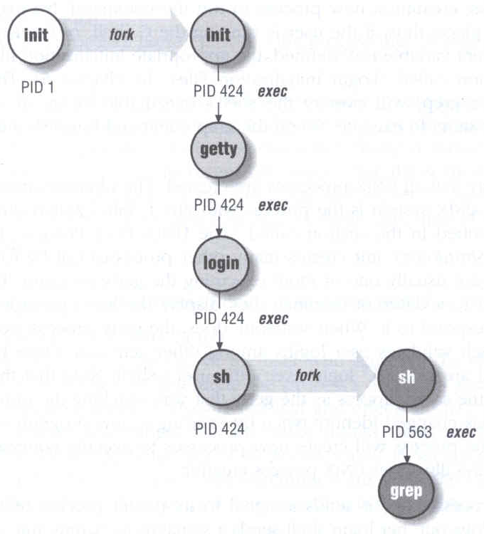
Steps in the boot process – multiuser operator
From now on, the system is fully operational, but no one can login
init will spawn getty processes to listen for login
login: read username and prompt for password

Slide 24
FreeBSD startup scripts
init will run /etc/rc
/etc/rc will reads the following configuration
/etc/defaults/rc.conf
/etc/rc.conf
/etc/rc.d
Manual: rc(8)

Slide 25
Ways to shut down or reboot
Turning off the power ⬅ Please Don’t！
May cause disk failure / filesystem dirty
Using the shutdown command
Using the halt and reboot command
halt = shutdown –h
reboot = shutdown –r
poweroff = shutdown -p
Sending init a TERM signal
kill –TERM 1 (go into single user mode)
Using telinit to change init’s level (for Linux using System-V)

Slide 26
Ways to shut down or reboot – shutdown command
OS | Pathname | Time | R | H | S | F
FreeBSD | /sbin/shutdown | time | -r | -h
Linux | /sbin/shutdown | time | -r | -h
Solaris | /usr/sbin/shutdown | -gsecs | -i6 | -i0 | -is
SunOS | /usr/sbin/shutdown | +mins | -r | -h |  | -f
R=Reboot, H=Halt, S=Enter Single user mode, F=Skip fsck
time format can be
+m (after m minutes)
hh:mm ➔linux
yymmddhhmm/now ➔ FreeBSD

Slide 27
Poweroff
ACPI / APM
Advanced Configuration and Power Management
Advanced Power Management
In FreeBSD, (if cannot poweroff automatically)
(1) Try “shutdown -p now”
(2) Compile this into kernel
device apm0 at nexus?flag 0x20
(3) Rebuild the kernel
(4) Edit /etc/rc.conf
apm_enable=“YES”
apmd_enable=“YES”
(5) Reboot
(6) Try “shtudown –p now”

Slide 28
Appendix
System-V

Slide 29
Startup Scripts
SystemV-style startup scripts
sun, linux
/etc/init.d/
/etc/rc.d/rcn.d/
Each script is responsible for one
daemon or one aspect of system.
Example: sshd in sun OS
Symbolic link
case "$1" in
'start')
if [ -x /usr/local/sbin/sshd ]; then
echo "Starting the secure shell daemon"
/usr/local/sbin/sshd &
fi
;;
'stop')
echo "Stopping the secure shell daemon "
pkill -TERM sshd
;;
*)
echo "Usage: /etc/init.d/sshd { start | stop }"
;;
esac
exit 0

Slide 30
Startup Scripts – SystemV-style startup scripts (1)
Run-level
/etc/inittab
init follow the inittab from level 0 to level k
Example: inittab in sun1
Run Level | Startup scripts | Meaning
0 | /etc/rc.d/rc0.d/ | Halt
1 | /etc/rc.d/rc1.d/ | Single User Mode
2 | /etc/rc.d/rc2.d/ | Multiuser without NFS
3 | /etc/rc.d/rc3.d/ | Full multiuser mode
4 | /etc/rc.d/rc4.d/ | Unused
5 | /etc/rc.d/rc5.d/ | X11
6 | /etc/rc.d/rc6.d/ | reboot

Slide 31
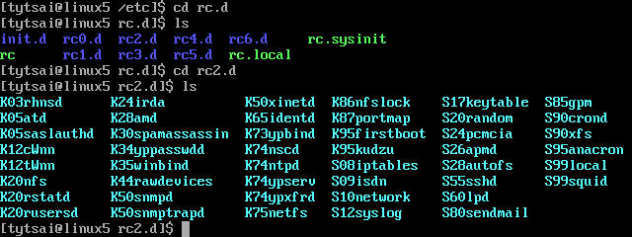
Startup Scripts – SystemV-style startup scripts (2)
/etc/rc.d/rcn.d/
When init transitions from lower run level to higher one,
it runs all the scripts that start with “S” in ascending order with “start” argument
When init transitions from high run level to lower one,
it runs all the scripts that start with “K” in descending order with “stop” argument

Slide 32
Startup Scripts – SystemV-style startup scripts (3)
If you write a daemon and want init to start/stop it,
write a script and put in /etc/init.d
make suitable symbolic link in rcn.d
ln –s /etc/init.d/initiald /etc/rc2.d/S61initiald
ln –s /etc/init.d/initiald /etc/rc0.d/K33initiald

Slide 33
Startup Scripts – SystemV-style startup scripts (4)
In linux
/etc/sysconfig/ contain config data used by startup scripts
Ex:
network
Set global network option (hostname, gateway, ..)
HOSTNAME=linux5
GATEWAY=140.113.209.254
network-scripts/
Contain accessory scripts and network config file
EX: ifcfg-eth0
DEVICE=eth0
BROADCAST=140.113.209.255
IPADDR=140.113.209.145
NETMASK=255.255.255.0
ONBOOT=yes

Slide 34
Ways to shut down or reboot – telinit
Only for SystemV systems
Linux, Solaris
% telinit 1

