Slide 1
FTP - File Transfer Protocol
lctseng / Liang-Chi Tseng

Slide 2
FTP
FTP
File Transfer Protocol
Used to transfer data from one computer to another over the internet.
Client-Server Architecture.
FTP connections
Control connection
Created when an FTP session is established
Only for passing control information
Data connection
Each time that data is sent, a distinct TCP data connect is established
Data connection Modes:
Active Mode
Passive Mode

Slide 3
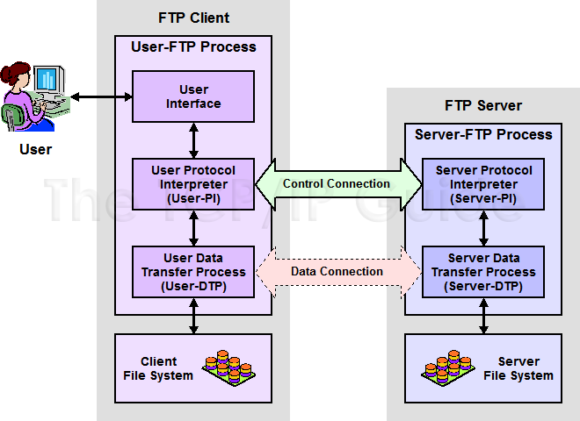
FTP
FTP Request For Comments (RFCs):
RFC 959 – File Transfer Protocol
RFC 2228 – FTP Security Extensions
RFC 2428 – FTP Extensions for IPv6 and NATs
RFC 2640 – UTF-8 support for file name

Slide 4
FTP – Flow (1)
Client
Connect to server port 21 from port A.
USER ####
PASS ********
EPRT |1|ip|portnum|
Send some requests get return data from portnum
Quit
Server
Binding on port 21
Accepts connection from client, output welcome messages.
331 User name okay, need password.
230 User logged in, proceed.
200 PORT Command successful.
Binding source port 20, connect to client port portnum, send data.
…

Slide 5
FTP – Flow (2)
ftp user must exist before doing this!
% telnet freebsd.cs.nctu.edu.tw 21
Trying 140.113.17.209...
Connected to freebsd.cs.nctu.edu.tw.
Escape character is '^]'.
220---------- Welcome to Pure-FTPd [privsep] ----------
220-You are user number 7 of 1000 allowed.
220-Local time is now 16:25. Server port: 21.
220-Only anonymous FTP is allowed here
220-IPv6 connections are also welcome on this server.
220 You will be disconnected after 15 minutes of inactivity.
USER ftp
230 Anonymous user logged in
PASS ftp
230 Any password will work
EPRT |1|140.113.235.135|65000|
200 PORT command successful
list
150 Connecting to port 65000
226-Options: -l
226 2 matches total
quit
221-Goodbye. You uploaded 0 and downloaded 0 kbytes.
221 Logout.
Connection closed by foreign host.
Example
Control Connection
Notes:
ftp user must exist before do this!

Slide 6
FTP – Flow (3)
Example (contd.)
Retrieving Data
Client must bind the random port
Files info under /home/ftp is sent to client through this port
% nc -l 65000
drwxr-xr-x 852 888 2010 80328 Mar 28 11:39 distfiles
drwxr-xr-x 16 888 2010 34 May 11 2008 pub

Slide 7
FTP – commands, responses
Commands
USER username
PASS password
LIST
Return list of file in current dir.
CWD dirname
Change working directory
RETR filename
Retrieves (gets) file.
STOR filename
Stores (puts) file onto server.
EPRT |1|ip|port|
Set to active mode
PASV(EPSV)
Set to passive mode
DELE
Remove file on the server.
QUIT
Return Codes
First code
1: Positive Preliminary reply
2: Positive Completion reply
3: Positive Intermediate reply
4: Transient Negative Completion reply
5: Permanent Negative Completion reply
Second code
0: The failure was due to a syntax error
1: A reply to a request for information.
2: A reply relating to connection information
3: A reply relating to accounting and authorization.
5: The status of the Server file system

Slide 8
FTP – Active Mode vs. Passive Mode (1)
Active Mode
FTP client bind a random port (>1023) and sends the random port to FTP server using “EPRT” command.
When the FTP server initiates the data connection to the FTP client, it binds the source port 20 and connect to the FTP client the random port sent by client.
EPRT |1|ip|port|
EPRT |2|ipv6|port|
Passive Mode
FTP client sends “EPSV/PASV” command to the server, make the server bind a random port (>1023) and reply the random port back.
When initializing the data connection, the FTP client connect to the FTP Server the random port, get data from that port.
EPSV ➔ Server reply: 229 Entering Extended Passive Mode (|||41868|)
PASV ➔ Server reply: 227 Entering Passive Mode (h1,h2,h3,h4,p1,p2)
※ IP:port (6bytes) → h1,h2,h3,h4,p1,p2
Ex. 140.113.17.215:45678 → 140,113,17,215,178,110

Slide 9
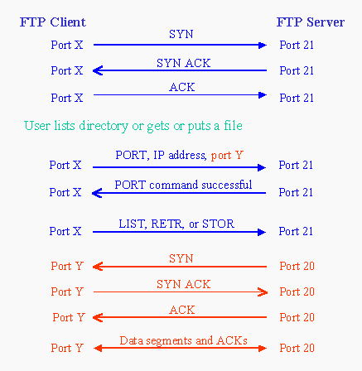
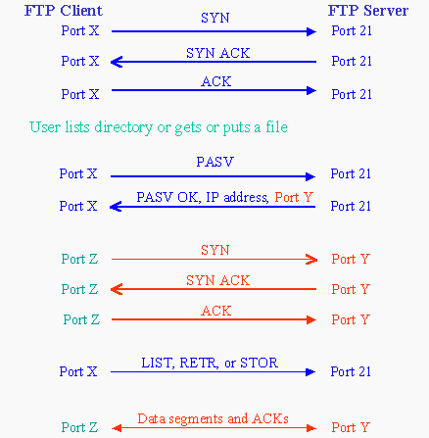
FTP – Active Mode vs. Passive Mode (2)
Active mode
Passive mode

Slide 10
FTP – When FTP meets NAT/Firewall (1)
Active mode, NAT/Firewall on client side.
Wireless AP
Passive mode can solve this problem.
NAT/Firewall
NAT/Firewall
Client
Server
Client
Server
PORT IP, port Y
PASV
reply IP, port Z
Connect to port Y BLOCKED
Connect to port Z
PASS
Active Mode
Passive Mode

Slide 11
FTP – When FTP meets NAT/Firewall (2)
Passive mode, NAT/Firewall on Server side.
Active mode can solve this problem.
NAT/Firewall
NAT/Firewall
Client
Server
Client
Server
PASV
PORT IP, port Y
reply IP, port Z
Connect to port Z
BLOCKED
Connect to port Y PASS
Passive Mode
Active Mode

Slide 12
FTP – When FTP meets NAT/Firewall (3)
Real Problem: Firewall on both sides.
Solution: ftp-proxy running on NAT/Firewall
To be explain in firewall course (NA)
NAT/Firewall
NAT/Firewall
NAT/Firewall
NAT/Firewall
Client
Server
Client
Server
PORT IP, port Y
PASV
reply IP, port Z
Connect to port Y BLOCKED
Connect to port Z
BLOCKED
Active Mode
Passive Mode

Slide 13
FTP - Security
Security concern
As we seen, FTP connections (both command and data) are transmitted in clear text.
What if somebody sniffing the network?
We need encryption.
Solutions
FTP over TLS (FTPS、FTPES)
Only commands are encrypted while transmitting.
Better performance.
FTP over SSH
Tunneling a normal FTP session over an SSH connection.
SSH File Transfer Protocol (SFTP)
Both commands and data are encrypted while transmitting.
One connection, but poor performance.

Slide 14
Pure-FTPd - Intro (1)
Introduction
A small, easy to set up, fast and secure FTP server
Support chroot
Restrictions on clients, and system-wide.
Verbose logging with syslog
Anonymous FTP with more restrictions
Virtual Users, and Unix authentication
FXP (File eXchange Protocol)
FTP over TLS
UTF-8 support for filenames

Slide 15
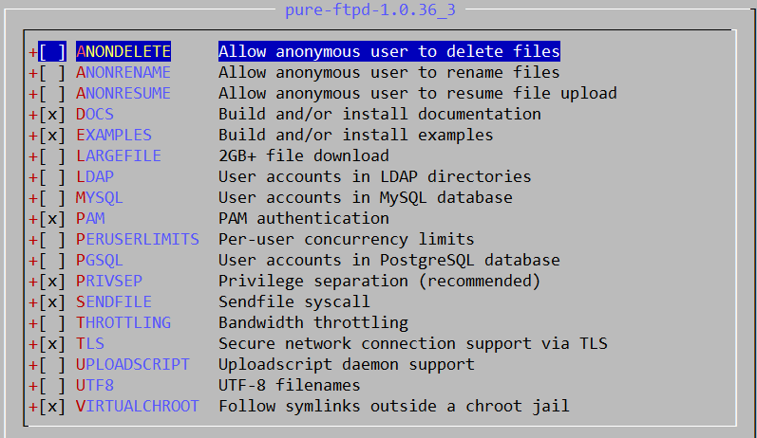
Pure-FTPd - Intro (2)
Installation
Ports: /usr/ports/ftp/pure-ftpd
Package is also available
Options

Slide 16
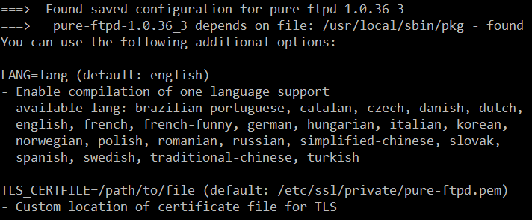
Pure-FTPd - Intro (3)
Other options
TLS_CERTFILE (Default: /etc/ssl/private/pure-ftpd.pem)
LANG (Change the language of output messages)
Startup:
Add pureftpd_enable="YES" in /etc/rc.conf

Slide 17
Pure-FTPd - Configurations (1)
Configurations:
File: /usr/local/etc/pure-ftpd.conf
Documents
Configuration sample: /usr/local/etc/pure-ftpd.conf.sample
All options are explained clearly in this file.
Other documents
See /usr/local/share/doc/pure-ftpd/*

Slide 18
Pure-FTPd - Configurations(2)
ChrootEveryone yes
TrustedGID 0
AnonymousOnly no
NoAnonymous no
PureDB /usr/local/etc/pureftpd.pdb
UnixAuthentication yes
AntiWarez yes
Umask 133:022
TrustedIP 140.113.0.0
CreateHomeDir yes
TLS 2
FileSystemCharset UTF-8
ClientCharset UTF-8
There are more configuration there!

Slide 19
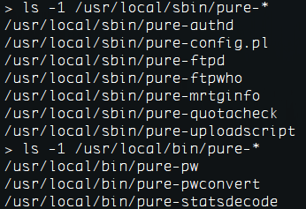
Pure-FTPd - Tools
pure-*
pure-ftpwho
List info of users who are currently connecting to the FTP server.
pure-pw
Manage Virtual Users in PureDB format
pure-pw(8)
See README.Virtual-Users

Slide 20
Pure-FTPd - Anonymous Users and Virtual Users
Anonymous Users
Virtual Users
FTP-only accounts without messing up your system accounts.
Store individual quotas, ratios, bandwidth.
Virtual users share the same system user.
They are chrooted and have their own home directory.

Slide 21
Pure-FTPd - Problem Shooting
Logs Location
In default, syslogd keeps ftp logs in /var/log/xferlog
Most frequent problems
pure-ftpd: (?@?) [ERROR] Unable to find the 'ftp' account
It’s ok, but you may need it for Anonymous FTP Account.
pure-ftpd: (?@?) [ERROR] Sorry, but that file doesn't exist: [/etc/ssl/private/pure-ftpd.pem]
If you set TLS = 2, then this file is needed.
How to generate a pure-ftpd.pem?
See README.TLS

Slide 22
FTP - More Tools
ftp/pureadmin
Management utility for the PureFTPd
ftp/lftp
Shell-like command line ftp client, support TLS
ftp/wget, ftp/curl
Retrieve files from the Net via HTTP(S) and FTP
ftp/mget
Multithreaded commandline web-download manager
FileZilla
A graphical cross-platform FTP client, support TLS
Pure-FTPd WebUI
PHP based web interface for ​Pure-FTPd

