Slide 1
How to Shrink a Partition on Your Hard Drive
hmwang

Slide 2
Windows

Slide 3
How to Shrink a Partition on Your Hard Drive
(Windows)
Windows 8 / 7 / Vista user
Windows 內建工具
Windows XP user
EaseUS Partition Master
ATTENTION: backup your data first !
注意: 先備份您的重要資料!!!
3

Slide 4
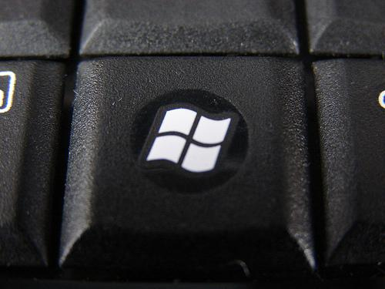
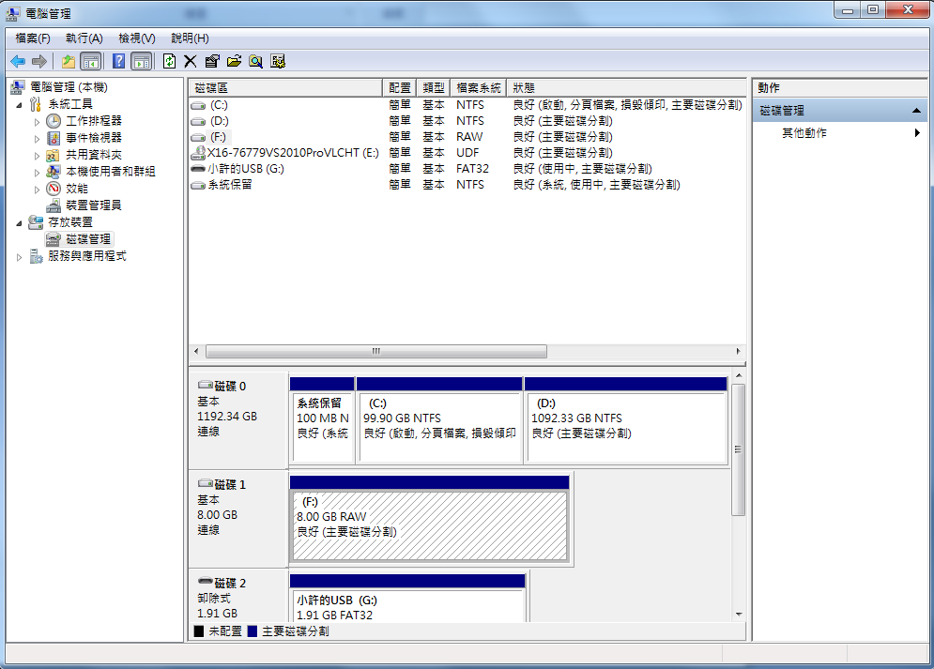
Windows 8 / 7 / Vista user (1/4)
在我的電腦按右鍵
選擇“管理”
選擇“磁碟管理”。
WinKey + R
輸入“diskmgmt.msc”
點選“確定”。
或
4

Slide 5
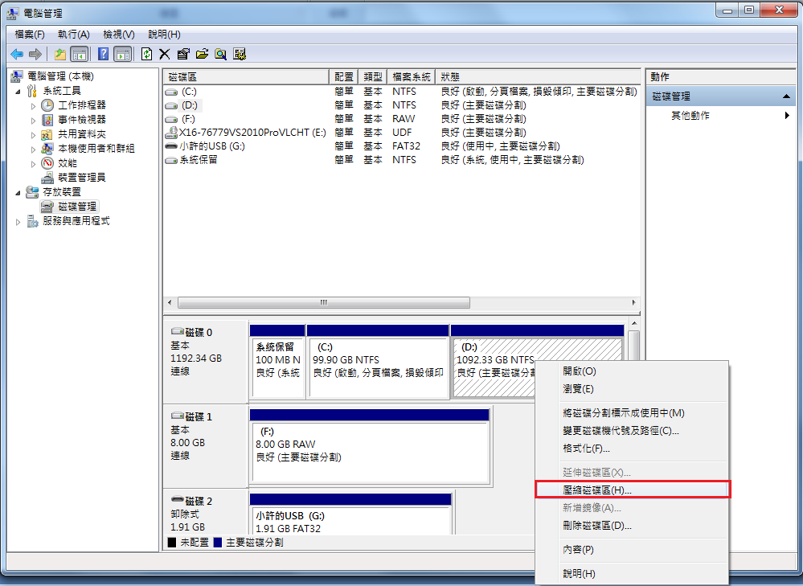
Windows 8 / 7 / Vista user (2/4)
在你選擇的磁碟區，按右鍵，選擇“壓縮磁碟區”。
5

Slide 6
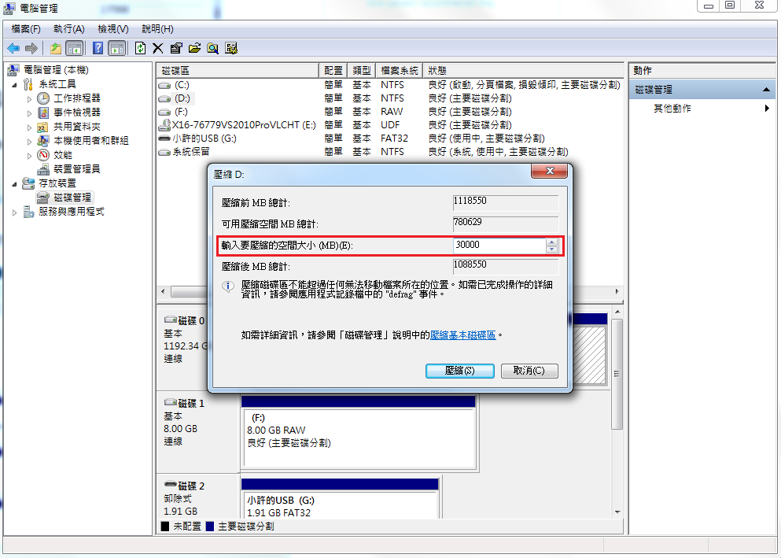
Windows 8 / 7 / Vista user (3/4)
設定想要切割的磁區大小，設定好後按下“壓縮”。
6

Slide 7
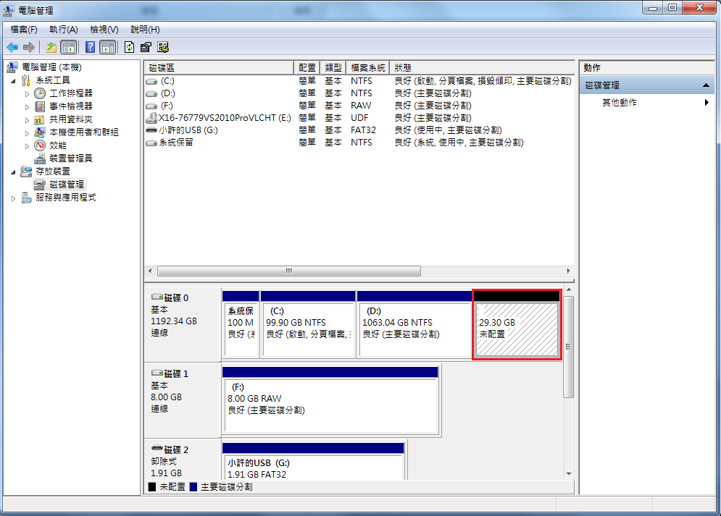
Windows 8 / 7 / Vista user (4/4)
回到磁碟管理的視窗，會在D磁區的後方，看見已經切割出來的磁區空間。
7

Slide 8
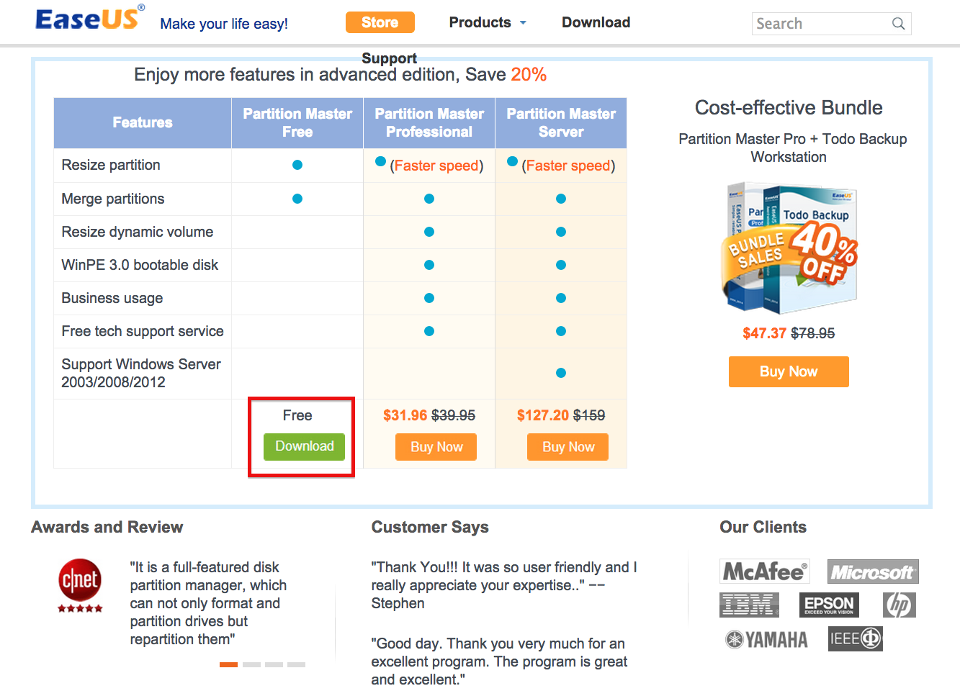
XP user (1/5)
Install EaseUS Partition Master.
http://www.partition-tool.com/landing/home-download.htm
8

Slide 9
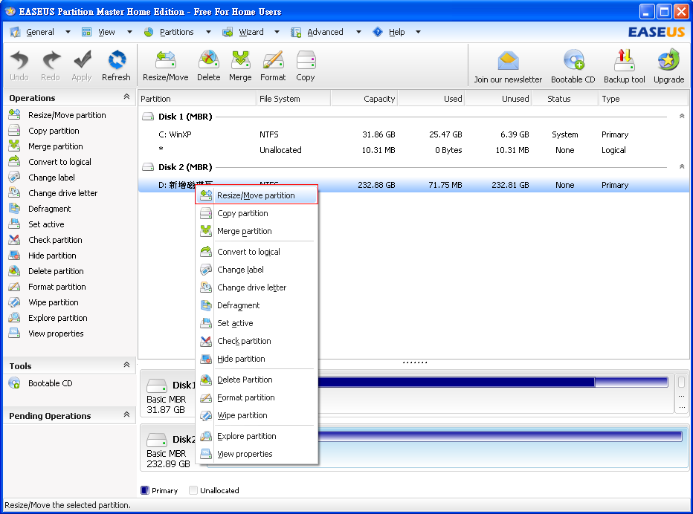
XP user (2/5)
Select D: drive
Right click
Select “Resize/Move partition”.
9
Notes:
*

Slide 10
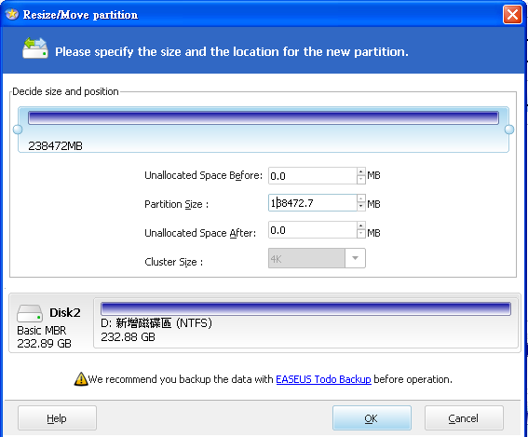
XP user (3/5)
Click “OK”.
10

Slide 11
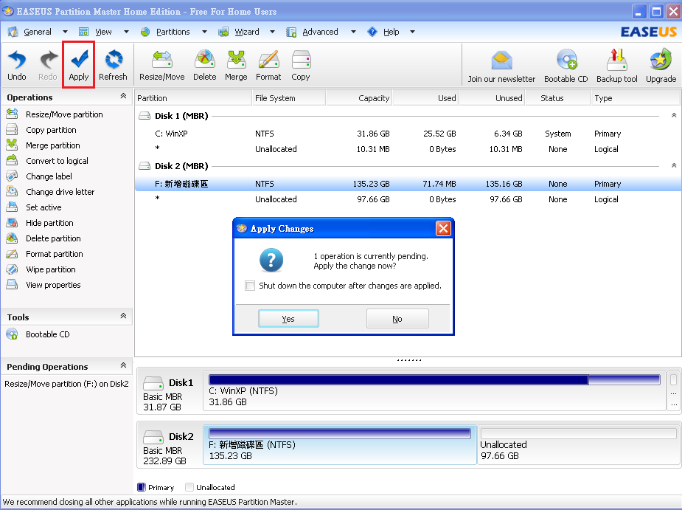
XP user (4/5)
Click “Apply” .
11

Slide 12
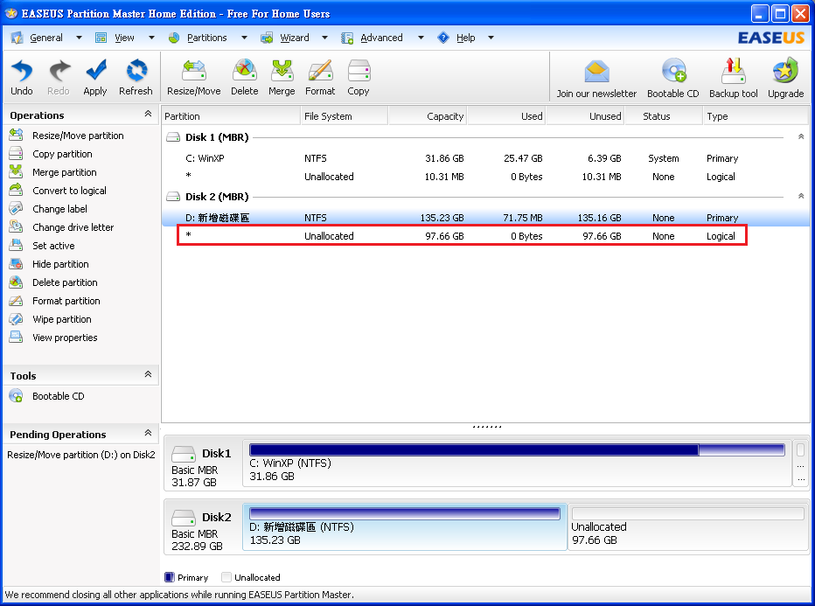
XP user (5/5)
12

Slide 13
GParted Live USB

Slide 14
How to Shrink a Partition on Your Hard Drive
(GParted Live USB)
GUI
GParted
ATTENTION: backup your data first !
注意: 先備份您的重要資料!!!
14

Slide 15
GParted Live USB (1/4)
How to install?
Download gparted-live-0.19.1-4-i486.iso
http://downloads.sourceforge.net/gparted/gparted-live-0.19.1-4-i486.iso
For GNU/Linux & Mac User
Open Terminal
$ sudo dd if=/path-to-gparted-live-0.19.1-4-i486.iso of=/dev/sdx bs=4M; sync
For Windows User
Choose one to create bootable Live USB
Tuxboot
Unetbootin
LinuxLive USB Creator
15

Slide 16
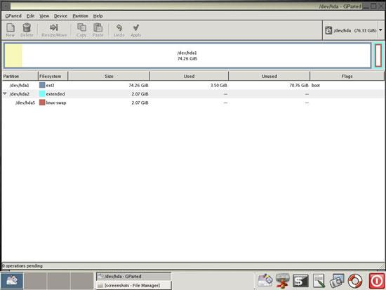
GParted Live USB (2/4)
Open GParted
Click the disk you want to shrink and click Resize/Move
16

Slide 17
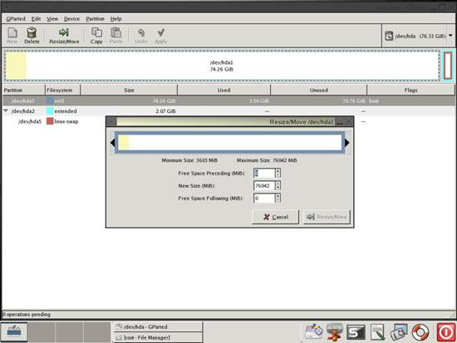
GParted Live USB (3/4)
Drag the black arrow to shrink then click Resize/Move button
17

Slide 18
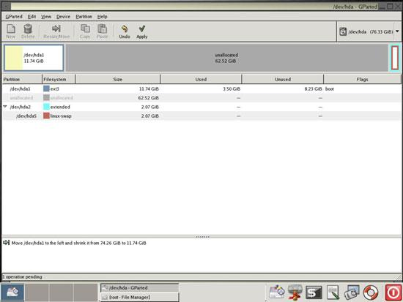
GParted Live USB (4/4)
Then you will see a new & unallocated space
18

Slide 19
Appendix
Commands for Disk Partitioning
gpart (recommend on FreeBSD)
parted
gdisk
cgdisk
sgdisk
fdisk
cfdisk
sfdisk
19

Slide 20
References
How to Shrink a Partition on Your Hard Drive
http://tips4pc.com/format%20your%20computer/how_to_shrink_a_partition_on_you.htm
EaseUS
http://www.easeus.com/
如何調整Windows 8的磁碟分割區？
7club.ithome.com.tw/index.php/article/10036527/1
GParted Live on USB
http://gparted.org/liveusb.php
Modify Your Partitions With GParted Without Losing Data
http://www.howtoforge.com/partitioning_with_gparted
20

