Slide 1
System Administration Practice Homework 1-1 : FreeBSD Base
lctseng

Slide 2
Requirements
Basic
FreeBSD Base
10.1-Release
Don’t use other version
Add a user
User should also be in the ‘wheel’ group
Use this user to do this homework instead of root
Set your machine to current time zone and adjust current time
Enable sshd

Slide 3
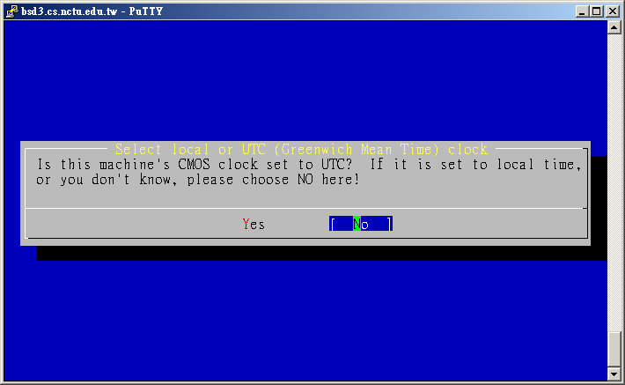
Timezone
These must be do as root or using sudo
bsdconfig or
tzsetup or
Find right timezone file in /usr/share/zoneinfo and copy to /etc/localtime

Slide 4
Submission
$ : shell prompt
Login with the user you created
$ rm -f /tmp/sahw1-1.tmp
Perform this as root if it cried about ‘Permission denied’
$ uname -a >> /tmp/sahw1-1.tmp
$ date >> /tmp/sahw1-1.tmp
Please keep your language settings as English (en-US)
$ id >> /tmp/sahw1-1.tmp
$ service sshd status >> /tmp/sahw1-1.tmp
$ mail -s '[SAHW1-1] 0005566' sahw1@nasa.cs.nctu.edu.tw < /tmp/sahw1-1.tmp

Slide 5
Check submission result
Web page at https://nasa.cs.nctu.edu.tw/2015sahw1/
You can submit many times, only the last count
Due: 10/1

Slide 6
FAQ(1/3)
Adjust current time
ntpdate(8) //non-continuous
or
ntpd(8) //continuous
http://www.freebsd.org/doc/en/books/handbook/network-ntp.html
Server
time.stdtime.gov.tw
tick.stdtime.gov.tw
tock.stdtime.gov.tw
watch.stdtime.gov.tw
clock.stdtime.gov.tw
server 0.tw.pool.ntp.org
server 1.asia.pool.ntp.org
server 2.asia.pool.ntp.org

Slide 7
FAQ(2/3)
My network is not working
VM
Make sure you have correct VirtualBox/VMWare settings
Make sure your host computer has Internet access
Install on a real machine
In your dormitory, switch to windows and authenticate
Use w3m command line browser
www/w3m

Slide 8
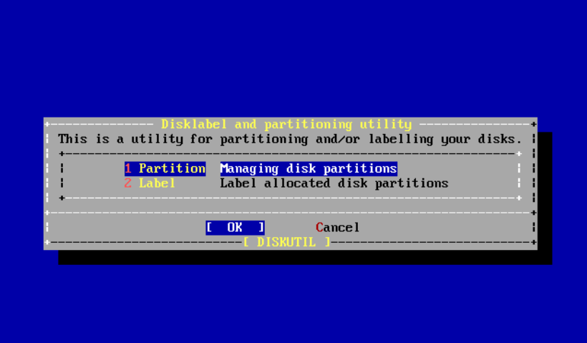
FAQ(3/3)
My WinXP / Win7 / Win8 is gone…
# sysctl kern.geom.debugflags=16
# sade => Partition

Slide 9
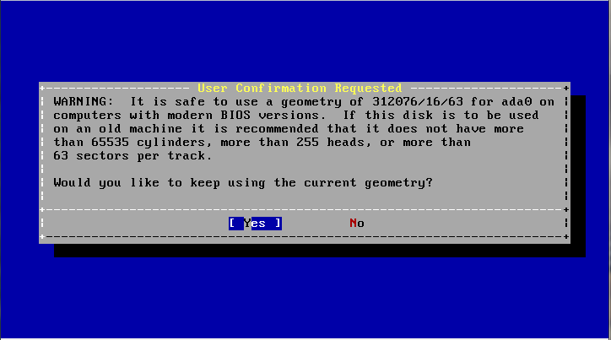
FAQ(3/3)
Yes

Slide 10
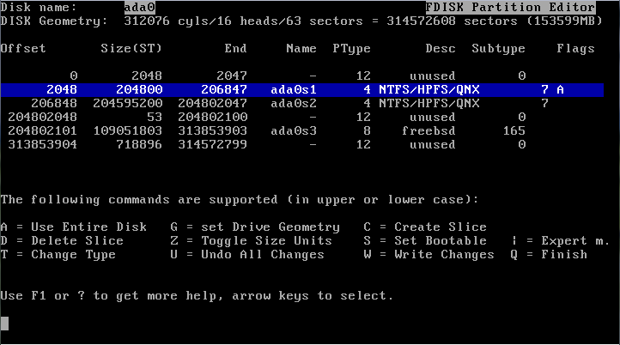
FAQ(3/3)
Select your XP / Win7 / Win8 partition and click S to set it bootable note: Win7's boot partition will be about 100MB And XP's will be the same size as C:

Slide 11
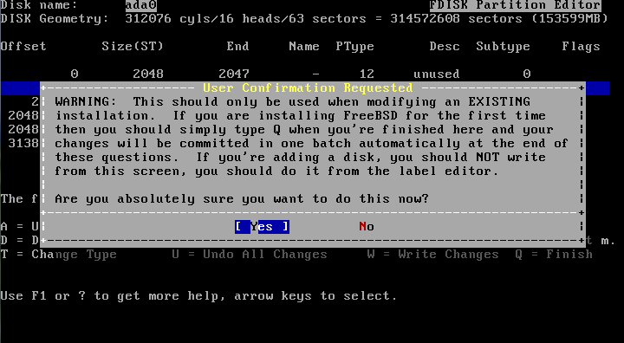
FAQ(3/3)
Press W to Write your Changes ; Q to finish

Slide 12
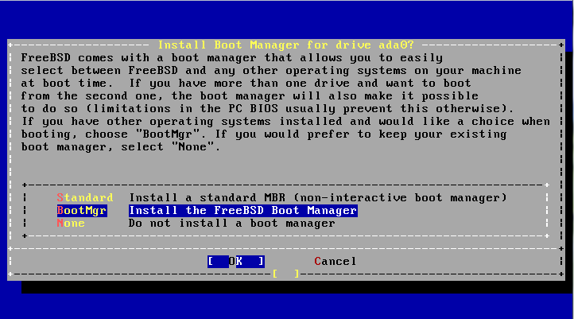
FAQ(3/3)
Install FreeBSD Boot Manager

Slide 13
Help!
Newsgroup cs.course.sysadm
BS2 board CS-SysAdmin
CSCC
ta@nasa.cs.nctu.edu.tw
IRC channel #nctuNASA on freenode

