Slide 1
System Administration Practice Homework 1-3 : Chinese World
lctseng

Slide 2
Requirements (1)
Basic system (40%)
Build a basic X Server and Window Manager(with Display Manager) and Wine
Software Rank B (20%)
Software Rank A (20%)
Software Rank S (25%)
Bonus (Up to 15%)
Choose to install one application for each category
You still can install more than one for precaution
* for recommended

Slide 3
Requirements (2)
There are many applications bundled with KDE, but…
You need to demo with your NEWLY INSTALLED applications
0 credits for using bundled application
Exception: that application is listed on slides
Guide line: use the software listed on the slides
Meet the requirements listed after each software to get points

Slide 4
Requirements (3)
Attention!
TA WON’T tell you which command to execute during demo
We have checklist for you
Make a demo flow for yourself
Time limit: 20~30(暫定) minutes for you to demo HW1
You get points according to your demo during time limit
No further grading when time limit exceeds

Slide 5
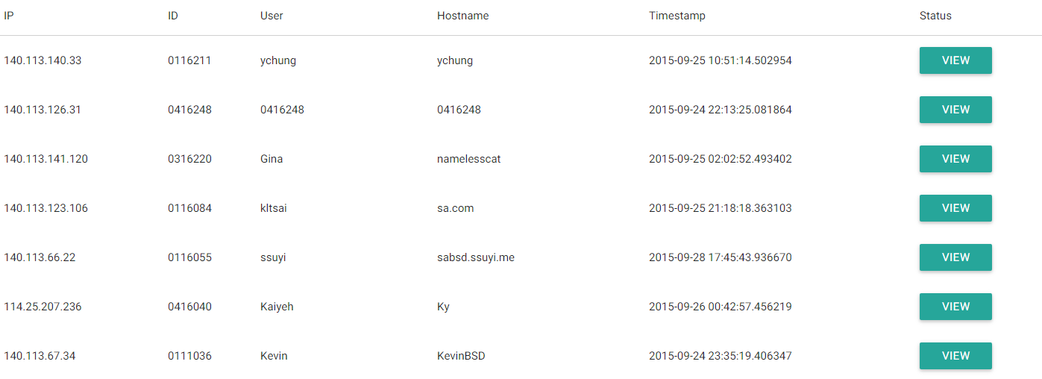
Base system (40%) (1)
FreeBSD base system (a.k.a Hw1-1) (5%)
No points for having any errors
Find your id and show that you have no error
Make sure your record is correct before 10/1 23:59

Slide 6
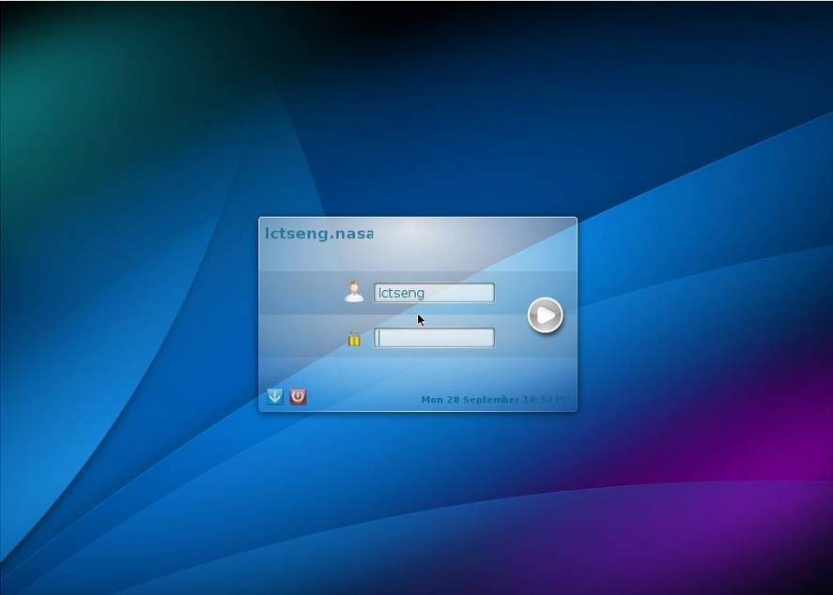
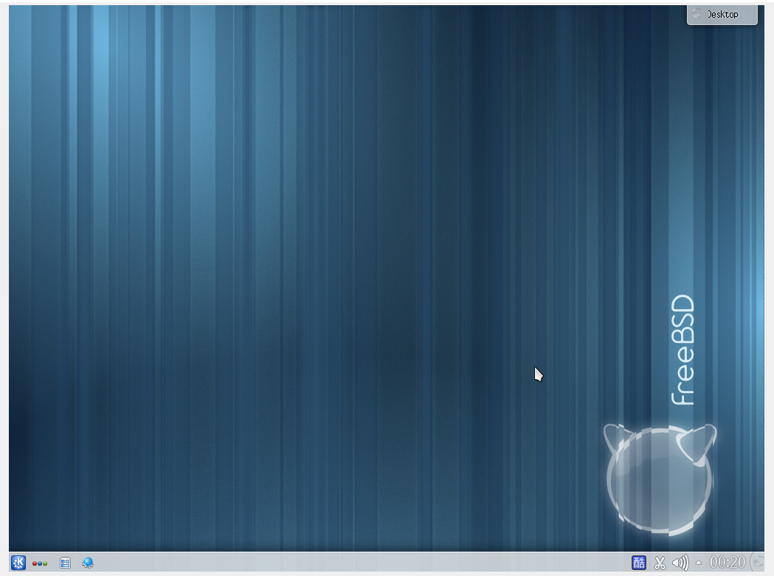
Base system (40%) (2)
X server + Window manager (total 12%)
Basic Xorg (can see simplest windows) (5%)
Window Manager (desktop enviromnent) (4%)
Display Manager (friendly login screen) (3%)

Slide 7
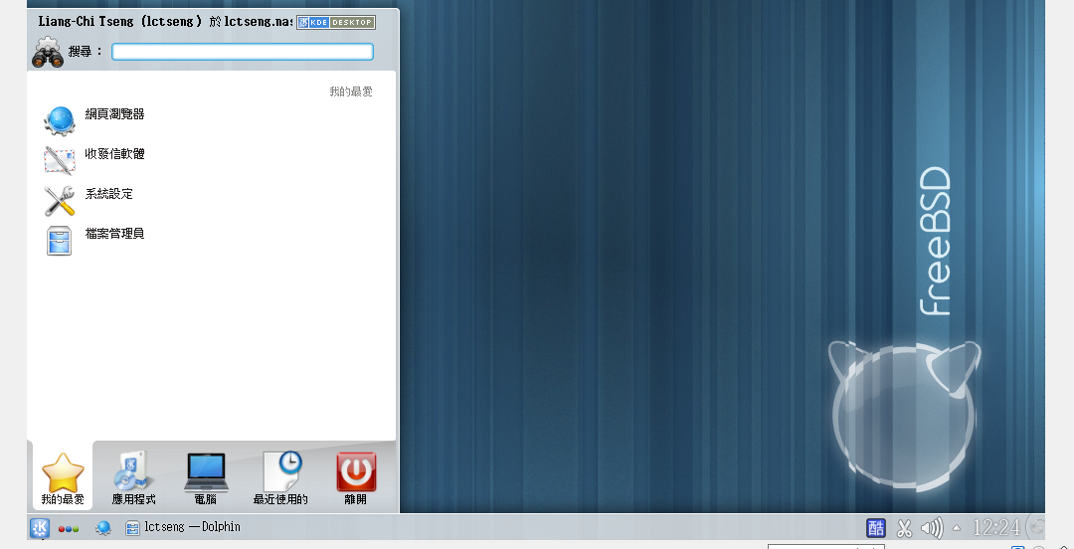
Base system (40%) (3)
Chinese support (total 13%)
KDE with Chinese (display) (3%)

Slide 8
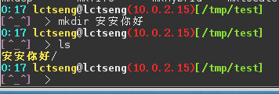
Base system (40%) (4)
Chinese support (total 13%)
Display commands with Chinese (5%)
E.g. date
Typing Chinese in your terminal (with Chinese support, e.g. ROXTerm) (5%)
Create a directory with Chinese name

Slide 9
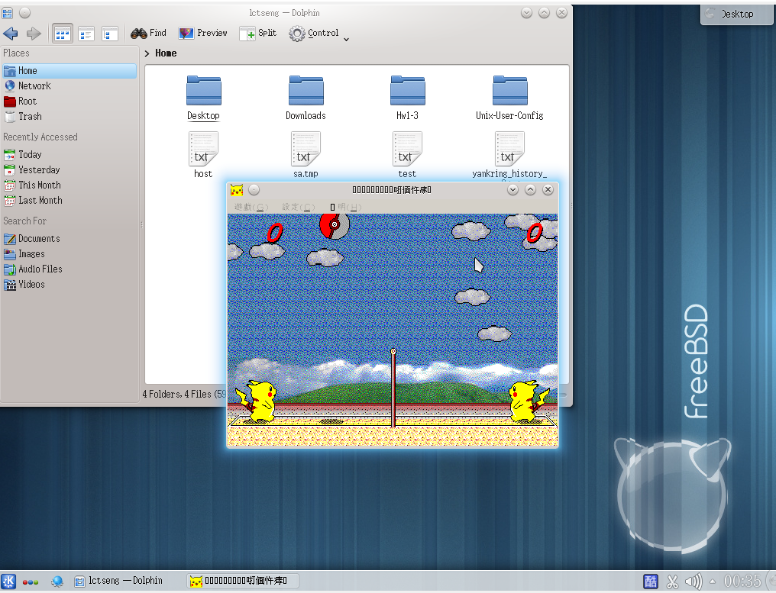
Base system (40%) (5)
Wine (total 10%)
Play: 皮卡丘打排球 (4%)
Play a game without any error
Download this game:
https://nasa.cs.nctu.edu.tw/2015sahw1/files/Volleyball.exe

Slide 10
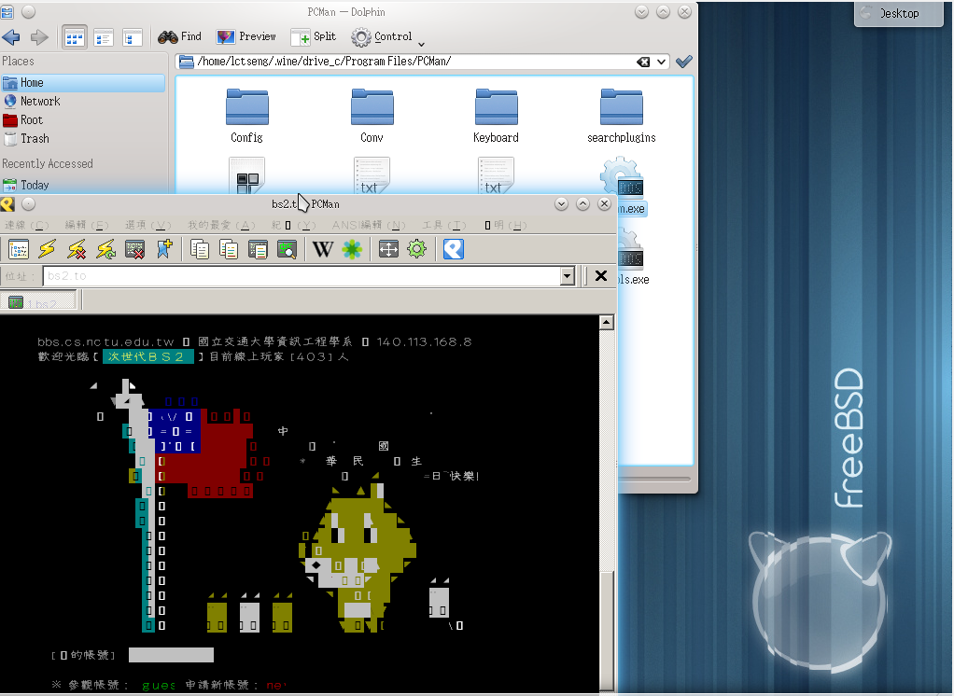
Base system (40%) (6)
Wine (total 10%)
Install PCMan for windows and run it (3 %)
Path: ~/.wine/drive_c/ProgramFiles/PCMan
Download the installer
https://nasa.cs.nctu.edu.tw/2015sahw1/files/PCMan.exe
With Chinese support (3%)

Slide 11
Software Rank B (20%)
Terminal (5%)
rxvt-unicode*
ROXTerm*
xterm
eterm
aterm
FTP client (2%)
filezilla*
Mail client (6%)
Thunderbird*
Evolution
Instant Messenger (3%)
pidgin*
PDF reader (2%)
Xpdf *
evince
mupdf
Browser (2%)
Firefox*
Opera
Chromium

Slide 12
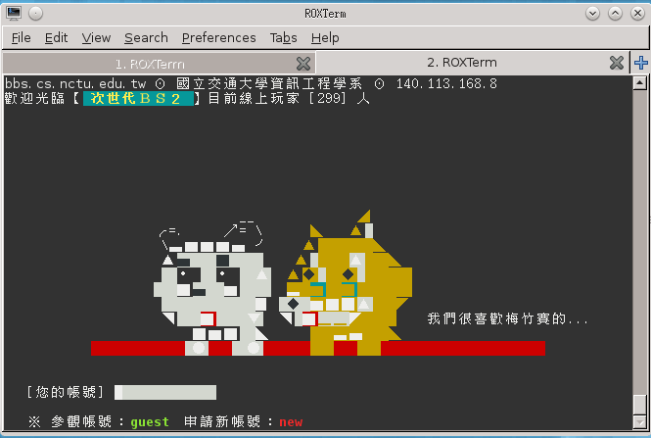
Software Rank B – Requirement (1)
Terminal (total 5%)
rxvt-unicode*
ROXTerm*
xterm
eterm
Aterm
Requirements
ssh to ssh.bs2.to (bbs) (1%)
$ ssh bbsu@ssh.bs2.to
Chinese support (4%)
Above command using UTF-8 (not Big5!)
You must have correct encoding in env. variables

Slide 13
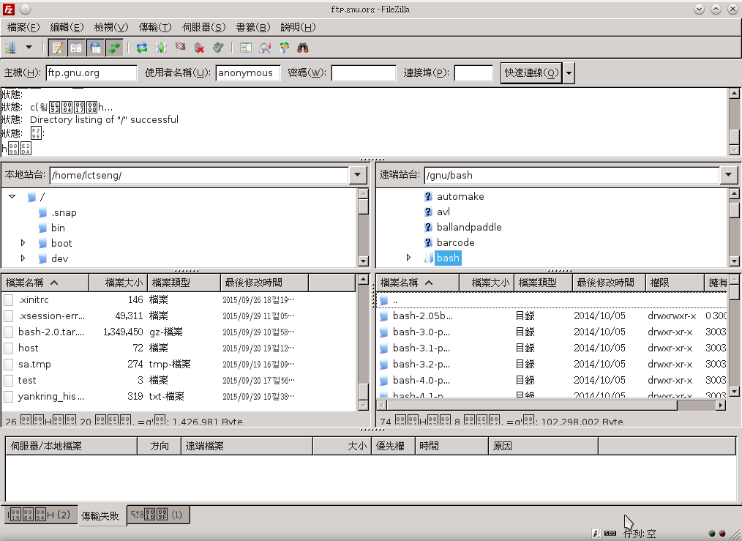
Software Rank B – Requirement (2)
FTP client (total 2%)
filezilla*
Requirements
Download files from ftp://ftp.gnu.org/gnu/bash (1%)
Display in Chinese (1%)

Slide 14
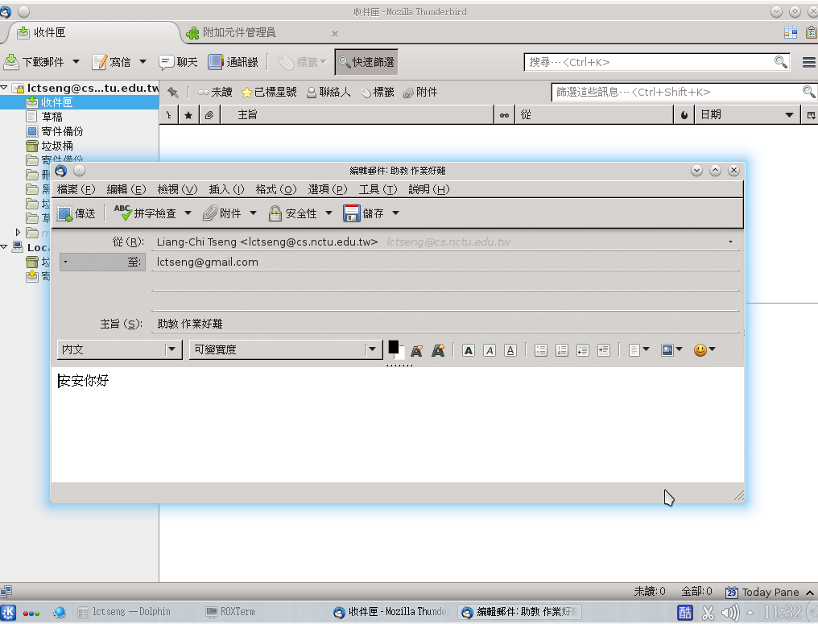
Software Rank B – Requirement (3)
Mail client (total 6%)
Thunderbird*
Evolution
Requirements
Send mails (2%)
Receive mails (2%)
Chinese support
display (1%)
input (1%)
Note: don’t sent to yourself

Slide 15
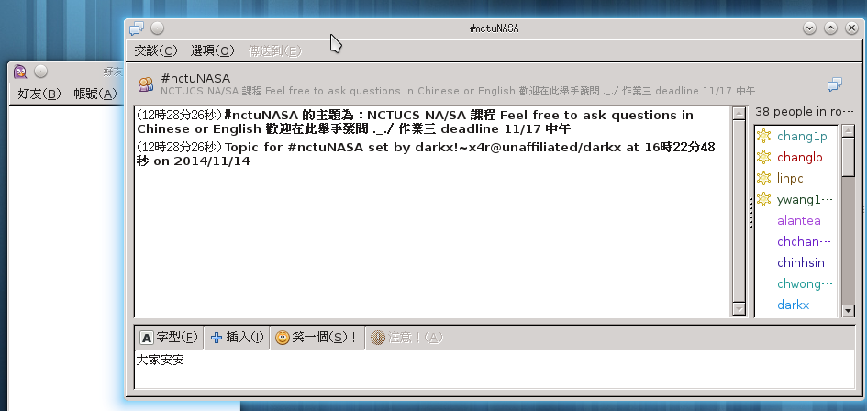
Software Rank B – Requirement (4)
Instant Messenger (total 3%)
pidgin*
Requirements
Join #nctuNASA IRC group (1%)
Can see Chinese (1%)
Input in Chinese (1%)

Slide 16
Software Rank B – Requirement (5)
PDF reader (2%)
xpdf *
evince
mupdf
Requirements
Open any PDF file with applications listed above
You can download PDF files from here
https://nasa.cs.nctu.edu.tw/sa/2015/

Slide 17
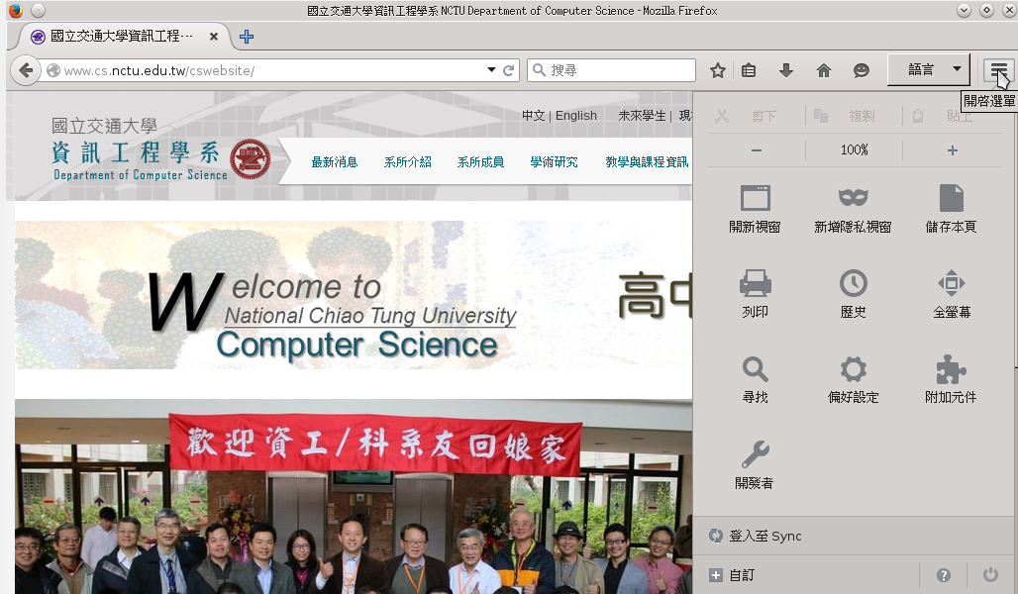
Software Rank B – Requirement (6)
Browser (total 2%)
Firefox*
Opera
Chromium
Requirements
Open http://www.cs.nctu.edu.tw (1%)
Chinese interface (1%)

Slide 18
Software Rank A (20%)
Browser (10%)
(with Flash support)
Firefox*
Opera
Chromium
Multimedia : Video, Audio(4%)
Mplayer*
VLC
Xmms
BBS client (2%)
pcmanx*
Pictures editor/viewer (2%)
Gimp*
Remote desktop (2%)
freeNX
(32bits only)
tightvnc
tigervnc
Tsclient
Remmina
vinagre

Slide 19
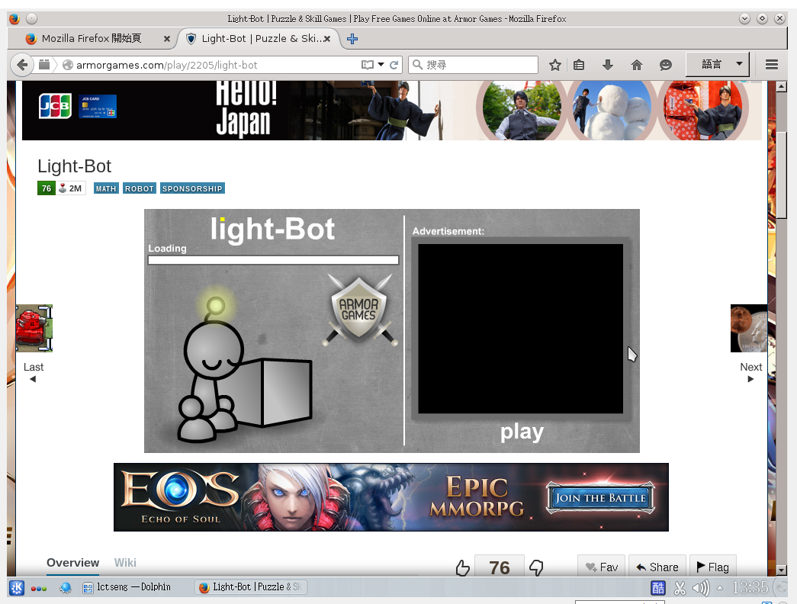
Software Rank A – Requirement (1)
Browser (with Flash support) (10%)
Firefox*
Opera
Chromium
Requirement
http://armorgames.com/play/2205/light-bot
Play this flash game *normally*

Slide 20
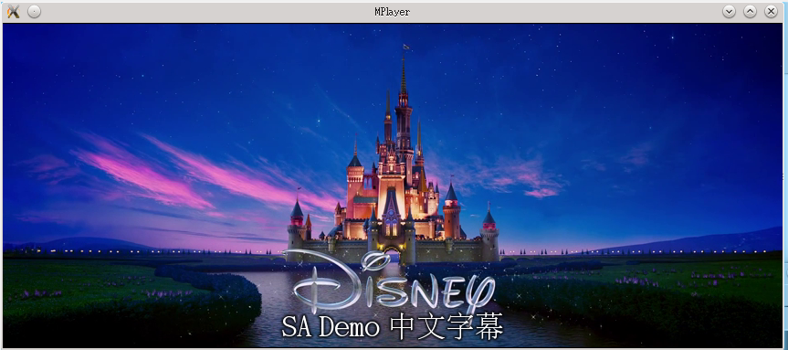
Software Rank A – Requirement (2)
Multimedia : Video, Audio(total 4%)
Mplayer*
VLC
Xmms
Requirement
Play this video (with audio) (1%)
Video: https://nasa.cs.nctu.edu.tw/2015sahw1/files/sahw1.mp4
Subtitle: https://nasa.cs.nctu.edu.tw/2015sahw1/files/sahw1.srt
Load subtitle (1%)
Show Chinese subtitle (2%)
Attention! This subtitle is encoded in UTF-8 w/ BOM

Slide 21
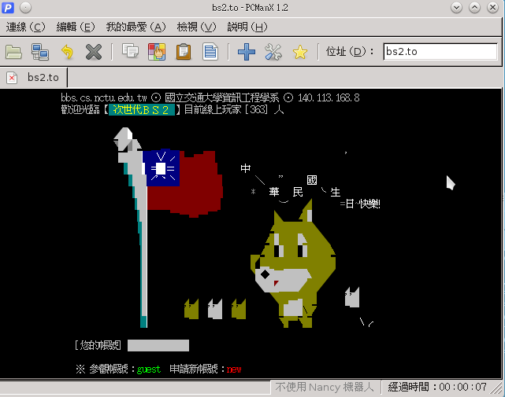
Software Rank A – Requirement (3)
BBS client (total 2%)
pcmanx*
Requirement
Connect to bs2.to (1%)
Chinese support (1%)

Slide 22
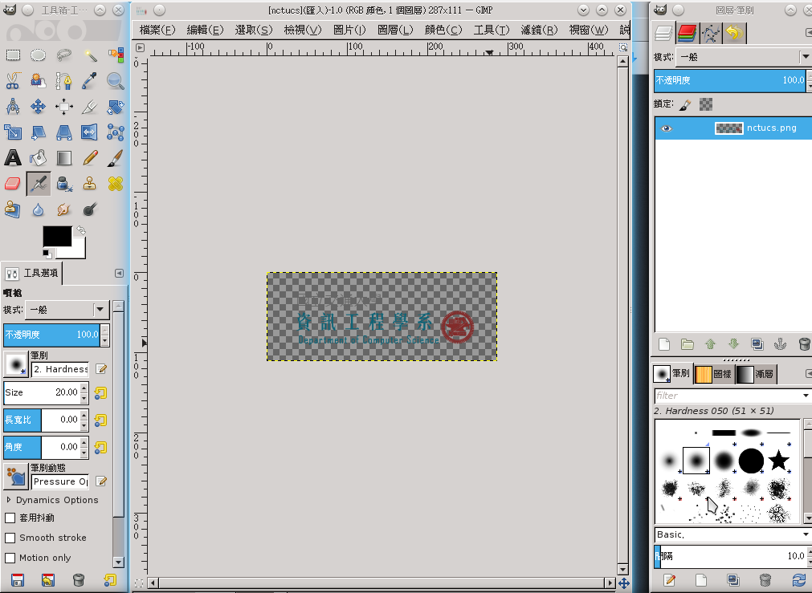
Software Rank A – Requirement (4)
Pictures editor/viewer (2%)
Gimp*
Requirement
Download and edit the picture
https://nasa.cs.nctu.edu.tw/2015sahw1/files/nctucs.png

Slide 23
Software Rank A – Requirement (5)
Remote desktop (2%)
freeNX
(32bits only)
tightvnc
tigervnc
tsclient
remmina
vinagre
Requirement
Connect to TA’s VNC server, announce when demo
You can connect to your own computer for testing

Slide 24
Software Rank S (25%)
Office (4%)
openoffice
libreoffice*
P2P software (3%)
transmission*
deluge
Virtual Machine (18%)
virtualbox-ose*
aqemu

Slide 25
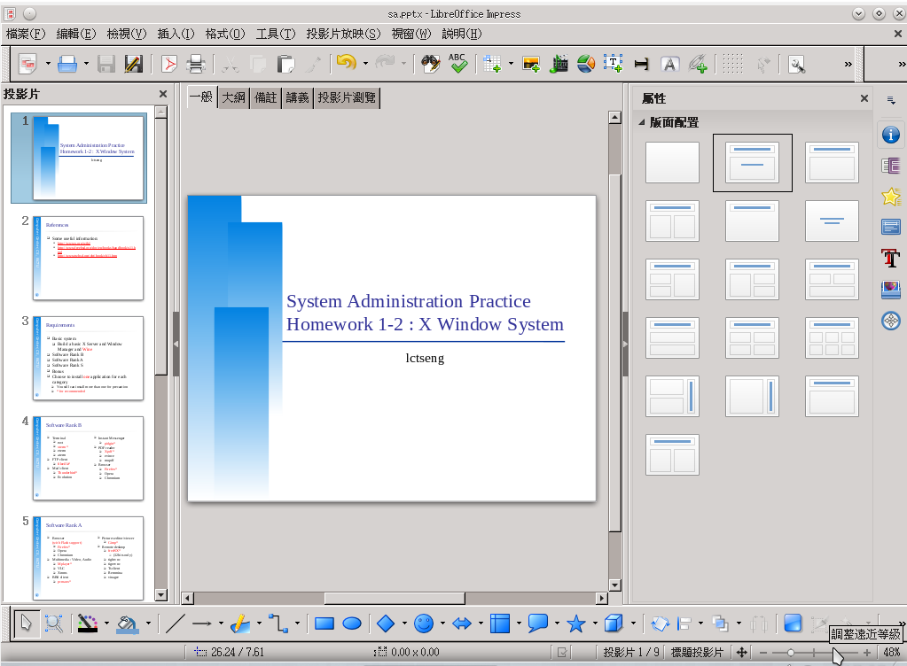
Software Rank S – Requirement (1)
Office (total 4%)
openoffice
libreoffice*
Requirement
Open any pptx file with applications listed above (2%)
You can download pptx files from here
https://nasa.cs.nctu.edu.tw/sa/2015/
Chinese support (2%)

Slide 26
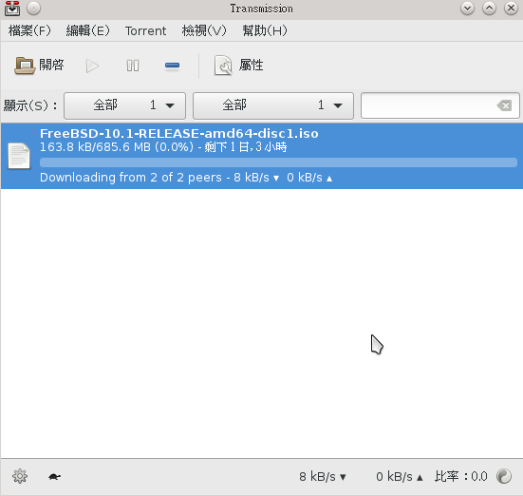
Software Rank S – Requirement (2)
P2P software (total 3%)
transmission*
deluge
Requirement
Download files via torrents(2%) (show the progress)
Chinese support (1%)
You can get torrents from:
http://www.gotbsd.net
Notes: No NCTU-Wireless

Slide 27
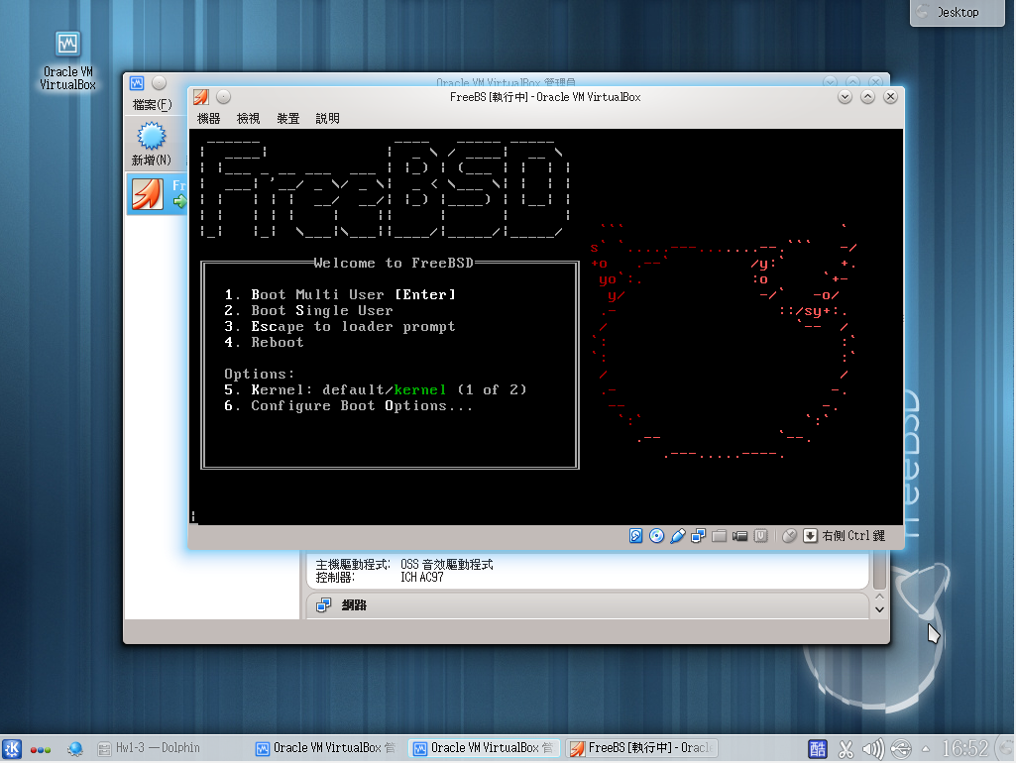
Software Rank S – Requirement (3)
Virtual Machine (total 18%)
virtualbox-ose*
aqemu
Requirement
Open an FreeBSD VM inside your FreeBSD (17%)
Tips: use host CD (from host OS) if you cannot load .ISO from virtualbox
Chinese support (1%)

Slide 28
Bonus (up to 15%)
IDE Environment
Code::Blocks with C/C++ compiling/executing (2%)
Eclipse with Java compiling/executing(3%)
Games (in Wine) (5%)
try to install WoW, PoE, LoL(US) … fancy 3D games
Make sure it can run normally.
Other language support (2%)
Full Japanese support for 皮卡丘打排球
Show the Japanese application title correctly
Misc
applications which cannot be built up easily

Slide 29
Due Time
You need to go to CSCC to fill the sheet to make an appointment about your demo time
Will open for signup from 10/7 (Mon)
Demo 10/12(Mon)~10/18 (Sun)
Demo time will be chosen from these days (announced on 10/7)
Please follow your appointment in demo sheet
If you are not available for all demo time, please make appointment with TA, choose earlier time before deadline
Important! DO NOT use root account when demonstrating your homework!
Try to use normal user with sudo when doing your homework
You may get 0 credit if using root!

Slide 30
Help!
Newsgroup cs.course.sysadm
BS2 board CS-SysAdmin
CSCC
ta@nasa.cs.nctu.edu.tw (For complex problems)
IRC channel #nctuNASA (Recommend)
passwd: ILoveCSCC
Use screen or tmux to stay online, so TAs can tag you to answer your questions.
Before you ask a question…
提問的智慧: How To Ask Questions The Smart Way
http://mis.ndhu.edu.tw/docu/question.htm

