Slide 1
Jail
frank

Slide 2
What is jail?
Lightweight container that isolate processes/
access to file system/network stack
Introduced in FreeBSD 4.X
Build upon the concept of chroot
Operating-system-level
virtualization

Slide 3
Jail v.s. chroot
Jails differs from chroot by the level of separation:
Chroot limits scope of filesystem for the process
While Jail isolates processes from the rest of system

Slide 4
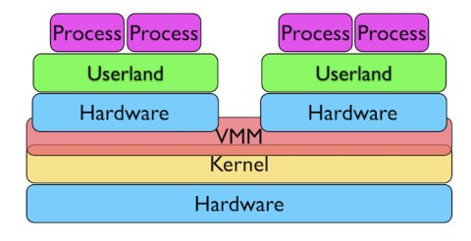
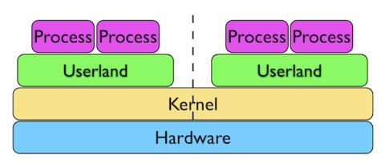
Jail v.s. VM
VM Jail

Slide 5
Jail: Advantage
Jail
Easy to deploy and maintain
Boot up fast (within seconds, while VM takes minutes)
Much less overhead (Disk I/O, emulated NIC, CPU)

Slide 6
How to create a jail?
A jail is characterized by four elements:
Path: the starting point from which jail is entered
Hostname: Hostname used by jail
IP address: IP assigned to the jail
Command: the path name of executable to run inside the jail

Slide 7
How to create a jail?
Basic Jail Environment:
/myjail: place to put our jails, the “Path” of jail
/myjail/bin, /myjail/sbin: basic tools
/myjail/lib,/myjail/libexec: library dependencies
/myjail/dev: devfs
# jail -c jid=1 name=myjail path=/myjail mount.devfs \
ip4.addr=”127.0.0.1” host.hostname=myjail \
command=”/bin/sh”

Slide 8
How to create a jail?
There must be at least one process attached to specific jail. Otherwise, set persist parameter.
# jls // list running jails

Slide 9
When will a jail be destroyed?
Jail will be destroyed when no process is running in jail, unless “persist” is specified.
Jails with “persist” propertie may be destroyed manually using “jail -r <JID/Name>”

Slide 10
Create a jail with freebsd world
Download pre-built base system
# fetch “http://ftp.tw.freebsd.org/pub/releases/amd64/10.1-RELEASE/base.txz”
# mkdir /myjail // jail path
# tar -xf base.txz -C /myjail // extract base into jail path
# freebsd-update -b /myjail fetch install // upgrade base system

Slide 11
Create a jail with freebsd world
# jail -c name=myjail path=/myjail \
ip4.addr=vmx0|127.0.0.10/24 mount.devfs \
host.hostname=myjail.urcrazy.net \
exec.start=”sh /etc/rc” \
exec.stop=”sh /etc/rc.shutdown”

Slide 12
Managing Jails
Start jails upon system boot:
In rc.conf: jail_enable=”YES”
Saving jail configurations in /etc/jail.conf:
myjail {
path=/myjail;
mount.devfs;
host.hostname=myjail.urcrazy.net;
exec.start=”sh /etc/rc”;
exec.shutdown=”sh /etc/rc.shutdown”;
ip4.addr=”127.0.0.1”;
}

Slide 13
Managing Jails
Start/Stop all jails:
# service jail start/stop
Start/Stop specfic jails:
# service jail start/stop <jail name>

Slide 14
Managing multiple Jails
per jail base system:
waste of space
adds complexity to system adminstration
Solution?
Shared-base-system Jails

Slide 15
Managing multiple Jails
Common Implementation:
Using ZFS
easy to backup/snapshot/clone

Slide 16
Managing multiple Jails using ZFS
Separate read-only and read-write areas
Read-write area:
/usr/local
/usr/X11R6
/usr/home or /home
/tmp
/var
/root
/usr/ports/distfiles

Slide 17
Managing multiple Jails using ZFS
# cd /jail/basejail
# mv etc tmp var root ../skel
# mv usr/local ../skel/usr-local
# mkdir s

Slide 18
Managing multiple Jails using ZFS
# ln -s /s/etc etc
# ln -s /s/home home
# ln -s /s/root root
# ln -s /s/usr-local usr/local
# ln -s /s/usr-X11R6 /usr/X11R6
# ln -s /s/distfiles usr/ports/distfiles
# ln -s /s/tmp tmp
# ln -s /s/var var

Slide 19
Managing multiple Jails using ZFS
# cd ../skel
# mkdir home usr-X11R6 distfiles

Slide 20
Managing multiple Jails using ZFS
for each jails:
create directory
/jail/${jail_name} and /jail/${jail_name}_rw
copy file in /jail/skel into /jail/${jail_name}_rw
cpdup /jail/skel/ /jail/${jail_name}_rw

Slide 21
Managing multiple Jails using ZFS
create individual fstab file fstab.${jail_name}
/jail/basejail /jail/${jail_name} nullfs ro 0 0
/jail/${jail_name}_rw /jail/${jail_name}/s nullfs rw 0 0

Slide 22
Managing multiple Jails using ZFS
Further simplify jail.conf using variables and wildcard
* {
path=/jail/$name;
mount.devfs;
mount.fstab=/jail/fstab.$name;
devfs_ruleset=4;
host.hostname=$name.urcrazy.net;
exec.start=”sh /etc/rc”;
exec.shutdown=”sh /etc/rc.shutdown”;
}
jail01 {
ip4.addr=”127.0.0.1”;
}
jail02 {
ip4.addr=”127.0.0.2”;
}

Slide 23
Managing multiple Jails using ZFS
Recap
To create new jail:
create jail and jail_rw directory
copy /jail/skel/ into jail_rw directory
mount read-only basejail to jail directory
mount jail_rw to jail/s
do 2 and 3 with individual fstab file
add jail configuration into jail.conf

Slide 24
Managing Jail using tools
There are tools designed to aid jails managements
qjail
ezjail

Slide 25
Managing Jail using ezJail
# pkg install ezjail
# ezjail-admin install -p
To create jail
# ezjail-admin create <jail name> <jail ip>
To list jail
# ezjail-admin list

Slide 26
Managing Jail using ezJail
To enter jail console:
# ezjail-admin console <jail name>
To create archive for jail
# ezjail-admin archive <jail name>
To deploy jail from archive
# ezjail-admin create -a <archive>

Slide 27
Jail Networking
Using NAT
# ifconfig lo1 create
jail1 ip: lo1|10.0.0.1/24
jail2 ip: lo1|10.0.0.2/24
In rc.conf:
cloned_interfaces=”lo1”

Slide 28
Jail Networking
Using NAT
pf.conf:
ext_if=”vmx0”
jail_if=”lo1”
nat on $ext_if from $jail_if to any -> $ext_if

Slide 29
Jail Networking
Ping command returned
Operation not permitted
Solution:
allow.raw_sockets =1;

Slide 30
Fine tunning Jail
Jail has many restrictions, some of them can be tuned via setting sysctl and jail.conf parameters.
Make sure you know exactly what you’re doing
# sysctl -d security.jail.param

