Slide 1
LDAP (Lightweight Directory Access Protocol)

Slide 2
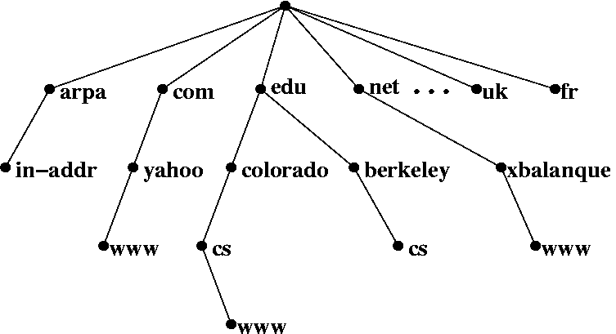
What is Directory Service?
What is Directory Service (名錄服務)
• A directory service is highly optimized for reads.
• A directory service implements a distributed model for storing information.
• A directory service can extend the type of information stores.
• A directory service has advanced search capabilities.
• A directory service has loosely consistent replication among
directory servers.
Domain Name Service

Slide 3
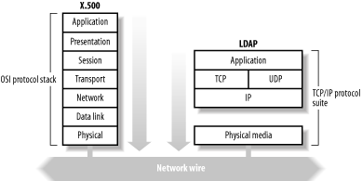
What is LDAP
Lightweight Directory Access Protocol (LDAP)
• LDAP v3: RFC 3377
• RFC 2251-2256, 2829, 2830, 3377
Why LDAP is lightweight
• subset of X.500
X.500 base on OSI stack
LDAP base on TCP/IP
LDAP omits many X.500
operations that are rarely used
Providing a smaller and
simpler set of operations

Slide 4
LDAP Directory Information Tree (DIT)
dc=net
dc=nctucs
Attribute types and values
dc=sap
objectClass: person
cn: mango king
sn: king
telephoneNumber: 689-5566
ou=group
ou=people
cn=mango king
DN(distinguished name):
cn=mango king,ou=people,dc=sap,dc=nctucs,dc=net
RDN: relative distinguished name

Slide 5
LDAPv3 overview – LDIF
LDAP Interchange Format (LDIF)
Defined in RFC 2849
standard text file format for storing LDAP configuration information and directory contents
An LDIF file is
A collection of entries separated from each other by blank lines
A mapping of attribute names to values
A collection of directives that instruct the parser how to process the information
The data in the LDIF file must obey the schema rules of your LDAP directory

Slide 6
LDAPv3 overview – LDIF
Sample LDIF
# sample entry
dn: cn=mango king,ou=people,dc=sap,dc=nctucs,dc=net
objectClass: person
cn: mango king
sn: king
telephoneNumber: 689-5566
dc=net
dc=nctucs
dc: domain component
ou: organizational unit
cn: comman name
dn: distinguished name
rdn: relative dn
dc=sap
ou=people
ou=group
cn=mango king

Slide 7
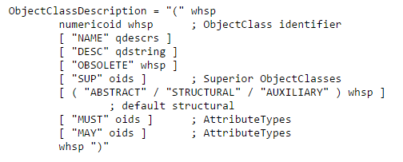
LDAPv3 overview - objectClass
/usr/local/etc/openldap/schema/core.schema
http://www.openldap.org/doc/admin23/schema.html

Slide 8
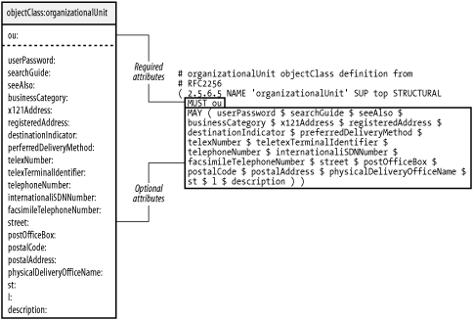
LDAPv3 overview - objectClass
http://www.openldap.org/doc/admin23/schema.html

Slide 9
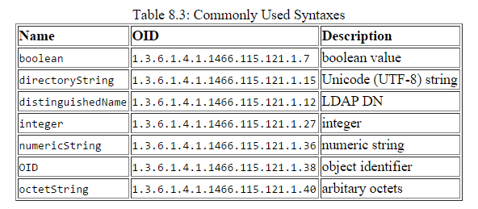
LDAPv3 overview - Attribute
Matching rules
Type
Server should support values of this length
http://www.openldap.org/doc/admin23/schema.html

Slide 10
Comparison with relational databases
It is tempting to think that having a RDBMS backend to the directory solves all problems. However, it is a pig.
This is because the data models are very different. Representing directory data with a relational database is going to require splitting data into multiple tables.

Slide 11
OpenLDAP
Installation
pkg install openldap-server
cd /usr/ports/net/openldap-server24 ; make install clean
slap.conf
• Blank lines and lines beginning with a pound sign (#) are ignored
• Parameters and associated values are separated by whitespace characters
• A line with a blank space in the first column is considered to be a continuation of the previous one.

Slide 12
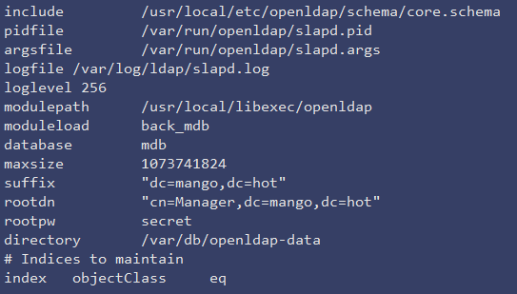
slap.conf

Slide 13
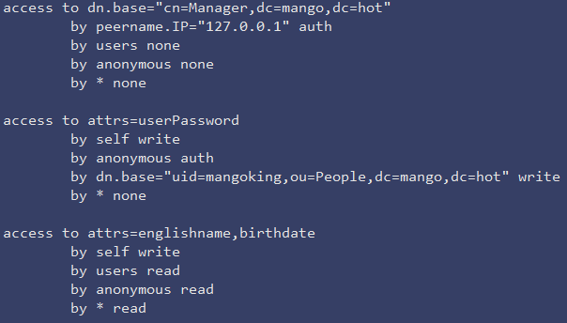
Directory ACL

Slide 14
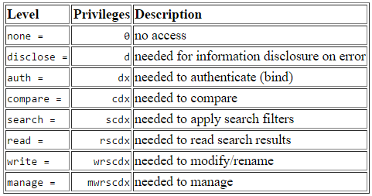
Directory ACL

Slide 15
Enable slapd
Edit /etc/rc.conf
slapd_enable=“YES”
slapd_flags for specific options
service slapd start
http://www.openldap.org/doc/admin24/runningslapd.html

Slide 16
Slapd tools
slapcat
• This tool reads records from a slapd database and writes them to a file or standard output
slapadd
• This tool reads LDIF entries from a file or standard input and writes the new records to a slapd database
slapindex
• This tool regenerates the indexes In a slapd database
slappasswd
• This tool generates a password hash suitable for use as an Lq in slapd.conf

Slide 17
LDAP tools
ldapsearch
• This tool issues LDAP search queries to directory servers
ldapadd, ldapmodify
• These tools send updates to directory servers
ldapcompare
• This tool asks a directory server to compare two values
ldapdelete
• This tool deletes entries from an LDAP directory

Slide 18
ldap.conf
ldapsearch -x -b “dc=mango,dc=hot” \
-H “ldap://sahome.mango.hot” “uid=mangoking”
Edit /usr/local/etc/openldap/ldap.conf
=> ldapsearch -x “uid=mango”

Slide 19
LDAP authentication
pkg install nss-pam-ldapd
Edit /usr/local/etc/nslcd.conf
Edit /etc/nsswitch.conf
Edit /etc/pam.d/system

Slide 20
LDAP authentication
Edit /usr/local/etc/nslcd.conf
Just like ldap.conf

Slide 21
LDAP authentication
Edit /etc/nsswitch.conf
https://www.freebsd.org/doc/en/articles/ldap-auth/client.html

