Slide 1
X Window System
mangoking
2015/09/24

Slide 2
Outline
X Window System
Introduction
Architecture
X11 Implementation
The Window Manager
Steps of exercise
Install and Configuring X11
Install Window Manager
2

Slide 3
X Window System (1)
Introduction
X can be called "X"、"X11"、"X Window", using to provides a graphical user interface (GUI).
X was designed from the beginning to be network-centric, and adopts a "client-server" model.
History
1984: The X Window system was developed as part of Project Athena at MIT.
1987: X Version 11 is released. X is now controlled and maintained by the Open Group.
2005/12: X11R7.0
2009/10: X11R7.5
2010/11: X11R7.6
2012/6/6: X11R7.7
3

Slide 4
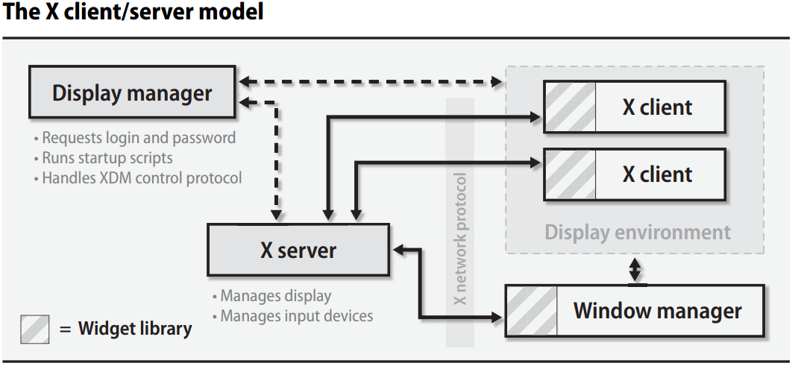
X Window System (2)
Architecture:
A client-server architecture
The X client request display service
The X server provide display service
Communicate with X Protocol
4

Slide 5
X Window System (3)
Client-Server Design
Client
An application written using X libraries (e.g. Xlib)
Request service (like create window)
Receive events from X server (like mouse input)
Server
Runs locally and accepts multiple X clients
Manage the keyboard, mouse and display device
Create, draw and destroy graphic objects on screen
5

Slide 6
X Window System (4)
X Protocol
The X Protocol is also divided into device dependent and device independent layers.
Advantages of X protocol
The X server is highly portable (various OS, Language)
The X Clients also have high portability
Local and network based computing look and feel the same
6

Slide 7
X11 Implementation
Open-source implementations of X Window System
XFree86 project
Since 1992, dormant in Dec, 2011
Latest Version: 4.8.0 Dec 15, 2008
Xorg foundation
Since 2004, forked from XFree86 4.4 RC2
X11 official flavor
Latest Version: 7.7 June 6, 2012
7

Slide 8
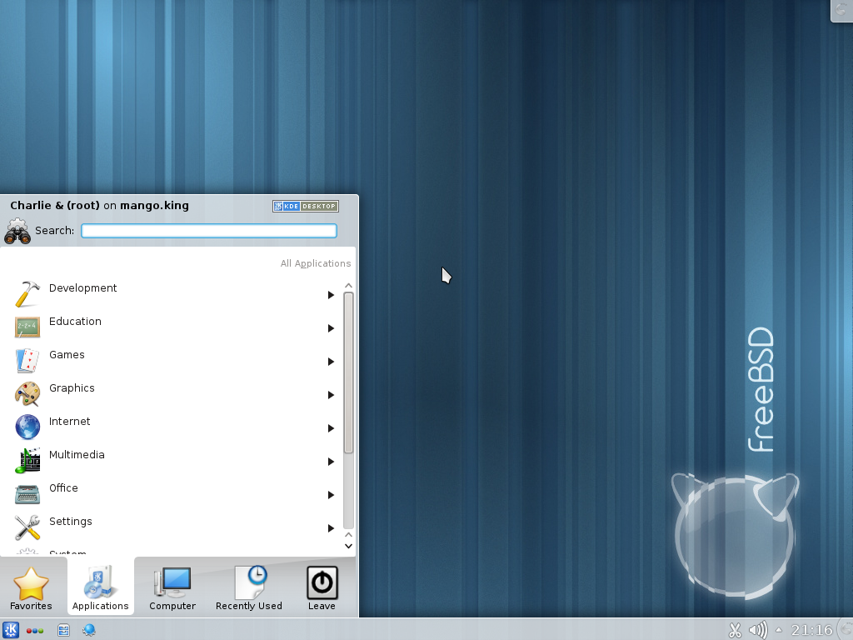
The Window Manager (1)
Window Manager
A special kind of "X Client" provides certain look-and-feel window in front of you.
Background, desktop, theme
Virtual desktop
Window attributes and operations size
resize, minimize, maximize
position: overlap, move
Interactions between X server and X client will be redirected to a window manager.
8

Slide 9
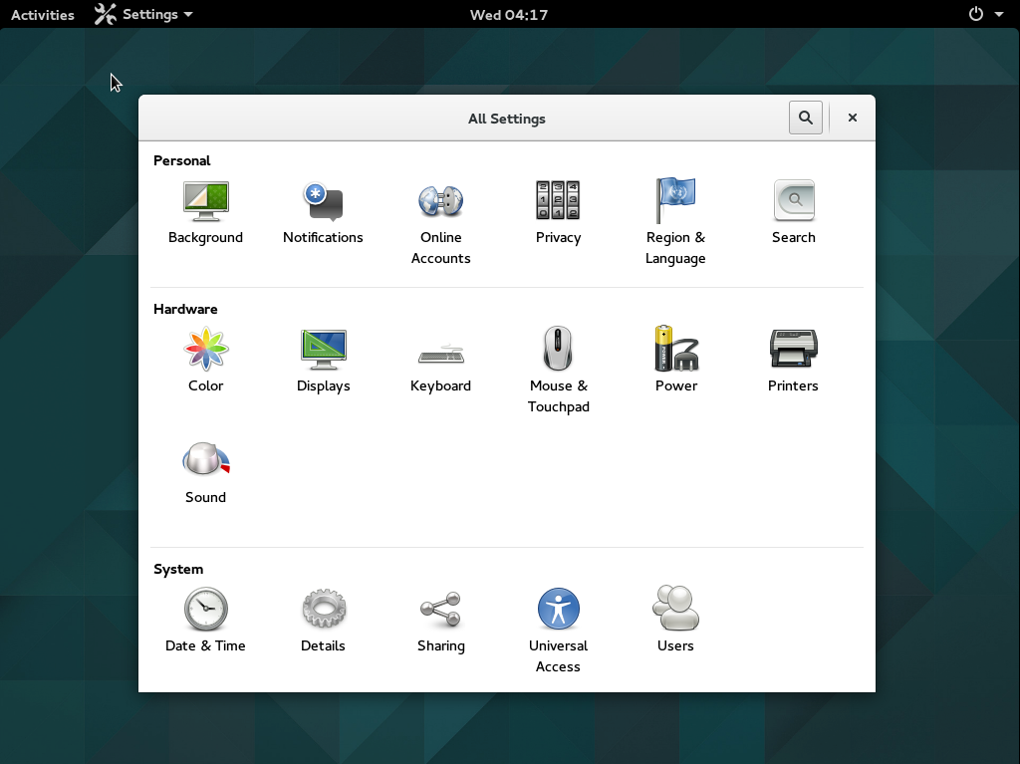
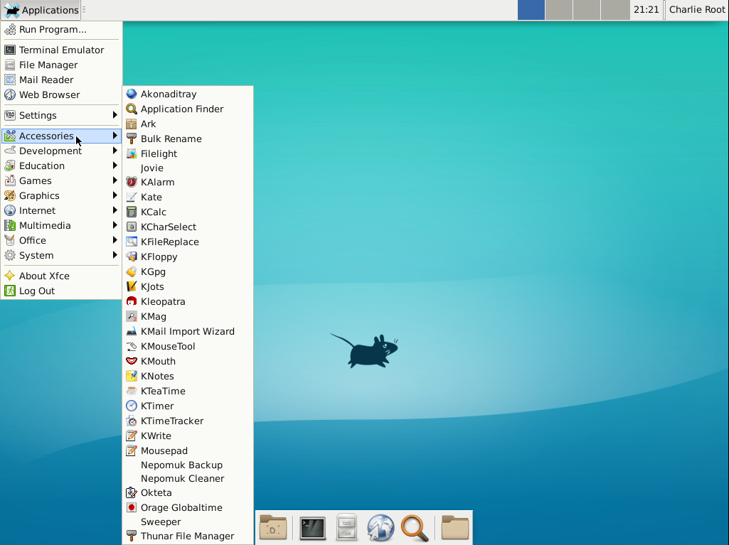
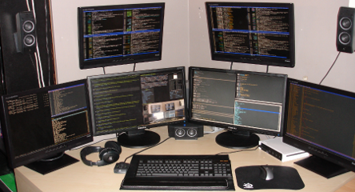
The Window Manager (2)
Some Popular Window Managers
Gnome
KDE
LXDE
LXQt
Xfce
etc..
9

Slide 10
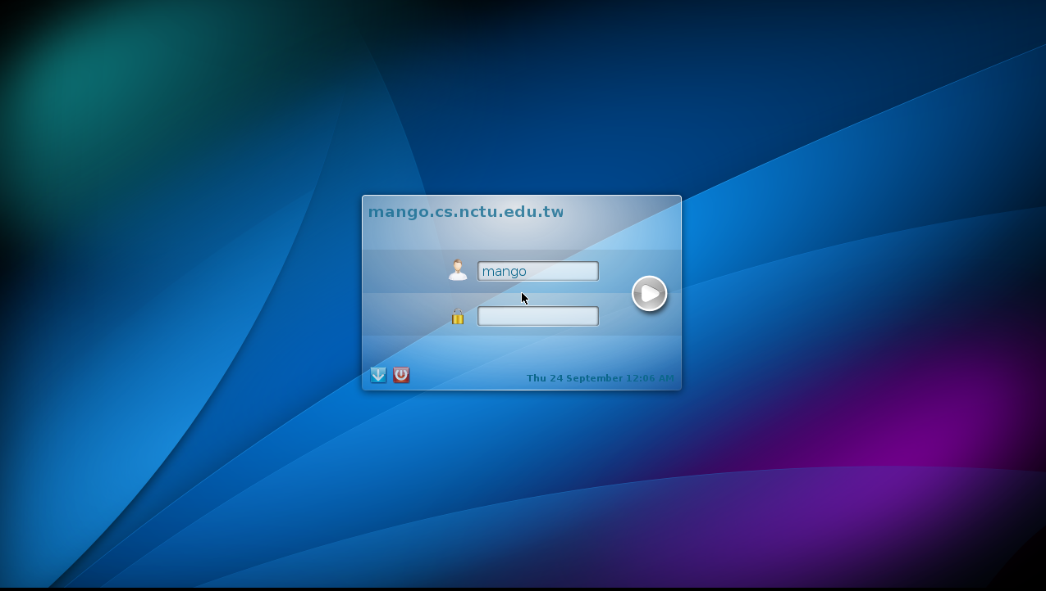
The Display Manager
Display Manager (login manager)
A display manager is typically a graphical user login interface that is displayed before The Windows Manager.
8

Slide 11
Steps of exercise
Install X11
Configuring X11
Install Window Manager and Display Manager
Configuring Window Manager and Display Manager
10

Slide 12
Install X11
We use Xorg as our X Server
To build and install Xorg from the ports
Login as root
/usr/ports/x11/xorg
# pkg install xorg or # portmaster x11/xorg
To build Xorg in its entirety, be sure to have at least 4 GB of free space available.
/usr/ports/*/*/work/*
/usr/local/*
df (command)
11

Slide 13
Configuring X11 (1)
Pre-step – know your hardware
Monitor specifications
Horizon Synchronization frequency
Ex: 31 ~ 81 KHz
Vertical Synchronization frequency
Ex: 56 ~ 76 KHz
Video adaptor chipset
Ex: ATI Radeon 4670EAH
Ex: nVIDIA GeFource 9800GT
Ex: ATI Mobility RADEON 7500 (16M) (IBMT30)
Ex: vboxvideo
Video Adapter Memory
Ex:128MB
12

Slide 14
Configuring X11 (2)
Starting with version 7.4
Xorg can use HAL (Hardware Abstraction Layer) to autodetect keyboards and mice.
Install the following ports
sysutils/hal
devel/dbus
And adding the following lines into /etc/rc.conf
hald_enable="YES"
dbus_enable="YES"
13

Slide 15
Configuring X11 (3)
Steps of X11 configuration
As of version 7.3, Xorg often work without any configuration file.
# startx
X11 configuration
Generate an X11 configuration skeleton file
# Xorg -configure
The file will be put in /root/xorg.conf.new
Test the existing configuration
# Xorg -config /root/xorg.conf.new -retro
If a black and grey grid and an X mouse cursor appear, the configuration was successful
14

Slide 16
Configuring X11 (4)
Section "Screen"
Identifier "Screen0"
Device "Card0"
Monitor "Monitor0"
DefaultDepth 24
SubSection "Display"
Viewport 0 0
Depth 24
Modes "1280x1024" "1024x768"
EndSubSection
EndSection
Tune Configuration file
Edit /root/xorg.conf.new
Section Monitor
Section Screen
Section InputDevice
Section "InputDevice"
Identifier "Mouse0"
Driver "mouse"
Option "Protocol" "auto"
Option "Device" "/dev/sysmouse"
Option "ZAxisMapping" "4 5"
EndSection
Section "Monitor"
Identifier "Monitor0"
VendorName "Monitor Vendor"
ModelName "Monitor Model“
HorizSync 31.0 - 81.0
VertRefresh 56.0 - 76.0
EndSection
15

Slide 17
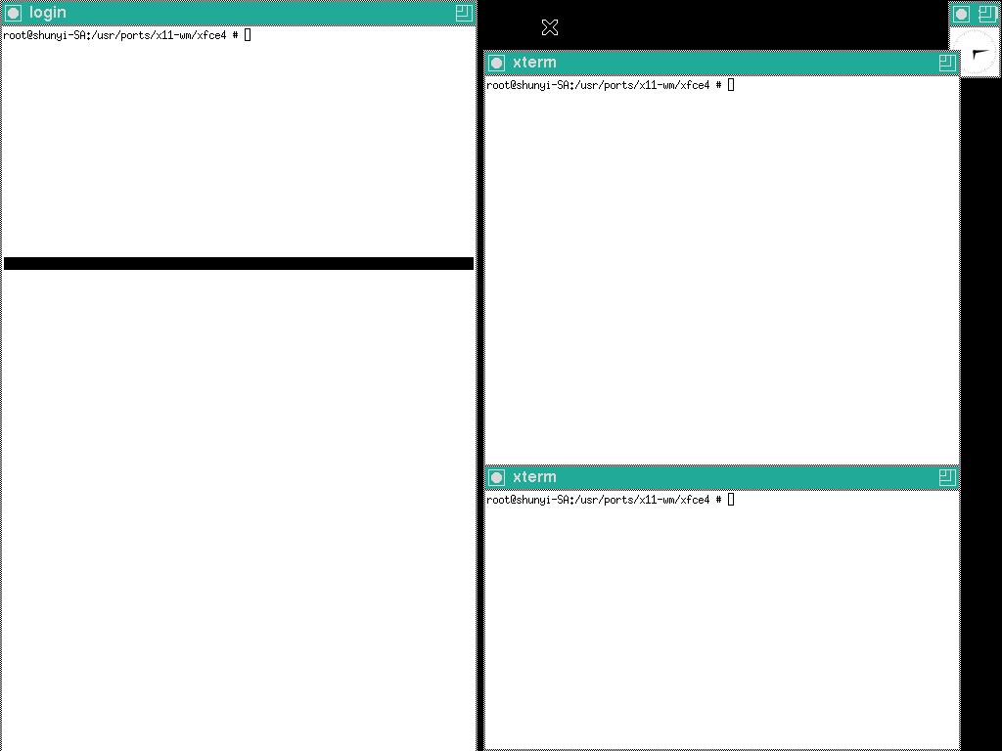
Configuring X11 (5)
Copy the configuration file to real place
% cp /root/xorg.conf.new /usr/local/etc/X11/xorg.conf
Start X
% startx
16

Slide 18
Install Window/Display Manager (1)
Here we use kde as our WM and kdm as our DM
http://www.kde.org
KDE needs much memory, you can use xfce alternatively.
http://www.xfce.org
Installation
x11/kde4
# pkg install x11/kde or # portmaster x11/kde4
x11-wm/xfce4
# pkg install xfce4 or # portmaster x11-wm/xfce4
17

Slide 19
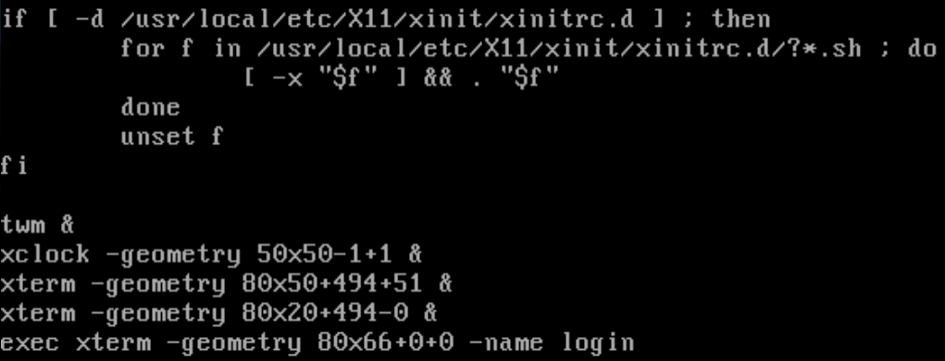
Install Window/Display Manager (2)
Configuring X11 to use Windows Manager
Edit "xinitrc"
File Location:
System Default: /usr/local/etc/X11/xinit/xinitrc
Personal: ~/.xinitrc
Format: just like a shell script!
exec /usr/local/bin/startkde
echo "/usr/local/bin/startkde" > ~/.xinitrc
18

Slide 20
Install Window/Display Manager (3)
Run your X Window
% startx
19

Slide 21
Install Window/Display Manager (3)
Test your Display manager
% service kdm4 onestart
Run DM at the end of booting
% add ‘kdm4_enable=“YES” ‘ to /etc/rc.conf
19

Slide 22
References
http://www.x.org/wiki/
http://en.wikipedia.org/wiki/X_Window_System
http://en.wikipedia.org/wiki/XFree86
http://en.wikipedia.org/wiki/X.Org_Server
http://en.wikipedia.org/wiki/X_display_manager_(program_type)
http://en.wikipedia.org/wiki/Virtual_Network_Computing
http://www.xfce.org
http://www.freebsd.org/doc/handbook/x11.html
http://www.freebsd.org/doc/zh_TW/books/handbook/x11.html
http://www.gilesorr.com/wm/table.html
25

Slide 23
Appendix A: X Startup (1)
xinit - X Window System initializer
xinit [ [ client ] options ] [ -- [ server ] [ display ] options ]
Files
Default client script:
~/.xinitrc
/usr/local/etc/X11/xinit/xinitrc
(run xterm if .xinitrc does not exist)
Default server script:
~/ .xserverrc
/usr/local/etc/X11/xinit/xserverrc
(run X if .xserverrc does not exist)
startx:
script to initiate an X session
20

Slide 24
Appendix A: X Startup (2)
Xdm - X Display Manager
Xdm provides services similar to those provided by init, getty and login on character terminals
x11/xdm
Other display manager
gdm, kdm
Files:
/etc/ttys
Default script
~/.xsession
ttyv8 "/usr/local/bin/xdm -nodaemon" xterm on secure
21

Slide 25
Appendix B: Remote X client
To launch an X client from a remote host for display on the local X server, you need to do following steps:
Start X Server with tcp connection support
% X
Permit for the remote host to display X clients on the local machine.
% xhost [+]remotehost
Set DISPLAY for remote X clients
% setenv DISPLAY server:display
22

Slide 26
Appendix C: X11 forwarding
To forward X11 connection
Connection to X11 DISPLAY can be forward by ssh, any X11 programs started will go through the encrypted channel.
Server:
Enables X11 forwarding: ssh -X
Enables trusted X11 forwarding: ssh -Y (may be dangerous)
Client:
Execute any X clients you want
※Note:
X11 forwarding can represent a security hazard.
23

Slide 27
Appendix D: VNC
VNC (Virtual Network Computing)
a graphical desktop sharing system to remotely control another computer.
Use Remote Frame Buffer (RFB) protocol.
Start VNC Server (and input a connection password)
% vncserver
VNC startup script
~/.vnc/xstartup (just like ~/.xinitrc)
Than you can connect to vnc server by a vnc client
Common VNC Client
RealVNC https://www.realvnc.com/
UltrlVNC http://www.uvnc.com/
24

