Slide 1
System Administration Practice
chchang2222

Slide 2
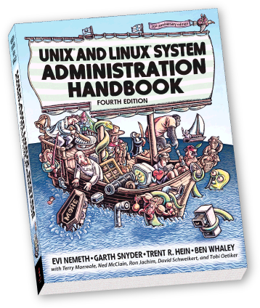
Syllabus
Website:
https://e3.nctu.edu.tw
Instructor:
易志偉
Time:
Thu. IJK (PM 6:30 ~ 9:20)
Place:
EC114
English Slides and Exams, Chinese Lecture (TAs can support)
TAs:
Email to TAs: ta@nasa.cs.nctu.edu.tw
IRC channel #nctuNASA (ILoveCSCC) on freenode
資安學程 http://isc.cs.nctu.edu.tw/
大學部雲端系統學分學程 http://delta.nctu.edu.tw/

Slide 3
Syllabus – Course Textbook and Reference
Textbook
UNIX and Linux System Administration Handbook, 4th ed.
Slides
References:
FreeBSD Handbook
FreeBSD Porter's Handbook
FreeBSD Mastery Series
Archlinux Wiki

Slide 4
Syllabus – Course Overview (1/2)
Main Topics
FreeBSD Installation
Package Management
Shell Scripting
User Management
File System& Disks
Network Filesystem
Service Management
Driver and Kernel
Periodic Processes & Syslog
Virtualization: bHyve and Jail
Performance, Security and System backup

Slide 5
Syllabus – Course Overview (2/2)
Seminar Topics
OpenStack Introduction (Gemini)
OpenStack Hands-on (Gemini)
How To Build Your Own Rack? (Edge-core)
ITSM & ITIL Introduction (ITRI)
IT Service Level Agreenment: Definition and Implementation (ITRI)

Slide 6
Syllabus – Grading Policy
Midterm
Date: 2016/11/10
15~20%
Final
Date: 2017/01/12
15~20%
Exercise
60 ~ 75%
No Delay Work
5 exercises

Slide 7
Syllabus – Prerequisite
Background Knowledges
It is better to have taken
“Introduction to Computers and Programming” (計算機概論)
“Introduction to Networking” (計算機網路概論)
At least
Experience of using Unix-like environment
Environment
One dedicated PC (Or dual OS in your PC, VM is also accepted.)
With Unix-like OS installed (e.g. FreeBSD, Linux, Sun OS, …etc.)
FreeBSD is recommended for the reason: TA supports.

Slide 8
Syllabus – Schedule
日期 | 周 | 課程內容 | 上課地點
2016/9/15 | 1 | 中秋節放假
2016/9/22 | 2 | Syllabus | EC114
 |  | Install FreeBSD 10.3
 |  | Package Management
2016/9/29 | 3 | Shells | EC114
 |  | Shell Programming
2016/10/6 | 4 | OpenStack 介紹課 | EC114
2016/10/13 | 5 | User Management | EC114
2016/10/20 | 6 | File System & Disks | EC114
2016/10/27 | 7 | NFS | EC114
2016/11/3 | 8 | OpenStack 實作課 | EC315
2016/11/10 | 9 | 期中考 | EC114
2016/11/17 | 10 | Service Management | EC114
2016/11/24 | 11 | Driver and kernel | EC114
2016/12/1 | 12 | How to build your own rack? | EC114
2016/12/8 | 13 | ITSM & ITIL Introduction | EC114
2016/12/15 | 14 | Periodic Processes & Syslog and log rotate | EC114
2016/12/22 | 15 | Jail | EC114
 |  | bHyve
2016/12/29 | 16 | IT Service Level Agreement 定義與實做 | EC114
2017/1/5 | 17 | Performance | EC114
 |  | Security
 |  | System backup
2017/1/12 | 18 | 期末考 | EC114

Slide 9
Attitude
Attend every class
Do every exercise
As early as possible
On your own
Read books and practice at least 6 hours every week
Use unix-like environment
Recommend: more than 1.5 hours/day averagely.
Collect information on the internet
The newer, the better.

Slide 10
SA-NA Junction
FreeBSD
10.3-RELEASE
http://ftp.tw.freebsd.org/pub/FreeBSD/releases/ISO-IMAGES/10.3/

Slide 11
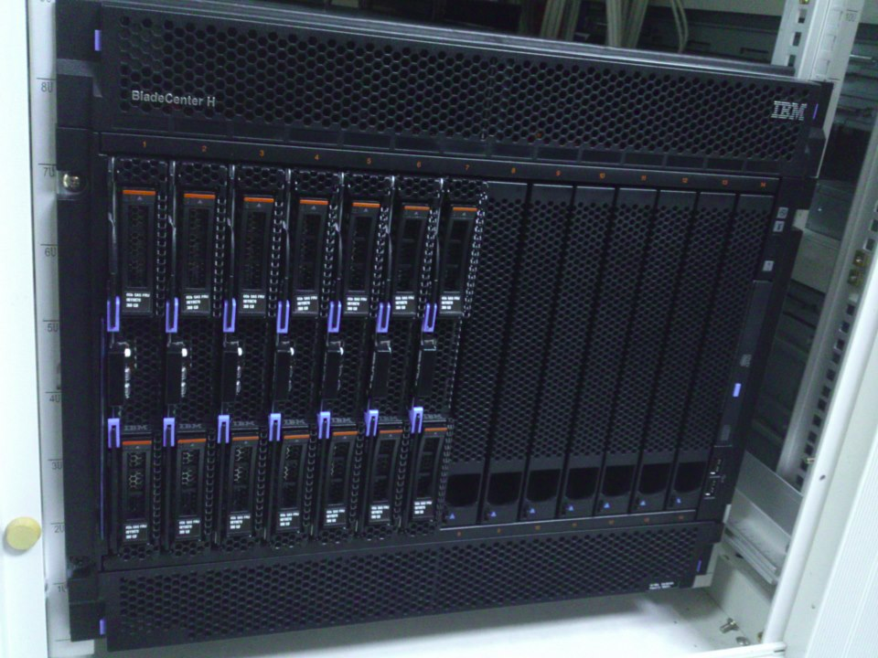
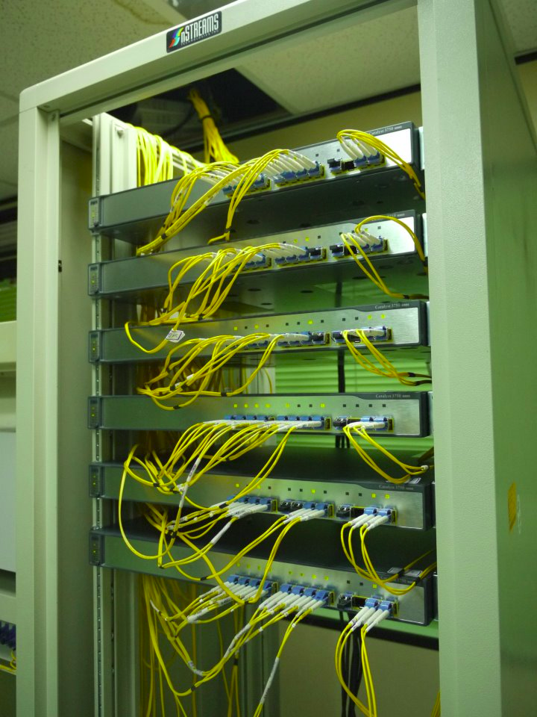
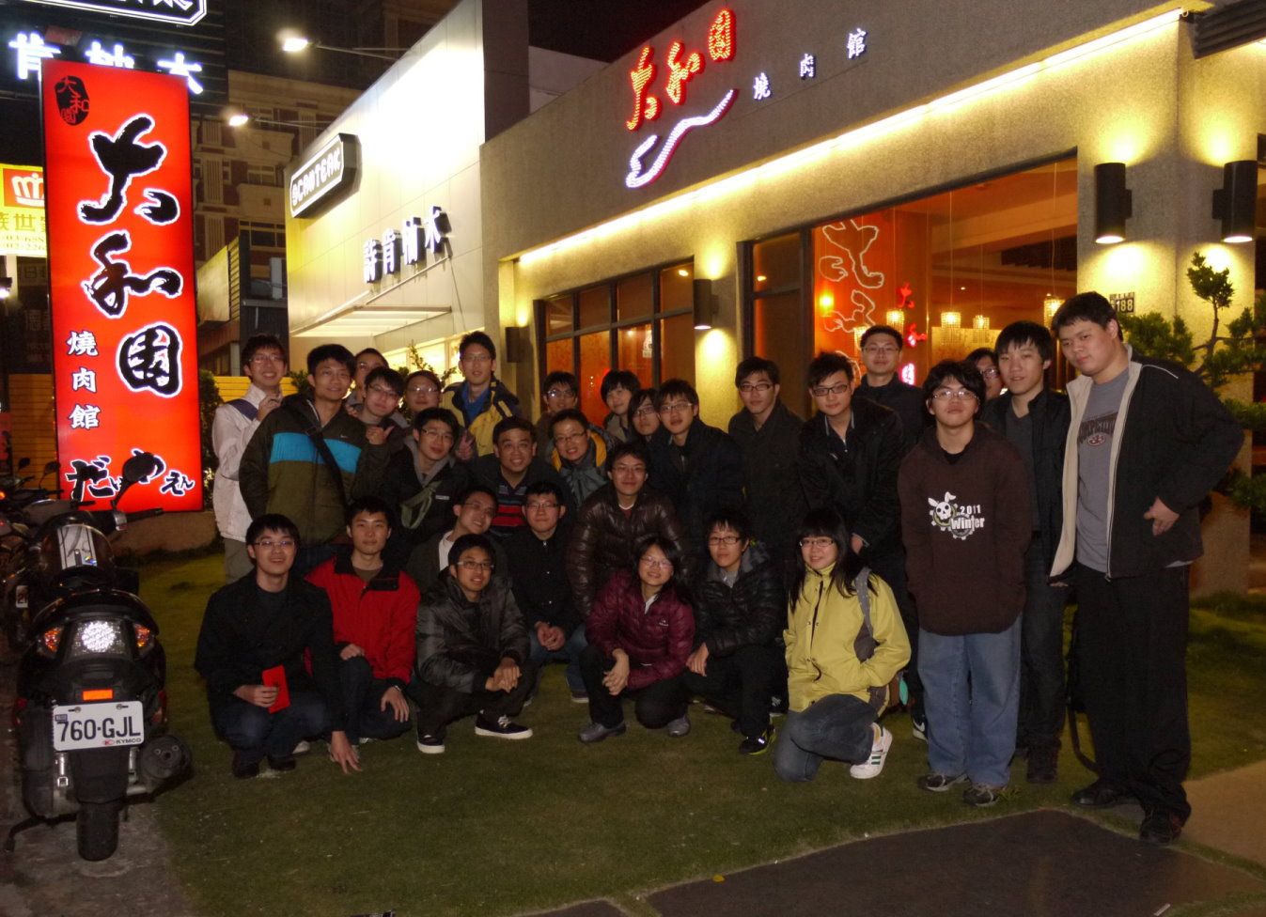
We Want You!

