Slide 1
System Administration Practice Homework 2: Shell Programming
yench

Slide 2
Requirements
3-1: Filesystem Statistic (20%)
3-2: Dialog Browser (60%)
Make a web browser by using dialog
Modify code by yourself at demo (20%)
Please write the scripts in Bourne Shell (sh)
No score if you use csh, bash or other languages.
Due: 2016/10/14 upload ${student_ID}.tar on E3
Demo at next week. Two day in 2016/10/17~21

Slide 3
3-1: Filesystem Statistic

Slide 4
3-1: Filesystem Statistic - Requirement
Inspect the current directory(“.”) and all sub-directory.
Calculate the number of directories.
Do not include ‘.’ and ‘..’
Calculate the number of files.
Calculate the sum of all file size.
List the top 5 biggest files.
Only consider the regular file. Do not count in the link, FIFO, block device... etc.

Slide 5
3-1: Filesystem Statistic - Requirement
Use one-line command
Only pipes are allowed.
No temporary file or shell variables.
No “&&” “||” “>” “>>” “<” “;” “&”, but you can use them in the awk command. Actually, you don’t need them to finish this homework.
Hint: ls(1) with -A and -R

Slide 6
3-1: Filesystem Statistic - Requirement
Grade
File is executable. (4%)
List top 5 file size and name. (4%)
Dir num is correct. (4%)
File num is correct. (4%)
Total size is correct. (4%)

Slide 7
3-2: Dialog browser

Slide 8
Dialog (1)
Dialog is a program that will let you to present a variety of questions or display messages using dialog boxes from a shell script.
These types of dialog boxes are implemented (though not all are necessarily compiled into dialog):
buildlist, calendar, checklist, dselect, editbox, form, fselect,
gauge, infobox, inputbox, inputmenu, menu, mixedform,
mixedgauge, msgbox (message), passwordbox, pause,
prgbox, programbox, progressbox, radiolist, rangebox,
passwordform, tailbox, tailboxbg, textbox, timebox,
treeview, and yesno (yes/no).

Slide 9
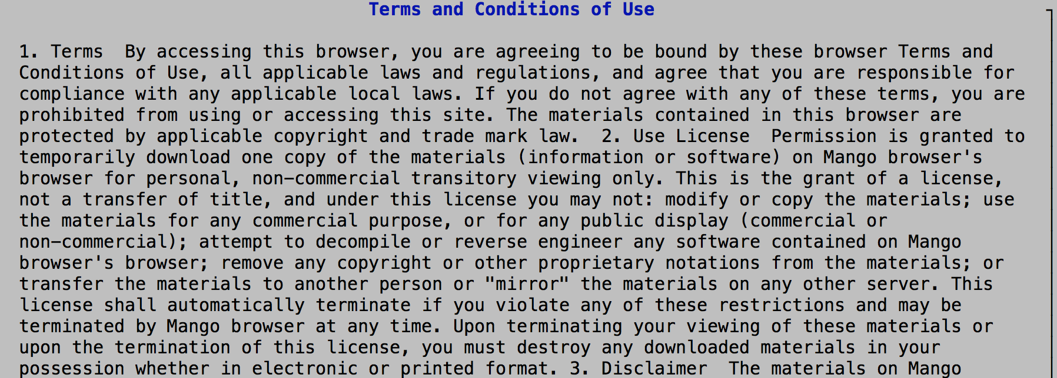
Terms and Conditions of Use – 3%
Use `yesno` dialog: --yesno text height width
Example:
dialog --title “terms” --yesno “xxx” 200 100
The content of terms don’t matter
Place terms in `~/.mybrowser/userterm`

Slide 10
Flowchart
Terms
NO
Exit

Slide 11
Dialog of disagreement
Use `msgbox` dialog: --msgbox text height width
Example:
dialog --title 'Apology' --msgbox "Sorry" 200 100

Slide 12
Flowchart - Homepage (3%)
Terms
YES
Homepage

Slide 13
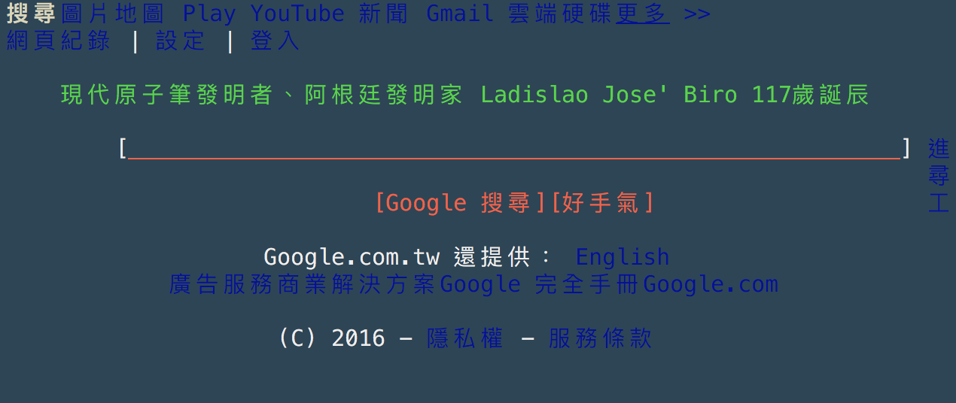
How to generate a page?
Use w3m and `msgbox` dialog
What is w3m?
a text based web browser and pager
dialog --msgbox “$(w3m --dump google.com)” 200 100

Slide 14
Flowchart – URL (12%)
Current page
If the input is an URL,
go to the page.
OK
You can use RE to determine whether the input is an URL.
Using other tricks is OK.
Input box
Show current url at here
Use `inputbox` dialog to get the input.

Slide 15
Flowchart – Built-in command (30%)
YES
Current page
Is the page changed?
CANCEL
OK
NO
Input box
Do the command
If the input starts with ‘/’, it is a built-in command

Slide 16
What commands do we have?
/S /source – curl -s -L , w3m --dump_source*
Show the source code of the page in the `msgbox` dialog.
/L /link – use RE to grep <a href=“link”>…</a>
Show all links of this page in the `menu` dialog.
Select one of them to go to that link.
/D /download – wget, curl -o, fetch -o
Show all links of the page in the `menu` dialog.
Select one of them to download that link to ~/Downloads/.
/B /bookmark – save bookmark in `~/.mybrowser/bookmark`
Show `add`, `delete` and all bookmarks.
/H /help – place this page in `~/.mybrowser/help`
Show the help page.

Slide 17
/S, /source: show the source code

Slide 18
/L, /link: show all links of this page

Slide 19
/D, /download: select a link to download

Slide 20
/B, /bookmark: Show all bookmarks.

Slide 21
/H, /help: the help page

Slide 22
Flowchart – Shell command (6%)
Current page
Show the result
OK
Input box
Run the shell code
If the input starts with ‘!’, it is a shell command

Slide 23
Flowchart – Invalid input (3%)
Current page
Input box
Invalid input
Error page

Slide 24
Flowchart – Exit (3%)
Current page
Input box
CANCEL
Exit

Slide 25
Bonus
3-1 Top 10 shortest code ( less pipe > less character ) (5%)
3-2 Last page, next page (3%)
Use commands to go to last or next page.
3-2 Error log in ~/.mybrowser/error (2%)
Without any error output on tty

Slide 26
Help
IRC channel #nctuNASA on irc.freenode.net
Email ta@nasa.cs.nctu.edu.tw or E3

