Slide 1
Installing Applications in FreeBSD
pschiu

Slide 2
Before we start
Permission issue
root: the super user
Like administrator in M$ Windows
Don’t execute commands as root directly
It’s DANGEROUS
Such as #rm –rf / tmp
But sometimes you still need to be root to do something
Install software
Manage system file
Create/modify users

Slide 3
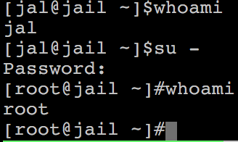
Before we start
Become root
Console login with root
By default, cannot login with root via SSH
Change current user
Don’t need to login with console
Use command ‘su -’, and them type root’s password
To see which credit you are using, use ‘whoami’

Slide 4
Before we start
As mentioned before, don’t run as root directly
Can we execute with root’s credential only for some specific commands?
Like ‘Run as administrator’ in Windows
Is there similar commands in FreeBSD?

Slide 5
Before we start
Run commands with other user’s permission
‘sudo’ command
Only simplest explanation here for basic usage
‘sudo’ syntax and other details will explain in later chapter
Here only tell you how to simply enable ‘sudo’
How to enable sudo?
‘sudo’ is not a built-in command, need to be installed manually

Slide 6
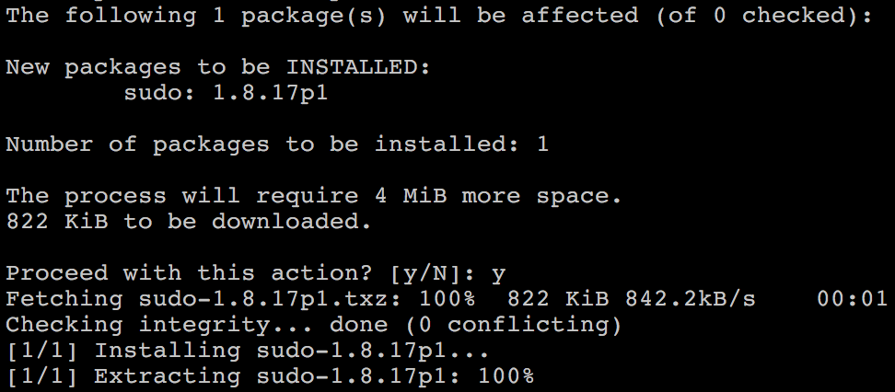
Before we start – Enable ‘sudo’
Install the package
Check Internet connection
ping 8.8.8.8
Become root (su -)
Execute ‘pkg install sudo’
This will install ‘sudo’ from Internet
Proceed with this action? [y/N]: y
Type ‘Y’( means yes) when it ask for conform

Slide 7
Before we start – Enable ‘sudo’
Allowing your user to execute ‘sudo’
Switch to root first
Type ‘setenv EDITOR ee’ to change your editor for this time
Will explain this in later chapter
This will allow you to use a notepad-like editor
If you are familiar with default editor ‘vi’, just skip this step
Type ‘visudo’ to edit the sudoer file
Specific who can use ‘sudo’
Around line 87, type ‘jal ALL=(root) ALL’
Please replace ‘jal’ with your own username
Save the file and exit, back to normal user
Use ‘logout / exit’ command or press ctrl + d

Slide 8
Before we start – Using ‘sudo’
Now, you can prepend ‘sudo’ before commands to run them as root
But please think carefully before you type
Execute commands with ‘sudo’
$ sudo whoami
You have root’s credential
$ sudo pkg install vim
Install software without become root directly
You need to re-type your password
Don’t need to re-type within 5 minutes

Slide 9
Install software
Package
Pre-built
Like most of installer (.msi) in Windows
Other Unix-Like system: rpm, yum, dpkg, apt-get…
FreeBSD: pkg (default from 10.0)
Don’t use old pkg_* commands!
pkg_add pkg_deinstall pkg_delete pkg_* only for version before 10
Source
Compile the source files first and then install
Tarball, a pack of source code
tar -xzvf certain-source.tar.gz
cd certain-source
./configure --help
./configure [options …]
make
make install (root permission)

Slide 10
Install software : Overview
Three technologies
Packages
Ports
Tarball
Packages
pre-built ports, contain pre-compiled copies of all the commands for the application, as well as any configuration files or documentation.
Ports
a collection of files designed to automate the process of compiling an application from source code and additional patches
a set of Makefile, patches, description files, …
Both packages and ports understand dependencies
Tarball
fetch it, configure the installation options, and compile it by yourself. NO DEPENDENCY CHECKING.

Slide 11
Overview
Package benefits
Packages do not require any additional compilation
Benefit for slow machines
Ports benefits
You can tweak the compilation options to generate code that is specific to a different processor – speed
Some applications have compile time options relating to what they can and cannot do – customization
Why tar ball?
Some software cannot be found in port collections
Some latest version of software may have new configurations that do not exist in port

Slide 12
Package System (1)
pkg
New generation of FreeBSD package system
Install new software
Fetch packages from Internet
pkg install <names of packages…>
pkg install vim screen tmux
Run with root’s permission (sudo)
Automatically update the database
Perform dependency check
Will install software that required by new software

Slide 13
Package System (2)
Update packages database only
pkg update
Upgrade currently installed software
pkg upgrade <names of packages…>
pkg upgrade vim
pkg upgrade
Upgrade all installed software
This will also update the database
Delete a package
pkg delete <names of packages>
pkg delete php53
Will check dependency
pkg delete -f <names of packages>
-f : force
Disable dependency check

Slide 14
Package System (3)
Show information about installed packages
pkg info
Show all installed packages
Use ‘grep’ to find specific packges
pkg info | grep vim
pkg info <name of package>
Show detailed information
pkg info php56
Show version of installed packages
pkg version
pkg version -v

Slide 15
How to use ports
Obtain the ports collection
List of ports available to be installed into system
We should…
Find the application
Change to the directory for the port
Ports will
Fetch the tarball from internet (FreeBSD website or original web)
Ask for configuration friendly
Compile the source code
Install your application to DESTDIR/PREFIX

Slide 16
Obtaining the Ports Collection
Port directory
/usr/ports/<category>/<name>

Slide 17
Obtaining the Ports Collection
portsnap(8)
Fetch and update your port tree
fetch, extract, update, cron
$ portsnap fetch extract update
With root permission
/etc/portsnap.conf
$ sudo ee /etc/portsnap.conf
SERVERNAME=portsnap.FreeBSD.org

Slide 18
Ports system (1)
Find your application
cd /usr/ports
make search name=program name
make search key=string

Slide 19
Ports system (2)
psearch(1)
Simple but useful tool to find ports
ports-mgmt/psearch
Install it before you use
pSearch <portname>
$ psearch vim

Slide 20
Ports system (3)
Type “make install clean” to install your application
make config (/var/db/ports/)
make fetch (/usr/ports/distfiles/)
make checksum
make extract
make patch
make configure
make build
“make” means all of the above
make install
make clean
make distclean
Clean files generated by configure process

Slide 21
Ports system (4)
The ports system uses fetch(1) to download the files
MASTER_SITES environment variable
/etc/make.conf
Options for ports
make config
Won’t build or install the port
Use this to re-configure ports (otherwise , it uses old one instead)
hidden options (not shown in ‘make config’)
Edit the Makefiles under that port directory
MASTER_SITE_BACKUP?= \
ftp://ftp6.tw.freebsd.org/FreeBSD/distfiles/${DIST_SUBDIR}/ \
ftp://ftp.tw.freebsd.org/pub/distfiles/${DIST_SUBDIR}/ \
http://FreeBSD.cs.nctu.edu.tw/distfiles/${DIST_SUBDIR}/
MASTER_SITE_OVERRIDE?= ${MASTER_SITE_BACKUP}
WITHOUT_X11="YES”
WITH_THREADS=yes
CPUTYPE?=native

Slide 22
Ports system (5)
I installed the application but
Command not found…
Logout, and then login.
If you use (t)csh
rehash

Slide 23
Deinstall Applications
Two methods
pkg delete
Find the package name via pkg info
Dependency check
pkg delete -f : disable dependency check
make deinstall
Change to the ports directory
make deinstall
Delete it anyway
Similar to ‘ pkg delete -f ’

Slide 24
Upgrading Ports using Portmaster
ports-mgmt/portmaster
A utility for easily upgrading and installing ports
It was designed to make use of the tools found in the base system
ports-mgmt/portupgrade
Install or upgrade a port
$ portmaster sysutils/lsof
/usr/ports/UPDATING
Read before you update any port or software!!
Useful options
-B, -D, -a, -r, -y, -H, -w
$ portmaster -dyBwH editors/vim
$ cd /usr/ports/ports-mgmt/portmaster
$ make install clean
Notes:
B：不要備份舊的package
D：不要清除distfiles
a：升級全部
r：指定某一個port要重新build
y：讓所有問問題的時候都自動回答yes
H：把噴出來的資訊存到log檔案而不是螢幕上
w：保留舊的shared library

Slide 25
Package/Port Security Issue
Show security issues about installed packages
No matter from port or from package
pkg audit
Upgrade these packages to avoid security problems

Slide 26
Try to install from ports
screen, tmux
vim, emacs
mutt
wget, curl
irssi
expect
nmap
mtr
ca_root_nss
lftp
lynx, w3m

