Slide 1
Backups

Slide 2
Outline
Backup devices and media
Backup philosophy
Unix backup and archiving commands

Slide 3
Backup Media – By Storage (1)
By Storage category
Hard disk
IDE/ SATA / SCSI
40 ~ 60 MB /s
1 TB SATA : NT 2100.
2 TB SATA : NT 3600.
73GB SCSI: NT 7200.
CD/DVD R RW
CD
6 ~ 8 MB/s
DVD
8 ~ 15 MB/s
CD-R 0.7G : NT 6.
DVD-R 4.7G : NT 10.
DVD DL 8.5GB : NT 150~300.

Slide 4
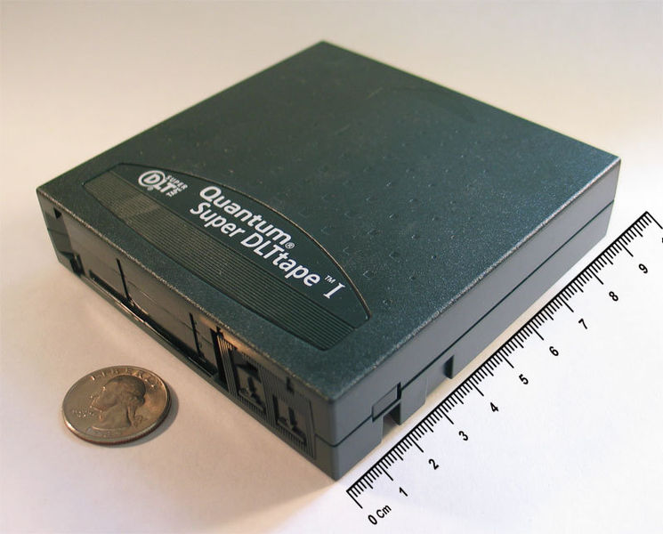
Backup Media – By Storage (2)
Tape
DAT (Digital Audio Tape) 4mm tapes
DDS (Digital Data Storage), Minimal Error Rate, Higher Efficiency
DDS-4 (often used)
20/40GB(compressed), about NT 400.
1.0~3.0MB/s
Travan tapes
High Transfer Rate
Travan 40 (often used)
20/40GB(compressed), about NT 2000.
Up to 8.0MB/s
DLT (Digital Linear Tape)
High Capacity, Solid Reliability
Media
Max 800 GB, about NT 4000.
Speed: Up to 60 MB/s
LTO Ultrium
Fast Transfer Rate, High Performance, and High Storage Capacity
LTO Ultrium 3 (often used)
Max 1600 GB, about NT 5000.
Speed: up to 80 MB/s
Tape Drive is much more expensive……

Slide 5
Backup Media – By Storage (3)
MO (Magneto-Optical)
MO 540, 640, 1.3G, 2.3G
Removable Media
Floppy, LS-120, ZIP
Jukebox
Automatically change removable media
DAT, DLT, CD, …
Tape Library
Hardware backup solution for large data set

Slide 6
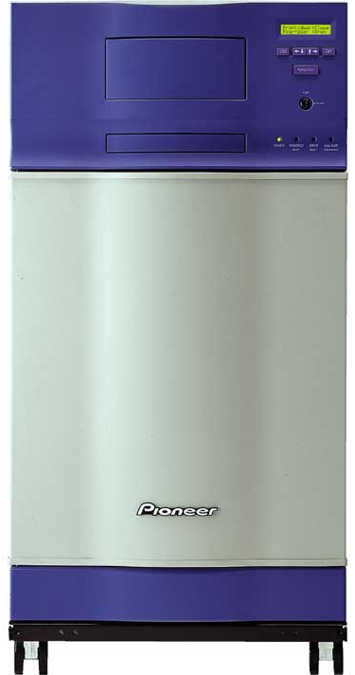
Backup Media – By Storage (5)
Jukebox
Automatically change removable media
Available for several types of media
DAT, DLT, CD

Slide 7
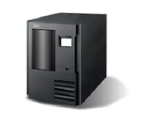
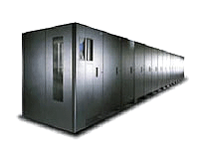
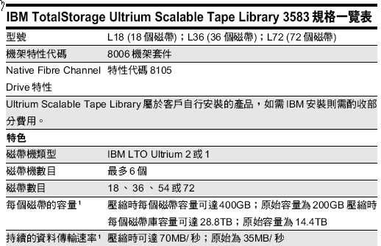
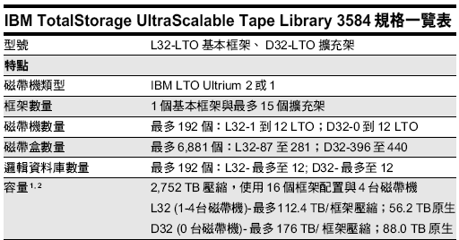
Backup Media – By Storage (4)
Tape Library

Slide 8
Backup Media – By Availability
Off-line Storage
CD、DVD、MO
Adv:
low cost, high reliability
Disadv:
Not-convenient, low speed
Near-line Storage
JukeBox、Tape Library
Adv:
High capacity, high reliability
Disadv:
High malfunction rate, Not-convenient
On-line Storage
Disk Array (RAID)
Adv:
Fast and high availability
Disadv:
High cost

Slide 9
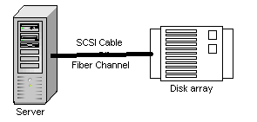
Backup Media – By Enterprise Product (1)
RAID architecture

Slide 10
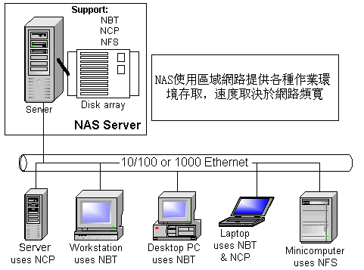
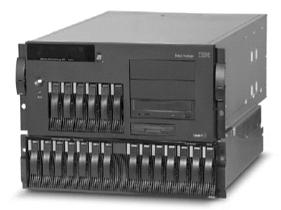
Backup Media – By Enterprise Product (2)
NAS (Network Attached Storage)
Storage + Server + Cross-platform access OS + network access protocol
IBM NAS 300G
Supported Protocol:
NFS, HTTP, FTP, CIFS
Netware

Slide 11
Backup Philosophy
Perform all dumps from one machine
Label your taps
Pick a reasonable backup interval
Choose filesystems carefully
Make daily dumps fit on one tape
Make filesystems smaller than your dump device
Keep Tapes off-site
Protect your backups
Limit activity during dumps
Check your tapes
Develop a tape life cycle
Design your data for backups
Prepare for the worst

Slide 12
Dumping filesystems – dump command (1)
Used to backup filesystem into a large file to archive to an external device
Advantages:
Backups can span multiple output media
Files of any type can be backed up and restored
Permissions, ownerships, and modification times are preserved
Files with holes are handled correctly
Backups can be performed incrementally
Limitations:
Each filesystems must be dumped individually
Only filesystems on the local machine can be dumped
NFS filesystem is not allowed

Slide 13
Dumping filesystems – dump command (2)
Backup level
0 ~ 9
Level 0 ➔ full backup
Level N ➔ incremental backup of Level≦ N-1
for N = 1 ~ 9
dump command format
% dump [arguments] file-system
dump command arguments
u: update the /etc/dumpdates file after dump
f: the output backup file
Special device file, like /dev/nrsa0
Ordinary file
‘-’ to standard out
“user@host:file”
d: tape density in bytes per inch
s: tape length in feet
a: auto-size, bypass all tape length considerations (default d = 1600, s = 2300)

Slide 14
Dumping filesystems – dump command (3)
Example: Full backup
zfs[/mnt] -chiahung- ls -lh
drwxr-xr-x 3 root wheel 512B Nov 22 15:34 ./
drwxr-xr-x 20 root wheel 25B Nov 18 20:02 ../
-rw-r--r-- 1 root wheel 512M Nov 21 22:20 haha
zfs[/mnt] -chiahung- cat /etc/dumpdates
zfs[/mnt] -chiahung- df -h
Filesystem Size Used Avail Capacity Mounted on
zfs 15G 4.1G 11G 27% /
devfs 1.0K 1.0K 0B 100% /dev
/dev/da0s1a 8.7G 512M 7.5G 6% /mnt
zfs[/mnt] -chiahung- sudo dump 0uLf - /dev/da0s1a > ~/dump.0
DUMP: Date of this level 0 dump: Sun Nov 22 15:37:44 2009
DUMP: Date of last level 0 dump: the epoch
DUMP: Dumping snapshot of /dev/da0s1a to standard output
DUMP: mapping (Pass I) [regular files]
DUMP: mapping (Pass II) [directories]
DUMP: estimated 525772 tape blocks.
DUMP: dumping (Pass III) [directories]
DUMP: dumping (Pass IV) [regular files]
DUMP: DUMP: 525625 tape blocks
DUMP: finished in 36 seconds, throughput 14600 KBytes/sec
DUMP: level 0 dump on Sun Nov 22 15:37:44 2009
DUMP: DUMP IS DONE
zfs[/mnt] -chiahung- cat /etc/dumpdates
/dev/da0s1a 0 Sun Nov 22 15:37:44 2009

Slide 15
Dumping filesystems – dump command (4)
Example: Incremental backup
zfs[/mnt] -chiahung- sudo cp -Rp /etc /mnt/
zfs[/mnt] -chiahung- ls -lh
drwxr-xr-x 4 root wheel 512B Nov 22 15:48 ./
drwxr-xr-x 20 root wheel 25B Nov 18 20:02 ../
drwxr-xr-x 20 root wheel 2.0K Nov 22 15:35 etc/
-rw-r--r-- 1 root wheel 512M Nov 21 22:20 haha
zfs[/mnt] -chiahung- sudo dump 2uLf - /dev/da0s1a > ~/dump.2
DUMP: Date of this level 2 dump: Sun Nov 22 15:49:04 2009
DUMP: Date of last level 0 dump: Sun Nov 22 15:37:44 2009
DUMP: Dumping snapshot of /dev/da0s1a to standard output
DUMP: mapping (Pass I) [regular files]
DUMP: mapping (Pass II) [directories]
DUMP: estimated 2267 tape blocks.
DUMP: dumping (Pass III) [directories]
DUMP: dumping (Pass IV) [regular files]
DUMP: DUMP: 2124 tape blocks
DUMP: finished in less than a second
DUMP: level 2 dump on Sun Nov 22 15:49:04 2009
DUMP: DUMP IS DONE
zfs[/mnt] -chiahung- cat /etc/dumpdates
/dev/da0s1a 0 Sun Nov 22 15:37:44 2009
/dev/da0s1a 2 Sun Nov 22 15:49:04 2009
zfs[/mnt] -chiahung- ls -lh ~/dump*
-rw-rw-r-- 1 chiahung user 513M Nov 22 15:38 /home/chiahung/dump.0
-rw-rw-r-- 1 chiahung user 2.1M Nov 22 15:49 /home/chiahung/dump.2

Slide 16
Restoring from dumps – restore command (1)
Restore can do
Restoring individual files
Restoring entire filesystem
Options of restore command
i: interactive restore
r: restore an entire filesystem
f: the backup file that restore is going to use

Slide 17
Restoring from dumps – restore command (2)
Restore individual file interactively
zfs[/tmp] -chiahung- cat ~/dump.2 | restore if -
restore > ?
Available commands are:
ls [arg] - list directory
cd arg - change directory
pwd - print current directory
add [arg] - add `arg' to list of files to be extracted
delete [arg] - delete `arg' from list of files to be extracted
extract - extract requested files
setmodes - set modes of requested directories
quit - immediately exit program
what - list dump header information
verbose - toggle verbose flag (useful with ``ls'')
help or `?' - print this list
If no `arg' is supplied, the current directory is used

Slide 18
Restoring from dumps – restore command (4)
Restore individual file interactively (cont.)
zfs[/tmp] -chiahung- cat ~/dump.2 | restore if -
restore > ls
.:
.snap/ etc/
restore > cd etc
restore > add make.conf
restore > extract
set owner/mode for '.'? [yn] n
restore > quit
zfs[/tmp] -chiahung- ls -ld etc
drwxr-xr-x 2 chiahung wheel 3 Nov 22 15:35 etc/
zfs[/tmp] -chiahung- ls -l etc
total 6
drwxr-xr-x 2 chiahung wheel 3 Nov 22 15:35 ./
drwxrwxrwt 10 root wheel 42 Nov 22 15:58 ../
-rw-r--r-- 1 chiahung wheel 590 Nov 19 23:04 make.conf

Slide 19
Restoring from dumps – restore command (5)
Restore entire filesystem
% restore -rf /home/temp/root.0
Steps
Restore level 0 first
Restore incremental dumps
0 0 0 0 0
0 5 5 5 5
0 3 2 5 4 5
0 9 9 5 9 9 3 9 9 5 9 9
0 3 5 9 3 5 9

Slide 20
Other archiving programs
tar command
Read multiple files and packages them into one file
Example
% tar czvf etc.tar.gz /etc/
% tar xzvf etc.tar.gz
% tar cf – fromdir | tar xfp – –C todir
dd command
Copy filesystems between partitions of exactly the same size
Example
% dd if=/dev/rst0 of=/dev/rst1
% dd if=/tmp/kern.flp of=/dev/fd0
% dd if=/dev/da1 of=/dev/da2 bs=1048576

Slide 21
CS home backup
Using rsync
% rsync –a --delete
-a: archive mode
Recursive and preserve everything
--delete:
Delete any file that are not in the sending side
0 4 * * 1 (cd /raid;/usr/local/bin/rsync -aH --delete cs /backup/user/)
0 4 * * 2 (cd /raid;/usr/local/bin/rsync -aH --delete gcs /backup/user/)
0 4 * * 3 (cd /raid;/usr/local/bin/rsync -aH --delete dcs /backup/user/)
0 4 * * 4 (cd /raid;/usr/local/bin/rsync -aH --delete alumni /backup/user/)

Slide 22
CS home backup
Snapshot
CS home snapshot
csduty[/net/account/.snapshot/hourly.0] -chiahung- cd /net/account/
csduty[/net/account] -chiahung- ls
./ .snapshot/ dcs/ gcs/ relative/
../ cs/ faculty/ other/ staff/
csduty[/net/account] -chiahung- cd .snapshot/
csduty[/net/account/.snapshot] -chiahung- ls
./ hourly.11/ hourly.6/ nightly.1/ nightly.2/ nightly.7/
../ hourly.2/ hourly.7/ nightly.10/ nightly.3/ nightly.8/
hourly.0/ hourly.3/ hourly.8/ nightly.11/ nightly.4/ nightly.9/
hourly.1/ hourly.4/ hourly.9/ nightly.12/ nightly.5/
hourly.10/ hourly.5/ nightly.0/ nightly.13/ nightly.6/00

Slide 23
Snapshot
derek[/] -chiahung- df -h
Filesystem Size Used Avail Capacity Mounted on
/dev/ad4s1a 70G 16G 48G 25% /
devfs 1.0K 1.0K 0B 100% /dev
derek[/] -chiahung- sudo mount -u -o snapshot /.snap/snapshot /
derek[/] -chiahung- df -h
Filesystem Size Used Avail Capacity Mounted on
/dev/ad4s1a 70G 16G 48G 25% /
devfs 1.0K 1.0K 0B 100% /dev
derek[~] -chiahung- sudo mdconfig -a -t vnode -f /.snap/snapshot -u 1
WARNING: opening backing store: /.snap/snapshot readonly
derek[~] -chiahung- sudo mount -r /dev/md1 /mnt
derek[~] -chiahung- ls /mnt/
./ COPYRIGHT compat@ ftp/ mnt/ sys@
../ bin/ dev/ home/ proc/ tmp/
.cshrc boot/ dist/ lib/ rescue/ usr/
.profile cdrom/ entropy libexec/ root/ var/
.snap/ cdrom1/ etc/ media/ sbin/
derek[~] -chiahung- sudo umount /mnt
derek[~] -chiahung- sudo mdconfig -d -u 1

