Slide 1
Drivers and the Kernel
lctseng
arr. by pschiu

Slide 2
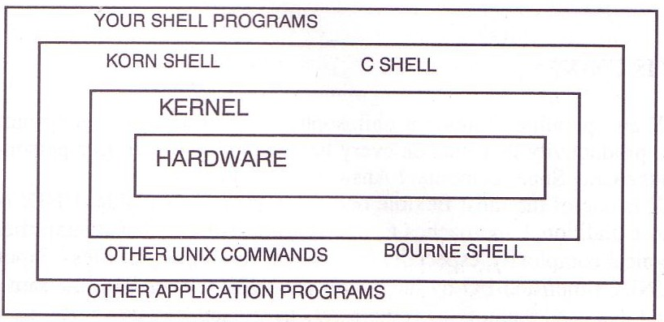
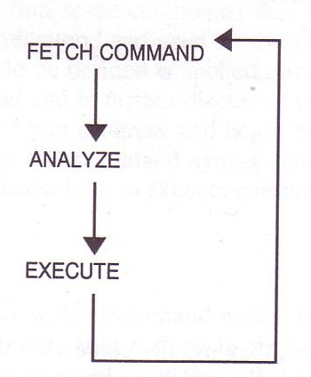
Introduction – UNIX Kernel and Shell
interpret

Slide 3
Roles of Kernel
Components of a UNIX System
User-level programs
Kernel
Hardware
Two roles of kernel (OS)
High-level abstractions
Process managements
Time sharing, memory protect
File system management
Memory management
I/O management
Low-level interface
drivers
Notes:
https://zh.wikipedia.org/zh-tw/抽象化_(計算機科學)

Slide 4
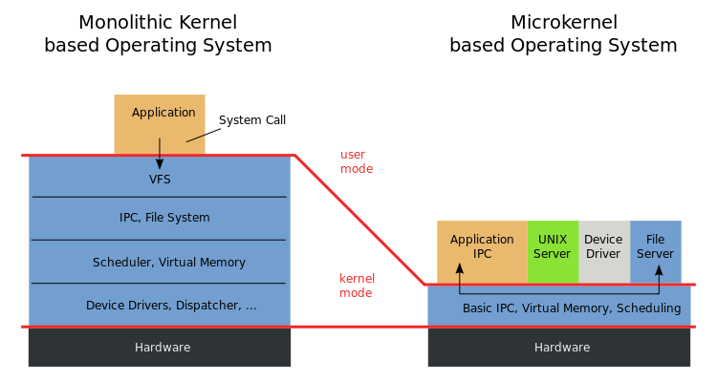
Kernel Types
Since BSD…
單體式核心(單核心)
微核心
<The picture is cited from wiki>
Notes:
https://zh.wikipedia.org/zh-tw/整塊性核心
https://zh.wikipedia.org/zh-tw/微內核
https://zh.wikipedia.org/zh-tw/内核
http://sls.weco.net/blog/william/29-may-2007/4808
https://hackmd.io/s/SklN6PRC#
IPC，Inter-Process Communication

Slide 5
Kernel Types
Concept of being modulized…
only provides essential functionalities;
Put other sophisticated functions into user level
e.g. I/O management in the user level
increase scalability and less difficult in maintenance
How to communicate?
Message passing – less efficient
Two extreme types
Micro kernel
Provide only necessarily, compact and small functionalities
Other functions is added via well-defined interface
Monolithic kernel (龐大的kernel – e.g. unix)
Whole functionalities in one kernel
Modern OS
Solaris
Completely modular kernel
Load necessarily module when it is needed
BSD/Linux-derived system
Much of the kernel's functionality is contained in modules
More integrated…
Monolithic kernel developing towards micro kernel (being more modulized),
but without IPC (message passing) problem

Slide 6
Kernel related directory
Build directory and location
System | Build Directory | Kernel file
FreeBSD | /usr/src/sys | /kernel ( < 4.x) /boot/kernel/kernel (> 5.x)
Red Hat | /usr/src/linux | /vmlinuz or /boot/vmlinuz
Solaris | - | /kernel/unix
SunOS | /usr/kvm/sys | /vmunix
*.ko(s)

Slide 7
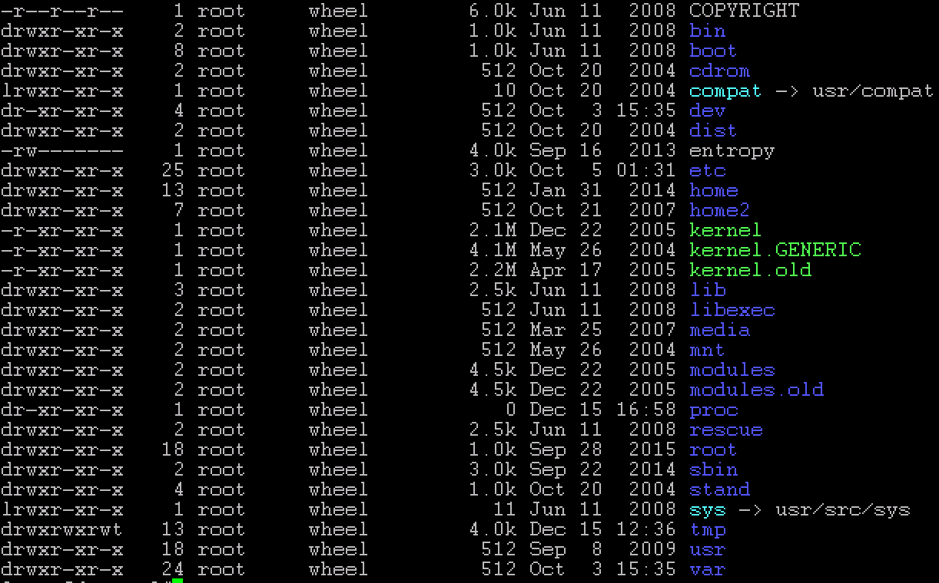
FreeBSD 4.x and < 4.0 kernel files

Slide 8
Why configure the kernel?
Generic: with various devices…,
functions supported
The native kernel is often big and common
Tailoring kernel to match site situation
Purge unnecessary kernel devices and options
Add functionalities that you want
OS patch
Remedy security hole of kernel implementation
Fine-tune system performance
Such as adjusting important system parameters
A Custom kernel benefits
Fast boot time
Lower memory usage
Additional hardware support
kernel image → memory usage
https://www.freebsd.org/doc/handbook/kernelconfig-custom-kernel.html
Notes:
https://www.freebsd.org/doc/handbook/kernelconfig-custom-kernel.html

Slide 9
Building a FreeBSD Kernel - 1
<ARCH> represents one of i386, amd64, ia64, powerpc, sparc64
Kernel Source
/usr/src/sys
Kernel Configuration File
/usr/src/sys/<ARCH>/conf
GENERIC, LINT (< 4.X)
GENERIC, “make LINT” under this dir ( > 5.x)
All Support Options
/usr/src/sys/<ARCH>/conf/NOTES
LINT file: lists all options
→ To generate LINT file
http://www.freebsd.org/doc/en_US.ISO8859-1/books/handbook/kernelconfig-building.html
Notes:
http://mail.lsps.tp.edu.tw/~gsyan/freebsd2001/kernel.html
/usr/src/sys/i386/conf

Slide 10
Building a FreeBSD Kernel - 2
All Supported Architectures
amd64 - 64bit Intel or AMD CPU
i386 - 32bit Intel or AMD CPU, Microsoft XBOX
ia64 - Intel's IA-64, Intel Itanium® Processor Family
pc98 - NEC PC-98x1
powerpc - Sony Playstation 3, IBM pSeries, Apple PowerMac G3 G5
sparc64 - Sun Fire Server 15K, 10K, Ultra10
arm - ex: Raspberry Pi
Steps to Build a New Kernel
Edit /usr/src/sys/<ARCH>/conf/<KERNCONF>
For example, save a conf file named as SABSD
% cd /usr/src ;
% make buildkernel KERNCONF=SABSD
% make installkernel KERNCONF=SABSD
SABSD: configuration file
http://www.freebsd.org/doc/en_US.ISO8859-1/books/handbook/kernelconfig-building.html
Notes:
http://mail.lsps.tp.edu.tw/~gsyan/freebsd2001/kernel.html
/usr/src/sys/i386/conf

Slide 11
To Build a FreeBSD Kernel…
What to Choose?
What to Load?
Option Settings?
Device Drivers?

Slide 12
Finding the system hardware(1)
Listing devices from M$ windows
Before venturing into kernel configuration
Get an inventory of the machine’s hardware
Microsoft's Device Manager
dmesg
cat /var/run/dmesg.boot
Personal Habit
When installed fresh FreeBSD
# dmesg > /root/hardware
Listing devices from dmesg
psm0: <PS/2 Mouse> irq 12 on atkbdc0
psm0: [GIANT-LOCKED]
psm0: [ITHREAD] psm0: model Generic PS/2 mouse, device ID 0
Notes:
dmesg > /root/hardware

Slide 13
Finding the system hardware(2)
pciconf
pciconf -l
ath0@pci0:3:0:0: class=0x020000 card=0x058a1014 chip=0x1014168c
vendor = 'Atheros Communications Inc.'
device = 'AR5212 Atheros AR5212 802.11abg wireless'
class = network subclass = ethernet
May not support by GENERIC…

Slide 14
Finding the system hardware(3)
pciconf & man page
man -k Atheros
Find drivers from company name
pciconf -l & man
List all attached devices
man [device]
man em
ehci1@pci0:0:29:7: class=0x0c0320 card=0x3a3a8086 chip=0x3a3a8086 rev=0x00 hdr=0x00
pcib10@pci0:0:30:0: class=0x060401 card=0x244e8086 chip=0x244e8086 rev=0x90 hdr=0x01
isab0@pci0:0:31:0: class=0x060100 card=0x3a168086 chip=0x3a168086 rev=0x00 hdr=0x00
ahci0@pci0:0:31:2: class=0x010601 card=0x3a228086 chip=0x3a228086 rev=0x00 hdr=0x00
none8@pci0:0:31:3: class=0x0c0500 card=0x3a308086 chip=0x3a308086 rev=0x00 hdr=0x00
em0@pci0:3:0:0: class=0x020000 card=0x00008086 chip=0x10d38086 rev=0x00 hdr=0x00
em1@pci0:2:0:0: class=0x020000 card=0x00008086 chip=0x10d38086 rev=0x00 hdr=0x00

Slide 15
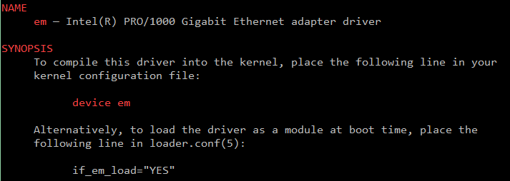
Finding the system hardware(4)
Man page for devices
man [device]
bge # Broadcom BCM570xx Gigabit Ethernet
fxp # Intel EtherExpress PRO/100B (82557, 82558)
em # Intel PRO/1000 Gigabit Ethernet Family
igb # Intel PRO/1000 PCIE Server Gigabit Family
rl # RealTek 8129/8139
vmx # VMware VMXNET3 Ethernet
Notes:
bge # Broadcom BCM570xx Gigabit Ethernet
fxp # Intel EtherExpress PRO/100B (82557, 82558)
em # Intel PRO/1000 Gigabit Ethernet Family
igb # Intel PRO/1000 PCIE Server Gigabit Family
rl # RealTek 8129/8139
vmx # VMware VMXNET3 Ethernet

Slide 16
Building a FreeBSD Kernel – Configuration file
The explanations on
options and devices…
Each line is a control phrase
[Ref] http://www.freebsd.org/doc/en_US.ISO8859-1/books/handbook/kernelconfig-config.html
Keyword + arguments
e.g. device fxp
Keyword | Function | Example
machine | Sets the machine type | i386 or amd64
cpu | Sets the CPU type | I586_CPU or HAMMER
ident | Sets the name of the kernel | SABSD
maxusers | Sets the kernel’s table sizes | 0
options | Sets various comiple-time options | INET or INET6
device | Declares devices | fxp or em
cpu I486_CPU
cpu I586_CPU
cpu I686_CPU
ident GENERIC
options SCHED_ULE # ULE scheduler
options PREEMPTION # Enable kernel thread preemption
options INET # InterNETworking
device em
i386/conf/GENERIC

Slide 17
Dependency

Slide 18
Kernel backup
Your last chance to prevent module
missing…to survive!!
Old kernel is automatically moved to kernel.old
when you’re making the new kernel
Kernel file locations
Put in the /boot directory
/boot/GENERIC/kernel, /boot/kernel.old/kernel
/kernel.GENERIC, /kernel.old (Freebsd 4.x)
Backup bootable kernel
#cp -Ra /boot/kernel /boot/kernel.GENERIC
If something goes wrong
ok mode !
unload kernel; load kernel.old/kernel
load kernel modules
mv /boot/kernel /boot/kernel.bad
or kernel.GENERIC

Slide 19
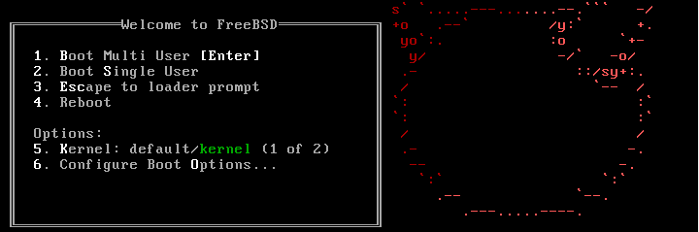
Ok mode
Or “enable modules” in the ok mode..

Slide 20
Tuning the FreeBSD Kernel
e.g. maxusers/maxfiles and providing www service…
sysctl command
Dynamically set or get kernel parameters
All changes made by sysctl will be lost across reboot
Use sysctl to tune the kernel and test it, then recompile the kernel
Format:
% sysctl [options] name[=value] …
Ex:
% sysctl -a list all kernel variables
% sysctl -d kern.maxfiles print the description of the variable
% sysctl kern.maxfiles print the value of the variable
% sudo sysctl kern.maxfiles=2048
The other way is to write your settings into /etc/sysctl.conf…

Slide 21
Kernel modules
Module loading…
e.g. kldload if_fxp
Kernel module location
/boot/kernel/*.ko
/modules ( Freebsd 4.x)
kldstat
Load/unload kernel modules
kldload(8), kldunload(8)
Note
Some security environments prevent the loading and unloading of kernel modules
→ Where details can be viewed
zfs[/boot/kernel] -chiahung- kldstat
Id Refs Address Size Name
1 15 0xc0400000 4abd60 kernel
2 1 0xc08ac000 13b0fc zfs.ko
3 2 0xc09e8000 3d5c opensolaris.ko
4 2 0xc09ec000 16b84 krpc.ko
5 1 0xc0a03000 8c48 if_le.ko

Slide 22
E.g. Procedure of Loading a Device Module
Loading a device module
pciconf -l for a device
man vendor name for module name in BSD
grep the name in /boot/kernel/*.ko
kldload [module name]
Setup permanently by
recompile the kernel, or
add [module name]_enable="YES" in /boot/loader.conf

Slide 23
Reference
http://www.freebsd.org/doc/en/books/handbook/kernelconfig-config.html
/usr/src/sys/<ARCH>/conf
NOTES
LINT
GENERIC
→ machine dependent kernel configuration notes.

