Slide 1
File System
frank

Slide 2
Files
% ls –l
d rwx--x--x 7 wutzh gcs 1024 Sep 22 17:25 public_html
File type
File access mode
# of links
File user owner
File group owner
File size
File last modify time
File name

Slide 3
Outline
File System Architecture
Pathname
File Tree
Mounting
File Types
inode and file
Link
File Access Mode
Changing File Owner
FreeBSD bonus flags

Slide 4
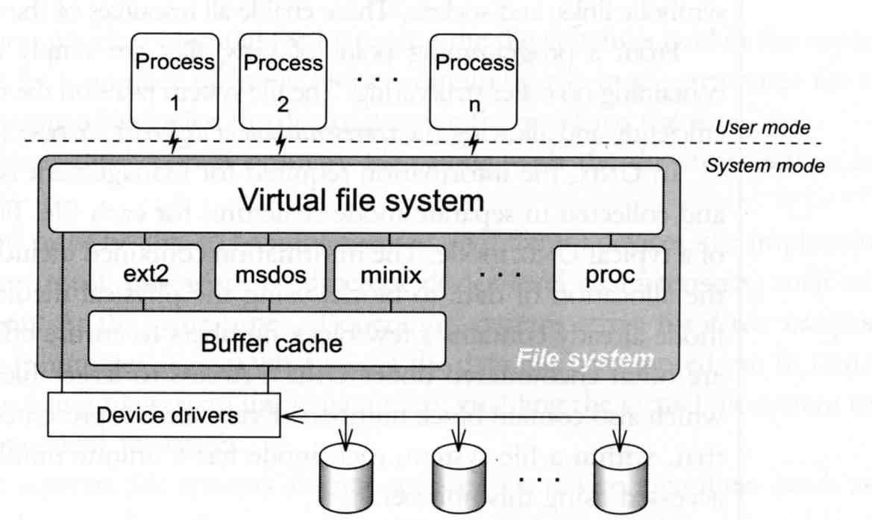
File System Architecture (1)
Application ⬄ Kernel ⬄ Hardware
Applications call system-calls to request service
Kernel invokes corresponding drivers to fulfill this service

Slide 5
File System Architecture (2)
The basic purpose of filesystem
Represent and organize the system’s storage
Four main components:
Namespace
A way of naming things and arranging them in a hierarchy
API
A set of system calls for navigating and manipulating nodes
Security model
A scheme for protecting, hiding and sharing things
Implementation
Code that ties the logical model to an actual disk

Slide 6
File System Architecture (3)
Objects in the filesystem:
What you can find in a filesystem:
Files and directories
Hardware device files
Processes information
Interprocess communication channel (IPC)
Shared memory segments (SHM)
We can use common filesystem interface to access such “object”
open、read、write、close、seek、ioctl, fcntl, …

Slide 7
Pathname
Two kinds of path
Absolute path ➔ start from /
Ex. /u/dcs/97/9755806/test/hehe.c
Relative path ➔ start from your current directory
Ex. test/hehe.c
Constrains of pathname
Single component: ≦ 255 characters
Single absolute path: ≦ 1023 characters

Slide 8
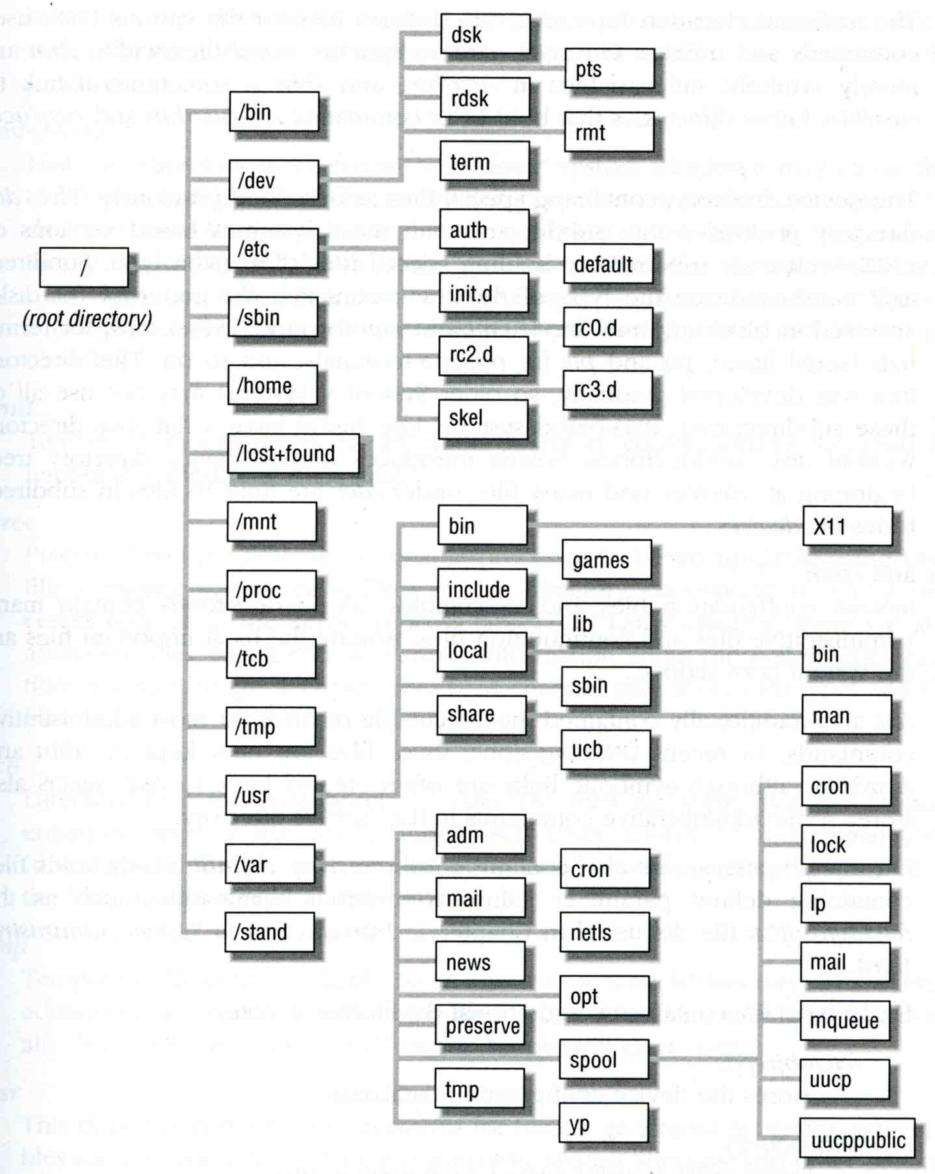
File Tree

Slide 9
Layout of File Systems (1)
hier(7)
pathname | Contents
/ | The root directory of the file system
/bin & /sbin | User utilities & system programs fundamental to both single-user and multi-user environments
/usr | User utilities and applications
/usr/bin & /usr/sbin | Local executable
/lib | Shared and archive libraries
/libexec | Critical system utilities needed for binaries in /bin and /sbin
/mnt | Empty directory commonly used by system administrators as a temporary mount point
/tmp | Temporary files that are not guaranteed to persist across sys- tem reboots, also, there is /var/tmp
/usr/lib | Support libraries for standard UNIX programs
/usr/libexec | System daemons & system utilities (executed by other programs)
/usr/include | Libraries Header files
/usr/local | local executables, libraries, etc

Slide 10
Layout of File Systems (2)
pathname | Contents
/usr/src | BSD, third-party, and/or local source files
/usr/obj | architecture-specific target tree produced by building the /usr/src tree
/etc | system configuration files and scripts
/usr/local/etc | /etc of /usr/local, mimics /etc
/dev | Device entries for disks, terminals, modems, etc
/proc | Images of all running process
/var | Multi-purpose log, temporary, transient, and spool files
/var/db | Database files
/var/db/pkg & /var/db/ports | Ports Collection management files. ports(7)
/var/log | Various system log files
/var/mail | user mailbox files
/var/spool | Spooling directories for printers, mails, etc

Slide 11
Mounting file system (1)
mount(8)
The filesystem in composed of chunks
Most are disk partitions
Network file servers
Memory disk emulators
Kernel components
Etc,…
“mount” command
Map the mount point of the existing file tree to the root of the newly attached filesystem
% mount /dev/ad2s1e /home2
The previous contents of the mount point become inaccessible

Slide 12
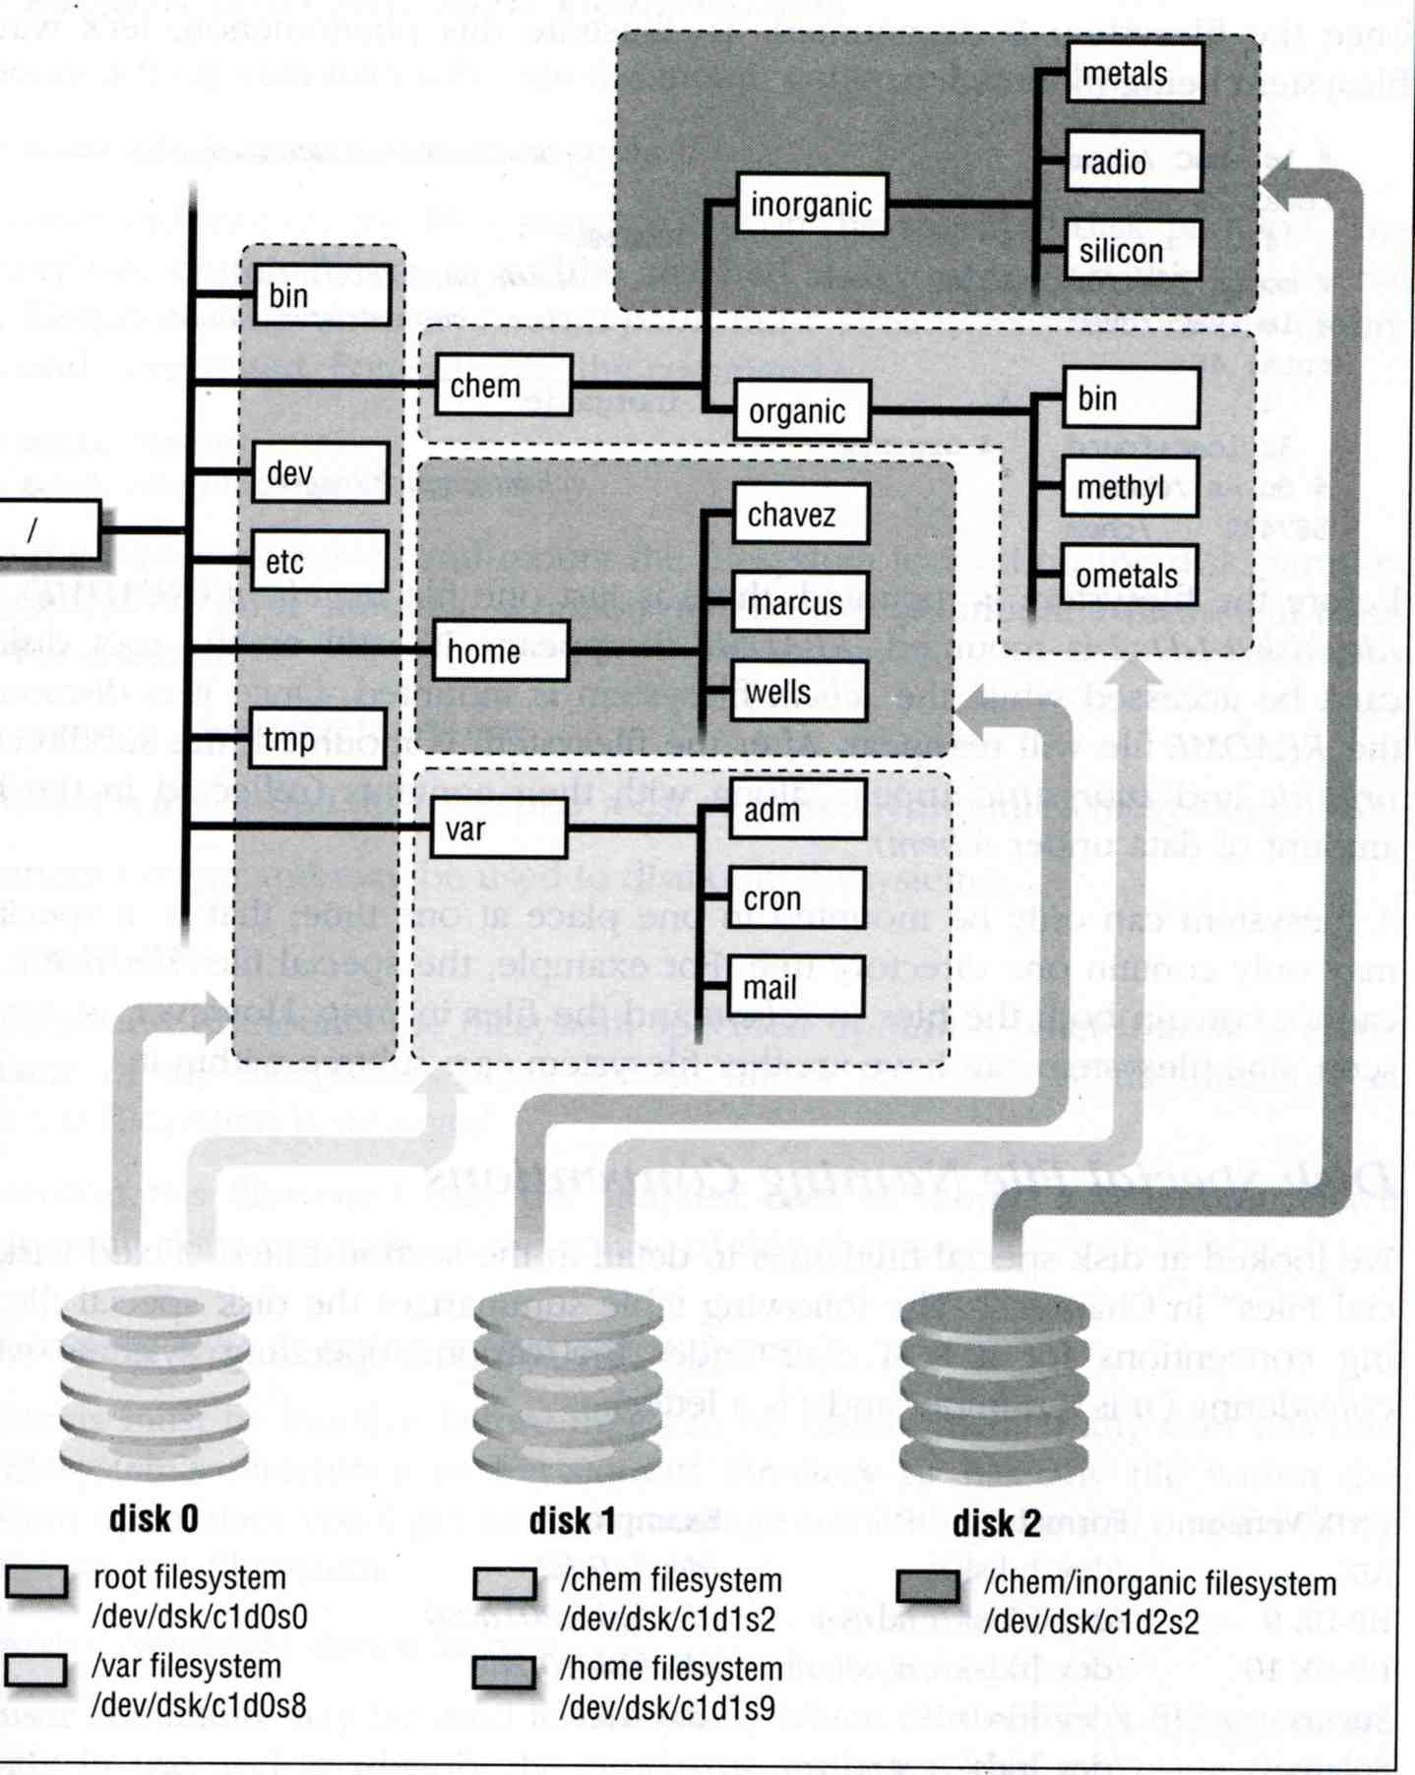
Mounting file system (2)
Example

Slide 13
Mounting file system (3)
fstab(5)
Filesystem table – fstab
Automatically mounted at boot time
/etc/fstab
Filesystem in this file will be checked and mounted automatically at boot time
Ex.
# Device Mountpoint FStype Options Dump Pass#
/dev/ad0s1a / ufs rw 1 1
/dev/ad0s1b none swap sw 0 0
/dev/ad0s1d /home ufs rw 2 2
/dev/acd0 /cdrom cd9660 ro,noauto 0 0
csduty:/bsdhome /bsdhome nfs rw,noauto 0 0

Slide 14
Mounting file system (4)
umount(8)
Unmounting File Stsyem
“umount” command
% umount { node | device }
Ex: umount /home, umount /dev/ad0s1e
Busy filesystem
Someone’s current directory is there or there are opened files
Use “umount –f”
We can use “lsof” or “fstat” like utilities to figure out who makes it busy

Slide 15
Mounting file system (5)
fstat
lsof (/usr/ports/sysutils/lsof) – list open files
wutzh@NASA ~ $ fstat
USER CMD PID FD MOUNT INUM MODE SZ|DV R/W
wutzh fstat 94218 wd / 234933 drwxr-xr-x 16 r
root screen 87838 4 /tmp 9947 prwx------ 0 r
wutzh@NASA ~ $ lsof
COMMAND PID USER FD TYPE SIZE/OFF NODE NAME
screen 87838 root cwd VDIR 7 522069 /usr/ports/sysutils/screen
screen 87838 root rtd VDIR 26 3 /
screen 87838 root txt VREG 337968 424757 /usr/local/bin/screen
screen 87838 root txt VREG 245976 679260 /libexec/ld-elf.so.1
screen 87838 root txt VREG 314504 678109 /lib/libncurses.so.8
screen 87838 root txt VREG 64952 678438 /lib/libutil.so.8
screen 87838 root txt VREG 33536 677963 /lib/libcrypt.so.5
screen 87838 root txt VREG 1255568 677294 /lib/libc.so.7

Slide 16
File Types (1)
Symbol | File types
- | Regular file
b | Block device file
c | Character device file
d | Directory
l | Symbolic link
s | UNIX domain socket
p | Named pipe
File types
file command
determine file type
% file .tcshrc ➔ .tcshrc: ASCII text
% file /bin ➔ /bin: directory
% file /bin/sh ➔ /bin/sh: ELF 32-bit LSB executable, Intel 80386, version 1 (FreeBSD), dynamically linked (uses shared libs), stripped
/usr/ports/sysutils/file

Slide 17
File Types (2)
Directory
. and ..
mkdir / rmdir

Slide 18
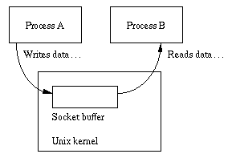
File Types (3)
UNIX domain socket
Created by socket()
Local to a particular host
Be referenced through a filesystem object rather than a network port

Slide 19
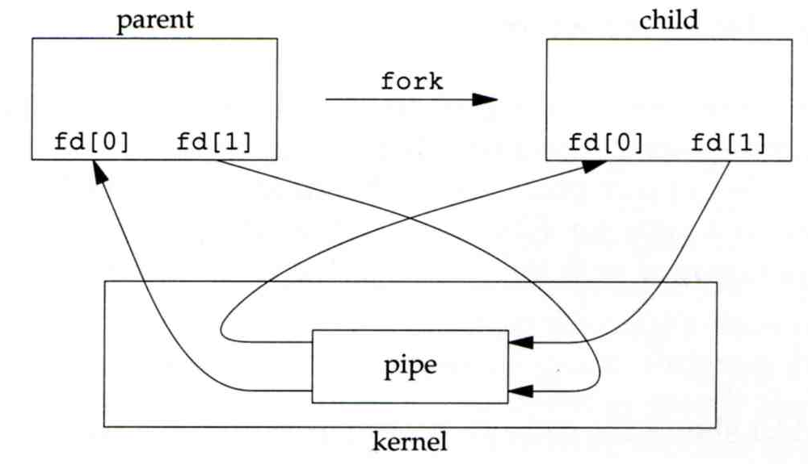
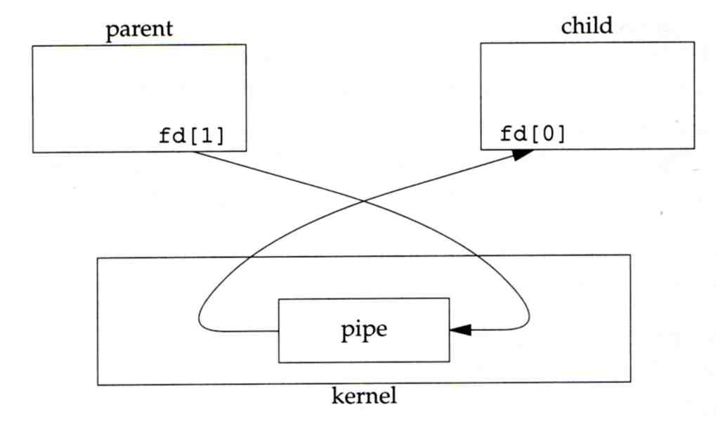
File Types (4)
Named Pipes
Let two processes do “FIFO” communication

Slide 20
File Types (5)
Named Pipe
$ mkfifo [-m mode] fifo_name ...
$ mkfifo pipe
$ du >> pipe
(another process)
$ sort -n pipe

Slide 21
File Types (6)
Symbolic Link
A file which points to another pathname
% ln –s ori-file soft-file
Like “short-cut” in Windows

Slide 22
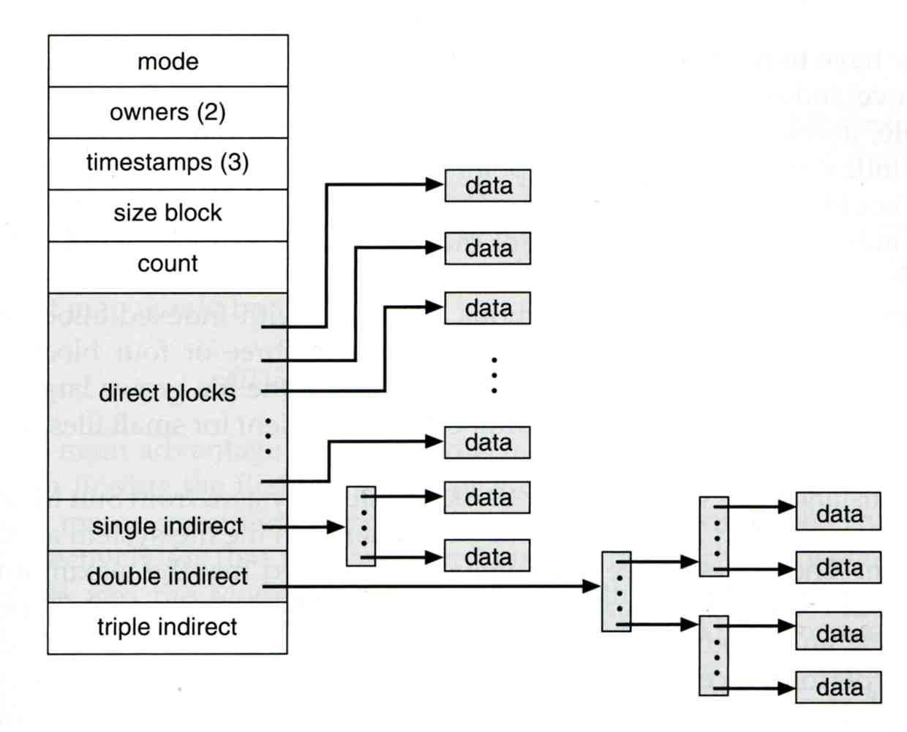
inode and file (1)
inode
A structure that records information of a file
You can use “ls –i” to see each file’s inode number
wutzh@NASA ~ $ ls -i
19255327 public_html

Slide 23
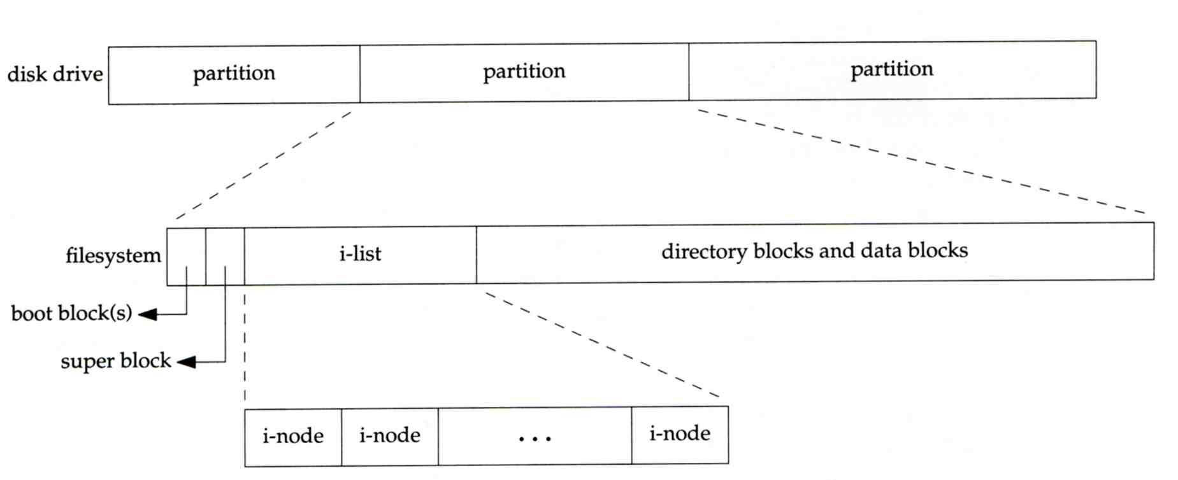
inode and file (2)
Filesystem
Boot blocks
Super block
Inode list
Data block

Slide 24
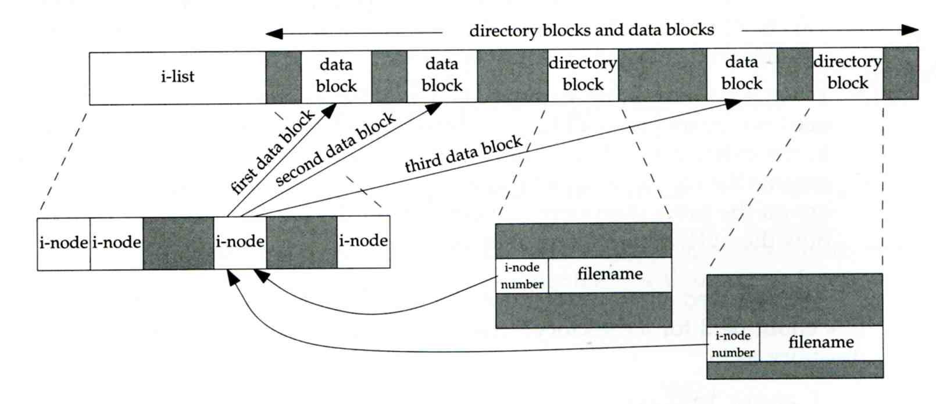
inode and file (3)
More detail of inode and data block

Slide 25
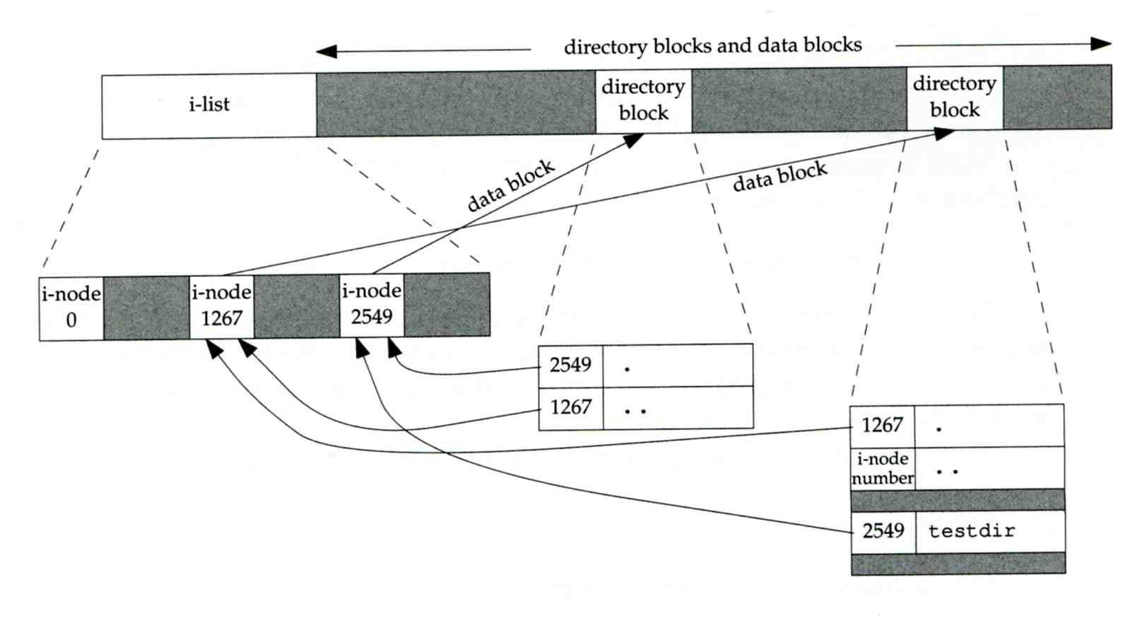
inode and file (4)
Example
.
..
testdir
testdir
wutzh
/home/wutzh/testdir

Slide 26
Hard Link V.S. Symbolic Link (1)
Link
Hard link
associate two or more filenames with the same inode
Must in the same partition
% ln ori-file hard-file
Soft (symbolic) link
A file which points to another pathname
% ln –s ori-file soft-file

Slide 27
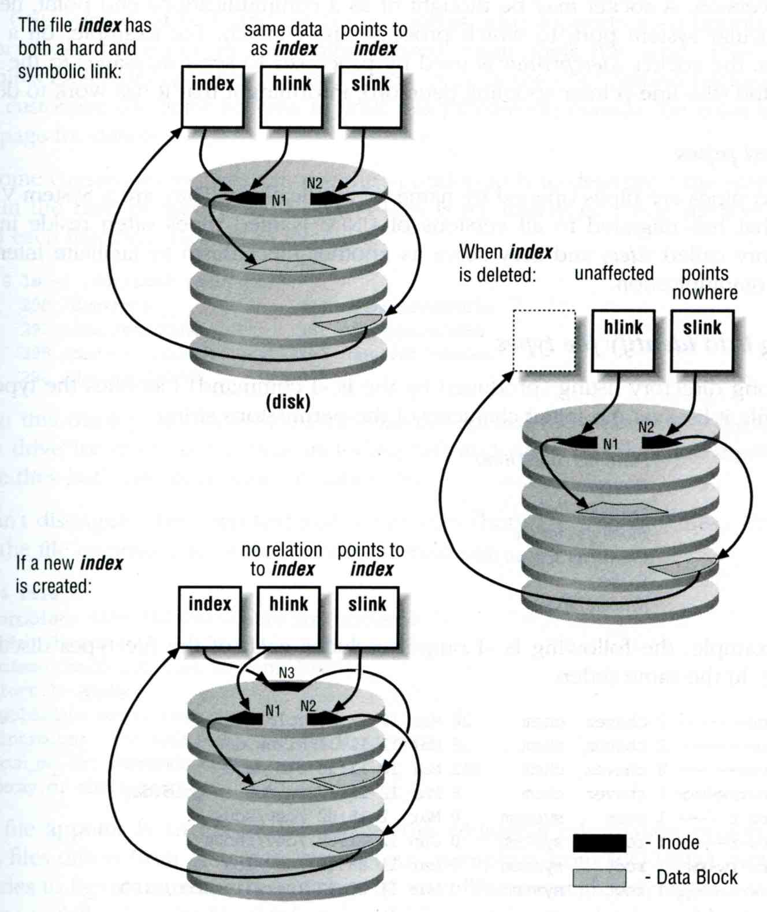
Hard Link V.S. Symbolic Link (2)
% touch index
% ln index hlink
% ln –s index slink

Slide 28
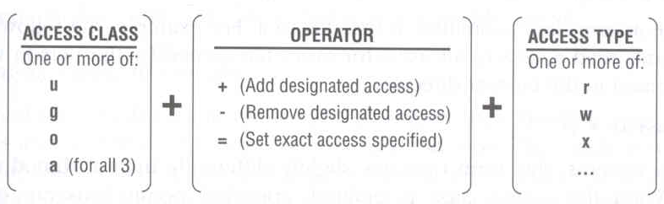
File Access Mode (1)
rwx r-x r-x
User, group, other privileges
chmod command
chmod(1), “MODES” section
% chmod access-string file
% chmod u+x test.sh
% chmod go-w .tcshrc
% chmod u+w,g-w hehe haha
% chmod –R 755 public_html/

Slide 29
File Access Mode (2)
setuid, setgid, sticky bit
setuid, setgid on file
The effective uid/gid of resulting process will be set to the UID/GID of the file
setuid
passwd, chsh, crontab
setgid
top, fstat, write
setgid on directory
Cause newly created files within the directory to be the same group as directory
sticky on directory (/tmp)
Do not allow to delete or rename a file unless you are
The owner of the file
The owner of the directory
root

Slide 30
File Access Mode (3)
Decimal argument of chmod
setuid: 4000
setgid: 2000
sticky : 1000
Mode | Attribute | Mode | Attribute
755 | - rwx r-x r-x | 644 | - rw- r-- r--
4755 | - rws r-x r-x | 600 | - rw- --- ---
2755 | - rwx r-s r-x | 400 | - r-- r-- r--
2775 | d rwx rws r-x | 1777 | d rwx rwx rwt
755 | d rwx r-x r-x | 4555 | - r-s r-x r-x
750 | d rwx r-x --- | 711 | - rwx --x --x
700 | d rwx --- --- | 711 | d rwx --x --x

Slide 31
File Access Mode (4)
Assign default permissions: umask
Shell built-in command
Inference the default permissions given to the files newly created.
The newly created file permission:
Use full permission bit (file: 666, dir: 777) and ~umask value.
Example:
umask | New File | New Dir
022 | - rw- r-- r-- | d rwx r-x r-x
033 | - rw- r-- r-- | d rwx r-- r--
066 | - rw- --- --- | d rwx --x --x
000 | - rw- rw- rw- | d rwx rwx rwx
477 | - r-- --- --- | d r-x --- ---
777 | - --- --- --- | d --- --- ---

Slide 32
File Protection
Command | Minimum Access Needed
 | On file itself | On directory file is in
cd /home/test |  | x
ls /home/test/*.c |  | r
ls –s /home/test/*.c |  | rx
cat runme | r | x
cat >> runme | w | x
run-binary | x | x
run-script | rx | x
rm rumme |  | wx

Slide 33
Changing File Owner
Changing File Owner
Commands:
chown -- change user owner
chgrp -- change group owner
Change the file ownership and group ownership
% chown –R wutzh /home/wutzh
% chgrp –R dcs /home/wutzh
% chown –R wutzh:dcs /home/wutzh
% chown –R :dcs /home/wutzh

Slide 34
FreeBSD bonus flags
chflags(1)
chflags command
schg system immutable flag (root only)
sunlnk system undeletable flag (root only)
sappnd system append-only flag (root only)
uappend user append-only flag (root, user)
uunlnk user undeletable flag (root, user)
…
ls -ol
wutzh@NASA ~ $ ls -ol /libexec/
total 1034
-r-xr-xr-x 1 root wheel schg 238472 Sep 21 12:50 ld-elf.so.1*
-r-xr-xr-x 1 root wheel - 238512 Jul 24 17:15 ld-elf.so.1.old
-r-xr-xr-x 1 root wheel schg 212204 Sep 21 12:51 ld-elf32.so.1
-r-xr-xr-x 1 root wheel - 212248 Jul 24 17:17 ld-elf32.so.1.old

