Slide 1
Network Information Service

Slide 2
NIS – The Network Information Service (1)
NIS (YP – Yellow Page)
Release by SUN in 1980s
For master server
System files are kept in original locations and edited as before
There will be a server process takes care of availability of these files over the network
Data files are hashed and formed a database for lookup efficiency
yp_mkdb
Makefile
NIS domain
The NIS server and it’s clients
Multiple NIS server
One master NIS server and multiple NIS slave servers

Slide 3
NIS – The Network Information Service (2)
/etc/netgroup
Group users, machines, nets for easy reference in other system files
Can be used in such as /etc/{passwd,group,exports}, /etc/exports
[format]
groupname list-of-members
[member-format]
(hostname, username, nisdomainname)
Example of /etc/netgroup
adm_user (,wutzh,) (,chiahung,) (,liuyh,)
adm_cc_cs (cshome,,) (csduty,,) (csmailgate,,)
sun_cc_cs (sun1,,) (sun2,,) (sun3,,)
bsd_cc_cs (bsd1,,) (bsd2,,) (bsd3,,)
linux_cc_cs (linux1,,) (linux2,,) (linux3,,)
all_cc_cs adm_cc_cs sun_cc_cs bsd_cc_cs linux_cc_cs

Slide 4
NIS – The Network Information Service (3)
Prioritizing sources
System information can come from many resource
Local, NIS, …
Specify the sources that we are going to use and the order of them
/etc/{passwd, group}
+
Entire NIS map is included
+@
Include only certain netgroup
+name
Include only a single
/etc/nsswitch.conf
…
passwd: compat
group: compat
shadow: files nis
hosts: files nis dns
…
Notes:
為什麼修改nsswitch.conf中ldap的位置會對系統速度造成影響？
http://www.coctec.com/docs/service/show-post-34850.html
那個 compat 是做什麼用的呢?
http://expert.lccnet.com.tw/thread-3387-1-1.html

Slide 5
NIS – The Network Information Service (4)
Use netgroup in other system files
Example for used in /etc/passwd
Example for used in /etc/exports
…
pop:*:68:6:Post Office Owner:/nonexistent:/sbin/nologin
www:*:80:80:World Wide Web Owner:/nonexistent:/sbin/nologin
nobody:*:65534:65534:Unprivileged user:/nonexistent:/sbin/nologin
+@admin-user:*:::::
+:*:::::/usr/local/bin/cs.nologin
/raid -alldirs –maproot=root mailgate ccserv backup
/raid -alldirs –maproot=65534 –network 140.113.209 –mask 255.255.255.0
/home -ro –mapall=nobody –network 140.113.235.0 –mask 255.255.255.0
/usr/src /usr/obj –maproot=0 bsd_cc_csie

Slide 6
NIS – The Network Information Service (5)
Advantages of NIS
Not necessary for administrator to be aware of NIS internal data format
Cross-platform
Disadvantages of NIS
If a slave NIS server is down, the slave’s copy may not be updated
Periodically poll data (cron)
Not secure
Any host on a network can claim to be NIS Server
Any one can read your NIS maps
Consume network bandwidth
Notes:
Cross-platform

Slide 7
How NIS works (1)
NIS directory
/var/yp
NIS Server Map directory
In a subdirectory of the NIS directory named for the NIS domain
/var/yp/+cs.nis
Example:

Slide 8
How NIS works (2)
NIS master server → NIS slave servers
“ypxfr” pull command
Every NIS slave server runs ypxfr periodically
“yppush” push command
NIS master server use yppush to instruct each slave to execute ypxfr
ypservers special map
It does not correspond to any flat file
A list of all NIS slave servers in that NIS domain
ypinit

Slide 9
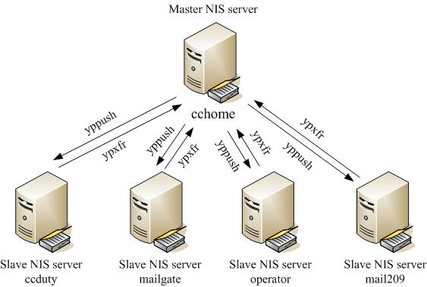
How NIS works (3)
Example of cs

Slide 10
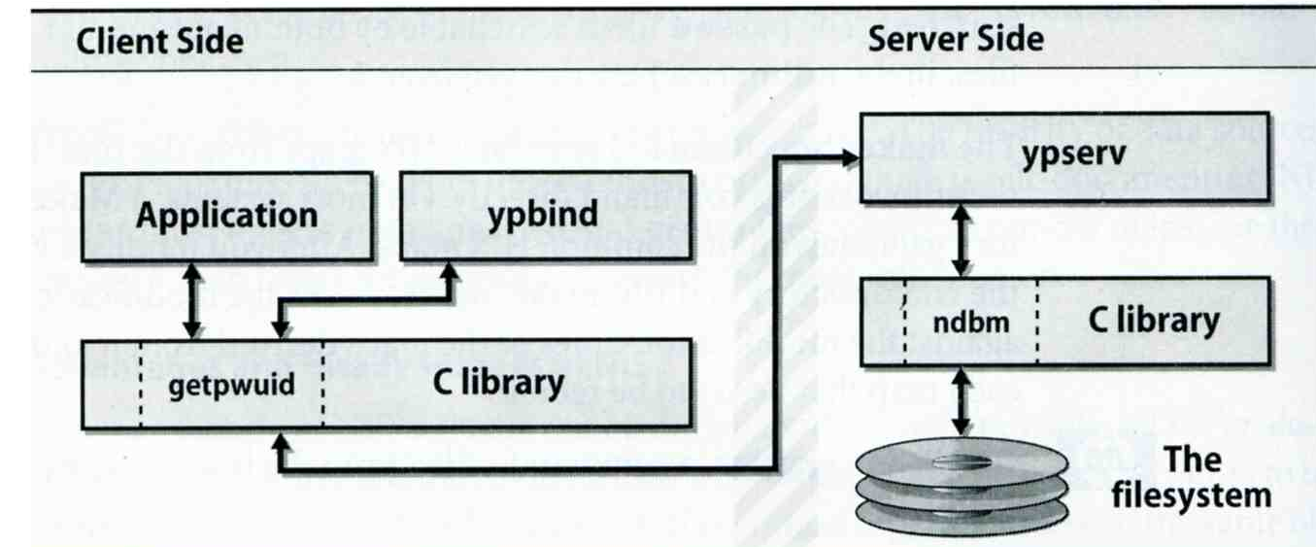
How NIS works (4)
After all maps are ready
Request and response
ypserv daemons
Run on NIS servers
Waiting for NIS requests and answering them by looking up information in maps
ypbind daemons
Run on every machine in NIS domain
Locate a ypserv and return the identity to the C library, which then contact the server directly

Slide 11
How NIS works (5)
NIS commands and daemons
Program | Description
domainname | Set or print name of current NIS domain
makedbm yp_mkdb (FreeBSD) | Build hashed map
ypinit | Configure a host as master or slave
ypset | Let ypbind to bind a particular NIS server
ypwhich | Find out which yp server is using
ypcat | Print the value contained in an NIS map
yppasswd | Change password on the NIS server
ypchfn | Change GECOS information on NIS server
ypchsh | Change login shell on NIS server
yppasswdd | Server daemon for yppasswd,ypchsh,ypchfn

Slide 12
Configuring NIS Servers
Steps
Sequence: Master Server → Slave Servers → each client
Master Server
Set nis domain name
Use ypinit to construct a list of slave servers
Run ypserv and rpc.yppasswdd daemons
Slave Servers
Set nis domain name
Use ypinit to set master NIS server
Get NIS maps
NIS client
Set nis domain name
Modify /etc/passwd, /etc/group
Run ypbind daemons

Slide 13
Configuring NIS Servers – FreeBSD (1)
Edit /etc/rc.conf
If your host does not want to be a NIS client, remove nis_client related entries
It is a good idea to force NIS master server to ypbind itself
% man ypbind
…
# NIS
nisdomainname=“sabsd.nis"
nis_server_enable="YES"
nis_server_flags="“
nis_client_enable=“YES”
nis_client_flags=“-s –m –S sabsd.nis,sabsd”
nis_yppasswdd_enable="YES"
nis_yppasswdd_flags=“”
…

Slide 14
Configuring NIS Servers – FreeBSD (2)
Initializing the NIS Maps
NIS maps are generated from configuration files in /etc with exceptions : /etc/master.passwd, /etc/netgroup, /etc/passwd
% cp /etc/master.passwd /var/yp/master.passwd
% cp /etc/netgroup /var/yp/netgroup
Edit /var/yp/master.passwd , removing all system accounts
% cd /var/yp
% ypinit –m sabsd.nis
% reboot
Rebuild yp maps whenever the configuration files are changed
Example
When you change /var/yp/master.passwd
% cd /var/yp
% make

Slide 15
Configuring NIS Servers – FreeBSD (3)
Makefile of NIS
…
YPSRCDIR = /etc
YPDIR = /var/yp
YPMAPDIR = $(YPDIR)/$(DOMAIN)
ETHERS = $(YPSRCDIR)/ethers # ethernet addresses (for rarpd)
BOOTPARAMS= $(YPSRCDIR)/bootparams # for booting Sun boxes (bootparamd)
HOSTS = $(YPSRCDIR)/hosts
NETWORKS = $(YPSRCDIR)/networks
PROTOCOLS = $(YPSRCDIR)/protocols
RPC = $(YPSRCDIR)/rpc
SERVICES = $(YPSRCDIR)/services
SHELLS = $(YPSRCDIR)/shells
GROUP = $(YPSRCDIR)/group
ALIASES = $(YPSRCDIR)/mail/aliases
NETGROUP = $(YPDIR)/netgroup
PASSWD = $(YPDIR)/passwd
MASTER = $(YPDIR)/master.passwd
YPSERVERS = $(YPDIR)/ypservers # List of all NIS servers for a domain
PUBLICKEY = $(YPSRCDIR)/publickey
NETID = $(YPSRCDIR)/netid
AMDHOST = $(YPSRCDIR)/amd.map
…

Slide 16
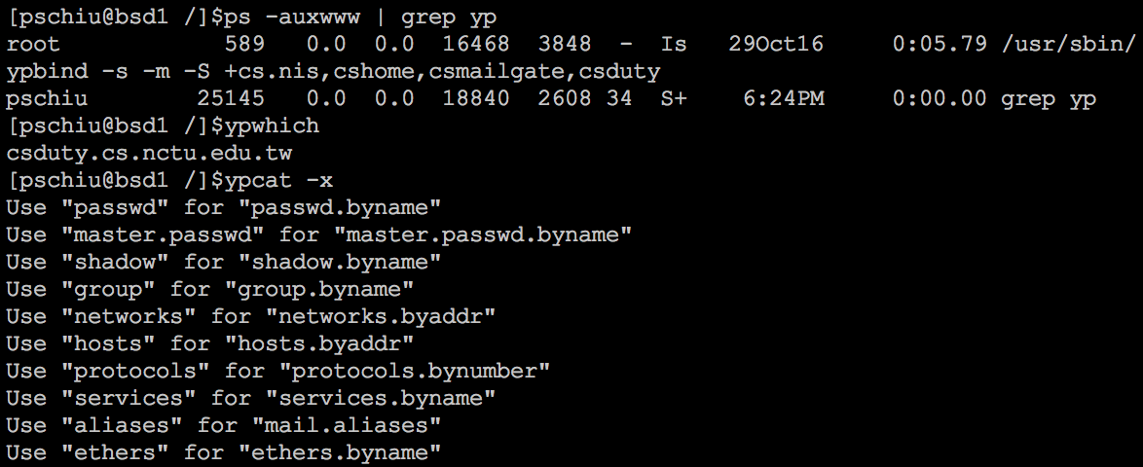
Configuring NIS Servers – FreeBSD (4)

Slide 17
Configuring NIS Servers – FreeBSD (5)
NIS client configuration
Edit /etc/rc.conf
Edit /etc/master.passwd (using vipw) and /etc/group
reboot
…
# NIS
nisdomainname="sabsd.nis"
nis_client_enable=“YES”
nis_client_flags=“-s”
…
…
nobody:*:65534:65534::0:0:Unprivileged user:/nonexistent:/usr/sbin/nologin
+:*::::::::
nobody:*:65534:
+:*::

Slide 18
Q & A

