Slide 1
Periodic Processes
lctseng / Liang-Chi Tseng
Edit: yench

Slide 2
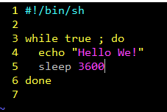
Run commands in a specific period?
Using a shell script
Use the built-in command: crontab
@hourly echo "Hello We!"

Slide 3
CRON – Schedule Commands (1)
What do we want?
Do things at right time automatically
cron daemon
The daemon that handles periodic execution
cron daemon reads configuration file and executes commands on time
Reference
cron(8) – the daemon
crontab(1) – the command
crontab(5) – the /etc/crontab table file

Slide 4
First impression of crontab
Example configuration of crontab
SHELL=/bin/sh
PATH=/etc:/bin:/sbin:/usr/bin:/usr/sbin
HOME=/var/log
MAILTO=admin@nasa.cs.nctu.edu.tw
#minute hour mday month wday who command
*/5 * * * * root /usr/libexec/atrun
*/11 * * * * operator /usr/libexec/save-entropy
0 * * * * root newsyslog
1 3 * * * root periodic daily
15 4 * * 6 root periodic weekly
30 5 1 * * root periodic monthly
1,31 0-5 * * * root adjkerntz -a

Slide 5
CRON – Schedule Commands (2)
Configuration file
So called: crontab (cron table)
Location of user cron configuration file
Every user can have at most one crontab file and this file will be named the user’s login ID
Edit using crontab(1) command
Location of System Cron Configuration file
/etc/crontab
System | Cron Dir
FreeBSD | /var/cron/tabs
Red Hat | /var/spool/cron
Solaris | /var/spool/cron/crontabs
SunOS | /var/spool/cron/crontabs

Slide 6
CRON – Schedule Commands (3)
Configuration File Format
Ignored
Blank lines or leading spaces and tabs
Comments
pound-sign: lines whose first non-space character is a #
environment setting
name = value
Default environment variables:
LOGNAME, SHELL, PATH, HOME, MAILTO
cron command
Format:
# minute hour day month weekday command
33 7 * * * /bin/date >> /tmp/log

Slide 7
CRON – Schedule Commands (4)
cron command format – minute hour day month weekday command
Field | Description | Range
minute | Minute of the hour | 0 ~ 59
hour | Hour of the day | 0 ~ 23
day | Day of the month | 1 ~ 31
month | Month of the year | 1 ~ 12
weekday | Day of the week | 0 ~ 7 (0,7 = Sunday)
Rule Matching
* matches everything
Single character matches exactly
Dash(-) matches range
Comma(,) matches any listed value
Slash(/) matches skips of the number's value through the range.

Slide 8
CRON – Schedule Commands (5)
crontab time format example
45 10 * * 1-5 ➔ AM 10:45, from Mon. to Fri.
10 * * * * ➔ On 10 minutes of each hour
*/3 * * * * ➔ Every three minutes
30 15 5 * * ➔ PM 3:30 of each 5-th day
0 0 14 2 * ➔ On the Midnight of Valentine’s day
5 0-6 * * * ➔ On 5 minutes, from 0 to 6 o’clock.
0,30 * 13 * 5 ➔ every half-hour on Fri. and every
half-hour on the 13-th day
crontab example
20 1 * * * find /tmp -atime +3 -exec rm -f {} ‘;’
55 23 * * 0-3,6 /home/lctseng/cputemp-check.sh

Slide 9
CRON – Schedule Commands (6)
Special strings to specify the time
string | meaning | in 5 fields format
@reboot | Run once, at startup. | N/A
@yearly | Run once a year | 0 0 1 1 *
@annually | (same as @yearly)
@monthly | Run once a month | 0 0 1 * *
@weekly | Run once a week | 0 0 * * 0
@daily | Run once a day | 0 0 * * *
@midnight | (same as @daily)
@hourly | Run once an hour | 0 * * * *
@every_minute | Run once a minute | */1 * * * *
@every_second | Run once a second | N/A

Slide 10
crontab command
crontab(1)
% crontab -e [-u user]
Edit the [user’s] crontab using editor
Only privileged user (root) can use “-u” option
% crontab -l
List the content of the crontab
% crontab -r
Remove the current crontab
% crontab filename
Install filename as your crontab

Slide 11
crontab management
To Allow or deny user
By default, all users can have their own crontab
allow file
A list of users that may use crontab, any other not in the list can not use it
deny file
Reverse meaning
log
System | Allow or deny file | Log file
FreeBSD | /var/cron/{allow,deny} | By syslogd
Red Hat | /etc/cron.{allow,deny} | /var/log/cron
Solaris | /etc/cron.d/cron.{allow,deny} | /var/cron/log
SunOS | /var/spool/cron/cron.{allow,deny} | By syslogd

Slide 12
System crontab: /etc/crontab
System crontab
/etc/crontab
SHELL=/bin/sh
PATH=/etc:/bin:/sbin:/usr/bin:/usr/sbin
HOME=/var/log
MAILTO=admin@nasa.cs.nctu.edu.tw
#minute hour mday month wday who command
*/5 * * * * root /usr/libexec/atrun
*/11 * * * * operator /usr/libexec/save-entropy
0 * * * * root newsyslog
1 3 * * * root periodic daily
15 4 * * 6 root periodic weekly
30 5 1 * * root periodic monthly
1,31 0-5 * * * root adjkerntz -a

Slide 13
The implementation of crontab(1)
Get a look at the source code from Minix
http://www.cise.ufl.edu/~cop4600/cgi-bin/lxr/http/source.cgi/commands/simple/cron.c
How to become a daemon?

Slide 14
The implementation of crontab(2)
Get a look at the source code from Minix
http://www.cise.ufl.edu/~cop4600/cgi-bin/lxr/http/source.cgi/commands/simple/cron.c
How to do tasks periodically?

Slide 15
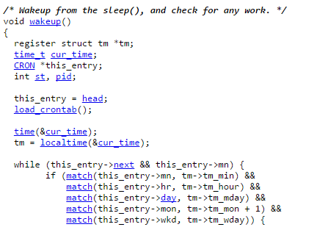
The implementation of crontab(3)
Get a look at the source code from Minix
http://www.cise.ufl.edu/~cop4600/cgi-bin/lxr/http/source.cgi/commands/simple/cron.c
How to do tasks periodically?

Slide 16
periodic utility (1)
periodic utility
Run periodic system function under /etc/periodic
/etc/periodic.conf
/etc/defaults/periodic.conf

Slide 17
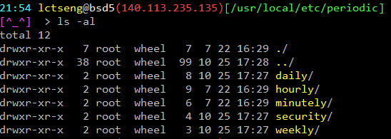
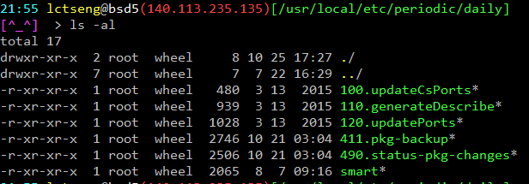
periodic utility (2)
periodic utility
For custom system programs: /usr/local/etc/periodic

Slide 18
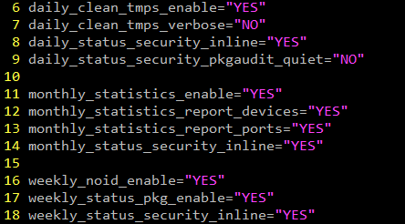
periodic utility (3)
Execution order depends on filenames
Use number as prefix to control the order
All scripts under that directory will be executed
Unlike /etc/rc.conf
Even though there is no “YES” in /etc/periodic.conf
/etc/periodic.conf

Slide 19
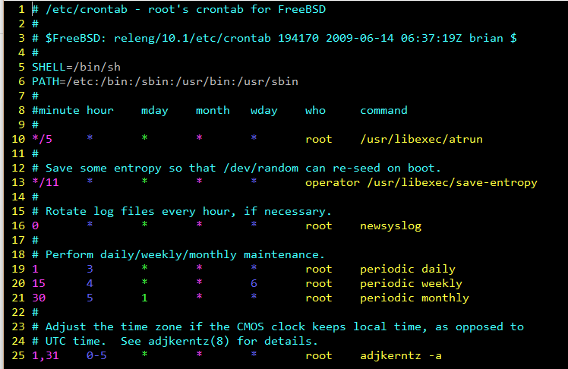
periodic utility (4)
Driven by crontab

Slide 20
at command (1)
at command
executes commands at a specified time (one-time use)
at [-q queue] [-f file] [-mldbv] time
or at [-q queue] [-f file] [-mldbv] -t [[CC]YY]MMDDhhmm[.SS]
at management
atq
View job queue
atrm
Remove jobs
/var/at/at.{allow,deny}
Specify who can/cannot use at
By default, only root can use “at”

Slide 21
at command (2)
Output will send via email
Driven by crontab (invoked every 5 minutes)
Reference
at(1)
atrun(8)

