Slide 1
Security

Slide 2
FreeBSD Security Advisories
http://www.freebsd.org/security/advisories.html

Slide 3
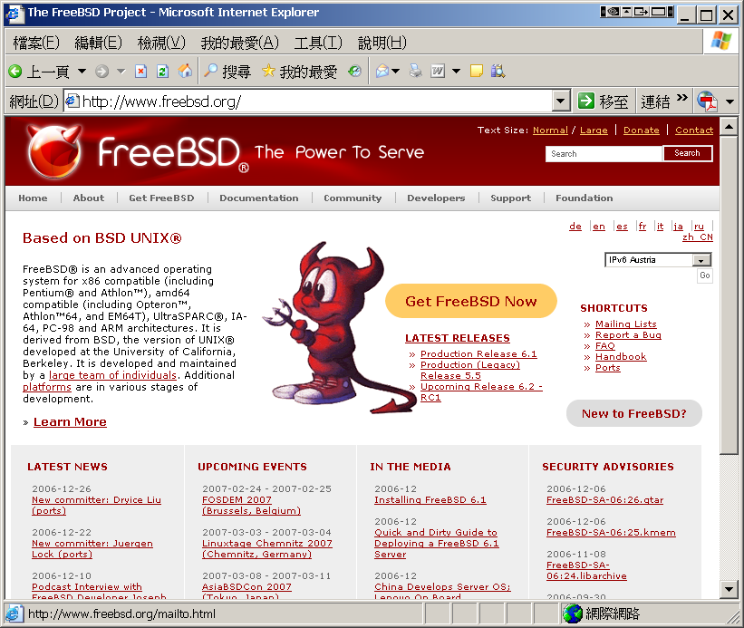
FreeBSD Security Advisories
Advisory
Security information
Where to find it
Web page (Security Advisories Channel)
http://www.freebsd.org

Slide 4
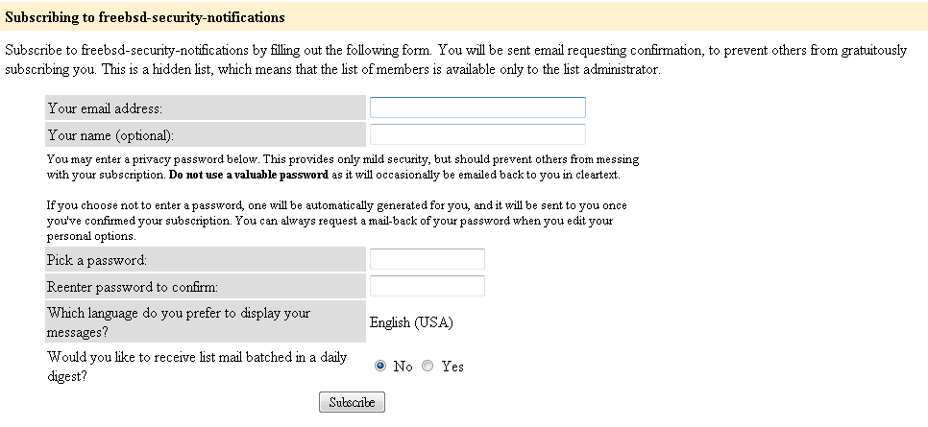
FreeBSD Security Advisories
Where to find it
freebsd-security-notifications Mailing list
http://lists.freebsd.org/mailman/listinfo/freebsd-security-notifications

Slide 5
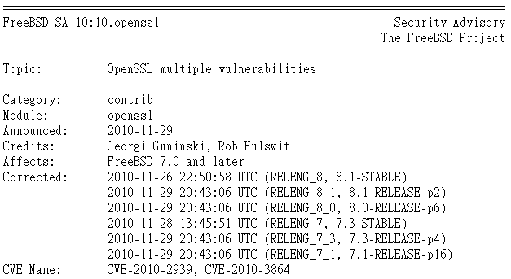
FreeBSD Security Advisories
Example
openssl

Slide 6
FreeBSD Security Advisories
CVE-2010-3864
http://web.nvd.nist.gov/view/vuln/detail?vulnId=CVE-2010-3864

Slide 7
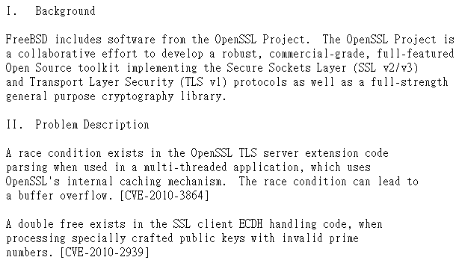
FreeBSD Security Advisories
Example
Problem Description

Slide 8
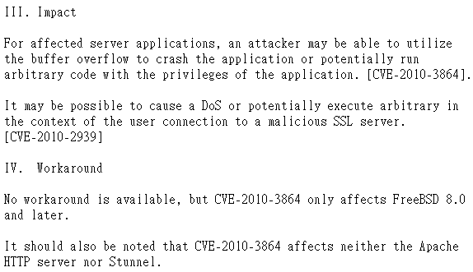
FreeBSD Security Advisories
Example
Workaround

Slide 9
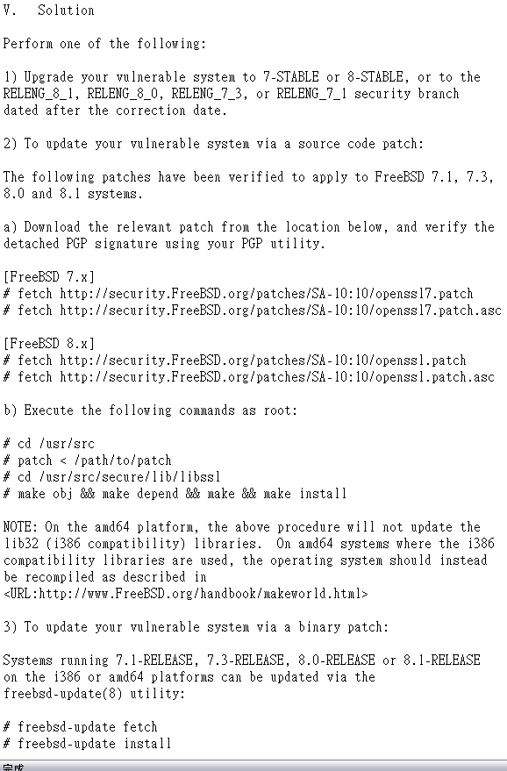
FreeBSD Security Advisories
Example
Solution
Upgrade to
Source code patch
Binary patch

Slide 10
Common Security Problems
Unreliable wetware
Phishing site
Software bugs
FreeBSD security advisor
portaudit (ports-mgmt/portaudit)
Open doors
Account password
Disk share with the world

Slide 11
Pkg audit
Pkg audit
Audit installed packages against known vulnerabilities.
Security Output
mysql56-client-5.6.30 is vulnerable:
Remote-Code-Execution vulnerability in mysql and its variants CVE 2016-6662
WWW: https://vuxml.FreeBSD.org/freebsd/dc596a17-7a9e-11e6-b034-f0def167eeea.html
vim-7.4.1832 is vulnerable:
vim -- arbitrary command execution
CVE: CVE-2016-1248
WWW: https://vuxml.FreeBSD.org/freebsd/c11629d3-c8ad-11e6-ae1b-002590263bf5.html
curl-7.50.1 is vulnerable:
cURL -- multiple vulnerabilities
CVE: CVE-2016-8625
CVE: CVE-2016-8624
CVE: CVE-2016-8623
CVE: CVE-2016-8622
CVE: CVE-2016-8621
CVE: CVE-2016-8620
CVE: CVE-2016-8619
CVE: CVE-2016-8618
CVE: CVE-2016-8617
CVE: CVE-2016-8616
CVE: CVE-2016-8615
WWW: https://vuxml.FreeBSD.org/freebsd/765feb7d-a0d1-11e6-a881-b499baebfeaf.html

Slide 12
Common trick
Tricks
ssh scan and hack
ssh guard
sshit
…
Phishing
XSS & sql injection
…
Objective
Spam
Jump gateway
File sharing
…

Slide 13
Process file system - procfs
Procfs
A view of the system process table
Normally mount on /proc
mount –t procfs proc /proc

Slide 14
setuid program
passwd
/etc/master.passwd is of mode 600 (-rw-------) !
Setuid shell scripts are especially apt to cause security problems
Minimize the number of setuid programs
Disable the setuid execution on individual filesystems
-o nosuid
zfs[~] -chiahung- ls -al /usr/bin/passwd
-r-sr-xr-x 2 root wheel 8224 Dec 5 22:00 /usr/bin/passwd
/usr/bin/find / -user root –perm -4000 –print |
/bin/mail –s “Setuid root files” username

Slide 15
Security issues
/etc/hosts.equiv and ~/.rhosts
Trusted remote host and user name DB
Allow user to login (via rlogin) and copy files (rcp) between machines without passwords
Format:
Simple: hostname [username]
Complex: [+-][hostname|@netgroup]
[[+-][username|@netgorup]]
Example
bar.com foo (trust user “foo” from host “bar.com”)
+@adm_cs_cc (trust all from amd_cs_cc group)
+@adm_cs_cc -@chwong
Do not use this

Slide 16
Why not su nor sudo?
Becoming other users
A pseudo-user for services, sometimes shared by multiple users
sudo –u news –s (?)
/etc/inetd.conf
login stream tcp nowait root /usr/libexec/rlogind rlogind
~notftpadm/.rhosts
localhost wangyr
rlogin -l news localhost
User_Alias newsTA=wangyr
Runas_Alias NEWSADM=news
newsTA ALL=(NEWSADM) ALL
Too dirty!

Slide 17
Security tools
nmap
john, crack
PGP
CA
…
Firewall
TCP Wrapper
…

Slide 18
TCP Wrapper
There are something that a firewall will not handle
Sending text back to the source
TCP wrapper
Extend the abilities of inetd
Provide support for every server daemon under its control
Logging support
Return message
Permit a daemon to only accept internal connetions

Slide 19
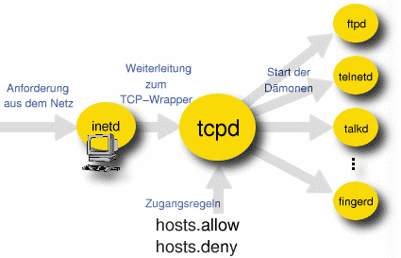
TCP Wrapper
TCP Wrapper
Provide support for every server daemon under its control

Slide 20
TCP Wrapper
To see what daemons are controlled by inetd, see /etc/inetd.conf
TCP wrapper should not be considered a replacement of a good firewall. Instead, it should be used in conjunction with a firewall or other security tools
#ftp stream tcp nowait root /usr/libexec/ftpd ftpd -l
#ftp stream tcp6 nowait root /usr/libexec/ftpd ftpd -l
#telnet stream tcp nowait root /usr/libexec/telnetd telnetd
#telnet stream tcp6 nowait root /usr/libexec/telnetd telnetd
shell stream tcp nowait root /usr/libexec/rshd rshd
#shell stream tcp6 nowait root /usr/libexec/rshd rshd
login stream tcp nowait root /usr/libexec/rlogind rlogind
#login stream tcp6 nowait root /usr/libexec/rlogind rlogind

Slide 21
TCP Wrapper
To use TCP wrapper
inetd daemon must start up with “-Ww” option (default)
Or edit /etc/rc.conf
Edit /etc/hosts.allow
Format:
daemon:address:action
daemon is the daemon name which inetd started
address can be hostname, IPv4 addr, IPv6 addr
action can be “allow” or “deny”
Keyword “ALL” can be used in daemon and address fields to means everything
inetd_enable="YES"
inetd_flags="-wW"

Slide 22
/etc/hosts.allow
First rule match semantic
Meaning that the configuration file is scanned in ascending order for a matching rule
When a match is found, the rule is applied and the search process will stop
example
ALL : localhost, loghost @adm_cc_cs : allow
ptelnetd pftpd sshd: @sun_cc_cs, @bsd_cc_cs, @linux_cc_cs : allow
ptelnetd pftpd sshd: zeiss, chbsd, sabsd : allow
identd : ALL : allow
portmap : 140.113.17. ALL : allow
sendmail : ALL : allow
rpc.rstatd : @all_cc_cs 140.113.17.203: allow
rpc.rusersd : @all_cc_cs 140.113.17.203: allow
ALL : ALL : deny

Slide 23
/etc/hosts.allow
Advance configuration
External commands (twist option)
twist will be called to execute a shell command or script
External commands (spawn option)
spawn is like twist, but it will not send a reply back to the client
# The rest of the daemons are protected.
telnet : ALL \
: severity auth.info \
: twist /bin/echo "You are not welcome to use %d from %h."
# We do not allow connections from example.com:
ALL : .example.com \
: spawn (/bin/echo %a from %h attempted to access %d >> \
/var/log/connections.log) \
: deny

Slide 24
/etc/hosts.allow
Wildcard (PARANOID option)
Match any connection that is made from an IP address that differs from its hostname
See
man 5 hosts_access
man 5 hosts_options
# Block possibly spoofed requests to sendmail:
sendmail : PARANOID : deny

Slide 25
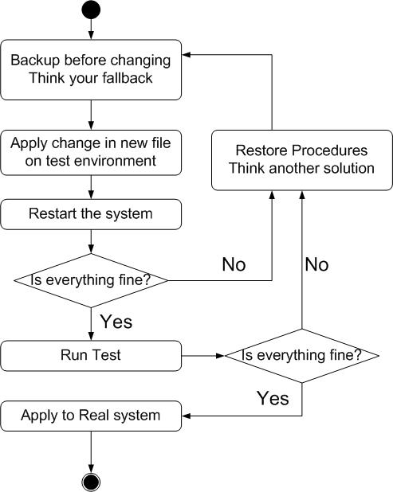
When you perform any change.
Philosophy of SA
Know how things really work.
Plan it before you do it.
Make it reversible
Make changes incrementally.
Test before you unleash it .

