Slide 1
ZFS
The Last Word in Filesystem
frank

Slide 2
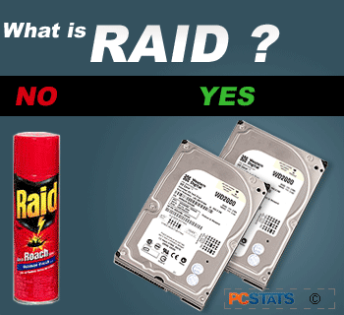
What is RAID?

Slide 3
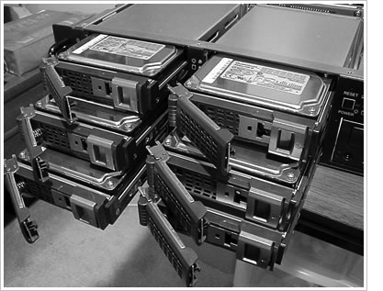
RAID
Redundant Array of Indepedent Disks
A group of drives glue into one

Slide 4
Common RAID types
JBOD
RAID 0
RAID 1
RAID 5
RAID 6
RAID 10?
RAID 50?
RAID 60?

Slide 5
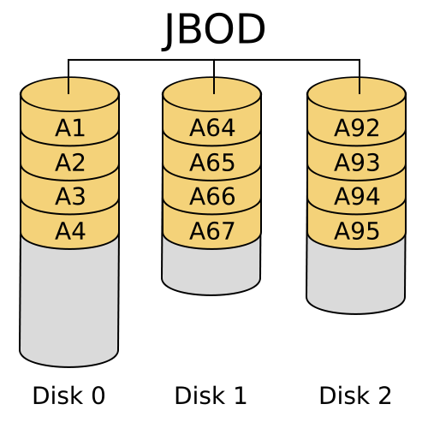
JBOD (Just a Bunch Of Disks)
http://www.mydiskmanager.com/wp-content/uploads/2013/10/JBOD.png

Slide 6
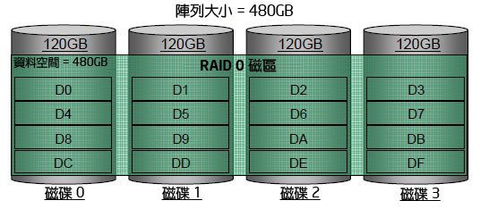
RAID 0 (Stripe)
http://www.intel.com/support/tw/chipsets/imsm/sb/cs-009337.htm

Slide 7
RAID 0 (Stripe)
Striping data onto multiple devices
2X Write/Read Speed
Data corrupt if ANY of the device fail.
http://www.intel.com/support/tw/chipsets/imsm/sb/cs-009337.htm

Slide 8
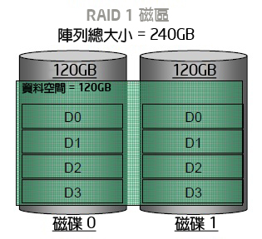
RAID 1 (Mirror)
http://www.intel.com/support/tw/chipsets/imsm/sb/cs-009337.htm

Slide 9
RAID 1 (Mirror)
Devices contain identical data
100% redundancy
Fast read
http://www.intel.com/support/tw/chipsets/imsm/sb/cs-009337.htm

Slide 10
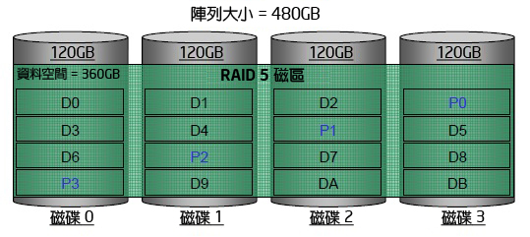
RAID 5
http://www.intel.com/support/tw/chipsets/imsm/sb/cs-009337.htm

Slide 11
RAID 5
Slower the raid 0 / raid 1
Higher cpu usage
http://www.intel.com/support/tw/chipsets/imsm/sb/cs-009337.htm

Slide 12
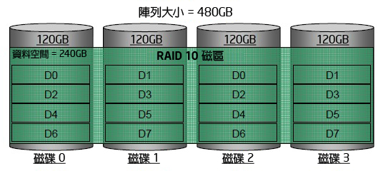
RAID 10?
RAID 1+0
http://www.intel.com/support/tw/chipsets/imsm/sb/cs-009337.htm

Slide 13
RAID 50?
https://www.icc-usa.com/wp-content/themes/icc_solutions/images/raid-calculator/raid-50.png

Slide 14
RAID 60?
https://www.icc-usa.com/wp-content/themes/icc_solutions/images/raid-calculator/raid-60.png

Slide 15
Here comes ZFS

Slide 16
Why ZFS?
Easy adminstration
Highly scalable (128 bit)
Transactional Copy-on-Write
Fully checksummed
Revolutionary and modern
SSD and Memory friendly

Slide 17
ZFS Pools
ZFS is not just filesystem
ZFS = filesystem + volumn manager
Work out of the box
Zuper zimple to create
Controlled with single command
zpool

Slide 18
ZFS Pools Components
Pool is create from vdevs (Virtual Devices)
What is vdevs?
disk: A real disk (daa)
file: A file (caveat! https://bugs.freebda.org/bugzilla/show_bug.cgi?id=195061)
mirror: Two or more disks mirrored together
raidz1/2: Three or more disks in RAID5/6*
spare: A spare drive
log: A write log device (ZIL SLOG; typically SSD)
cache: A read cache device (L2ARC; typically SSD)

Slide 19
RAID in ZFS
Dynamic Stripe: Intelligent RAID0
Mirror: RAID 1
Raidz1: Improved from RAID5 (parity)
Raidz2: Improved from RAID6 (double parity)
Raidz3: triple parity
Combined as dynamic stripe

Slide 20
Create a simple zpool
zpool create mypool /dev/daa /dev/dab
Dynamic Stripe (RAID 0)
|- /dev/daa
|- /dev/dab

Slide 21
zpool create mypool
mirror /dev/daa /dev/dab
mirror /dev/dac /dev/dad
What is this?

Slide 22
WT* is this
zpool create mypool
mirror /dev/da0 /dev/da1
mirror /dev/da2 /dev/da3
raidz /dev/da4 /dev/da5 /dev/da6
log mirror /dev/da7 /dev/da8
cache /dev/da9 /dev/da10
spare /dev/da11 /dev/da12

Slide 23
Zpool command
zpool scrub
try to discover silent error or hardware failure
zpool history [pool name]
show all the history of zpool
zpool add <pool name> <vdev>
add additional capacity into pool
zpool create/destroy
create/destory zpool
zpool list
list all the zpool
zpool status [pool name]
show status of zpool
zpool export/import [pool name]
export or import given pool
zpool set/get <properties/all>
set or show zpool properties
zpool online/offline <pool name> <vdev>
set an device in zpool to online/offline state
zpool attach/detach <pool name> <device> <new device>
attach a new device to an zpool/detach a device from zpool
zpool replace <pool name> <old device> <new device>
replace old device with new device

Slide 24
Zpool properties
Each pool has customizable properties
NAME PROPERTY VALUE SOURCE
zroot size 460G -
zroot capacity 4% -
zroot altroot - default
zroot health ONLINE -
zroot guid 13063928643765267585 default
zroot version - default
zroot bootfs zroot/ROOT/default local
zroot delegation on default
zroot autoreplace off default
zroot cachefile - default
zroot failmode wait default
zroot listsnapshots off default

Slide 25
Zpool Sizing
ZFS reservce 1/64 of pool capacity for safe-guard to protect CoW
RAIDZ1 Space = Total Drive Capacity -1 Drive
RAIDZ2 Space = Total Drive Capacity -2 Drives
RAIDZ3 Space = Total Drive Capacity -3 Drives
Dyn. Stripe of 4* 100GB= 400 / 1.016= ~390GB
RAIDZ1 of 4* 100GB = 300GB - 1/64th= ~295GB
RAIDZ2 of 4* 100GB = 200GB - 1/64th= ~195GB
RAIDZ2 of 10* 100GB = 800GB - 1/64th= ~780GB
http://cuddletech.com/blog/pivot/entry.php?id=1013

Slide 26
ZFS Dataset

Slide 27
ZFS Datasets
Two forms:
filesystem: just like traditional filesystem
volumn: block device
nested
each dataset has associatied properties that can be inherited by sub-filesystems
controlled with single command
zfs

Slide 28
Filesystem Datasets
Create new dataset with
zfs create <pool name>/<dataset name>
New dataset inherits properties of parent dataset

Slide 29
Volumn Datasets (ZVols)
Block storage
Located at /dev/zvol/<pool name>/<dataset>
Used for iSCSI and other non-zfs local filesystem
Support “thin provisioning”

Slide 30
Dataset properties
NAME PROPERTY VALUE SOURCE
zroot type filesystem -
zroot creation Mon Jul 21 23:13 2014 -
zroot used 22.6G -
zroot available 423G -
zroot referenced 144K -
zroot compressratio 1.07x -
zroot mounted no -
zroot quota none default
zroot reservation none default
zroot recordsize 128K default
zroot mountpoint none local
zroot sharenfs off default

Slide 31
zfs command
zfs set/get <prop. / all> <dataset>
set properties of datasets
zfs create <dataset>
create new dataset
zfs destroy
destroy datasets/snapshots/clones..
zfs snapshot
create snapshots
zfs rollback
rollback to given snapshot
zfs promote
promote clone to the orgin of filesystem
zfs send/receive
send/receive data stream of snapshot
with pipe

Slide 32
Snapshot
Natural benefit of ZFS’s Copy-On-Write design
Create a point-in-time “copy” of a dataset
Used for file recovery or full dataset rollback
Denoted by @ symbol

Slide 33
Create snapshot
# zfs snapshot tank/something@2015-01-02
done in secs
no addtional disk space consume

Slide 34
Rollback
# zfs rollback zroot/something@2015-01-02
IRREVERSIBLY revert dataset to previous state
All more current snapshot will be destroyed

Slide 35
Recover single file?
hidden “.zfs” directory in dataset mountpoint
set snapdir to visible

Slide 36
Clone
“copy” a separate dataset from a snapshot
caveat! still dependent on source snapshot

Slide 37
Promotion
reverse parent/child relationship of cloned dataset and referenced snapshot
so that the referenced snapshot can be destroyed or reverted

Slide 38
Replication
# zfs send tank/somethin@123 | zfs recv ….
dataset can be piped over network
dataset can also be received from pipe

Slide 39
Performance Tuning

Slide 40
General tuning tips
System memory
Access time
Dataset compression
Deduplication
ZFS send and receive

Slide 41
Random Access Memory
ZFS performance depands on the amount of system
recommended minimum: 1GB
4GB is ok
8GB and more is good

Slide 42
Dataset compression
save space
increase cpu useage
increase data throughput

Slide 43
Deduplication
requires even more memory
increases cpu useage

Slide 44
ZFS send/recv
using buffer for large streams
misc/buffer
misc/mbuffer (network capable)

Slide 45
Database tuning
For PostgreSQL and MySQL users recommend using a different recordsize than default 128k.
PostgreSQL: 8k
MySQL MyISAM storage: 8k
MySQL InnoDB storage: 16k

Slide 46
File Servers
disable access time
keep number of snapshots low
dedup only of you have lots of RAM
for heavy write workloads move ZIL to separate Sda drives
optionally disable ZIL for datasets (beware consequences)

Slide 47
Webservers
Disable redundant data caching
Apache
EnableMMAP Off
EnableSendfile Off
Nginx
Sendfile off
Lighttpd
server.network-backend="writev"

Slide 48
Cache and Prefetch

Slide 49
ARC
Adaptive Replacement Cache
Resides in system RAM
major speedup to ZFS
the size is auto-tuned
Default:
arc max: memory size - 1GB
metadata limit: ¼ of arc_max
arc min: ½ of arc_meta_limit (but at least 16MB)

Slide 50
Tuning ARC
you can disable ARC on per-dataset level
maximum can be limited
increasing arc_meta_limit may help if working with many files
# sysctl kstat.zfs.misc.arcstats.size
# sysctl vfs.zfs.arc_meta_used
# sysctl vfs.zfs.arc_meta_limit
reference: http://www.krausam.de/?p=70

Slide 51
L2ARC
L2 Adaptive Replacement Cache
is designed to run on fast block devices (Sda)
helps primarily read-intensive workloads
each device can be attached to only one ZFS pool
# zpool add <pool name> cache <vdevs>
# zpool add remove <pool name> <vdevs>

Slide 52
Tuning L2ARC
enable prefetch for streaming or serving of large files
configurable on per-dataset basis
turbo warmup phase may require tuning (e.g. set to 16MB)
vfs.zfs.l2arc_noprefetch
vfs.zfs.l2arc_write_max
vfs.zfs.l2arc_write_boost

Slide 53
ZIL
ZFS Intent Log
guarantees data consistency on fsync() calls
replays transaction in case of a panic or power failure
use small storage space on each pool by default
to speed up writes, deploy zil on a separate log device(Sda)
per-dataset synchonocity behavior can be configured
# zfs set sync=[standard|always|disabled] dataset

Slide 54
File-level Prefetch (zfetch)
analyses read patterns of files
tries to predict next reads
Loader tunable to enable/disable zfetch: vfs.zfs.prefetch_disable

Slide 55
Device-level Prefetch (vdev prefetch)
reads data after small reads from pool devices
useful for drives with higher latency
consumes constant RAM per vdev
is disabled by default
Loader tunable to enable/disable vdev prefetch: vfs.zfs.vdev.cache.size=[bytes]

Slide 56
ZFS Statistics Tools
# sysctl vfs.zfs
# sysctl kstat.zfs
using tools:
zfs-stats: analyzes settings and counters since boot
zfsf-mon: real-time statistics with averages
Both tools are available in ports under sysutils/zfs-stats

Slide 57
References
ZFS tuning in FreeBda (Martin Matuˇska):
slides:
http://blog.vx.sk/uploads/conferences/EuroBdacon2012/zfs-tuning-handout.pdf
video:
https://www.youtube.com/watch?v=PIpI7Ub6yjo
Becoming a ZFS Ninja (Ben Rockwood):
http://www.cuddletech.com/blog/pivot/entry.php?id=1075
ZFS Administration:
https://pthree.org/2012/12/14/zfs-administration-part-ix-copy-on-write/

